Slide 1
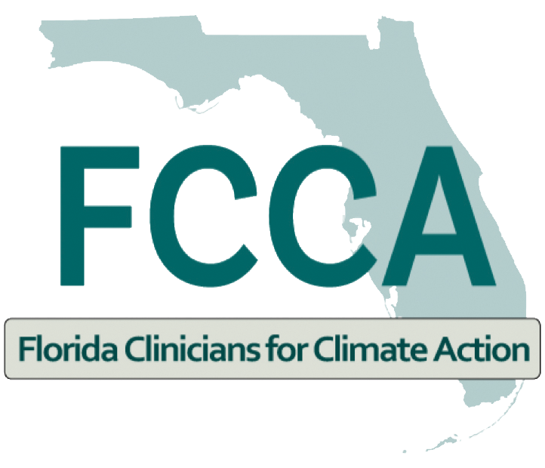

Heat Stress and Heat Illness Prevention CME Series
Session 3
Climate Pollution, Heat Stress, and Birth Outcomes
December 1, 2022

Slide 2


Catherine Toms, M.D., MPH
Director, Green Cars for Kids
Sr. Advisor for Climate & Health, Health Care Without Harm
Florida Clinicians for Climate Action, Steering Committee
ctoms@greencars4kids.org
Bruce Bekkar, M.D.
Climate for Health Fellow, Leadership Circle Executive Committee, ecoAmerica
Editorial Board member, Journal of Climate Change and Health
Chair Emeritus, Public Health Advisory Council, Climate Action Campaign
greendoc@me.com

Slide 3
Climate Overview
Maternal & Infant Mortality in Miami-Dade
and Areas With Highest Vulnerability
Catherine Toms, MD, MPH
Florida Clinicians for Climate Action
Green Cars for Kids
Miami, Florida
December 1, 2022

Slide 4
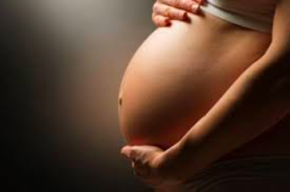

Disclosure
I have no actual or potential conflict of interest in relation to this presentation.
New York Times, June 18, 2020
Notes:
In the first session of this climate and health series, we covered the ways climate change impacts our general patient population. If you would like to review, I refer you to that first session or the QR code on this slide will link to our website with additional information and resources. It is important to remember that there is scientific consensus that the burning of fossil fuels (coal, gas and oil) is the primary driver of the climate crisis. A literature search done by Cornell University in 2021 found that 99% of scientists agree that anthropogenic activity has warmed our atmosphere, oceans, and land.

Slide 5
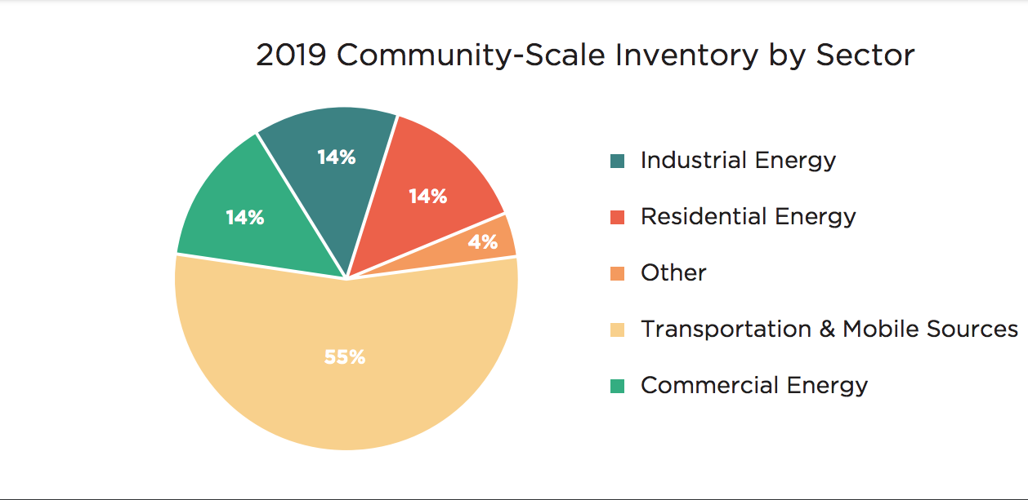
Miami-Dade County Community Scale Emissions
Source: Miami-Dade County’s 2019 Community-Scale greenhouse gas (GHG) emissions inventory
Notes:
The latest data from the US Energy and Information Agency show that 50% of Florida’s total GHG emissions come from transportation (cars and passenger trucks). The transportation sector accounted for 55% of MDC's Greenhouse Gas Emissions (GHG) according to the county's last emissions inventory. If we can transition to electric vehicles with zero tailpipe emissions, public and active transit, we can drastically reduce our carbon pollution leading to cleaner air in the short term and slowing rising temperatures in the long-term.

Slide 6
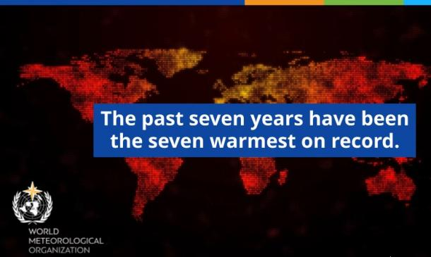
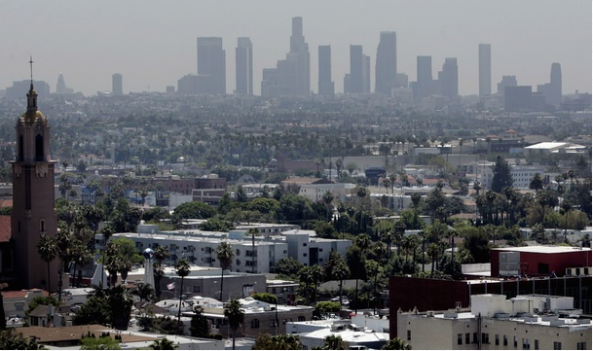
Mark Lynas et al. 2021 Environ. Res. Lett. 16 114005
DOI 10.1088/1748-9326/ac2966
Giudice, LC, Llamas-Clark, EF, DeNicola, N, et al. Int J Gynecol Obstet. 2021; 155: 345– 356. doi:https://doi.org/10.1002/ijgo.13958
Sillmann J, Hawkins E & Forster P et al. Intergovernmental Program for Climate Change (IPCC) Sixth Assessment Report. August 2021. https://www.ipcc.ch/assessment-report/ar6/
https://firststreet.org/risk-factor/
Notes:
FIGO (the International Federation of Gynecology and Obstetrics) states that, “the current climate crisis presents an imminent health risk to pregnant people, developing fetuses, and reproductive health.” Like the general populations, women in their childbearing years are impacted by the climate crisis including injury during severe storms, flooding, vector-borne disease, and mental health. This session’s focus is on heat and air pollution and its effect on the pregnant woman and fetus often with life-long and even generational health and economic consequences.
Extreme heat: We are seeing warmer, wetter weather as our atmosphere traps more CO₂ and other GHGs. Infact, the last 8 years have been the hottest ever recorded (2021 was added since the above graphic was made). Global warming is projected to exceed a 3°C increase in average temperature by 2100, and the United Nations’ Intergovernmental Program for Climate Change (or IPCC) given a “code red” for the planet.
Miami-Dade County is at extreme risk from heat and humidity. According to the First Street Foundation, a hot day in Miami-Dade County is considered to be any day above a “feels like” temperature of 105ºF. Miami-Dade County is expected to experience a total of 7 hot days this year. Due to a changing climate, models project that the county will experience 29 days above 105ºF annually by 2050 (in 30 years). So, simple messaging to pregnant women to stay cool, hydrated, rest and stay informed about the current heat exposure risk is essential.

Slide 7
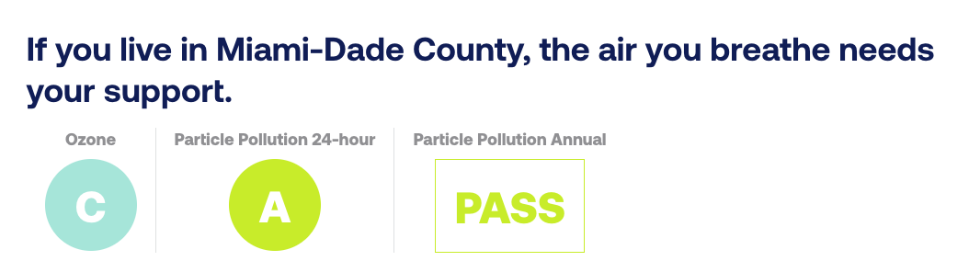


source:
Notes:
Air pollution: According to the Amer. Lung Assn.'s 2022 State of the Air Report, More than 40% of Americans—over 137 million people—are living in places with failing grades for unhealthy levels of particle pollution or ozone (only two of the eight primary air pollutants caused by the burning of fossil fuels). Ground-level Ozone (O3) often called "smog,",along with particle pollution (PM2.5) and other pollutants damages lungs, heart and placenta tissue by reacting chemically with it.
There are disparities in exposure- people of color are 3.6 x more likely than whites to live in a county with failing grades. According to the Amer. Lung Assn.'s 2022 State of the Air Report, Miami-Dade County earned a C rating for high ozone days.

Slide 8
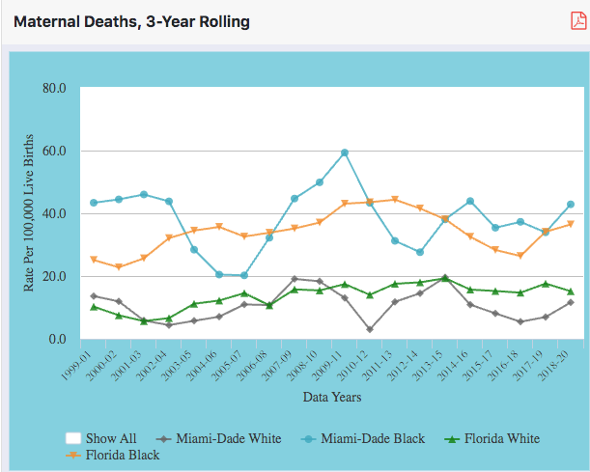

FLORIDA DEPARTMENT OF HEALTH Division of Public Health Statistics and Performance Management
Notes:
From 2018-2020, 16 Women in MDC and 131 women in Florida died from causes related to or aggravated by a pregnancy. These deaths are not distributed evenly in our population. This chart from the FL Depart. of Health shows the disparity in maternal deaths between white and black women in Florida as well as MDC.
https://www.flhealthcharts.gov/Charts/

Slide 9
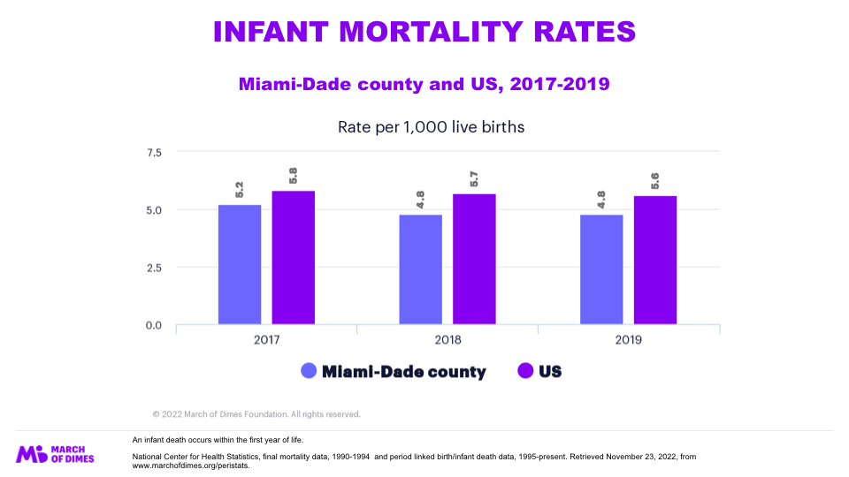

Notes:
In Miami-Dade county in 2019, 145 infants died before reaching their first birthday, an infant mortality rate of 4.8 per 1,000 live births.
Between 2009 and 2019, the infant mortality rate in Miami-Dade county declined more than 14%.
In 2020, 1214 infants died in Florida.In 2019, 69.6% of infant deaths occurred in the neonatal period, and 30.3% occurred in the postneonatal period.

Slide 10
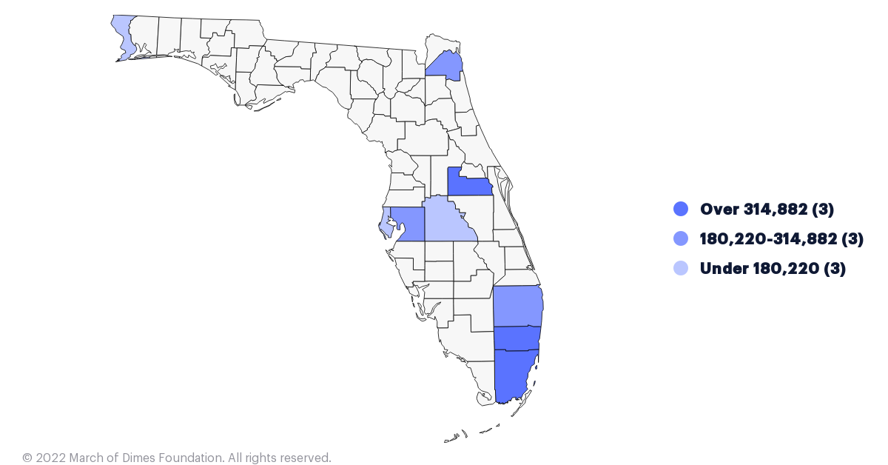
POPULATION OF WOMEN 15-44 YEARS
Miami-Dade county, 2020
US Census Bureau. Population estimates based on bridged race categories released by the National Center for Health Statistics. Retrieved November 22, 2022, from www.marchofdimes.org/peristats.

Slide 11

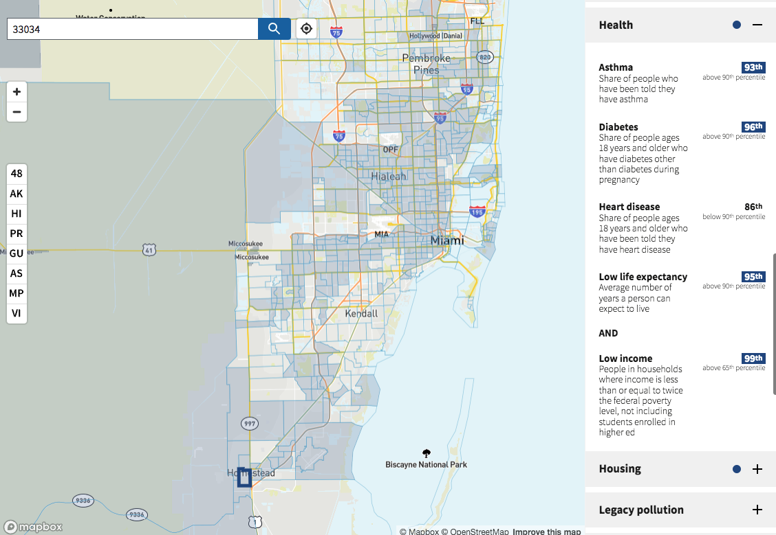

Heading
Climate & Economic Justice
Screening tool
Notes:
How do we find these women in MDC and other counties across the country who are at greatest risk of climate pollution impacting their pregnancy? https://screeningtool.geoplatform.gov/en/
I used the Climate and Economic Justice Screening Tool-
This census tract data from a community in the city of Homestead in the southwest- 42 miles sw from downtown.

Slide 12
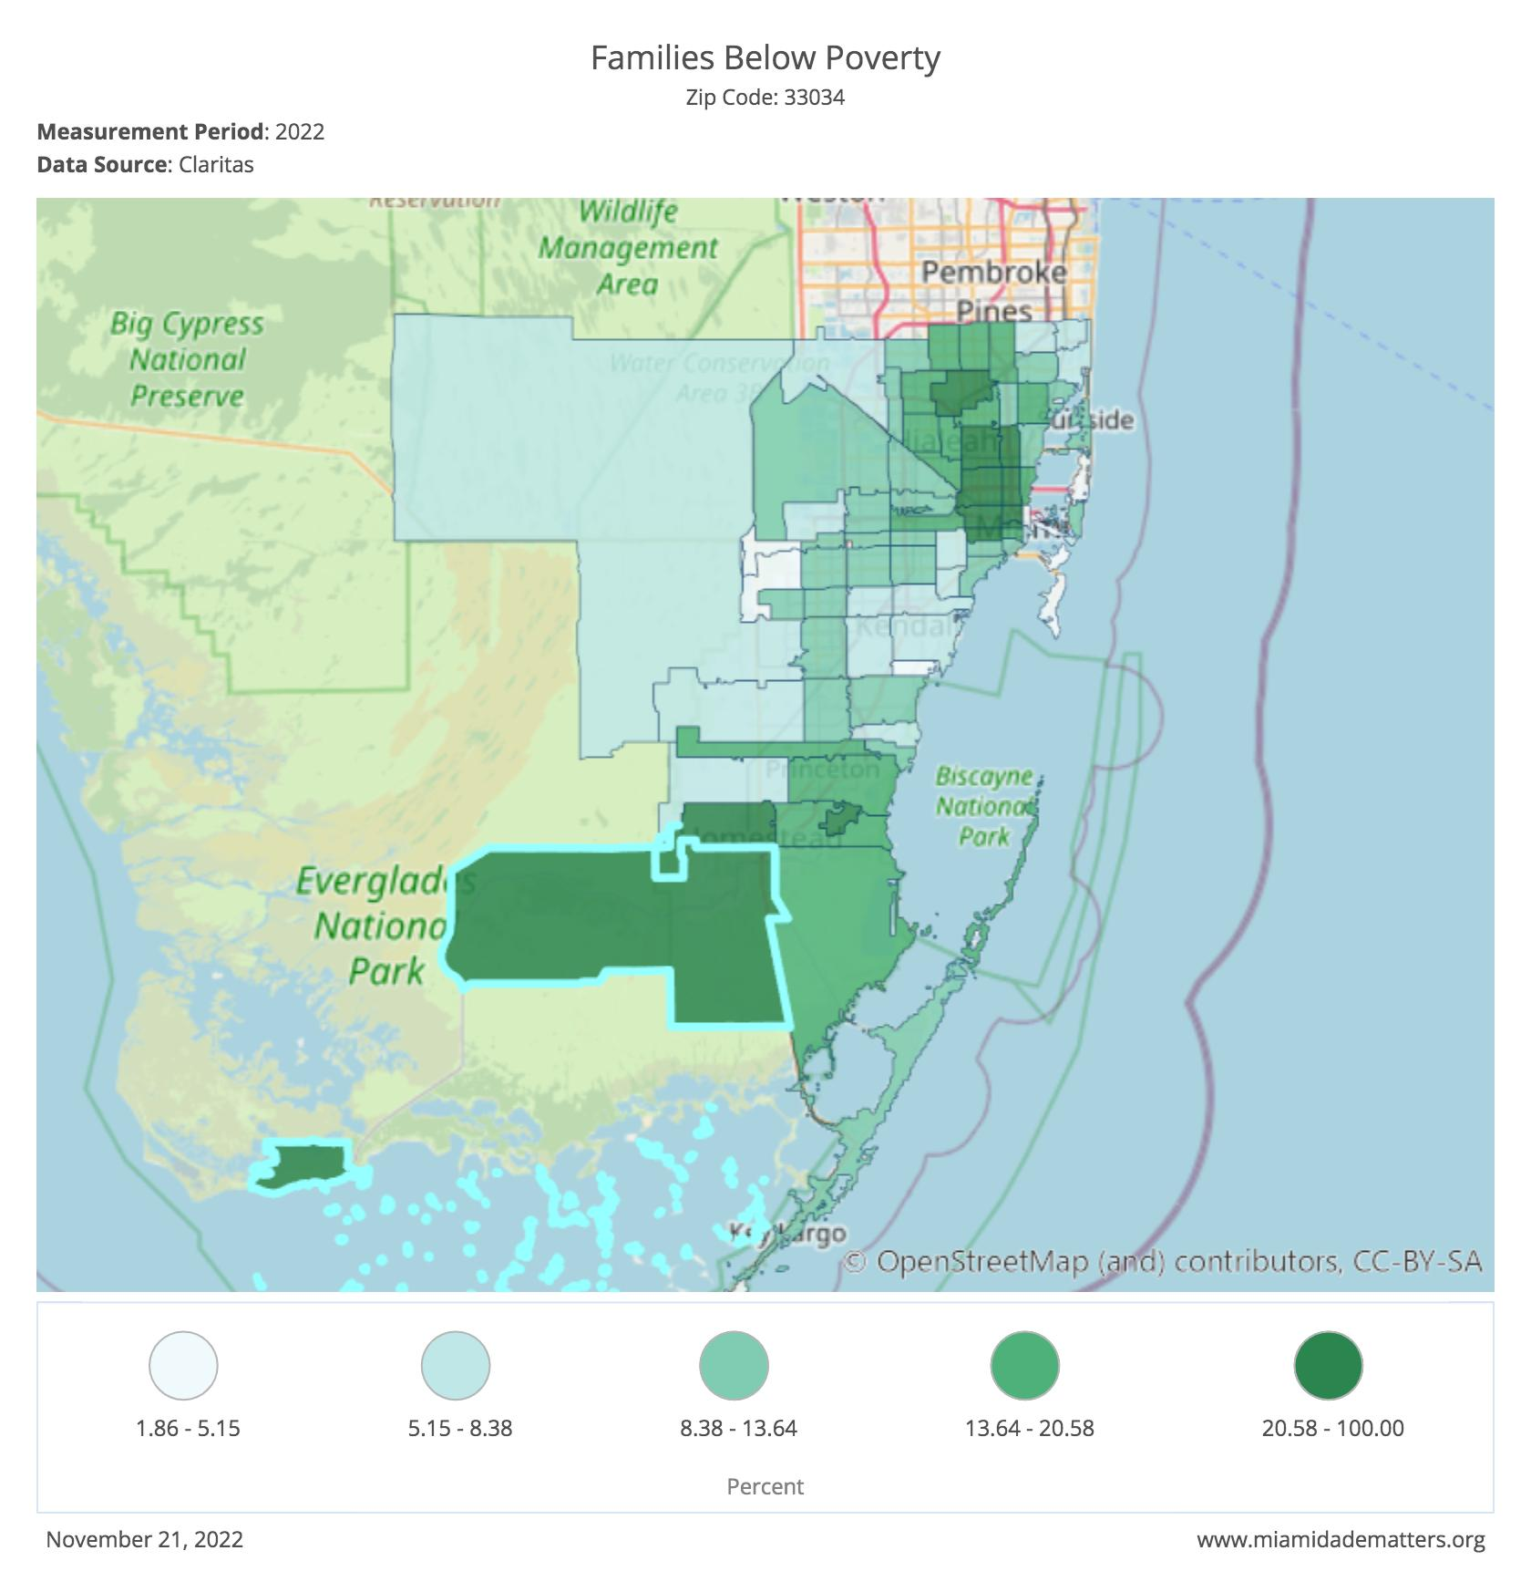

Zip Code: 33034
1,501 Families
31.79% of Families
Notes:
Poverty is associated with poor health including during pregnancy. This website supported with data collected by MDC shows families living below the poverty level. This is a zipcode in Homestead -SW Miami dade 42 miles from downtown. It has the highest number of families living below the poverty level in the county.

Slide 13
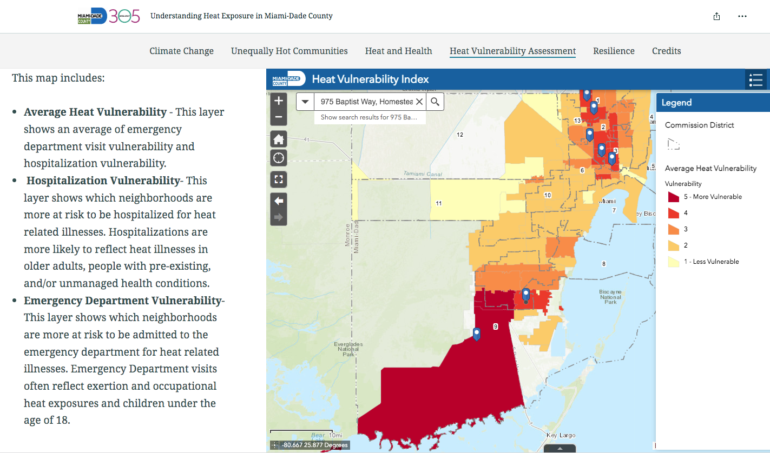
Uejio, C. J. & Ahn, Y.
Notes:
https://storymaps.arcgis.com/stories/6f1e91cf8a8e4d5d9bd67525575c042e#ref-n-zCZOSp
Citation: Miami-Dade Extreme Heat Vulnerability Mapping Report, Christopher K. Uejio & Yoonjung Ahn
This is a mapping tool available on the MDC Resilient 305 website based on a study by Uejio and Ahn showing the rates of HRI ED visits from 2015-2019 across the study area. The highest rates were reported in the southern portions of the county (Florida City and Homestead), and surrounding the Miami International Airport (Hialeah, Little Havana, Fontainebleau). The previous slide overlaps with this heat vulnerability mapping.
It is important to keep in mind that our hands are not tide, there is much we can do as clinicians and citizens to protect our patients and act to reduce greenhouse gas emissions that cause the warming of our world. We can educate patients and peers, advocate for climate-friendly policies and practices with our lawmakers and at our own facilities, and we can act by making climate conscious choices ourselves. With that, I will hand the conversation over to Dr. Bruce Bekkar.

