Slide 1
Impact of earnings reports on stock prices
Chris Abruzzo, Santosh Aditya, Tung Dang, Lin Hui, Vatanak Lim
FRE-6883, Spring 2021

Slide 2




Introduction / Executive summary
Russell 1000
Tracks the highest-ranking
1,000 stocks in the Russell 3000 Index
IWB (iShares Russell 1000 ETF)
Tracks the investment results of the Russell 1000® Index
Used as benchmark return when calculating the abnormal return
Project Goal: Evaluate the impact of quarterly earnings report on stock price movement
Brief summary: the release of earnings report does have an impact on the stock price
Notes:
Resources: Russell 1000, big and steady companies, using their stock information for our implementation
IWB: Russell 1000 ETF, Measures the performance of large- and mid-capitalization sectors of the U.S. equity market, use as benchmark return to calculate abnormal return for each stock.
Goal:
Summary:

Slide 3
Task Allocation
Chris Abruzzo (Team Lead)
•Make plan and assign tasks
•Organize group meetings
•Implement GNUplot
•Design the PowerPoint
Santosh Aditya
•Implementation of libcurl
•Parse data from Yahoo
Finance
•Clean the data
Vatanak Lim
•Design data structure
•Calculate AAR and CAAR
•Design Class Group and
Bootstrap
Lin Hui
•Design and implement Menu
•Pull earnings from Zacks
•Design the diagram and slides
Tung Dang
•Design Class Stock
•Design data structure
•Implement Multi-thread
Notes:
Google drive to store share all works
Shorter

Slide 4
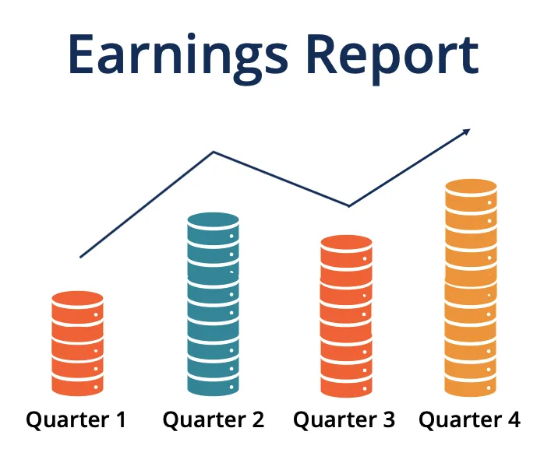
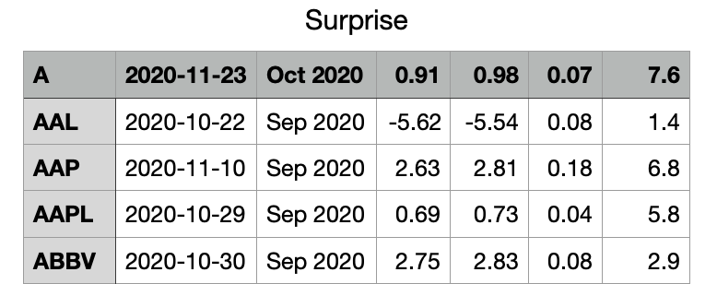
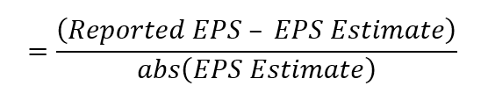
Company Earnings from Zacks
Utilize Matlab script to pull earnings information from Zacks.com
Matlab Script: pull earnings information from Zacks, restrict the period ending in {Aug, Sep, Oct 2020} to match the calendar quarter. Duplicate earnings from single company are removed.
Pulled info was stored in Surprises.csv
Information stored:
Ticker
Announcement date
Period ending
Estimated earrings
Actual earnings
Surprise
Surprise %
Notes:
Restrict period ending in { }.
Some companies have two earnings information for a single period, and duplicates were removed.
Some companies don’t have earnings information available, so totally we retrieved about 967 earnings records.
Surprise.csv: unsorted earnings information, we will sort it based on surprise% after reading the file in c++

Slide 5
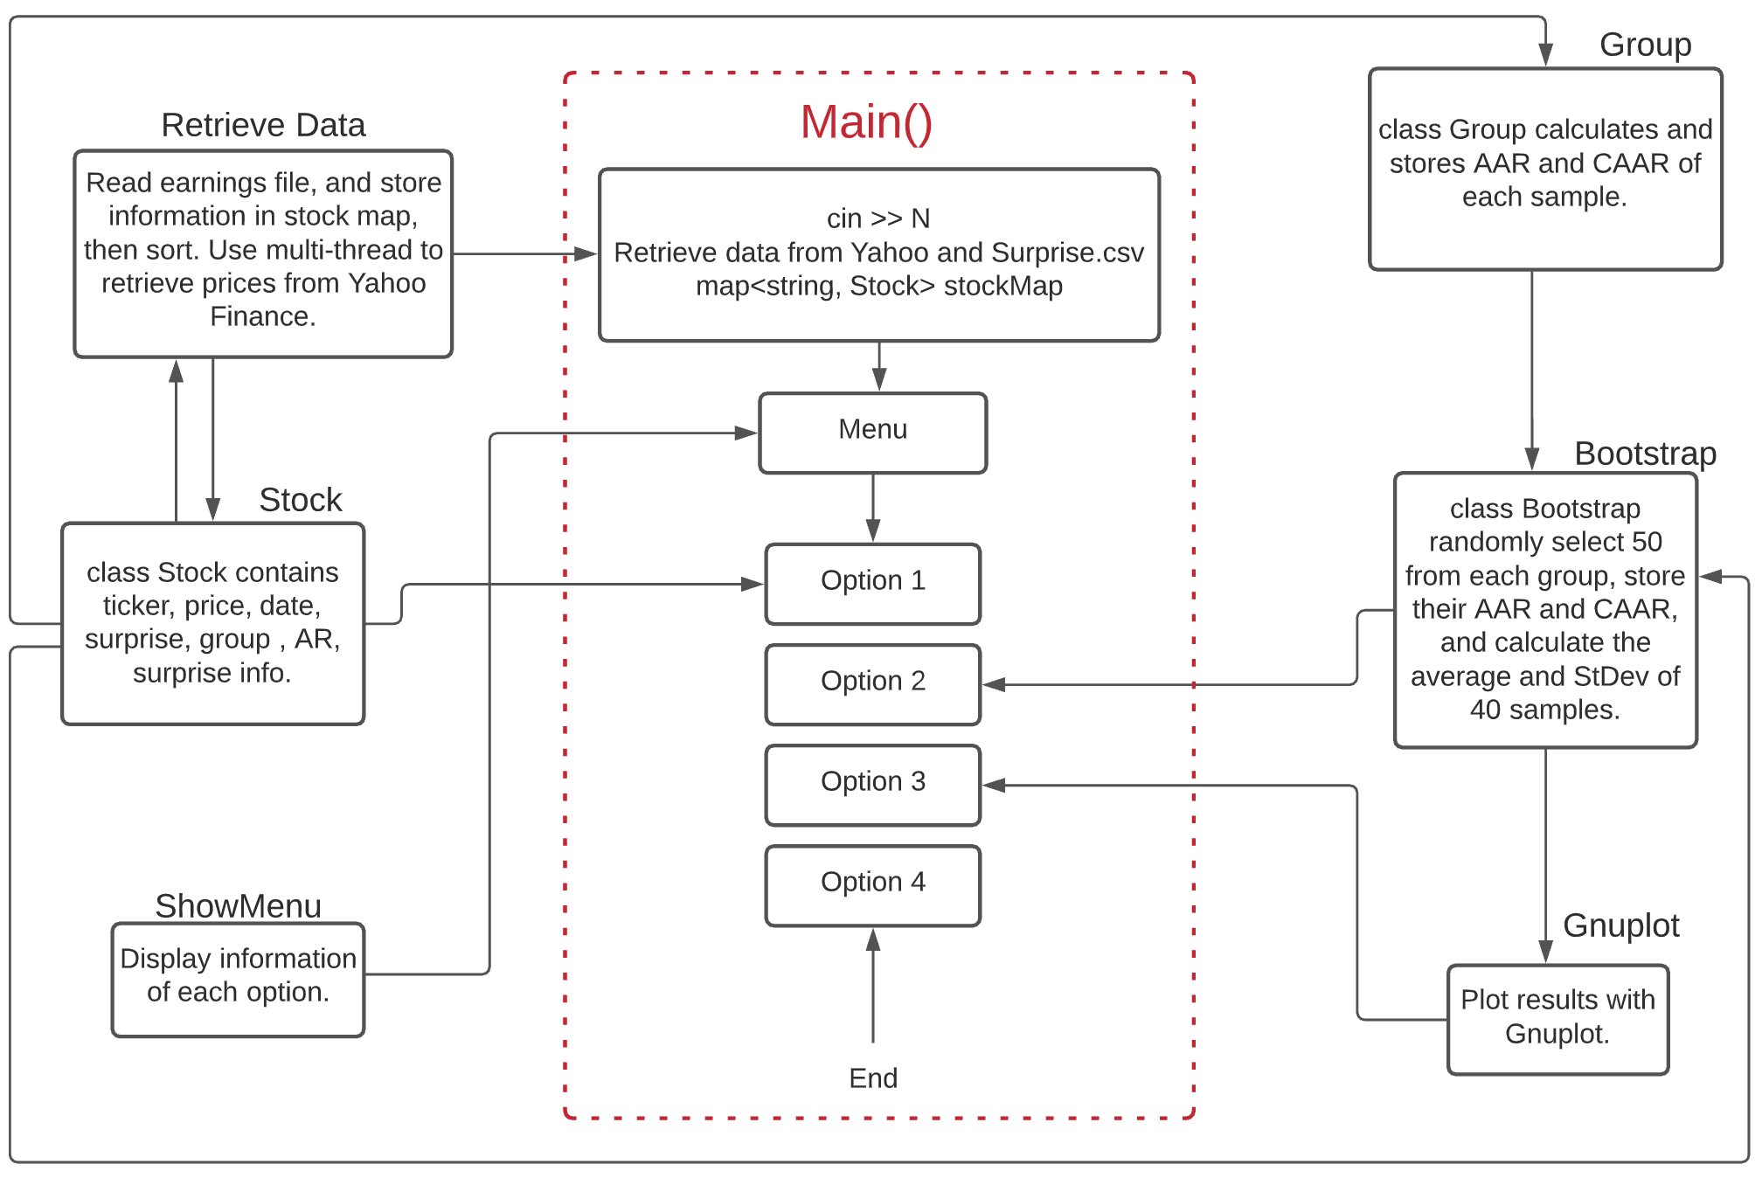
Design
Notes:
6 headers to implement the work
Retrieve data: read earnings file, store ticker, announcement date, estimated and actual earnings, surprises into a stock map, and sort them based on earnings, assign the group number to each stock, 0-Beat, 1-Meet, 2- Miss
Then retrieve Yahoo Finance data, push_back the date and adjusted close to vectors, and store in each stock object.
Stock: contains all necessary attributes needed, like date, price andexcess returns
Group: calculates AAR and CAAR using a map of stocks, and stores them for each time we take sample
Bootstrap: randomly select 50 stocks from each group, calculate and store AAR and CAAR, then perform sampling 40 times, and take the average and StDev.
Gnuplot: use the Gnuplot to plot the average of CAAR for three groups.
ShowMenu: embedded input N in the retrieve data, so our menu only has four options. Menu function will show the menu option, and display information accordingly. The menu will repeat to pop up if exit is not selected.

Slide 6
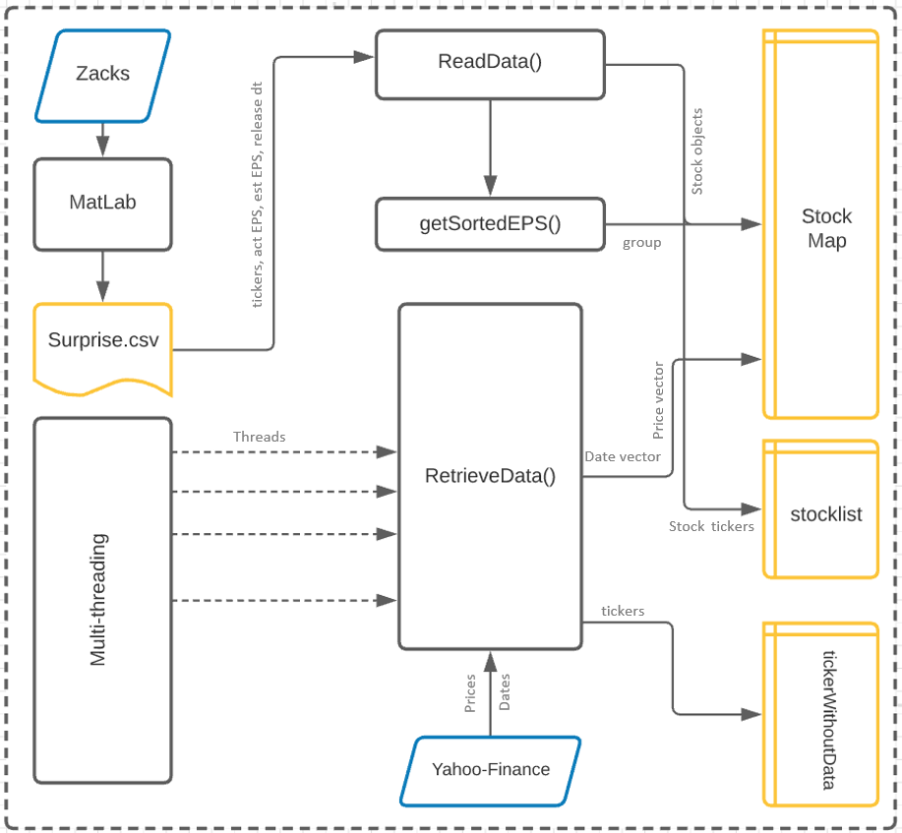
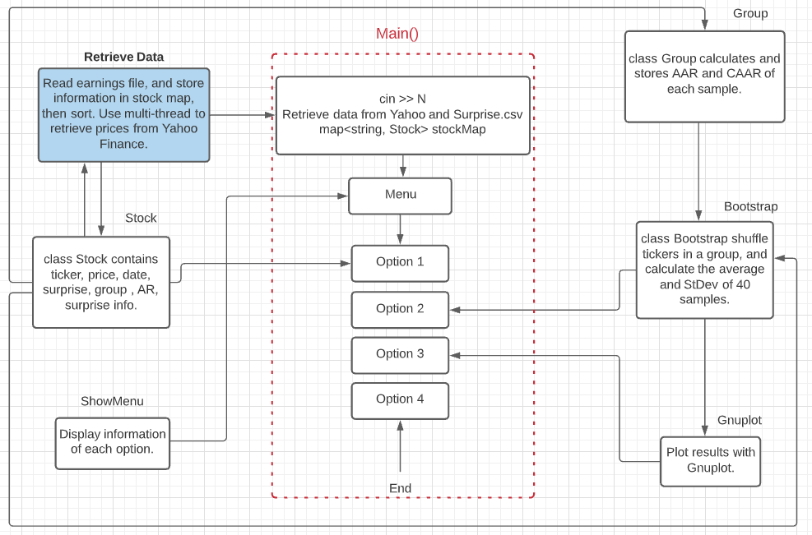
Data Retrieval
Goal : Extract financial information for the stocks and populate stock class object’s attributes with them
Data populated : ticker, act. EPS, est. EPS, release date, stock group, prices,dates
Data Structure : StockMap - map<string, Stock> | stocklist - vector<string> | tickerswithoutdata vector<string> | Dates and prices - stored as vectors
ReadData(): Reads the csv output from MatLab program and populates StockMap with Stock objects, with Tickers as keys
RetrieveData(): Multi-thread initiates this function with partial stock list; function extracts data from yahoo finance and stores it in Adjclose and Date vectors of Stock objects.
GetSortedEPS(): Sorts the ticker based on Surprise%, and populates group data member of the stock objects.
Notes:
We use the out put from the MATLAB code to extract stock details and store them into
map<string, Stock>& stockMap - a map containing Stock name as the key and Stock object as the value
vector<string>& stocklist - A vector of strings to store tickers. This will be used to pull data from libcurl
ReadData(string filename, map<string, Stock>& stockMap, vector<string>& stocklist)
-Takes in the file name as an input. New objects of stockMap and stocklist are created and passed by reference, because they need to be updated with the Stock information
- Creates a temp variable row to store all the words in each line of MATLAB file. Different values of this vector string are used to create a Stock Object using constructor with parameters [Stock stockTemp(row[0], date, stod(row[3]), stod(row[4]))] . This row variable is cleared after extracting all the words in a line and creating Stock objects
- The stock objects created are stored in the StockMap by using ticker as key and Stock object as values
- The tickers are stored into stocklist, which will later be used for pulling price data through libcurl
- Once we retrieve the information, we use independent function getSortedEPS to sort the data and assign group values “Beat”, “Meet”, “Miss” to each of the objects in stock map
getSortedEPS(map<string, Stock>& stockMap) - This function takes in the Stock Map with all the data filled in and returns map<int, string> tickRank which store the ticker and its rank
First we iterate through the stock map and create a vector<pair<string, double>> . The string value is the ticker and double is the surprise. This is being done to utilize vector’s sort functionality
We define a variable called group_size = size of the StockMap/3, as we want the data to be split into three groups
Then we iterate through this vector of pairs and identify the groups based on an nested if statement. The identified group is set using Stock object member function SetGroup for every stock object in the stock map. The objects are referenced through their key
RetrieveData(map<string, Stock>& stockMap, vector<string>::iterator begin, vector<string>::iterator end, int N, vector<string>& tickerWithoutData)
Step 1: Get cookies and crumb -> create URL -> setup libcurl handle -> parse data -> store it into price and date vectors
Inputs - Stockmap, begin and end iterators, N from user input, and a vector to store tickers without data
First it creates two strings sCookies, sCrumb which will be used later for URL creation. These are pulled only once using a dummy URL for Amazon. The cookies are also stored into a text file for retrieving later
The function creates a URL string specific to the symbol. The symbol is retrieved from the iterator by dereferencing it.
This URL is passed to the curl handle using curl_easy_setopt and the data is extracted into a memory struct object data
We use a similar technique shown in class to extracted data is converted to string format and using getline function we go through each line and extract the Pricing Date and Adjusted Close price
The data is pulled for a wide range initially to offer flexibility
Step 2: Get Ann date -> Find the index of ann date -> create slice using N value -> notify user if data is incomplete -> using the slice indices slice Price and Date vector -> assign these sliced vectors to the stock object
In the previous step we retrieved price and dates for a very wide range. We need to slice this data based on the N value and assign the price and stock vectors to a Stock object in the StockMap
We use the GetAncDate function from the Stock object to get the Announcement date. We find the index of this date in the date vector and slice it accordingly
If there is not enough data in our slice, we store the symbols into wrong.txt file for the user to check later
Using the slice values, we slice the Price and Date vectors from previous step and assign them to the stock object

Slide 7
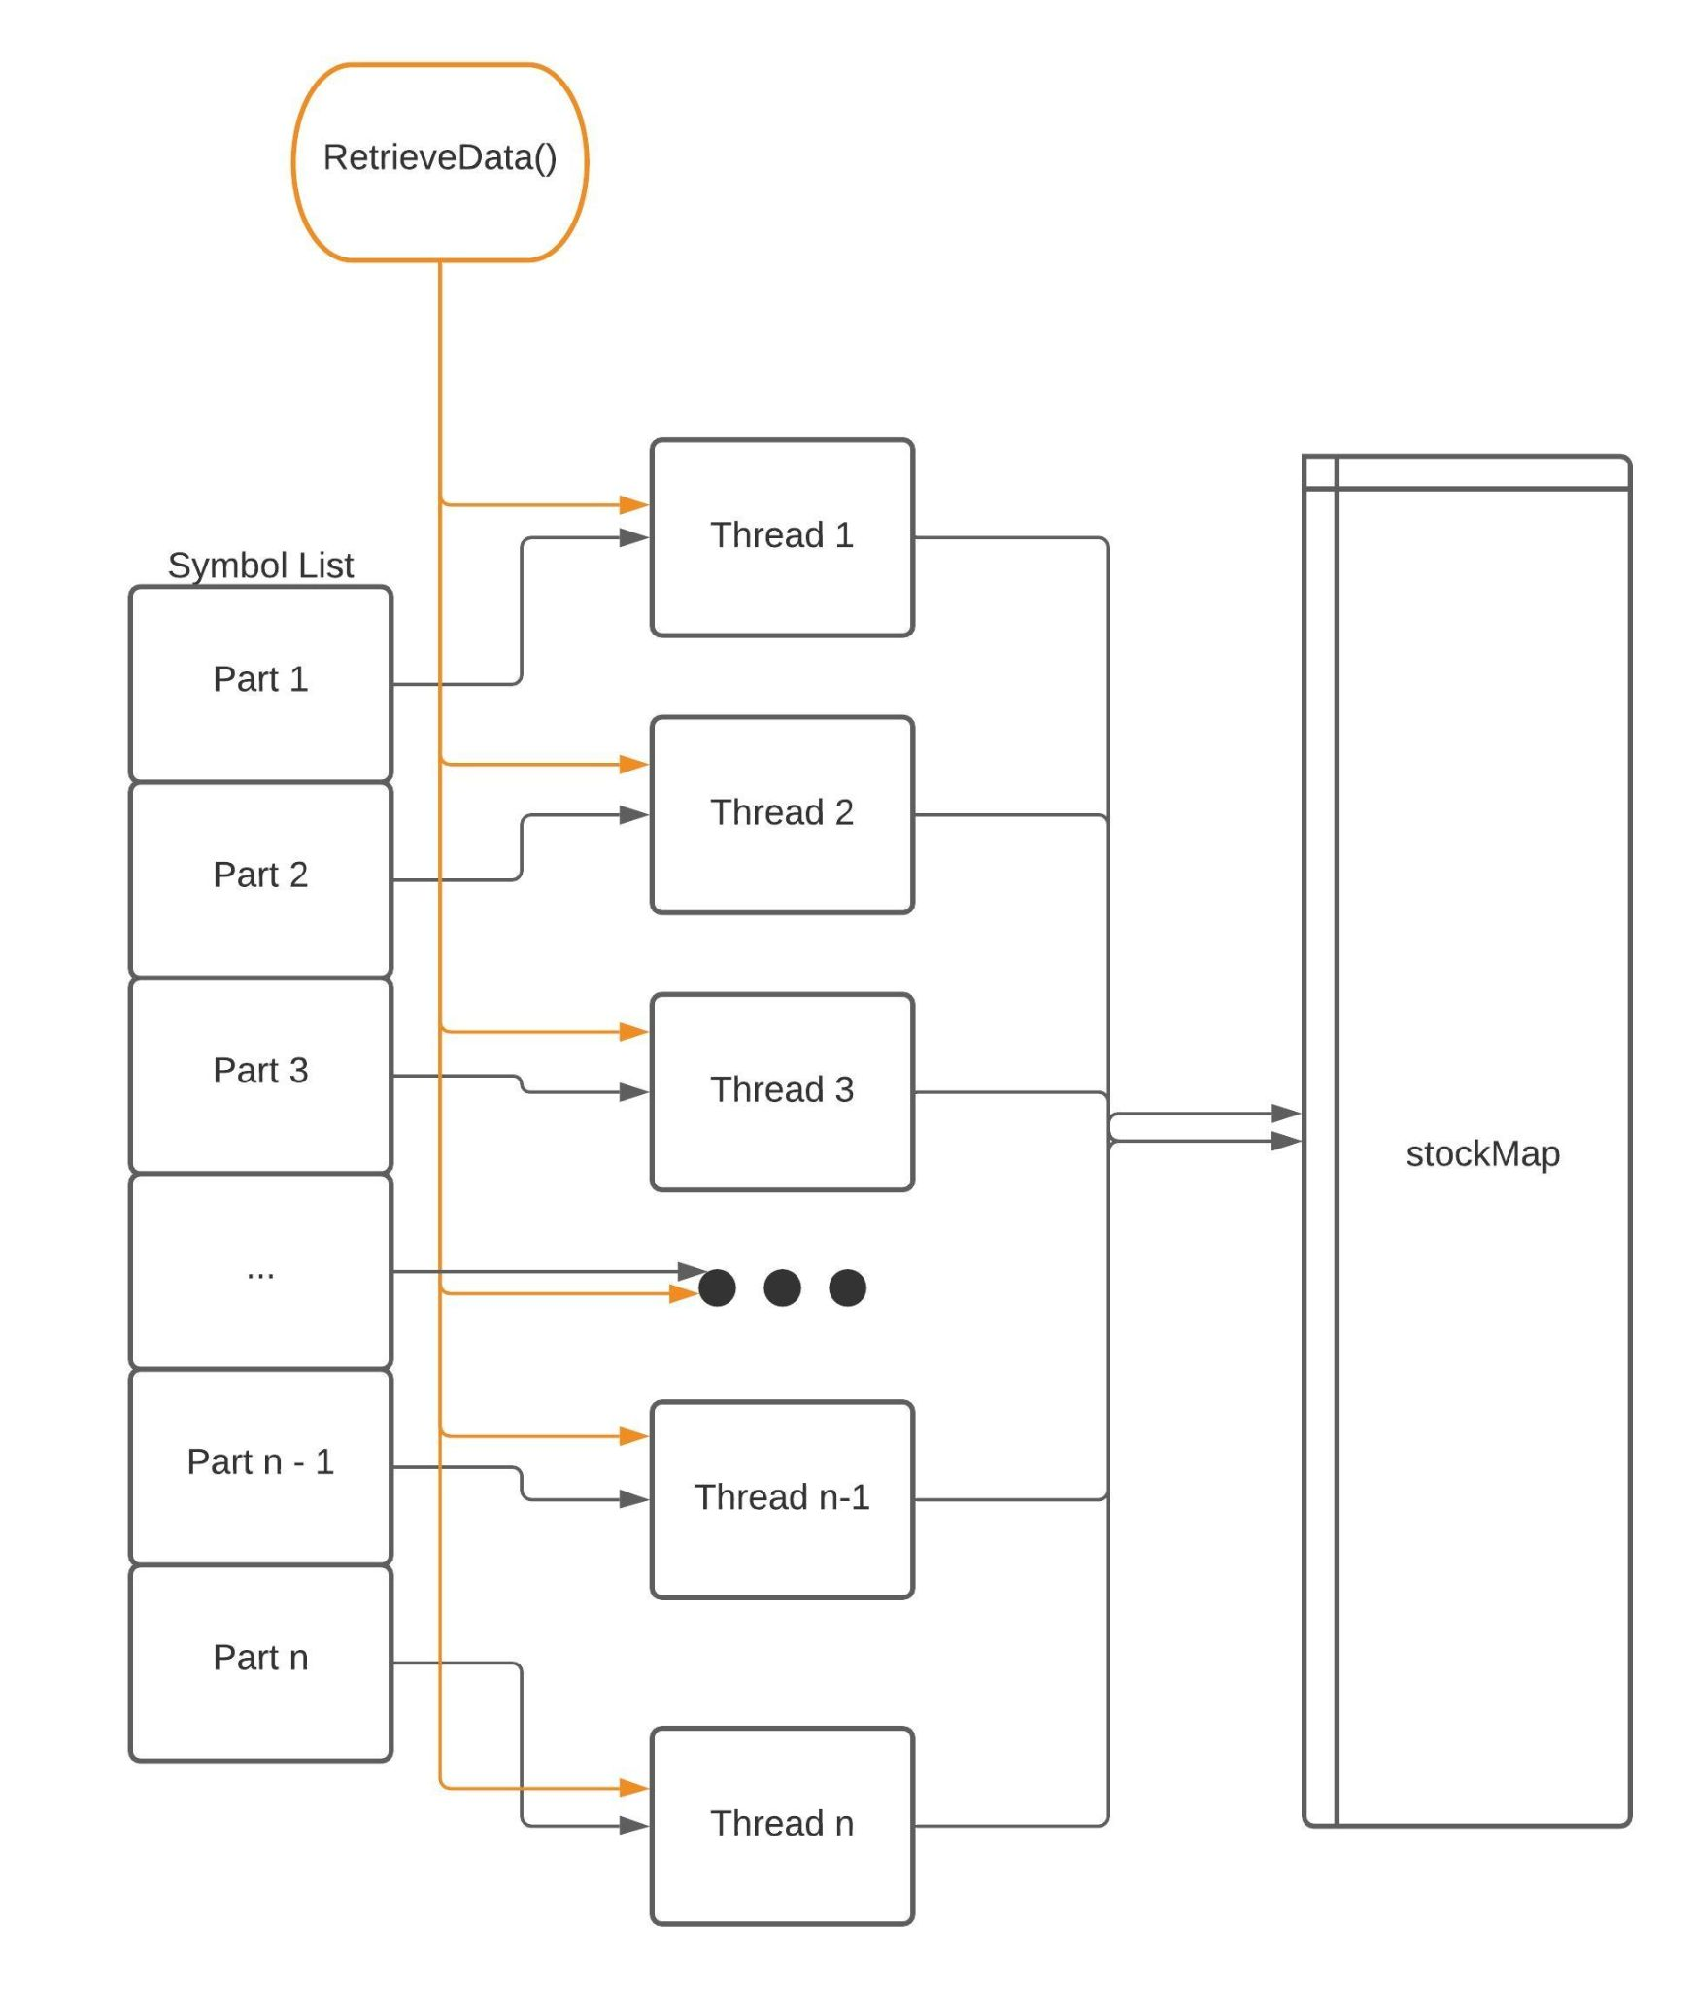
Multi-threading
Split 1000 Russell stock list (vector<string>) into smaller lists
Use predefined number of threads to call retrieving data functions on each batch in parallel so that the process would take less time
Each thread queries & write data for different tickers, no race condition
Notes:
RetrieveData(map<string, Stock>& stockMap, vector<string>::iterator begin, vector<string>::iterator end, int N, vector<string>& tickerWithoutData)
The RetrieveData function is supposed to be called 967 times to query data for 967 stocks.
Multi-thread can help reducing the time of running by getting a number of threads to invoke the functions in parallel.
It helps decreasing the running time from 120s to more than 20 seconds
The symbol list vector is then split into smaller vectors with roughly equal number of elements so that each thread handles a roughly equal amount of tickers. Each small vector is marked by two pointers pointing to the beginning and the ending elements. This two pointers are inputs of RetrieveData function (vector<string>::iterator begin, vector<string>::iterator end) so that it would know which ticker it would query (It does not handle “end”, instead the next thread would do that. In case “end” point to the end of overall symbol list, the function would stop.)
As each thread would write on different keys of the map, there would be no issue of race condition in this case

Slide 8
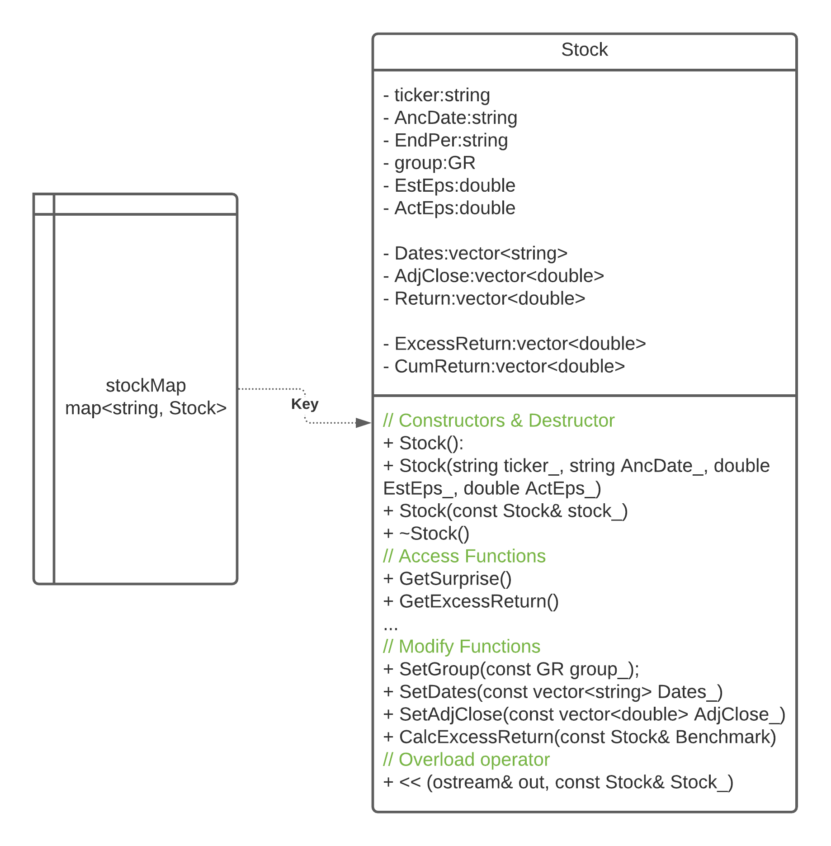
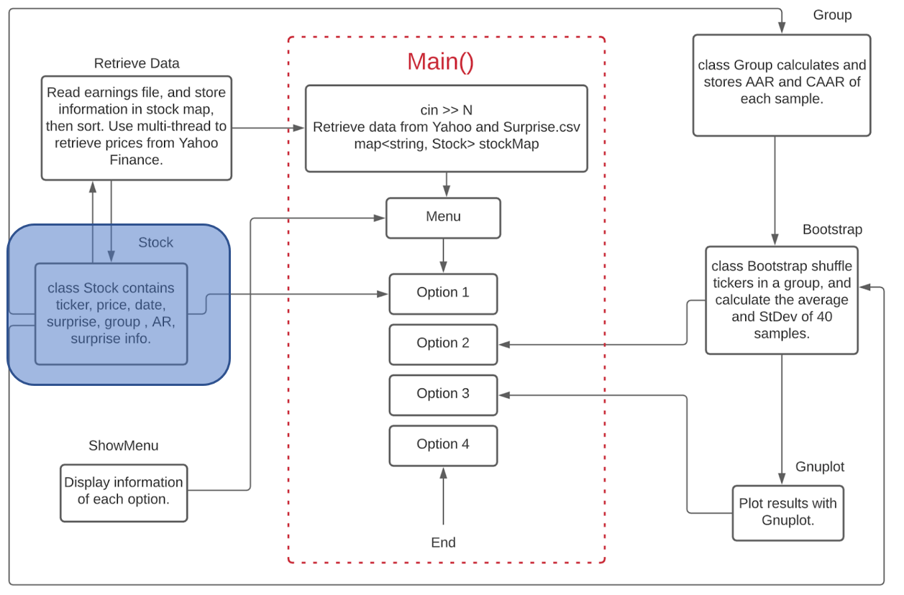
Class Stock
ReadData(string filename, map<string, Stock>& stockMap, vector<string>& stocklist)
RetrieveData(map<string, Stock>& stockMap, vector<string>::iterator begin, vector<string>::iterator end, int N, vector<string>& tickerWithoutData)
Stock’s modifying functions
Notes:
This class is written to contain all the information about a single stock
Including: Ticker name, Earning Announcement Date + Est. Earning + Actual Earning, Group the stock belongs to (Beat, Meet, Miss), historical prices and different types of returns based on the historical prices.
The constructors of class includes default constructor, constructor with 4 parameters, copy constructor and a destructor
The class is encapsulated so that user can only get access to the information by using its member functions
There are four modifying functions to add data of dates and their comparable returns (inlc. normal return, excess return)
Finally, there is an out stream operator overloading to write stock’s stock information on outstream object.
stockMap populating process:
ReadData() reads from ‘surprise.csv’ to create all pair of key, value in stockMap; after which the stock’s ticker, AncDate, GR, EstEps, ActEps are initialized and assigned to their values.
RetrieveData() then queries historical price from YahooFinance and writes the data on Dates and AdjClose vectors. Based on AdjClose, the Return and CumReturn vectors are calculated.
Excess Return is calculated after we select a benchmark for it (in form of stock object).

Slide 9
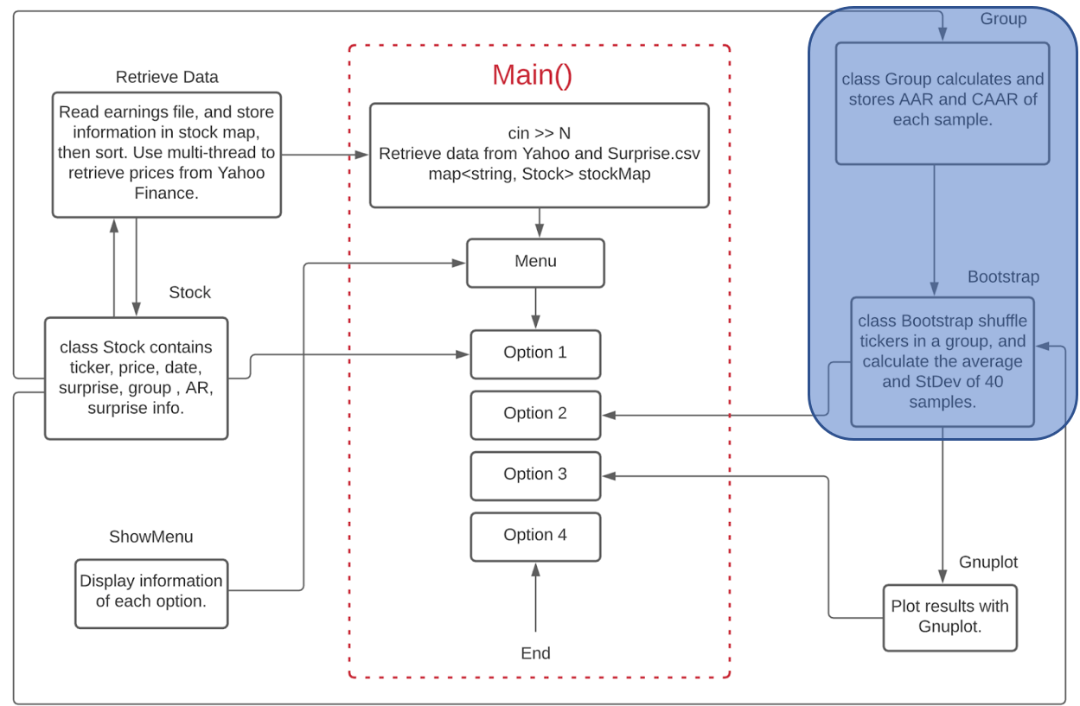
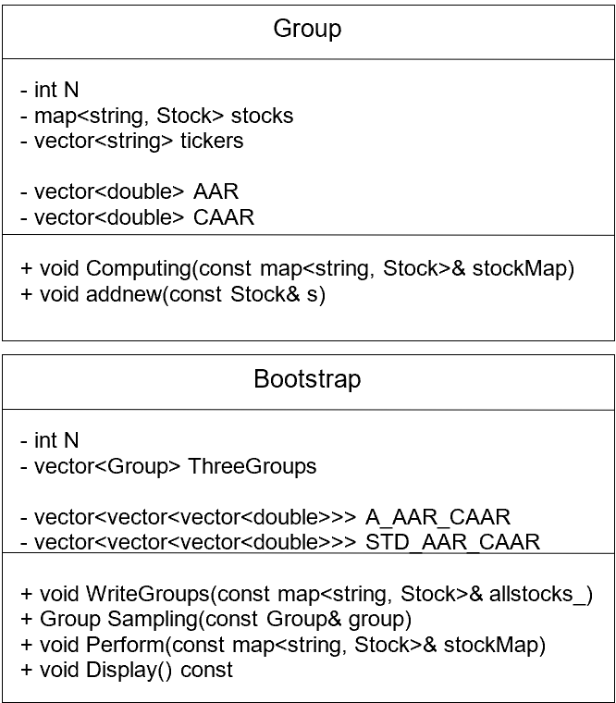
Class Group & Bootstrap
addnew (const Stock& s)
Computing (const map<string, Stock>& stockMap)
WriteGroups (const map<string, Stock>& stockMap)
Perform (const map<string, Stock>& stockMap)
Ultimate Goal !!!
Average AAR, Average CAAR and Standard Deviations

Slide 10
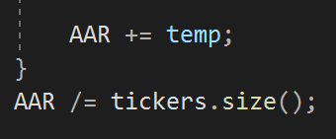
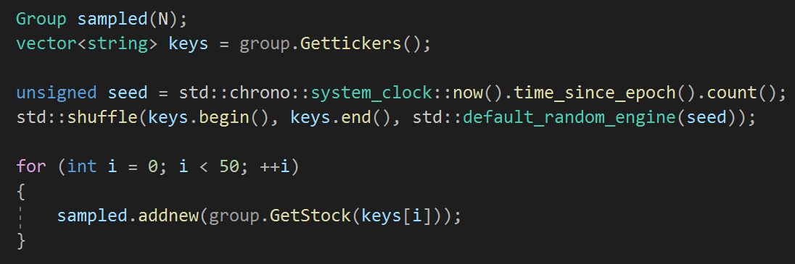
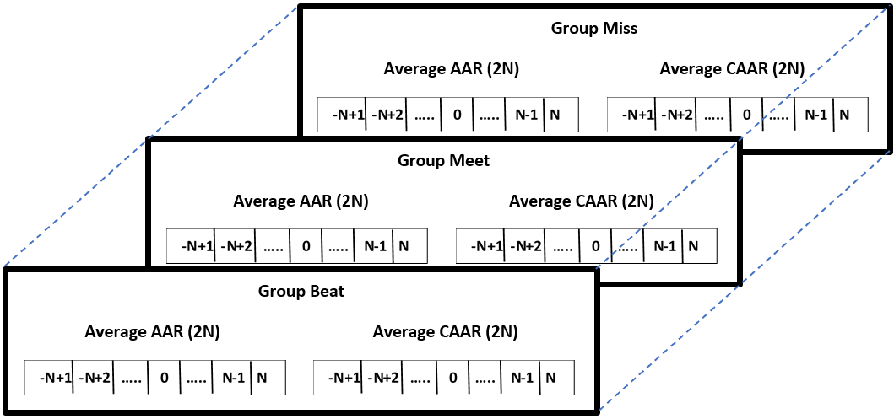
Class Group & Bootstrap’s Highlighted Features
Operators Overloading:
vector<double>& operator += (vector<double>& v1, const vector<double>& v2)
vector<double>& operator /= (vector<double>& v, double num)
Easy to use
Easy to read
Sampling:
Shuffle only tickers
Then use it to add stocks to groups
3D Matrices:

Slide 11
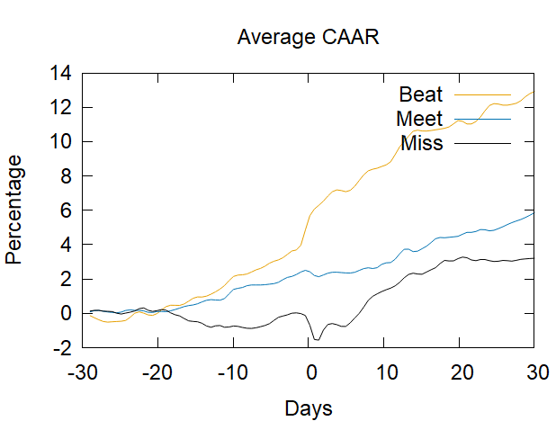
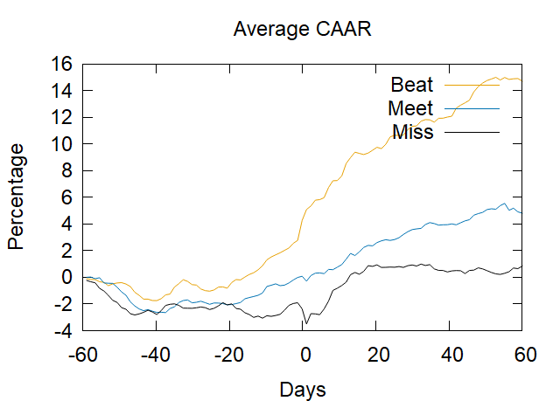
Plotting with Gnuplot
Average CAAR for 2N Days (N=30)
Average CAAR for 2N Days (N=60)
Notes:
Thanks Nak. Hi, my name is Chris Abruzzo picking up from where Nak left off, our program is now capable of retrieving all the data and performing the calculations to gain insight on the impact of earnings on stock prices.
Info stored in the 3D matrix that Nak mentioned - needs to be visualized
Used GNUplot to do so
GNUplot - a command-line program that can generate two- and three-dimensional plots of functions, data, and data fits.
Our gnuplot.cpp writes three Files, ‘Beat’, ‘Meet’ and ‘Miss’ in the directory
Writes Files by accessing the 3D matrix using an instance of the Bootstrapping Class and writing the corresponding data for the three groups to the correct files
Opens the locally installed GNUPlot program
And sends command line to plot the graph
Everytime the Bootstrap is computed, a new matrix is formed and new graphs will populate with the new data

Slide 12
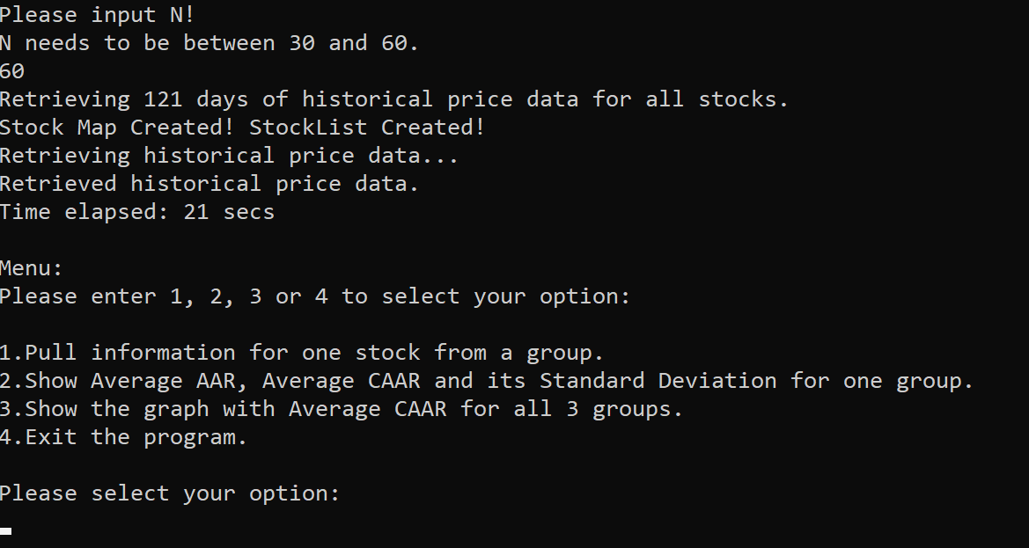
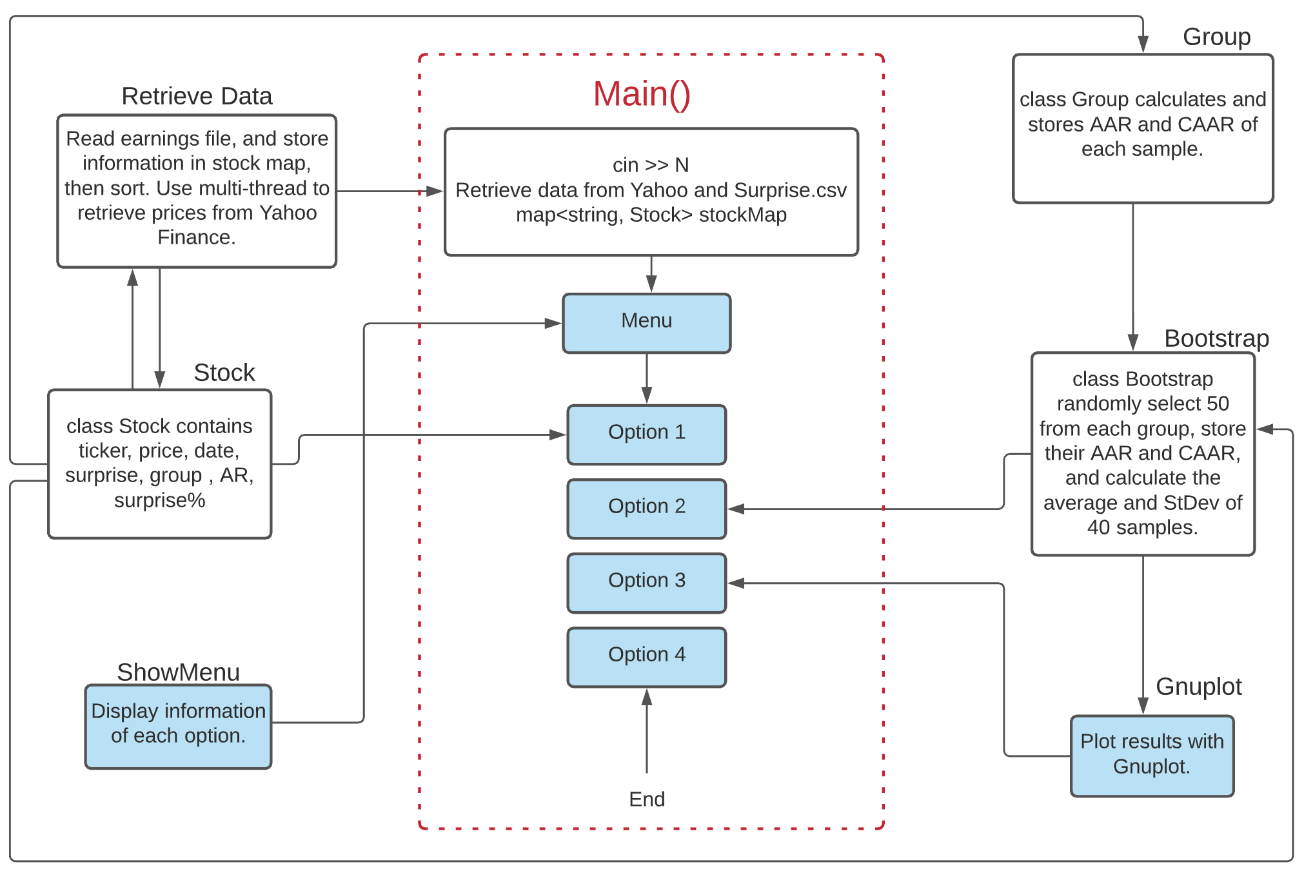
Program Menu
Pull information for a particular stock from a group.
Info displayed to user: Announcement Date, Period End, Estimated Earning, Actual Earning, Surprise, Surprise %, Group, Adj Daily Price and Cumulative Return
Show Average AAR, Average CAAR and its Standard Deviation for one of the three groups.
Show a plot of the with Average CAAR for all 3 groups from -N + 1 to N days before/after the earnings date.
Exit the program.
Notes:
Next, to organize the program we created a user friendly interface.
Provides an easy to use interface for the end user
Calls on the header file “ShowMenu.h”
Main.cpp -> MainMenu(int N, const map<string, Stock>& stockMap_) - called in main. Utilizes switch and cases to direct the program which outpot to provide from the user input
ShowMenu() - populates menu options to console for user
Users can choose between 4 options:
Display information on a particular stock from a group
Display the average AAR, Average CAAR and the respective standard deviations for the time frame of 2n+1
Display the plot of the average CAAR for the three groups on a single plot
Exit the program
Once an option is selected and the desired output is printed to the screen, the menu populates again and prompts the user to make another selection.
Completed by using a while loop
Any incorrect inputs from the user causes the program to display an error message
“Invalid option number, please try again.”
With that, we have a functioning program!

Slide 13
Results
Graph CAAR for all three groups
Beat: Significantly drifts upward
Meet: Positive upward trend
Miss: Surprisingly up at first, but mediocre performance in longer term
Notes:
Movement before, at, and after earnings announcement

Slide 14
Conclusion
Earnings Report has high correlation with CAAR
The longer the time period after the Earnings Call, the more pronounced the effect of Beating, Meeting, or Missing
This may be due to investors taking time to assess the earnings reports and take action on the news.
Logically makes sense, better than expected performance from companies attracts more investors.
Future Studies:
Explore other aspects of earnings calls, like forecasts

Slide 15
References
Numerical Methods in Finance with C++, by Maciej J. Capinski and Tomasz Zastawniak, Cambridge University Press, 2012
Introduction to C++ for Financial Engineers: An Object-Oriented Approach, Daniel J. Duffy, ISBN 0470015381, Wiley, 2006
https://query1.finance.yahoo.com/v7/finance/download/
http://zacks.thestreet.com/CompanyView.php

Slide 16
Thank you!
Please stay put for demo!

