Slide 1
Contact Manager Project

Slide 2
Group 8 Members:
Ming Jiang
Henry Ton
Lili Lin
Joe Hummel
Austin Bryant
Priyank Krishnamoorthi
Daniel Keller

Slide 3
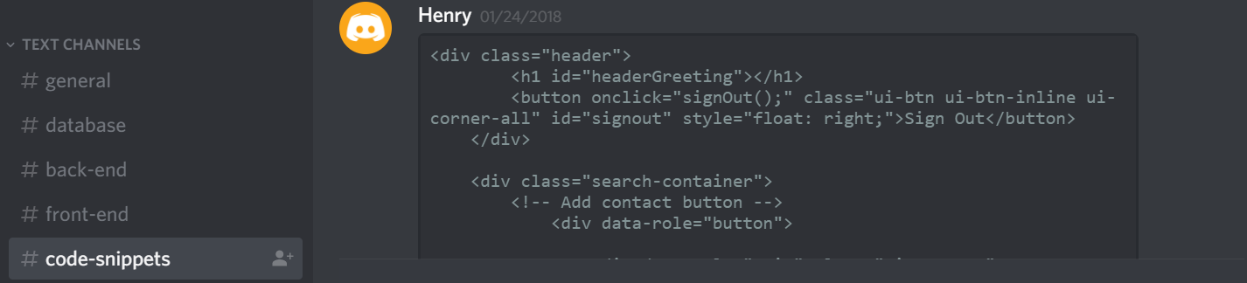
Project Description
Contact Manager that allows the user to login and show all their contacts
Ability to add, delete and search contacts
Challenges: Learning new technology, splitting project up into little tasks so everyone learned a bit of everything, and managed communication via discord

Slide 4
Project Development
LAMP Stack
MySQL database set up on Azure
MySQL Workbench
Bootstrap
Password Hashing
Prevented against SQL Injection by using parameterized queries

Slide 5
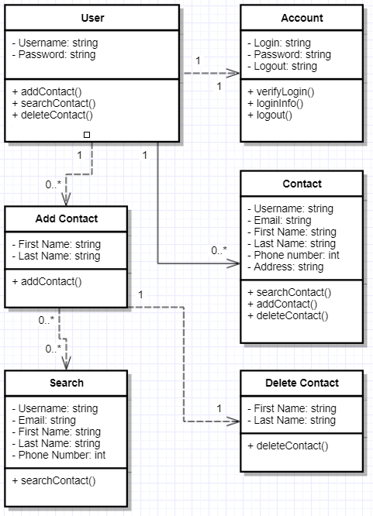
UML Diagrams - Class

Slide 6
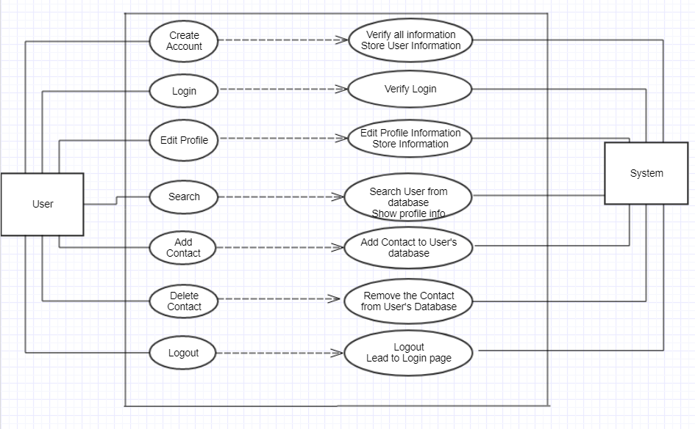
UML Diagrams – Use Case

Slide 7
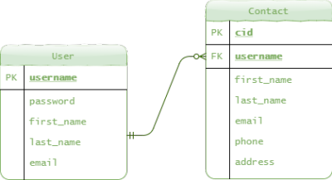
ER Diagram

Slide 8
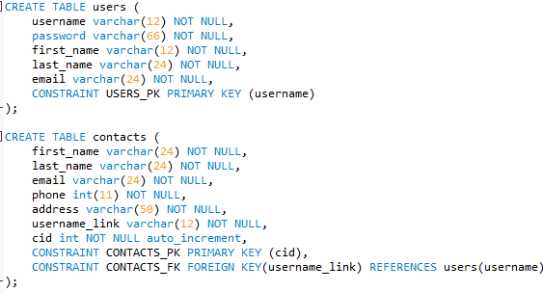
Database
MySQL setup on Azure

Slide 9
Demo!
http://cop4331groupeight.com

Slide 10
Questions?

