Slide 1

Data Structure and Algorithms
Airlines Management System

Slide 2
Airlines Management System
Prepared By
Abu Bakkar Siddique Emon
I’D: 2201011
Tanzim Ahmed khan
I’D: 2201018
Most. Sukria Akter
I’D: 2201021

Slide 3
At a glance
Introduction
Motivation
Objectives
Header Files
Flowchart
Application of Project
DSA Implementation
Implemented Screenshots
Features & Tools
Limitations
Conclusion

Slide 4
Introduction
In today's modern world, we can fastly reach our destinations with the help of airplanes. The Airline Management System, developed as part of this project, is a user-friendly platform for storing, retrieving, and managing information of passengers and airlines.
The Airline Management System is a software application that offers a comprehensive set of features for managing airlines, enabling users to create accounts, book tickets, view ticket details, modify tickets, confirm payments, and cancel tickets.This system is designed to streamline the process of managing airline information, the system ensures that users can access the details they need and get their destined service quickly and easily.

Slide 5
Motivation
A manual system which mainly involves registering manually.
Large files of record
Time consuming
High numbers of errors
Manual system
By using C++
It becomes easy to handle

Slide 6
Objectives
For airlines-
To manage airlines flights, passengers, and crew members.
To keep track of airlines finances and generate reports.
For passengers
To improve customer service.

Slide 7
Header Files
#define _CRT_SECURE_NO_WARNINGS
#include <iostream>
#include <stdio.h>
#include <stdlib.h>
#include <string>
#include <ctime>
using namespace std;

Slide 8
Flowchart
Class file handaling
Class user input
Class facilities
Class display cities
Class Booking
Class passenger
Economy
Class
Premium
Class
Business
Class
First
Class

Slide 9
Applications
Can be used for educational purposes.
Can be used at airports with further modification

Slide 10
DSA Implementation
Queue, Structures, Arrays and Vectors , String Manipulation, Linked List, Control Structures, Object-Oriented Programming(OOP) Concepts, implements the Bellman-Ford Algorithm to find the minimum cost of traveling between all pairs of cities, Dijkstra's algorithm, searcing algorithm......etc, DSA concepts are used in our projects.

Slide 11
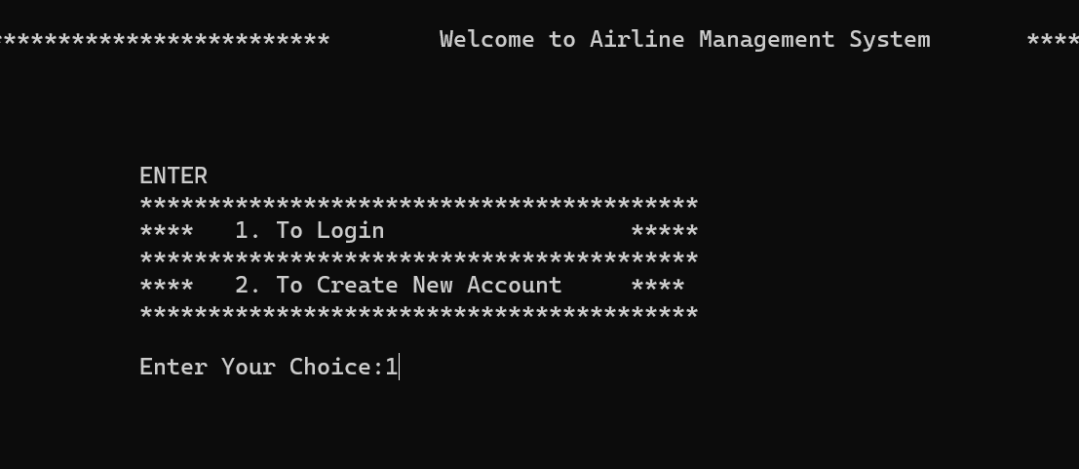
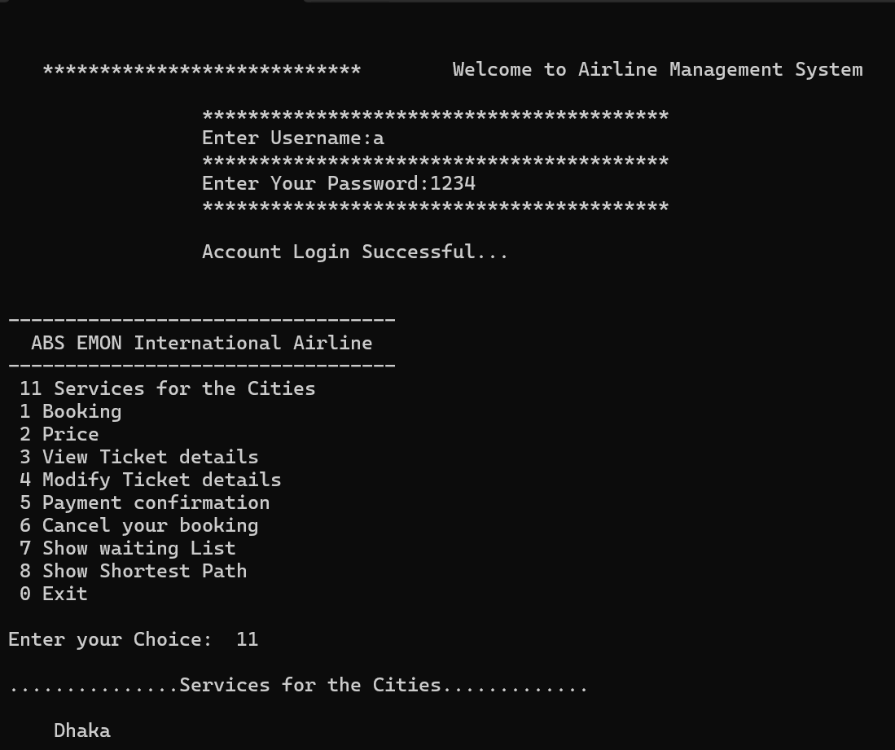
Implemented Screenshots

Slide 12
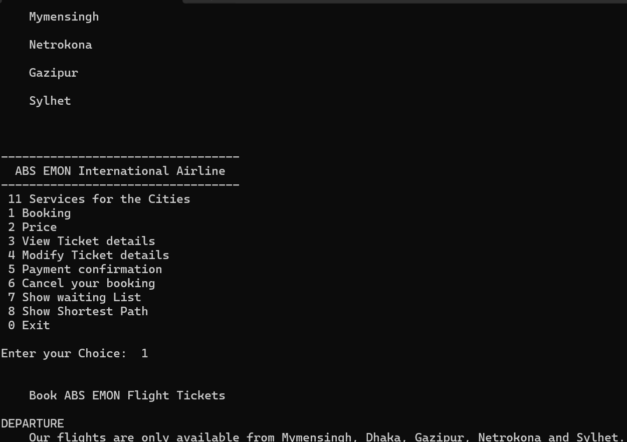
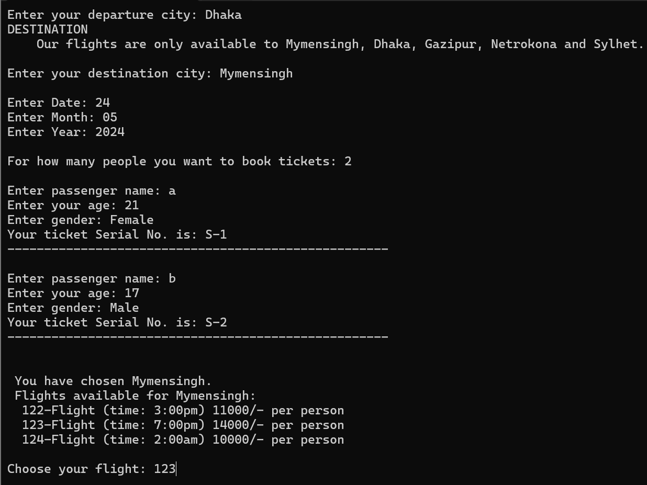
Implemented Screenshots

Slide 13
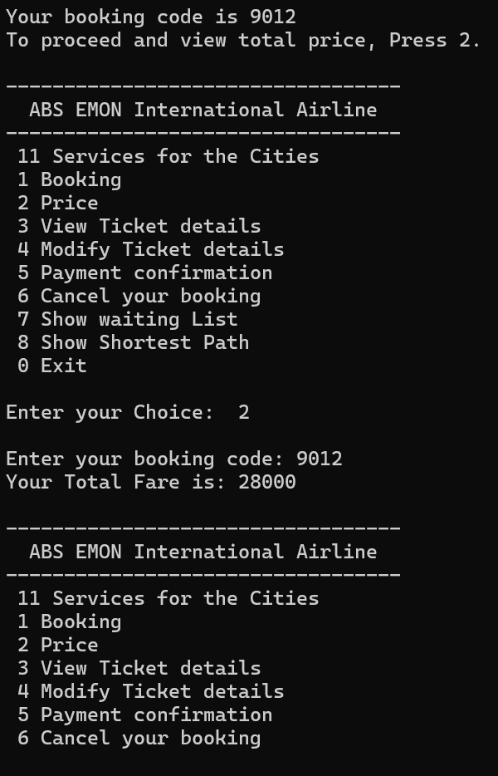
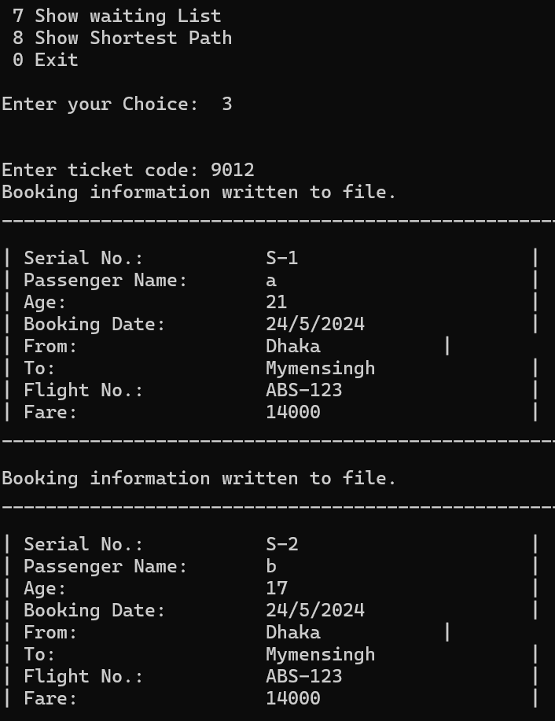
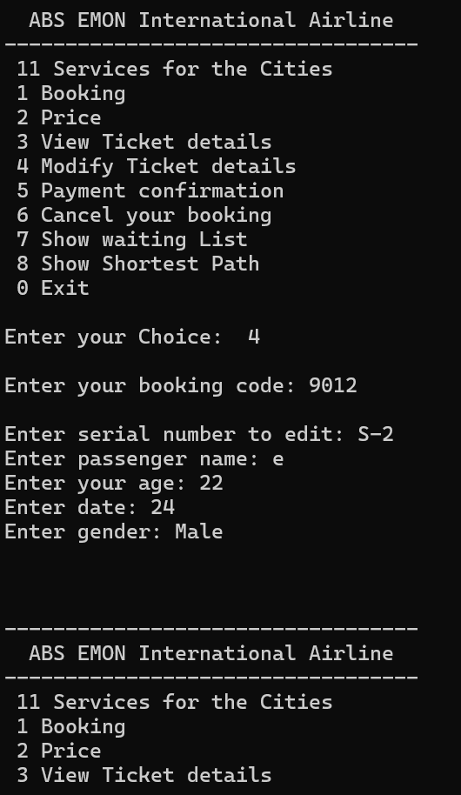
Implemented Screenshots

Slide 14
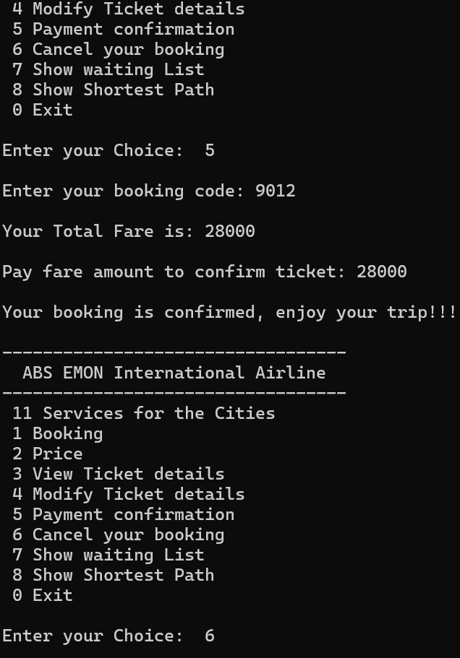
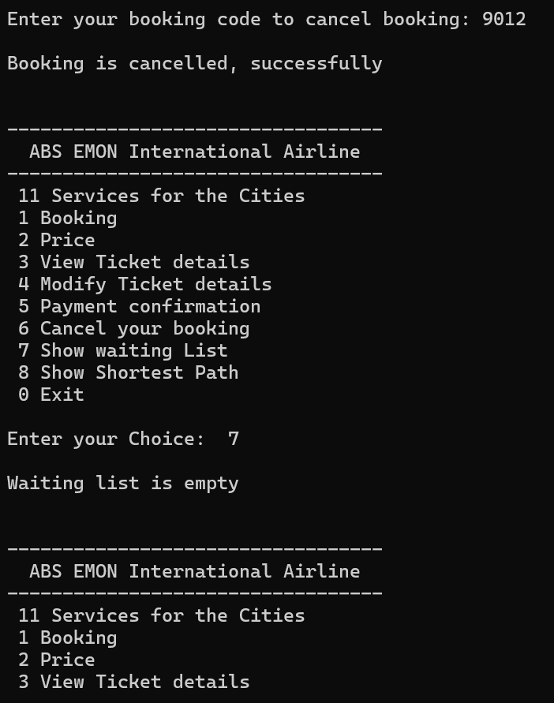
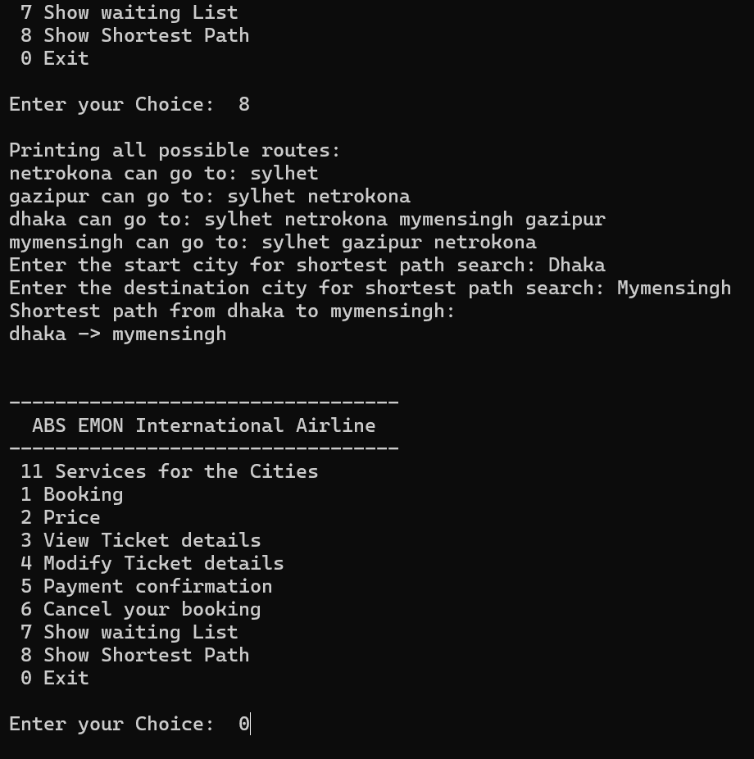
Implemented Screenshots

Slide 15
Features & Tools
Display List of cities, Book Ticket , Service for the cities, Price, View Ticket details
Modify Ticket details, Payment Confirmation , Cancel booking , Show waiting list .
By including concept of file handeling , we can save more data.
C++ GUI WxWdigets .
By making it online , we can use it on a larger scale.

Slide 16
Limitations
The system will not be able to manage cargo flights.
The system will not be able to manage international flights.
The system will not be able to manage flights for multiple airlines.

Slide 17
Conclusion
This software can be used for systematic storing data.
Provides instant access of:
-positions and availability of flights

Slide 18
Thank You

