Slide 1



New - First assume same type/acc sensors using only unattacked training data
NN for dyn: https://www.youtube.com/watch?v=JfeB_n4zsRM
Best prediction without sensors
μ = Next x (or y,vx,vy,ax,ay )
(prior, no sensor data)
Takes place of prior
Learn the model.
x,y,vx,vy,ax,ay
NN
Unattacked x sensor for train (same x,y,vx,vy,ax,ay,μ)
Think more about how to find
Same sensor acc.
Data approximated
Unattacked interval
NN for smallest interval
around μ enclosing 95% of unattacked sensor data for x (or ...) at input state
x,y,vx,vy,ax,ay,μ
Unattacked interval
Trained with
some zero
Prediction based on
Unattacked sensors
Attacked for testing, train with unattacked+zeros
Zero if outside unattacked interval
θ = Next x,y,vx,vy,ax,ay
(uses sensor data)
$$S_{1}$$
$$S_{2}$$
Zero if outside unattacked interval
NN
$$S_{3}$$
Zero if outside unattacked interval
Trained to ignore zeros
x,y,vx,vy,ax,ay,μ
Pick closest x,y,vx,vy,ax,ay,μ
Train to ignore zeros? Insert lots of them. Take inputs and add lots of zeros. Maybe better method?

Slide 2
How to find interval
First NN: Use many sequences of vehicle motion and keep track of current and next state. Use to train NN to predict next state from current to minimize loss in prediction (MSE?).
Second NN: Use many sequences of vehicle motion and keep track of histograms from each of a set of discrete states. Use this to train a NN to find the smallest interval holding 95% of unattacked data. There are also methods that produce the variance of a prediction. It may be possible to use this.
Last NN: train similarly with unattacked data and teach it to ignore zeros.
It may be possible to use the ideas in anomaly detection here also, but we also have to include something to check agreement between sensors and prior (no sensors) information.
Check literature on NN for dynamic systems and learning intervals.

Slide 3
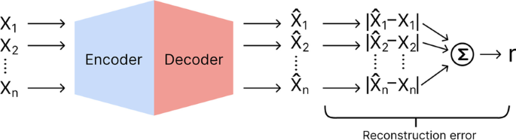
GAN and LSTM based autoencoders
Using only GAN (TadGAN) or auto-encoders reconstruction-based unsupervised approaches which are typically used to identify anomalous data points, fails to locate the bad sensors without external inputs (protected sensor).
These above approaches when trained with large number of paths can successfully reconstructs sensor values coming even from attacked sensors and thus fails identify anomalous data points in attacked sensors.
When such models successfully reconstruct each sensor data, the reconstruction error can be indistinguishable between attacked or un-attacked sensors and thus failing to classify the anomalous sensor data

Slide 4
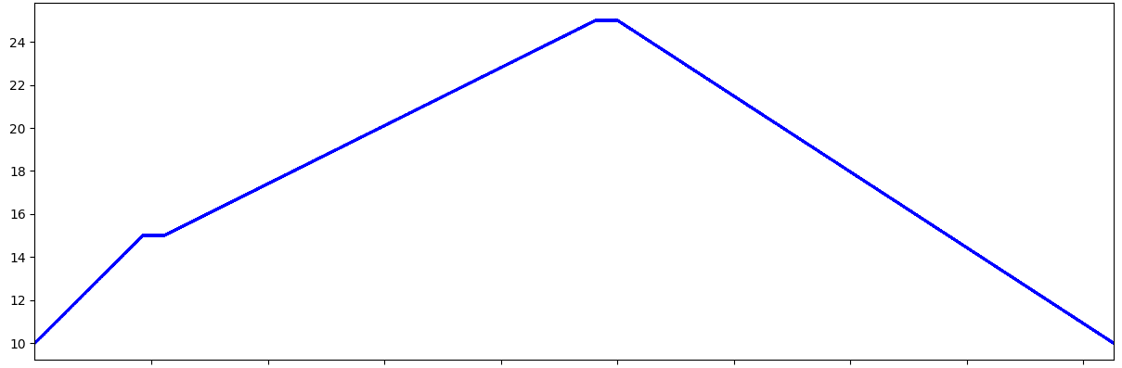
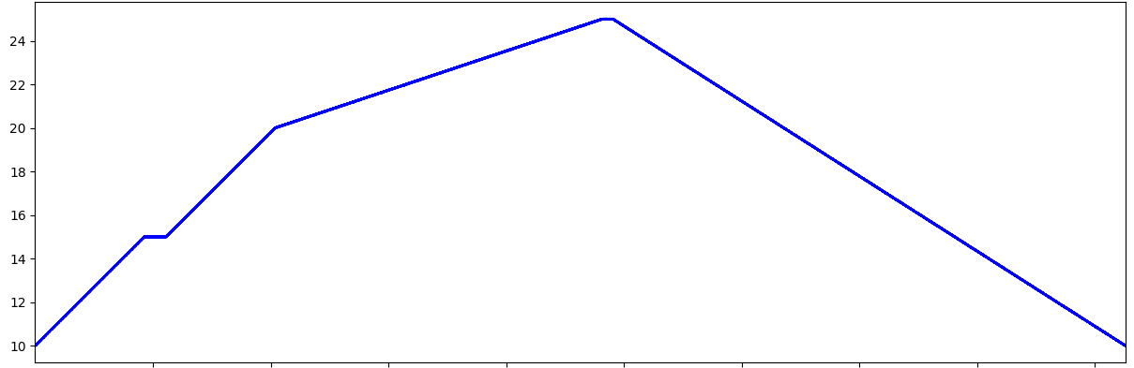
GAN and LSTM based autoencoders
Let us consider two paths and assume one of these is attacked resulting in different x-position values over time while traversing through each of these paths.
The highlighted area on both curves are slightly different which may reflect an attack. Either of the above path sensor data may be attacked and we have found that GAN based approach (TADGAN) or LSTM auto-encoder could not produce a high reconstruction error when trained on path 1 and tested on path 2
Path 1 - Training path for ML-alone approach
Path 2 – Testing path for ML-alone approach

Slide 5
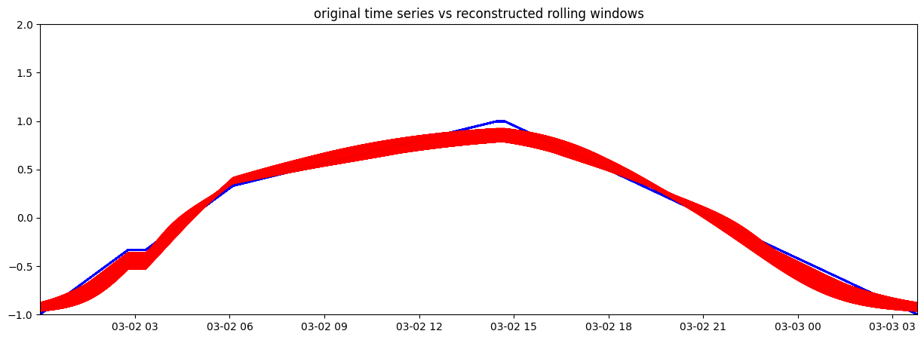
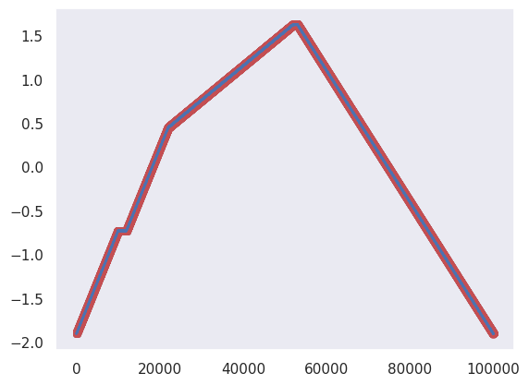
GAN and LSTM based autoencoders
We tried the two approaches to reconstruct time sequence of x position. Both approaches encodes the sequences to a lower dimension and then decodes or reconstruct the sequence without incorporating the underlying anomalies leading to large reconstruction error and thus identification of anomalous data.
The highlighted area on both curves shows successful reconstruction of the paths which can potentially be anomalous and is generated from an attacked sensor.
The red band in TadGAN is obtained by generating multiple synthetic samples by sampling from the latent space of generator network
Reconstruction of path 2 using TadGAN
Path 2 Reconstruction using LSTM AutoEncoder

Slide 6
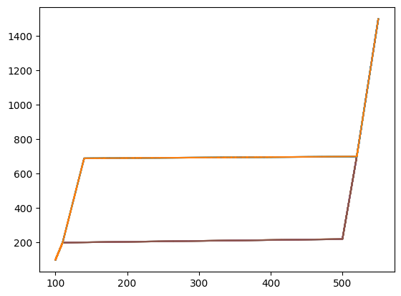
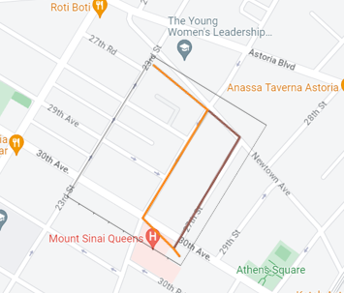
GAN and LSTM based autoencoders
Now, let’s consider a 2-D path reconstruction where x and y coordinates are recorded by senser. Same as before, let’s consider 2 paths, one of which may be attacked as shown in figures below –
Path 1
Path 2

Slide 7
Propose approach
The machine learning alone is not sufficient to identify the anomalous path as it alone can never tell which path is attacked.
For system to be successful in identifying attacks, and predict next instance accurately, it needs prior information.
Here, we introduce logic of protected sensor.
Now, let’s consider a system of 6 sensors measuring x coordinate of a vehicle. Under a relay attack, following situation may arise –
1 protected sensor on which attack is not possible
4 unattacked sensor on which attack was not attempted
1 attacked sensor, where recorded values may be changed due to attack, causing the system to infer that vehicle is on another path

Slide 8
Propose approach
Train a NN (TadGAN), using 1 protected sensor measuring x coordinate, to predict next time step t, using 25 previous time steps
Protected sensor (P₁)^{t-1}
S1
From unattacked system, find mean std. dev. at each time step of 6 unattacked sensor. An unattacked sensor is within +/- 3* std. dev. from the protected sensor
Unattacked sensor (U₁)^{t-1}
S2
At time t-1, if within +/- 3*std dev, then unattacked
Unattacked sensor (U₂) ^{t-1}
Use the original sesnsor values of previous time steps t-1,…, t-25 to predict sensor value ((U_{n}) ^{t}) at time t
(U₁)^{t}
S3
At time t-1, if within +/- 3*std dev, then unattacked
(U₂)^{t}
Unattacked sensor (U₃) ^{t-1}
(U₃)^{t}
S4
At time t-1, if within +/- 3*std dev, then unattacked
(U₄)^{t}
Unattacked sensor (U₄) ^{t-1}
S5
At time t-1, if within +/- 3*std dev, then unattacked
Attacked sensor (A₅) ^{t-1}
Replace the original value with mean of (U₁)^{t-1} (U₂) ^{t-1} (U₃) ^{t-1} (U₄) ^{t-1} and predict (A₅) ^{t}
S6
At time t-1, if within +/- 3*std dev, then unattacked
(A₅)^{t}
Checking all sensors for attack at each time step

Slide 9
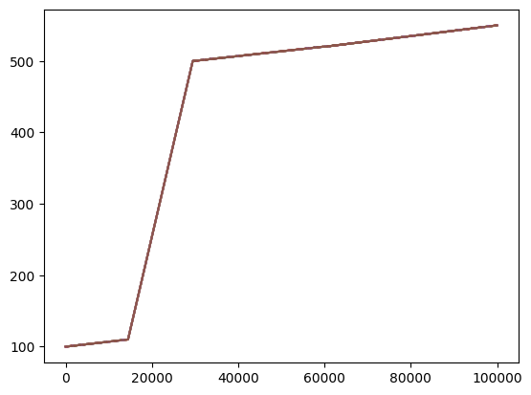
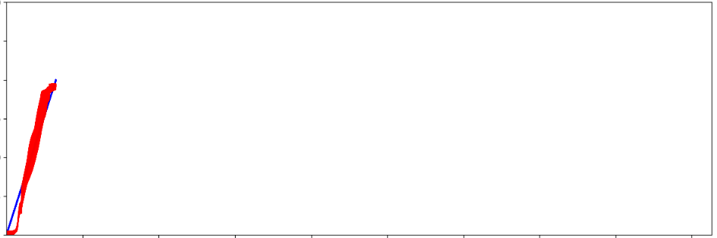
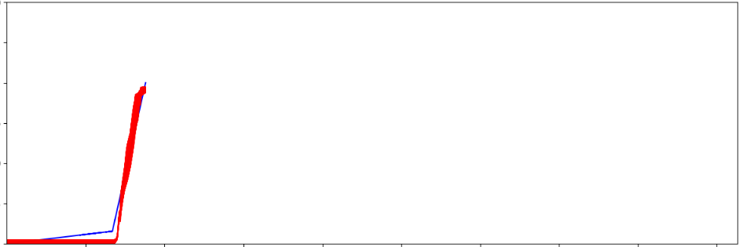
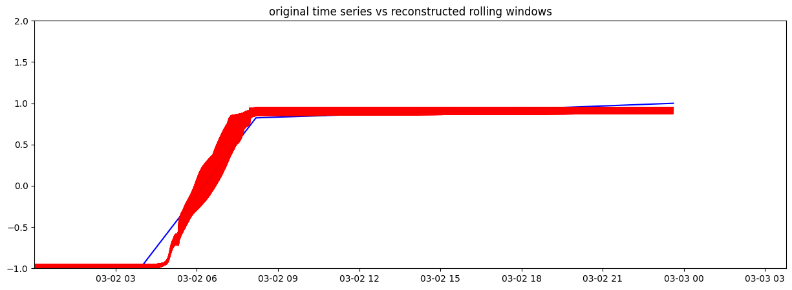
Proposed Approach Reconstructing next instance of x-coordinate for unattacked (U₁) sensors
Actual path (x coordinate) of vehicle
Path recorded by P₁ U₁, U₂, U₃, U₄
Real time reconstruction of path using U₁ and recording above figures at every 1,000th time step
We can notice, the reconstructed path aligns with actual path (blue line in figure) as recorded by protected and unattacked sensors

Slide 10
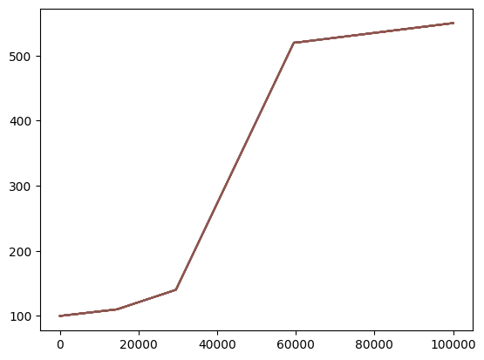
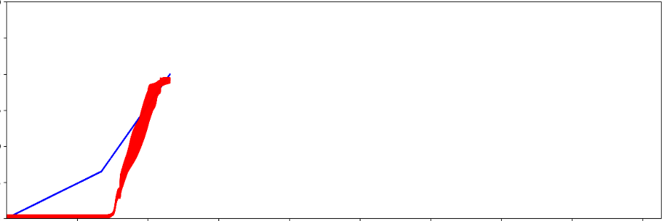
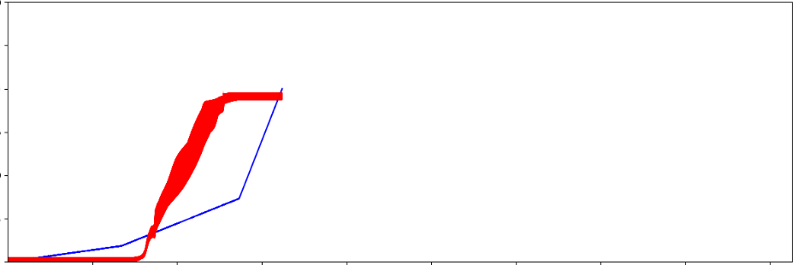
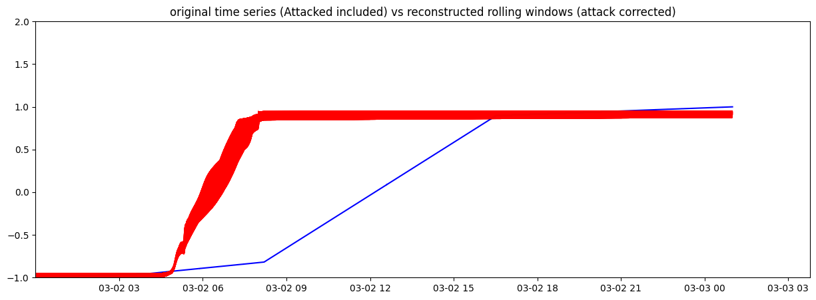
Proposed Approach Reconstructing next instance of x-coordinate for attacked (A₁) sensors
Actual path (x coordinate) of vehicle
Path recorded by A₁
Real time reconstruction of path using A₁ and recording above figures at every 5,000th time step
We can notice, the reconstructed path does not align with actual path (blue line in figure) as recorded by attacked sensors, it actually aligns with original path recorded by protected sensor

