Slide 1
Machine Learning Shot logs dataset
Abdellah Sabry – Salem Ben Mabrouk – Dahmani Nassim

Slide 2
Our Dataset
Our dataset contains data on shots taken during the 2014-2015 season, who took the shot, where on the floor was the shot taken from, who was the nearest defender, how far away was the nearest defender, time on the shot clock, and much more.
It will be useful for evaluating who the best shooter is, who the best defender is, the hot-hand hypothesis, etc.

Slide 3
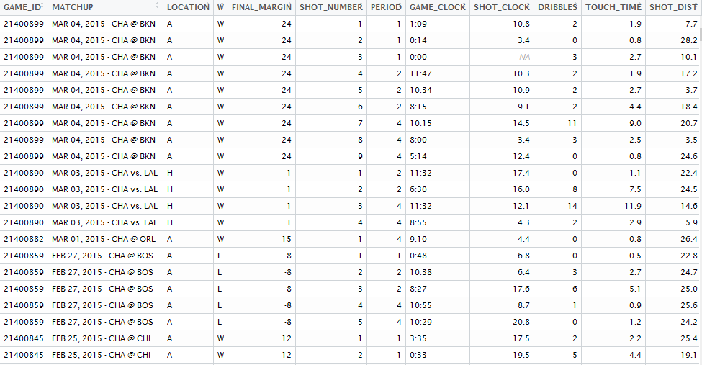
Preview

Slide 4
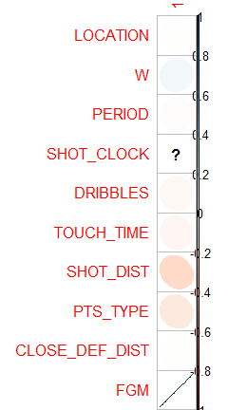
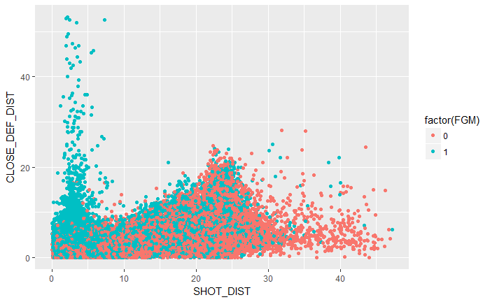
Supervised models
In our first model we’ll predict the result of the shot in function of the location of the match, the distance of the shot, the distance to the closest defender, the period, win or not and the type of points

Slide 5
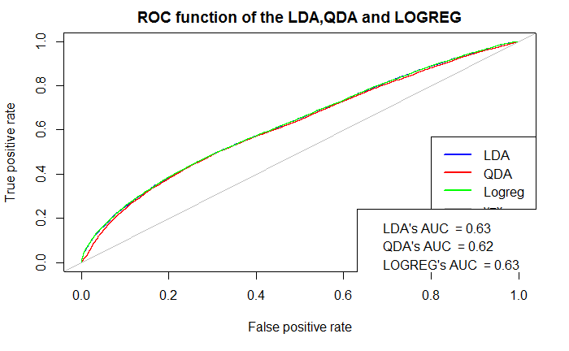
Supervised model
For the logistic regression model , the MASS model and the quadratic discriminant analysis we have a 0,60 accuracy

Slide 6
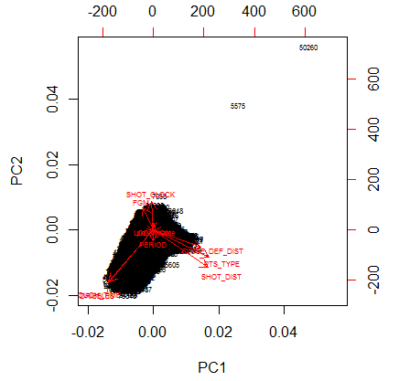
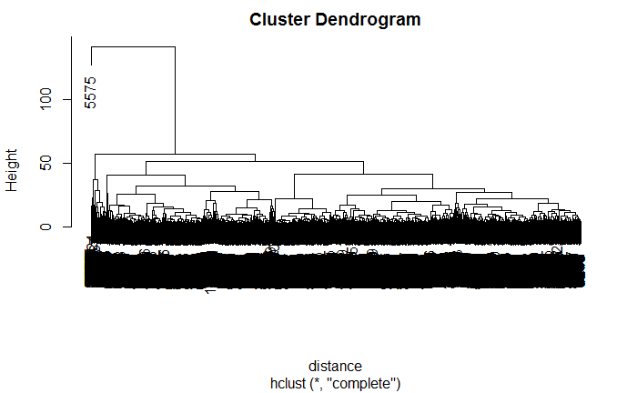
Unsupervised model

Slide 7
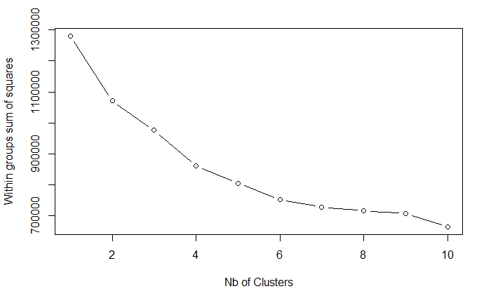
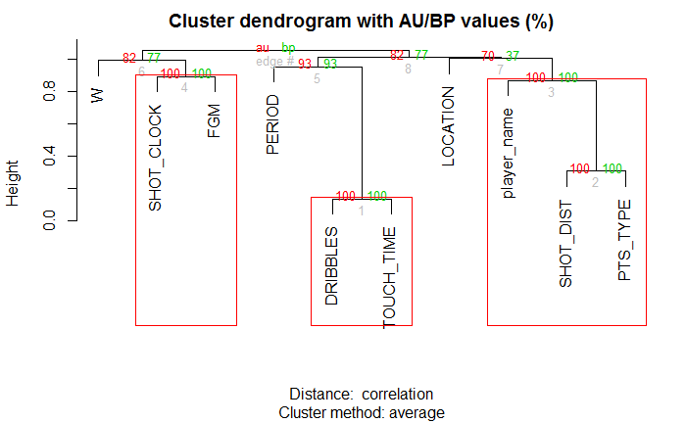
Unsupervised model

