Slide 1

UGBS · OMIS 405 Group 3
Automatic Text
Summarisation of
HOD Research Papers
NLP-Driven Analysis of Research Themes, Methods & Collaborations
Across 7 Departments · 140 Papers · 3 Summarisation Models
Group 3 - Roderick | Jonathan | Williams | Haziel | Samed

Slide 2
Table of Contents
01
Introduction & Study Overview
08
Q(c) — Applied vs Theoretical Orientation
02
Methodology — Data Collection & NLP Pipeline
09
Q(d) — Preferred Research Methods
03
NLP Model Comparison (LDA · BERTopic · T5/BART)
10
Q(e) — Emerging Hot Topics
04
Accuracy Validation & Quality Assessment
11
Q(f) — Cross-HOD Collaboration & Overlaps
05
HOD Research Profiles & Summaries
12
HOD Comparison Summary Table
06
Q(a) — Dominant Research Themes
13
Key Findings & Conclusions
07
Q(b) — Shared Intellectual Tradition

Slide 3
01 · Introduction & Study Overview
Background
7
3
The University of Ghana Business School (UGBS) hosts 7 departments, each led by a Head of Department (HOD) who is also an active researcher. This project applies Natural Language Processing (NLP) to automatically summarise and analyse the top-cited academic papers published by each HOD — providing a data-driven portrait of the Business School's collective intellectual identity. A total of 140 papers (20 per HOD) were processed using three NLP models: LDA, BERTopic, and T5/BART.
Departments & HODs
NLP Models Compared
140
21
Papers Processed
Papers Validated
6 Key Research Questions Answered (a–f)

Slide 4
02 · Methodology — Data Collection & NLP Pipeline
STEP 1 Paper Retrieval
STEP 2 Text Corpus Creation
STEP 3 NLP Summarisation
Top 20 papers by citation count retrieved from Google Scholar for each of the 7 UGBS HODs (140 total). PDFs downloaded and converted to plain text (.txt) corpus files.
Each paper converted to a structured .txt file containing title, abstract, introduction, methodology, results & conclusion. Files named systematically (HOD_paper#.txt).
Three models applied: LDA (topic extraction, extractive), BERTopic (transformer embeddings, extractive), and T5/BART (abstractive generation). Same prompt used per model for consistency.
STEP 4 Accuracy Validation
STEP 5 Theme Analysis
3 randomly selected papers per HOD (21 total) manually validated: abstract read, NLP summary compared, hallucinations/omissions/misinterpretations noted and rated.
NLP used to extract bigrams, trigrams, LDA topics, and keyword frequencies. Cross-HOD analysis performed for collaboration mapping and emerging topic detection.
University of Ghana Business School · NLP Research Analysis · 2024

Slide 5
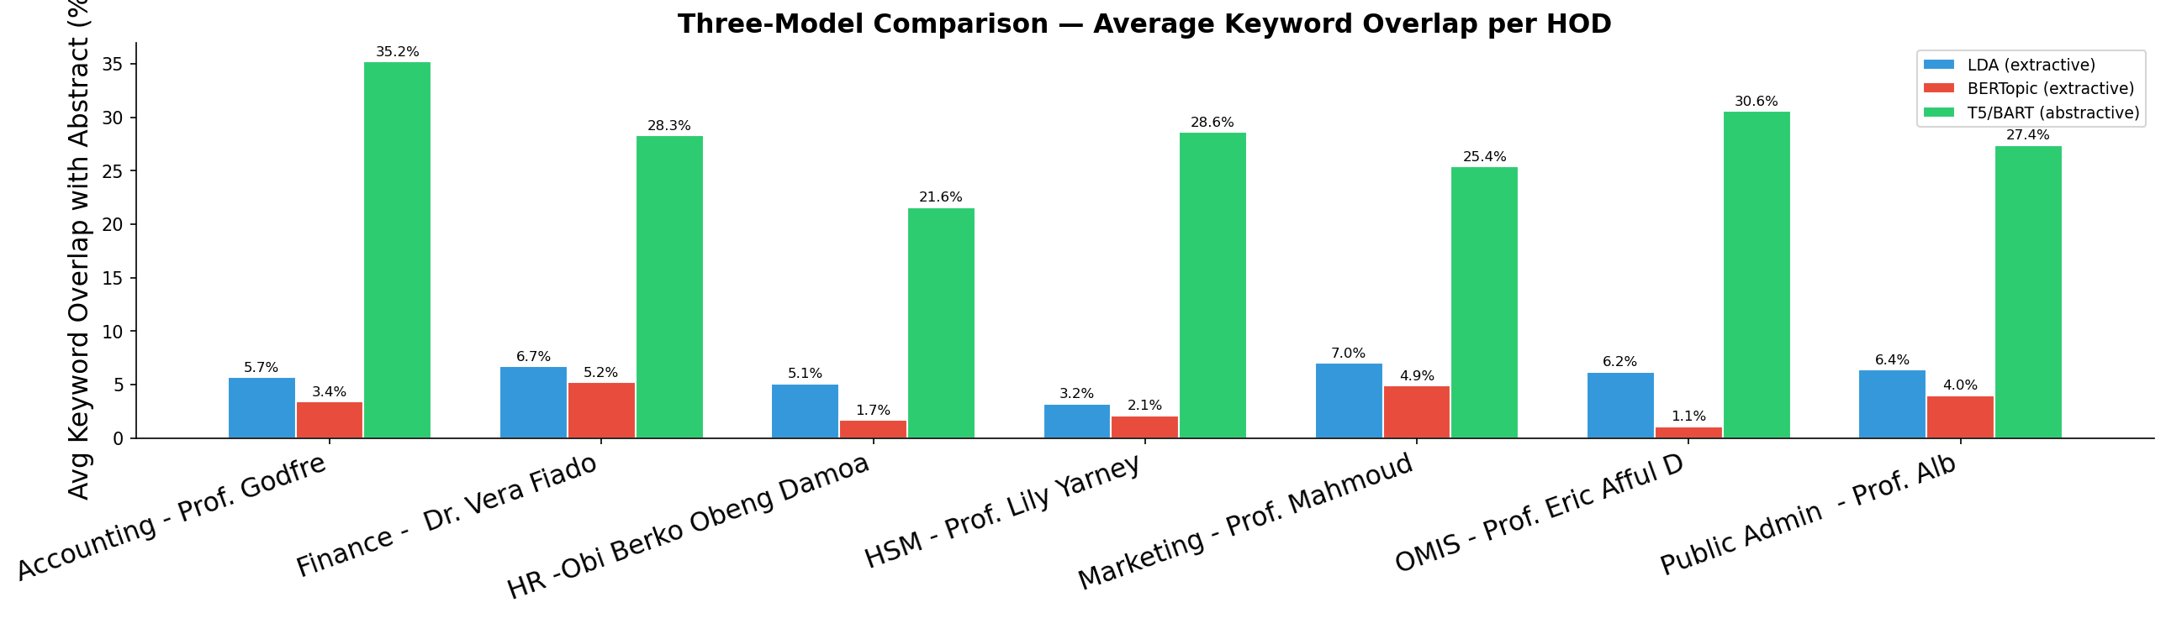
03 · NLP Model Comparison
LDA
BERTopic
T5 / BART
Extractive
Extractive
Abstractive
Latent Dirichlet Allocation identifies probabilistic topic distributions across paper corpora. Assigns each paper to dominant topics via keyword co-occurrence patterns.
Transformer-based clustering using sentence embeddings (BERT). Groups semantically similar sentences into coherent topics. Best for short-text topic coherence.
Sequence-to-sequence transformer model. Generates novel summary sentences by paraphrasing and synthesising information — not just extracting it. Clearly the top performer.
Avg Keyword Overlap:
Avg Keyword Overlap:
Avg Keyword Overlap:
4.5–7.7%
0–7.9%
25–37%
T5/BART consistently outperformed LDA and BERTopic across all 7 HODs in keyword overlap with original abstracts

Slide 6
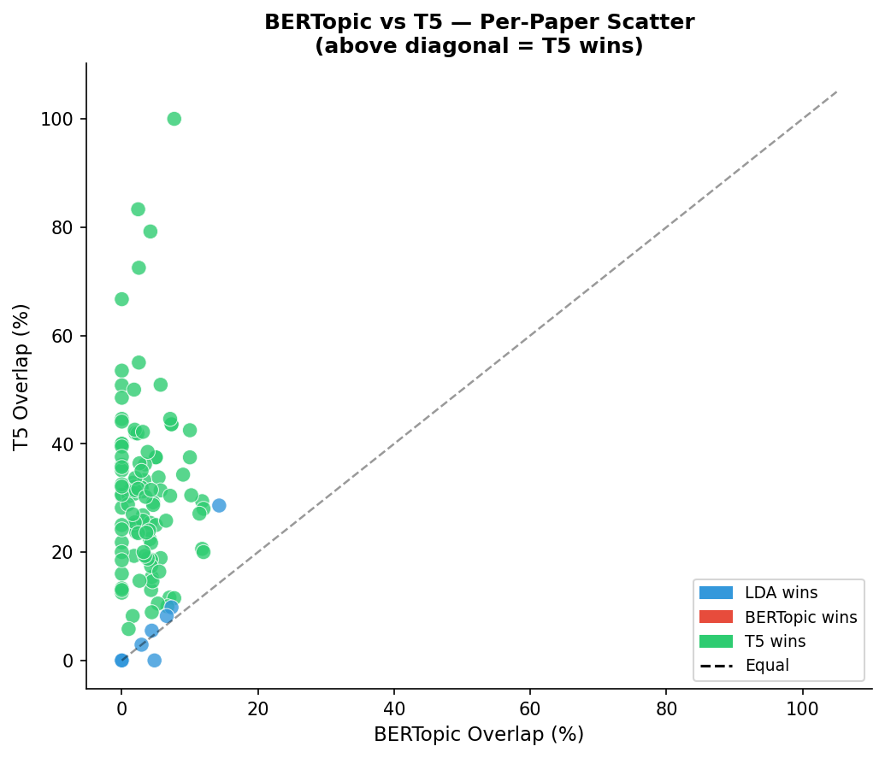
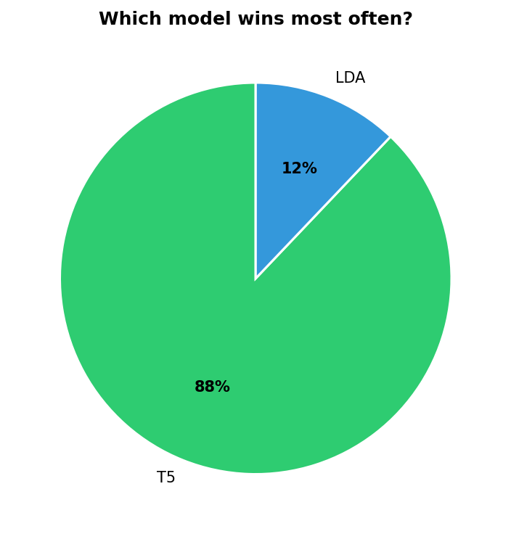
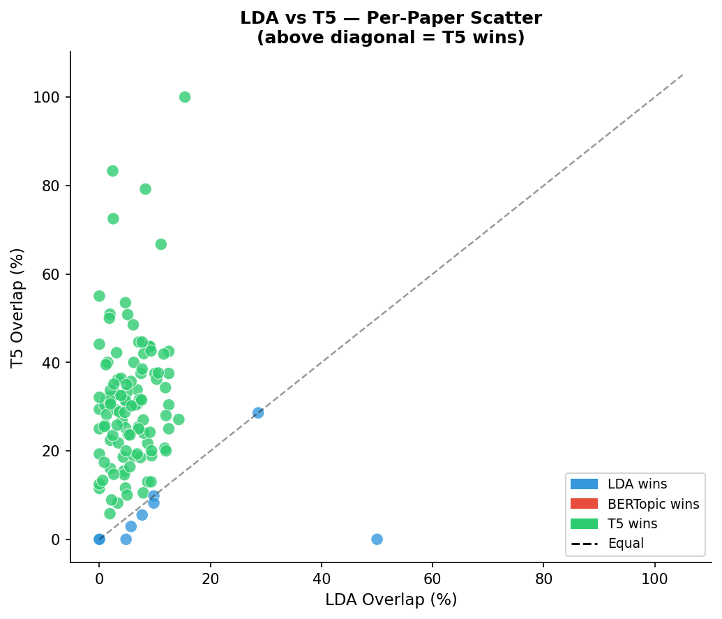
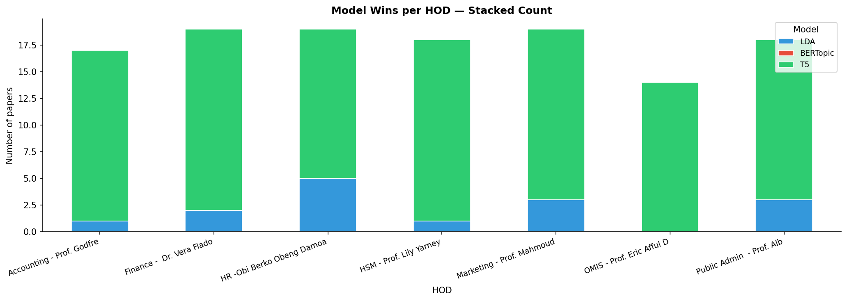
03 · Model Performance — Visual Comparison
T5/BART clearly outperforms LDA and BERTopic, with most points concentrated above the diagonal. This shows it captures key ideas from papers more accurately and consistently across all HODs.

Slide 7
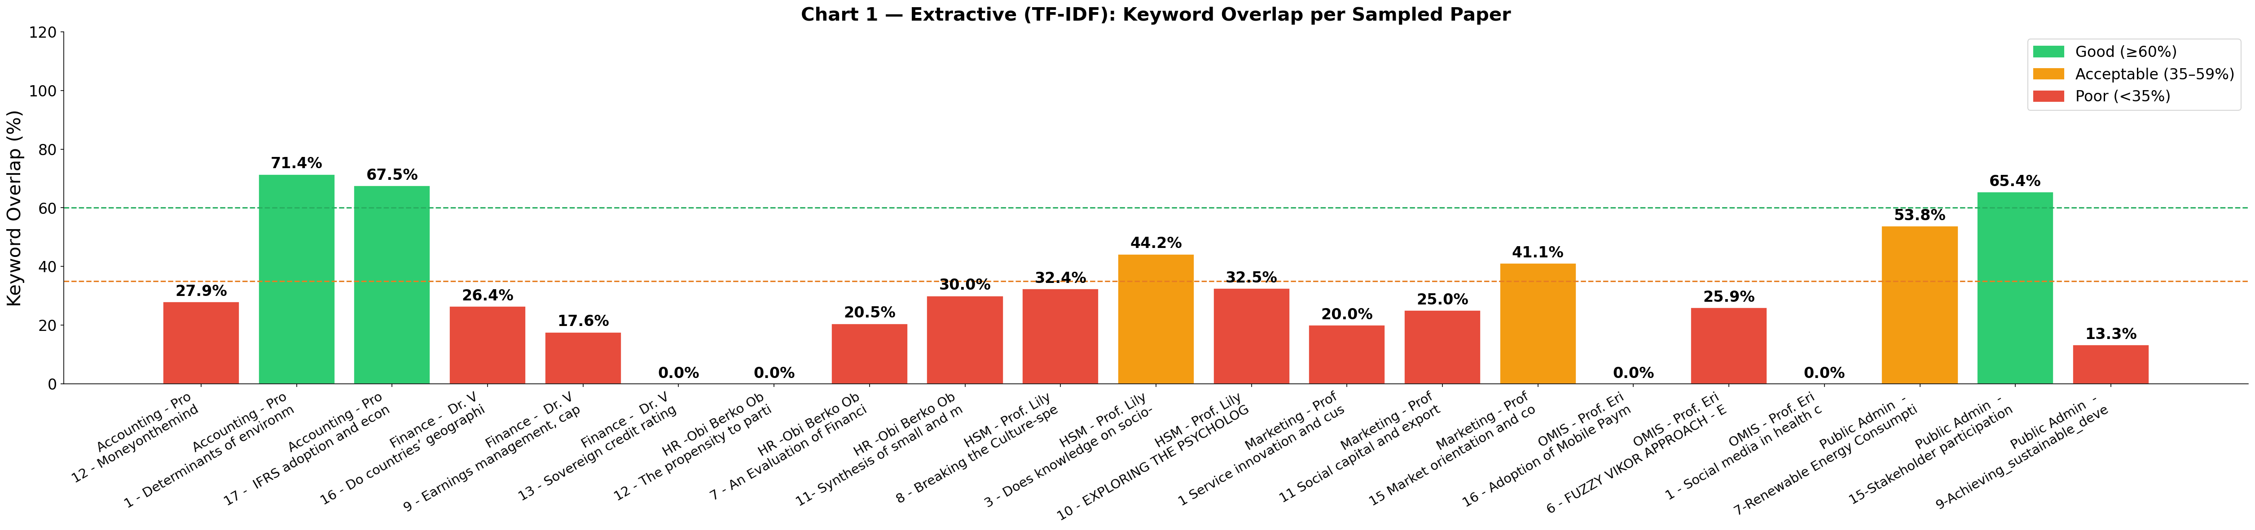
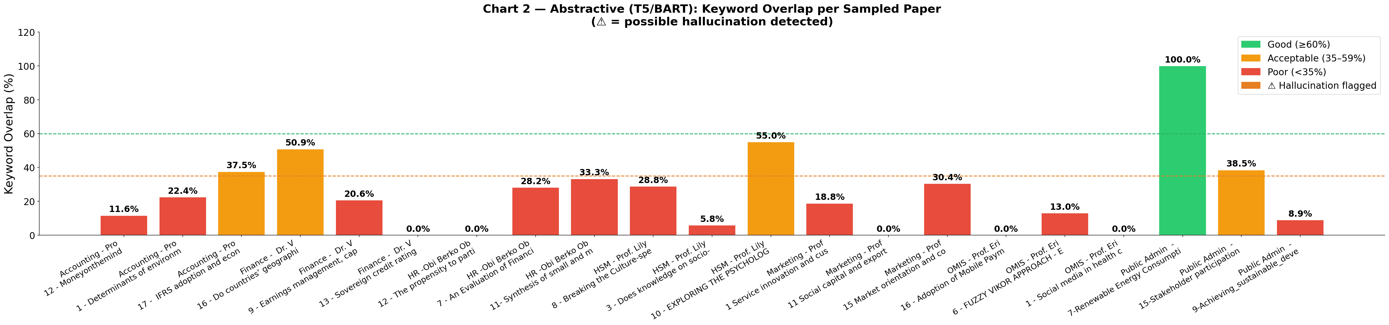
04 · Accuracy Validation & Quality Assessment
Most summaries fall within the “good” and “acceptable” range, meaning the models capture the main ideas reasonably well. However, extractive methods often miss important context, leading to lower completeness.

Slide 8
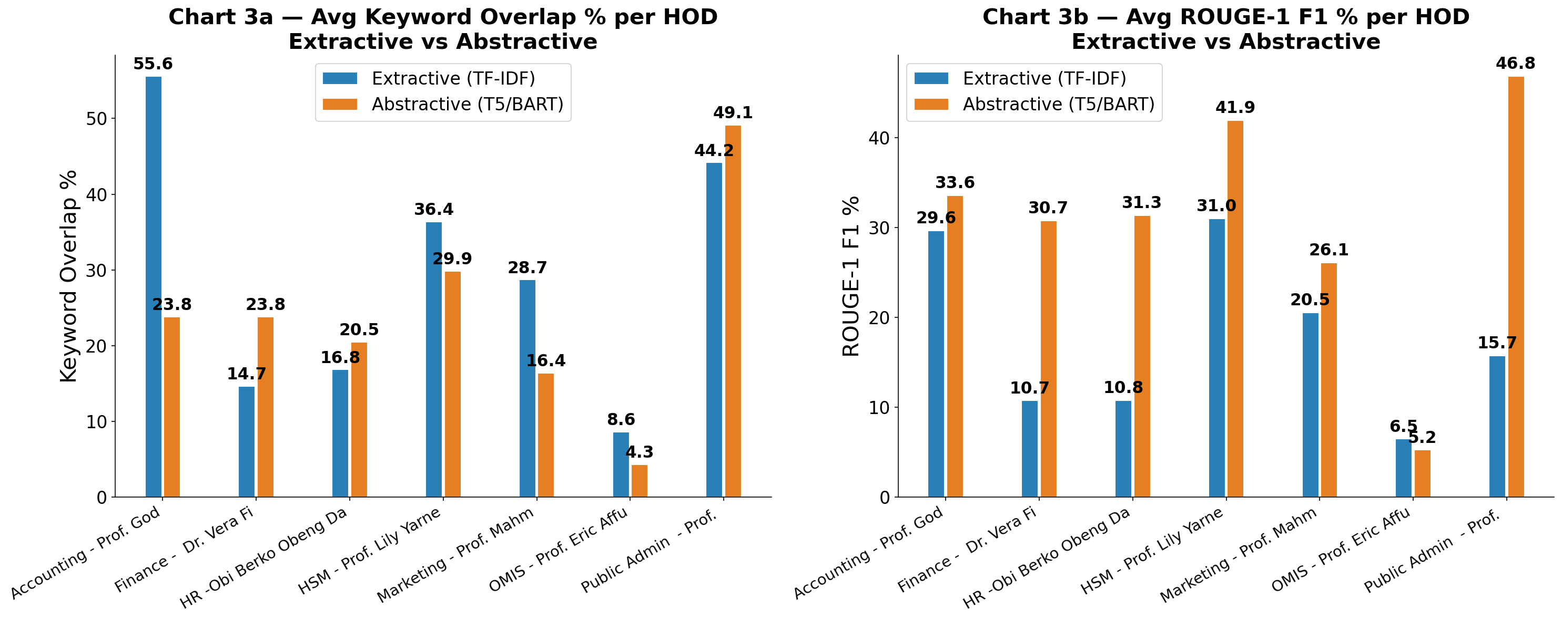
04 · Accuracy Validation & Quality Assessment
Keyword overlap is inconsistent across models, with extractive methods performing better in some cases due to direct keyword preservation.
T5/BART generally outperforms extractive methods in ROUGE-1 scores across most HODs, indicating better summary quality, with only minor exceptions.

Slide 9
05 · HOD Research Profiles & Summaries
[Accounting] Prof. Godfred Matthew Yaw Owusu
[Marketing] Prof. Mahmoud Abdulai
Sustainability Reporting · Tax Compliance · Financial Behaviour
Market Orientation · Mobile Money · Customer Retention
Method: Quantitative | Validation: 55.6%
Method: Quantitative | Validation: 28.7%
[Finance] Dr. Vera Fiador
[OMIS] Prof. Eric Afful Dadzie
Corporate Governance · Economic Growth · Earnings Management
Renewable Energy · Health Information · Open Data
Method: Quantitative | Validation: 14.7%
Method: Quantitative | Validation: 8.6%
[HR / OHRM] Obi Berko Obeng Damoah
[Public Admin] Prof. Albert Ahenkan
Corporate Social Responsibility · Decent Work · Business Ethics
Renewable Energy · Climate Change · Performance Mgmt
Method: Quantitative | Validation: 16.8%
Method: Quantitative | Validation: 44.2%
[HSM] Prof. Lily Yarney
Public Health · Orphan Care · Maternal Mortality
Method: Quantitative | Validation: 36.4%
All 7 HODs processed 20 papers each. Primary method: Quantitative. All oriented toward Applied research.

Slide 10
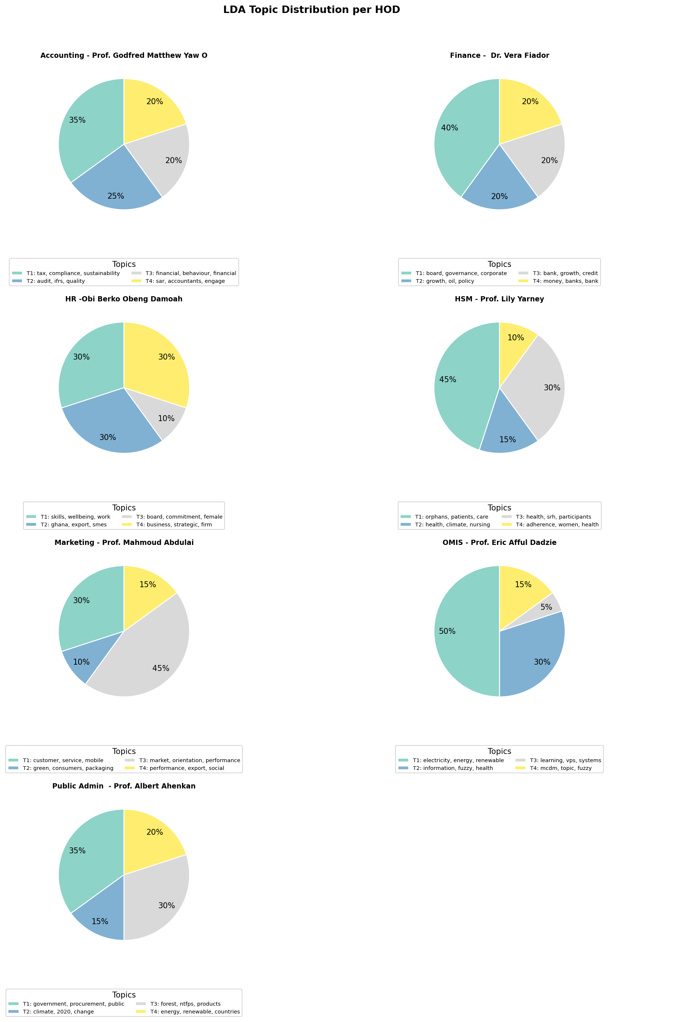
05 · LDA Topic Distributions per HOD
Each pie shows the proportional weight of LDA topics (T1–T4) within that HOD's 20-paper corpus

Slide 11
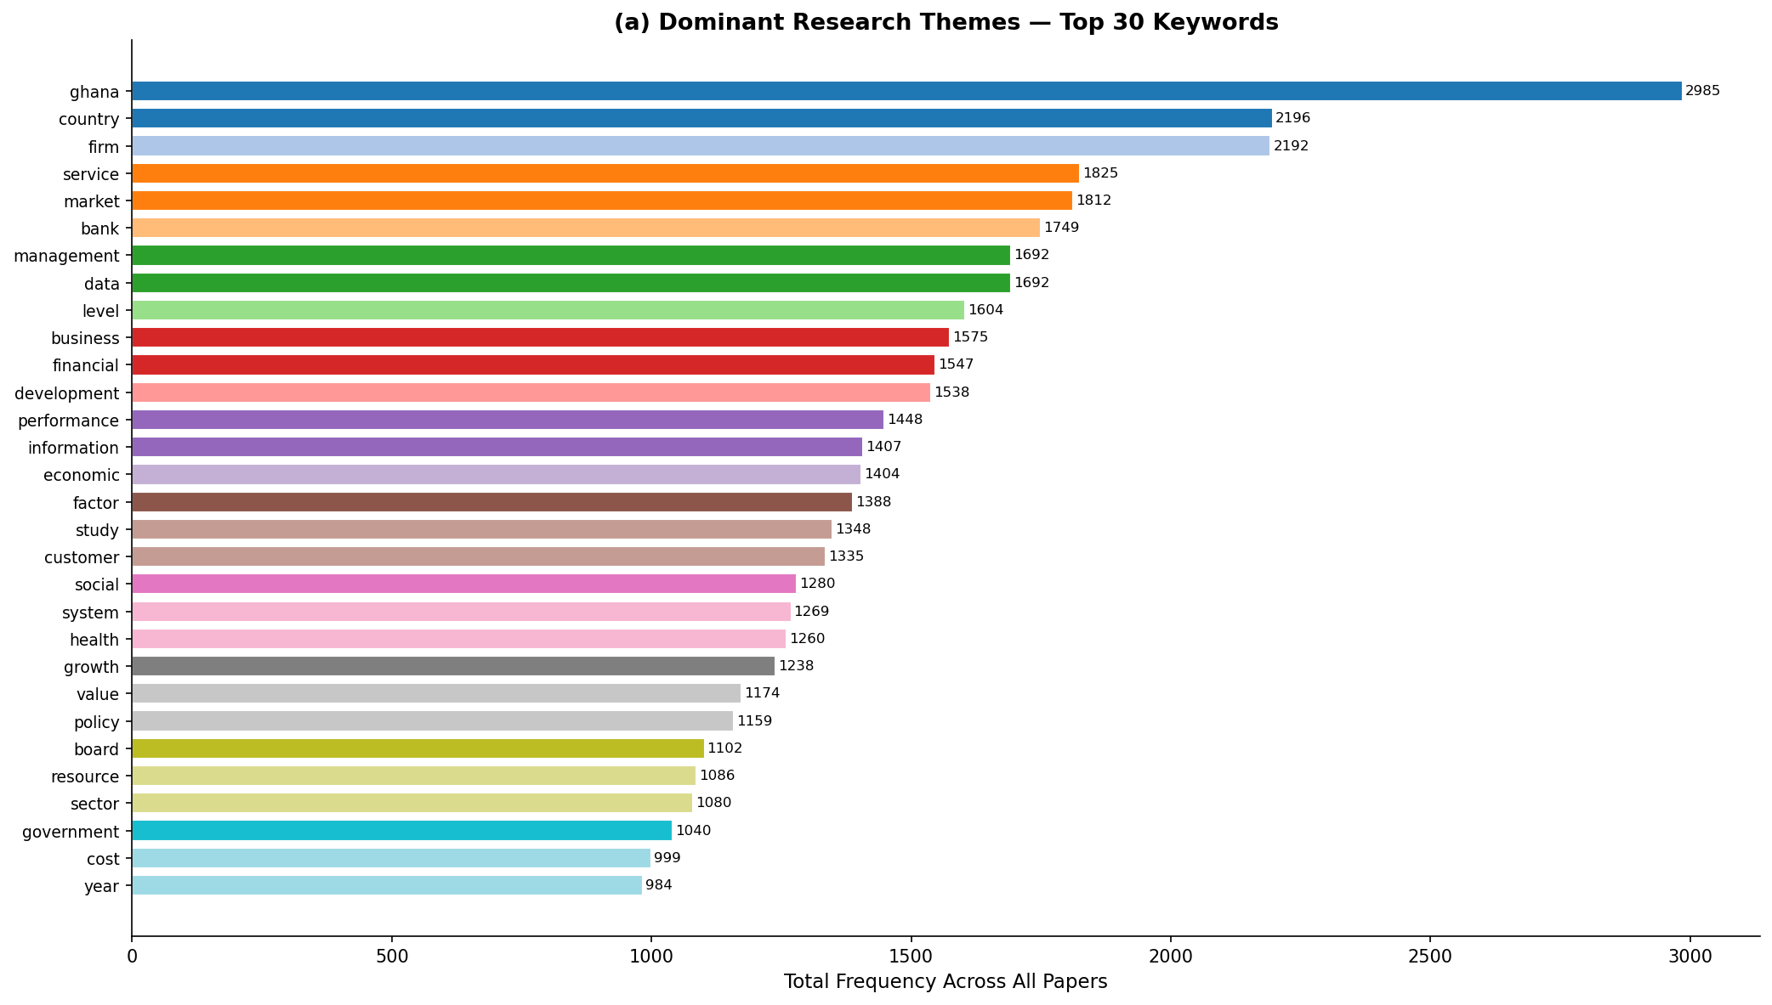
5 Research Pillars
🏛 Corporate Governance & Financial Systems
firm, financial, bank, board, management, resource, cost
💰 Business Operations & Market Dynamics
Market, service, customer, business, value, performance
🌍 Health & CSR
Social, health , factor
📱 Digital Services & Innovation
Data, system, information, level
🌱 Economic Development & Policy
Country, economic, development, growth, policy, government, srector

Slide 12
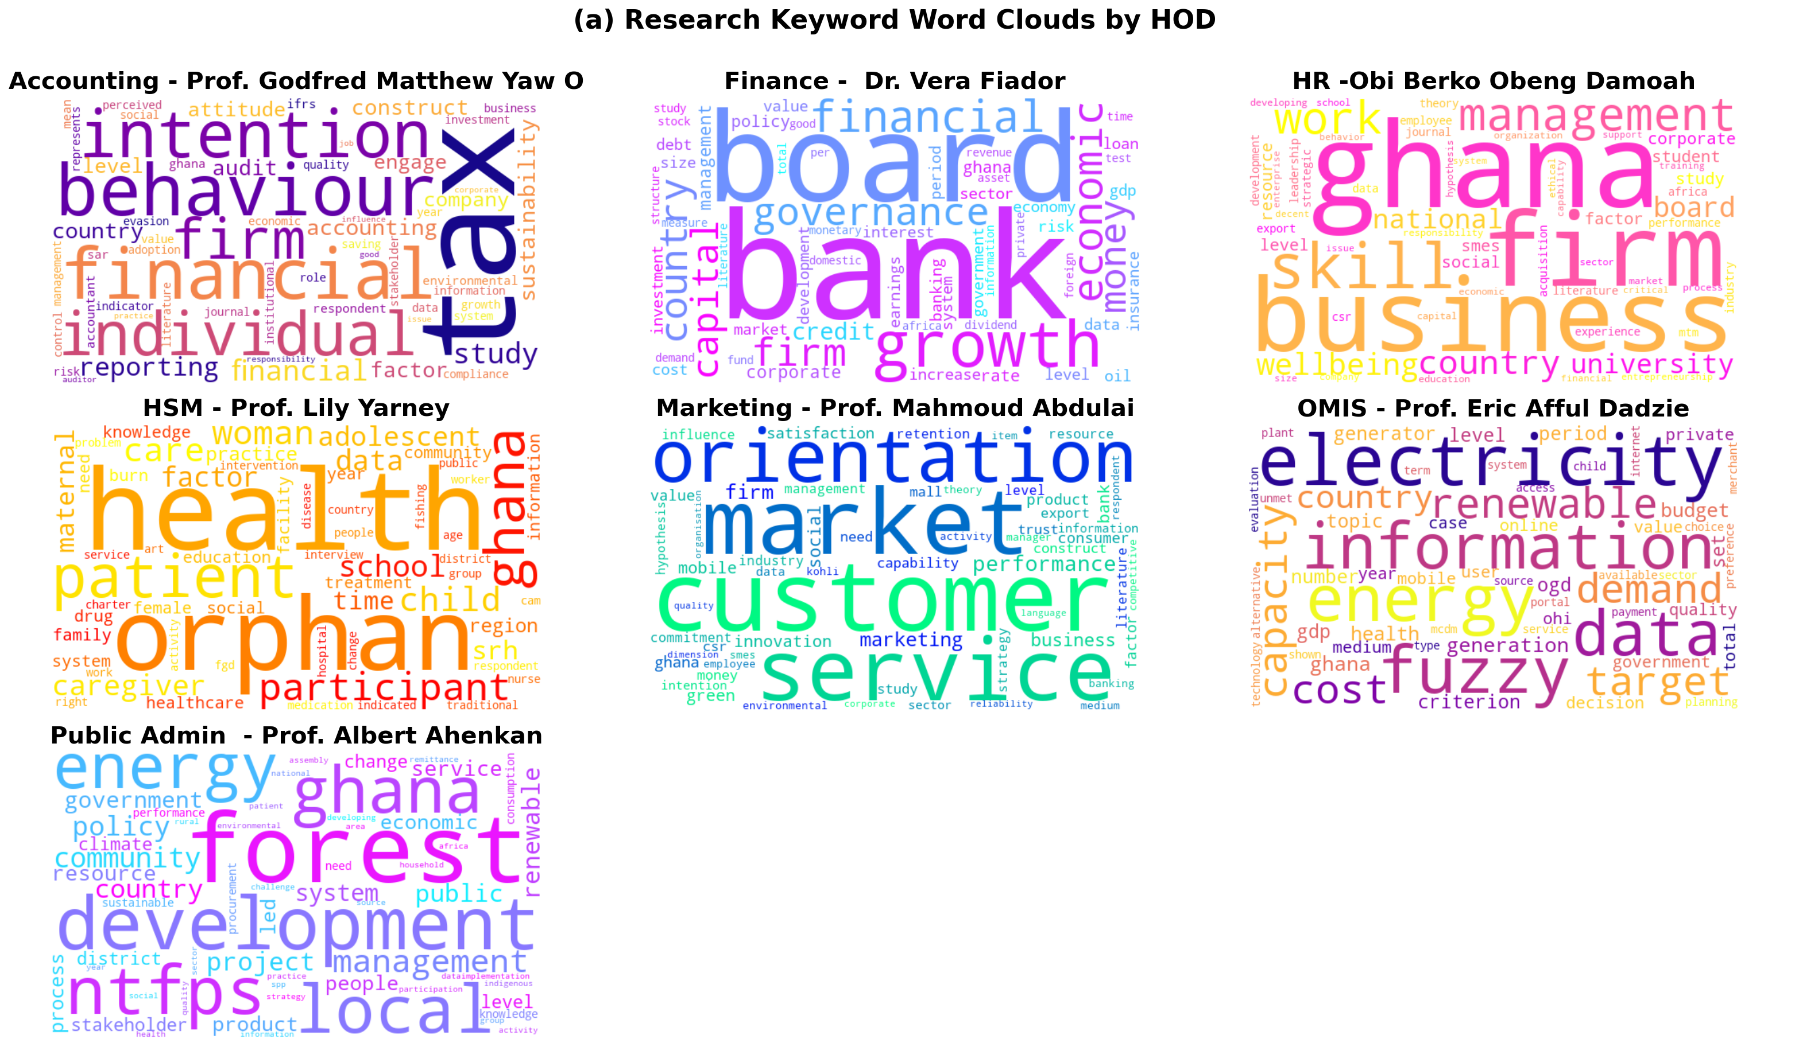
The word clouds highlight distinct research priorities across departments, with each HOD demonstrating a clearly defined thematic focus. Accounting emphasizes financial reporting and firm behavior, Finance focuses on governance and economic growth, HR centers on employee wellbeing and organizational management, while HSM is strongly oriented toward health outcomes and patient care. Marketing prioritizes customer behavior and market orientation, OMIS focuses on energy systems and data-driven decision-making, and Public Administration emphasizes policy, development, and governance.

Slide 13
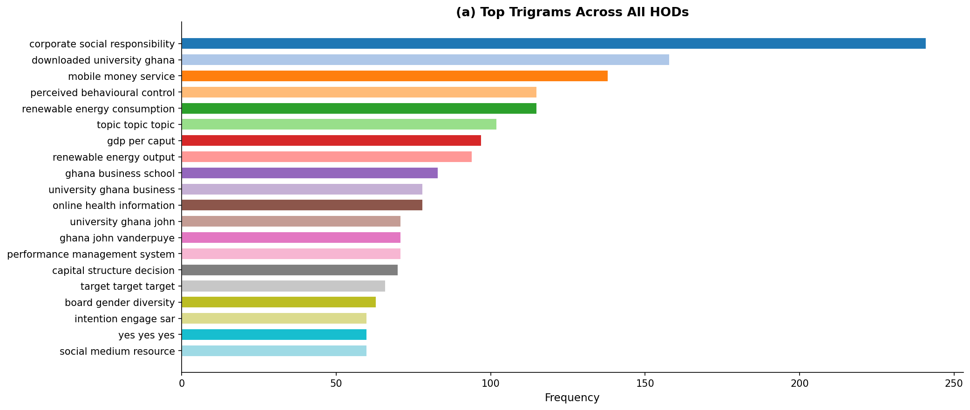
Q(a) · Dominant Research Themes

Slide 14
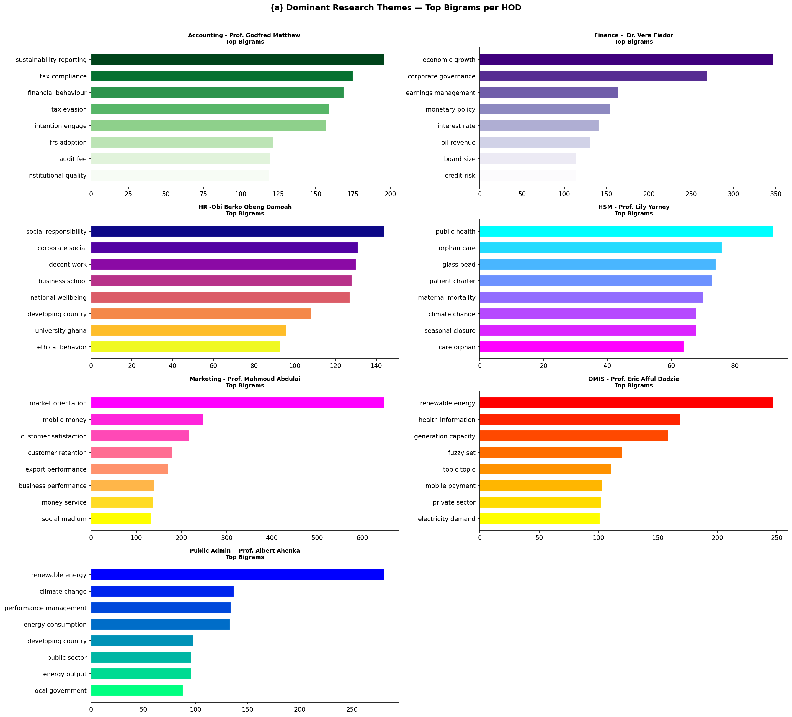
Q(a) · Top Bigrams per HOD — Signature Research Terms

Slide 15
Q(a) · Top Bigrams per HOD — Signature Research Terms

Slide 16
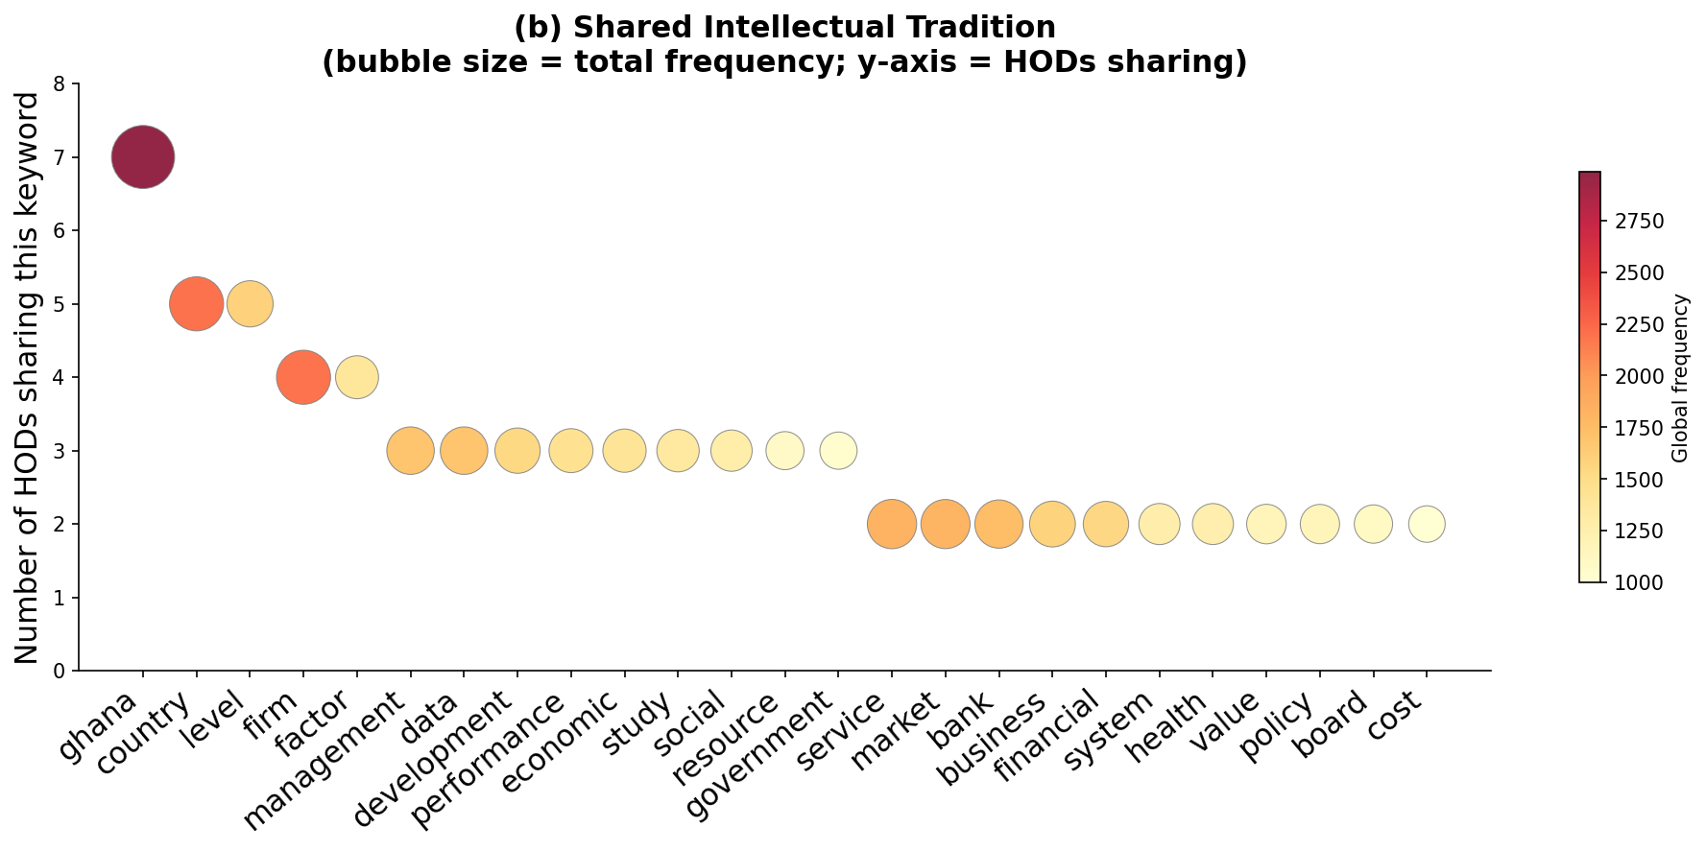
Q(b) · Is There a Shared Intellectual Tradition?
Interpretation
Ghana is shared by all 7 HODs — a unifying national context. Country, level, firm, factor appear in 4–5 HODs, suggesting shared institutional economics vocabulary. Verdict: There IS a shared tradition of Ghana-contextualised, firm-level empirical research — but disciplinary diversity means no single school of thought.
Common Methodological Anchor
Where Diversity Remains
All HODs rely predominantly on quantitative, survey-based, regression-driven approaches grounded in Ghana-specific firm and household data.
Disciplinary focus diverges sharply: public health (HSM), energy systems (OMIS/Public Admin), and social responsibility (HR) each occupy distinct intellectual spaces.

Slide 17
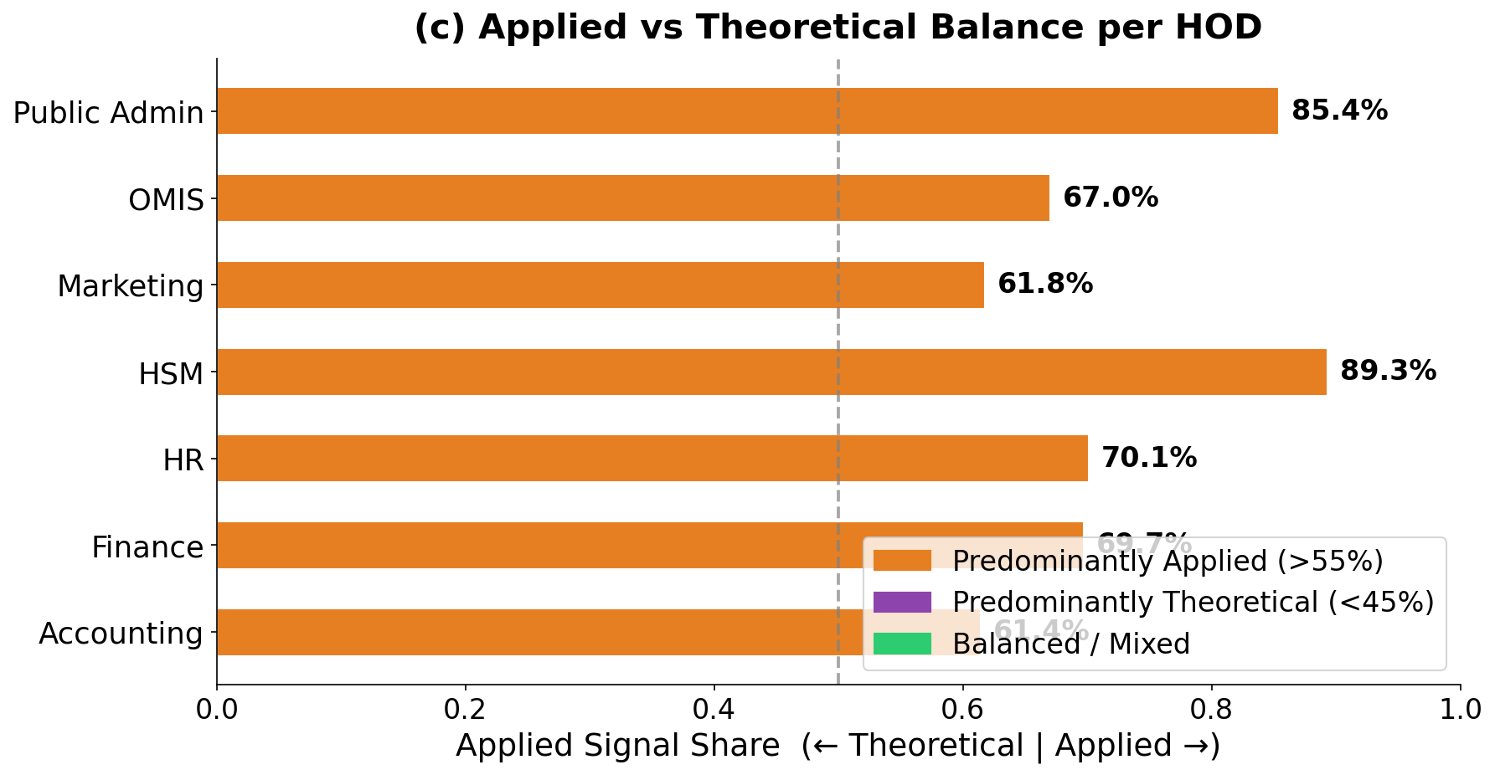
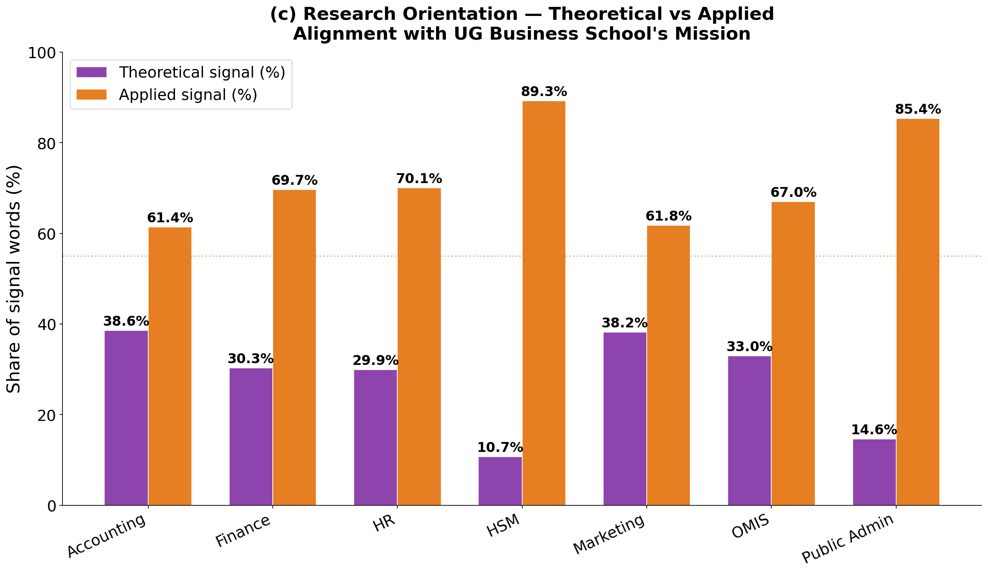
Q(c) · Applied vs Theoretical Orientation
VERDICT: All 7 HODs show a predominantly applied orientation, with applied signals ranging from approximately 61% to 89%, significantly exceeding theoretical contributions
🎯 Practical Focus
📊 Policy-Ready
🔬 Theory Embedded
Research centres on solving real-world Ghanaian business problems — tax evasion, market orientation, energy access, healthcare delivery.
Papers target practitioners and policy-makers. Recommendations are specific to Ghana's institutional and economic context.
Theoretical frameworks (resource-based view, TPB, TAM) appear, but as tools to explain applied findings — not as ends in themselves.

Slide 18
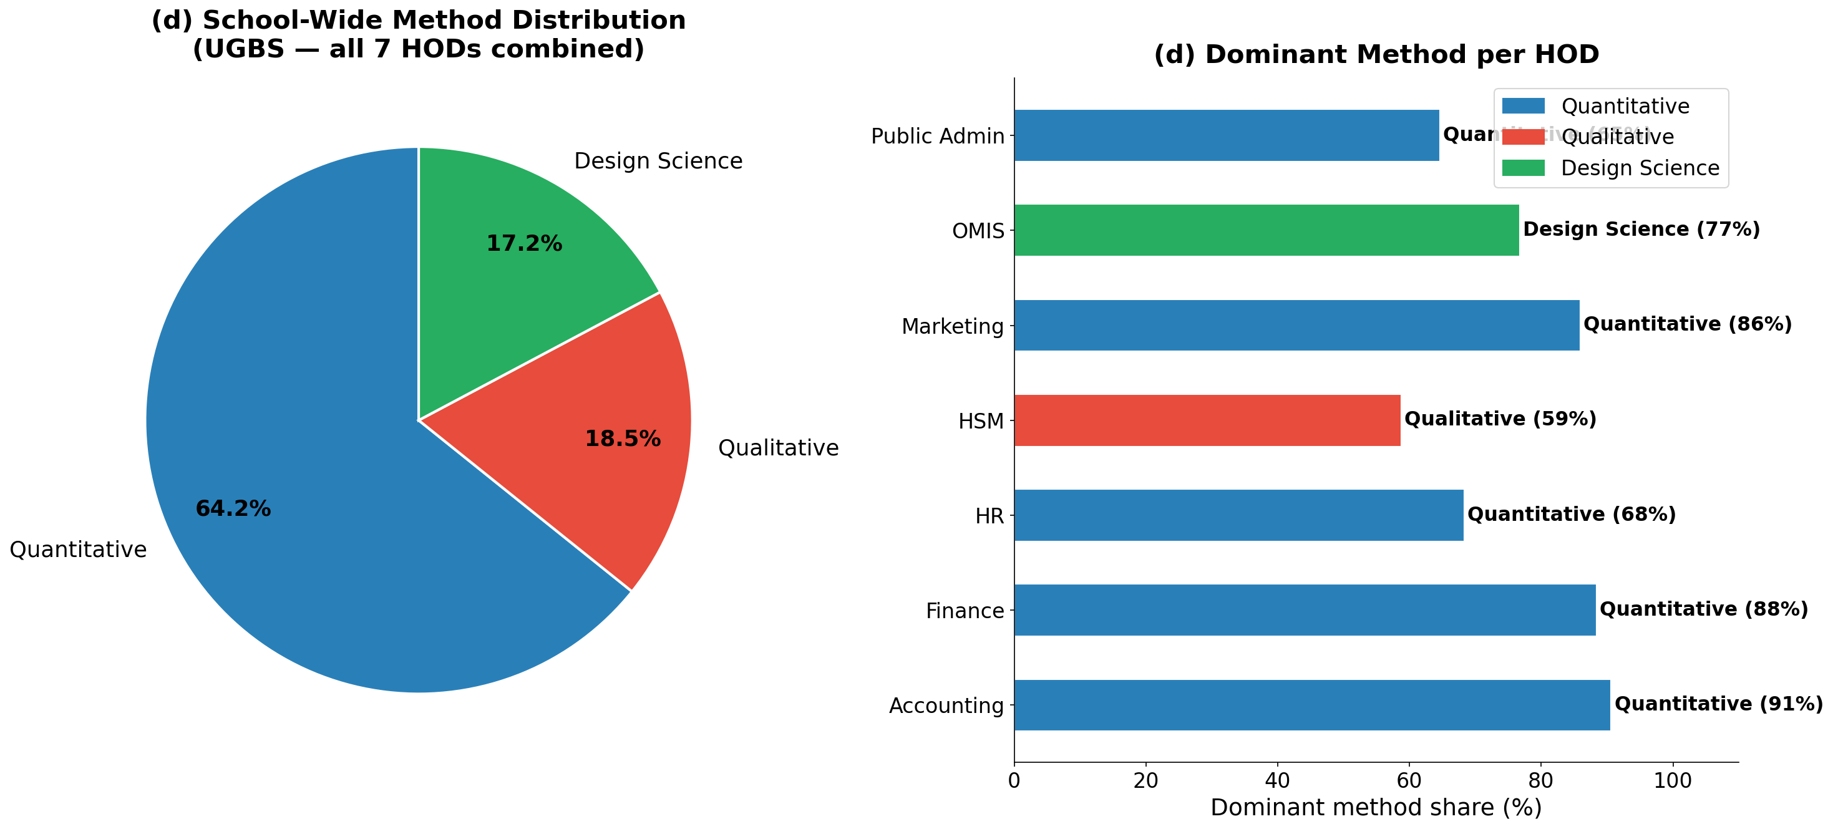
Q(d) · Preferred Research Methods
Quantitative dominant (43–53%) across all HODs. Qualitative second (27–36%). Design science emerging (17–26%).

Slide 19
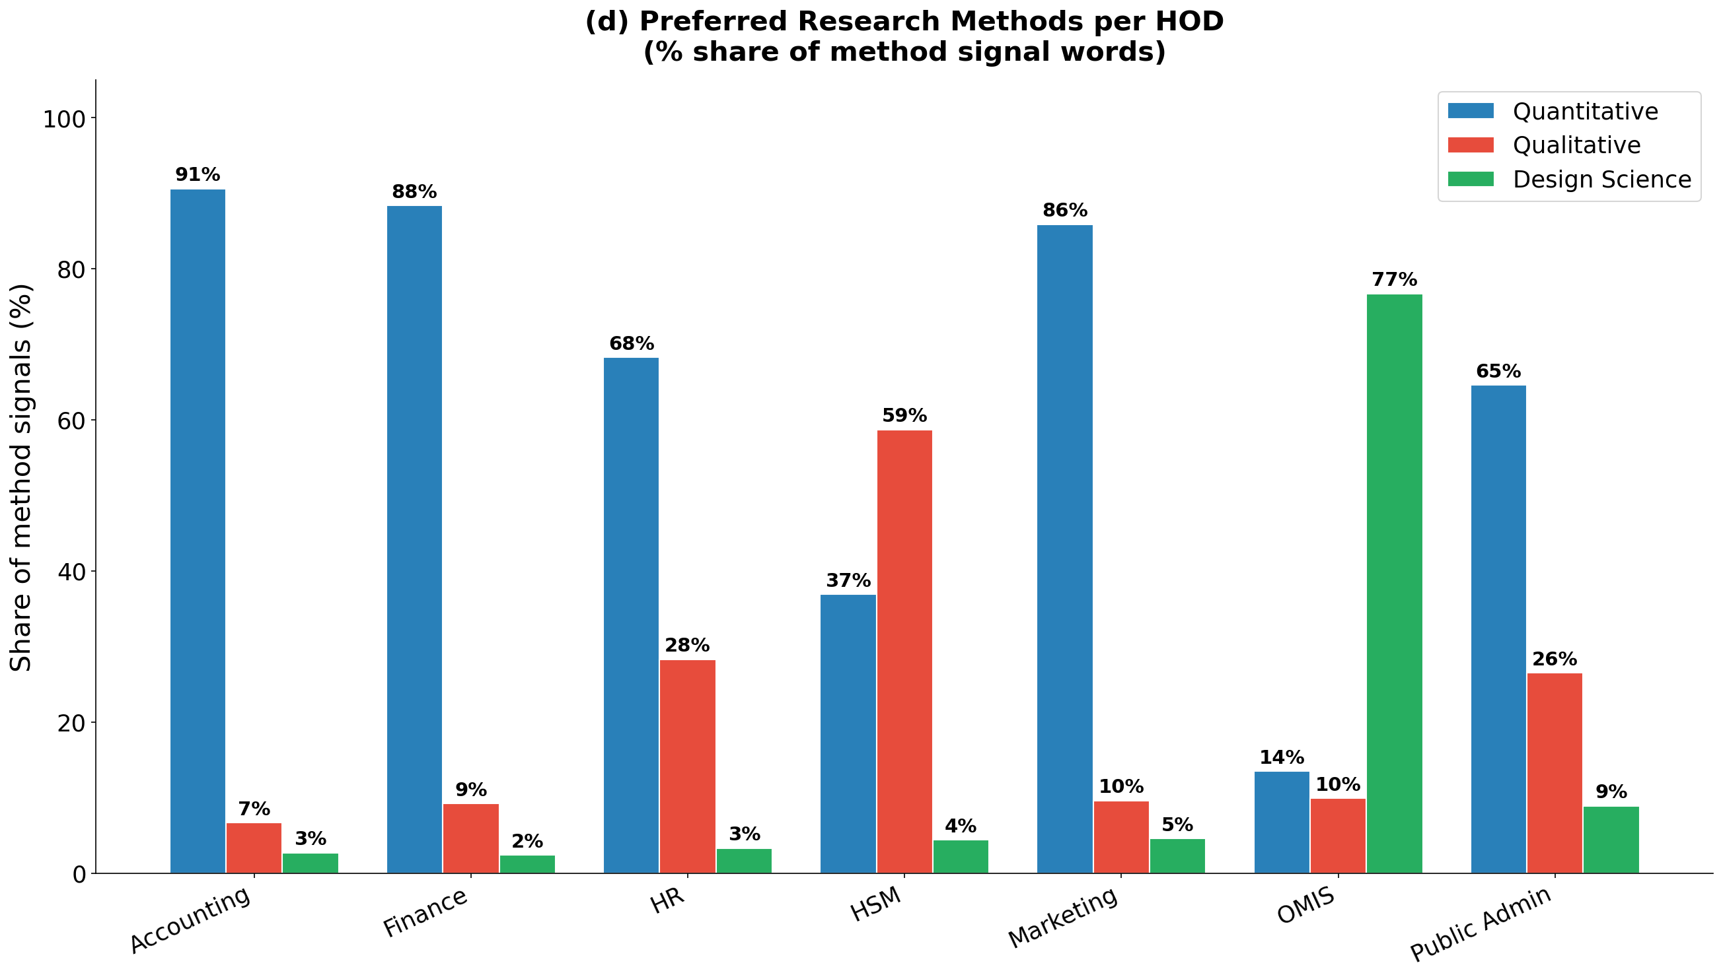
Q(d) · Preferred Research Methods
Quantitative methods dominate across most HODs, particularly in Accounting, Finance, and Marketing. HSM shows a stronger qualitative orientation, while OMIS stands out with a significant use of design science approaches.
Overall, the school demonstrates a strong quantitative foundation with methodological diversity across departments.

Slide 20
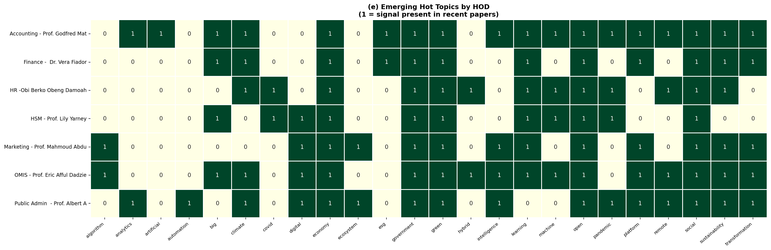
Q(e) · Emerging 'Hot Topics' Across HODs
Climate & Sustainability
Digital Economy & Transformation
Machine Learning & AI
COVID-19 & Pandemic Effects
5 of 7 HODs
5 of 7 HODs
5 of 7 HODs
4 of 7 HODs

Slide 21
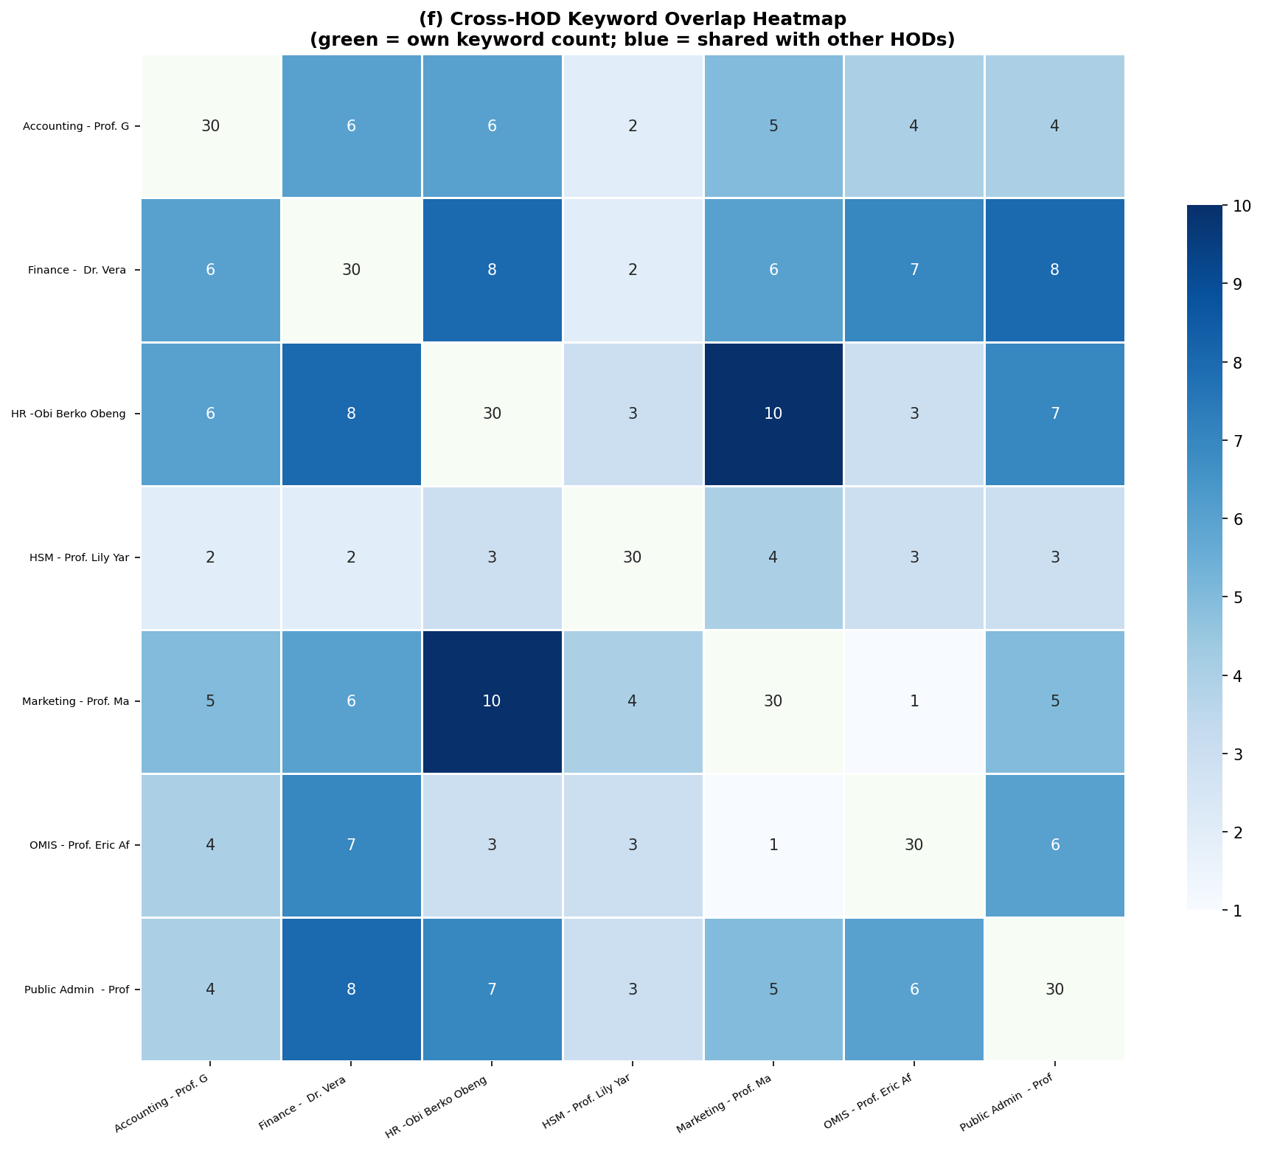
Q(f) · Cross-HOD Keyword Overlap & Collaboration Potential
Top Overlaps
10
HR ↔ Marketing
CSR, export, business, firm, Ghana
8
Finance ↔ HR
Board, corporate, country, development
8
Finance ↔ Public Admin
Country, development, economic, govt
7
OMIS ↔ Finance
Cost, country, data, GDP, Ghana
7
HR ↔ Public Admin
Country, development, mgmt, performance
6
Accounting ↔ Finance
Country, economic, financial, firm
6
Finance ↔ Marketing
Bank, firm, Ghana, market, money

Slide 22
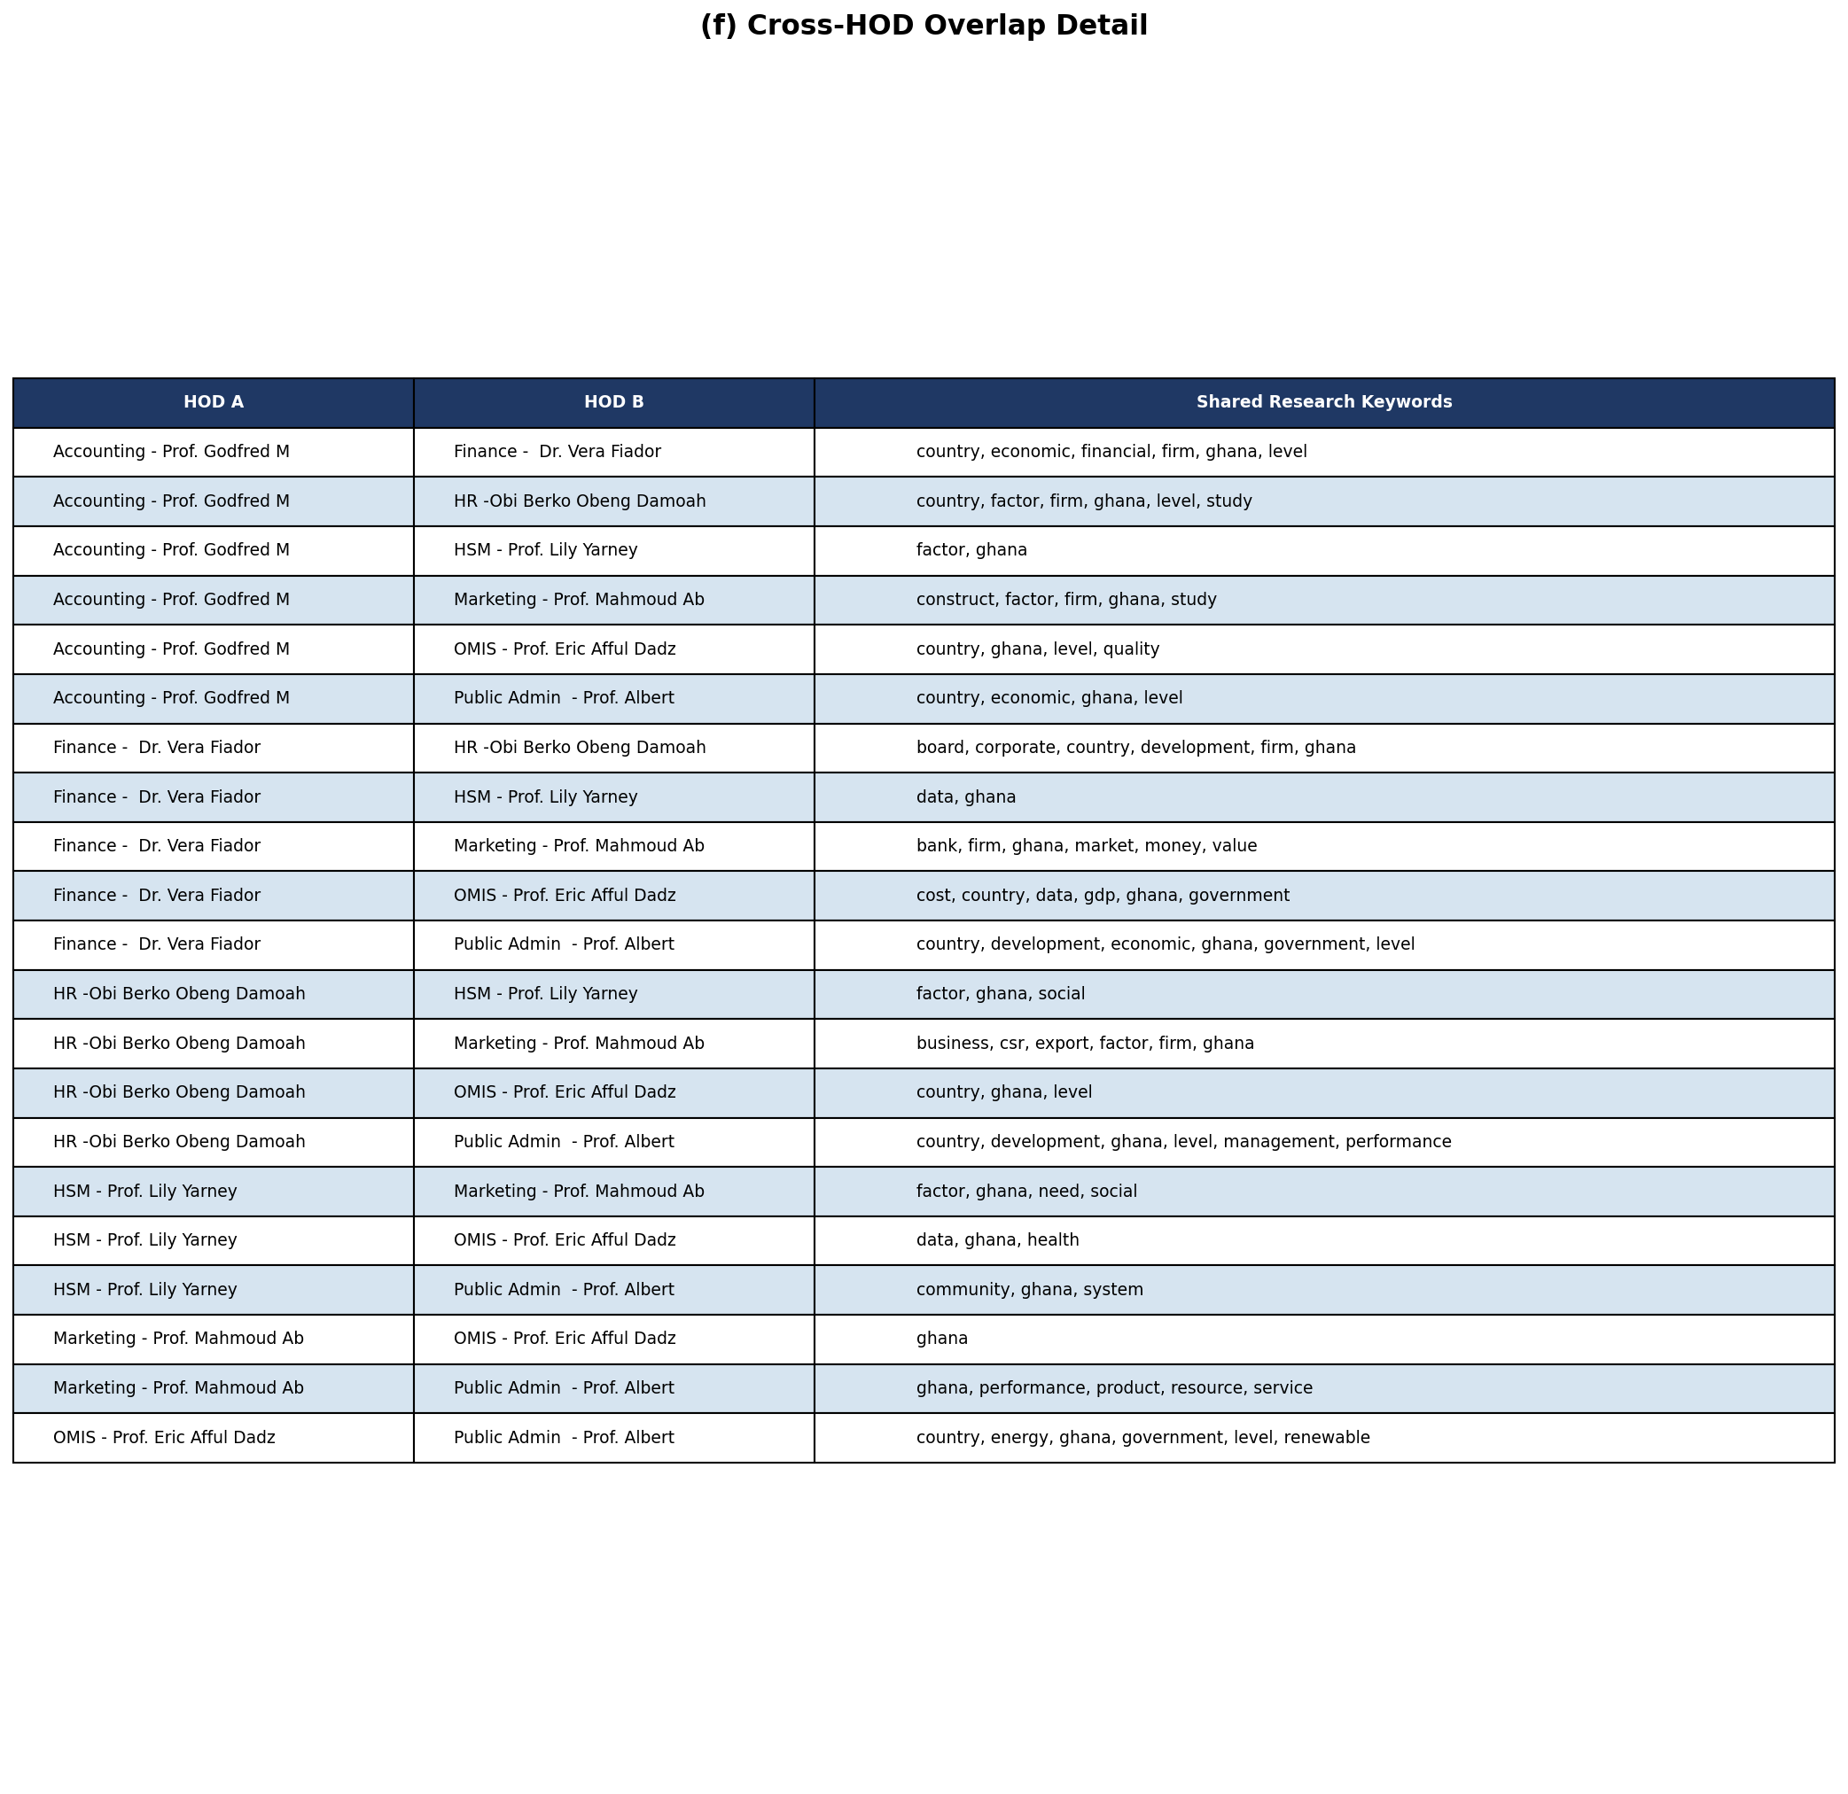
Q(f) · Collaboration Potential & Shared Keywords Detail
The table highlights the extent of shared research focus across HODs through common keywords. Frequent overlaps such as “Ghana,” “country,” “firm,” and “development” indicate a strong shared emphasis on Ghana-centered, firm-level, and policy-relevant research.
Higher overlap between specific pairs, particularly Finance–HR, HR–Marketing, and Finance–Public Administration, suggests strong thematic alignment and potential for interdisciplinary collaboration.

Slide 23
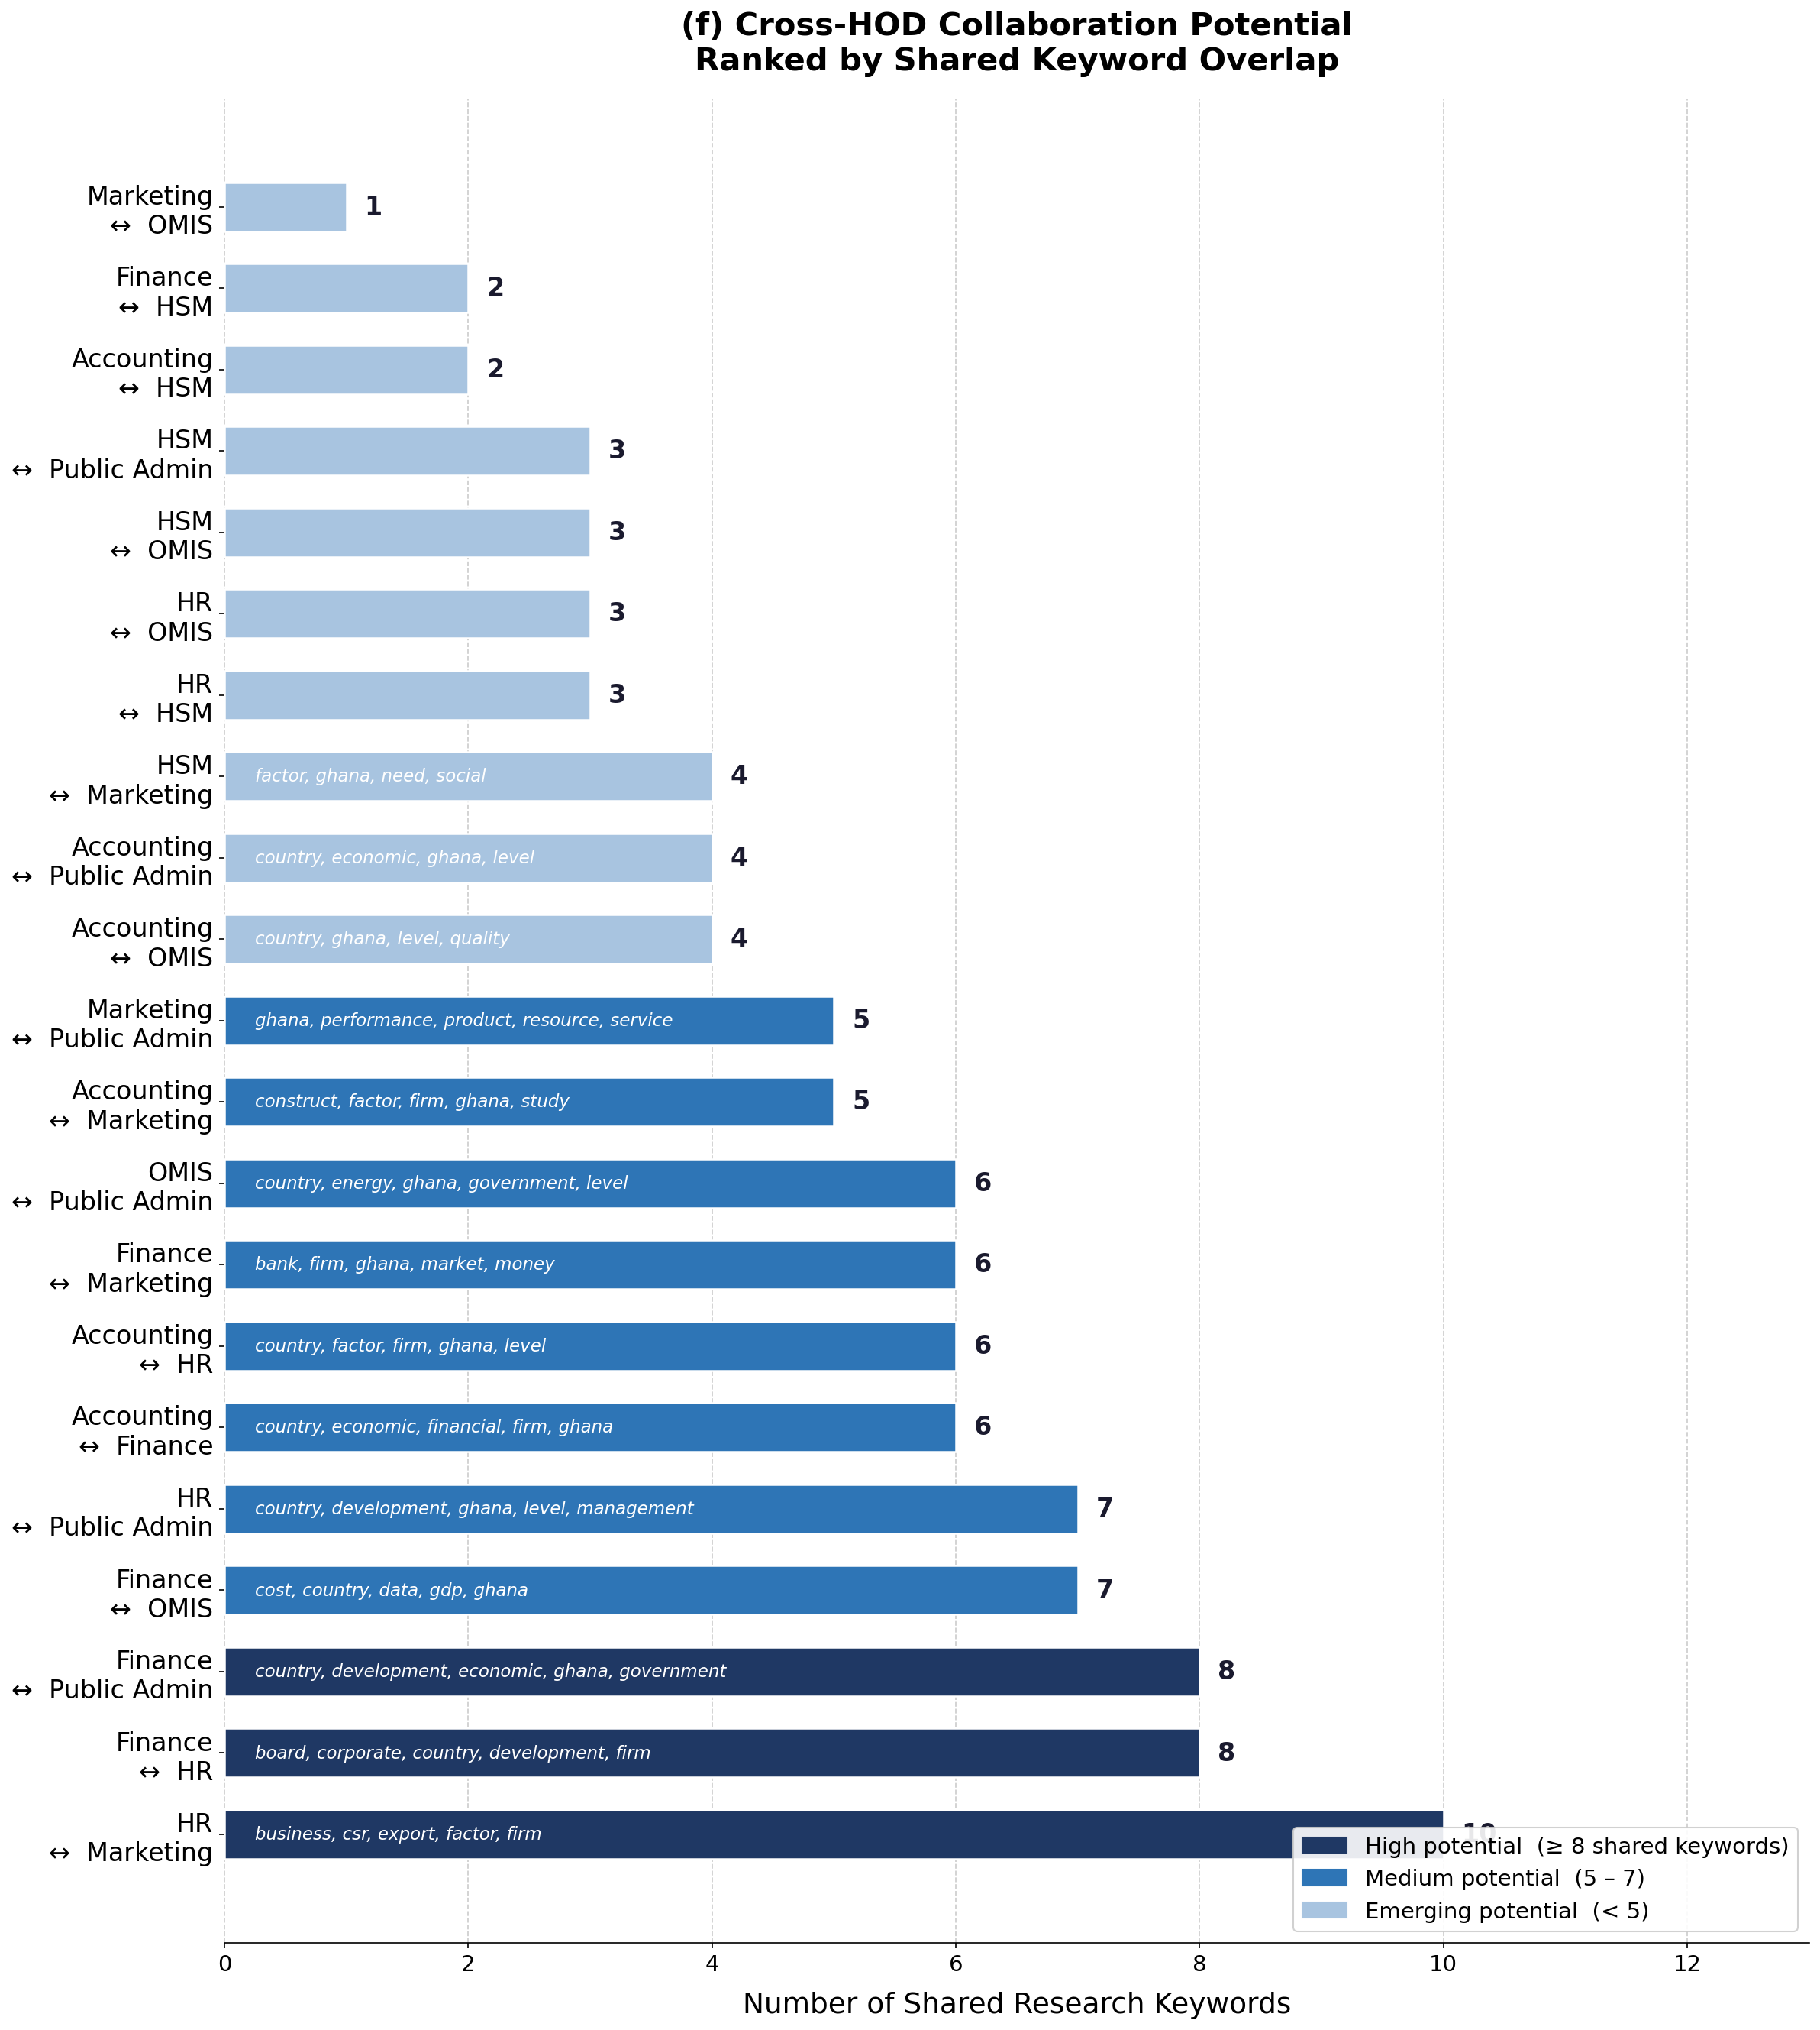
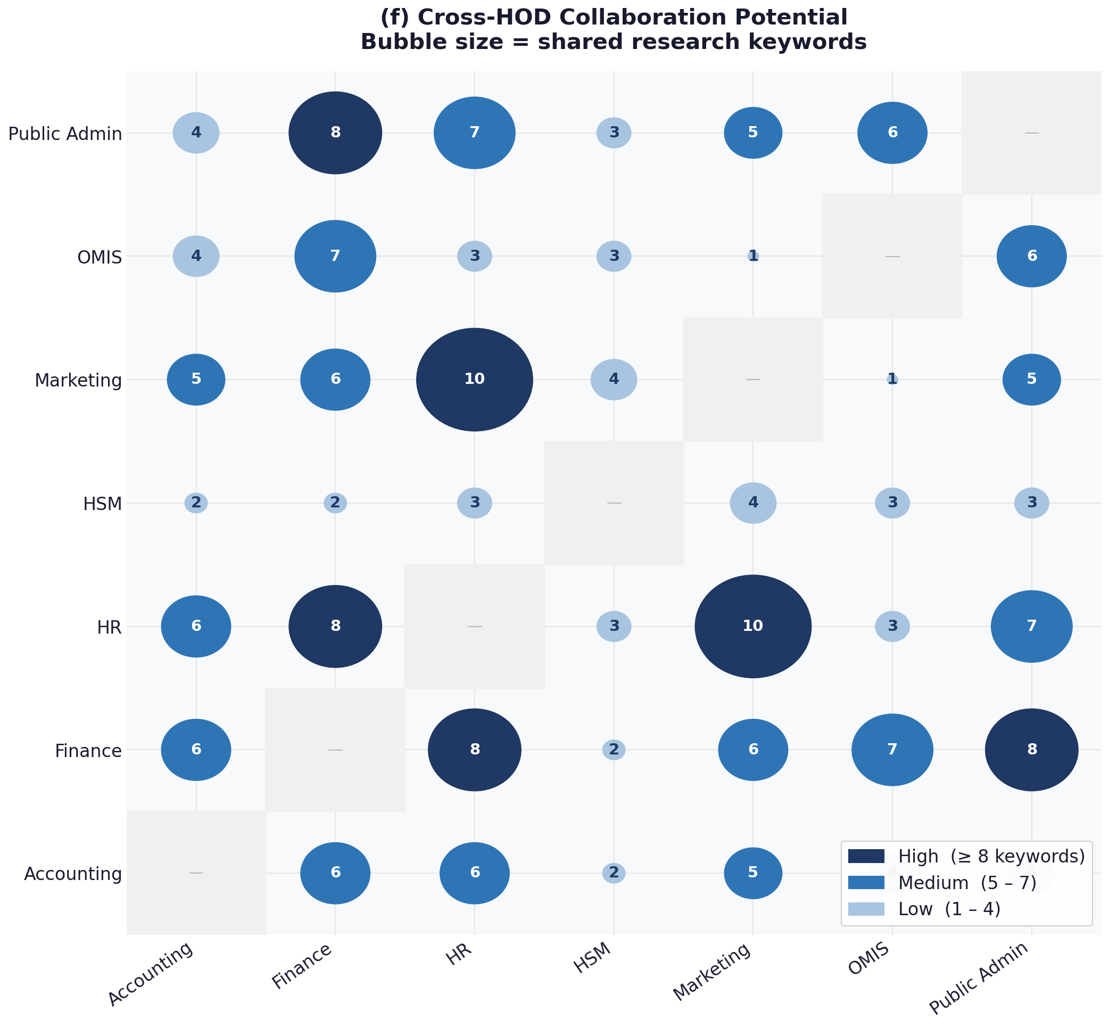
Q(f)
The heatmap and ranking charts confirm that while all HODs share some common ground, certain pairs exhibit deeper thematic alignment, especially around development, governance, and business performance.
Strong collaboration potential, especially across HR, Marketing, and Finance.

Slide 24
12 · HOD Comparison Summary Table
HOD (Dept)
Top 3 Themes
Method
Orient.
Val %
Key Connections
Accounting
Prof. G. Owusu
Sustainability
Tax Compliance
Financial Behaviour
Quant
Applied
55.6%
Finance (financial)
HR (firm, factor)
All (Ghana)
Finance
Dr. Vera Fiador
Corp. Governance
Econ. Growth
Earnings Mgmt
Quant
Applied
14.7%
HR (board, corporate)
Public Admin (economic)
OMIS (data)
HR / OHRM
Obi Berko Obeng
CSR & Ethics
Decent Work
Business Export
Quant
Applied
16.8%
Marketing (CSR) — 10
Finance (board) — 8
Public Admin — 7
HSM
Prof. L. Yarney
Public Health
Orphan Care
Maternal Mortality
Quant
Applied
36.4%
OMIS (health, data)
HR (social, factor)
Marketing (need)
Marketing
Prof. M. Abdulai
Market Orientation
Mobile Money
Customer Retention
Quant
Applied
28.7%
HR (CSR) — 10
Finance (bank, market)
Public Admin (product)
OMIS
Prof. E. Dadzie
Renewable Energy
Health Info Systems
Open Gov Data
Quant
Applied
8.6%
Finance (data, cost)
Public Admin (energy) — 6
HSM (health)
Public Admin
Prof. A. Ahenkan
Renewable Energy
Climate Change
Performance Mgmt
Quant
Applied
44.2%
Finance (economic) — 8
HR (mgmt) — 7
OMIS (energy) — 6

Slide 25
13 · Key Findings & Conclusions
🏆
T5/BART is the Superior NLP Model
🤝
HR & Marketing: Strongest Collaboration Link
Averaging 25–37% keyword overlap vs <8% for LDA and BERTopic. Abstractive summarisation captures meaning — not just keywords.
The highest cross-HOD overlap (score=10) on CSR, export, and business themes — an ideal pair for joint research initiatives.
🇬🇭
Ghana Context is the Unifying Thread
🌱
Sustainability & Digital Economy Emerging
'Ghana' appears in all 7 HODs' top keywords. Research is firmly grounded in Ghana's national development context.
Climate change, renewable energy, digital transformation, and machine learning appear across 5–6 of 7 HODs' recent papers.
📊
Quantitative-Applied Dominance
⚡
OMIS–Public Admin Energy Nexus
All HODs predominantly use quantitative methods (43–53%) and are applied-oriented — focused on solving real business and policy problems.
Both HODs publish on renewable energy, government policy, and energy systems — strong basis for interdisciplinary infrastructure research.

Slide 26
UGBS
University of Ghana
Business School
NLP Summarisation & Research Analysis
7 HODs · 140 Papers · 3 NLP Models · 6 Research Questions Answered
Analysis produced using LDA · BERTopic · T5/BART | 2024

