Slide 1
CSE431: Natural Language Processing
Improving End-to-End Bangla Speech Recognition with Semi-supervised Training
Submitted by:
Group no. 11
Moh. Absar Rahman
Lamia Tasnova
Shafi Ahmed
Jawad Bin Sayed
Submitted to:
Annajiat Alim Rasel
Senior Lecturer
BRAC University

Slide 2
Abstract
Introduction
Automatic speech recognition systems needs large annotated speech corpus for training which is very difficult using manual annotation. That is why BSR(Bangla Speech Recognition) based on semi-supervised learning is used. Using this approach, the authors reduced Word Error Rate (WER) of the system from 37% to 31.9%.
For the development of ASR(Automatic Speech Recognition) system, an annotated speech corpus is needed
Prerequisites such as environment recording, clear utterances, and additional informations are required.
Several hundred to few thousands hours of speech corpus are needed for achieving a large vocabulary continuous speech
Focused on improving an end to end speech recognition system for Bangla with the implementation of semi-supervised training
Includes semi-supervised training into deep learning based end to end ASR

Slide 3
Related works
Large-scale semi-supervised training in deep learning acoustic model for asr
Authors: Yanhua Long, Yijie Li, Shuang Wei, Qiaozheng Zhang, and Chunxia Yang.
Unsupervised pre-training for sequence to sequence speech
Authors: Zhiyun Fan, Shiyu Zhou, and Bo Xu
Graph-based semi-supervised acoustic modeling in dnn-based speech recognition
Authors: Yuzong Liu and Katrin Kirchhoff
Datasets
There are mainly three types of data in this corpus. These are:
Paired speech corpus: This corpus has around 229 hours of annotated speech data. The total number of utterances is around 217000 and the number of speakers is 505
Unpaired audio data: Many news recordings from the internet were crawled and then splitted based on silence.1000 hours worth of unpaired audio corpus.
Unpaired Text Data: Text was extracted from 40 bangladeshi newspaper websites. Then the data was cleaned and punctuations and non bengali characters were removed. This corpus has 800K bangla sentences

Slide 4
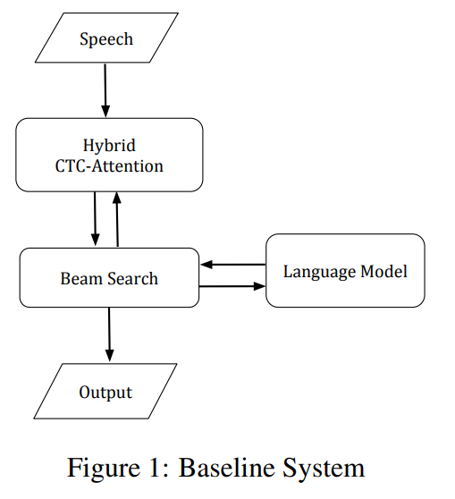
Model
Baseline System
CTC and attention networks combined
Shared encoder 6 layer network with 320 BLSTM/layer
40 MFCC per audio frame
RNN language model

Slide 5
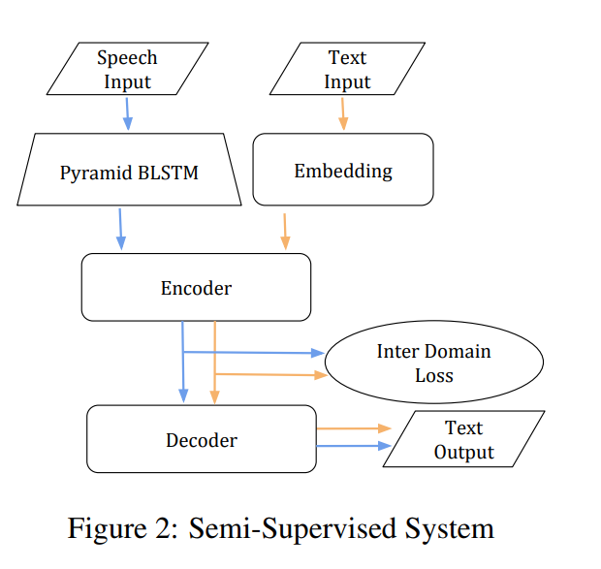
Model
Semi-supervised System
Pyramid BLSTM network for subsampling speech sequence
Shared encoder 6 layer network with 320 BLSTM per layer
Decoder 1 layer with 300 BLSTM units

Slide 6
Result Analysis:
Conclusion:
200 utterances were selected from the speech corpus. Then CTC-attention network is trained with paired speech corpus and then retrained with uppaired speech and text corpus. During initial initial supervised training the system learns to minimize the CTC and the attention loss, effectively minimizing the supervised speech to text loss.During re training the system learns to minimize the text auto-encoder loss. The semi supervised model was compared to with a baseline system. And it gives best results for PER,WER and SER . The model was also compared with Gaussian ML and Mean discrepancy. The model gives a d 31.9% percent WER which is better than Gaussian ML and Mean discrepancy. In conclusion the proposed unsupervised model performs better than the Gaussian ML and Mean discrepancy. It outperforms the ASR trained only on the paired speech corpus with language models
A semi-supervised approach for boosting the performance of Bangla ASR
Global encoding distance works better than the Gaussian KL divergence and MMD loss which was proposed previously.
Exploited 1000 hours worth of unpaired audio and text in semi-supervised learning to optimize the speech recognition system

