Slide 1
How to Frame Game a Close-Ended Test Magnifying Power, Instant Feedback, Weighted Distractors, Pacing, and Dynamic Scoreboard
Precha Thavikulwat, Towson University, Maryland pthavikulwat@towson.edu

Slide 2
Content
Frame Game
Close-Ended Item
Problem and Solution
Magnifying Power
Instant Feedback
Weighted Distractors
Pacing
Dynamic Scoreboard

Slide 3
Frame Game
Definition: Framework for loading different subject for different occasions
Crossword puzzle
Digital Escape Room

Slide 4
Close-Ended Item
Definition: Test item that elicits a machine-gradable response
Multiple choice item: stem, keys, and distractors
True or false: one key, one distractor
Fill in the blank: one or more keys, unspecified distractors
Mix and match: distractor of one item is key of another

Slide 5
Problem and Solution
Problem
Feedback: Delayed scoring and no sharing of scores
Idle time: Wide differences in completion times
Solution: Computerized administration
Increase number of scores per test item
Control pacing, submission, and sequencing
Dynamic scoreboard

Slide 6
Increase Number of Scores per Test Item
Methods
Instant feedback
Weighted distractors
Theory of magnifying power

Slide 7
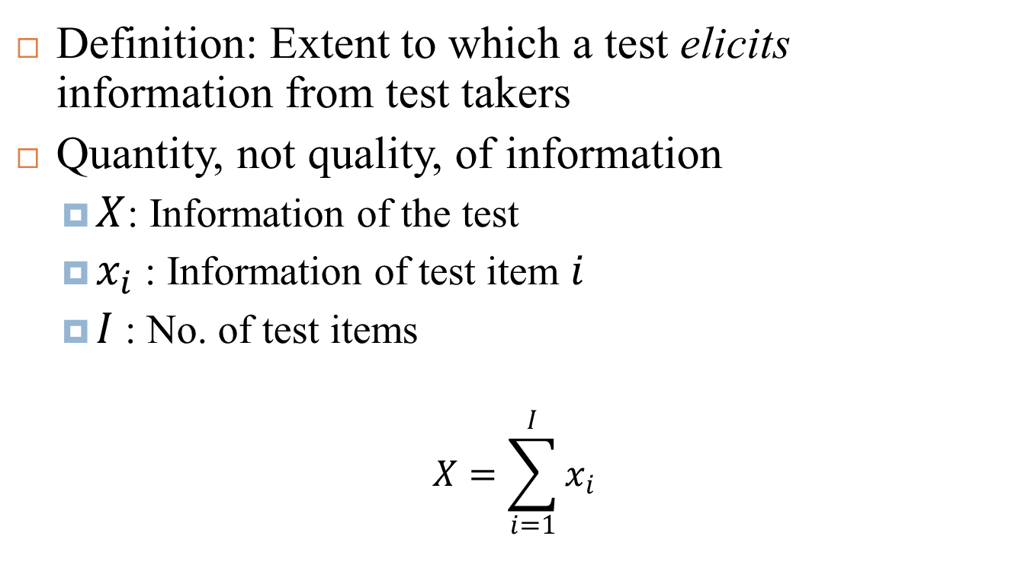
Magnifying Power
Definition: Extent to which a test elicits information from test takers
Quantity, not quality, of information
$X$: Information of the test
$x_{i}$: Information of test item $i$
$I$: No. of test items
$$X=\sum_{i=1}^{I}{x_{i}}$$

Slide 8
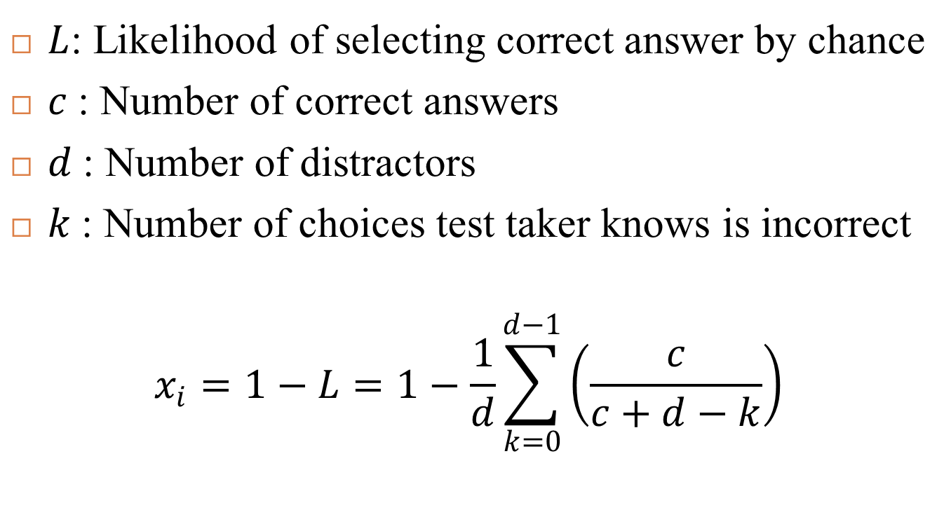

Information of Test Item ($x_{i}$)
$L$: Likelihood of selecting correct answer by chance
$c$: Number of correct answers
$d$: Number of distractors
$k$: Number of choices test taker knows is incorrect
$$x_{i}=1−L=1−\frac{1}{d}\sum_{k=0}^{d−1}{\left(\frac{c}{c+d−k}\right)}$$

Slide 9
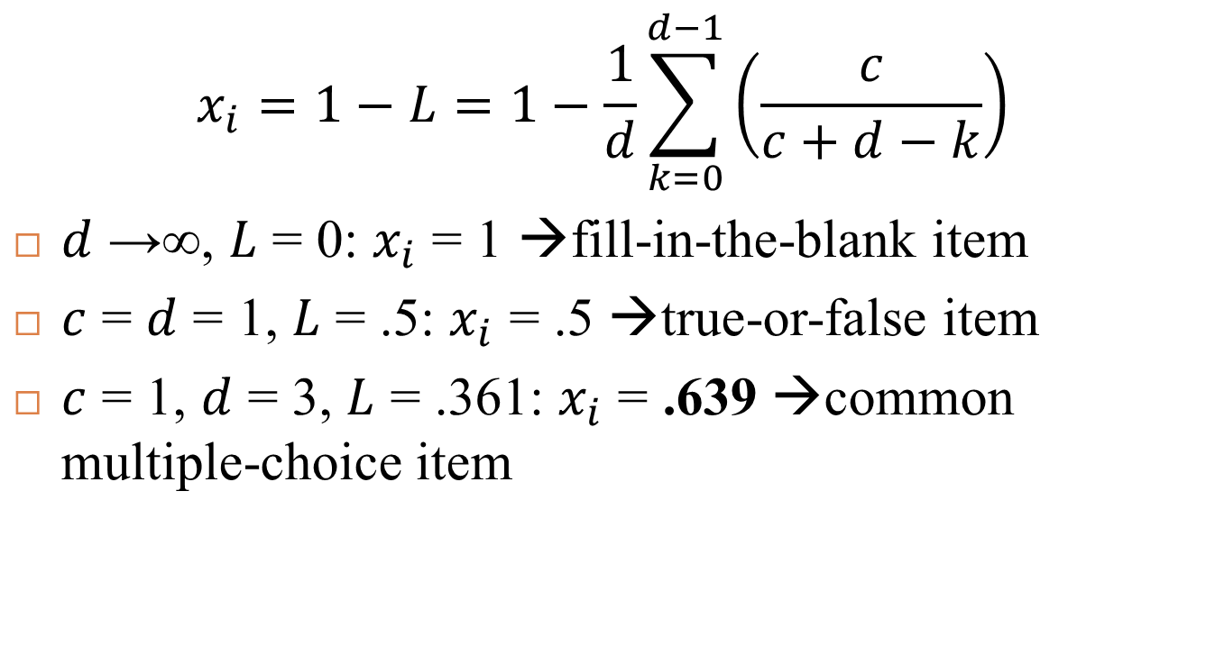

Implications for Magnifying Power($x_{i}$)
$$x_{i}=1−L=1−\frac{1}{d}\sum_{k=0}^{d−1}{\left(\frac{c}{c+d−k}\right)}$$
$d$ →∞, $L$ = 0: $x_{i}$ = 1 →fill-in-the-blank item
$c$ = $d$ = 1, $L$ = .5: $x_{i}$ = .5 →true-or-false item
$c$ = 1, $d$ = 3, $L$ = .361: $x_{i}$ = .639 →common multiple-choice item

Slide 10
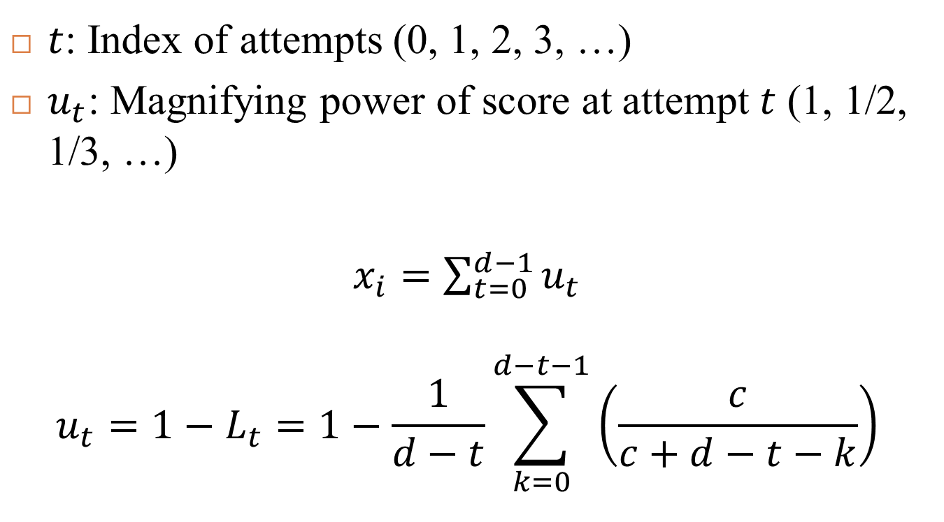
Instant Feedback
$t$: Index of attempts (0, 1, 2, 3, …)
$u_{t}$: Magnifying power of score at attempt $t$ (1, 1/2, 1/3, …)
$x_{i}=\sum_{t=0}^{d−1}{u_{t}}$
$$u_{t}=1−L_{t}=1−\frac{1}{d−t}\sum_{k=0}^{d−t−1}{\left(\frac{c}{c+d−t−k}\right)}$$

Slide 11
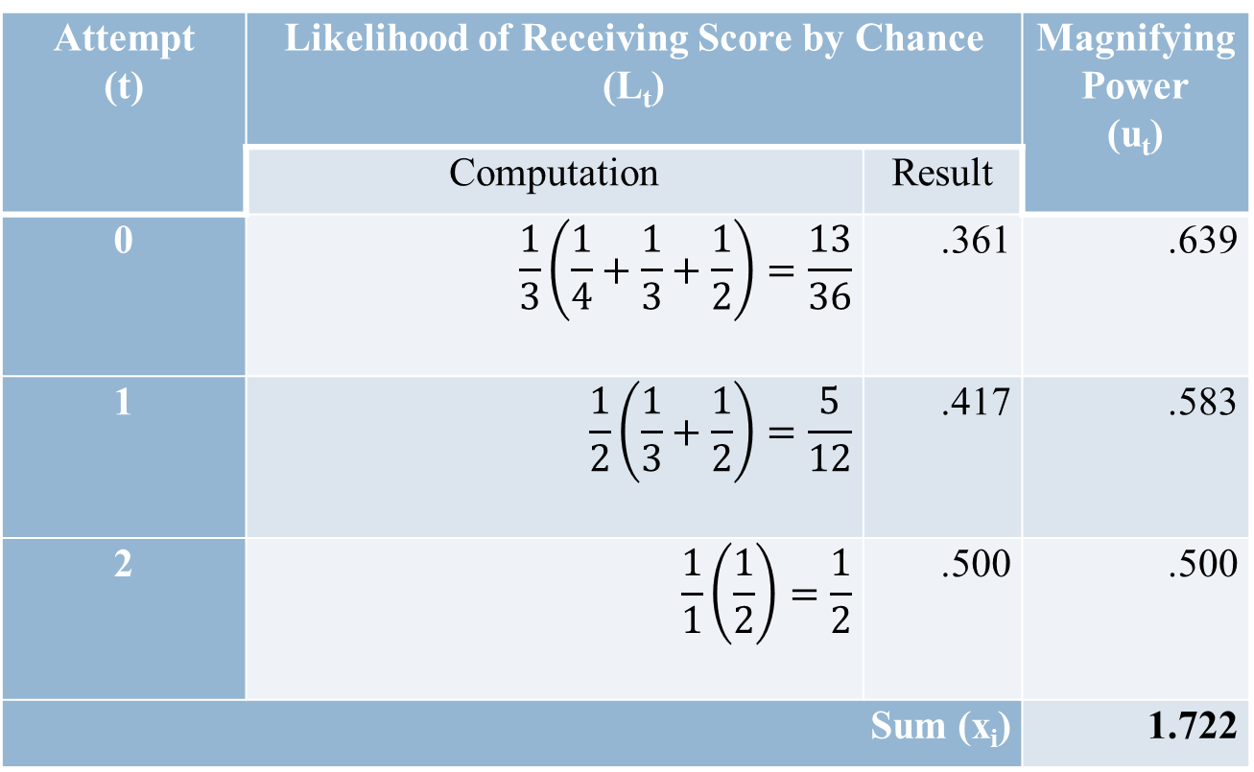
Instant Feedback (IF) One key and three distractors
Attempt (t) | Likelihood of Receiving Score by Chance (L_{t}) |  | Magnifying Power (u_{t})
 | Computation | Result
0 | $$\frac{1}{3}\left(\frac{1}{4}+\frac{1}{3}+\frac{1}{2}\right)=\frac{13}{36}$$ | .361 | .639
1 | $$\frac{1}{2}\left(\frac{1}{3}+\frac{1}{2}\right)=\frac{5}{12}$$ | .417 | .583
2 | $$\frac{1}{1}\left(\frac{1}{2}\right)=\frac{1}{2}$$ | .500 | .500
Sum (x_{i}) |  |  | 1.722

Slide 12
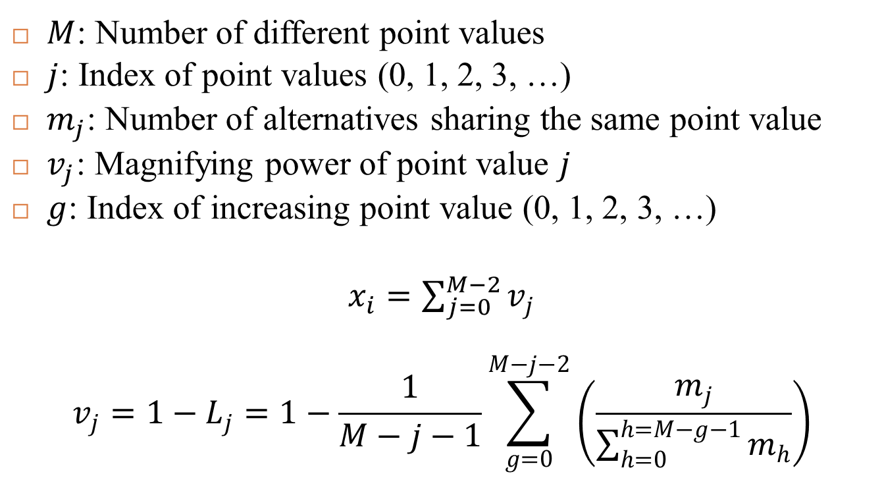
Weighted Distractors
$M$: Number of different point values
$j$: Index of point values (0, 1, 2, 3, …)
$m_{j}$: Number of alternatives sharing the same point value
$v_{j}$: Magnifying power of point value $j$
$g$: Index of increasing point value (0, 1, 2, 3, …)
$x_{i}=\sum_{j=0}^{M−2}{v_{j}}$
$$v_{j}=1−L_{j}=1−\frac{1}{M−j−1}\sum_{g=0}^{M−j−2}{\left(\frac{m_{j}}{\sum_{h=0}^{h=M−g−1}{m_{h}}}\right)}$$

Slide 13
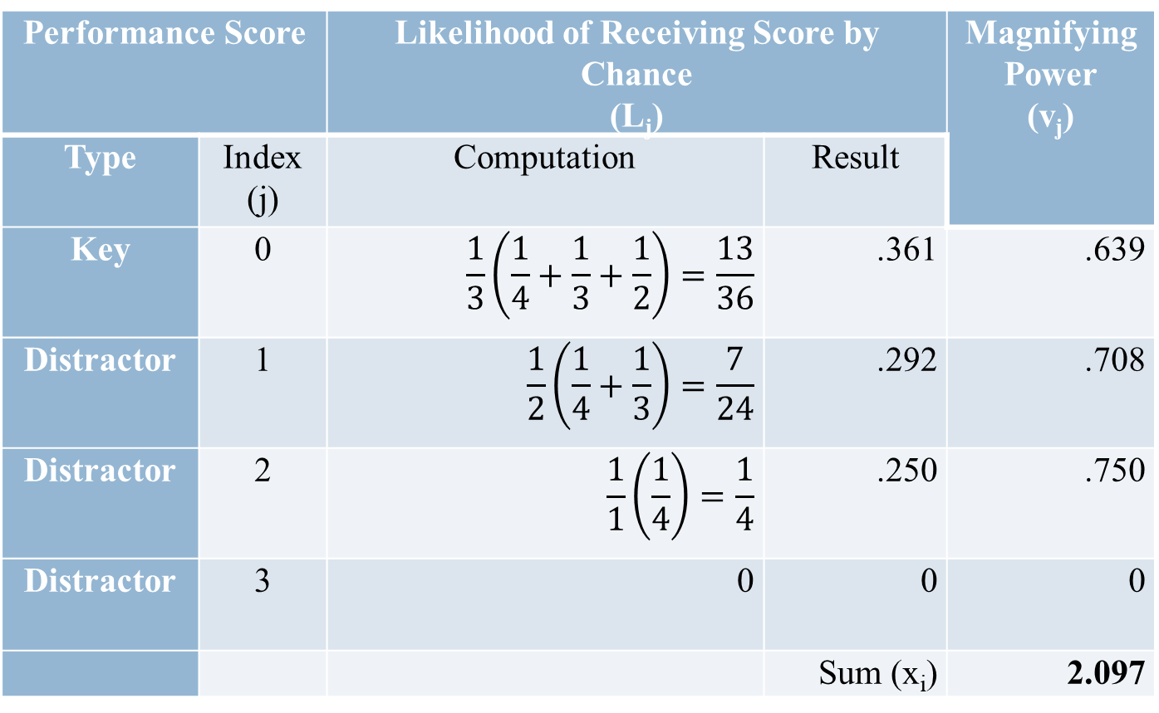
Weighted Distractors (WD) One key and three distractors
Performance Score |  | Likelihood of Receiving Score by Chance (L_{j}) |  | Magnifying Power (v_{j})
Type | Index (j) | Computation | Result
Key | 0 | $$\frac{1}{3}\left(\frac{1}{4}+\frac{1}{3}+\frac{1}{2}\right)=\frac{13}{36}$$ | .361 | .639
Distractor | 1 | $$\frac{1}{2}\left(\frac{1}{4}+\frac{1}{3}\right)=\frac{7}{24}$$ | .292 | .708
Distractor | 2 | $$\frac{1}{1}\left(\frac{1}{4}\right)=\frac{1}{4}$$ | .250 | .750
Distractor | 3 | 0 | 0 | 0
 |  |  | Sum (x_{i}) | 2.097

Slide 14
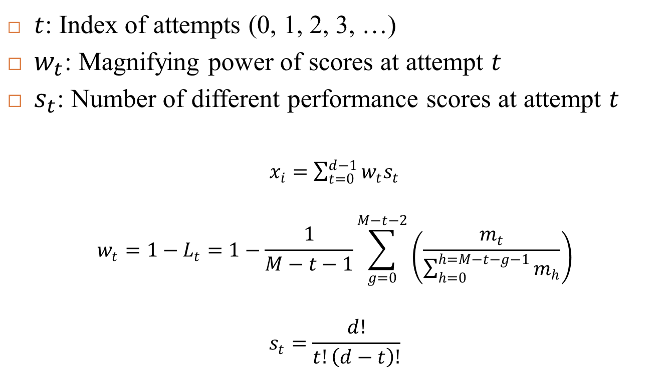
Combining Instant Feedback and Weighted Distractors
$t$: Index of attempts (0, 1, 2, 3, …)
$w_{t}$: Magnifying power of scores at attempt $t$
$s_{t}$: Number of different performance scores at attempt $t$
$x_{i}=\sum_{t=0}^{d−1}{w_{t}s_{t}}$
$$w_{t}=1−L_{t}=1−\frac{1}{M−t−1}\sum_{g=0}^{M−t−2}{\left(\frac{m_{t}}{\sum_{h=0}^{h=M−t−g−1}{m_{h}}}\right)}$$
$$s_{t}=\frac{d!}{t!\left(d−t\right)!}$$

Slide 15
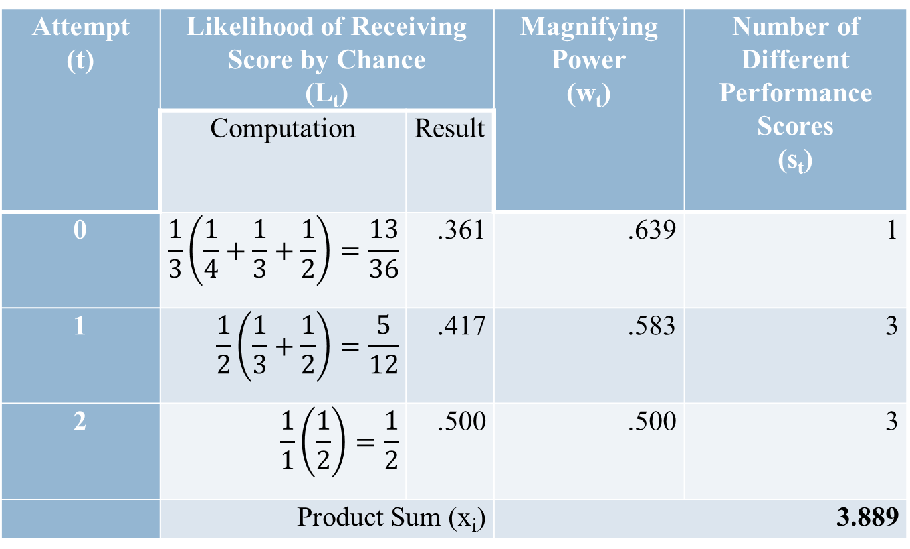
Combining IF and WD One key and three distractors
Attempt (t) | Likelihood of Receiving Score by Chance (L_{t}) |  | Magnifying Power (w_{t}) | Number of Different Performance Scores (s_{t})
 | Computation | Result
0 | $$\frac{1}{3}\left(\frac{1}{4}+\frac{1}{3}+\frac{1}{2}\right)=\frac{13}{36}$$ | .361 | .639 | 1
1 | $$\frac{1}{2}\left(\frac{1}{3}+\frac{1}{2}\right)=\frac{5}{12}$$ | .417 | .583 | 3
2 | $$\frac{1}{1}\left(\frac{1}{2}\right)=\frac{1}{2}$$ | .500 | .500 | 3
 | Product Sum (x_{i}) |  | 3.889

Slide 16
Effect on Magnifying Power of the Number of Distractors for a One-Key Multiple-Choice Item

Slide 17
Control of Play
Pacing by time or turn
Submission: Sprinting or no sprinting
Sequencing: Skipping or no skipping

Slide 18
GroupMaker
Pacing uncontrolled
Submission option: No sprinting
Sequencing option: No skipping
Player-directed dynamic scoreboard

Slide 19
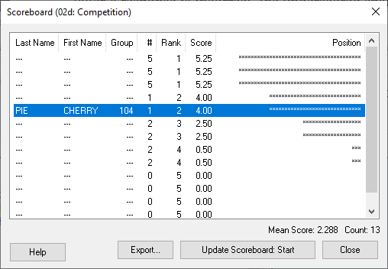
GroupMaker’s Player-Directed Dynamic Scoreboard

Slide 20
Conclusion
Magnifying Power = 10x
10 fill-in-the-blank items
20 true-or-false items
Multiple-choice item of one key and three distractors
15.6 conventionally administered
5.8 with instant feedback
4.8 with weighted distractors
2.6 with instant feedback and weighted distractors

Slide 21
Future Research
How is game play affected by a dynamic scoreboard, player-directed or not?
To what extent does a player-directed dynamic score motivate slower players to speed up and faster players to slow down?
How does magnifying power relate to the reliability and validity of the test?

