Slide 1
The ABSEL Conference Program Game A Frame Game
Precha Thavikulwat, Towson University, Maryland pthavikulwat@towson.edu

Slide 2
Content
Frame Game
Close-Ended Item
Problem and Solution
Magnifying Power
Instant Feedback
Weighted Distractors
Pacing
Dynamic Scoreboard

Slide 3
GroupMaker Community
From the Microsoft Store https://apps.microsoft.com/detail/9NK50R9QSMFR
More Available http://geobusinessgame.com/groupapp/community/publish.htm

Slide 4
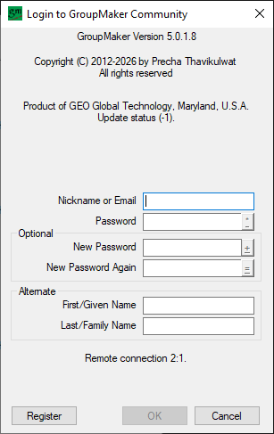
Login Panel

Slide 5
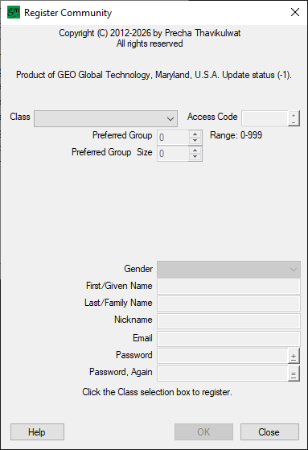
Register Panel

Slide 6
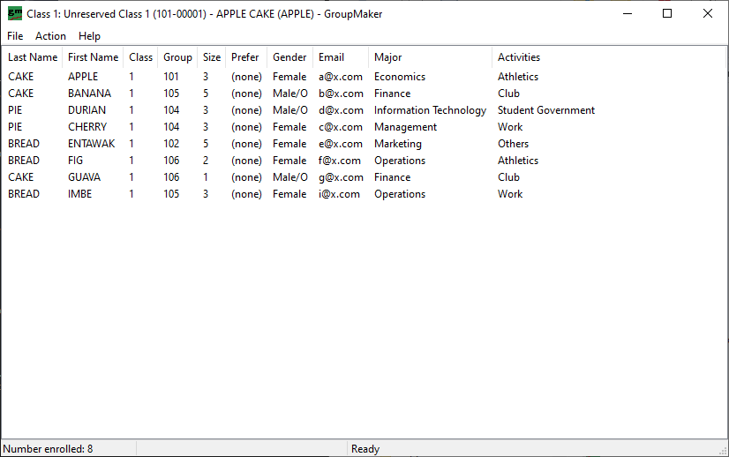
Main Frame

Slide 7
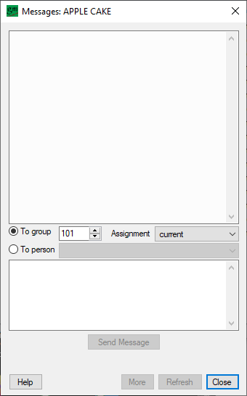
Message Panel

Slide 8
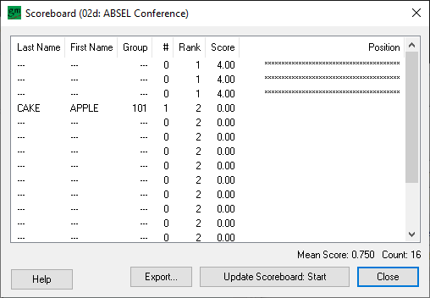
Scoreboard Panel

Slide 9
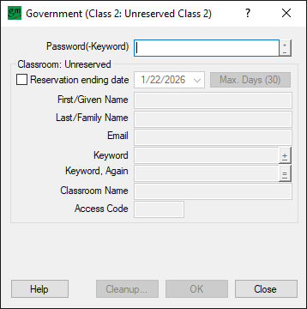
Government Panel

Slide 10
Conclusion
Magnifying Power = 10x
10 fill-in-the-blank items
20 true-or-false items
Multiple-choice item of one key and three distractors
15.6 conventionally administered
5.8 with instant feedback
4.8 with weighted distractors
2.6 with instant feedback and weighted distractors

Slide 11
Future Research
How is game play affected by a dynamic scoreboard, player-directed or not?
To what extent does a player-directed dynamic score motivate slower players to speed up and faster players to slow down?
How does magnifying power relate to the reliability and validity of the test?

