Slide 1

Building Telegram Bot using Node.js

Slide 2

What is a Chat Bot?
A computer program which conducts a conversation via auditory or textual methods.

Slide 3
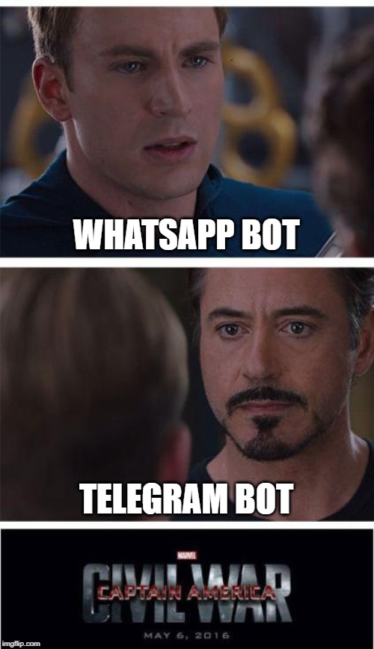
Why Telegram?
Liberal about bots
API Documentation is fantastic
Easy to set up
Enables plethora of stuff to do

Slide 4
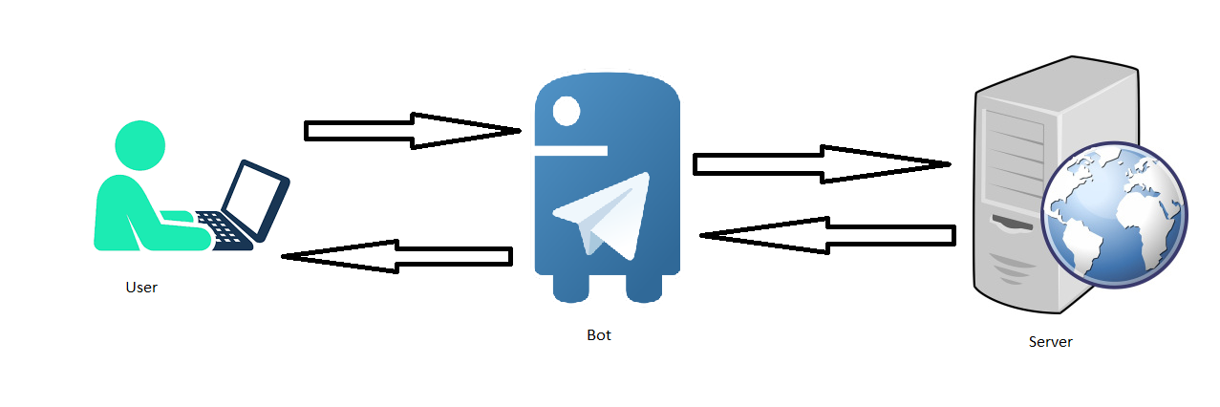
How does it work?

Slide 5

What will the chat bot do?
Shall provide trivia related to a number
API to be used: http://numbersapi.com

Slide 6
Let's code

Slide 7

Building Server
Bootstrap
Trivia Service
Route for handling webhook

Slide 8

Getting Token
Start a conversation with BotFather
Provide all the details
A token shall be granted

Slide 9

Final touches
Make server aware of the token
Start server
Expose the port using Ngrok
Set webhook
Test

Slide 10

Deployment
Firebase Functions
AWS Lambda
Any of the Vms (AWS/GCP/Azure/DO, etc)
Ensure HTTPS
Explore other features!

Slide 11


Slide 12
Links for reference
https://core.telegram.org/bots
https://core.telegram.org/bots/api
https://core.telegram.org/bots/webhooks

