Slide 1

Statements in C
Dr. Shridhar Sanshi, Assistant Professor
Department of CSE, NITK
Notes:
© NITK Surathkal

Slide 2
Control Statements -- Looping
while Loop
While both for and while loops are used to perform repetitive tasks in C, they have different strengths and are suited for different types of scenarios.
Use Case:
for loop: Best when the number of iterations is known ahead of time. Typically used when there's a fixed start and end condition with incremental/decremental steps.
while loop: Ideal when the number of iterations is not known in advance and depends on some condition during runtime.
Initialization & Iteration:
for loop: Initialization, condition, and increment are all handled in the loop header, making it ideal for counting loops.
while loop: Condition is tested at the start, and initialization and increment are handled separately, providing more flexibility for conditional checks.

Slide 3
Control Statements -- Looping
Examples while Loop is better
Indefinite Loops: When the Number of Iterations is Not Known
Infinite Loops: When You Want the Loop to Run Indefinitely
Conditional Loops: When Initialization or Incrementation Happens Outside the Loop
Pre-Check vs. Post-Check (while & do while)
Dynamic Conditions: If the loop condition changes dynamically based on the input, data stream, or user input, while is more flexible.
while Loop:
The syntax of the while loop is:
while(condition)
{
statement(s);
}

Slide 4
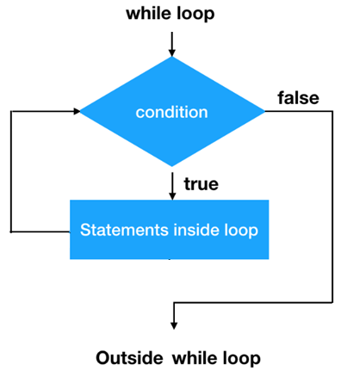
Control Statements -- Looping
Flowchart of while loop:

Slide 5
Control Statements -- Looping
Example 1: while loop with bounded
// Print 1 to 10 numbers
#include<stdio.h>
int main()
{
int counter=1;
int end = 10;
while(counter <= end)
{
printf("Counter=%d\n", counter);
counter = counter + 1;
}
return 0;
}

Slide 6
Control Statements -- Looping
Practice Questions
Sum of Digits Until Single Digit
Guessing Game: The user has to guess a number between 1 and 100. Keep asking until the guess is correct.
Find Greatest Common Divisor (GCD): Use the Euclidean algorithm to find the GCD of two numbers.
Finding Prime Numbers: Find all prime numbers less than a given number using a while loop.
Reversing a Number: Reverse the digits of a number.
Fibonacci Sequence Until a Limit: Print Fibonacci numbers until a certain limit.
Digit Counting: Count the number of digits in a number.

Slide 7


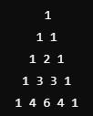
Control Statements -- Looping
The Pascal's triangle is a triangular array where each element is the sum of the two elements directly above it. The elements of Pascal's triangle correspond to the binomial coefficients.
The element at row n and column k of Pascal's triangle is given by the binomial coefficient:
Where: C(n,k) is the binomial coefficient, n! is the factorial of n, k! is the factorial of k,(n−k)! is the factorial of (n−k).
To calculate the value of an element in Pascal's triangle:
Example:

Slide 8

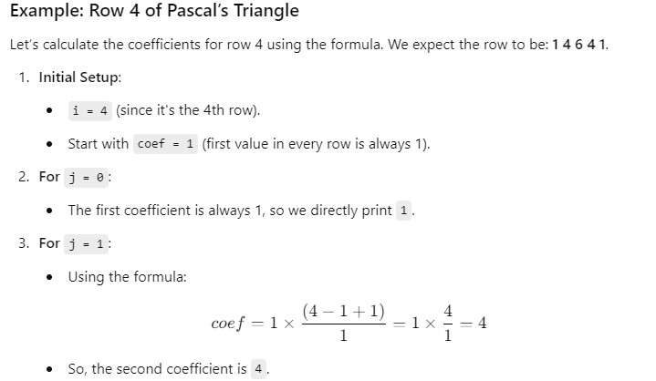
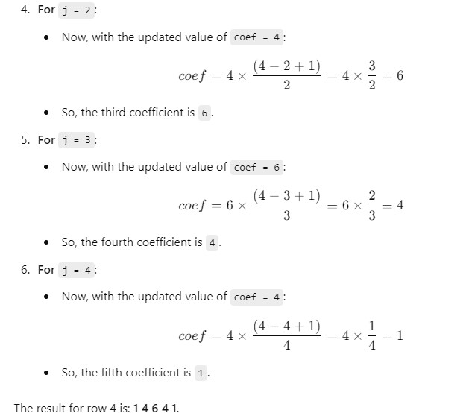
Control Statements -- Looping
However, instead of calculating factorials, we use a recursive formula to generate each coefficient based on the previous one in the row:
This formula says that each coefficient can be calculated from the previous coefficient in the row by multiplying it by a fraction (𝑛−𝑘+1)/𝑘 , where n is the current row and k is the current position in the row.

Slide 9
Control Statements -- Looping
#include <stdio.h>
int main() {
int rows, coef = 1;
printf("Enter the number of rows: ");
scanf("%d", &rows);
// Loop through each row
for (int i = 0; i < rows; i++) {
// Print leading spaces to center the triangle
for (int space = 1; space <= rows - i; space++) {
printf(" ");
}
// Calculate and print values in each row
for (int j = 0; j <= i; j++) {
// The first element in each row is always 1
if (j == 0 || i == 0) {
coef = 1;
} else {
// Calculate binomial coefficient using the relation
coef = coef * (i - j + 1) / j;
}
printf("%4d", coef);
}
// Move to the next line after each row
printf("\n");
}
return 0;
}

Slide 10
Control Statements -- Looping
do while Loop:
The syntax of the do while loop is:
do
{
statement(s);
} while(condition);

Slide 11
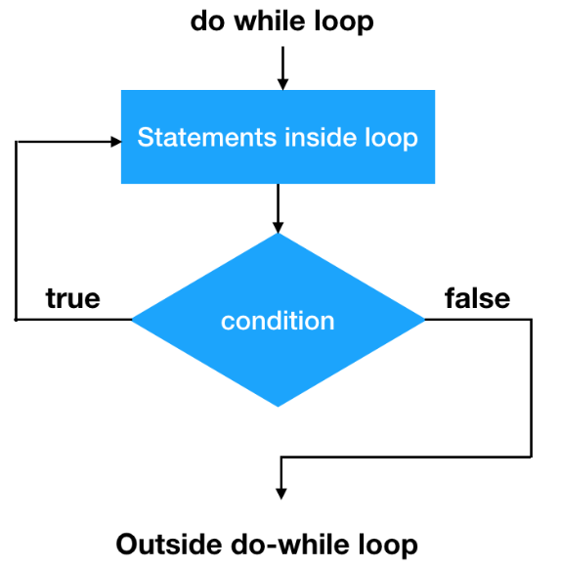
Control Statements -- Looping
Flowchart of do while loop:

Slide 12
Control Statements -- Looping
Example 1: do while loop with bounded
// Print 1 to 10 numbers
#include<stdio.h>
int main()
{
int counter=1;
int end = 10;
do
{
printf("Counter=%d\n", counter);
counter = counter + 1;
}while(counter <= end);
return 0;
}

