Slide 1

Statements in C
Dr. Shridhar Sanshi, Assistant Professor
Department of CSE, NITK
Notes:
© NITK Surathkal

Slide 2
Control Statements -- Looping
In programming, a loop is used to repeat a block of code until the specified condition is met.
C programming has three types of loops:
while loop
do...while loop
for loop
for Loop:
The syntax of the for loop is:
for (initializationStatement; testExpression; updateStatement)
{
// statements inside the body of loop
}

Slide 3
Control Statements -- Looping
for loop working:
1) The initialization statement is executed only once.
2) Then, the test expression is evaluated. If the test expression is evaluated to false, the for loop is terminated.
3) However, if the test expression is evaluated to true, statements inside the body of the for loop are executed, and the update expression is updated.
4) Again the test expression is evaluated.
This process (2 to 4) goes on until the test expression is false. When the test expression is false, the loop terminates.

Slide 4
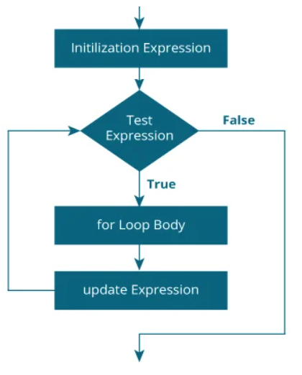
Control Statements -- Looping
Flowchart of for loop:

Slide 5
Control Statements -- Looping
Example 1: simple for loop
// Print numbers from 1 to 10
#include <stdio.h>
int main()
{
int i;
for (i = 1; i < 11; i++)
{
printf("%d ", i);
}
return 0;
}

Slide 6
Control Statements -- Looping
Example 1: for loop
i is initialized to 1.
The test expression i < 11 is evaluated. Since 1 less than 11 is true, the body of for loop is executed. This will print the 1 (value of i) on the screen.
The update statement i++ is executed. Now, the value of i will be 2. Again, the test expression is evaluated to true, and the body of for loop is executed. This will print 2 (value of i) on the screen.
Again, the update statement i++ is executed and the test expression i < 11 is evaluated. This process goes on until i becomes 11.
When i becomes 11, i < 11 will be false, and the for loop terminates.

Slide 7
Control Statements -- Looping
Example 2: for loop with break
// Print numbers from 1 to 50
#include <stdio.h>
int main()
{
int i;
for (i = 1; i < 100; i++)
{
if(i== 50)
break;
printf("%d ", i);
}
return 0;
}

Slide 8
Control Statements -- Looping
Example 3: for loop with continue
// Print even numbers from 1 to 100
#include <stdio.h>
int main()
{
int i;
for (i = 1; i < 101; i++)
{
if(i%2 != 0)
continue;
printf("%d ", i);
}
return 0;
}

Slide 9
Control Statements -- Looping
Example 3.1: for loop with unconditional
Modify Previous program to print odd numbers
// Print all positive odd numbers
#include <stdio.h>
int main()
{
int i;
for (i = 1;i<101; i++)
{
if(i%2 == 0)
continue;
printf("%d ", i);
}
return 0;
}

Slide 10

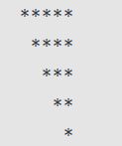
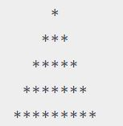
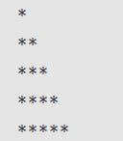

Control Statements -- Looping
Example 4: Nested
Square pattern in C
Left triangle star pattern in C
Left Down Triangle
Right Down Triangle
Pyramid
30 Pattern Program In C (Complete Code) (tutorialstonight.com)

