Slide 1
Flight Durations and Delays: How Long Will Take My Flight?
Anna Hughes

Slide 2
Model Architecture
DATA
  Most of data is downloaded from RITS: lots of files containing information about the flights from Aug 2011 to Sept 2014, planes specs from FAA
  Messy, heavy (4GB)
TOOLS
  S3 for data storage
  EC2 for data processing
  SQL (sqlite) for merging tables

Slide 3
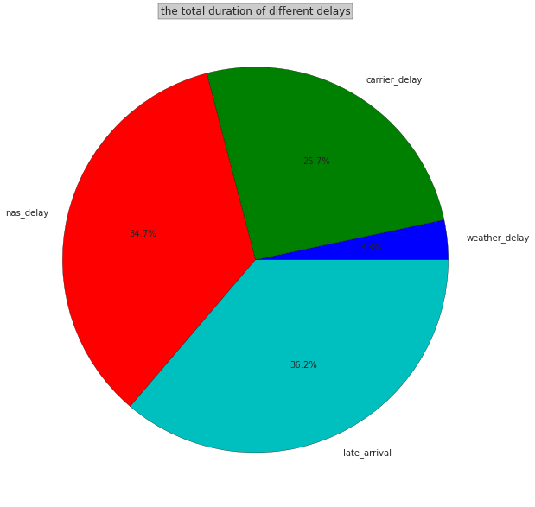
Flight delays
84% of the flights are on time, the rest are delayed

Slide 4
The Goal
Initial goal
  predict the probability of the flight being delayed
Problem
  Saying ‘every single flight is going to be on time’ is a better model than KNN, Naïve Bayes, Logistic Regression, Decision Trees and Random Forests
Why?
  Because the airlines include the ‘pad’ for each flight to make sure they are doing well with delay stats

Slide 5
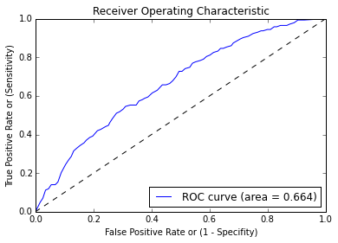
The Goal: Problem
  When having a cross-validation score 0.84 the results are not reliabl;e

Slide 6
New Goal
New goal
  Predict the actual duration of the flight
Inputs
  Date (Month, Weekday, Time)
  Aircraft specs (Year, Manufacturer, Model)
  Flight number (includes the airline)
  Scheduled duration of the flight

Slide 7
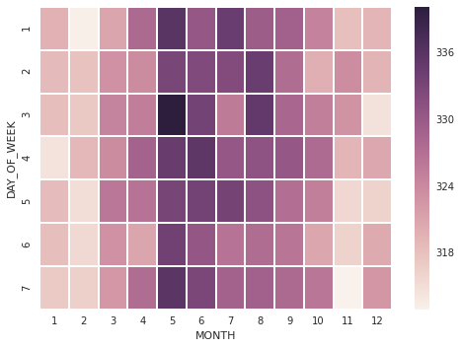
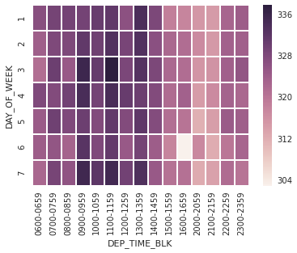
When to Fly
Winters are better than summers
On the evening is faster than on the morning

Slide 8
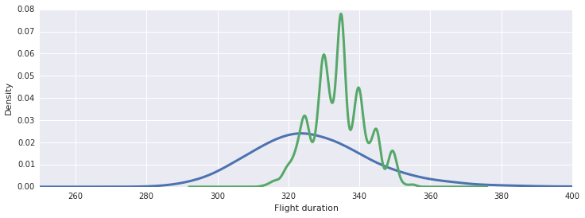
How Long Can Be a SFO JFK flight?
Actual flight durations have a normal distribution (BLUE)
Schedules flight durations have a normal distribution (GREEN)

Slide 9
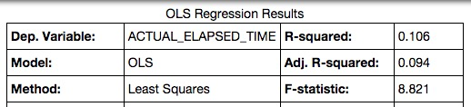
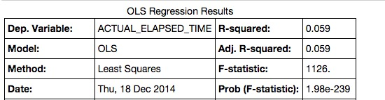
Results
My results (above) for prediction the duration of the flight are not that great, but they are more accurate than the actual scheduled duration

