Slide 1
Guidelines for Candidates
The purpose of the document is to provide clear guidelines to the candidates
You have three use cases to review from the list and select one which you would like to work on to enable us to evaluate the data science technical skills
Each use case has been detailed out in terms of objective and data
Please feel free to introduce any external data if you think it will strengthen the ML model; an extra credit for the innovation quotient will be given
We understand that some of the code may be there in open source platforms e.g. Kaggle but we expect you to create something authentic to get higher credit
Weightage would be given to Exploratory Data Analysis done w.r.t to ML Model developed
We expect to receive a clean Python or R Notebook with good documentation for seamless evaluation; please submit it via GIT account
Credit will be given to the candidates on any credible assumptions made while completing the exercise

Slide 2
Use case-2 : Build a Time Series Forecast Model for Inventory Management
Overview
Demand Forecast is the most critical aspect to manage inventory of a manufacturing company at an optimum level so as to ensure prevention of wastage on one hand and enough products to take care of all customer need. We have a scenario where an automotive component manufacturing company manufactures gears based on the manual forecast (F) done by Marketing executive who are attached to big car manufacturers, while the actual number (A) are way off from the forecast resulting in either wastage or unable to meet the demand of the car companies (customers).
The automotive component manufacturing company decides to leverage Time Series Forecast model to be more accurate in the demand management by maintaining right level of inventory.
Reconciliation
Market Forecast Numbers for Parts
Actual Sales Numbers for Parts

Slide 3
Use case-2 : Objective & Data
Problem:
In current world there is a discrepancy of 20% between the two numbers (F & A) which could lead to shortage or unsold inventory
Solution:
Build a 12 week Time Series Forecast models for Parts (Part No) to help auto component manufacturer maintain inventory at appropriate level and take care of current problem being faced by company
Dataset →
Note: Consider 2019 as test set

Slide 4
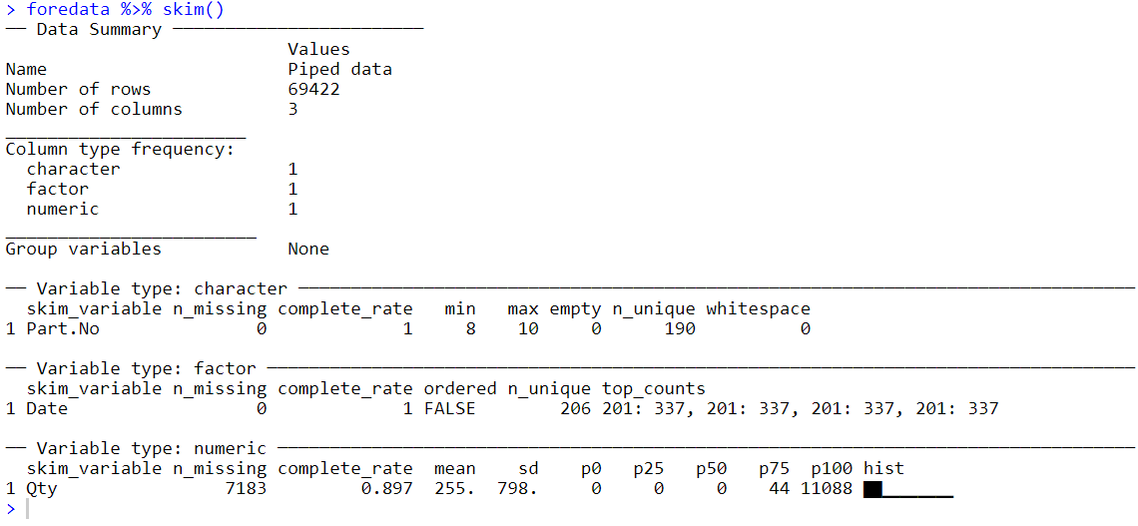
Use case-2 : Exploratory Data Analysis
-Around 50% of the parts have NA , will assume them as zero as imputing will not make sense and removing them will distort the time series

Slide 5
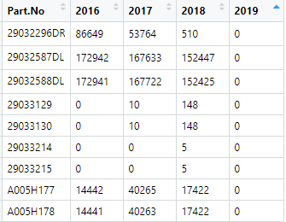
Use case-2 : Exploratory Data Analysis
-Most of the parts distribution is lefty skewed which means they have a lot of zeros(visual is large in shape)
-Certain parts(9 out of 190) have been discontinued in 2019, will drop those products
-Out of 181 product left 68 products have data with high sparsity ,dropping these products
We can think of certain linear models rather than time series to forecast this parts

Slide 6
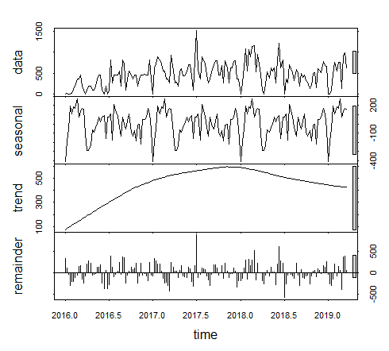
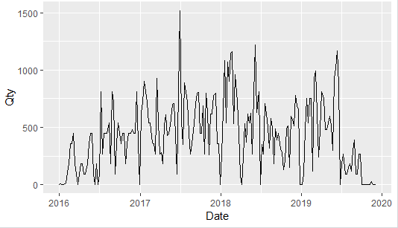
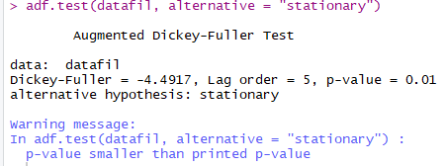
Use case-2 : Exploratory Data Analysis
-Going through some of the top demand parts like 29032913 to see their decomposition and check stationarity
-Went through most of the products to see how the decomposition looks like see if they are stationary or not
most of them where stationary the non stationary ones will be made stationary using box-cox transformation.
-There were certain seasonal variation for some of the parts as seen in the red circle above for the part 29032913

Slide 7
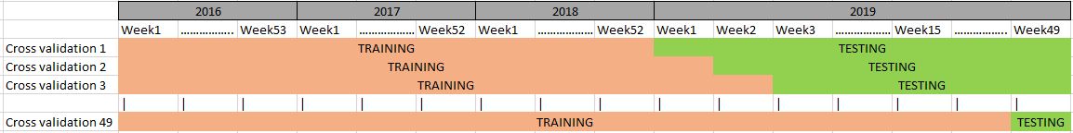
Use case-2 : Cross Validation
-Doing a k fold cross validation doesn’t make much sense as the data is time dependent and has seasonal variation , below is the how the cross validation is mapped out
-Model considered for training and cross validation
1) tbats
2) ets
3) STLM
4) S naïve
5) Prophet
6) Arima
7) Arimax
8) Arima with fourier
9) Catboost
10) Ensemble

Slide 8
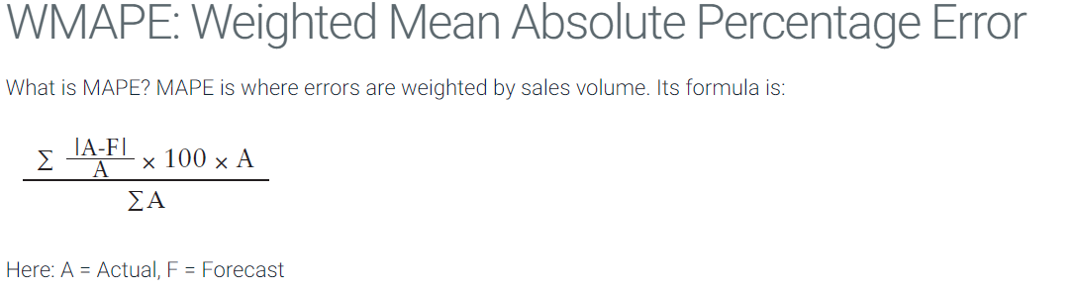
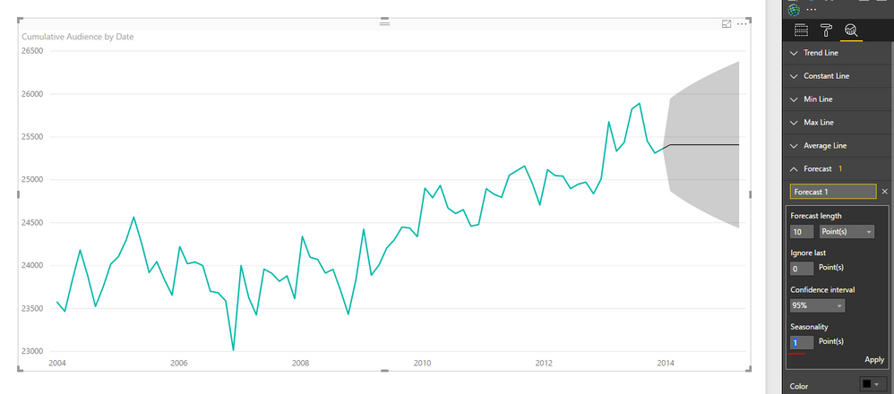
Use case-2 : Best Model
-For getting the best model we take WMAPE as score along with standard deviation of the forecast
-The standard deviation helps to negate those models whose WMAPE is less but looks something like below

Slide 9
Use case-2 : Future Improvements
-More hyper parameter tuning
-Adding more regressors

