Slide 1
Project Presentation of Industry Oriented Hands on Experience (22CS422)
On
Comparative Analysis of Deep Learning and Machine Learning for Email Spam Detection
Presented By:
Abhishek Verma – 2211981015
Aditya Mishra – 2211981024
Aditya Singh – 2211981030
Supervised By:
Dr. Monika Aggarwal
Department of Computer Science and Engineering,
Chitkara University, Punjab

Slide 2
Introduction
In today's digital world, email is a widely used communication tool in business, education, and personal interactions.
However, spam emails (junk or unwanted emails) pose a serious problem, often used for phishing, malware distribution, and fraud.
Spam emails account for over 77% of global email traffic, leading to security risks and financial losses.
Traditional spam detection methods rely on rule-based filtering, which is often ineffective against evolving spam techniques.
Machine learning (ML) models, such as Naïve Bayes, Decision Trees, and Neural Networks, have proven effective in detecting spam with higher accuracy.
This research explores and compares different deep learning approaches to improve spam email detection accuracy and efficiency.

Slide 3
Objectives
Main Goal of the Project
The goal of this project is to develop and compare deep learning models for accurate spam detection using SMS data. The study aims to identify effective architectures that can distinguish spam from legitimate messages, improving communication security and user trust.
Key Objectives
Develop models: Implement CNN, LSTM, and Transformer-based architectures for spam classification.
Train on dataset: Use a labeled SMS spam dataset of 4,789 messages to learn spam vs. ham patterns.
Compare approaches: Analyze performance across models in terms of accuracy, efficiency, and generalization.
Evaluate results: Use accuracy, precision, recall, and F1-score to measure reliability.

Slide 4
Dataset Used
Dataset Source
The dataset used in this study is the SMS Spam Collection Dataset from Kaggle, containing labeled SMS messages categorized as spam or ham.
Total Messages and Categories
The dataset includes 4,789 messages divided into two classes:
Spam: Unwanted or fraudulent messages
Ham: Legitimate messages
Preprocessing Techniques
Cleaning text (removing special characters and numbers)
Tokenization and stopword removal
Stemming/Lemmatization
Vectorization (TF-IDF or word embeddings)

Slide 5
Mid –term progress
What Has Been Completed?
Dataset Collection and Preprocessing
A dataset of 4,789 SMS messages has been collected, containing spam and ham classes.
Preprocessing steps such as text cleaning, tokenization, stopword removal, and vectorization have been applied.
Model Selection and Initial Training
Deep learning models including CNN, LSTM, and Transformer-based architectures have been selected for classification.

Slide 6
Model Architecture
Deep Learning Model Used
This study employs the Bidirectional Long Short-Term Memory (BiLSTM) model, a recurrent neural network (RNN) architecture widely applied in natural language processing tasks such as text classification.
Why This Architecture Was Chosen?
Sequential Understanding: BiLSTM captures long-term dependencies and sequential patterns in text, which are crucial for detecting spam in emails.
Context Awareness: By processing input sequences in both forward and backward directions, BiLSTM provides a deeper understanding of word semantics within an email.
Proven Effectiveness: RNN-based models, especially LSTMs and GRUs, have consistently demonstrated strong performance in spam detection due to their ability to learn linguistic and contextual patterns that differentiate spam from legitimate messages.

Slide 7
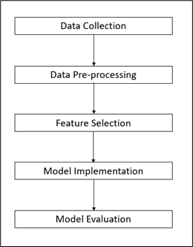
Model Architecture

Slide 8
Model Evaluation
Dataset | Loss | Accuracy (%) | Precision (%) | AUC (%)
Training | 26.36 | 98.87 | 99.09 | 99.93
Testing | 36.04 | 91.30 | 94.39 | 98.01
Training Performance:
The model shows excellent performance on the training data, achieving a very high accuracy (98.87%) and precision (99.09%), with an AUC (99.93%). A low loss value (26.36) indicates that the model fits the training data well.
Testing Performance:
. On the unseen test data, the model achieves strong accuracy (91.30%) and high precision (94.39%), with an AUC (98.01%). Although the test loss (36.04) is slightly higher than the training loss, the performance remains robust, suggesting minimal overfitting.

Slide 9
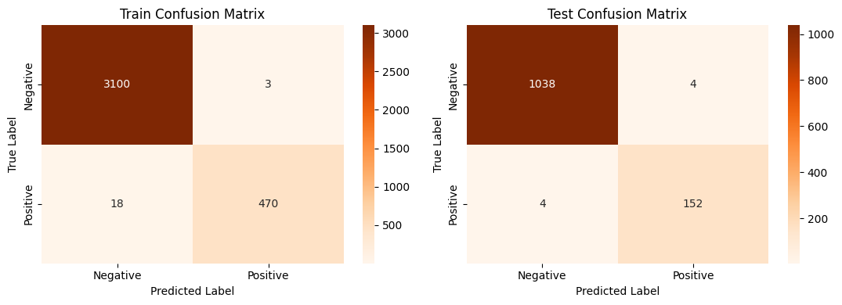
Model Evaluation

Slide 10
Model Architecture
Model Performance Summary
High classification accuracy on both training (~99.4%) and testing (~99.3%).
Ham (legitimate messages) were classified with very few errors: only 3 misclassified in training and 4 in testing.
Spam messages were also classified with high accuracy: 18 misclassified in training and only 4 in testing.
The model shows excellent generalization with nearly identical train and test results.
Minimal false positives and false negatives ensure strong reliability for real-world spam detection.

Slide 11
Conclusion
This research developed an email spam detection system using the Multinomial Naïve Bayes classifier. The model achieved over 98% accuracy with strong precision, recall, F1-score, and ROC-AUC performance. The system effectively classified spam and ham emails with low computational cost. The study also concludes that deep learning models may further improve performance in future work.

Slide 12
Thank You

