Slide 1
Text Preprocessing
Stemming and Lemmatization in NLP
Stemming and Lemmatization are Text Normalization (or sometimes called Word Normalization) techniques in the field of Natural Language Processing that are used to prepare text, words, and documents for further processing. Stemming and Lemmatization have been studied, and algorithms have been developed in Computer Science since the 1960's. We will learn about Stemming and Lemmatization in a practical approach covering the background, some famous algorithms, applications of Stemming and Lemmatization, and how to stem and lemmatize words, sentences and documents using the Python nltk package which is the Natural Language Tool Kit package provided by Python for Natural Language Processing tasks.

Slide 2
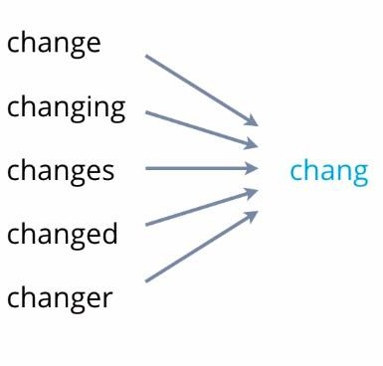
Text Preprocessing
Stemming
Stemming is a process that stems or removes last few characters from a word, often leading to incorrect meanings and spelling. Stemming is important in natural language understanding (NLU) and natural language processing (NLP). When a new word is found, it can present new research opportunities. For example -
waiting
consultant
wait
consult
wait
chang
consult
waiting
consulting
consultative
waits
consultants

Slide 3
Text Preprocessing
Stemming
Porter Stemmer(): The Porter stemming algorithm (or 'Porter stemmer') is a process for removing the commoner morphological and in flexional endings from words in English.
Lovins Stemmer
Dawson Stemmer
Krovetz Stemmer
Xerox Stemmer
N-Gram Stemmer
Snowball Stemmer
Lancaster Stemmer

Slide 4
Text Preprocessing
Lemmatization
Lemmatization usually refers to doing things properly with the use of a vocabulary and morphological analysis of words, normally aiming to remove inflectional endings only and to return the base or dictionary form of a word, which is known as the lemma .
Word Net Lemmatizer
Spacy Lemmatizer
TextBlob
Gensim Lemmatizer
TreeTagger

Slide 5
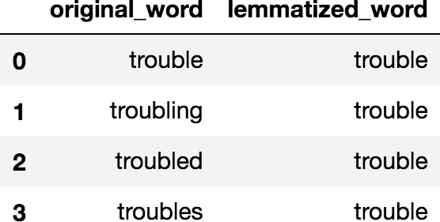

Text Preprocessing
Lemmatization
Lemmatization

Slide 6
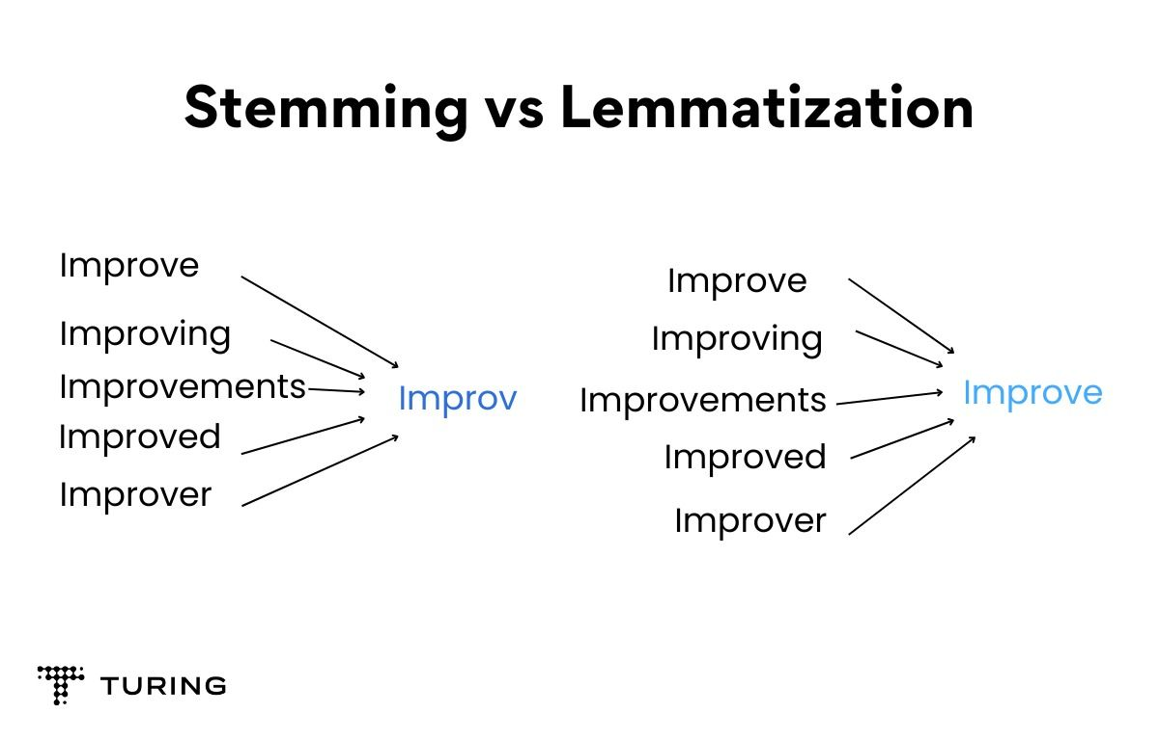
Text Preprocessing
Stemming vs Lemmatization

