Slide 1
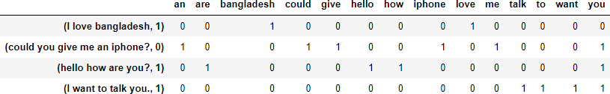
Different Techniques to Represent Words as Vectors:
Vectorizer
Word Embeddings or Word vectorization is a methodology in NLP to map words or phrases from vocabulary to a corresponding vector of real numbers which used to find word predictions, word similarities/semantics. The process of converting words into numbers are called Vectorization.

Slide 2
Different Techniques to Represent Words as Vectors:
Vectorizer
Feature transformation: transformation of data to improve the accuracy of the algorithm.
Feature selection: removing unnecessary features.
Feature extraction: transformation of raw data into features suitable for modeling.

Slide 3
Different Techniques to Represent Words as Vectors:
Vectorizer
Bag of Words: Count Vectorizer
TF-IDF Vectorizer
Word2Vec

Slide 4
Vectorizer
Different Techniques to Represent Words as Vectors:
Count Vectorizer
Count Vectorizer is a great tool provided by the scikit-learn library in Python. It is used to transform a given text into a vector on the basis of the frequency (count) of each word that occurs in the entire text.

Slide 5
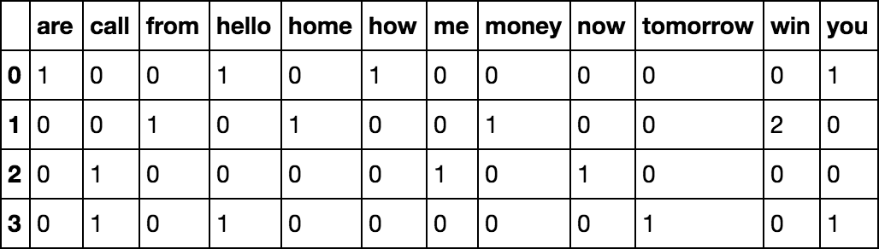
Vectorizer
Different Techniques to Represent Words as Vectors:
Sentences:
Count Vectorizer
[ 'Hello, how are you!’,
'Win money, win from home.’,
'Call me now’,
'Hello, Call you tomorrow?’ ]
Hello, How are you?
Win money, win from home
Call me now
Hello, Call you tomorrow?

Slide 6
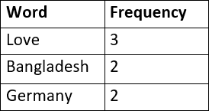
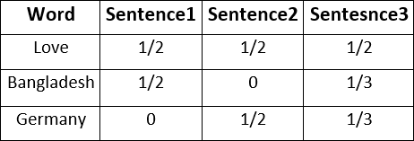
Vectorizer
Different Techniques to Represent Words as Vectors:
TF-IDF Vectorizer
Dataset:
Sentence1 = Love Bangladesh Sentence2 = Love Germany
Sentence3 = Love Bangladesh Germany
Term Frequency (TF) =
Number of repetition of word in sentence
Total word in sentence
1/3

Slide 7
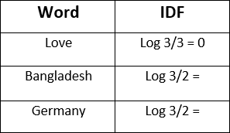
Different Techniques to Represent Words as Vectors:
Vectorizer
TF-IDF Vectorizer
Dataset:
Sentence1 = Love Bangladesh Sentence2 = Love Germany
Sentence3 = Love Bangladesh Germany
Total number of sentence
IDF = log
No sentence containing the word

Slide 8
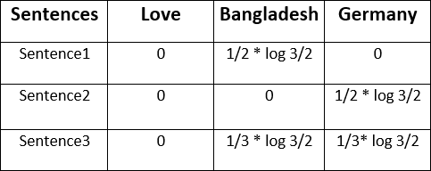
Different Techniques to Represent Words as Vectors:
Vectorizer
TF-IDF Vectorizer
TF
IDF
TF * IDF =

Slide 9
TF-idf vs Count Vectorizer
Different Techniques to Represent Words as Vectors:
Vectorizer
TF-IDF is better than Count Vectorizers because it not only focuses on the frequency of words present in the
corpus but also provides the importance of the words. The term "df" is called document frequency which means
in how many documents the word "subfield" is present within corpus.
Can TF IDF Be Negative?
No. The lowest value is 0. Both term frequency and inverse document frequency are positive numbers.
In AI inference and machine learning, sparsity refers to a matrix of numbers that includes many zeros or values that
will not significantly impact a calculation.

Slide 10
Vectorizer
Different Techniques to Represent Words as Vectors:
Word2Vec Vectorizer
Word2vec is a Neural Network that processes text by “vectorizing” words. Its input is a text corpus and its output
is a set of vectors: feature vectors that represent words in that corpus.

Slide 11
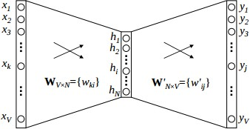
Vectorizer
Different Techniques to Represent Words as Vectors:
Word2Vec Vectorizer
Input
Hidden
Output
Fig: Word2Vec

Slide 12
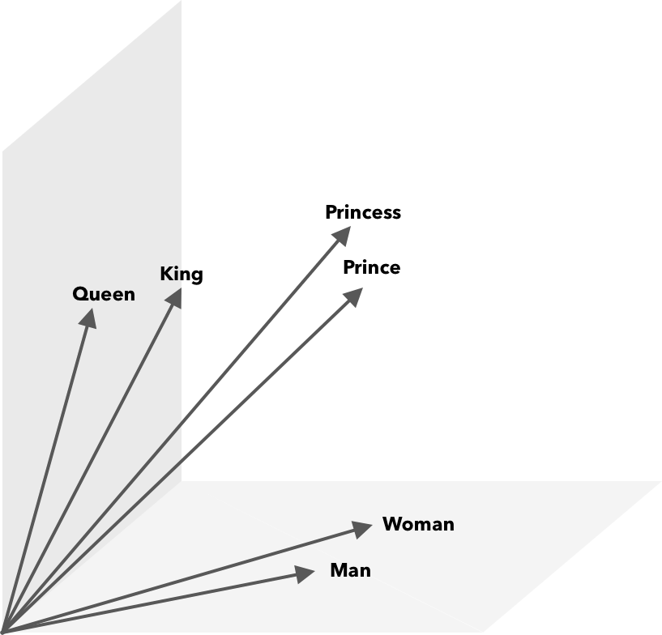
Vectorizer
Different Techniques to Represent Words as Vectors:
Word2Vec Vectorizer
King – Man + Women = Queen
Prince + mom = Queen
vec(“king”) - vec(“man”) + vec(“woman”)
=~ vec(“queen”)

