Slide 1
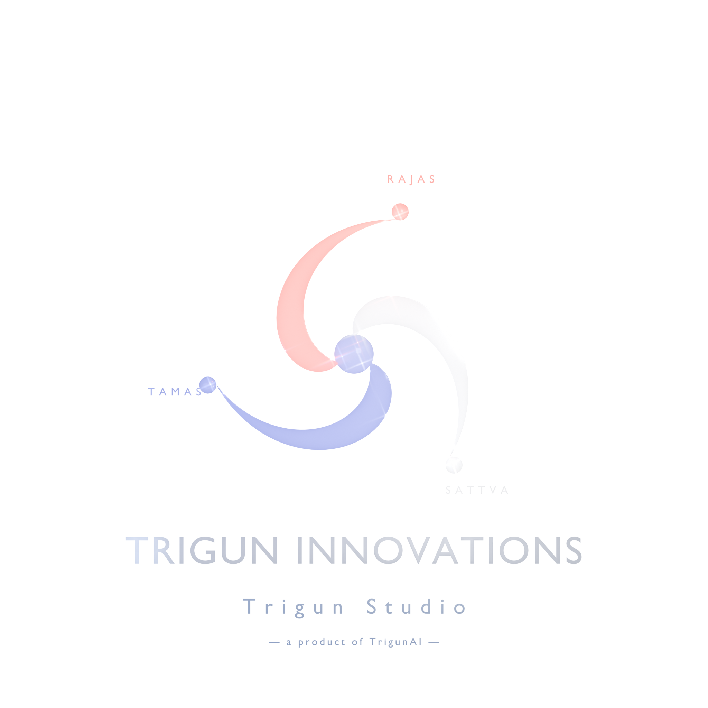
TrigunAI Innovations
Two engines, one company — AI education that ships, and physical-AI research.
NVIDIA Inception Member
Google Android XR Catalyst
Patna · Mumbai, India | CIN U86909BR2025PTC078945 | Incorporated 2025

Slide 2
TRIGUNAI
WHY NOW
Two pressures, one company built for both
India needs an AI workforce
Physical AI is the next decade
The world's #1 AI-learning market — 1.3M+ learners and rising (NASSCOM–Deloitte).
But the talent pipeline is fragmented and theory-heavy.
We teach by shipping — learners leave with a published app or a trained policy.
Robotics & embodied AI is where value compounds next.
India has minimal indigenous capability and little founder-accessible Isaac-grade infra.
We build that capability in-house on the NVIDIA stack.
Our bet: build the human-capital pipeline for India's physical-AI workforce — and own a piece of the stack while we do it.
TrigunAI Innovations
2 / 12

Slide 3
TRIGUNAI
THE MODEL
One company, two coupled engines
ENGINE A
ENGINE B
Learning Engine
Physical AI Engine
Courses that teach by shipping. Free content → paid live cohort. Run by Deepak. The revenue engine — funds everything.
Embodied-AI research → IP, course material, and (when funded) hardware products. Avinash leads; Deepak co-leads the drone.
Revenue funds research · Research makes the teaching credible · Both feed talent
TrigunAI Innovations
3 / 12

Slide 4
TRIGUNAI
ENGINE A — LEARNING
Teach by shipping
Recorded videos are free (the funnel). The paid product is a live cohort.
Live courses platform
learn.trigunai.com — magic-link auth, student + admin dashboards. In production.
Flagship course
Build & Ship a VR/MR App — 9 of 11 modules produced and public (EN + HI).
Course lineup
VR/MR (flagship) + Agentic AI + ML & Math, with Physical AI / Robotics in development.
Free funnel
"AI is the Universal Mind" — 7 animated episodes, bilingual, on YouTube.
Proof of shipping
GuruLok — a meditation VR app live on the Meta Quest store.
TrigunAI Innovations
4 / 12

Slide 5
TRIGUNAI
ENGINE B — PHYSICAL AI
Simulation-trained intelligence, deployed to the edge
TRACK 1
TRACK 2
Drone Cinematography Policy
ModusXR — AR Attention Guidance
PPO trained in NVIDIA Isaac Sim / Isaac Lab (4096 envs, A10G).
Exported to ONNX (~80 KB), runs on-device at 50 Hz; VR-validated in our Quest app.
Target hardware: Modal AI Starling 2 + GoPro Hero 12.
Three additive focus modes for optical see-through AR.
Participant in Google's Android XR Catalyst program.
Target hardware: XREAL Project Aura; prototyped on Quest 3 passthrough.
TrigunAI Innovations
5 / 12

Slide 6
TRIGUNAI
THE FLYWHEEL WE'RE BUILDING
Students learn inside the real research
Roadmap thesis — not yet operational
1
The Robotics course's labs ARE the real drone-policy pipeline.
2
Students learn RL on real NVIDIA hardware — not a toy copy.
3
Graduates become collaborators, hires, or customers.
4
We sit at the center of India's physical-AI talent flow.
Honest today: the two engines run independently; the robotics course is in development. The coupling is the plan, not a current claim.
TrigunAI Innovations
6 / 12

Slide 7
TRIGUNAI
NVIDIA TECH
NVIDIA, end to end
Isaac Sim
Isaac Lab
Omniverse
CUDA Toolkit
NVIDIA PyTorch
ONNX → edge
Member of NVIDIA Inception. Policies train on A10G GPUs; edge target is Jetson-class. Not locked in — the ONNX policy ports anywhere.
TrigunAI Innovations
7 / 12

Slide 8
TRIGUNAI
TRACTION
Where we actually are
Shipped & live
Honest stage
GuruLok VR app live on the Meta Quest store
7 bilingual episodes published (EN + HI)
Courses platform + 9 VR/MR modules live
Drone policy trained + VR-validated
ModusXR in Google Android XR Catalyst
5 hostnames in production (Azure, India)
Pre-revenue. Founding-cohort phase.
Paid wall opens with the first live cohort.
~₹4,000/mo infrastructure. Bootstrapped.
2 founders, no outside capital raised.
We show the real stage on purpose — pre-seed, built, and ready to validate willingness-to-pay.
TrigunAI Innovations
8 / 12

Slide 9
TRIGUNAI
BUSINESS MODEL
Free to understand · paid to transform
01
02
03
04
05
Free series
Community
Recorded courses
Live cohort + GPU + VR
B2B AI-literacy
Funnel + email capture
Recurring bridge
Proof + passive floor
THE PROFIT ENGINE
Later
One self-run cohort (₹35–49k × ~20) ≈ ₹7–8 L. The moat — provided GPU + VR + "we shipped it" — is uncopyable.
TrigunAI Innovations
9 / 12

Slide 10
TRIGUNAI
FOUNDERS
Two founders, two engines
Deepak Kumar
Avinash
CEO · Mumbai
CTO · Patna
Runs the Learning Engine; co-leads the drone policy.
Shipped a Quest app to Meta alpha; built the full video + RL training pipeline.
Leads the Physical AI Engine — ModusXR (Android XR Catalyst).
Deep-learning depth; maintains the shipped Quest apps.
Bootstrapped. NVIDIA Inception member. Google Android XR Catalyst participant.
TrigunAI Innovations
10 / 12

Slide 11
TRIGUNAI
THE ASK
Seed capital for hardware — operations are self-funded
Drone hardware
Modal AI Starling 2 + GoPro Hero 12 (~$2.5–3K) + a 6-month flight-test runway.
AR hardware
XREAL Aura developer kits + sustained ModusXR build bandwidth.
The software pipeline is ready. Hardware procurement is the only bottleneck to closing the sim-to-real gap. The Learning Engine funds day-to-day operations.
TrigunAI Innovations
11 / 12

Slide 12
Let's build the physical-AI workforce.
trigunai.com · learn.trigunai.com · physical-ai.trigunai.com
deepak@trigunai.com — subject: "Investor enquiry — Physical AI"
NVIDIA Inception Member · Google Android XR Catalyst

