Slide 1
Absolute S/W
Status #2
5/14/12

Slide 2
End of June Valentin deliverable not clear
Mongo POC is blank, looks like template not filled in? Deadline end of June?

Slide 3
4 data stores
Messaging
Details:
Reporting
Details: existing MSSQL reports
Online Analytics
Details: existing MSSQL reports
Offline Analytics (Hadoop maybe here, prove to company). One of the 3 reports? What is existing, what needed not there yet, what is something needed but can’t do currently?
Idea: variable importance for data mining/ML
Idea: simple dashboards/ stats.
Need leadtime to train consultants, esp. Palomino Labs

Slide 4
Valentin 4 files
DeviceSet.json, schema/tables?
3 reports for output (where in the 4 are these reports?)
AssetReport.json
DeviceSummaryReport.json
CallHistoryReport.json

Slide 5
Github/Jenkins
https://github.com/absolutesw
Password; a1bsolute
Check in current version of Hadoop/Hbase versions with mods for POC
Jenkins Server on AWS
Redhat server running builds of Hadoop/Hbase/Sqoop components with modifications for POC
Includes creating users, (add these into scripts); manually create user redhat for install

Slide 6
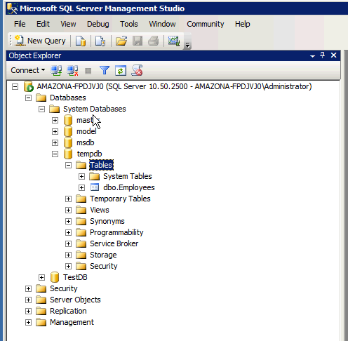
AWS MS SQL Server JDBC Connector for import

Slide 7
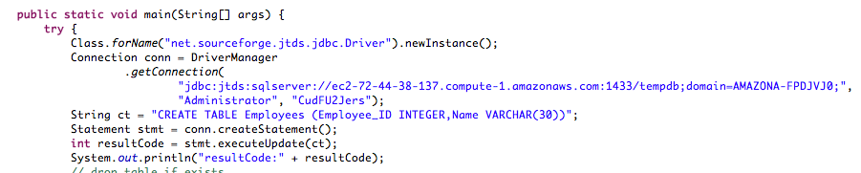
Code

Slide 8
Hadoop POC
Duplicating VT’s reports, waiting for access into MSSQL DB. Create flat table schema concatenation of all tables. No E/R logic.
Primary Key/Row Key for Region server distribution for performance not addressed.
Java Connector to MSSQL DB using AWS
Install Hadoop/Hbase on AWS Redhat 6.1
Importing tables from MSSQL DB.
Hadoop/Hbase Config from Cloudera training
Time :configure to fully distributed mode
Time:HBase performance 10x

Slide 9
Cloudera Training
Would like to accelerate Cloudera training for configuration for Hadoop POC to evaluate performance
YCSB benchmark?

Slide 10
Design Choice
Hbase vs. Hadoop(Hive/Pig) HDFS
HDFS: no indexing scheme, for running M/R jobs and analysis. File format and M/R programming idiom, not designed for random R/W with performance.
Hbase dominant choice for updates and reporting apps.

Slide 11
HBase
Hbase doesn’t use M/R Daemons
Uses tables/region servers
Hbase Data structures:
Keep write ahead logged data in memory before commit
Split/merge on Region Servers
Cloudera training covers Hbase configuration, performance in some cases 10x over default configuration; standard 3k/person
Hbase performance dependent on table and cf design. Need queries before design starts

Slide 12
HBase
Empty columns are not stored, will return no entry vs. null.
Avoid monotonically increasing keys in insertion, causes hotspots in a single regionserver. Assume random PK distribution on inserts. Not impt for data warehouse
CF names are 1 char. May be confusing to end users. They should never see this. A char is a long(8 bytes) in BT

Slide 13
HiveQL/HBase
HBase doesn’t have a query language
Hive is the easiest for existing RDMS ppl. Hive has engineering issues.

Slide 14
Questions
Can only access Hbase tables using PK, where there is an index
PK = ESN? What is ESN?
Issues not covered,
Failover: how to deploy patches in real time/production
Backups/recovery from past versions

