Slide 1
ALYA Parallel I/O Tutorial
Damien Dosimont
Barcelona, 29/11/2017

Slide 2
Overview

Slide 3
Parallelizing Alya’s I/O
Current situation:
  Alya’s I/O are currently performed sequentially
  Postprocess (alya2pos) is sequential as well
We propose to parallelize both using MPI-IO:
  Improve Alya I/O performance
    Reduce mesh reading time
    Reduce post/restart files reading and writing time
    Reduce memory footprint on master process
    Reduce communications to/from master and maintain a whole parallel workflow
  Improve postprocess performance
    Reduce reading and writing time
    VTK files management (mesh + fields : nodes/elements)

Slide 4
Parallelizing Alya’s I/O
Alya with sequential IO (simplified)
Iterations
Master
Mesh
Partition
Post/
Restart
Post/
Restart
Process 1
Subdom
Computation
Process 2
Subdom
Computation

Slide 5
Parallelizing Alya’s I/O
**New**: Alya with parallel IO (simplified)
Iterations
Master
Partition
Process 1
Mesh
Subdom
Post/Restart
Computation
Post/Restart
Process 2
Mesh
Subdom
Post/Restart
Computation
Post/Restart

Slide 6
Material
alya: MPI-IO feature, already implemented
alya-mpio-tools: tool set to manipulate mesh/post/rst files
  alya2mpio: convert ASCII mesh files to MPI-IO compliant binary files
  mpio2vtk: convert MPI-IO mesh/post/rst to vtk (parallel) files
  mpio2txt: dump MPI-IO post process files to txt
  libalya-mpio-reader: API to write your own converter (sequential or MPI)

Slide 7
CURRENT RESULTS

Slide 8
Example: Case CRM (Oriol), 2000 MPI processes on MN4
POINTS = 46 922 218
ELEMENTS = 158 528 254
BOUNDARIES = 7 025 777
ASCII Mesh = 13 GB
MPI-IO format Mesh = 8 GB (integers 8)

Slide 9
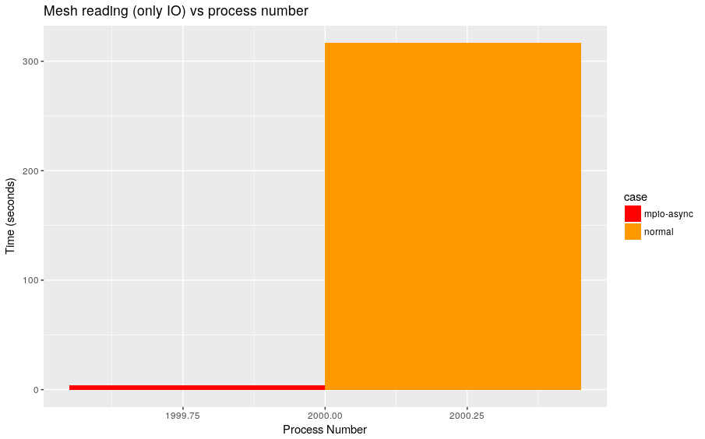
Mesh reading
3 s
314 s
Speed-up: 104.6

Slide 10
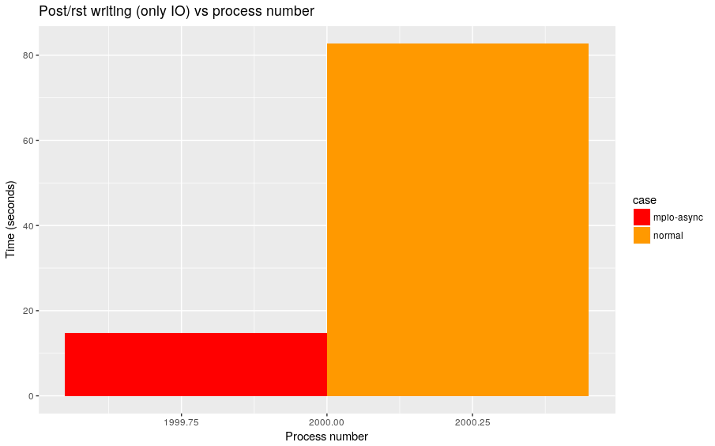
Postprocess files writing
17 s
82 s
Speed-up: 4.8

Slide 11
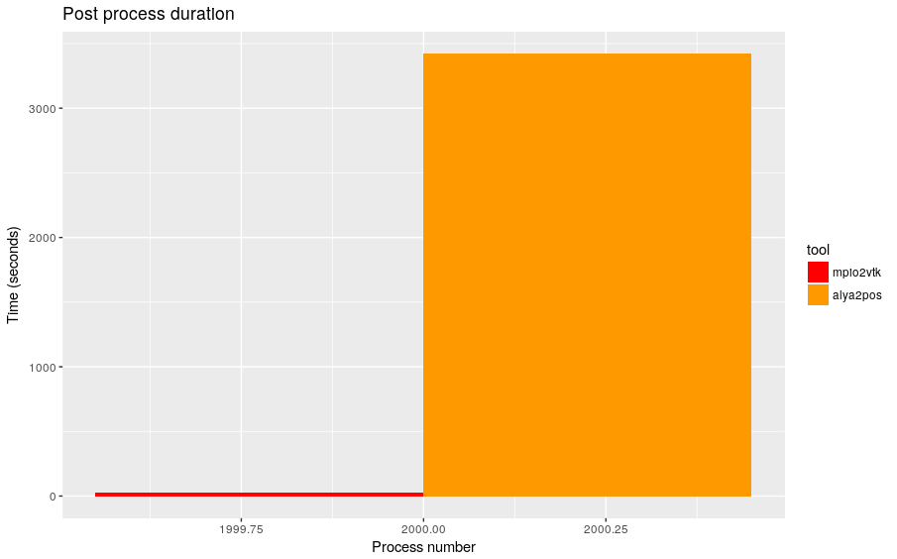
Postprocess files conversion (only one iteration)
30 s
3420 s
Speed-up: 114

Slide 12
TUTORIAL (on MARENOSTRUM IV)

Slide 13

Download, configure and compile Alya
Connect in ssh to MareNostrum 4
$ ssh mn1.bsc.es
Create working directories
$ mkdir tutorial-mpio
$ cd tutorial-mpio
Get, configure and compile Alya
$ svn co file:///gpfs/projects/bsc21/svnroot/Alya/Trunk alya
$ cd alya/Executables/unix
$ cp configure.in/config_ifort.in config.in
$ ./configure –x nastin parall
$ salloc –p interactive
$ make metis4
$ make –j4
$ cd ~

Slide 14
Download the example
Download the example
$ cp –r /gpfs/projects/bsc21/damien/share/tutorial/mpio/example ~/scratch/
Go to the example directory
$ cd ~/scratch/example/elbow/elbow
Compare with step-0
$ diff ../elbow ../step-0

Slide 15
I/O Operations
Two separate and independent operations are available in Alya:
  Parallel mesh reading
  Post-process and restart files reading/writing
Mesh reading requires to convert your mesh into binary files that are compliant with MPI-IO
Post-process/restart I/O does not require anything beside configuring the .dat file

Slide 16
WRITE POSTPROCESS/RESTART FILES

Slide 17
Configure the .dat file to enable MPI-IO
Open elbow.dat with your favorite text editor (vim, emacs, etc.)
$ vim elbow.dat
Add the following lines within the parallel service section (which starts line 19)
PARALL_SERVICE: On
IO: On
POSTPROCESS: On
RESTART: On
END_IO
PARTITION: FACES
PARTITIONING:
METHOD: METIS 4
END_PARTITIONING
END_PARALL_SERVICE
Compare with step-1
$ diff ../elbow ../step-1

Slide 18
Configure your job
Get the job files
$ cp ../jobs/* .
Compare with step-2
$ diff ../elbow ../step-2

Slide 19
Analyzing the job file content
$ cat run.sh
Part defining job’s name, outputs, tasks, time etc.
#!/bin/bash
#SBATCH --job-name=elbow-mpio-tutorial
#SBATCH --output=output.out
#SBATCH --error=output.err
#SBATCH --ntasks=4
#SBATCH --time=00:10:00
Define in which file ROMIO hints are located
export ROMIO_HINTS=./io_hints
Environment variables helping in optimizing MPI-IO performance (this configuration only suits with MN4 and should be adapted on other machines)
export I_MPI_EXTRA_FILESYSTEM_LIST=gpfs
export I_MPI_EXTRA_FILESYSTEM=on
This line runs alya
srun ~/tutorial-mpio/alya/Executables/unix/Alya.x elbow

Slide 20
Analyzing io_hints file content
$ cat io_hints
Enable the collective buffering (read and write) to improve I/O collective operations performance
romio_cb_read enable
romio_cb_write enable
Other hints can be added but all have not been tested yet…
They may increase but decrease as well the performance.
Look at ftp://ftp.mcs.anl.gov/pub/romio/users-guide.ps for more info

Slide 21
Launch the job
$ sbatch run.sh

Slide 22
Analyzing the job result
$ ls –l *mpio.bin
You can see two types of files:
post.mpio.bin are the post process files (processed mesh and fields)
rst.mpio.bin are the restart files (identical to the last iteration post files)

Slide 23
CONVERT POST-PROCESS TO VTK

Slide 24
Convert your files to vtk
$ cat post.sh
Part defining job’s name, outputs, tasks, time etc.
#!/bin/bash
#SBATCH --job-name=elbow-mpio-post
#SBATCH --output=output.out
#SBATCH --error=output.err
#SBATCH --ntasks=4
#SBATCH --time=00:10:00
export ROMIO_HINTS=./io_hints
export I_MPI_EXTRA_FILESYSTEM_LIST=gpfs
export I_MPI_EXTRA_FILESYSTEM=on
Load the alya-mpio-tools module
module load alya-mpio-tools
Run the tool (in parallel)
srun mpio2vtk elbow

Slide 25
Launch the job
$ sbatch post.sh

Slide 26
Analyzing the job result
$ ls –lR vtk
You can see three type of files:
elbow.pvd is the master file
elbow_[n].pvtu is the master file for the step [n]
elbow_[n]_[p].vtu is the vtk file for the step [n] and the part [p]
00000000.pvtu
00000000_[1].pvtu
00000000_[2].pvtu
00000000_[p].pvtu
.pvd
00000005.pvtu
00000005_[1].pvtu
00000005_[2].pvtu
00000005_[p].pvtu
[n].pvtu
[n]_[1].pvtu
[n]_[2].pvtu
[n]_[p].pvtu

Slide 27
Export only some iterations
The option –i enables to export only some iterations
srun mpio2vtk –i 0 –i 10 elbow
will only export the steps 0 and 10.

Slide 28
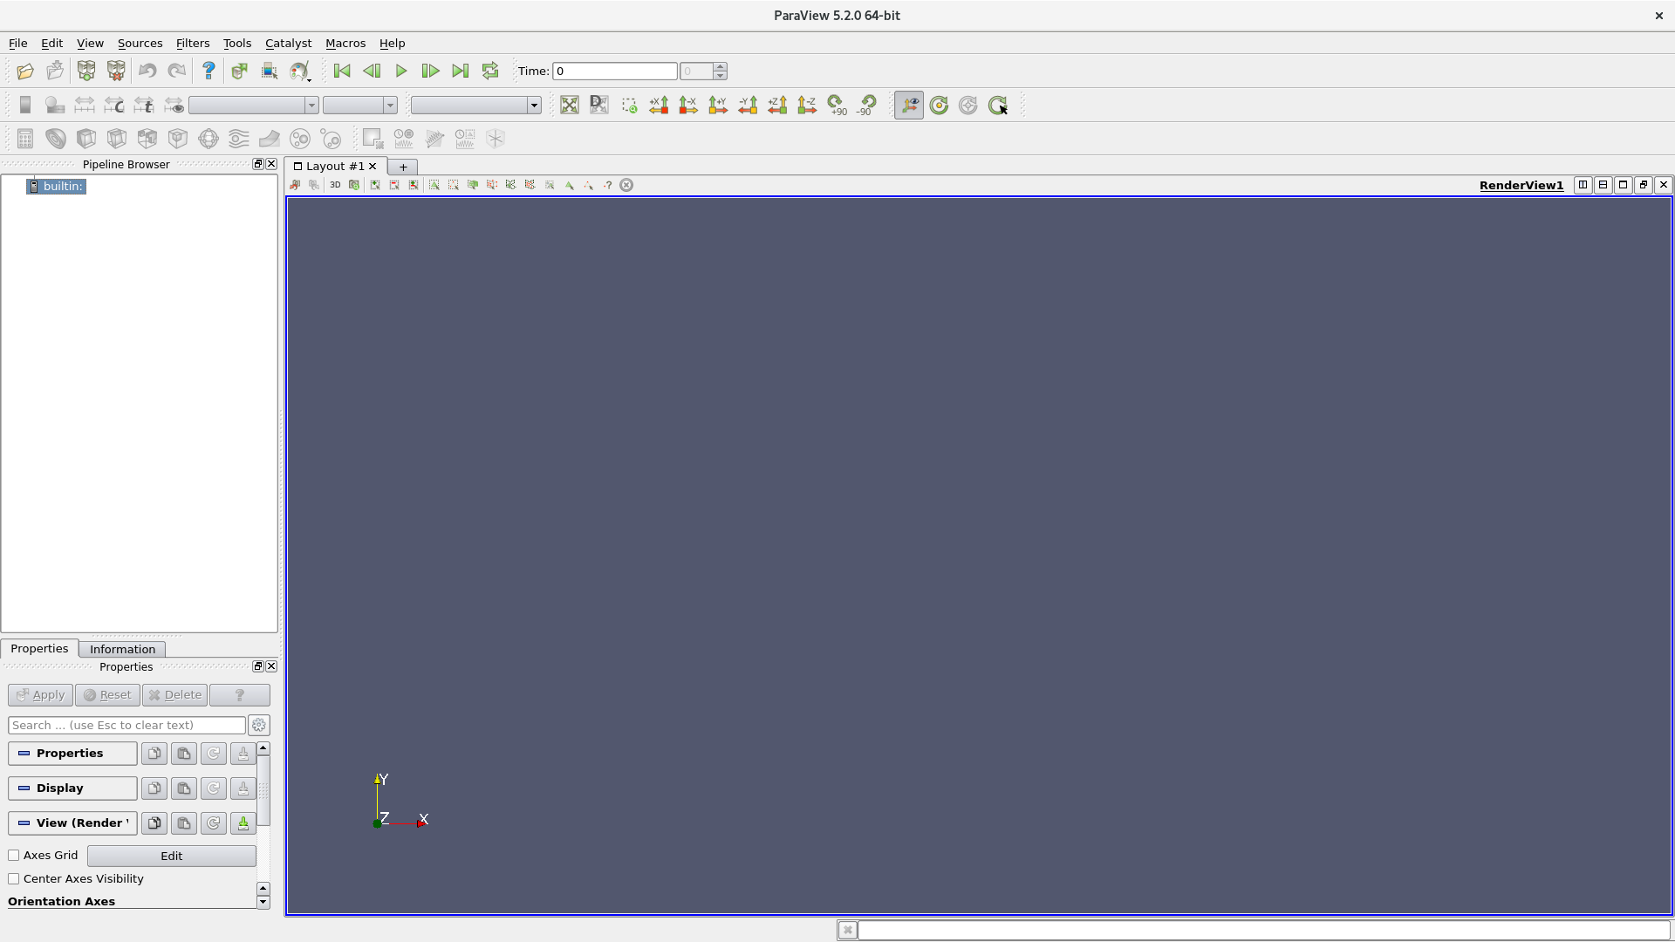
Open your results in Paraview

Slide 29
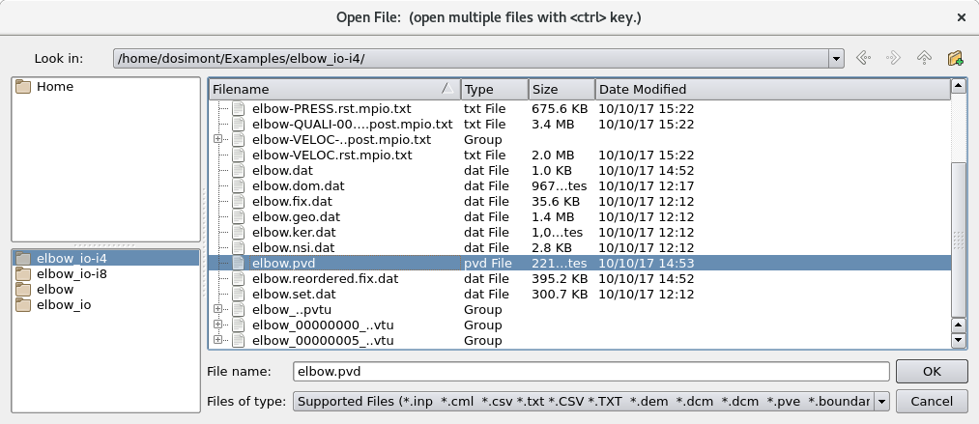
Open your results in Paraview

Slide 30
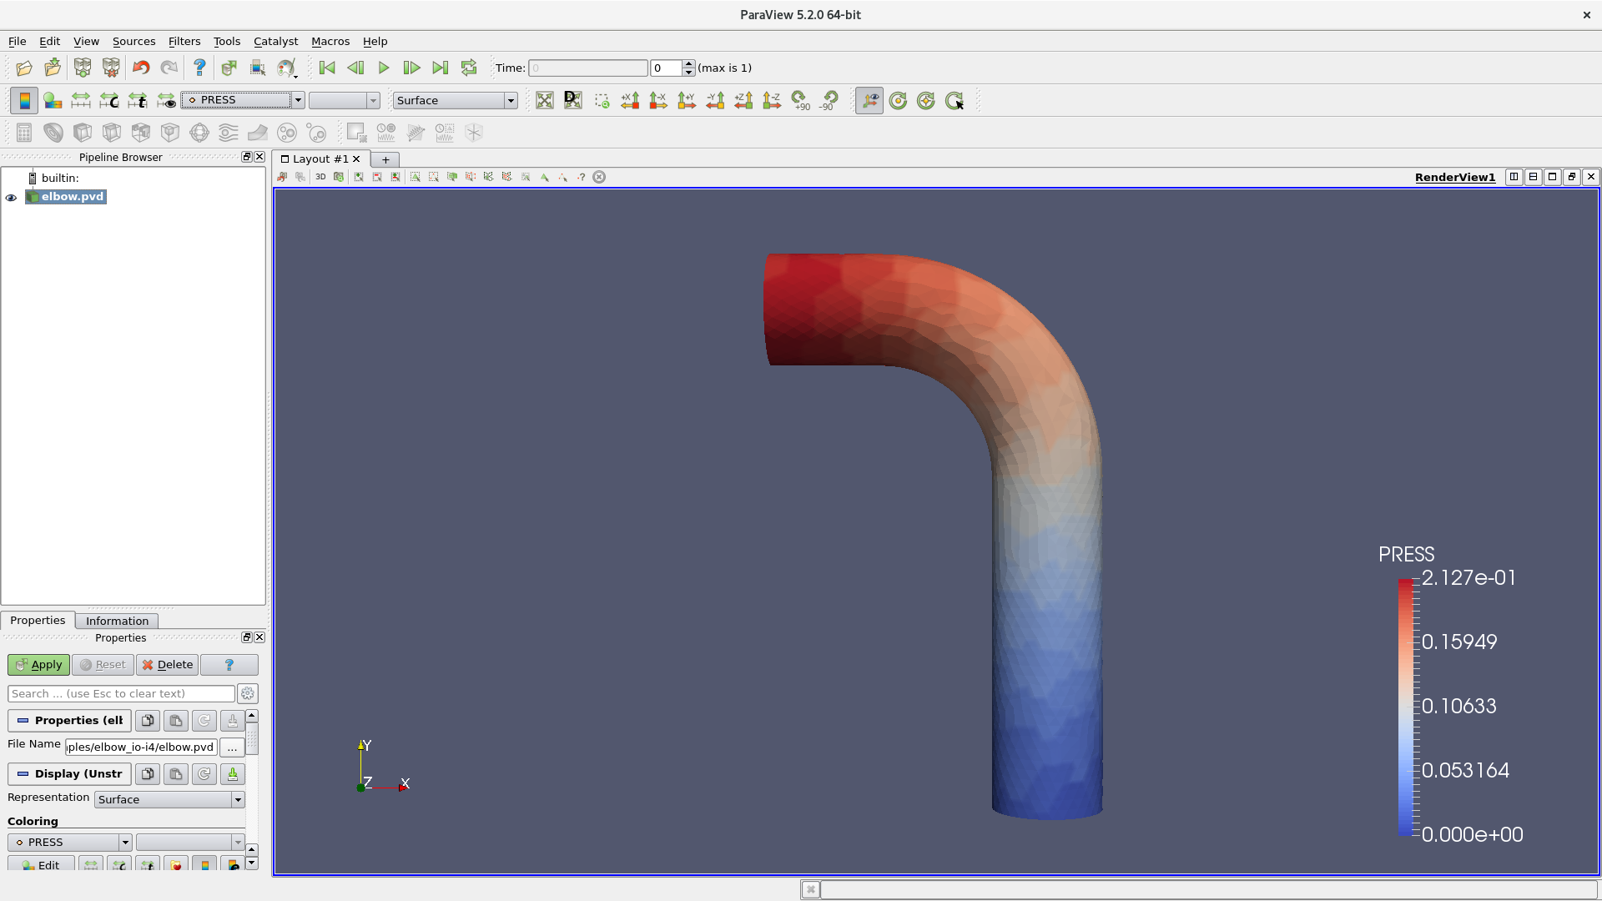
Open your results in Paraview

Slide 31
MESH READING

Slide 32
Convert the example mesh file
Original mesh elbow.geo.dat file is in ASCII
MPI-IO is bad at dealing with ASCII
  It cannot read ASCII characters directly and determine ends of lines
  File cannot be partitioned properly to be read by several processes
We have designed a binary format compliant with MPI-IO
  Let’s convert the ASCII geometry file using alya2mpio
alya2mpio
+
elbow.geo.dat
ASCII mesh file
*.mpio.bin
COORD, LNODS, LTYPE, LNODB, LTYPB,…
elbow.mpio.geo
Fields that have not been converted

Slide 33
Convert the example mesh file
Let’s clean the directory
$ ~/tutorial-mpio/alya/Utils/user/alya-clean
$ rm –fr vtk
Load the alya-mpio-tools module
$ module load alya-mpio-tools
Convert the mesh files
$ alya2mpio elbow
Compare with step-3
$ diff ../elbow ../step-3

Slide 34
Analyzing the conversion result
$ ls –l *.mpio.*
You can see two types of files:
.mpio.bin are the binary mesh files
elbow.mpio.geo is an ASCII file that contains the unconverted fields

Slide 35
Update the dom.dat file
The mesh reading MPI-IO feature works as it follows:
  First, it reads the mpio.bin mesh files in parallel
  Second, it reads the file pointed by the include in the .dom.dat domain file in sequential
In order to prevent Alya from reading the mesh twice (once in parallel, once in sequential), you have to replace the included elbow.geo.dat file by elbow.mpio.geo. This one is generated by the converter, and only contains fields that have not been exported in the binary files.
GEOMETRY
GROUPS=100
INCLUDE elbow.geo.dat
END_GEOMETRY

Slide 36
Update the dom.dat file
Open elbow.dom.dat with your favorite text editor (vim, emacs, etc.)
$ vim elbow.dom.dat
Replace the following part (line 19-22)
GEOMETRY
GROUPS=100
INCLUDE elbow.geo.dat
END_GEOMETRY
By this
GEOMETRY
GROUPS=100
INCLUDE elbow.mpio.geo
END_GEOMETRY
Compare with step-4
$ diff ../elbow ../step-4

Slide 37
Configure the .dat file to enable MPI-IO
Open elbow.dat with your favorite text editor (vim, emacs, etc.)
$ vim elbow.dat
Add the following lines within the parallel service section (which starts line 19)
PARALL_SERVICE: On
IO: On
GEOMETRY: On
POSTPROCESS: On
RESTART: On
END_IO
PARTITION: FACES
PARTITIONING:
METHOD: METIS 4
END_PARTITIONING
END_PARALL_SERVICE
Compare with step-5
$ diff ../elbow ../step-5

Slide 38
Launch the job
$ sbatch run.sh

Slide 39
Thank you!
For further information please contact
damien.dosimont@bsc.es

