Slide 1
AltaML Interview Project
Manual
By Steve

Slide 2
1. Application explanation
This application analyzes the path of the virtual turtle travelled using the given file and shows the results below.
  Turtle’s starting and ending positions.
  Turtle’s full route information and map.
  Information about duplicate positions.
  The user can get more information by reading the information in the next slides.
2. Development Environment
This application was developed using JavaScript, HTML and CSS.

Slide 3
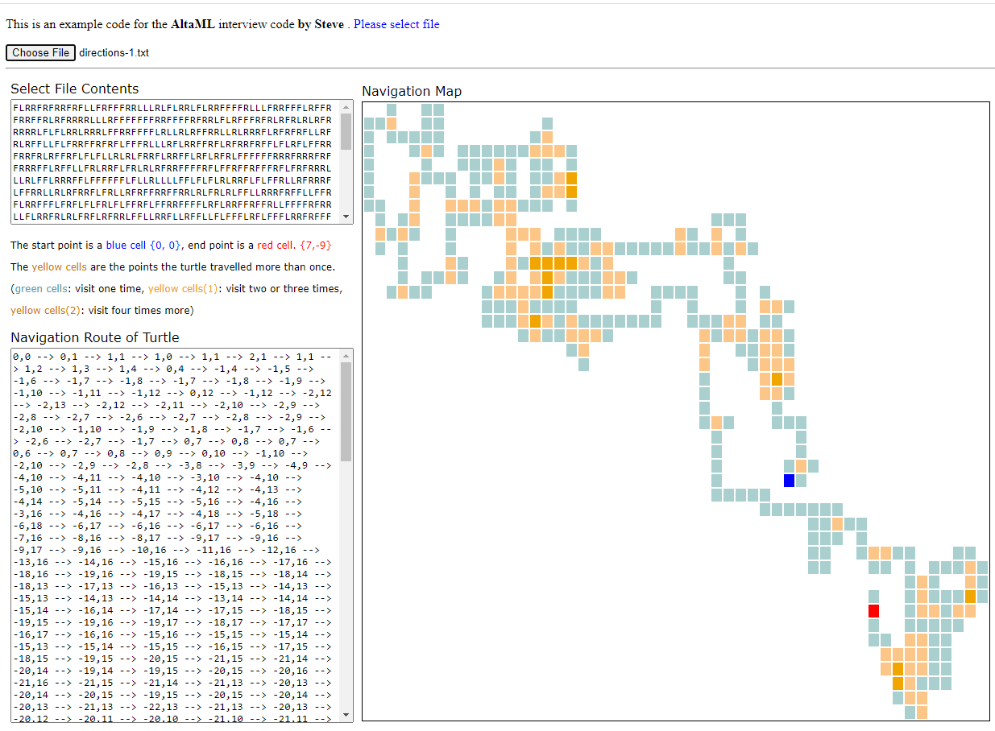
3. User Manual
5
1
2
3
4

Slide 4
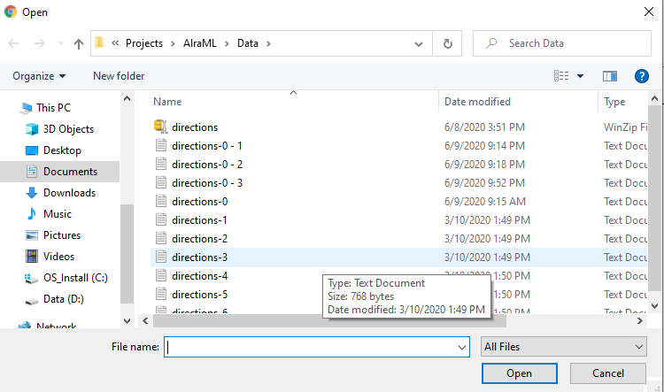

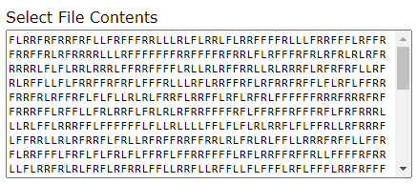
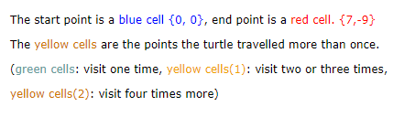
1
: Choose File button
User can use this button for select the test file
2
: Select File Contents
This text box shows the contents of the user’s selected file
3
: Result
This area shows the result summary after the file is analyzed

Slide 5
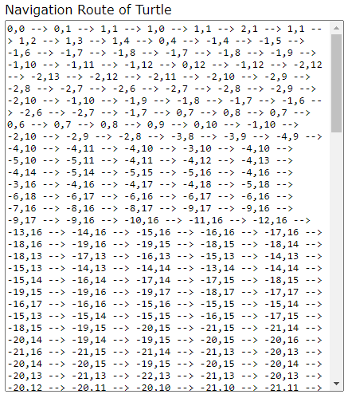
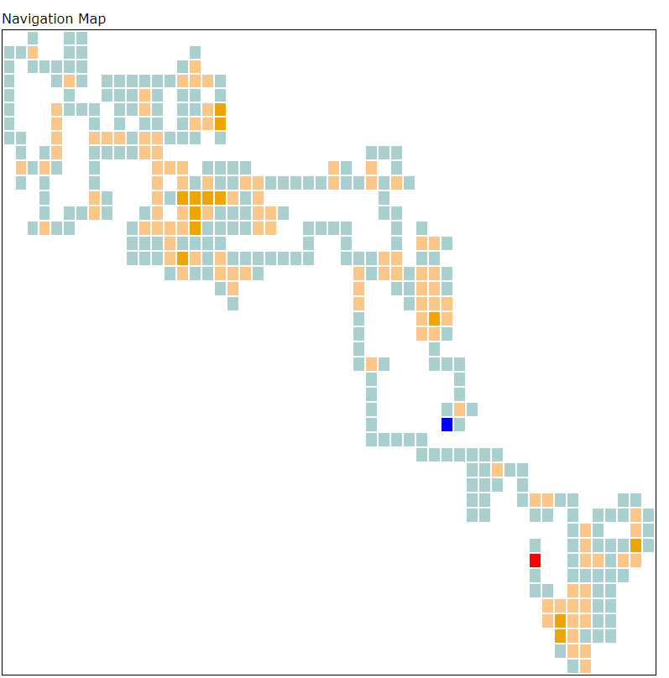
4
: Navigation Route of Turtle
This text box shows the path information of the turtle.
5
: Navigation Map
This map box shows the visualization of the path of the turtle has traveled

Slide 6
Thank You !

