Slide 1
JavaScript Menu Project
Manual
By Steve

Slide 2
1. Application explanation
3 Level navigation menu system for Web application
2. Development Environment
This application was developing use by Zerb-foundation, JavaScript, HTML and CSS.

Slide 3
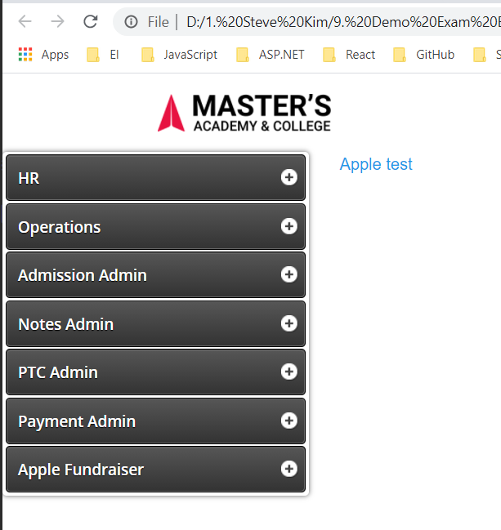
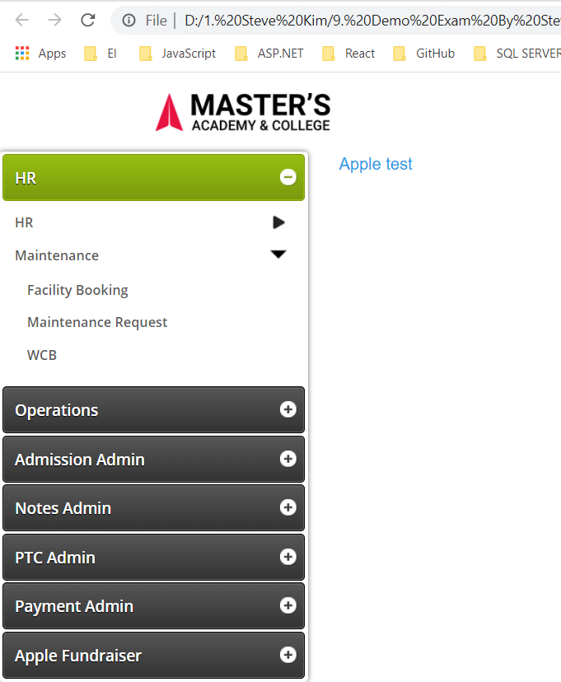
3. Sample Screen

Slide 4
Thank You !

