Slide 1
Classification Metrics and Loss Functions
Old Dominion Vision Lab Seminar
Alex Glandon
2025

Slide 2
Overview
Statistical Point Estimation​ [1]
Statistical Hypothesis Testing​ [3]
Classification Models​
Relationship to Point Estimation​
Relationship to Hypothesis Testing​
Classification Metrics for Example Applications​
Classification Metrics vs Loss Functions​
Imbalanced Data [4]

Slide 3
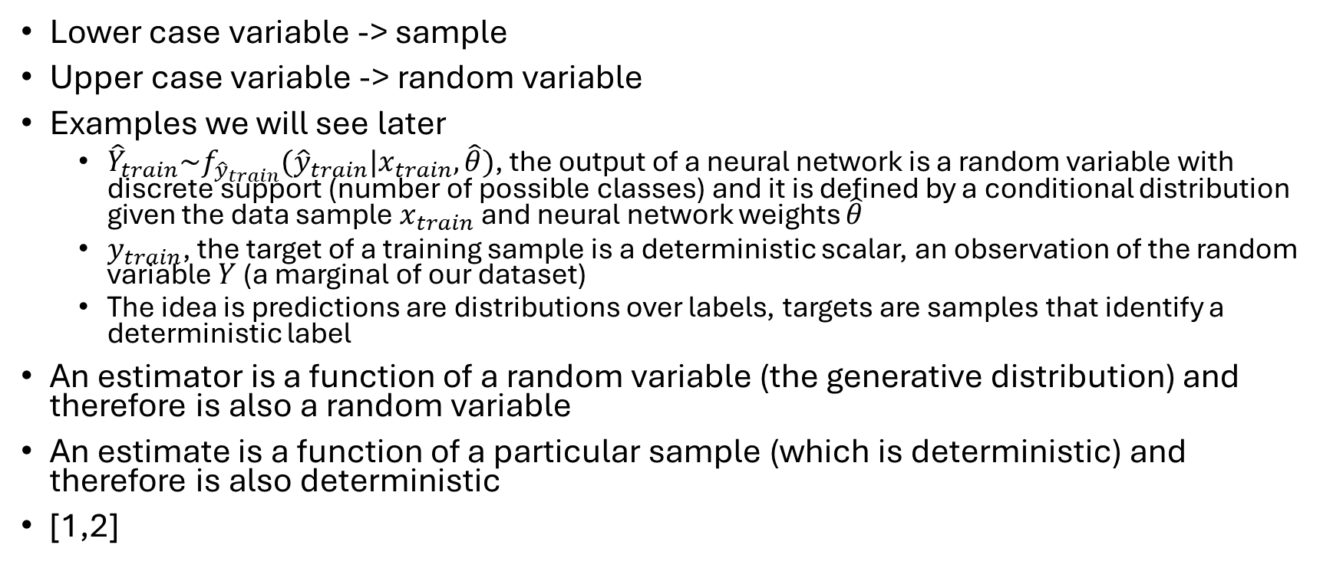
Notation
Lower case variable -> sample
Upper case variable -> random variable
Examples we will see later
${\hat{Y}}_{train}\sim f_{{\hat{y}}_{train}}({\hat{y}}_{train}{|x}_{train},\hat{θ})$, the output of a neural network is a random variable with discrete support (number of possible classes) and it is defined by a conditional distribution given the data sample $x_{train}$ and neural network weights $\hat{θ}$
$y_{train}$, the target of a training sample is a deterministic scalar, an observation of the random variable $Y$ (a marginal of our dataset)
The idea is predictions are distributions over labels, targets are samples that identify a deterministic label
An estimator is a function of a random variable (the generative distribution) and therefore is also a random variable
An estimate is a function of a particular sample (which is deterministic) and therefore is also deterministic
[1,2]

Slide 4
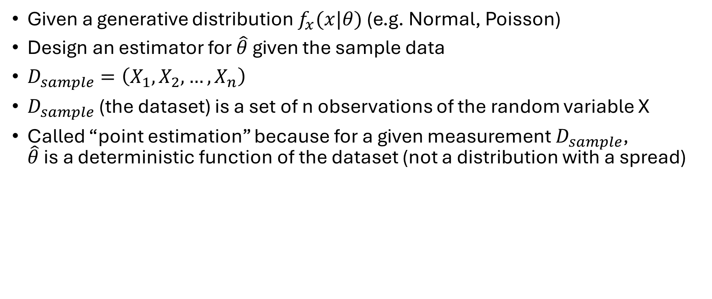
Statistical Point Estimation
Given a generative distribution $f_{x}(x|θ)$ (e.g. Normal, Poisson)
Design an estimator for $\hat{θ}$ given the sample data
$D_{sample}=\left(X_{1},X_{2},…,X_{n}\right)$
$D_{sample}$ (the dataset) is a set of n observations of the random variable X
Called “point estimation” because for a given measurement $D_{sample}$, $\hat{θ}$ is a deterministic function of the dataset (not a distribution with a spread)

Slide 5
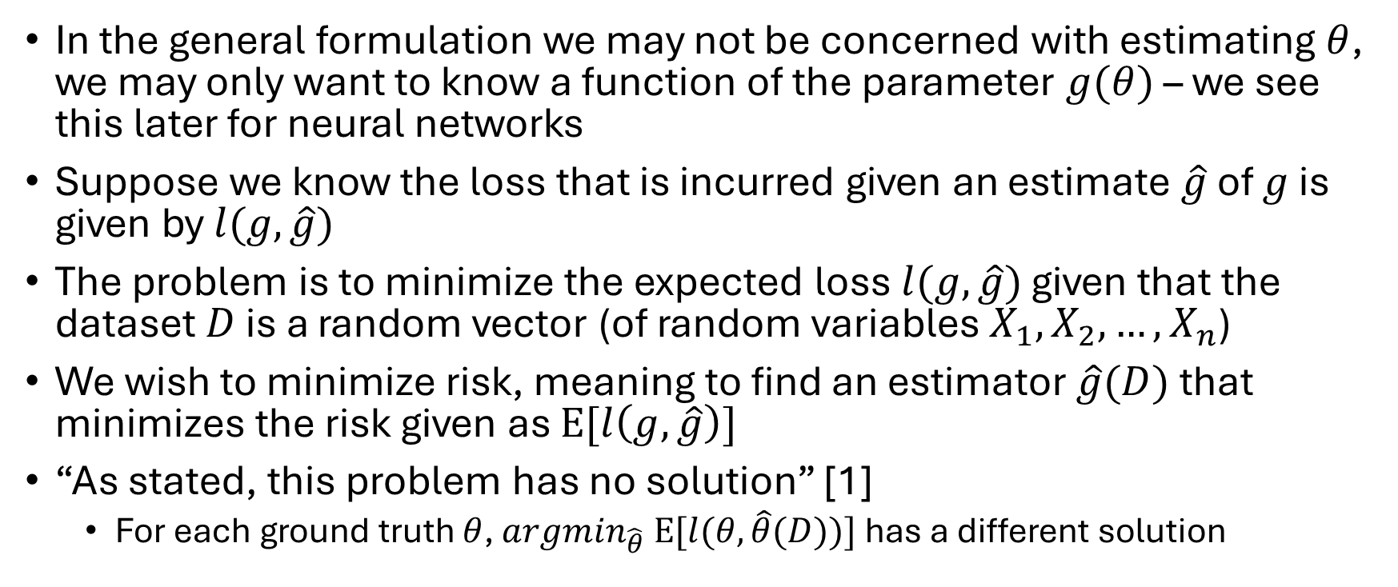
Statistical Point Estimation
In the general formulation we may not be concerned with estimating $θ$, we may only want to know a function of the parameter $g(θ)$ – we see this later for neural networks
Suppose we know the loss that is incurred given an estimate $\hat{g}$ of $g$ is given by $l(g,\hat{g})$
The problem is to minimize the expected loss $l(g,\hat{g})$ given that the dataset $D$ is a random vector (of random variables $X_{1},X_{2},…,X_{n}$)
We wish to minimize risk, meaning to find an estimator $\hat{g}(D)$ that minimizes the risk given as $E[l\left(g,\hat{g}\right)]$
“As stated, this problem has no solution” [1]
For each ground truth $θ$, ${argmin}_{\hat{θ}} E[l(θ,\hat{θ}(D))]$ has a different solution

Slide 6
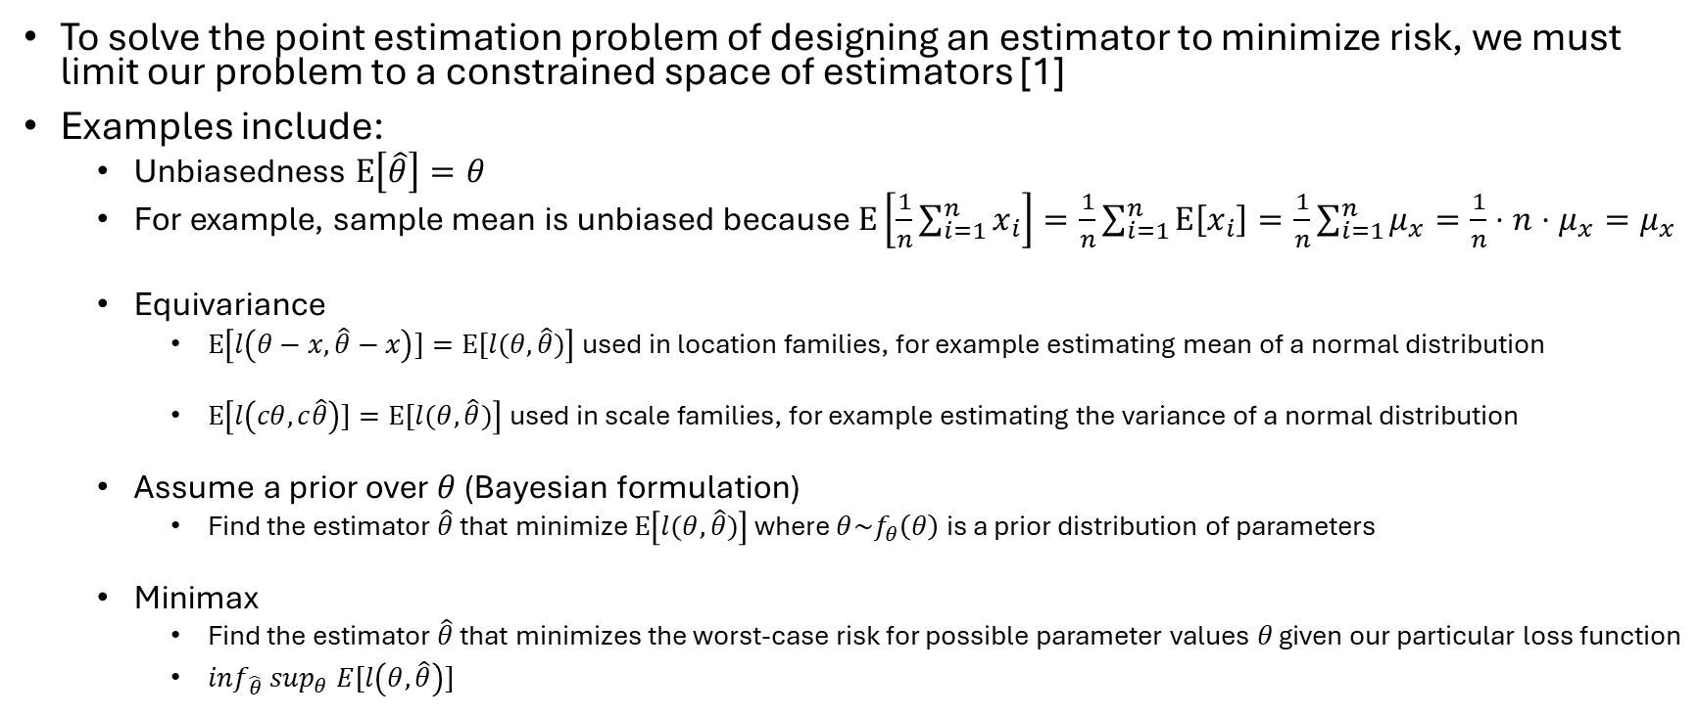
Constraining the Point Estimation Problem
To solve the point estimation problem of designing an estimator to minimize risk, we must limit our problem to a constrained space of estimators [1]
Examples include:
Unbiasedness $E\left[\hat{θ}\right]=θ$
For example, sample mean is unbiased because $E\left[\frac{1}{n}\sum_{i=1}^{n}{x_{i}}\right]=\frac{1}{n}\sum_{i=1}^{n}{E\left[x_{i}\right]=\frac{1}{n}}\sum_{i=1}^{n}{μ_{x}}=\frac{1}{n}⋅n⋅μ_{x}=μ_{x}$
Equivariance
$E\left[l\left(θ−x,\hat{θ}−x\right)]=E[l(θ, \hat{θ})\right]$ used in location families, for example estimating mean of a normal distribution
$E\left[l\left(cθ,c\hat{θ}\right)]=E[l(θ,\hat{θ})\right]$ used in scale families, for example estimating the variance of a normal distribution
Assume a prior over $θ$ (Bayesian formulation)
Find the estimator $\hat{θ}$ that minimize $E\left[l(θ,\hat{θ})\right]$ where $θ\sim f_{θ}\left(θ\right)$ is a prior distribution of parameters
Minimax
Find the estimator $\hat{θ}$ that minimizes the worst-case risk for possible parameter values $θ$ given our particular loss function
${\inf_{\hat{θ}} sup}_{θ} E[l\left(θ,\hat{θ}\right)]$

Slide 7
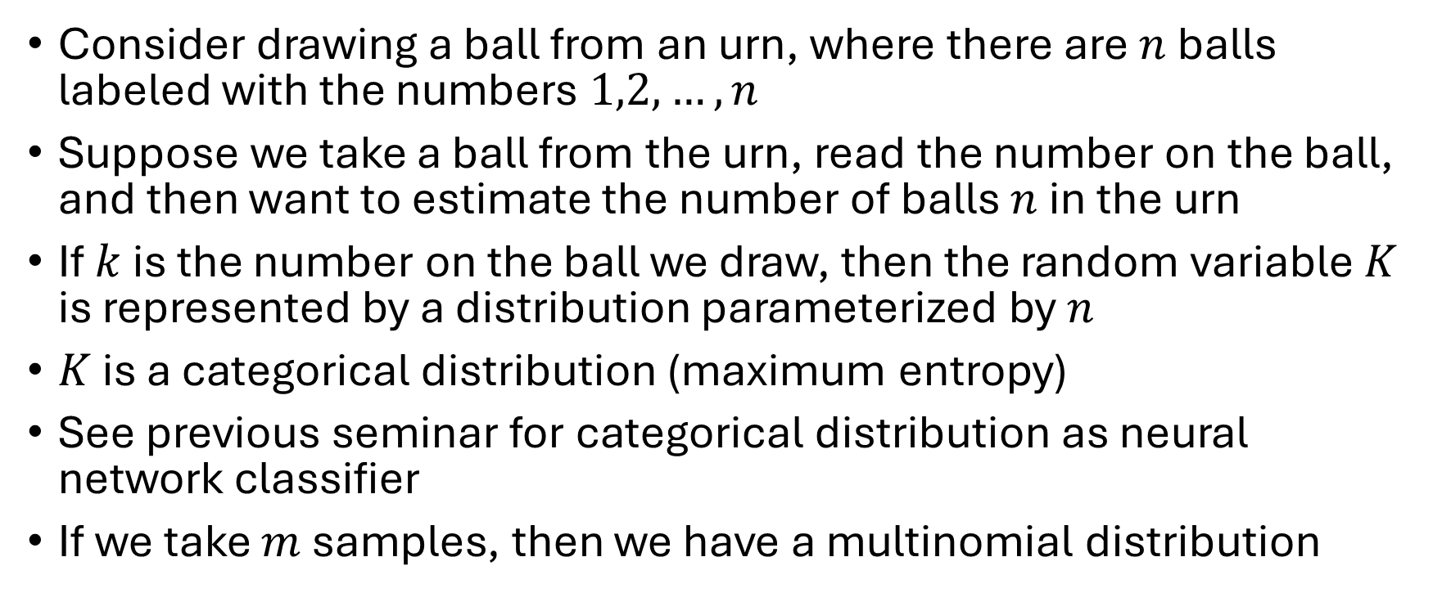
Example of Constrained Point Estimation
Consider drawing a ball from an urn, where there are $n$ balls labeled with the numbers $1,2,…,n$
Suppose we take a ball from the urn, read the number on the ball, and then want to estimate the number of balls $n$ in the urn
If $k$ is the number on the ball we draw, then the random variable $K$ is represented by a distribution parameterized by $n$
$K$ is a categorical distribution (maximum entropy)
See previous seminar for categorical distribution as neural network classifier
If we take $m$ samples, then we have a multinomial distribution

Slide 8
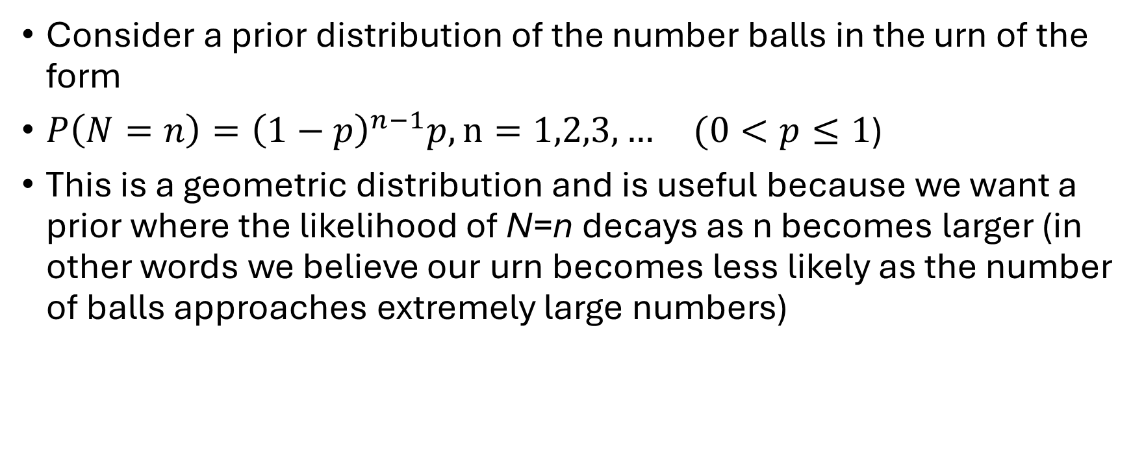
Bayesian solution for urn size
Consider a prior distribution of the number balls in the urn of the form
$P\left(N=n\right)={\left(1−p\right)}^{n−1}p, n=1,2,3,… (0<p≤1$)
This is a geometric distribution and is useful because we want a prior where the likelihood of N=n decays as n becomes larger (in other words we believe our urn becomes less likely as the number of balls approaches extremely large numbers)

Slide 9
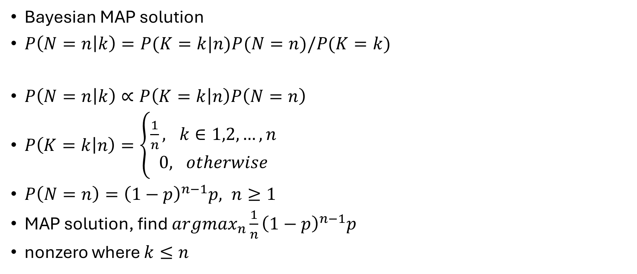
Bayesian solution for urn size (see related MAP notes from previous lab seminar)
Bayesian MAP solution
$P\left(N=n | k\right)=P(K=k|n)P(N=n)/P(K=k)$
$P\left(N=n | k\right)∝P\left(K=k | n\right)P\left(N=n\right)$
$P\left(K=k | n\right)=\left\{\begin{aligned}\frac{1}{n}, k∈1,2,…,n \\ 0, otherwise\end{aligned}\right.$
$P\left(N=n\right)={\left(1−p\right)}^{n−1}p, n≥1$
MAP solution, find ${argmax}_{n}\frac{1}{n}{\left(1−p\right)}^{n−1}p$
nonzero where $k≤n$

Slide 10
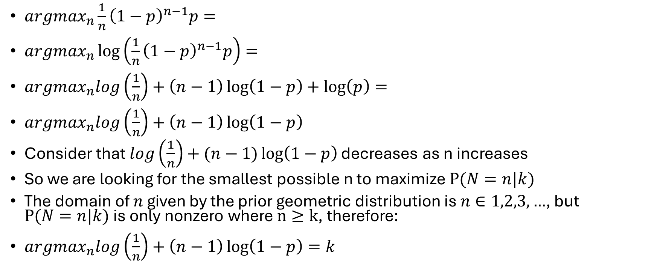
Bayesian solution for urn size (see related notes from my previous lab seminar)
${argmax}_{n}\frac{1}{n}{\left(1−p\right)}^{n−1}p=$
${argmax}_{n}\log\left(\frac{1}{n}{\left(1−p\right)}^{n−1}p\right)=$
${argmax}_{n}log\left(\frac{1}{n}\right)+\left(n−1\right)\log\left(1−p\right)+\log\left(p\right)=$
${argmax}_{n}log\left(\frac{1}{n}\right)+\left(n−1\right)\log\left(1−p\right)$
Consider that $log\left(\frac{1}{n}\right)+(n−1)\log\left(1−p\right)$ decreases as n increases
So we are looking for the smallest possible n to maximize $P(N=n|k)$
The domain of $n$ given by the prior geometric distribution is $n∈1,2,3,…$, but $P(N=n|k)$ is only nonzero where $n≥k$, therefore:
${argmax}_{n}log\left(\frac{1}{n}\right)+\left(n−1\right)\log\left(1−p\right)=k$

Slide 11
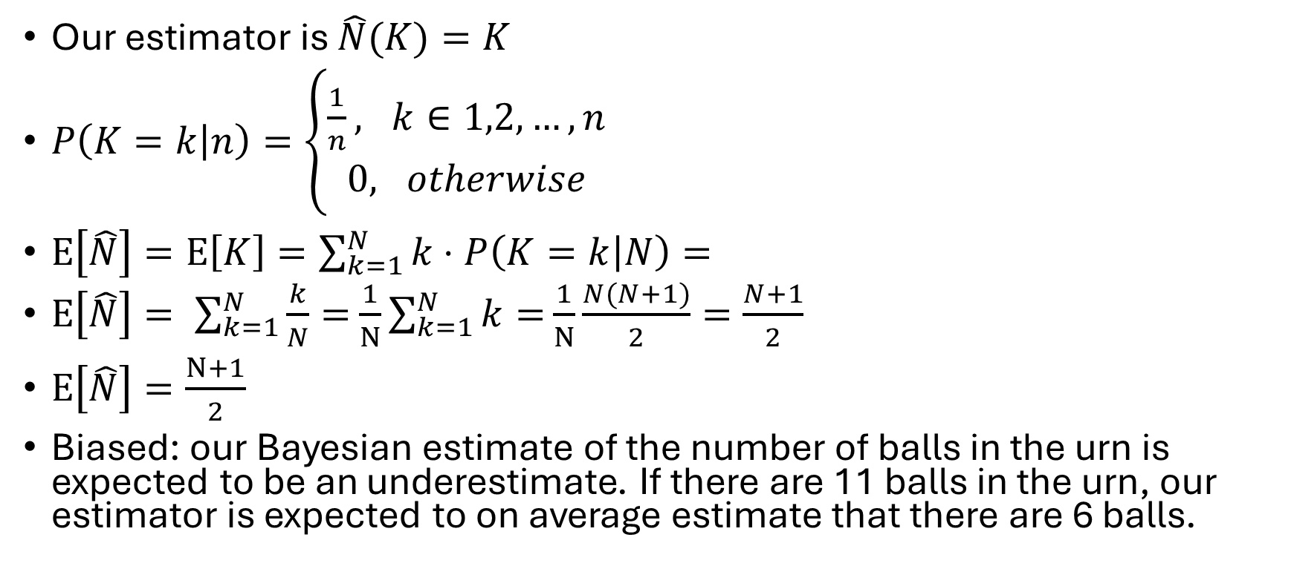
Bayesian solution is biased
Our estimator is $\hat{N}(K)=K$
$P\left(K=k | n\right)=\left\{\begin{aligned}\frac{1}{n}, k∈1,2,…,n \\ 0, otherwise\end{aligned}\right.$
$E\left[\hat{N}\right]=E\left[K\right]=\sum_{k=1}^{N}{k⋅P\left(K=k | N\right)=}$
$E\left[\hat{N}\right]= \sum_{k=1}^{N}{\frac{k}{N}=}$ $\frac{1}{N}\sum_{k=1}^{N}{k=}$ $\frac{1}{N}\frac{N(N+1)}{2}=\frac{N+1}{2}$
$E\left[\hat{N}\right]=\frac{N+1}{2}$
Biased: our Bayesian estimate of the number of balls in the urn is expected to be an underestimate. If there are 11 balls in the urn, our estimator is expected to on average estimate that there are 6 balls.

Slide 12
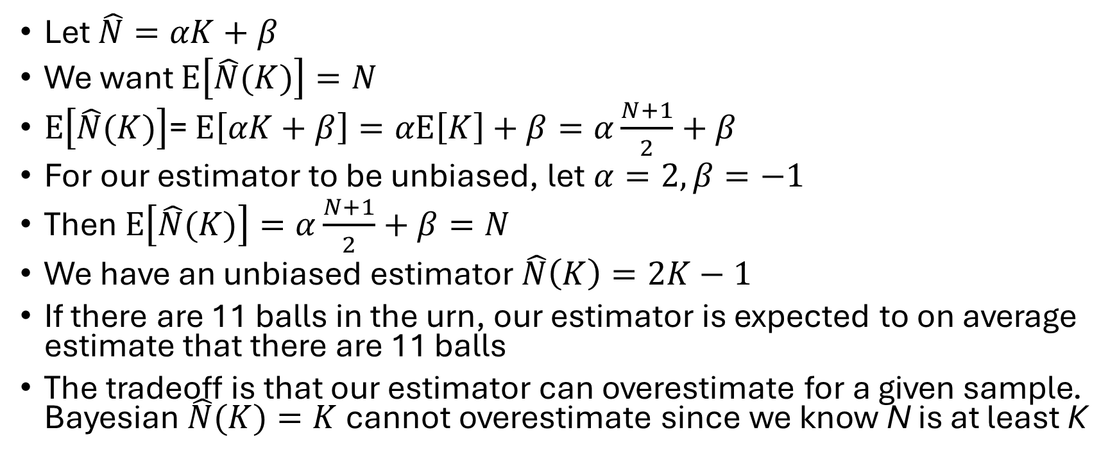
Example Unbiased Solution
Let $\hat{N}=αK+β$
We want $E\left[\hat{N}(K)\right]=N$
$E\left[\hat{N}(K)\right]$= $E\left[αK+β\right]=αE\left[K\right]+β=α\frac{N+1}{2}+β$
For our estimator to be unbiased, let $α=2, β=−1$
Then $E\left[\hat{N}(K)\right]=α\frac{N+1}{2}+β=N$
We have an unbiased estimator $\hat{N}\left(K\right)=2K−1$
If there are 11 balls in the urn, our estimator is expected to on average estimate that there are 11 balls
The tradeoff is that our estimator can overestimate for a given sample. Bayesian $\hat{N}(K)=K$cannot overestimate since we know N is at least K

Slide 13
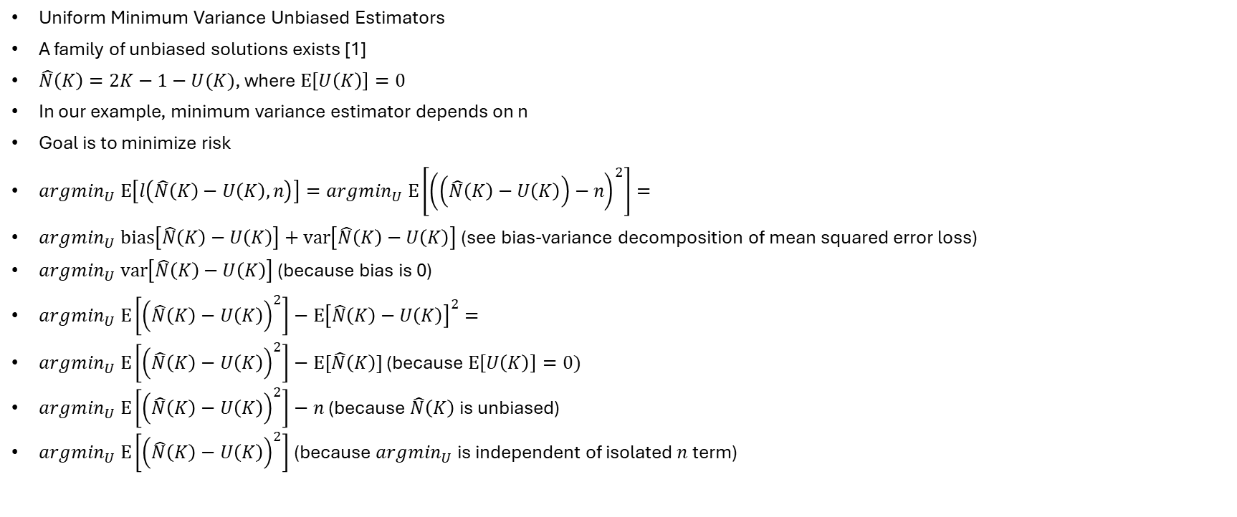
UMVU Estimators
Uniform Minimum Variance Unbiased Estimators
A family of unbiased solutions exists [1]
$\hat{N}\left(K\right)=2K−1−U(K)$, where $E\left[U\left(K\right)\right]=0$
In our example, minimum variance estimator depends on n
Goal is to minimize risk
$argmin_{U} E\left[l\left(\hat{N}\left(K\right)−U\left(K\right),n\right)\right]=argmin_{U} E\left[{\left(\left(\hat{N}\left(K\right)−U\left(K\right)\right)−n\right)}^{2}\right]=$
$argmin_{U} bias\left[\hat{N}\left(K\right)−U\left(K\right)\right]+var\left[\hat{N}\left(K\right)−U\left(K\right)\right]$ (see bias-variance decomposition of mean squared error loss)
$argmin_{U} var\left[\hat{N}\left(K\right)−U\left(K\right)\right]$ (because bias is 0)
$argmin_{U} E\left[{\left(\hat{N}\left(K\right)−U\left(K\right)\right)}^{2}\right]−E{\left[\hat{N}\left(K\right)−U\left(K\right)\right]}^{2}=$
$argmin_{U} E\left[{\left(\hat{N}\left(K\right)−U\left(K\right)\right)}^{2}\right]−E[\hat{N}\left(K\right)]$ (because $E\left[U\left(K\right)\right]=0)$
$argmin_{U} E\left[{\left(\hat{N}\left(K\right)−U\left(K\right)\right)}^{2}\right]−n$ (because $\hat{N}\left(K\right)$ is unbiased)
$argmin_{U} E\left[{\left(\hat{N}\left(K\right)−U\left(K\right)\right)}^{2}\right]$ (because $argmin_{U}$ is independent of isolated $n$ term)

Slide 14
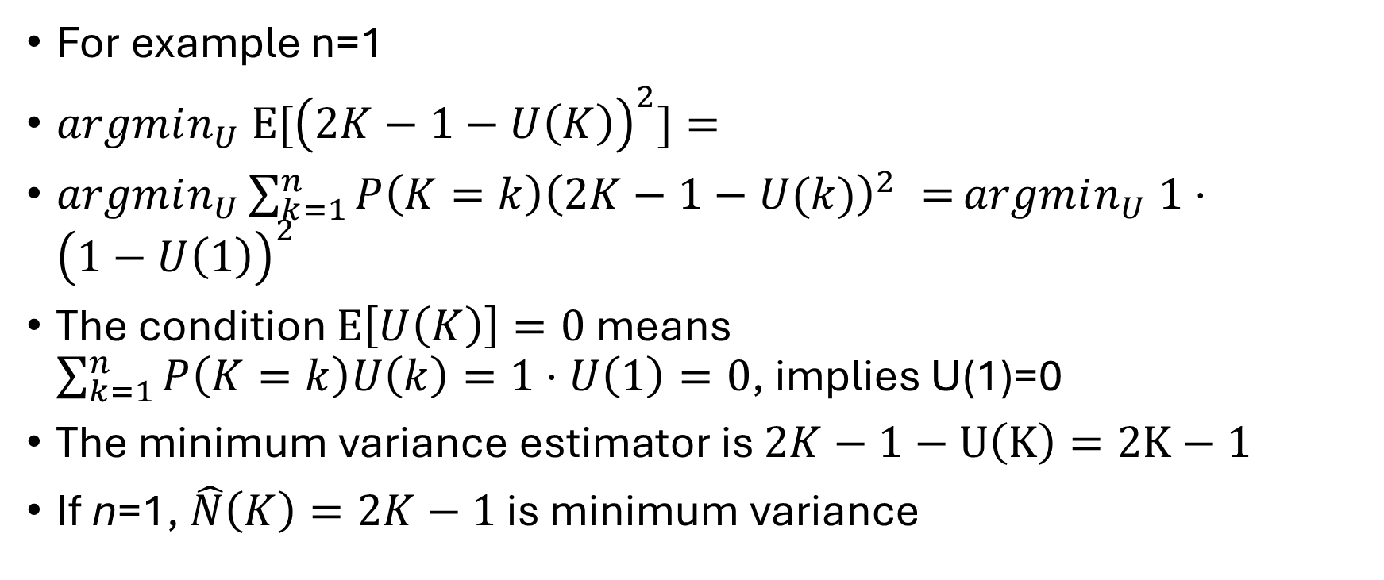
UMVU Estimators
For example n=1
$argmin_{U} {E[\left(2K−1−U\left(K\right)\right)}^{2}]=$
$argmin_{U}\sum_{k=1}^{n}{P\left(K=k\right){\left(2K−1−U(k)\right)}^{2} =}argmin_{U} 1⋅{\left(1−U\left(1\right)\right)}^{2}$
The condition $E\left[U\left(K\right)\right]=0$ means $\sum_{k=1}^{n}{P\left(K=k\right)U\left(k\right)=1⋅U\left(1\right)=0}$, implies U(1)=0
The minimum variance estimator is $2K−1−U\left(K\right)=2K−1$
If n=1, $\hat{N}\left(K\right)=2K−1$ is minimum variance

Slide 15
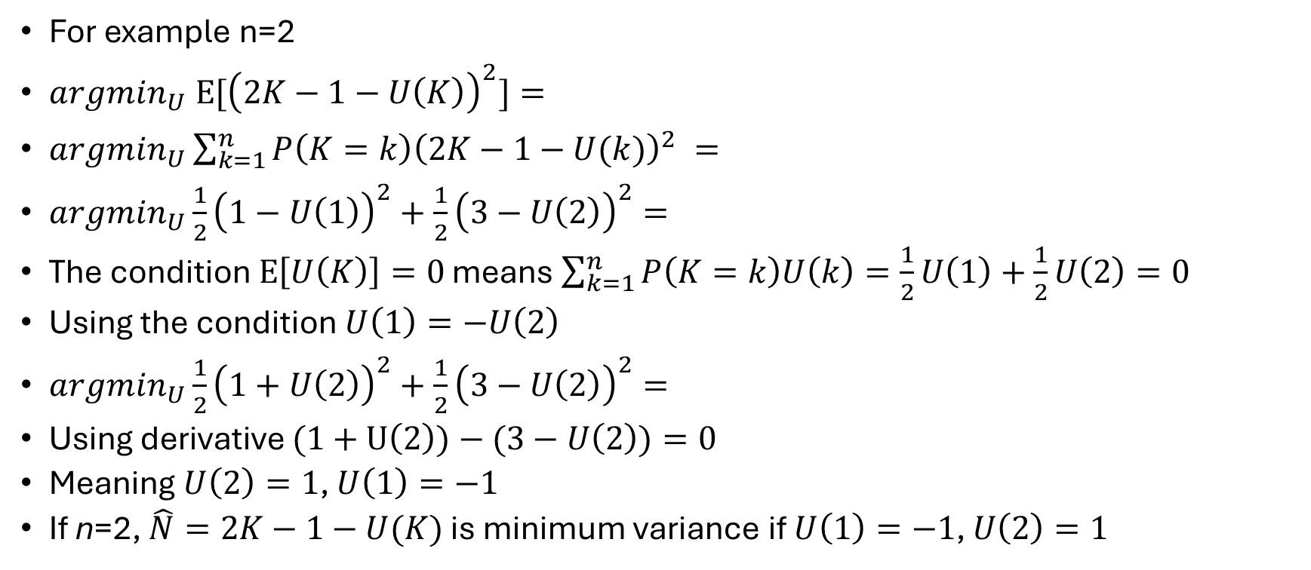
UMVU Estimators
For example n=2
$argmin_{U} {E[\left(2K−1−U\left(K\right)\right)}^{2}]=$
$argmin_{U}\sum_{k=1}^{n}{P\left(K=k\right){\left(2K−1−U(k)\right)}^{2} =}$
$argmin_{U}\frac{1}{2}{\left(1−U\left(1\right)\right)}^{2}+\frac{1}{2}{\left(3−U\left(2\right)\right)}^{2}=$
The condition $E\left[U\left(K\right)\right]=0$ means $\sum_{k=1}^{n}{P\left(K=k\right)U\left(k\right)=\frac{1}{2}U\left(1\right)+\frac{1}{2}U\left(2\right)=0}$
Using the condition $U\left(1\right)=−U\left(2\right)$
$argmin_{U}\frac{1}{2}{\left(1+U\left(2\right)\right)}^{2}+\frac{1}{2}{\left(3−U\left(2\right)\right)}^{2}=$
Using derivative $(1+U\left(2\right))−(3−U\left(2\right))=0$
Meaning $U\left(2\right)=1$, $U\left(1\right)=−1$
If n=2, $\hat{N}=2K−1−U(K)$ is minimum variance if $U\left(1\right)=−1$, $U\left(2\right)=1$

Slide 16
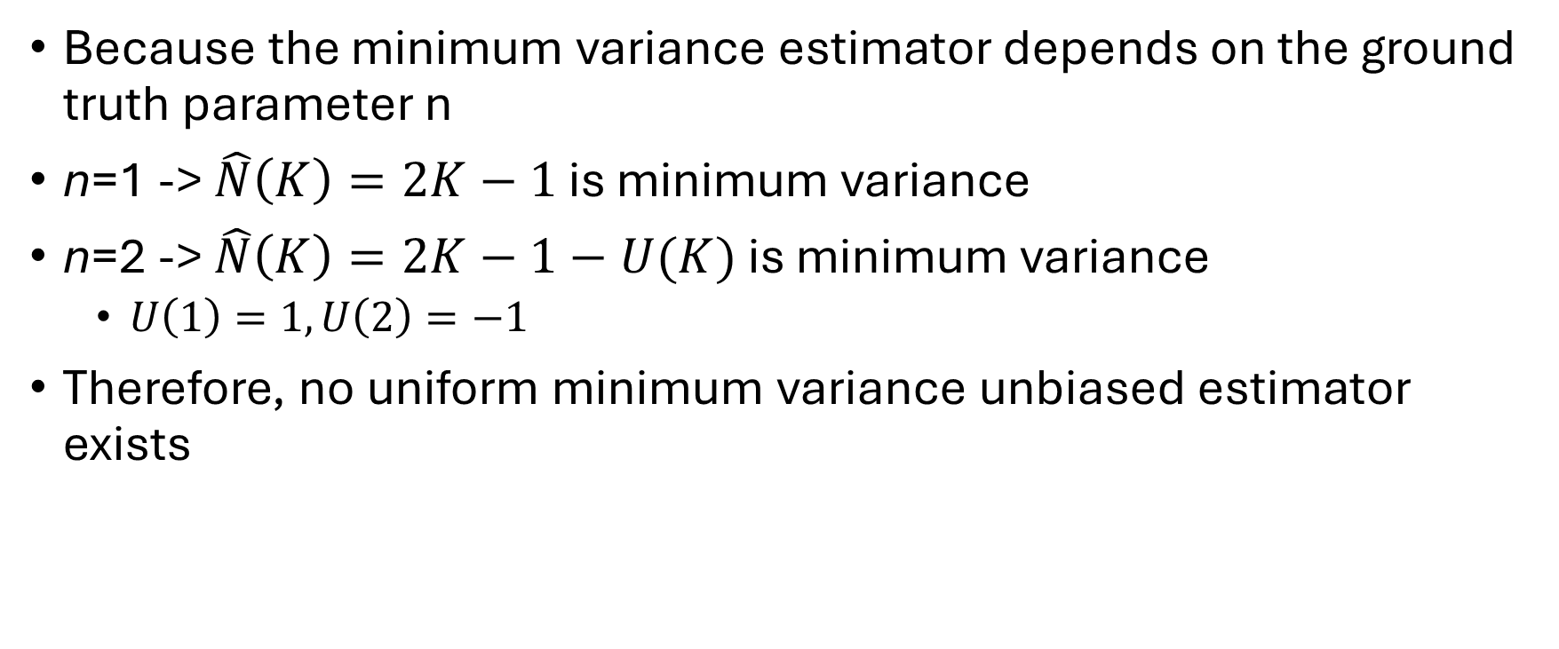
UMVU Estimators
Because the minimum variance estimator depends on the ground truth parameter n
n=1 -> $\hat{N}\left(K\right)=2K−1$ is minimum variance
n=2 -> $\hat{N}\left(K\right)=2K−1−U(K)$ is minimum variance
$U\left(1\right)=1,U\left(2\right)=−1$
Therefore, no uniform minimum variance unbiased estimator exists

Slide 17
Summary
Picking a ball out of an urn with numbered balls
Estimating the number of balls in the urn has no best solution and we must consider tradeoffs
Bayes is biased
If we find any unbiased estimator, it will have high variance for certain values of n (because no UMVU exists)

Slide 18
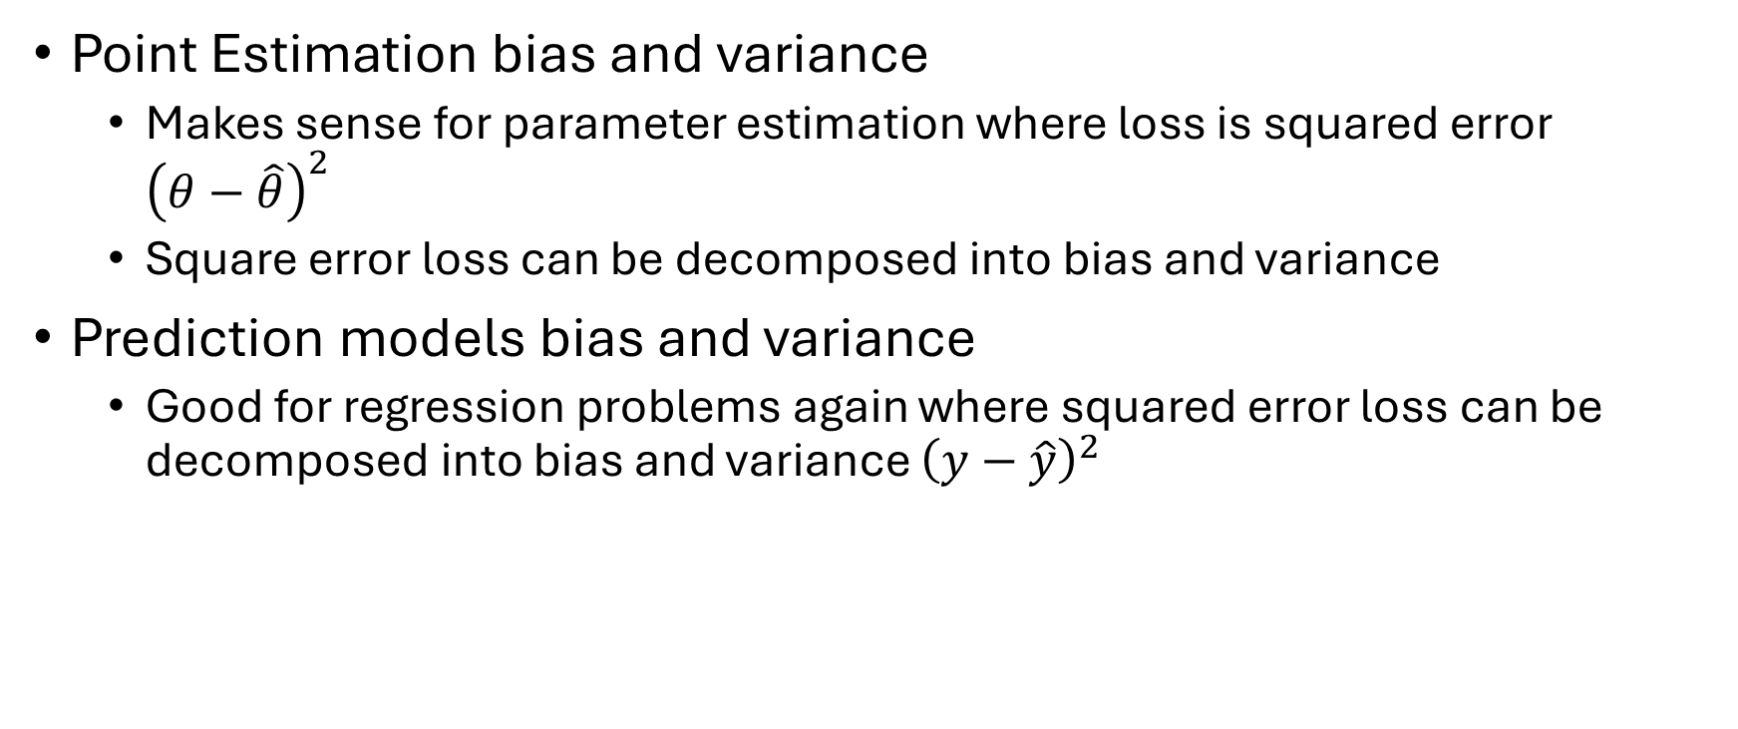
Prediction Models -Bias and Variance
Point Estimation bias and variance
Makes sense for parameter estimation where loss is squared error ${\left(θ−\hat{θ}\right)}^{2}$
Square error loss can be decomposed into bias and variance
Prediction models bias and variance
Good for regression problems again where squared error loss can be decomposed into bias and variance ${\left(y−\hat{y}\right)}^{2}$

Slide 19
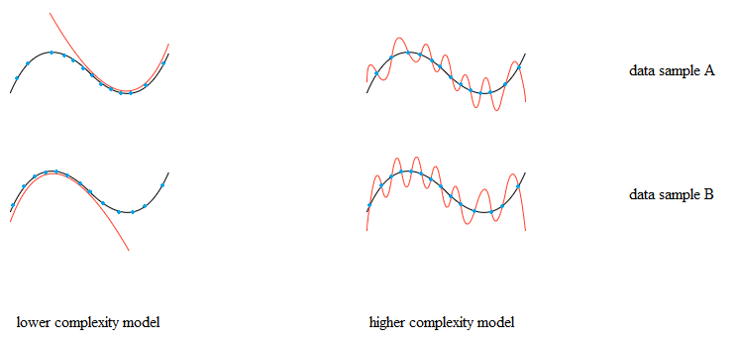
Prediction Models -Bias and Variance
Overfitting and Underfitting
If loss is squared error, a model that is overfit or underfit will have loss with both bias and variance

Slide 20
Prediction Models -Bias and Variance
Underfitting example on left
High bias because half of the curve is wrong half of the time
High variance because there are two modes

Slide 21
Prediction Models -Bias and Variance
Overfitting example on left
High bias because most of the curve is high error between the points
High variance because the curve changes based on the sample

Slide 22
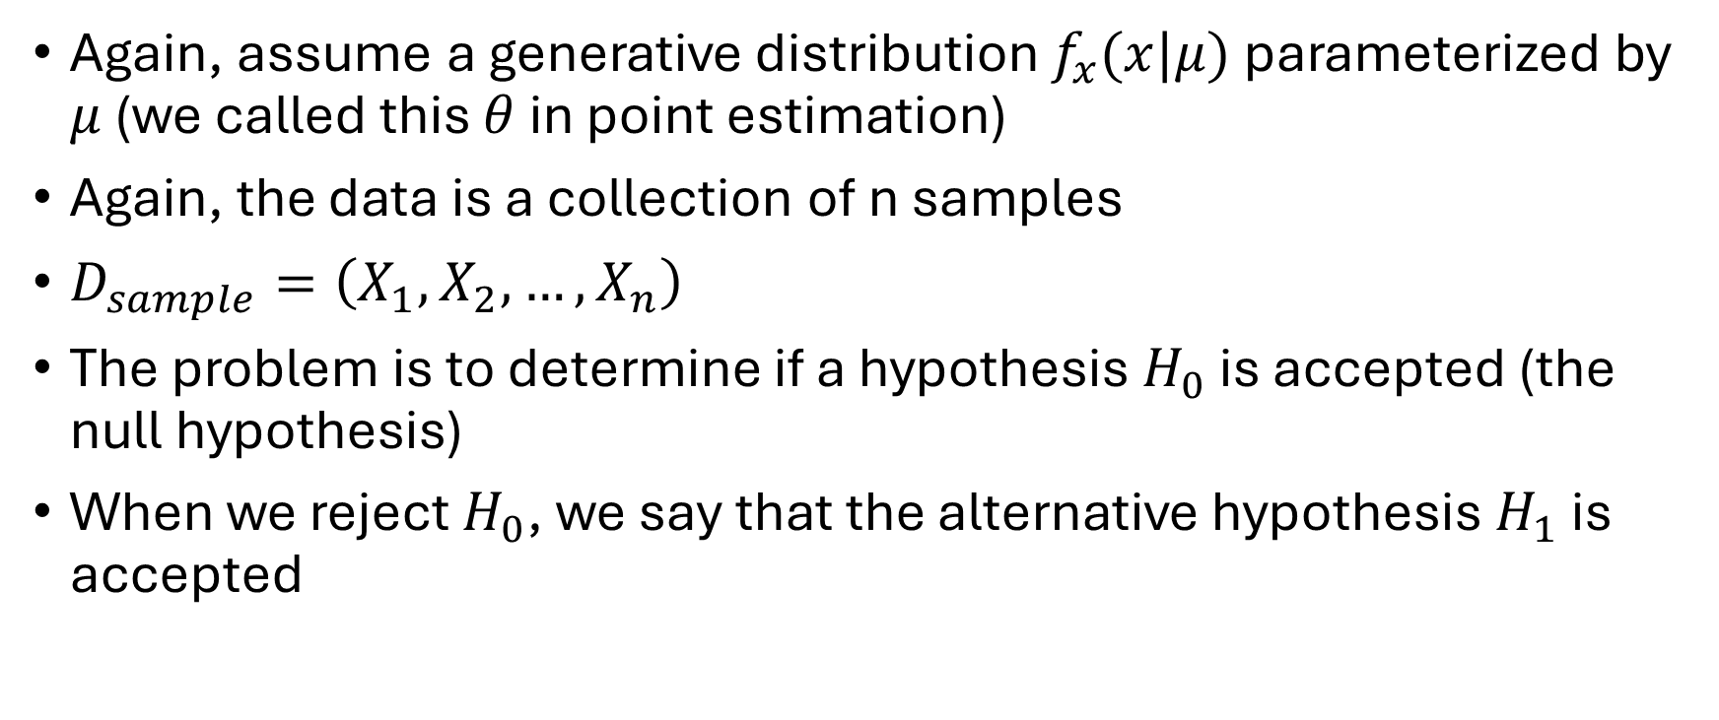
Statistical Hypothesis Testing [3]
Again, assume a generative distribution $f_{x}(x|μ)$ parameterized by $μ$ (we called this $θ$ in point estimation)
Again, the data is a collection of n samples
$D_{sample}=\left(X_{1},X_{2},…,X_{n}\right)$
The problem is to determine if a hypothesis $H_{0}$ is accepted (the null hypothesis)
When we reject $H_{0}$, we say that the alternative hypothesis $H_{1}$ is accepted

Slide 23
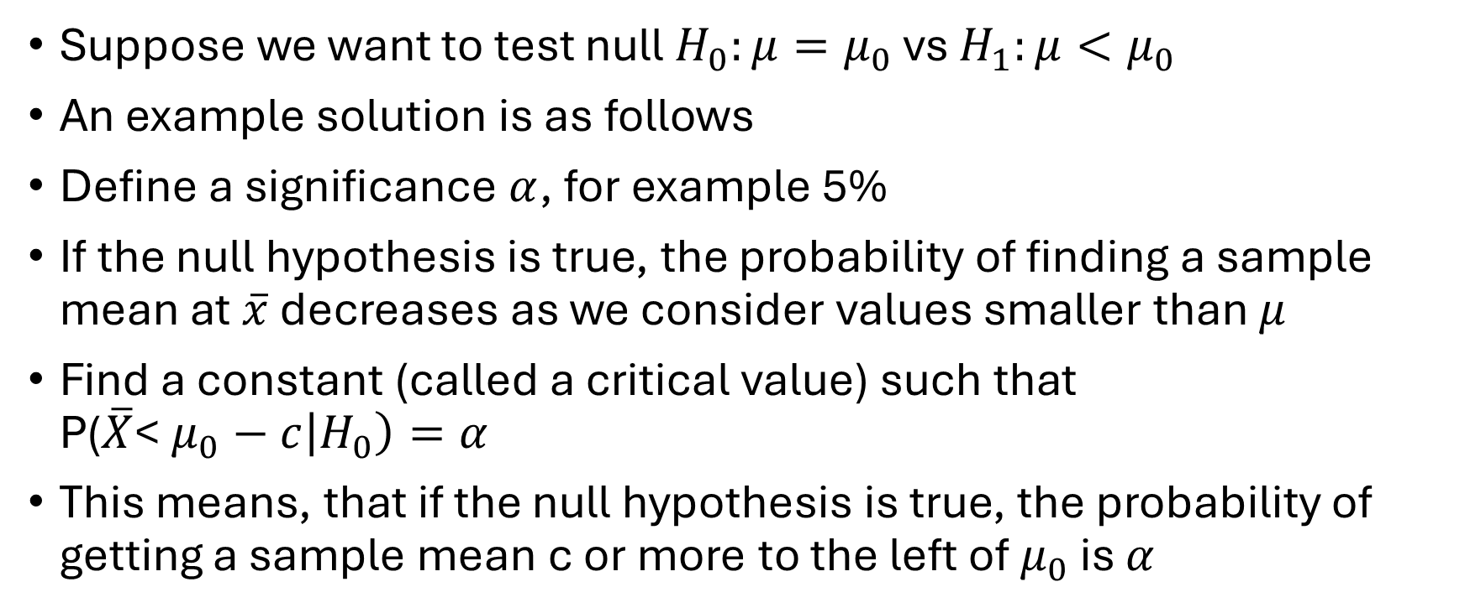
Statistical Hypothesis Testing
Suppose we want to test null $H_{0}:μ=μ_{0}$ vs $H_{1}:μ<μ_{0}$
An example solution is as follows
Define a significance $α$, for example 5%
If the null hypothesis is true, the probability of finding a sample mean at $\overline{x}$ decreases as we consider values smaller than $μ$
Find a constant (called a critical value) such that P($\overline{X}$< $μ_{0}−c\left|H_{0}\right)=α$
This means, that if the null hypothesis is true, the probability of getting a sample mean c or more to the left of $μ_{0}$ is $α$

Slide 24
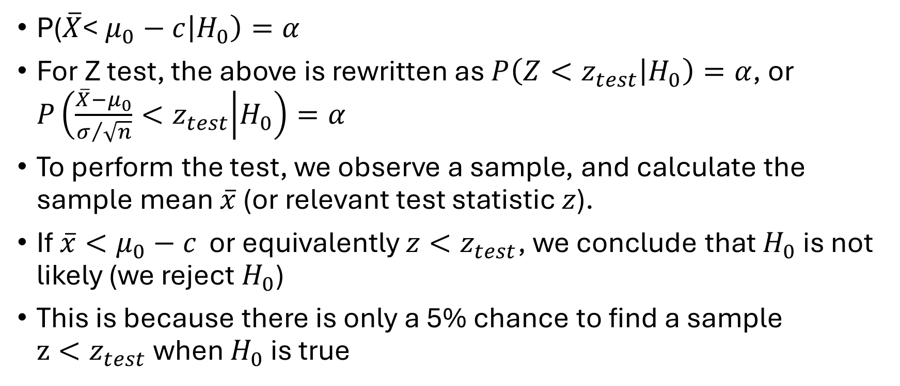
Statistical Hypothesis Testing
P($\overline{X}$< $μ_{0}−c\left|H_{0}\right)=α$
For Z test, the above is rewritten as $P\left(Z<z_{test} | H_{0}\right)=α$, or $P\left(\frac{\overline{X}−μ_{0}}{σ/{\sqrt{n}}}<z_{test} | H_{0}\right)=α$
To perform the test, we observe a sample, and calculate the sample mean $\overline{x}$ (or relevant test statistic $z$).
If $\overline{x}<μ_{0}−c$ or equivalently $z<z_{test}$, we conclude that $H_{0}$ is not likely (we reject $H_{0}$)
This is because there is only a 5% chance to find a sample $z<z_{test}$ when $H_{0}$ is true

Slide 25

Statistical Hypothesis Testing
Suppose $H_{0}:μ=μ_{0}$ vs $H_{1}:μ=μ_{0}−0.0000001$
Then even if our test says $H_{0}$ is likely, we may also believe $H_{1}$ is likely
How do we solve this?

Slide 26
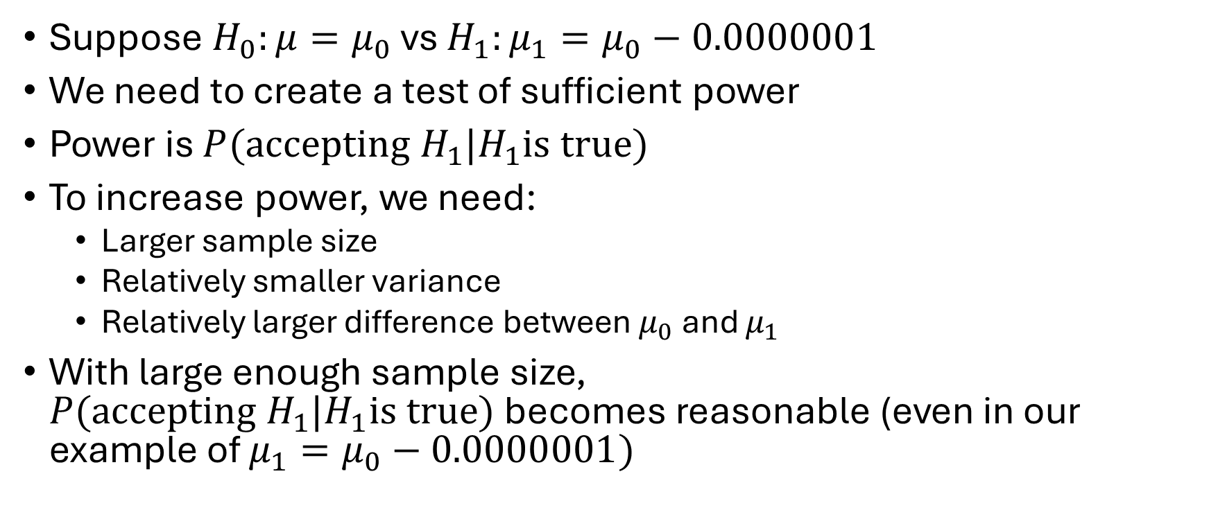
Statistical Hypothesis Testing
Suppose $H_{0}:μ=μ_{0}$ vs $H_{1}:μ_{1}=μ_{0}−0.0000001$
We need to create a test of sufficient power
Power is ${P(accepting H}_{1}|H_{1}is true)$
To increase power, we need:
Larger sample size
Relatively smaller variance
Relatively larger difference between $μ_{0}$ and $μ_{1}$
With large enough sample size, ${P(accepting H}_{1}|H_{1}is true)$ becomes reasonable (even in our example of $μ_{1}=μ_{0}−0.0000001)$

Slide 27
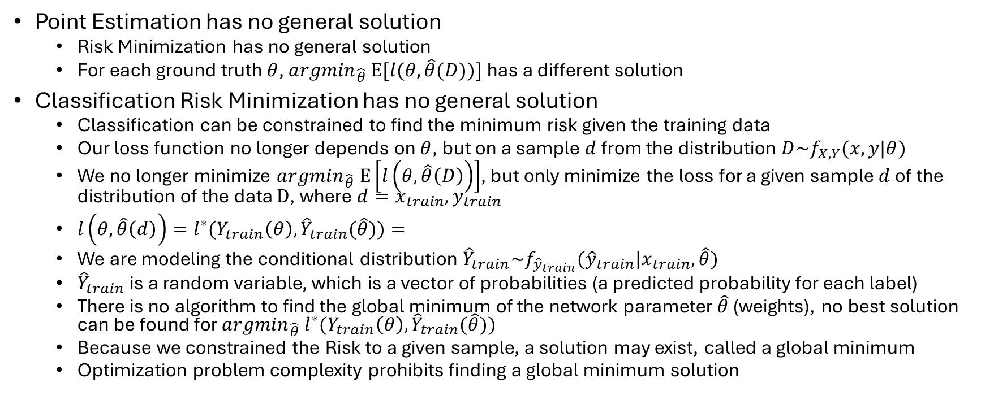
Classification Models -Relationship to Point Estimation
Point Estimation has no general solution
Risk Minimization has no general solution
For each ground truth $θ$, ${argmin}_{\hat{θ}} E[l(θ,\hat{θ}(D))]$ has a different solution
Classification Risk Minimization has no general solution
Classification can be constrained to find the minimum risk given the training data
Our loss function no longer depends on $θ$, but on a sample $d$ from the distribution $D\sim f_{X,Y}(x,y|θ)$
We no longer minimize ${argmin}_{\hat{θ}} E\left[l\left(θ,\hat{θ}\left(D\right)\right)\right]$, but only minimize the loss for a given sample $d$ of the distribution of the data $D$, where $d=x_{train}, y_{train}$
$l\left(θ,\hat{θ}\left(d\right)\right)={l^{∗}(Y}_{train}\left(θ\right),{\hat{Y}}_{train}(\hat{θ}))=$
We are modeling the conditional distribution ${\hat{Y}}_{train}\sim f_{{\hat{y}}_{train}}({\hat{y}}_{train}{|x}_{train},\hat{θ})$
${\hat{Y}}_{train}$ is a random variable, which is a vector of probabilities (a predicted probability for each label)
There is no algorithm to find the global minimum of the network parameter $\hat{θ}$ (weights), no best solution can be found for ${argmin}_{\hat{θ}}{ l}^{∗}(Y_{train}\left(θ\right),{\hat{Y}}_{train}(\hat{θ}))$
Because we constrained the Risk to a given sample, a solution may exist, called a global minimum
Optimization problem complexity prohibits finding a global minimum solution

Slide 28
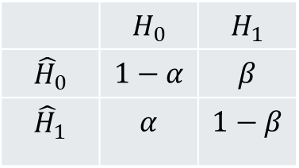
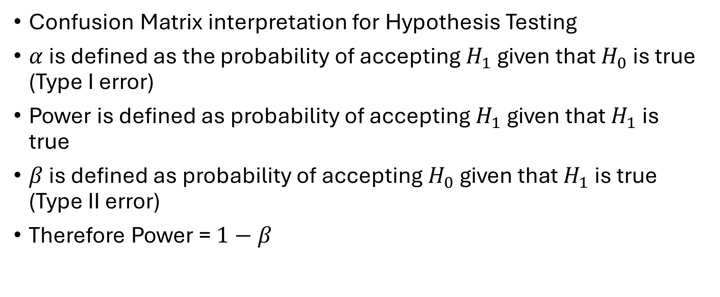
Classification Models -Relationship to Hypothesis Testing
Confusion Matrix interpretation for Hypothesis Testing
$α$ is defined as the probability of accepting $H_{1}$ given that $H_{0}$ is true (Type I error)
Power is defined as probability of accepting $H_{1}$ given that $H_{1}$ is true
$β$ is defined as probability of accepting $H_{0}$ given that $H_{1}$ is true (Type II error)
Therefore Power = $1−β$
 | $$H_{0}$$ | $$H_{1}$$
$${\hat{H}}_{0}$$ | $$1−α$$ | $$β$$
$${\hat{H}}_{1}$$ | $$α$$ | $$1−β$$

Slide 29
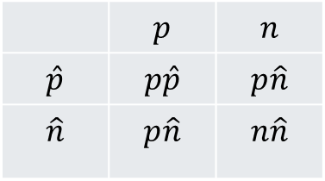
Classification Models -Relationship to Hypothesis Testing
Confusion Matrix interpretation for Hypothesis Testing and Classification Models
Confusion matrix in both paradigms represents Prediction on the Left and Ground Truth on the Top
Can be extended to multiple classes
 | $$p$$ | $$n$$
$$\hat{p}$$ | $$p\hat{p}$$ | $$p\hat{n}$$
$$\hat{n}$$ | $$p\hat{n}$$ | $$n\hat{n}$$
 | $$H_{0}$$ | $$H_{1}$$
$${\hat{H}}_{0}$$ | $$1−α$$ | $$β$$
$${\hat{H}}_{1}$$ | $$α$$ | $$1−β$$

Slide 30
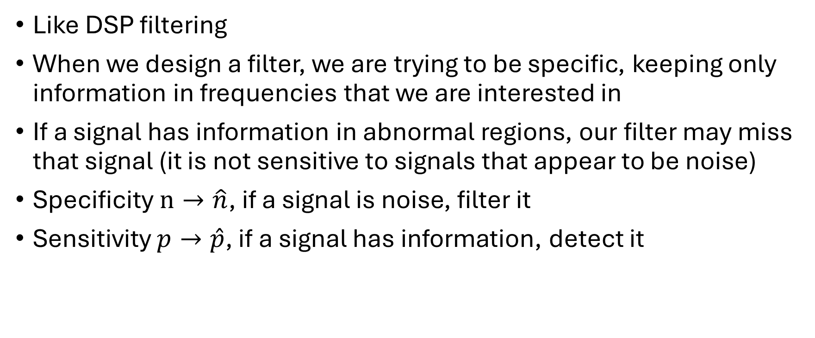
Classification Metrics for Example Applications​ - Sensitivity and Specificity
Like DSP filtering
When we design a filter, we are trying to be specific, keeping only information in frequencies that we are interested in
If a signal has information in abnormal regions, our filter may miss that signal (it is not sensitive to signals that appear to be noise)
Specificity $n→\hat{n}$, if a signal is noise, filter it
Sensitivity $p→\hat{p}$, if a signal has information, detect it

Slide 31
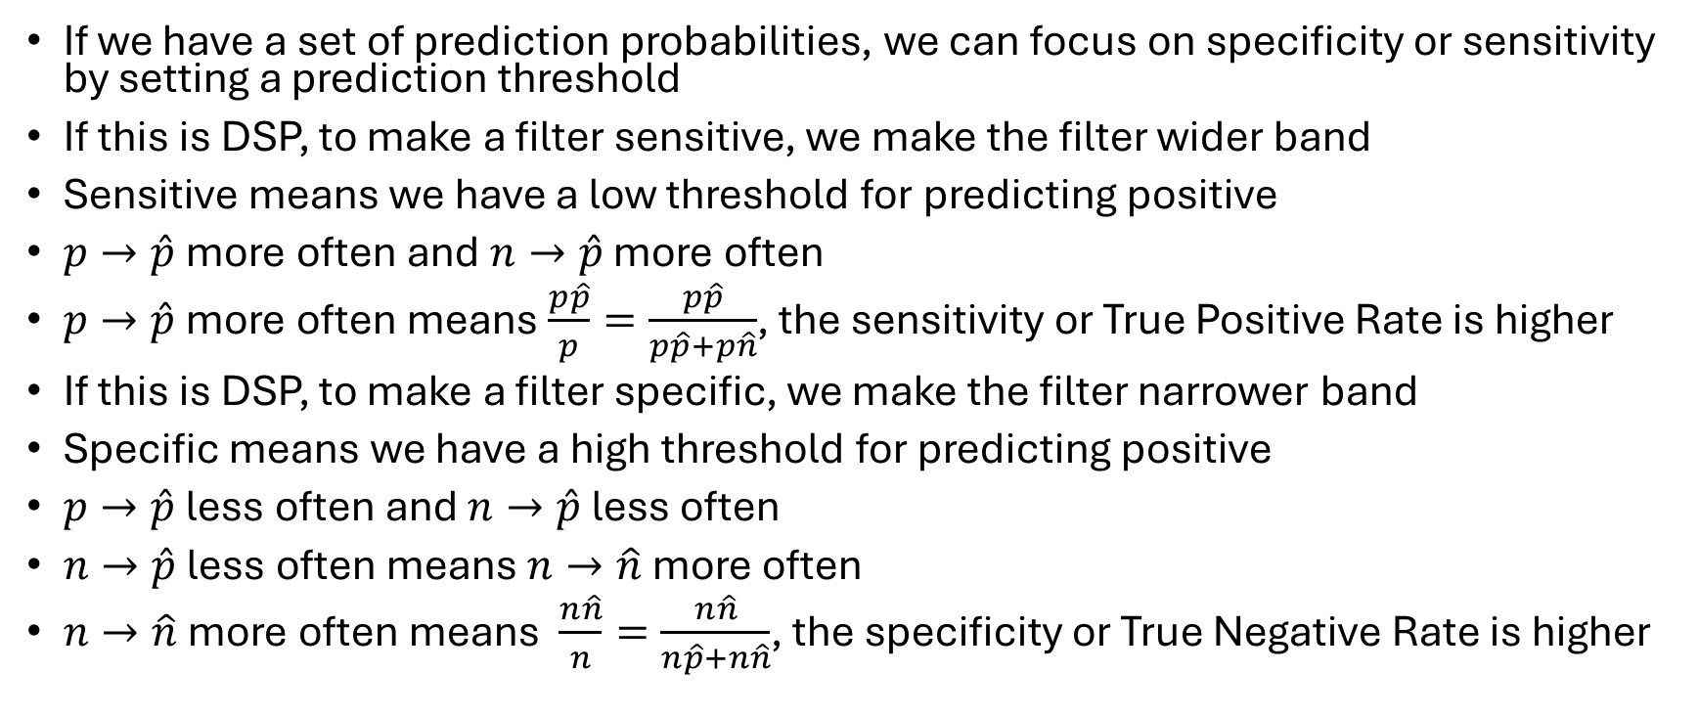
Classification Metrics for Example Applications​ - ROC
If we have a set of prediction probabilities, we can focus on specificity or sensitivity by setting a prediction threshold
If this is DSP, to make a filter sensitive, we make the filter wider band
Sensitive means we have a low threshold for predicting positive
$p→\hat{p}$ more often and $n→\hat{p}$ more often
$p→\hat{p}$ more often means $\frac{p\hat{p}}{p}=\frac{p\hat{p}}{p\hat{p}+p\hat{n}}$, the sensitivity or True Positive Rate is higher
If this is DSP, to make a filter specific, we make the filter narrower band
Specific means we have a high threshold for predicting positive
$p→\hat{p}$ less often and $n→\hat{p}$ less often
$n→\hat{p}$ less often means $n→\hat{n}$ more often
$n→\hat{n}$ more often means $\frac{n\hat{n}}{n}=\frac{n\hat{n}}{n\hat{p}+n\hat{n}}$, the specificity or True Negative Rate is higher

Slide 32
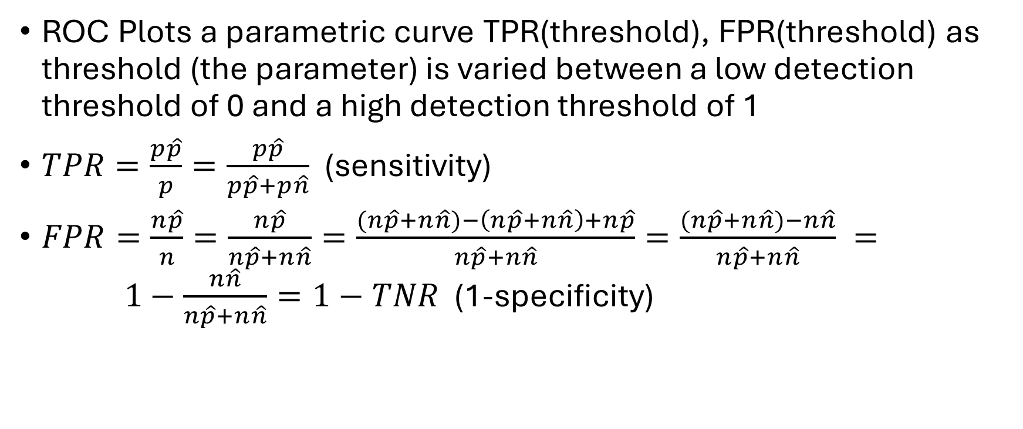
Classification Metrics for Example Applications​ - ROC
ROC Plots a parametric curve TPR(threshold), FPR(threshold) as threshold (the parameter) is varied between a low detection threshold of 0 and a high detection threshold of 1
$TPR=\frac{p\hat{p}}{p}=\frac{p\hat{p}}{p\hat{p}+p\hat{n}}$ (sensitivity)
$FPR=\frac{n\hat{p}}{n}=\frac{n\hat{p}}{n\hat{p}+n\hat{n}}=\frac{(n\hat{p}+n\hat{n})−\left(n\hat{p}+n\hat{n}\right)+n\hat{p}}{n\hat{p}+n\hat{n}}=\frac{(n\hat{p}+n\hat{n})−n\hat{n}}{n\hat{p}+n\hat{n}} = 1−\frac{n\hat{n}}{n\hat{p}+n\hat{n}}=1−TNR$ (1-specificity)

Slide 33
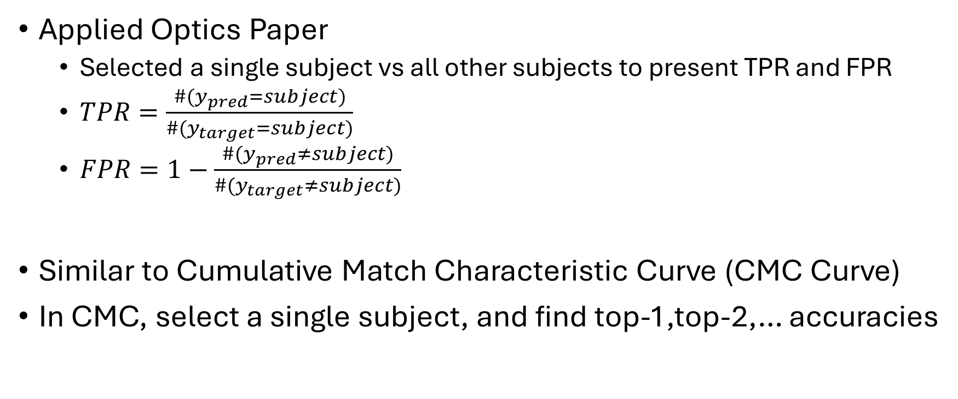
Classification Metrics for Example Applications​ - ROC Multiclass
Applied Optics Paper
Selected a single subject vs all other subjects to present TPR and FPR
$TPR=\frac{{\#(y}_{pred}=subject)}{\#(y_{target}=subject)}$
$FPR=1−\frac{{\#(y}_{pred}≠subject)}{\#(y_{target}≠subject)}$
Similar to Cumulative Match Characteristic Curve (CMC Curve)
In CMC, select a single subject, and find top-1,top-2,… accuracies

Slide 34
Classification Metrics for Example Applications​ - ROC Security Application
Security: Sensitivity is a Must
If a subject is a bad actor, we must detect the subject (high sensitivity)

Slide 35
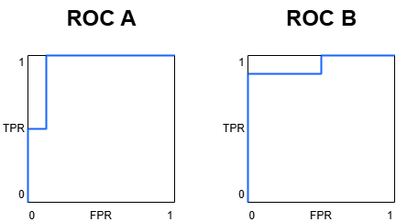
Classification Metrics for Example Applications​ - ROC Multiclass
These example ROC plots have the same area under curve (AUC)
Which ROC is preferred for security or high sensitivity demand?

Slide 36
Classification Metrics for Example Applications​ - ROC Multiclass
ROC A:
TPR 50%, FPR 0% -> sensitivity 50%, specificity 100%
TPR 100%, FPR 12.5% -> sensitivity 100%, specificity 87.5%
ROC B:
TPR 87.5%, FPR 0% -> sensitivity 87.5%, specificity 100%
TPR 100%, FPR 50% -> sensitivity 100%, specificity 50%

Slide 37
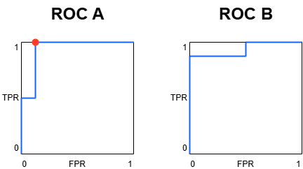
Classification Metrics for Example Applications​ - ROC Multiclass
ROC A:
TPR 50%, FPR 0% -> sensitivity 50%, specificity 100%
TPR 100%, FPR 12.5% -> sensitivity 100%, specificity 87.5%
ROC B:
TPR 87.5%, FPR 0% -> sensitivity 87.5%, specificity 100%
TPR 100%, FPR 50% -> sensitivity 100%, specificity 50%
Best option is to maximize sensitivity at 100%, best specificity there is 87.5% (ROC A)

Slide 38
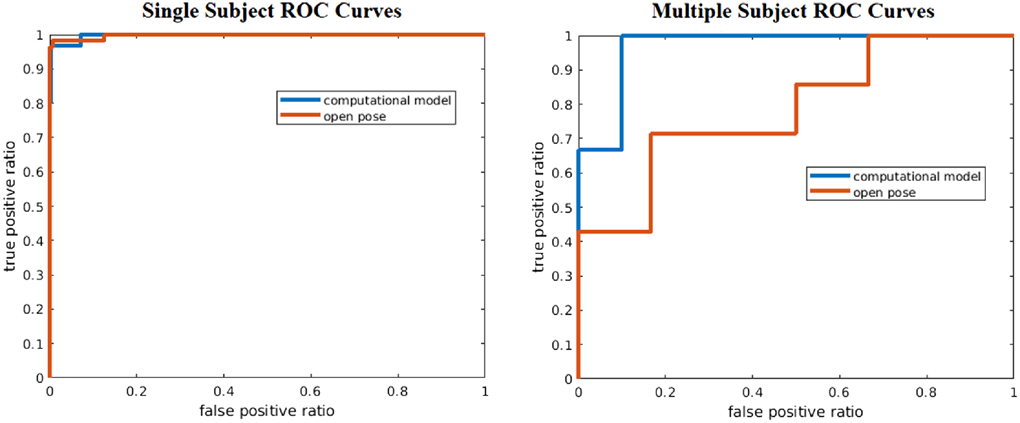
Classification Metrics for Example Applications​ - ROC Security Application

Slide 39
Classification Metrics for Example Applications​ - ROC Security Application
Single Subject
Computational Model has 100% sensitivity at lower specificity than OpenPose –> meaning our model is better for security
I was incorrect about my interpretation during the previous presentation:
If the single subject (left ROC below) looked like ROC A that would be more desirable
Because we would have 100% sensitivity at an even higher specificity

Slide 40
Classification Metrics for Example Applications​ - ROC Security Application
Multiple Subject
Computational Model better for whole curve

Slide 41
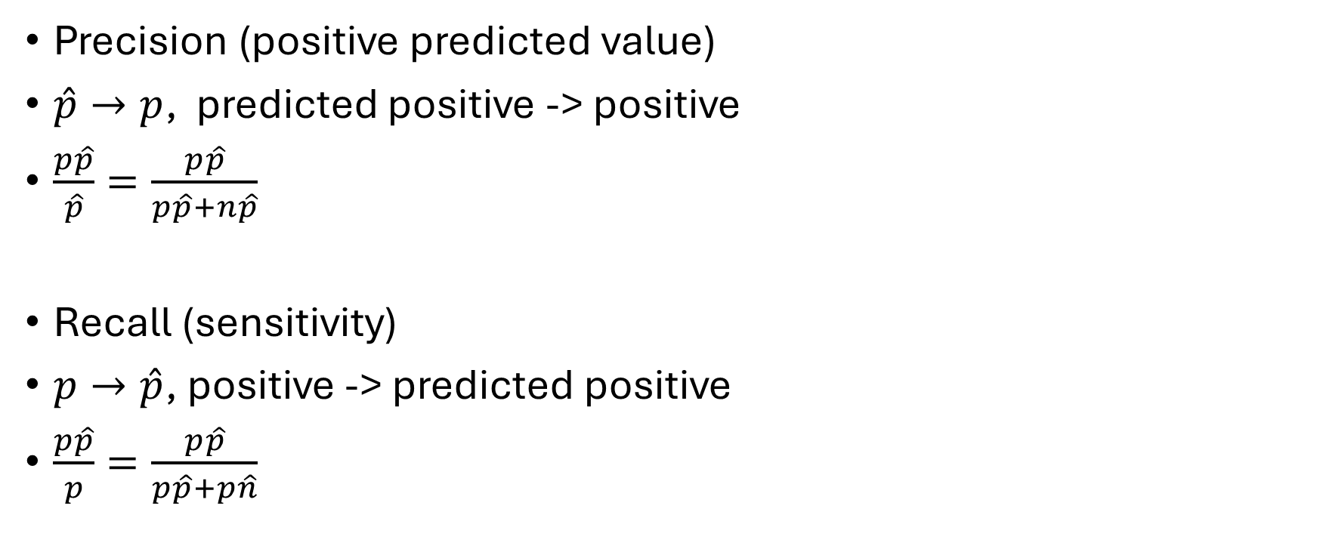
Classification Metrics for Example Applications​ -Precision and Recall
Precision (positive predicted value)
$\hat{p}→p$, predicted positive -> positive
$\frac{p\hat{p}}{\hat{p}}=\frac{p\hat{p}}{p\hat{p}+n\hat{p}}$
Recall (sensitivity)
$p→\hat{p}$, positive -> predicted positive
$\frac{p\hat{p}}{p}=\frac{p\hat{p}}{p\hat{p}+p\hat{n}}$

Slide 42
Classification Metrics for Example Applications​ -Sensitivity and Specificity vs Precision and Recall
Sensitivity and Specificity measure a classifier's expected performance on any sample (or more generally on any dataset)
Precision and Recall measure a classifier’s performance on a particular dataset

Slide 43
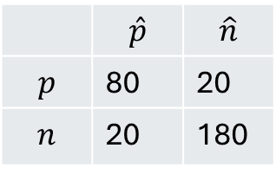
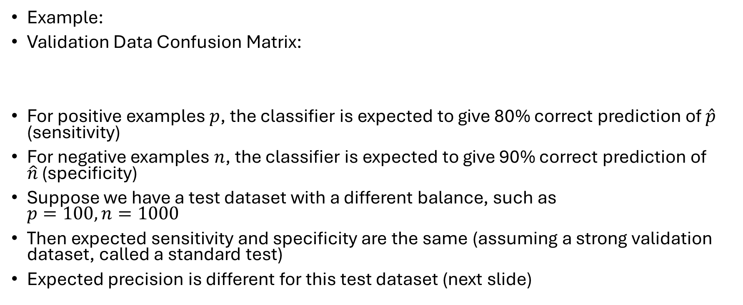
Classification Metrics for Example Applications​ -Sensitivity and Specificity vs Precision and Recall
Example:
Validation Data Confusion Matrix:
For positive examples $p$, the classifier is expected to give 80% correct prediction of $\hat{p}$ (sensitivity)
For negative examples $n$, the classifier is expected to give 90% correct prediction of $\hat{n}$ (specificity)
Suppose we have a test dataset with a different balance, such as $p=100, n=1000$
Then expected sensitivity and specificity are the same (assuming a strong validation dataset, called a standard test)
Expected precision is different for this test dataset (next slide)
 | $$\hat{p}$$ | $$\hat{n}$$
$$p$$ | 80 | 20
$$n$$ | 20 | 180

Slide 44
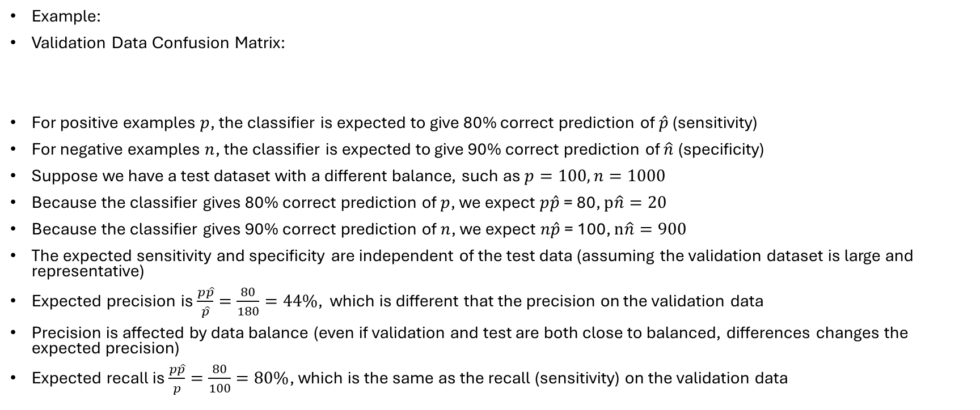
Classification Metrics for Example Applications​ -Sensitivity and Specificity vs Precision and Recall
Example:
Validation Data Confusion Matrix:
For positive examples $p$, the classifier is expected to give 80% correct prediction of $\hat{p}$ (sensitivity)
For negative examples $n$, the classifier is expected to give 90% correct prediction of $\hat{n}$ (specificity)
Suppose we have a test dataset with a different balance, such as $p=100, n=1000$
Because the classifier gives 80% correct prediction of $p$, we expect $p\hat{p}$ = 80, $p\hat{n}=20$
Because the classifier gives 90% correct prediction of $n$, we expect $n\hat{p}$ = 100, $n\hat{n}=900$
The expected sensitivity and specificity are independent of the test data (assuming the validation dataset is large and representative)
Expected precision is $\frac{p\hat{p}}{\hat{p}}=\frac{80}{180}=44\%$, which is different that the precision on the validation data
Precision is affected by data balance (even if validation and test are both close to balanced, differences changes the expected precision)
Expected recall is $\frac{p\hat{p}}{p}=\frac{80}{100}=80\%$, which is the same as the recall (sensitivity) on the validation data
 | $$\hat{p}$$ | $$\hat{n}$$
$$p$$ | 80 | 20
$$n$$ | 20 | 180

Slide 45
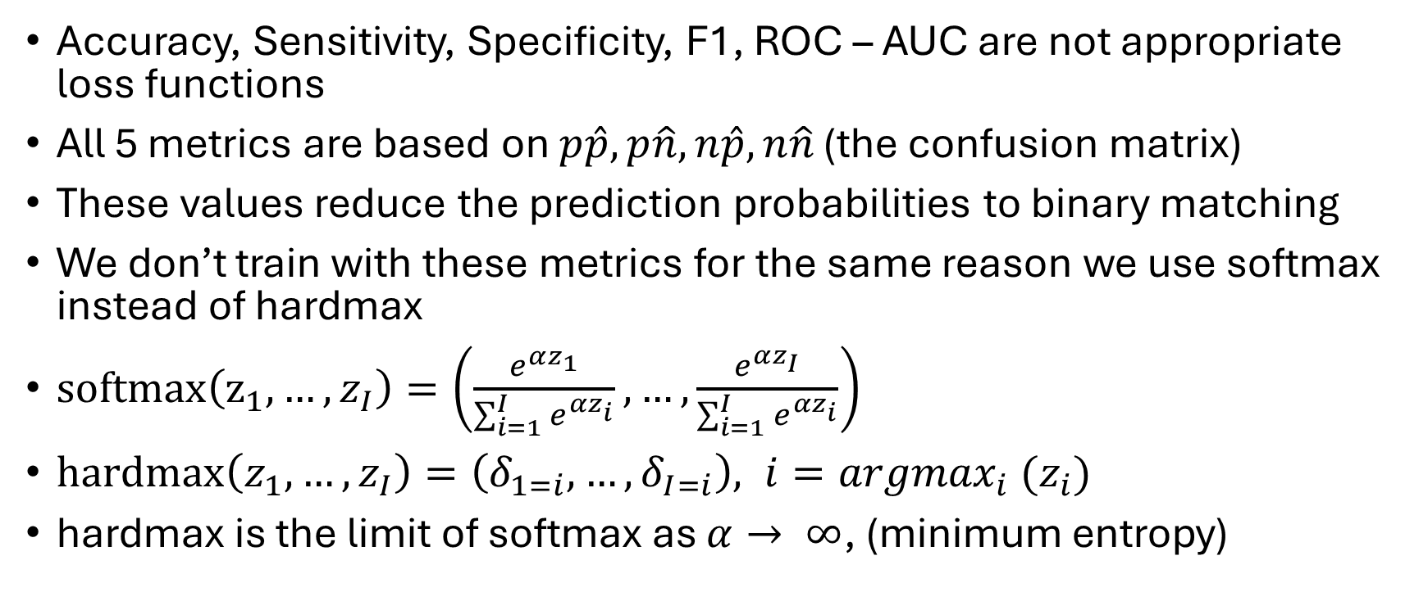
Classification Metrics vs Loss Functions
Accuracy, Sensitivity, Specificity, F1, ROC – AUC are not appropriate loss functions
All 5 metrics are based on $p\hat{p},p\hat{n},n\hat{p},n\hat{n}$ (the confusion matrix)
These values reduce the prediction probabilities to binary matching
We don’t train with these metrics for the same reason we use softmax instead of hardmax
$softmax\left(z_{1},…,z_{I}\right)=\left(\frac{e^{αz_{1}}}{\sum_{i=1}^{I}{e^{{αz}_{i}}}},…,\frac{e^{αz_{I}}}{\sum_{i=1}^{I}{e^{{αz}_{i}}}}\right)$
$hardmax\left(z_{1},…,z_{I}\right)=\left(δ_{1=i},…,δ_{I=i}\right), i={argmax}_{i}{ (z}_{i})$
hardmax is the limit of softmax as $α→ ∞$, (minimum entropy)

Slide 46
Classification Metrics vs Loss Functions
If we want to train a classifier, we need a loss that considers the predicted probability, not just the argmax or label prediction
For multiclass classification we use cross entropy, which we can derive from maximum log likelihood estimation (MLE)
We also see cross entropy in Maximum A Posteriori estimation (MAP) - see my last presentation

Slide 47
Classification Metrics vs Loss Functions -Imbalanced Data
Focal Loss [4]
Imbalanced data
For example, consider a problem with only a few positive ground truth and mostly negative ground truth

Slide 48
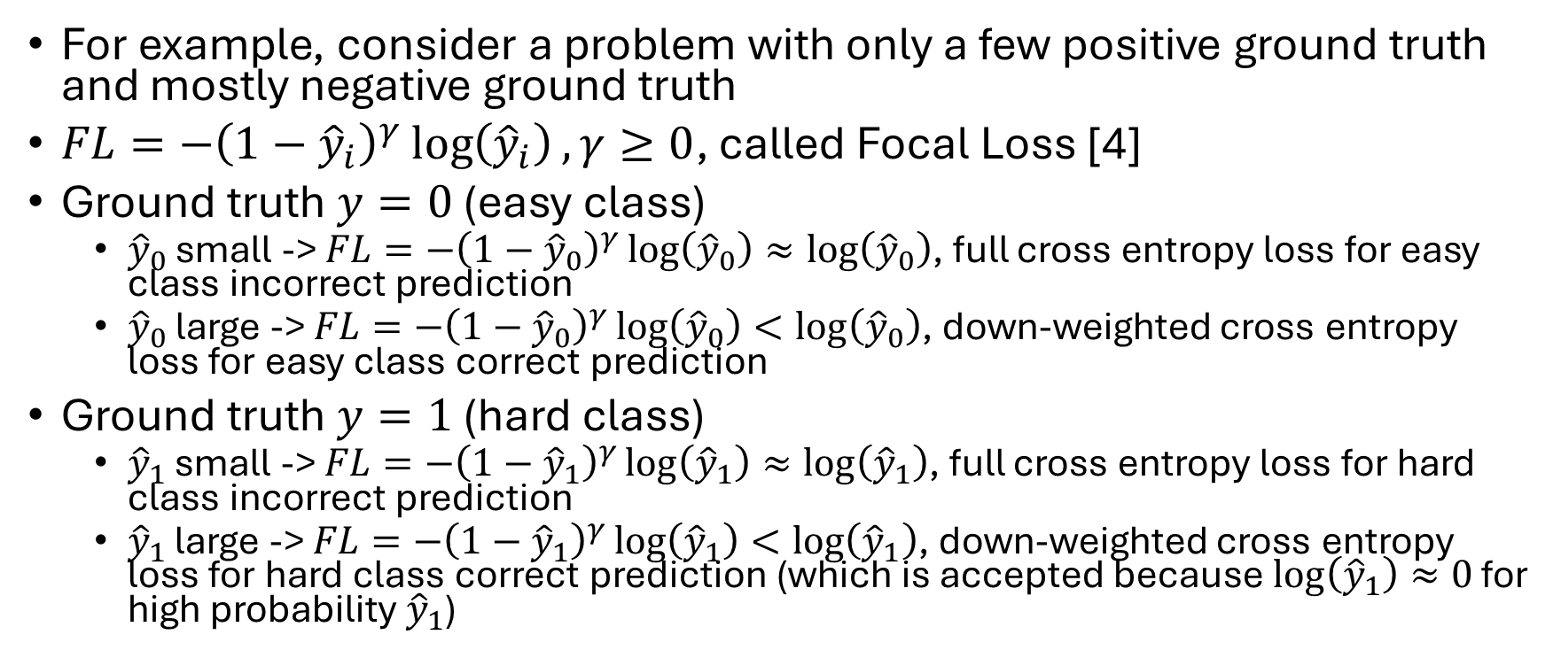
Classification Metrics vs Loss Functions -Imbalanced Data
For example, consider a problem with only a few positive ground truth and mostly negative ground truth
$FL=−{\left(1−{\hat{y}}_{i}\right)}^{γ}\log\left({\hat{y}}_{i}\right), γ≥0$, called Focal Loss [4]
Ground truth $y=0$ (easy class)
${\hat{y}}_{0}$ small -> $FL=−{\left(1−{\hat{y}}_{0}\right)}^{γ}\log\left({\hat{y}}_{0}\right)≈\log\left({\hat{y}}_{0}\right)$, full cross entropy loss for easy class incorrect prediction
${\hat{y}}_{0}$ large -> $FL=−{\left(1−{\hat{y}}_{0}\right)}^{γ}\log\left({\hat{y}}_{0}\right)<log⁡\left({\hat{y}}_{0}\right)$, down-weighted cross entropy loss for easy class correct prediction
Ground truth $y=1$ (hard class)
${\hat{y}}_{1}$ small -> $FL=−{\left(1−{\hat{y}}_{1}\right)}^{γ}\log\left({\hat{y}}_{1}\right)≈\log\left({\hat{y}}_{1}\right)$, full cross entropy loss for hard class incorrect prediction
${\hat{y}}_{1}$ large -> $FL=−{\left(1−{\hat{y}}_{1}\right)}^{γ}\log\left({\hat{y}}_{1}\right)<\log\left({\hat{y}}_{1}\right)$, down-weighted cross entropy loss for hard class correct prediction (which is accepted because $\log\left({\hat{y}}_{1}\right)≈0$ for high probability ${\hat{y}}_{1}$)

Slide 49
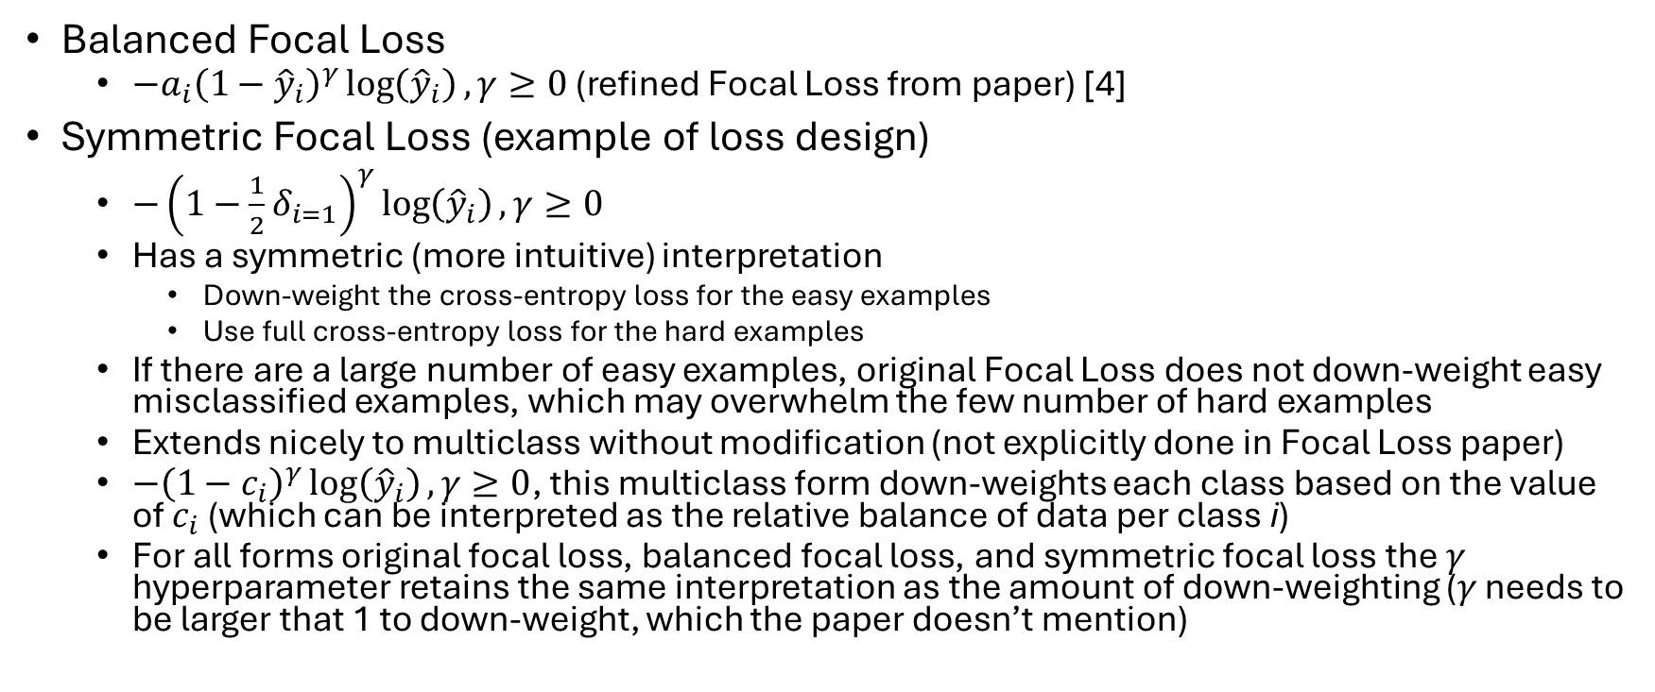
Classification Metrics vs Loss Functions -Imbalanced Data
Balanced Focal Loss
$−a_{i}{\left(1−{\hat{y}}_{i}\right)}^{γ}\log\left({\hat{y}}_{i}\right), γ≥0$ (refined Focal Loss from paper) [4]
Symmetric Focal Loss (example of loss design)
$−{\left(1−\frac{1}{2}δ_{i=1}\right)}^{γ}\log\left({\hat{y}}_{i}\right), γ≥0$
Has a symmetric (more intuitive) interpretation
Down-weight the cross-entropy loss for the easy examples
Use full cross-entropy loss for the hard examples
If there are a large number of easy examples, original Focal Loss does not down-weight easy misclassified examples, which may overwhelm the few number of hard examples
Extends nicely to multiclass without modification (not explicitly done in Focal Loss paper)
$−{\left(1−c_{i}\right)}^{γ}\log\left({\hat{y}}_{i}\right), γ≥0$, this multiclass form down-weights each class based on the value of $c_{i}$ (which can be interpreted as the relative balance of data per class i)
For all forms original focal loss, balanced focal loss, and symmetric focal loss the $γ$ hyperparameter retains the same interpretation as the amount of down-weighting ($γ$ needs to be larger that 1 to down-weight, which the paper doesn’t mention)

Slide 50
Classification Metrics vs Loss Functions -Imbalanced Data
Future consideration
Can use decision theory to find loss that fixes specificity at a desired level and tries to maximize sensitivity

Slide 51
Loss vs Accuracy
What is a better predictor of testing accuracy?
Validation Loss or
Validation Accuracy?
I believe validation accuracy is a better indicator, because the goal of a predictor is to predict which is measured by accuracy. Just because a model is confident, doesn’t mean that it is correct. It can also be confident and incorrect. It is hard to find a satisfying interpretation of prediction confidence. I couldn’t find an answer, so I did the following analysis.

Slide 52

First Consideration
For any model $M^{0}$ with validation loss $L_{V}^{0}$ and testing accuracy $A_{T}^{0}$, there exists a family of models $M^{∗}$ with validation loss $L^{∗}≠L_{V}$ and testing accuracy $A_{T}^{∗}=A_{T}^{0}$.

Slide 53
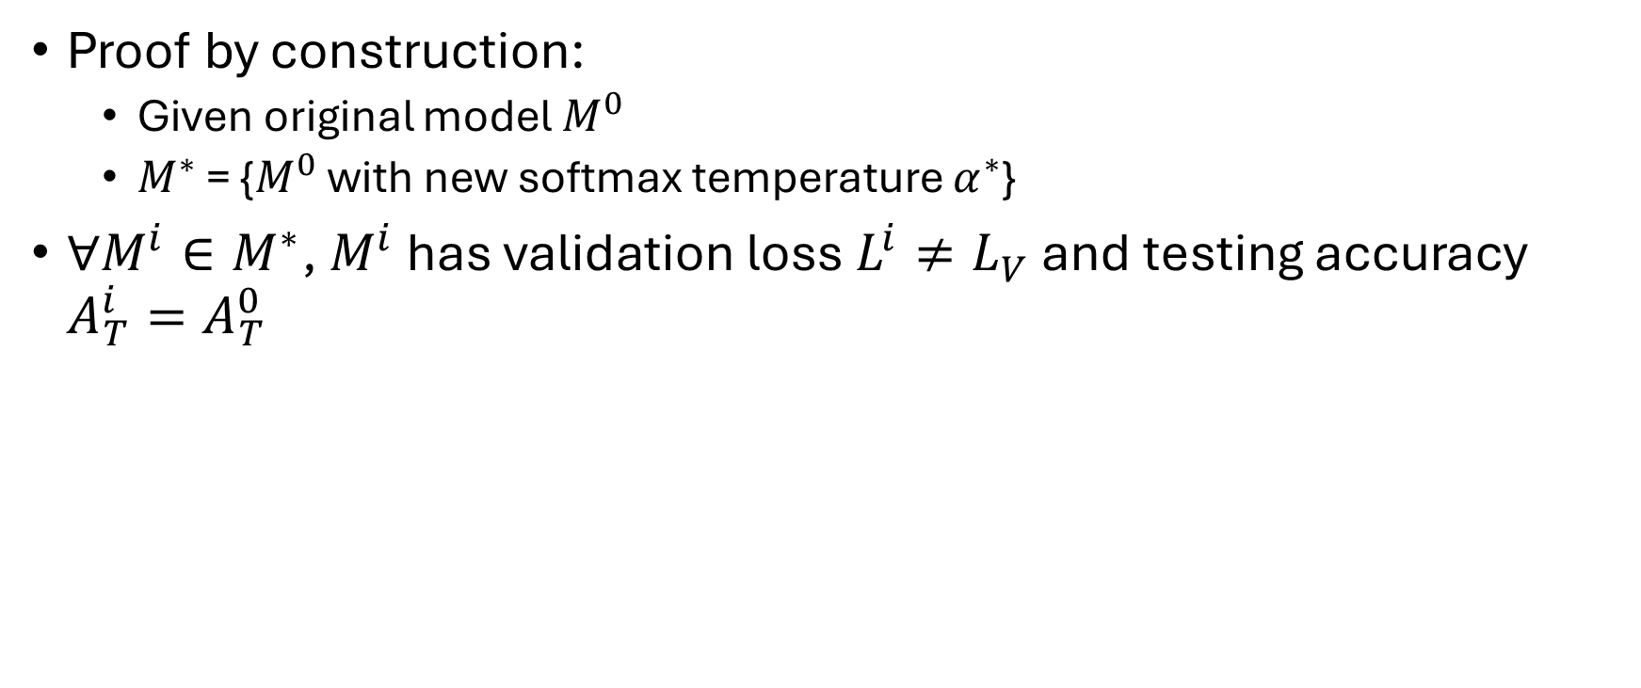
First Consideration
Proof by construction:
Given original model $M^{0}$
$M^{∗}$ = {$M^{0}$ with new softmax temperature $α^{∗}$}
${∀M^{i}∈M}^{∗}$, $M^{i}$ has validation loss $L^{i}≠L_{V}$ and testing accuracy $A_{T}^{i}=A_{T}^{0}$

Slide 54
First Consideration
We proved that there are models with different validations losses that have the same expected testing accuracy.
This doesn’t mean that we proved expected testing accuracy is better predicted by validation accuracy.
See next argument

Slide 55
Second Consideration
If all predictions had the same confidence, loss is minimized when confidence equals accuracy

Slide 56
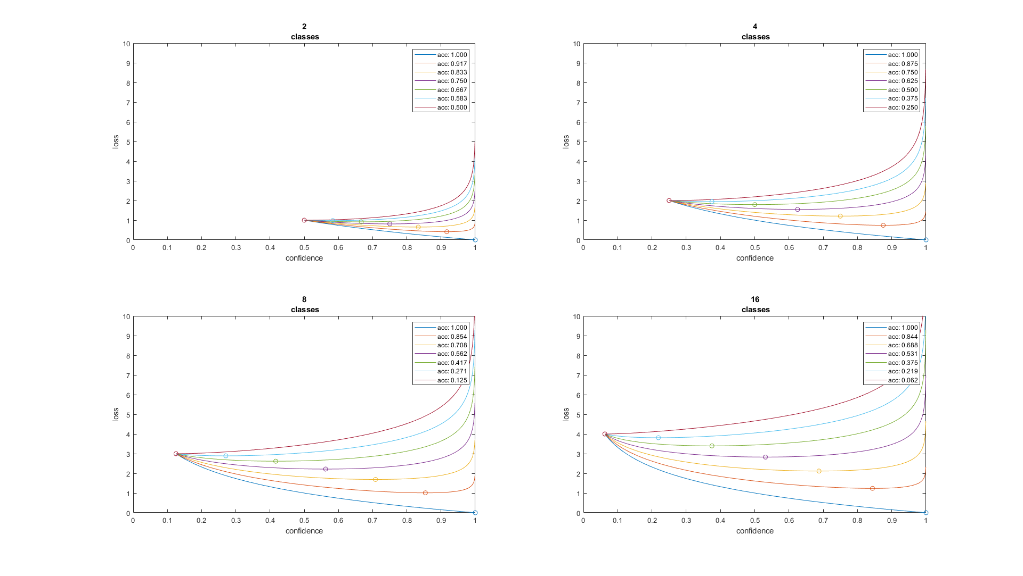

Slide 57
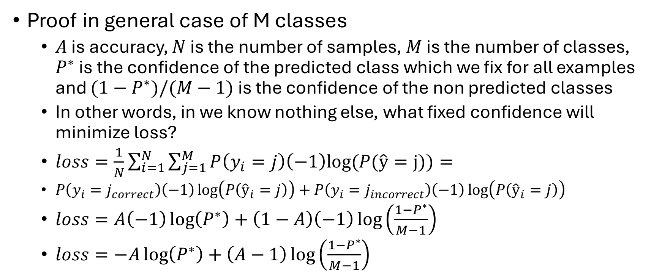
Second Consideration
Proof in general case of M classes
$A$ is accuracy, $N$ is the number of samples, $M$ is the number of classes, $P^{∗}$ is the confidence of the predicted class which we fix for all examples and ${(1−P}^{∗})/(M−1)$ is the confidence of the non predicted classes
In other words, in we know nothing else, what fixed confidence will minimize loss?
$loss=\frac{1}{N}\sum_{i=1}^{N}{\sum_{j=1}^{M}{P\left(y_{i}=j\right)\left(−1\right)log⁡(P(\hat{y}=j))}}=$
$P\left(y_{i}=j_{correct}\right)\left(−1\right)\log\left(P\left({\hat{y}}_{i}=j\right)\right)+P\left(y_{i}=j_{incorrect}\right)\left(−1\right)\log\left(P\left({\hat{y}}_{i}=j\right)\right)$
$loss=A\left(−1\right)\log\left(P^{∗}\right)+\left(1−A\right)\left(−1\right)\log\left(\frac{{1−P}^{∗}}{M−1}\right)$
$loss=−A\log\left(P^{∗}\right)+\left(A−1\right)\log\left(\frac{{1−P}^{∗}}{M−1}\right)$

Slide 58

Second Consideration
Proof continued
$loss=−A\log\left(P^{∗}\right)+\left(A−1\right)\log\left(\frac{{1−P}^{∗}}{M−1}\right)$
$argmin_{P^{∗}}\left(−A\right)\log\left(P^{∗}\right)+\left(A−1\right)\log\left(\frac{{1−P}^{∗}}{M−1}\right)=$
$argmin_{P^{∗}}\left(−A\right)\log\left(P^{∗}\right)+\left(A−1\right)\log\left({1−P}^{∗}\right)−\left(A−1\right)\log\left(M−1\right)=$
$argmin_{P^{∗}}\left(−A\right)\log\left(P^{∗}\right)+\left(A−1\right)\log\left({1−P}^{∗}\right)$
setting derivative to zero
$\left(−A\right)\frac{1}{\ln\left(2\right)P^{∗}}+\left(A−1\right)\frac{−1}{\ln\left(2\right){(1−P}^{∗})}=0$
$\left(−A\right)\frac{1}{\ln\left(2\right)P^{∗}}=\left(A−1\right)\frac{1}{\ln\left(2\right){(1−P}^{∗})}$
$\left(−A\right)\left(1−P^{∗}\right)=\left(A−1\right)P^{∗}$
$−A+{AP}^{∗}=AP^{∗}−P^{∗}$
$P^{∗}=A$

Slide 59

Second Consideration
$P^{∗}=A$
Again, this doesn’t prove that expected testing accuracy is better predicted by validation accuracy.

Slide 60
References
[1] Theory of Point Estimation - Lehmann and Casella
[2] Statistical Inference – Azzalini
[3] Fundamentals of Biostatistics – Rosner
[4] Ross et al. – Focal Loss for Dense Object Detection

