Slide 1
Loss Functions Seminar 2
Old Dominion Vision Lab Seminar
Alex Glandon
2025

Slide 2
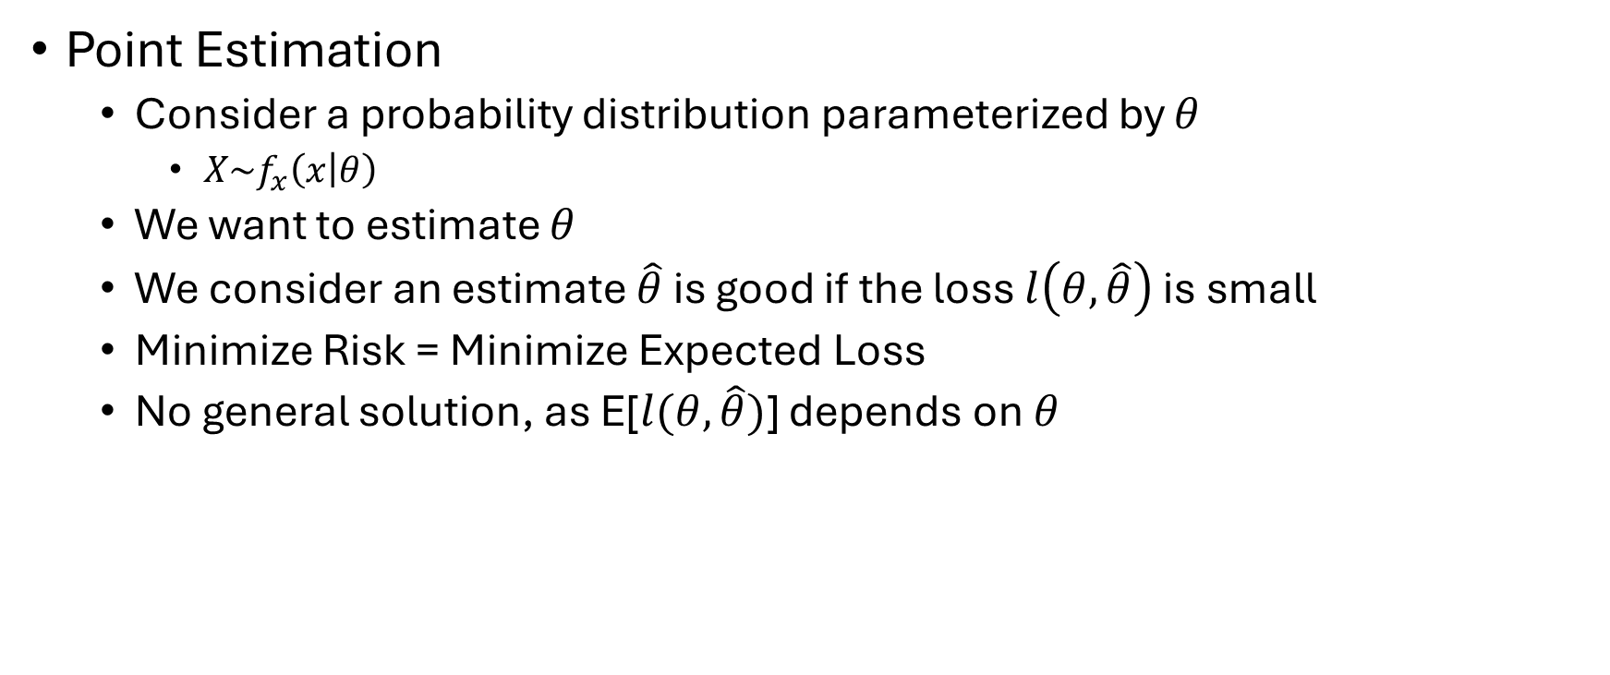
Review the Problem
Point Estimation
Consider a probability distribution parameterized by $θ$
$X\sim f_{x}\left(x | θ\right)$
We want to estimate $θ$
We consider an estimate $\hat{θ}$ is good if the loss $l\left(θ,\hat{θ}\right)$ is small
Minimize Risk = Minimize Expected Loss
No general solution, as E[$l(θ,\hat{θ})$] depends on $θ$

Slide 3
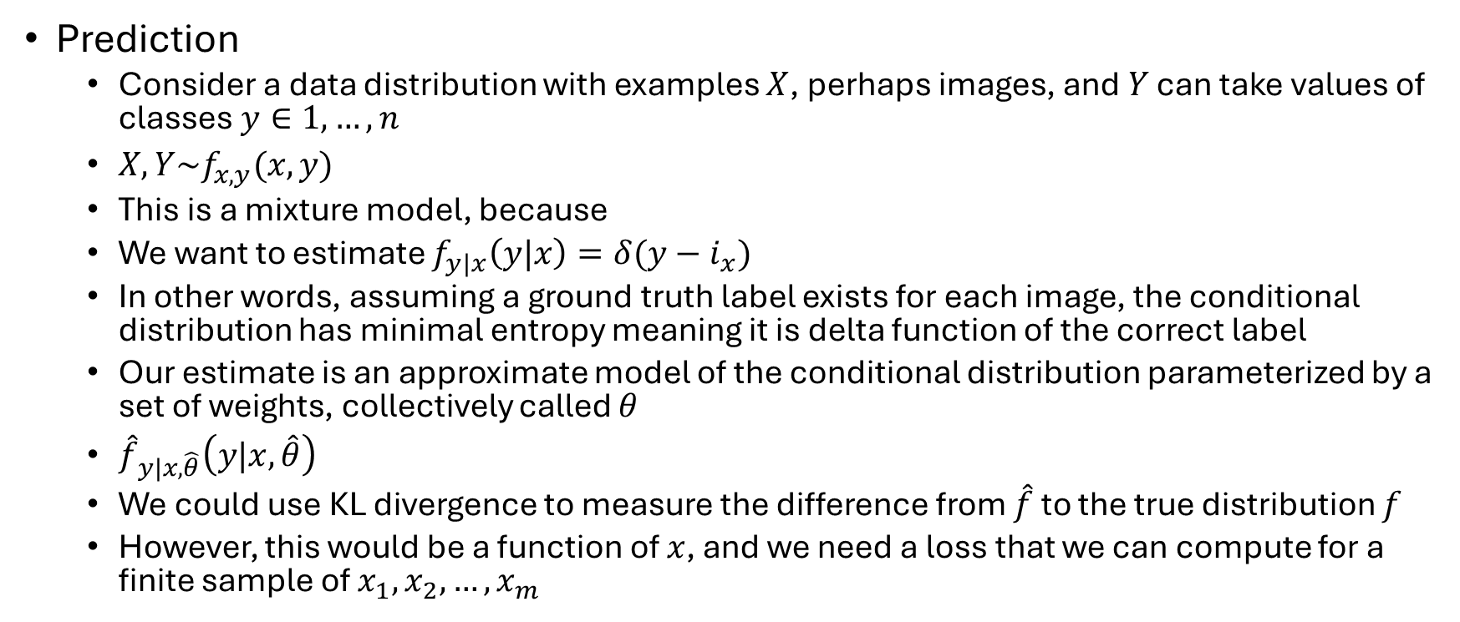
Review the Problem
Prediction
Consider a data distribution with examples $X$, perhaps images, and $Y$ can take values of classes $y∈1,…,n$
$X,Y\sim f_{x,y}(x,y)$
This is a mixture model, because
We want to estimate $f_{y|x}\left(y|x\right)=δ(y−i_{x})$
In other words, assuming a ground truth label exists for each image, the conditional distribution has minimal entropy meaning it is delta function of the correct label
Our estimate is an approximate model of the conditional distribution parameterized by a set of weights, collectively called $θ$
${\hat{f}}_{y|x,\hat{θ}}\left(y|x,\hat{θ}\right)$
We could use KL divergence to measure the difference from $\hat{f}$ to the true distribution $f$
However, this would be a function of $x$, and we need a loss that we can compute for a finite sample of $x_{1},x_{2},…,x_{m}$

Slide 4
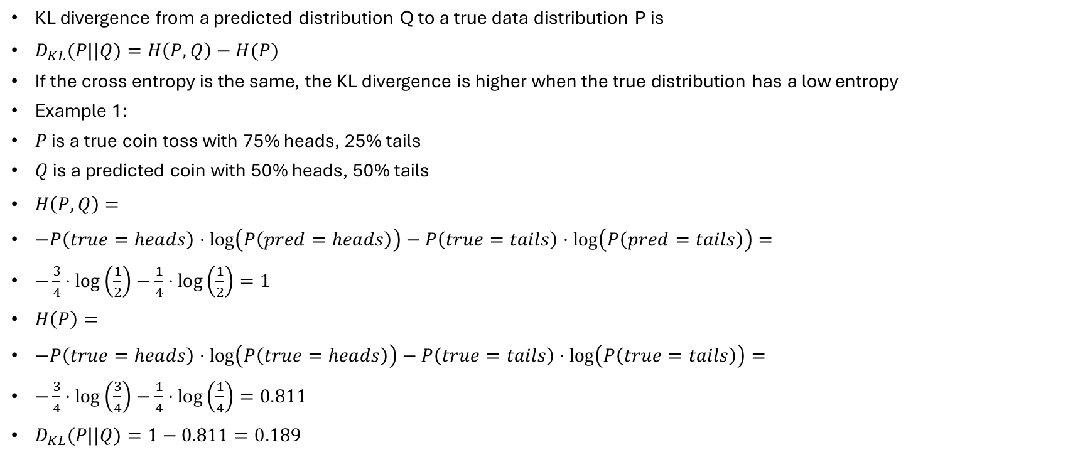
KL divergence and cross entropy
KL divergence from a predicted distribution Q to a true data distribution P is
$D_{KL}(P||Q)=H\left(P,Q\right)−H(P)$
If the cross entropy is the same, the KL divergence is higher when the true distribution has a low entropy
Example 1:
$P$ is a true coin toss with 75% heads, 25% tails
$Q$ is a predicted coin with 50% heads, 50% tails
$H\left(P,Q\right)=$
$−P\left(true=heads\right)⋅\log\left(P\left(pred=heads\right)\right)−P\left(true=tails\right)⋅\log\left(P\left(pred=tails\right)\right)=$
$−\frac{3}{4}⋅\log\left(\frac{1}{2}\right)−\frac{1}{4}⋅\log\left(\frac{1}{2}\right)=1$
$H\left(P\right)=$
$−P\left(true=heads\right)⋅\log\left(P\left(true=heads\right)\right)−P\left(true=tails\right)⋅\log\left(P\left(true=tails\right)\right)=$
$−\frac{3}{4}⋅\log\left(\frac{3}{4}\right)−\frac{1}{4}⋅\log\left(\frac{1}{4}\right)=0.811$
$D_{KL}(P||Q)=1−0.811=0.189$

Slide 5
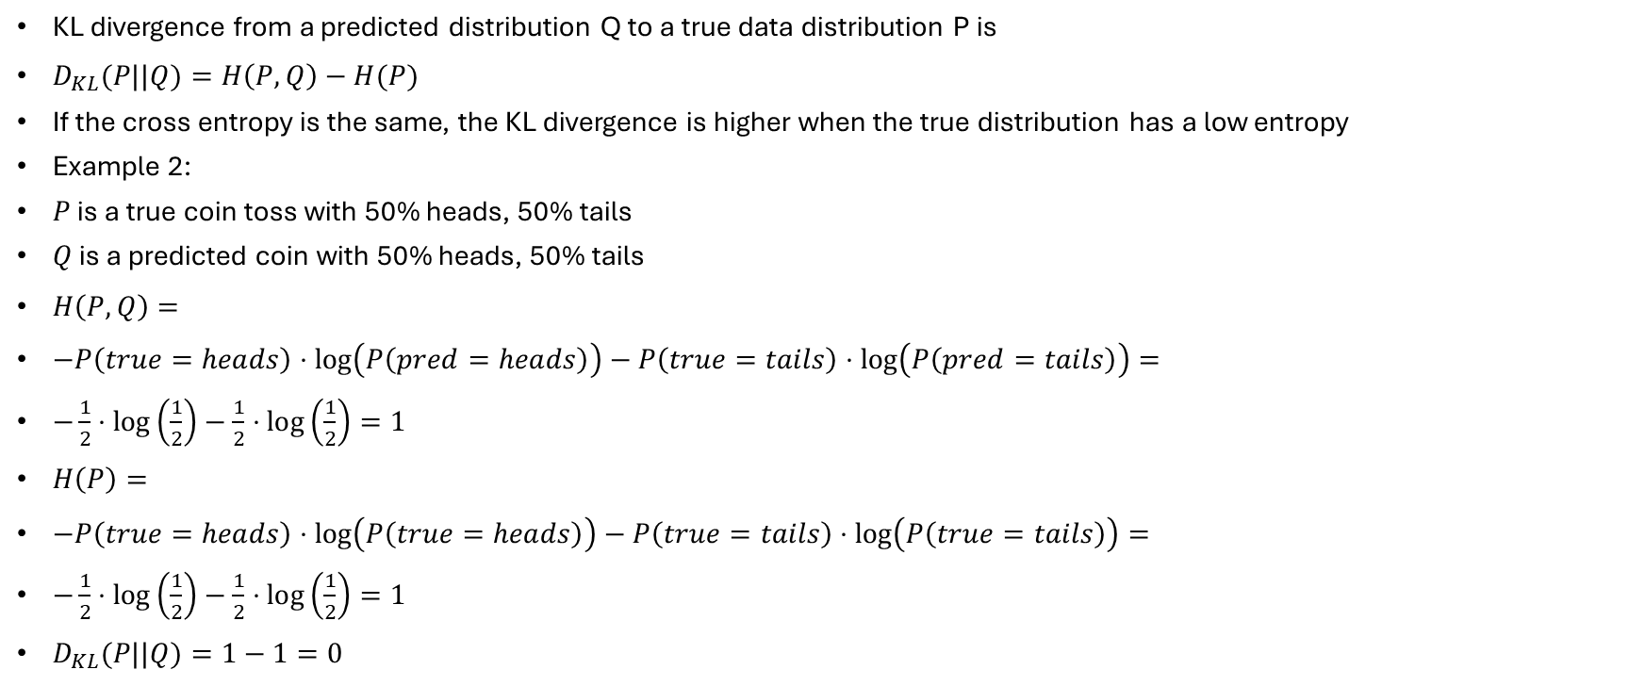
KL divergence and cross entropy
KL divergence from a predicted distribution Q to a true data distribution P is
$D_{KL}(P||Q)=H\left(P,Q\right)−H(P)$
If the cross entropy is the same, the KL divergence is higher when the true distribution has a low entropy
Example 2:
$P$ is a true coin toss with 50% heads, 50% tails
$Q$ is a predicted coin with 50% heads, 50% tails
$H\left(P,Q\right)=$
$−P\left(true=heads\right)⋅\log\left(P\left(pred=heads\right)\right)−P\left(true=tails\right)⋅\log\left(P\left(pred=tails\right)\right)=$
$−\frac{1}{2}⋅\log\left(\frac{1}{2}\right)−\frac{1}{2}⋅\log\left(\frac{1}{2}\right)=1$
$H\left(P\right)=$
$−P\left(true=heads\right)⋅\log\left(P\left(true=heads\right)\right)−P\left(true=tails\right)⋅\log\left(P\left(true=tails\right)\right)=$
$−\frac{1}{2}⋅\log\left(\frac{1}{2}\right)−\frac{1}{2}⋅\log\left(\frac{1}{2}\right)=1$
$D_{KL}(P||Q)=1−1=0$

Slide 6
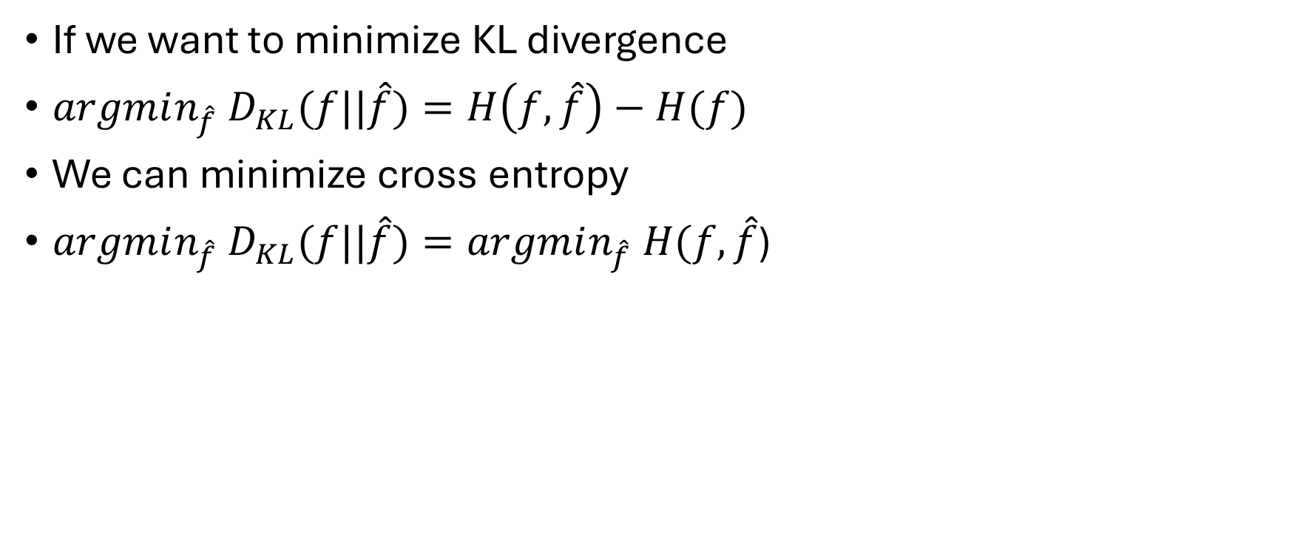
KL divergence and cross entropy
If we want to minimize KL divergence
$argmin_{\hat{f}} D_{KL}(f||\hat{f})=H\left(f,\hat{f}\right)−H(f)$
We can minimize cross entropy
$argmin_{\hat{f}} D_{KL}(f||\hat{f})=argmin_{\hat{f}} H(f,\hat{f}$)

Slide 7
Cross Entropy, ML, and MAP (Bayesian)
I will explain from point estimation perspective
The same applies to prediction, for example my first seminar on MAP for prediction

Slide 8
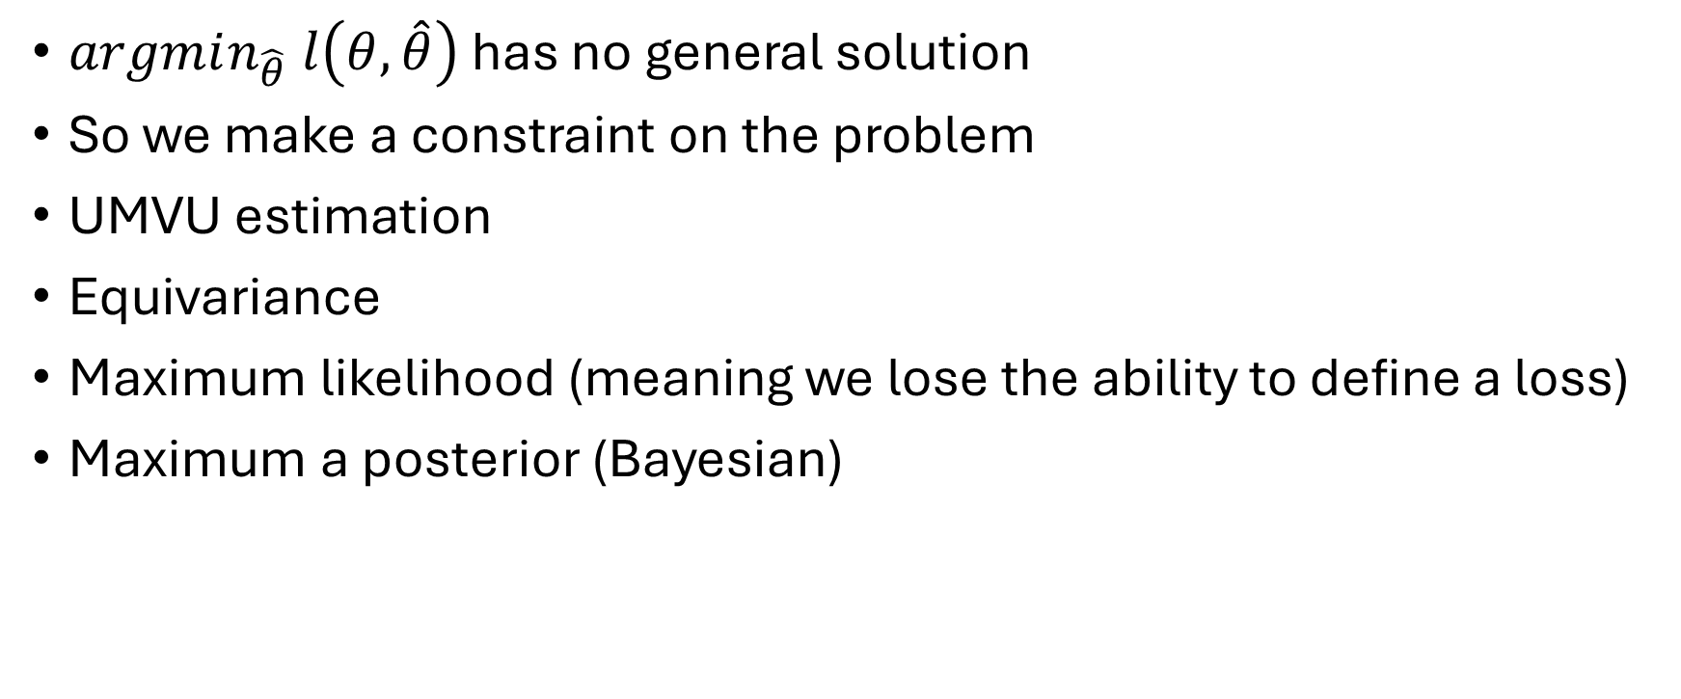
Point Estimation
$argmin_{\hat{θ}} l\left(θ,\hat{θ}\right)$ has no general solution
So we make a constraint on the problem
UMVU estimation
Equivariance
Maximum likelihood (meaning we lose the ability to define a loss)
Maximum a posterior (Bayesian)

Slide 9
Maximum Likelihood
I didn’t explain this for point estimation in last seminar
As an example, take normal distribution
We know for normal the sample mean is unbiased, and the sample variance is biased
Maximum likelihood of normal gives sample mean and sample variance as estimators of mean and variance, so in the case of maximum likelihood for variance, we can a problem with being biased

Slide 10
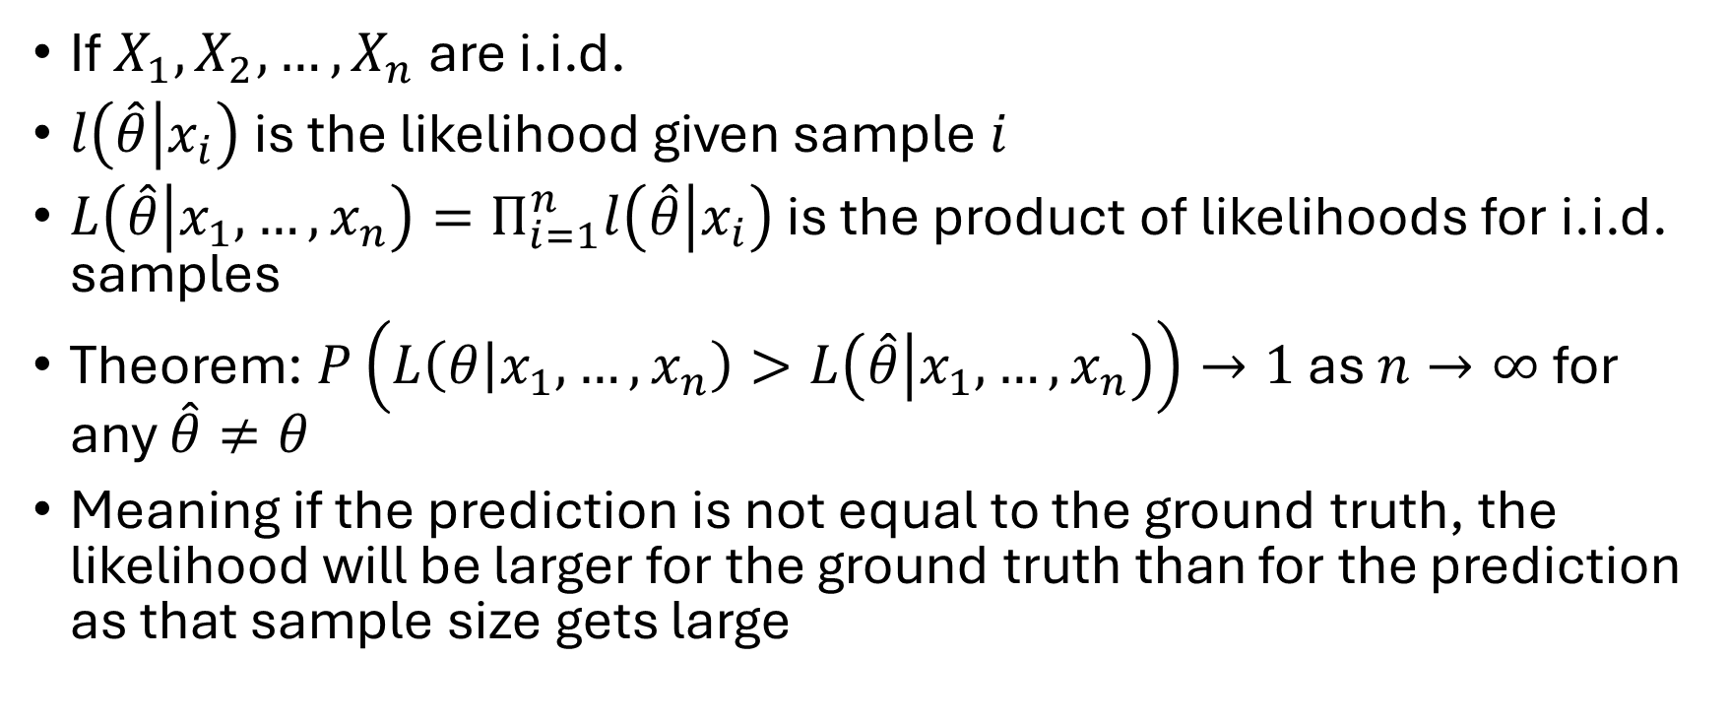
Maximum Likelihood Large Sample Size
If $X_{1},X_{2},…,X_{n}$ are i.i.d.
$l\left(\hat{θ} | x_{i}\right)$ is the likelihood given sample $i$
$L\left(\hat{θ} | x_{1},…,x_{n}\right)=Π_{i=1}^{n}l\left(\hat{θ} | x_{i}\right)$ is the product of likelihoods for i.i.d. samples
Theorem: $P\left(L\left(θ | x_{1},…,x_{n}\right)>L\left(\hat{θ} | x_{1},…,x_{n}\right)\right)→1$ as $n→∞$ for any $\hat{θ}≠θ$
Meaning if the prediction is not equal to the ground truth, the likelihood will be larger for the ground truth than for the prediction as that sample size gets large

Slide 11
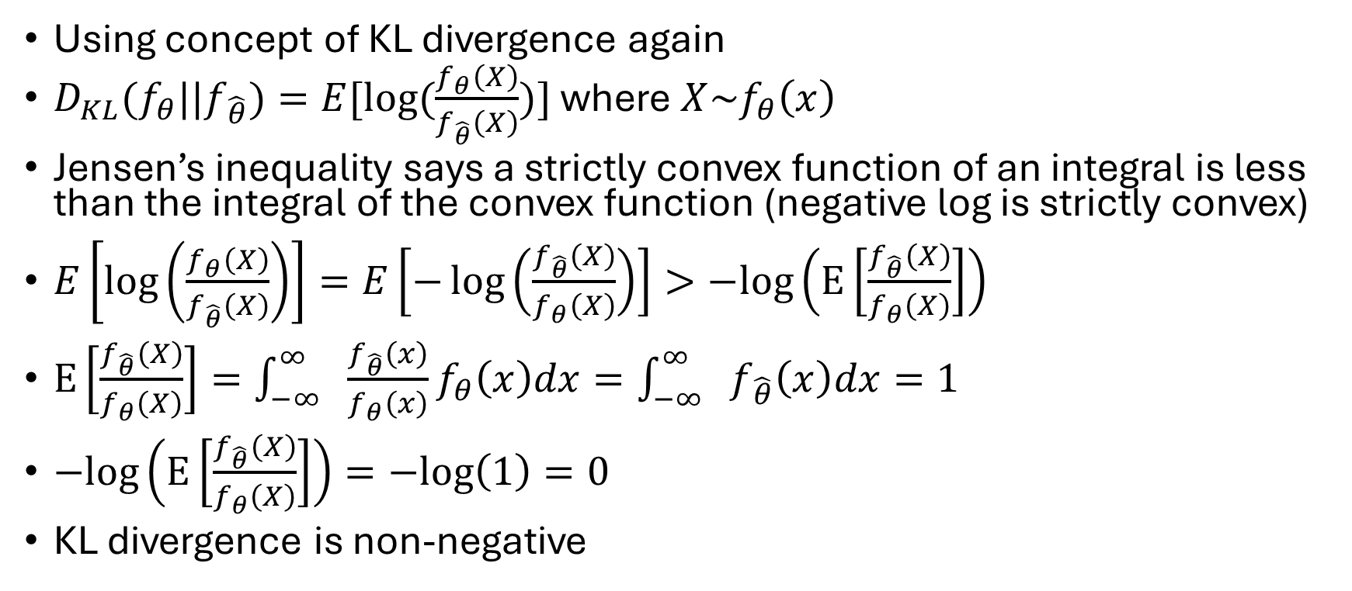
Maximum Likelihood Large Sample Size
Using concept of KL divergence again
$D_{KL}(f_{θ}||f_{\hat{θ}})=E[log⁡(\frac{f_{θ}\left(X\right)}{f_{\hat{θ}}\left(X\right)})]$ where $X\sim f_{θ}\left(x\right)$
Jensen’s inequality says a strictly convex function of an integral is less than the integral of the convex function (negative log is strictly convex)
$E\left[\log\left(\frac{f_{θ}\left(X\right)}{f_{\hat{θ}}\left(X\right)}\right)\right]=E\left[−\log\left(\frac{f_{\hat{θ}}\left(X\right)}{f_{θ}\left(X\right)}\right)\right]>−log\left(E\left[\frac{f_{\hat{θ}}\left(X\right)}{f_{θ}\left(X\right)}\right]\right)$
$E\left[\frac{f_{\hat{θ}}\left(X\right)}{f_{θ}\left(X\right)}\right]=\int_{−∞ }^{∞}{\frac{f_{\hat{θ}}\left(x\right)}{f_{θ}\left(x\right)}f_{θ}\left(x\right)dx}=\int_{−∞ }^{∞}{f_{\hat{θ}}\left(x\right)dx}=1$
$−log\left(E\left[\frac{f_{\hat{θ}}\left(X\right)}{f_{θ}\left(X\right)}\right]\right)=−log\left(1\right)=0$
KL divergence is non-negative

Slide 12

Maximum Likelihood Large Sample Size
Theorem: $P\left(L\left(θ | x_{1},…,x_{n}\right)>L\left(\hat{θ} | x_{1},…,x_{n}\right)\right)→1$ as $n→∞$ for any $\hat{θ}≠θ$
Proof:
From previous slide about KL divergence, for any $\hat{θ}≠θ$
$−\log\left(E\left[\frac{l\left(\hat{θ} | X\right)}{l\left(θ | X\right)}\right]\right)=0$
From Jensen’s inequality
$−\log\left(E\left[\frac{l\left(\hat{θ} | X\right)}{l\left(θ | X\right)}\right]\right)<E\left[−log\left(\frac{l\left(\hat{θ} | X\right)}{l\left(θ | X\right)}\right)\right]$
$0<E\left[−log\left(\frac{l\left(\hat{θ} | X\right)}{l\left(θ | X\right)}\right)\right]$
$0<−E\left[log\left(\frac{l\left(\hat{θ} | X\right)}{l\left(θ | X\right)}\right)\right]$
$E\left[log\left(\frac{l\left(\hat{θ} | X\right)}{l\left(θ | X\right)}\right)\right]<0$

Slide 13
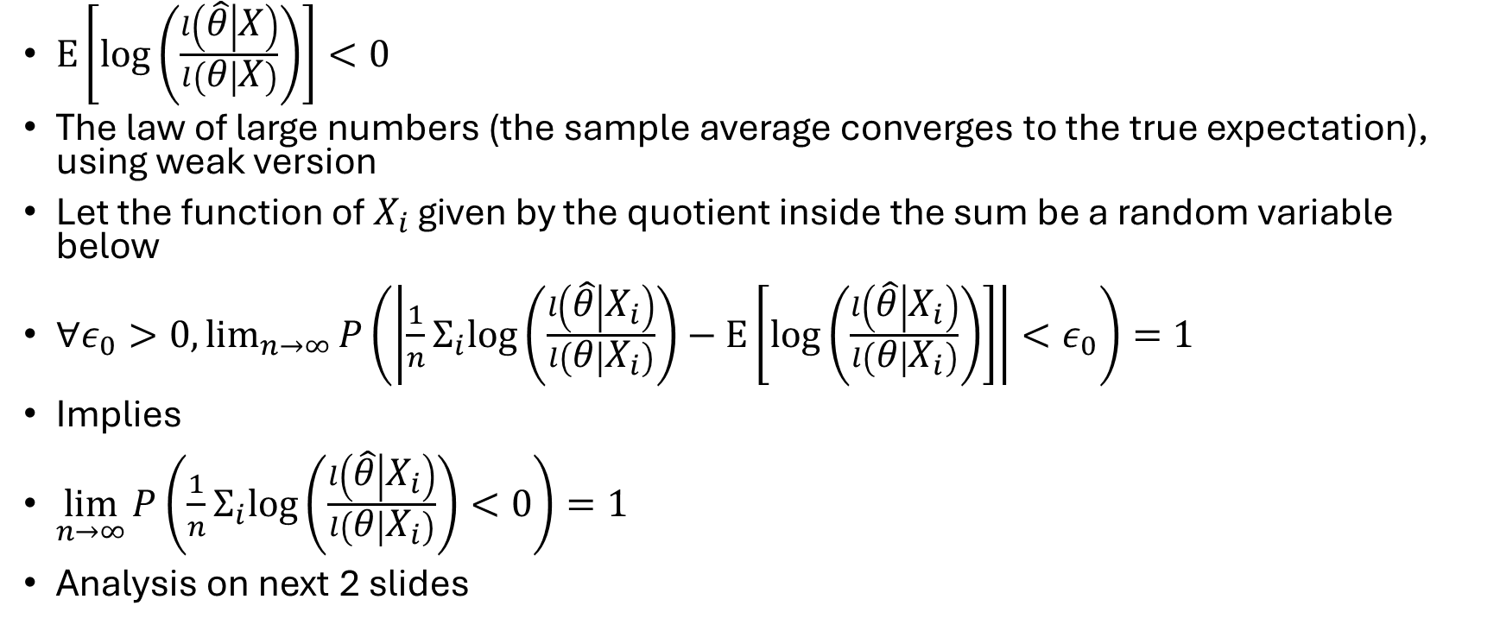
Maximum Likelihood Large Sample Size
$E\left[log\left(\frac{l\left(\hat{θ} | X\right)}{l\left(θ | X\right)}\right)\right]<0$
The law of large numbers (the sample average converges to the true expectation), using weak version
Let the function of $X_{i}$ given by the quotient inside the sum be a random variable below
$∀ε_{0}>0,\lim_{n→∞}{P\left(\left|\frac{1}{n}Σ_{i}log\left(\frac{l\left(\hat{θ} | X_{i}\right)}{l\left(θ | X_{i}\right)}\right)−E\left[log\left(\frac{l\left(\hat{θ} | X_{i}\right)}{l\left(θ | X_{i}\right)}\right)\right]\right|<ε_{0}\right)}=1$
Implies
$\lim_{n→∞}{P\left(\frac{1}{n}Σ_{i}log\left(\frac{l\left(\hat{θ} | X_{i}\right)}{l\left(θ | X_{i}\right)}\right)<0\right)}=1$
Analysis on next 2 slides

Slide 14
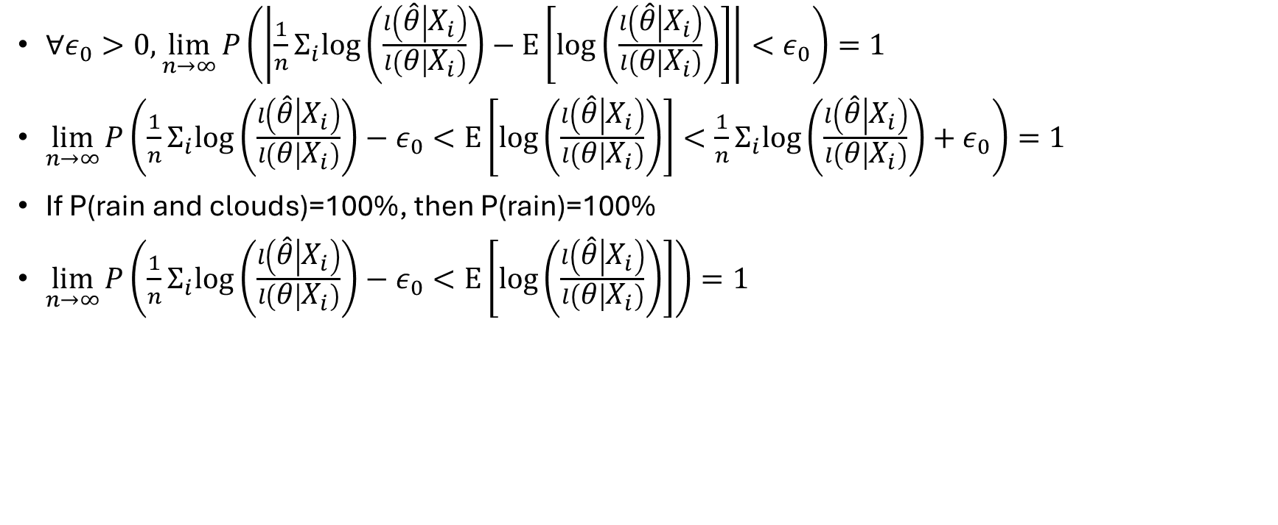
Maximum Likelihood Large Sample Size
$∀ε_{0}>0,\lim_{n→∞}{P\left(\left|\frac{1}{n}Σ_{i}log\left(\frac{l\left(\hat{θ} | X_{i}\right)}{l\left(θ | X_{i}\right)}\right)−E\left[log\left(\frac{l\left(\hat{θ} | X_{i}\right)}{l\left(θ | X_{i}\right)}\right)\right]\right|<ε_{0}\right)}=1$
$\lim_{n→∞}{P\left(\frac{1}{n}Σ_{i}log\left(\frac{l\left(\hat{θ} | X_{i}\right)}{l\left(θ | X_{i}\right)}\right)−ε_{0}<E\left[log\left(\frac{l\left(\hat{θ} | X_{i}\right)}{l\left(θ | X_{i}\right)}\right)\right]<\frac{1}{n}Σ_{i}log\left(\frac{l\left(\hat{θ} | X_{i}\right)}{l\left(θ | X_{i}\right)}\right)+ε_{0}\right)}=1$
If P(rain and clouds)=100%, then P(rain)=100%
$\lim_{n→∞}{P\left(\frac{1}{n}Σ_{i}log\left(\frac{l\left(\hat{θ} | X_{i}\right)}{l\left(θ | X_{i}\right)}\right)−ε_{0}<E\left[log\left(\frac{l\left(\hat{θ} | X_{i}\right)}{l\left(θ | X_{i}\right)}\right)\right]\right)}=1$

Slide 15

Maximum Likelihood Large Sample Size
$∀ε_{0}\lim_{n→∞}{P\left(\frac{1}{n}Σ_{i}log\left(\frac{l\left(\hat{θ} | X_{i}\right)}{l\left(θ | X_{i}\right)}\right)−ε_{0}<E\left[log\left(\frac{l\left(\hat{θ} | X_{i}\right)}{l\left(θ | X_{i}\right)}\right)\right]\right)}=1$
$E\left[log\left(\frac{l\left(\hat{θ} | X\right)}{l\left(θ | X\right)}\right)\right]<0$ means $∃ε_{1}>0$
$E\left[log\left(\frac{l\left(\hat{θ} | X\right)}{l\left(θ | X\right)}\right)\right]+ε_{1}=0$
$∃ε_{0}<ε_{1}→$
$\lim_{n→∞}{P\left(\frac{1}{n}Σ_{i}log\left(\frac{l\left(\hat{θ} | X_{i}\right)}{l\left(θ | X_{i}\right)}\right)−ε_{0}<{−ε}_{1}\right)=1}$
$\lim_{n→∞}{P\left(\frac{1}{n}Σ_{i}log\left(\frac{l\left(\hat{θ} | X_{i}\right)}{l\left(θ | X_{i}\right)}\right)<{−ε}_{1}+ε_{0} \right)}=1$
$\lim_{n→∞}{P\left(\frac{1}{n}Σ_{i}log\left(\frac{l\left(\hat{θ} | X_{i}\right)}{l\left(θ | X_{i}\right)}\right)<ε_{2}\right)=1} , ε_{2}<0$
Again, if P(rain and clouds)=100%, then P(rain)=100%
$\lim_{n→∞}{P\left(\frac{1}{n}Σ_{i}log\left(\frac{l\left(\hat{θ} | X_{i}\right)}{l\left(θ | X_{i}\right)}\right)<0\right)}=1$

Slide 16

Maximum Likelihood Large Sample Size
$\lim_{n→∞}{P\left(\frac{1}{n}Σ_{i}log\left(\frac{l\left(\hat{θ} | X_{i}\right)}{l\left(θ | X_{i}\right)}\right)<0\right)}=1$
$\lim_{n→∞}{P\left(Σ_{i}log\left(\frac{l\left(\hat{θ} | X_{i}\right)}{l\left(θ | X_{i}\right)}\right)<0\right)}=1$
$\lim_{n→∞}{P\left(\log\left(Π_{i}\left(\frac{l\left(\hat{θ} | X_{i}\right)}{l\left(θ | X_{i}\right)}\right)\right)<0\right)}=1$
$\lim_{n→∞}{P\left(Π_{i}\left(\frac{l\left(\hat{θ} | X_{i}\right)}{l\left(θ | X_{i}\right)}\right)<1\right)}=1$
$\lim_{n→∞}{P\left(\frac{Π_{i} l\left(\hat{θ} | X_{i}\right)}{Π_{i} l\left(θ | X_{i}\right)}<1\right)}=1$
$\lim_{n→∞}{P\left(Π_{i} l\left(θ | X_{i}\right)>Π_{i} l\left(\hat{θ} | X_{i}\right)\right)}=1$
$\lim_{n→∞}{P\left(L\left(θ | X_{1},…,X_{m}\right)>L\left(\hat{θ} | X_{1},…,X_{m}\right)\right)}=1$

Slide 17
Maximum Likelihood
Equivalent to minimizing mean squared loss for regression
Equivalent to minimizing cross entropy loss for classification
May not be the best if the number of samples is low
For example, if number of samples if low, we would not use maximum likelihood for normal variance estimation, we would use the unbiased estimator
May not be the best if the loss function is customized based on the problem
For example, consider a loss that penalizes small error more than large errors. According to Berger decision theory text, the first million dollars is worth more than the second million dollars, is an example of a loss function that is more complicated

Slide 18
MAP estimation
Bayesian estimation is a point estimation
Even in maximum likelihood, we have a distribution, but we find the mode or the max of the distribution
In Bayesian, we use a prior to weight the distribution, but again we need to select a parameter to use in prediction, so we take the mode or the max of the posterior
Considering a distribution is not special to Bayesian, is it just probabilistic
We also use distributions for UMVU, maximum likelihood, equivariance, minimax
Of course there are ways to use Bayesian other than point estimation

Slide 19
Urn problem question
If we find any unbiased estimator, it will have high variance for certain values of n (because no UMVU exists)
I think I said high variance for high values of n
An unbiased estimator could exist with high variance for lower values of n
I think in the urn problem, because each outcome is equally likely from 1 to n, that the variance increases for high values of n, haven’t found a proof yet
Proof sketch
An unbiased estimator of n, needs to assign probability mass to large values of k, so that when k is large our estimate of n is large
Because n may be small, we also need to assign probability values to small k
If we assign probability mass to small and large k, and n is high, our mass is distributed over a large spread, so we get high variance

