Slide 1
Ilia State University
Course Overview Systems Programming 1st Lecture, Mar 24. 2022
Instructor:
Amiran Malania

Slide 2
Overview
Ilia State University
Introduction
Course theme
Five realities
How the course fits into the CS/ECE curriculum
Academic integrity

Slide 3
Introduction
Ilia State University
I’m Amiran Malania
BSc in computer science from San Diego State University
Software Engineer at Qarva
Working on High Performance, High Concurrency Media Server
Researcher at Ilia’s Computing Center
Heap Exploits
Running and MTB

Slide 4
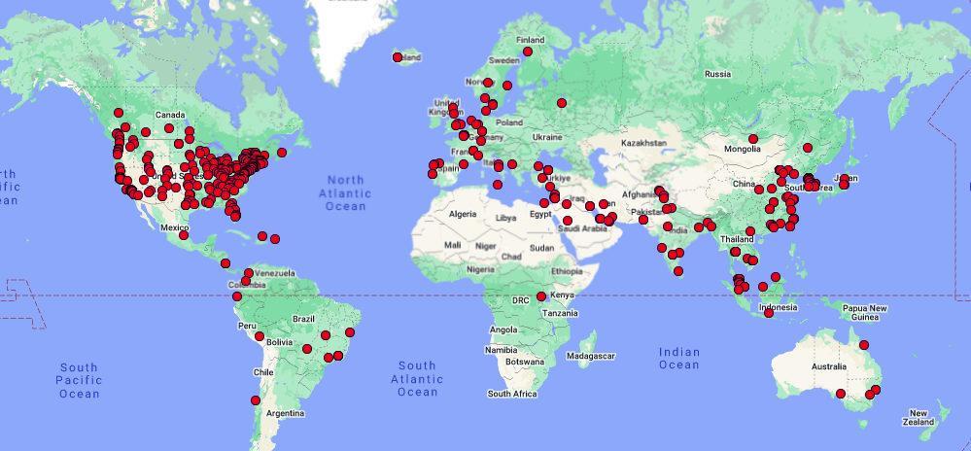
Carnegie Mellon University
Ilia State University
Created at The #1 CS School in The World
BSc in computer science from San Diego State University

Slide 5
Course Theme: Abstraction Is Good But Don’t Forget Reality
Ilia State University
Most CS and CE courses emphasize abstraction
Abstract data types
Asymptotic analysis
These abstractions have limits
Especially in the presence of bugs
Need to understand details of underlying implementations
Useful outcomes from taking this class
Become more effective programmers
Able to find and eliminate bugs efficiently
Able to understand and tune for program performance
Prepare for later “systems” classes in CS & CE
Compilers, Operating Systems, Networks, Computer Architecture, Embedded Systems, Storage Systems, etc.

Slide 6
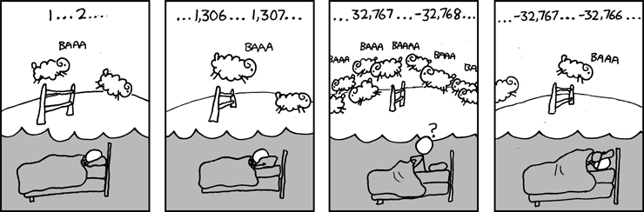
Great Reality #1: Ints are not Integers
Ilia State University
Example 1: Is x² ≥ 0?
Float’s: Yes!
Int’s:
40000 * 40000 ➙ 1600000000
50000 * 50000 ➙ ??
Source: xkcd.com/571

Slide 7
Computer Arithmetic
Ilia State University
Does not generate random values
Arithmetic operations have important mathematical properties
Cannot assume all “usual” mathematical properties
Due to finiteness of representations
Integer operations satisfy “ring” properties
Commutativity, associativity, distributivity
Observation
Need to understand which abstractions apply in which contexts
Important issues for compiler writers and serious application programmers

Slide 8
Great Reality #2: You’ve Got to Know Assembly
Ilia State University
Chances are, you’ll never write programs in assembly
Compilers are much better & more patient than you are
But: Understanding assembly is key to machine-level execution model
Behavior of programs in presence of bugs
High-level language models break down
Tuning program performance
Understand optimizations done / not done by the compiler
Understanding sources of program inefficiency
Implementing system software
Compiler has machine code as target
Operating systems must manage process state
Creating / fighting malware
x86 assembly is the language of choice!

Slide 9
Great Reality #3: Memory Matters Random Access Memory Is an Unphysical Abstraction
Ilia State University
Memory is not unbounded
It must be allocated and managed
Many applications are memory dominated
Memory referencing bugs especially pernicious
Effects are distant in both time and space
Memory performance is not uniform
Cache and virtual memory effects can greatly affect program performance
Adapting program to characteristics of memory system can lead to major speed improvements

Slide 10
Memory Referencing Bug Example
Ilia State University
typedef struct {
int a[2];
double d;
} struct_t;
double fun(int i) {
volatile struct_t s;
s.d = 3.14;
s.a[i] = 1073741824; /* Possibly out of bounds */
return s.d;
}
fun(0) ➙ 3.14
fun(1) ➙ 3.14
fun(2) ➙ 3.1399998664856
fun(3) ➙ 2.00000061035156
fun(4) ➙ 3.14
fun(6) ➙ Segmentation fault
Result is system specific

Slide 11
Memory Referencing Bug Example
Ilia State University
typedef struct {
int a[2];
double d;
} struct_t;
fun(0) ➙ 3.14
fun(1) ➙ 3.14
fun(2) ➙ 3.1399998664856
fun(3) ➙ 2.00000061035156
fun(4) ➙ 3.14
fun(6) ➙ Segmentation fault
Explanation:
Critical State | 6
? | 5
? | 4
d7 ... d4 | 3
d3 ... d0 | 2
a[1] | 1
a[0] | 0
Location accessed by fun(i)
struct_t

Slide 12
Memory Referencing Errors
Ilia State University
C and C++ do not provide any memory protection
Out of bounds array references
Invalid pointer values
Abuses of malloc/free
Can lead to nasty bugs
Whether or not bug has any effect depends on system and compiler
Action at a distance
Corrupted object logically unrelated to one being accessed
Effect of bug may be first observed long after it is generated
How can I deal with this?
Program in Java, Ruby, Python, ML, …
Understand what possible interactions may occur
Use or develop tools to detect referencing errors (e.g. Valgrind)

Slide 13
Great Reality #4: There’s more to performance than asymptotic complexity
Ilia State University
Constant factors matter too!
And even exact op count does not predict performance
Easily see 10:1 performance range depending on how code written
Must optimize at multiple levels: algorithm, data representations, procedures, and loops
Must understand system to optimize performance
How programs compiled and executed
How to measure program performance and identify bottlenecks
How to improve performance without destroying code modularity and generality

Slide 14
Memory System Performance Example
Ilia State University
void copyij(int src[2048][2048],
int dst[2048][2048])
{
int i,j;
for (i = 0; i < 2048; i++)
for (j = 0; j < 2048; j++)
dst[i][j] = src[i][j];
}
void copyji(int src[2048][2048],
int dst[2048][2048])
{
int i,j;
for (j = 0; j < 2048; j++)
for (i = 0; i < 2048; i++)
dst[i][j] = src[i][j];
}
4.3ms
81.8ms
2.0 GHz Intel Core i7 Haswell
Hierarchical memory organization
Performance depends on access patterns
Including how step through multi-dimensional array

Slide 15
Great Reality #5: Computers do more than execute programs
Ilia State University
They need to get data in and out
I/O system critical to program reliability and performance
They communicate with each other over networks
Many system-level issues arise in presence of network
Concurrent operations by autonomous processes
Coping with unreliable media
Cross platform compatibility
Complex performance issues

Slide 16
Course Perspective
Ilia State University
Most Systems Courses are Builder-Centric
Computer Architecture
Design pipelined processor in Verilog
Operating Systems
Implement sample portions of operating system
Compilers
Write compiler for simple language
Networking
Implement and simulate network protocols

Slide 17
Course Perspective (Cont.)
Ilia State University
Our Course is Programmer-Centric
Purpose is to show that by knowing more about the underlying system, one can be more effective as a programmer
Enable you to
Write programs that are more reliable and efficient
Incorporate features that require hooks into OS
E.g., concurrency, signal handlers
Cover material in this course that you won’t see elsewhere

Slide 18
Textbooks
Ilia State University
Randal E. Bryant and David R. O’Hallaron,
Computer Systems: A Programmer’s Perspective, Third Edition (CS:APP3e), Pearson, 2016
This book really matters for the course!
How to solve labs
Practice problems typical of exam problems
Robert C. Seacord,
Effective C: An Introduction To Professional C Programming
Personal favourite modern C book
Brian Kernighan and Dennis Ritchie,
The C Programming Language, Second Edition, Prentice Hall, 1988
Classic C book

Slide 19
Course Components
Ilia State University
Lectures
Higher level concepts
Practices
Applied concepts, important tools and skills for labs, clarification of lectures, exam coverage
Labs (7)
The heart of the course
1-2 weeks each
Provide in-depth understanding of an aspect of systems
Programming and measurement
Exams (midterm + final)
Test your understanding of concepts & mathematical principles

Slide 20
Programs and Data
Ilia State University
Topics
Bits operations, arithmetic, assembly language programs
Representation of C control and data structures
Includes aspects of architecture and compilers
Assignments
L1 (datalab): Manipulating bits
L2 (bomblab): Defusing a binary bomb
L3 (attacklab): The basics of code injection attacks

Slide 21
The Memory Hierarchy
Ilia State University
Topics
Memory technology, memory hierarchy, caches, disks, locality
Includes aspects of architecture and OS
Assignments
L4 (cachelab): Building a cache simulator and optimizing for locality.
Learn how to exploit locality in your programs.

Slide 22
Exceptional Control Flow
Ilia State University
Topics
Hardware exceptions, processes, process control, Unix signals, nonlocal jumps
Includes aspects of compilers, OS, and architecture
Assignments
L5 (tshlab): Writing your own Unix shell.
A first introduction to concurrency

Slide 23
Virtual Memory
Ilia State University
Topics
Virtual memory, address translation, dynamic storage allocation
Includes aspects of architecture and OS
Assignments
L6 (malloclab): Writing your own malloc package
Get a real feel for systems-level programming

Slide 24
Networking, and Concurrency
Ilia State University
Topics
High level and low-level I/O, network programming
Internet services, Web servers
concurrency, concurrent server design, threads
I/O multiplexing with select
Includes aspects of networking, OS, and architecture
Assignments
L7 (proxylab): Writing your own Web proxy
Learn network programming and more about concurrency and synchronization.

Slide 25
Lab Rationale
Ilia State University
Each lab has a well-defined goal such as solving a puzzle or winning a contest
Doing the lab should result in new skills and concepts

Slide 26
Welcome and Enjoy!
Ilia State University

