Slide 1
Bits, Bytes, and Integers Systems Programming 2nd and 3rd Lectures, Mar. 26 and Mar. 31, 2022
Instructors:
Amiran Malania

Slide 2
Before we get started…
Discord server will be on soon. Use it heavily!
Access to book and syllabus?
Providing Linux power user tutorial
VsCode for remote SSH access
Once again:
(1) Read chapters before class
(2) Attend classes
(3) Re-read the chapter + solve practice problems
(4) Do Labs
If stuck go to step (3)

Slide 3
Today: Bits, Bytes, and Integers
Representing information as bits
Bit-level manipulations
Integers
Representation: unsigned and signed
Conversion, casting
Expanding, truncating
Addition, negation, multiplication, shifting
Summary
Representations in memory, pointers, strings
Notes:
As we saw during our previous class, integer arithmetic could result in really strange behaviour. The reason we’re spending time on bit representations is to be able to understand exactly what happens when those strange accidents take place.

Slide 4
Everything is bits
Each bit is 0 or 1
By encoding/interpreting sets of bits in various ways
Computers determine what to do (instructions)
… and represent and manipulate numbers, sets, strings, etc…
Why bits? Electronic Implementation
Easy to store with bistable elements
Reliably transmitted on noisy and inaccurate wires
0
1
0
1.1V
0.9V
0.2V
0.0V

Slide 5
For example, can count in binary
Base 2 Number Representation
Represents 4 as 0100₂
Represent 15213₁₀ as 11101101101101₂
Represent 1.20₁₀ as 1.0011001100110011[0011]…₂

Slide 6
Encoding Byte Values
Byte = 8 bits
Binary 00000000₂ to 11111111₂
Decimal: 0₁₀ to 255₁₀
Hexadecimal 00₁₆ to FF₁₆
Base 16 number representation
Use characters ‘0’ to ‘9’ and ‘A’ to ‘F’
Write FA1D37B₁₆ in C as
0xFA1D37B
0xfa1d37b
Decimal
Hex
Binary
0
0
0000
1
1
0001
2
2
0010
3
3
0011
4
4
0100
5
5
0101
6
6
0110
7
7
0111
8
8
1000
9
9
1001
A
10
1010
B
11
1011
C
12
1100
D
13
1101
E
14
1110
F
15
1111
Notes:
Hex representations are especially useful. Be skilled at converting binary to hex and vice versa.

Slide 7
Example Data Representations
C Data Type | Typical 32-bit | Typical 64-bit | x86-64
char | 1 | 1 | 1
short | 2 | 2 | 2
int | 4 | 4 | 4
long | 4 | 8 | 8
float | 4 | 4 | 4
double | 8 | 8 | 8
long double | − | − | 10/16
pointer | 4 | 8 | 8
Notes:
These sizes for types are not guaranteed by C standard, besides char which always takes 1 byte. Size of a type could depend on the machine it’s run on, os, and compiler

Slide 8
Today: Bits, Bytes, and Integers
Representing information as bits
Bit-level manipulations
Integers
Representation: unsigned and signed
Conversion, casting
Expanding, truncating
Addition, negation, multiplication, shifting
Summary
Representations in memory, pointers, strings

Slide 9
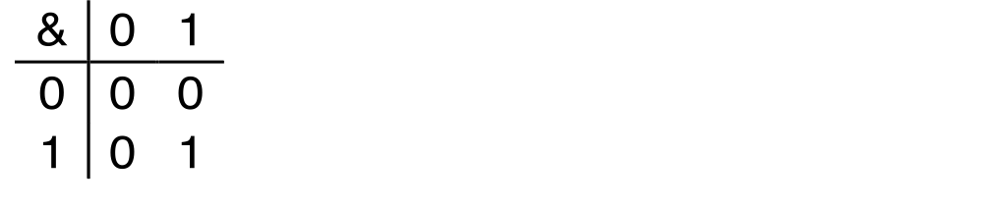
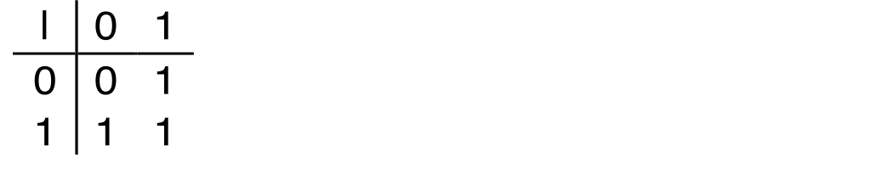
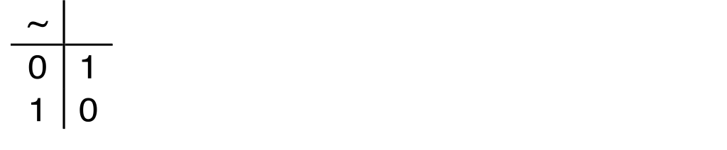
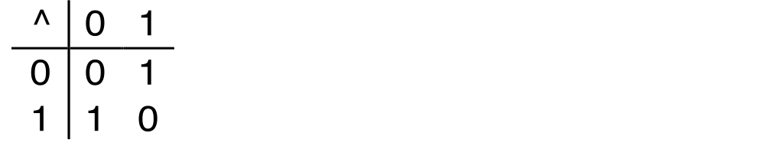
Boolean Algebra
Developed by George Boole in 19th Century
Algebraic representation of logic
Encode “True” as 1 and “False” as 0
And
A&B = 1 when both A=1 and B=1
Or
A|B = 1 when either A=1 or B=1
Not
~A = 1 when A=0
Exclusive-Or (Xor)
A^B = 1 when either A=1 or B=1, but not both
Notes:
We can think of bits in terms of what operations are performed on them. This is where bools algebra comes into play, it represents operations that can be performed on bits. This takes place in 19th century, but later, MIT’s studen Claud Shanon took this idea further and relized that he could represent information using bools algebra and apply to digital systems.

Slide 10
General Boolean Algebras
Operate on Bit Vectors
Operations applied bitwise
All of the Properties of Boolean Algebra Apply
01101001
& 01010101
01000001
01101001
| 01010101
01111101
01101001
^ 01010101
00111100
~ 01010101
10101010
01000001
01111101
00111100
10101010

Slide 11
Example: Representing & Manipulating Sets
Representation
Width w bit vector represents subsets of {0, …, w–1}
a_{j} = 1 if j ∈ A
01101001 { 0, 3, 5, 6 }
76543210
01010101 { 0, 2, 4, 6 }
76543210
Operations
& Intersection 01000001 { 0, 6 }
| Union 01111101 { 0, 2, 3, 4, 5, 6 }
^ Symmetric difference 00111100 { 2, 3, 4, 5 }
~ Complement 10101010 { 1, 3, 5, 7 }
Notes:
We can also use bits to represent sets of numbers. After that, this bit operations become set operations

Slide 12
Bit-Level Operations in C
Operations &, |, ~, ^ Available in C
Apply to any “integral” data type
long, int, short, char, unsigned
View arguments as bit vectors
Arguments applied bit-wise
Examples (Char data type)
~0x41 ➙ 0xBE
~01000001₂ ➙ 10111110₂
~0x00 ➙ 0xFF
~00000000₂ ➙ 11111111₂
0x69 & 0x55 ➙ 0x41
01101001₂ & 01010101₂ ➙ 01000001₂
0x69 | 0x55 ➙ 0x7D
01101001₂ | 01010101₂ ➙ 01111101₂

Slide 13
Contrast: Logic Operations in C
Contrast to Logical Operators
&&, ||, !
View 0 as “False”
Anything nonzero as “True”
Always return 0 or 1
Early termination
Examples (char data type)
!0x41 ➙ 0x00
!0x00 ➙ 0x01
!!0x41 ➙ 0x01
0x69 && 0x55 ➙ 0x01
0x69 || 0x55 ➙ 0x01
p && *p (avoids null pointer access)

Slide 14
Contrast: Logic Operations in C
Contrast to Logical Operators
&&, ||, !
View 0 as “False”
Anything nonzero as “True”
Always return 0 or 1
Early termination
Examples (char data type)
!0x41 ➙ 0x00
!0x00 ➙ 0x01
!!0x41 ➙ 0x01
0x69 && 0x55 ➙ 0x01
0x69 || 0x55 ➙ 0x01
p && *p (avoids null pointer access)
Watch out for && vs. & (and || vs. |)…
one of the more common oopsies in
C programming

Slide 15
Shift Operations
Left Shift: x << y
Shift bit-vector x left y positions
Throw away extra bits on left
Fill with 0’s on right
Right Shift: x >> y
Shift bit-vector x right y positions
Throw away extra bits on right
Logical shift
Fill with 0’s on left
Arithmetic shift
Replicate most significant bit on left
Undefined Behavior
Shift amount < 0 or ≥ word size
Argument x
01100010
<< 3
00010000
00010000
00010000
Log. >> 2
00011000
00011000
00011000
Arith. >> 2
00011000
00011000
00011000
Argument x
10100010
<< 3
00010000
00010000
00010000
Log. >> 2
00101000
00101000
00101000
Arith. >> 2
11101000
11101000
11101000

Slide 16
Today: Bits, Bytes, and Integers
Representing information as bits
Bit-level manipulations
Integers
Representation: unsigned and signed
Conversion, casting
Expanding, truncating
Addition, negation, multiplication, shifting
Summary
Representations in memory, pointers, strings
Summary

Slide 17
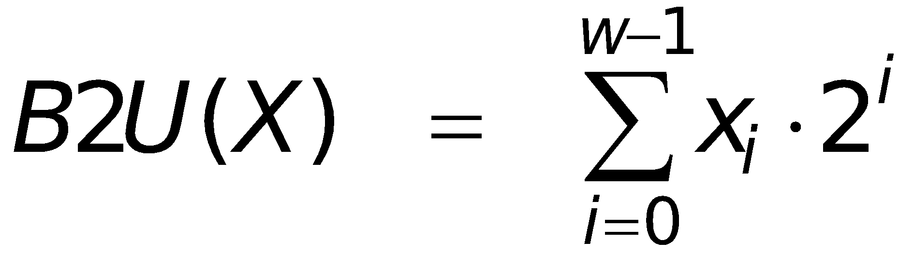
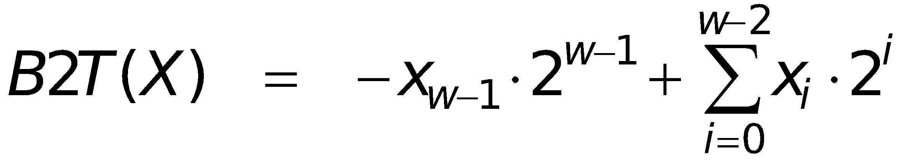
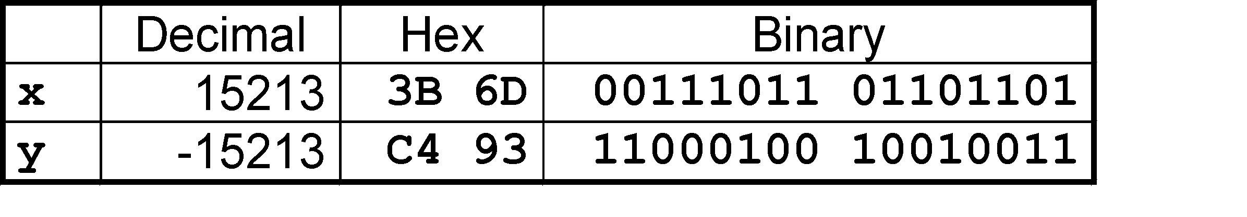
Encoding Integers
Unsigned
Two’s Complement
short int x = 15213;
short int y = -15213;
Sign
Bit
C short 2 bytes long
Sign Bit
For 2’s complement, most significant bit indicates sign
0 for nonnegative
1 for negative
Notes:
Do small example on 5 bits. Show that same bit pattern could be interpreted as negative if it happens to have 1 as most significant bit. Read book for more information. Tips (1) don’t get confused with equations in book (2) try out small examples w=4 to see what it does

Slide 18
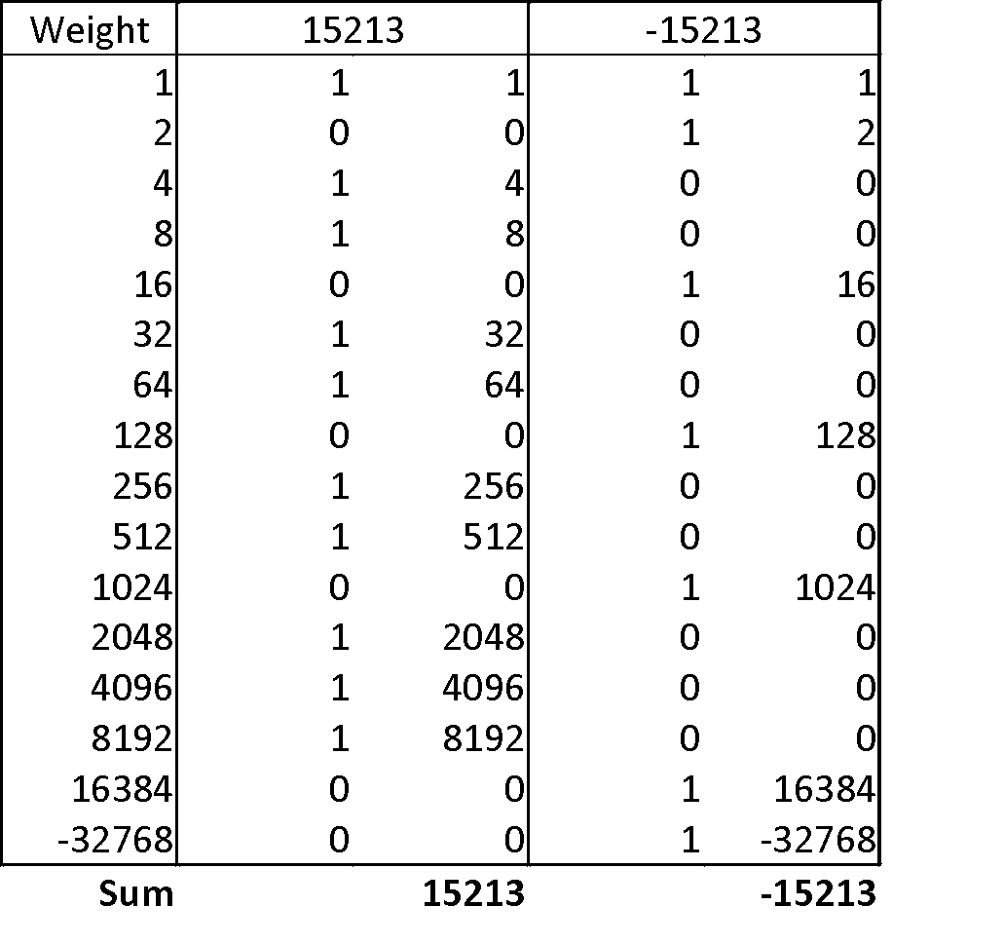
Two-complement Encoding Example (Cont.)
x = 15213: 00111011 01101101
y = -15213: 11000100 10010011

Slide 19
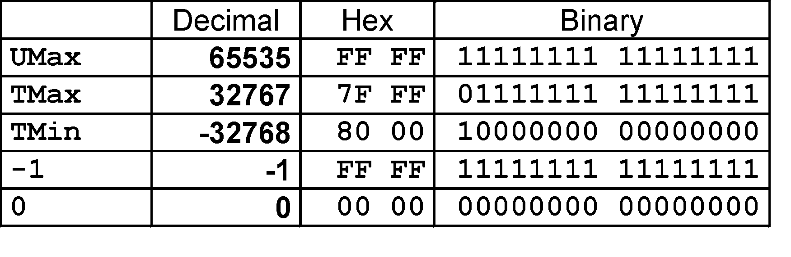
Numeric Ranges
Unsigned Values
UMin = 0
000…0
UMax = 2^{w} – 1
111…1
Two’s Complement Values
TMin = –2^{w–1}
100…0
TMax = 2^{w–1} – 1
011…1
Other Values
Minus 1
111…1
Values for W = 16
Notes:
Elaborate more on extremes. 000…000 and 111…1111

Slide 20
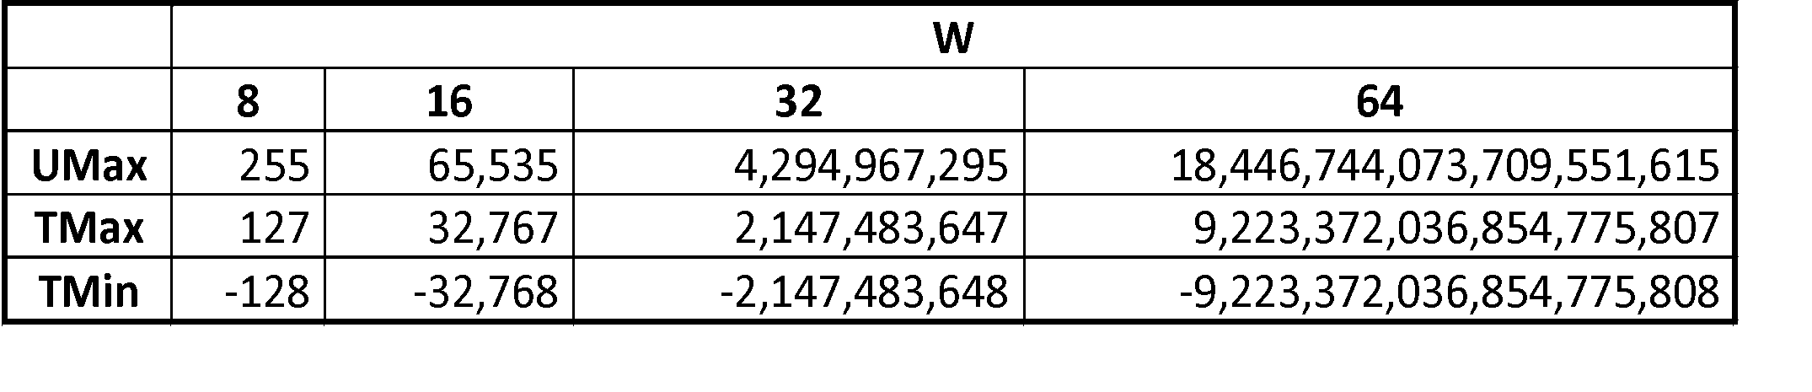
Values for Different Word Sizes
Observations
|TMin | = TMax + 1
Asymmetric range
UMax = 2 * TMax + 1
C Programming
#include <limits.h>
Declares constants, e.g.,
ULONG_MAX
LONG_MAX
LONG_MIN
Values platform specific

Slide 21
Unsigned & Signed Numeric Values
Equivalence
Same encodings for nonnegative values
Uniqueness
Every bit pattern represents unique integer value
Each representable integer has unique bit encoding
⇒ Can Invert Mappings
U2B(x) = B2U⁻¹(x)
Bit pattern for unsigned integer
T2B(x) = B2T⁻¹(x)
Bit pattern for two’s comp integer
X
B2U(X)
B2T(X)
0000
0
0
0001
1
1
0010
2
2
0011
3
3
0100
4
4
0101
5
5
0110
6
6
0111
7
7
1000
8
–8
1001
9
–7
1010
10
–6
1011
11
–5
1100
12
–4
1101
13
–3
1110
14
–2
1111
15
–1
Notes:
Pattern is really simple: we’re jumping +16 or -16 for the same representation. For instance 1000 = 8, 8 - 16 = -8 and -8 + 16 = 8. It’s extremely important to be familiar with this type of behaviour so that you can identify it in actual C programs.

Slide 22
Today: Bits, Bytes, and Integers
Representing information as bits
Bit-level manipulations
Integers
Representation: unsigned and signed
Conversion, casting
Expanding, truncating
Addition, negation, multiplication, shifting
Summary
Representations in memory, pointers, strings

Slide 23
Mapping Between Signed & Unsigned
Two’s Complement
Unsigned
T2U
x
T2B
B2U
ux
X
Maintain Same Bit Pattern
Unsigned
U2T
Two’s Complement
ux
U2B
B2T
x
X
Maintain Same Bit Pattern
Mappings between unsigned and two’s complement numbers: Keep bit representations and reinterpret
Notes:
So, these functions basically represent mappings so that we keep the same pattern but represent it in different ways

Slide 24
Mapping Signed ↔ Unsigned
Bits
0000
0001
0010
0011
0100
0101
0110
0111
1000
1001
1010
1011
1100
1101
1110
1111
Signed
0
1
2
3
4
5
6
7
-8
-7
-6
-5
-4
-3
-2
-1
Unsigned
0
1
2
3
4
5
6
7
8
9
10
11
12
13
14
15
T2U
T2U

Slide 25
Mapping Signed ↔ Unsigned
Bits
0000
0001
0010
0011
0100
0101
0110
0111
1000
1001
1010
1011
1100
1101
1110
1111
Signed
0
1
2
3
4
5
6
7
-8
-7
-6
-5
-4
-3
-2
-1
Unsigned
0
1
2
3
4
5
6
7
8
9
10
11
12
13
14
15
=
+/- 16

Slide 26
Relation between Signed & Unsigned
Two’s Complement
Unsigned
T2U
x
T2B
B2U
ux
X
Maintain Same Bit Pattern
w–1
0
ux
+
+
+
• • •
+
+
+
x
-
+
+
• • •
+
+
+
Large negative weight
becomes
Large positive weight

Slide 27
Conversion Visualized
2’s Comp. → Unsigned
Ordering Inversion
Negative → Big Positive
UMax
UMax – 1
TMax + 1
Unsigned
Range
TMax
TMax
2’s Complement Range
0
0
–1
–2
TMin

Slide 28
Signed vs. Unsigned in C
Constants
By default are considered to be signed integers
Unsigned if have “U” as suffix
0U, 4294967259U
Casting
Explicit casting between signed & unsigned same as U2T and T2U
int tx, ty;
unsigned ux, uy;
tx = (int) ux;
uy = (unsigned) ty;
Implicit casting also occurs via assignments and procedure calls
tx = ux;
uy = ty;

Slide 29
Casting Surprises
Expression Evaluation
If there is a mix of unsigned and signed in single expression, signed values implicitly cast to unsigned
Including comparison operations <, >, ==, <=, >=
Examples for W = 32: TMIN = -2,147,483,648 , TMAX = 2,147,483,647
Constant₁ Constant₂ Relation Evaluation
0 0U
-1 0
-1 0U
2147483647 -2147483647-1
2147483647U -2147483647-1
-1 -2
(unsigned)-1 -2
2147483647 2147483648U
2147483647 (int) 2147483648U
0 0U == unsigned
-1 0 < signed
-1 0U > unsigned
2147483647 -2147483648 > signed
2147483647U -2147483648 < unsigned
-1 -2 > signed
(unsigned) -1 -2 > unsigned
2147483647 2147483648U < unsigned
2147483647 (int) 2147483648U > signed
Notes:
Rule: by default values in C are signed. If any value in an expression is unsigned, whole xpression is converted to unsigne and than evaluated.

Slide 30
Summary Casting Signed ↔ Unsigned: Basic Rules
Bit pattern is maintained
But reinterpreted
Can have unexpected effects: adding or subtracting 2^{w}
Expression containing signed and unsigned int
int is cast to unsigned!!

Slide 31
Today: Bits, Bytes, and Integers
Representing information as bits
Bit-level manipulations
Integers
Representation: unsigned and signed
Conversion, casting
Expanding, truncating
Addition, negation, multiplication, shifting
Summary
Representations in memory, pointers, strings

Slide 32
Sign Extension
Task:
Given w-bit signed integer x
Convert it to w+k-bit integer with same value
Rule:
Make k copies of sign bit:
X ′ = x_{w–1} ,…, x_{w–1} , x_{w–1} , x_{w–2} ,…, x₀
k copies of MSB
w
X
• • •
• • •
X ′
• • •
• • •
k
w

Slide 33
Sign Extension Example
short int x = 15213;
int ix = (int) x;
short int y = -15213;
int iy = (int) y;
Decimal
Hex
Binary
x
15213
3B 6D
00111011 01101101
ix
15213
00 00 3B 6D
00000000 00000000 00111011 01101101
y
-15213
C4 93
11000100 10010011
iy
-15213
FF FF C4 93
11111111 11111111 11000100 10010011
Converting from smaller to larger integer data type
C automatically performs sign extension

Slide 34
Summary Of Part 1: Expanding, Truncating: Basic Rules
Expanding (e.g., short int to int)
Unsigned: zeros added
Signed: sign extension
Both yield expected result
Truncating (e.g., unsigned to unsigned short)
Unsigned/signed: bits are truncated
Result reinterpreted
Unsigned: mod operation
Signed: similar to mod
For small numbers yields expected behavior

Slide 35
Today: Bits, Bytes, and Integers
Representing information as bits
Bit-level manipulations
Integers
Representation: unsigned and signed
Conversion, casting
Expanding, truncating
Addition, negation, multiplication, shifting
Summary
Overview of Data Lab
Representations in memory, pointers, strings
Summary

Slide 36
Unsigned Addition
u
Operands: w bits
• • •
+
v
• • •
True Sum: w+1 bits
u + v
• • •
Discard Carry: w bits
UAdd_{w}(u , v)
• • •
Standard Addition Function
Ignores carry output
Implements Modular Arithmetic
s = UAdd_{w}(u , v) = u + v mod 2^{w}

Slide 37
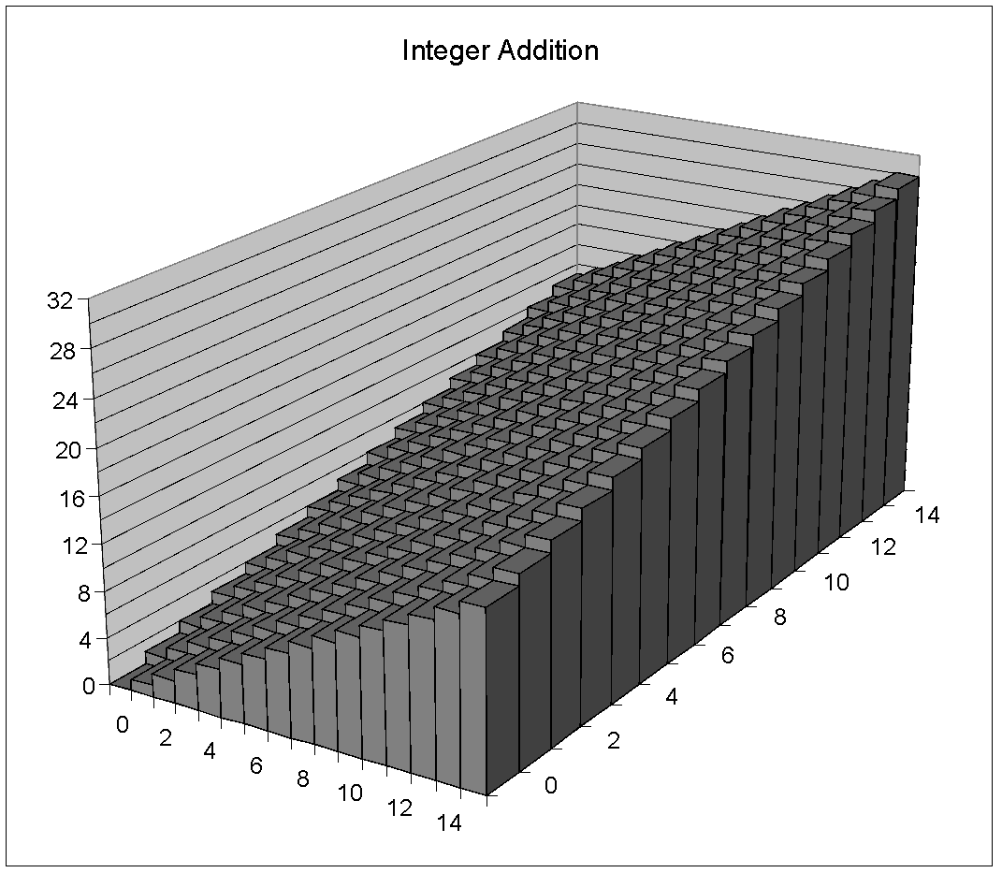
Visualizing (Mathematical) Integer Addition
Integer Addition
4-bit integers u, v
Compute true sum Add₄(u , v)
Values increase linearly with u and v
Forms planar surface
Add₄(u , v)
v
u

Slide 38
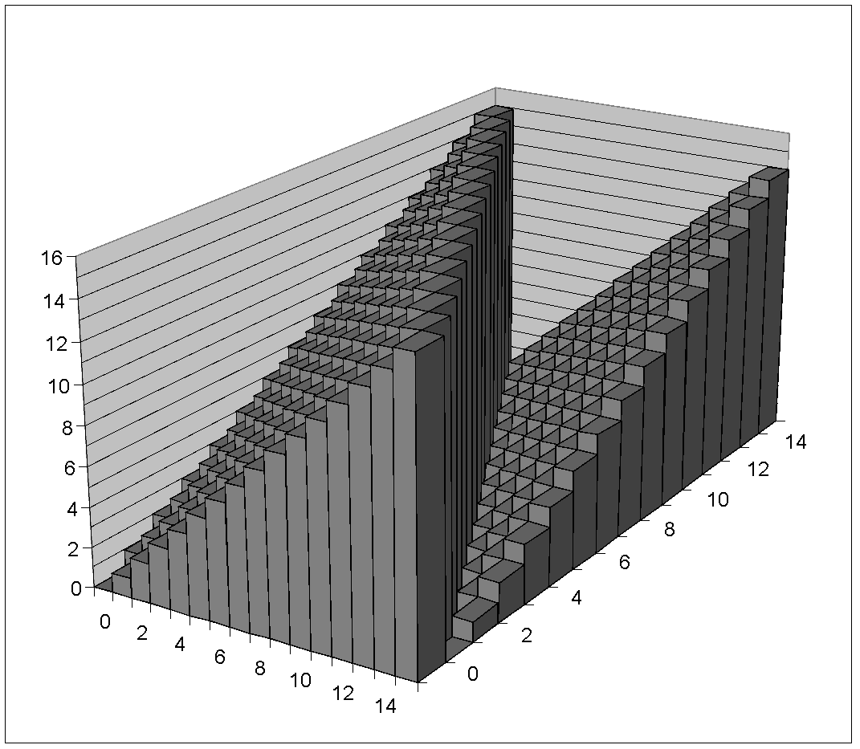
Visualizing Unsigned Addition
Wraps Around
If true sum ≥ 2^{w}
At most once
Overflow
UAdd₄(u , v)
True Sum
2^{w+1}
Overflow
2^{w}
v
0
Modular Sum
u

Slide 39
Two’s Complement Addition
Operands: w bits
u
• • •
+
v
• • •
True Sum: w+1 bits
u + v
• • •
Discard Carry: w bits
TAdd_{w}(u , v)
• • •
TAdd and UAdd have Identical Bit-Level Behavior
Signed vs. unsigned addition in C:
int s, t, u, v;
s = (int) ((unsigned) u + (unsigned) v);
t = u + v
Will give s == t

Slide 40
TAdd Overflow
Functionality
True sum requires w+1 bits
Drop off MSB
Treat remaining bits as 2’s comp. integer
True Sum
0 111…1
2^{w}–1
PosOver
TAdd Result
0 100…0
2^{w –1}–1
011…1
0 000…0
0
000…0
1 011…1
–2^{w –1}
100…0
1 000…0
–2^{w}
NegOver

Slide 41
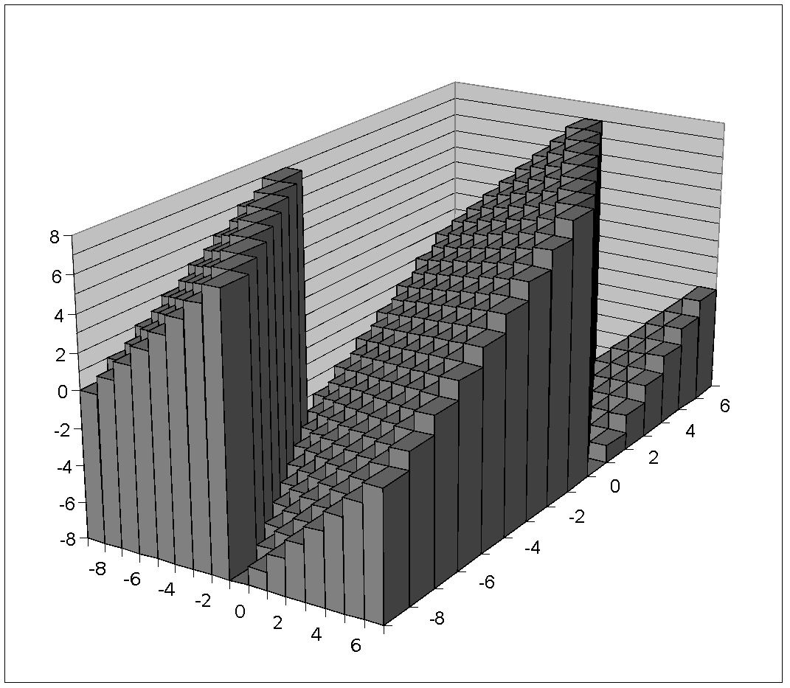
Visualizing 2’s Complement Addition
NegOver
Values
4-bit two’s comp.
Range from -8 to +7
Wraps Around
If sum ≥ 2^{w–1}
Becomes negative
At most once
If sum < –2^{w–1}
Becomes positive
At most once
TAdd₄(u , v)
v
u
PosOver

Slide 42
Multiplication
Goal: Computing Product of w-bit numbers x, y
Either signed or unsigned
But, exact results can be bigger than w bits
Unsigned: up to 2w bits
Result range: 0 ≤ x * y ≤ (2^{w} – 1) ² = 2^{2w} – 2^{w+1} + 1
Two’s complement min (negative): Up to 2w-1 bits
Result range: x * y ≥ (–2^{w–1})*(2^{w–1}–1) = –2^{2w–2} + 2^{w–1}
Two’s complement max (positive): Up to 2w bits, but only for (TMin_{w})²
Result range: x * y ≤ (–2^{w–1}) ² = 2^{2w–2}
So, maintaining exact results…
would need to keep expanding word size with each product computed
is done in software, if needed
e.g., by “arbitrary precision” arithmetic packages

Slide 43
Unsigned Multiplication in C
u
• • •
Operands: w bits
*
v
• • •
True Product: 2*w bits
u · v
• • •
• • •
UMult_{w}(u , v)
Discard w bits: w bits
• • •
Standard Multiplication Function
Ignores high order w bits
Implements Modular Arithmetic
UMult_{w}(u , v) = u · v mod 2^{w}

Slide 44
Signed Multiplication in C
u
• • •
Operands: w bits
*
v
• • •
True Product: 2*w bits
u · v
• • •
• • •
TMult_{w}(u , v)
Discard w bits: w bits
• • •
Standard Multiplication Function
Ignores high order w bits
Some of which are different for signed vs. unsigned multiplication
Lower bits are the same

Slide 45
Power-of-2 Multiply with Shift
Operation
u << k gives u * 2^{k}
Both signed and unsigned
Examples
u << 3 == u * 8
(u << 5) – (u << 3) == u * 24
Most machines shift and add faster than multiply
Compiler generates this code automatically
k
u
• • •
Operands: w bits
*
2^{k}
0
•••
0
1
0
•••
0
0
True Product: w+k bits
u · 2^{k}
• • •
0
•••
0
0
Discard k bits: w bits
UMult_{w}(u , 2^{k})
•••
0
•••
0
0
TMult_{w}(u , 2^{k})

Slide 46
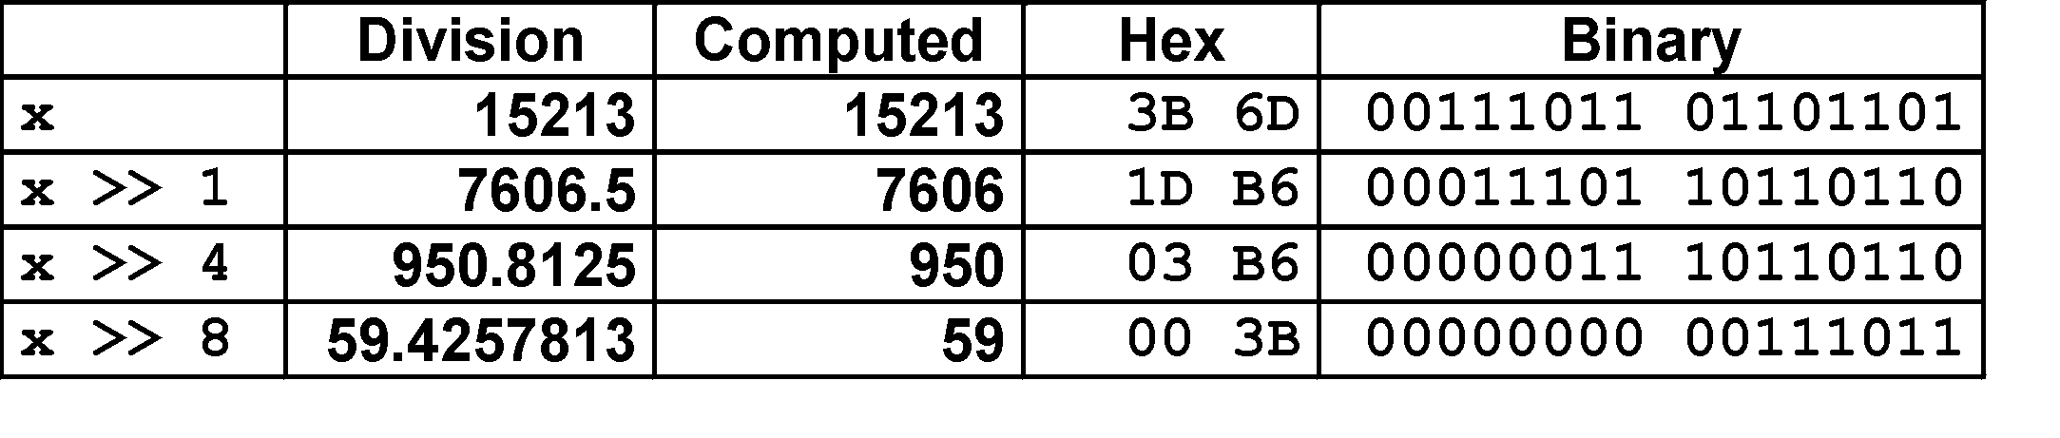
Unsigned Power-of-2 Divide with Shift
Quotient of Unsigned by Power of 2
u >> k gives ⎣ u / 2^{k} ⎦
Uses logical shift
k
u
•••
•••
Binary Point
Operands:
/
2^{k}
0
•••
0
1
0
•••
0
0
Division:
u / 2^{k}
0
.
0
•••
0
0
•••
•••
Result:
⎣ u / 2^{k} ⎦
0
0
•••
0
0
•••

Slide 47
Today: Bits, Bytes, and Integers
Representing information as bits
Bit-level manipulations
Integers
Representation: unsigned and signed
Conversion, casting
Expanding, truncating
Addition, negation, multiplication, shifting
Summary
Representations in memory, pointers, strings

Slide 48
Arithmetic: Basic Rules
Addition:
Unsigned/signed: Normal addition followed by truncate, same operation on bit level
Unsigned: addition mod 2^{w}
Mathematical addition + possible subtraction of 2^{w}
Signed: modified addition mod 2^{w} (result in proper range)
Mathematical addition + possible addition or subtraction of 2^{w}
Multiplication:
Unsigned/signed: Normal multiplication followed by truncate, same operation on bit level
Unsigned: multiplication mod 2^{w}
Signed: modified multiplication mod 2^{w} (result in proper range)

Slide 49
Why Should I Use Unsigned?
Don’t use without understanding implications
Easy to make mistakes
unsigned i;
for (i = cnt-2; i >= 0; i--)
a[i] += a[i+1];
Can be very subtle
#define DELTA sizeof(int)
int i;
for (i = CNT; i-DELTA >= 0; i-= DELTA)
. . .

Slide 50
Counting Down with Unsigned
Proper way to use unsigned as loop index
unsigned i;
for (i = cnt-2; i < cnt; i--)
a[i] += a[i+1];
See Robert Seacord, Secure Coding in C and C++
C Standard guarantees that unsigned addition will behave like modular arithmetic
0 – 1 🡪 UMax
Even better
size_t i;
for (i = cnt-2; i < cnt; i--)
a[i] += a[i+1];
Data type size_t defined as unsigned value with length = word size
Code will work even if cnt = UMax
What if cnt is signed and < 0?

Slide 51
Why Should I Use Unsigned? (cont.)
Do Use When Performing Modular Arithmetic
Multiprecision arithmetic
Do Use When Using Bits to Represent Sets
Logical right shift, no sign extension

Slide 52
Today: Bits, Bytes, and Integers
Representing information as bits
Bit-level manipulations
Integers
Representation: unsigned and signed
Conversion, casting
Expanding, truncating
Addition, negation, multiplication, shifting
Summary
Data Lab
Representations in memory, pointers, strings

Slide 53
Byte-Oriented Memory Organization
00•••0
FF•••F
• • •
Programs refer to data by address
Conceptually, envision it as a very large array of bytes
In reality, it’s not, but can think of it that way
An address is like an index into that array
and, a pointer variable stores an address
Note: system provides private address spaces to each “process”
Think of a process as a program being executed
So, a program can clobber its own data, but not that of others

Slide 54
Machine Words
Any given computer has a “Word Size”
Nominal size of integer-valued data
and of addresses
Until recently, most machines used 32 bits (4 bytes) as word size
Limits addresses to 4GB (2³² bytes)
Increasingly, machines have 64-bit word size
Potentially, could have 18 EB (exabytes) of addressable memory
That’s 18.4 X 10¹⁸
Machines still support multiple data formats
Fractions or multiples of word size
Always integral number of bytes

Slide 55
Word-Oriented Memory Organization
32-bit
Words
64-bit
Words
Bytes
Addr.
Addresses Specify Byte Locations
Address of first byte in word
Addresses of successive words differ by 4 (32-bit) or 8 (64-bit)
0000
Addr
=
??
0001
0000
0002
Addr
=
??
0003
0000
0004
Addr
=
??
0005
0004
0006
0007
0008
Addr
=
??
0009
0008
0010
Addr
=
??
0011
0008
0012
Addr
=
??
0013
0012
0014
0015

Slide 56
Example Data Representations
C Data Type | Typical 32-bit | Typical 64-bit | x86-64
char | 1 | 1 | 1
short | 2 | 2 | 2
int | 4 | 4 | 4
long | 4 | 8 | 8
float | 4 | 4 | 4
double | 8 | 8 | 8
long double | − | − | 10/16
pointer | 4 | 8 | 8

Slide 57
Byte Ordering
So, how are the bytes within a multi-byte word ordered in memory?
Conventions
Big Endian: Sun, PPC Mac, Internet
Least significant byte has highest address
Little Endian: x86, ARM processors running Android, iOS, and Windows
Least significant byte has lowest address

Slide 58
Byte Ordering Example
Example
Variable x has 4-byte value of 0x01234567
Address given by &x is 0x100
Big Endian
0x100
0x101
0x102
0x103
01
01
23
23
45
45
67
67
Little Endian
0x100
0x101
0x102
0x103
67
67
45
45
23
23
01
01

Slide 59
Representing Integers
Decimal: 15213
Binary: 0011 1011 0110 1101
Hex: 3 B 6 D
int A = 15213;
long int C = 15213;
IA32, x86-64
Sun
IA32
x86-64
Sun
6D
00
3B
00
6D
6D
00
00
3B
3B
3B
00
00
6D
00
00
3B
00
00
6D
00
int B = -15213;
00
IA32, x86-64
Sun
00
00
93
FF
C4
FF
FF
C4
FF
93
Two’s complement representation

Slide 60
Examining Data Representations
Code to Print Byte Representation of Data
Casting pointer to unsigned char * allows treatment as a byte array
typedef unsigned char *pointer;
void show_bytes(pointer start, size_t len){
size_t i;
for (i = 0; i < len; i++)
printf(”%p\t0x%.2x\n",start+i, start[i]);
printf("\n");
}
Printf directives:
%p: Print pointer
%x: Print Hexadecimal

Slide 61
show_bytes Execution Example
int a = 15213;
printf("int a = 15213;\n");
show_bytes((pointer) &a, sizeof(int));
Result (Linux x86-64):
int a = 15213;
0x7fffb7f71dbc 6d
0x7fffb7f71dbd 3b
0x7fffb7f71dbe 00
0x7fffb7f71dbf 00

Slide 62
Representing Pointers
int B = -15213;
int *P = &B;
Sun
IA32
x86-64
EF
FF
FB
2C
AC
28
F5
FF
3C
1B
FE
82
FD
7F
00
00
Different compilers & machines assign different locations to objects
Even get different results each time run program

Slide 63
Representing Strings
char S[6] = "18213";
Strings in C
Represented by array of characters
Each character encoded in ASCII format
Standard 7-bit encoding of character set
Character “0” has code 0x30
Digit i has code 0x30+i
String should be null-terminated
Final character = 0
Compatibility
Byte ordering not an issue
IA32
Sun
31
38
32
31
33
00
31
38
32
31
33
00

Slide 64
Integer C Puzzles
x < 0   ((x*2) < 0)
ux >= 0
x & 7 == 7   (x<<30) < 0
ux > -1
x > y   -x < -y
x * x >= 0
x > 0 && y > 0   x + y > 0
x >= 0   -x <= 0
x <= 0   -x >= 0
(x|-x)>>31 == -1
ux >> 3 == ux/8
x >> 3 == x/8
x & (x-1) != 0
Initialization
int x = foo();
int y = bar();
unsigned ux = x;
unsigned uy = y;

Slide 65
Bonus extras

Slide 66
Application of Boolean Algebra
Applied to Digital Systems by Claude Shannon
1937 MIT Master’s Thesis
Reason about networks of relay switches
Encode closed switch as 1, open switch as 0
A&~B
Connection when
A&~B | ~A&B
A
~B
~A
B
~A&B
= A^B

Slide 67
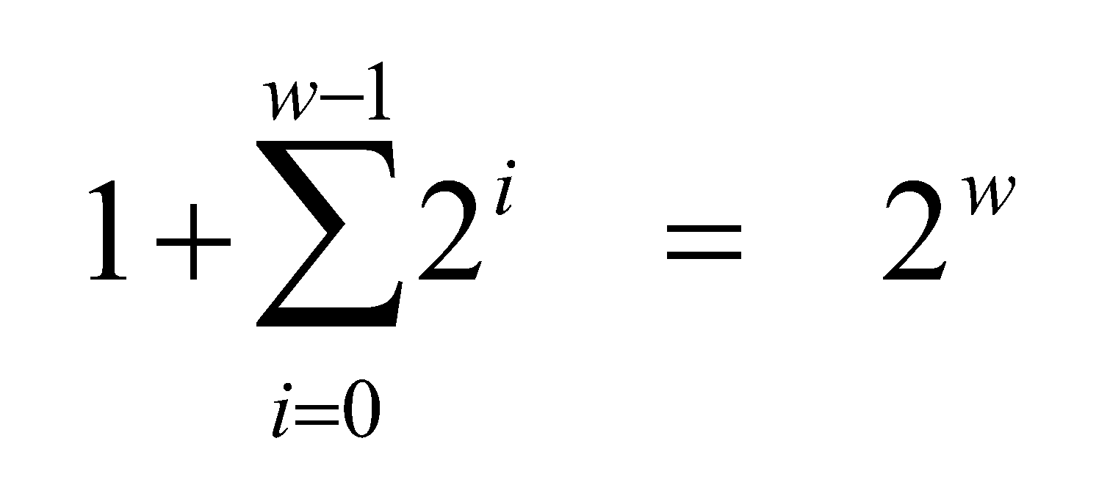
Binary Number Property
Claim
1 + 1 + 2 + 4 + 8 + … + 2^{w-1} = 2^{w}
w = 0:
1 = 2⁰
Assume true for w-1:
1 + 1 + 2 + 4 + 8 + … + 2^{w-1} + 2^{w} = 2^{w} + 2^{w} = 2^{w+1}
= 2^{w}

Slide 68
Code Security Example
/* Kernel memory region holding user-accessible data */
#define KSIZE 1024
char kbuf[KSIZE];
/* Copy at most maxlen bytes from kernel region to user buffer */
int copy_from_kernel(void *user_dest, int maxlen) {
/* Byte count len is minimum of buffer size and maxlen */
int len = KSIZE < maxlen ? KSIZE : maxlen;
memcpy(user_dest, kbuf, len);
return len;
}
Similar to code found in FreeBSD’s implementation of getpeername
There are legions of smart people trying to find vulnerabilities in programs

Slide 69
Typical Usage
/* Kernel memory region holding user-accessible data */
#define KSIZE 1024
char kbuf[KSIZE];
/* Copy at most maxlen bytes from kernel region to user buffer */
int copy_from_kernel(void *user_dest, int maxlen) {
/* Byte count len is minimum of buffer size and maxlen */
int len = KSIZE < maxlen ? KSIZE : maxlen;
memcpy(user_dest, kbuf, len);
return len;
}
#define MSIZE 528
void getstuff() {
char mybuf[MSIZE];
copy_from_kernel(mybuf, MSIZE);
printf(“%s\n”, mybuf);
}

Slide 70
Malicious Usage
/* Declaration of library function memcpy */
void *memcpy(void *dest, void *src, size_t n);
/* Kernel memory region holding user-accessible data */
#define KSIZE 1024
char kbuf[KSIZE];
/* Copy at most maxlen bytes from kernel region to user buffer */
int copy_from_kernel(void *user_dest, int maxlen) {
/* Byte count len is minimum of buffer size and maxlen */
int len = KSIZE < maxlen ? KSIZE : maxlen;
memcpy(user_dest, kbuf, len);
return len;
}
#define MSIZE 528
void getstuff() {
char mybuf[MSIZE];
copy_from_kernel(mybuf, -MSIZE);
. . .
}

Slide 71
Mathematical Properties
Modular Addition Forms an Abelian Group
Closed under addition
0 ≤ UAdd_{w}(u , v) ≤ 2^{w} –1
Commutative
UAdd_{w}(u , v) = UAdd_{w}(v , u)
Associative
UAdd_{w}(t, UAdd_{w}(u , v)) = UAdd_{w}(UAdd_{w}(t, u ), v)
0 is additive identity
UAdd_{w}(u , 0) = u
Every element has additive inverse
Let UComp_{w} (u ) = 2^{w} – u UAdd_{w}(u , UComp_{w} (u )) = 0

Slide 72
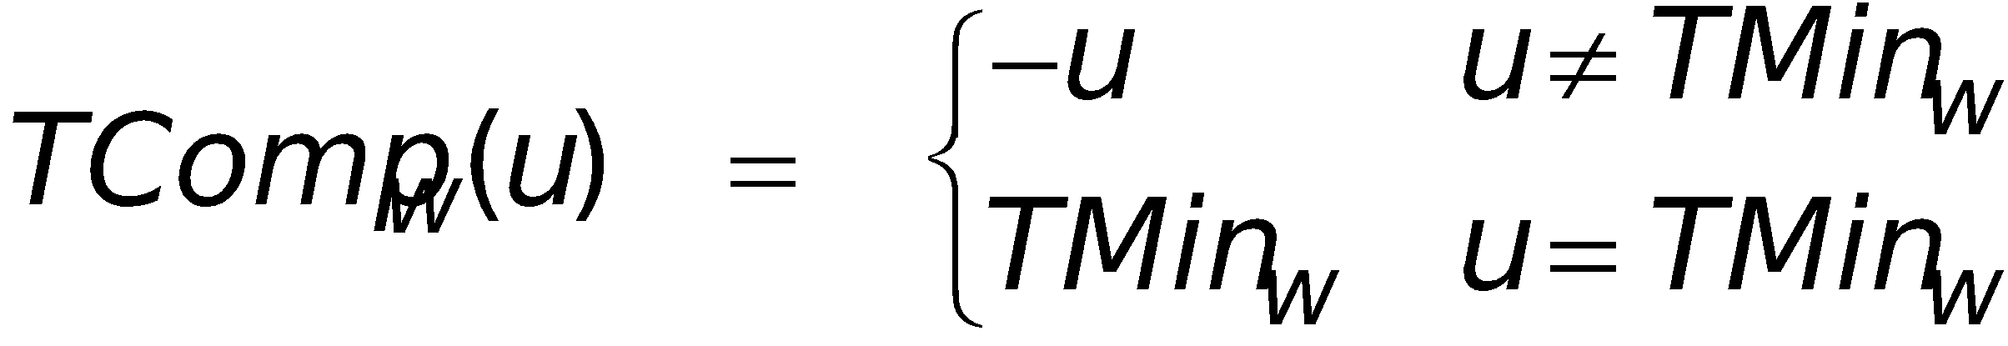
Mathematical Properties of TAdd
Isomorphic Group to unsigneds with UAdd
TAdd_{w}(u , v) = U2T(UAdd_{w}(T2U(u ), T2U(v)))
Since both have identical bit patterns
Two’s Complement Under TAdd Forms a Group
Closed, Commutative, Associative, 0 is additive identity
Every element has additive inverse

Slide 73
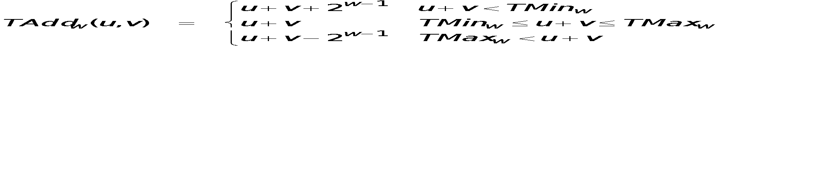
Characterizing TAdd
Positive Overflow
Functionality
True sum requires w+1 bits
Drop off MSB
Treat remaining bits as 2’s comp. integer
TAdd(u , v)
> 0
v
< 0
< 0
> 0
u
Negative Overflow
2^{w}
(NegOver)
2^{w}
(PosOver)

Slide 74
Negation: Complement & Increment
Claim: Following Holds for 2’s Complement
~x + 1 == -x
Complement
Observation: ~x + x == 1111…111 == -1
Complete Proof?
x
1
0
0
1
1
1
0
1
+
~x
0
1
1
0
0
0
1
0
-1
1
1
1
1
1
1
1
1

Slide 75
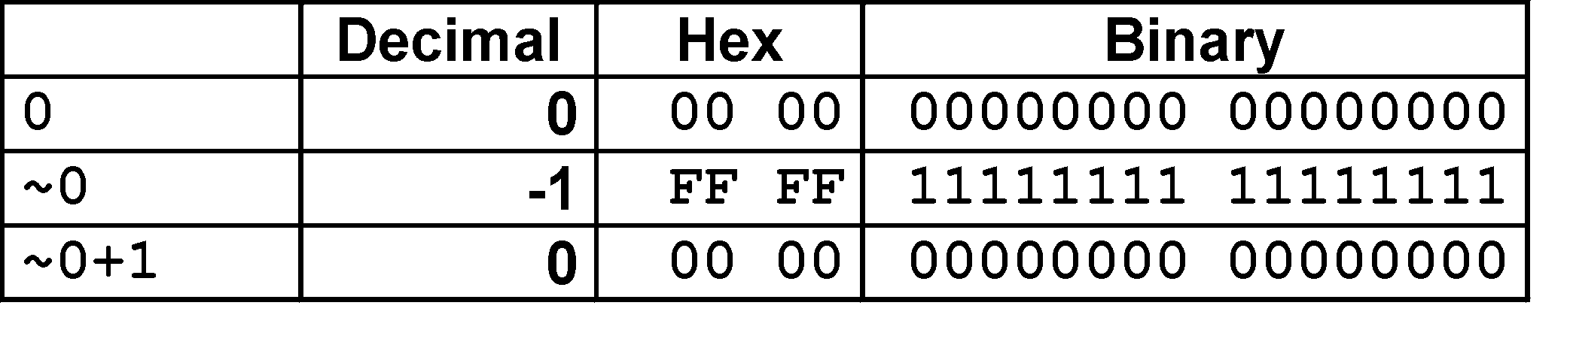
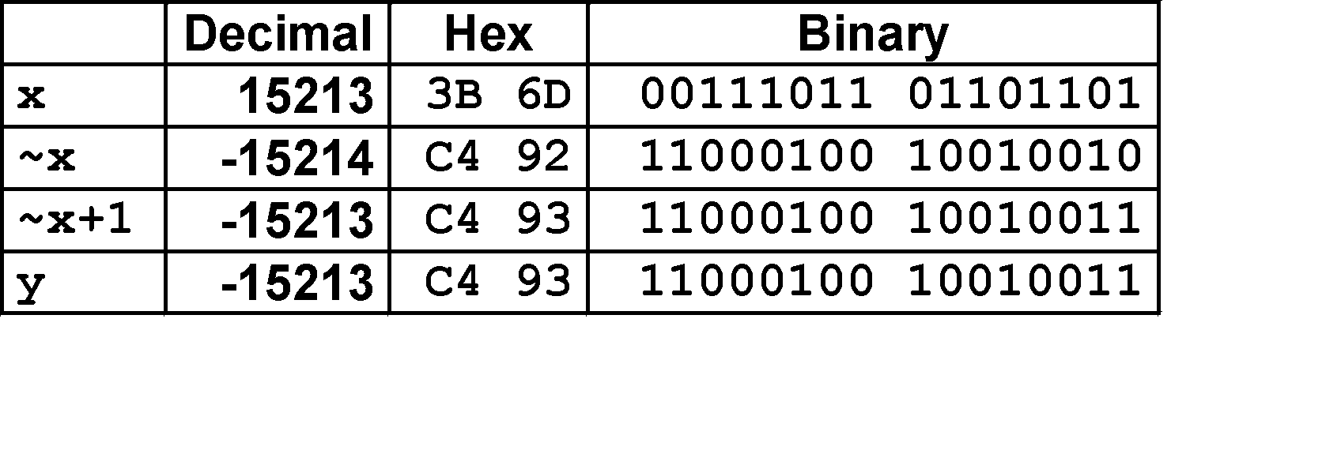
Complement & Increment Examples
x = 15213
x = 0

Slide 76
Code Security Example #2
SUN XDR library
Widely used library for transferring data between machines
void* copy_elements(void *ele_src[], int ele_cnt, size_t ele_size);
ele_src
malloc(ele_cnt * ele_size)

Slide 77
XDR Code
void* copy_elements(void *ele_src[], int ele_cnt, size_t ele_size) {
/*
* Allocate buffer for ele_cnt objects, each of ele_size bytes
* and copy from locations designated by ele_src
*/
void *result = malloc(ele_cnt * ele_size);
if (result == NULL)
/* malloc failed */
return NULL;
void *next = result;
int i;
for (i = 0; i < ele_cnt; i++) {
/* Copy object i to destination */
memcpy(next, ele_src[i], ele_size);
/* Move pointer to next memory region */
next += ele_size;
}
return result;
}

Slide 78
XDR Vulnerability
malloc(ele_cnt * ele_size)
What if:
ele_cnt = 2²⁰ + 1
ele_size = 4096 = 2¹²
Allocation = ??
How can I make this function secure?

Slide 79
Compiled Multiplication Code
C Function
long mul12(long x)
{
return x*12;
}
Compiled Arithmetic Operations
Explanation
leaq (%rax,%rax,2), %rax
salq $2, %rax
t <- x+x*2
return t << 2;
C compiler automatically generates shift/add code when multiplying by constant

Slide 80
Compiled Unsigned Division Code
C Function
unsigned long udiv8
(unsigned long x)
{
return x/8;
}
Compiled Arithmetic Operations
Explanation
shrq $3, %rax
# Logical shift
return x >> 3;
Uses logical shift for unsigned
For Java Users
Logical shift written as >>>

Slide 81
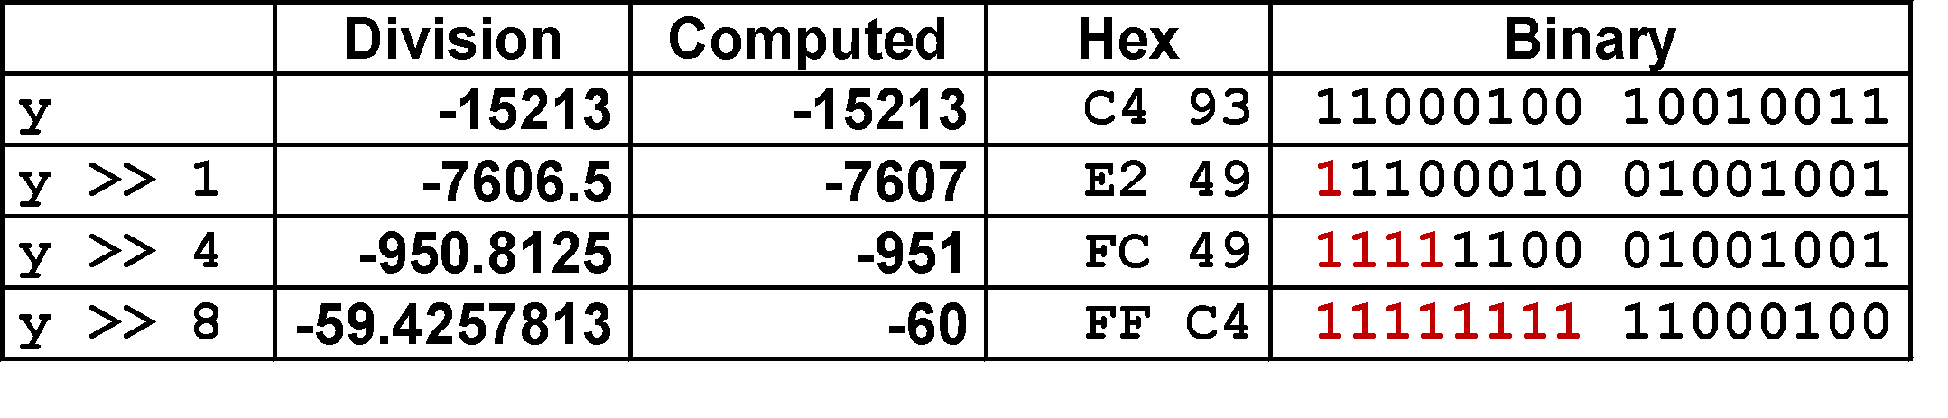
Signed Power-of-2 Divide with Shift
Quotient of Signed by Power of 2
x >> k gives ⎣ x / 2^{k} ⎦
Uses arithmetic shift
Rounds wrong direction when u < 0
k
x
•••
•••
Binary Point
Operands:
/
2^{k}
0
•••
0
1
0
•••
0
0
Division:
x / 2^{k}
0
•••
•••
.
•••
Result:
RoundDown(x / 2^{k})
0
•••
•••

Slide 82
Correct Power-of-2 Divide
Quotient of Negative Number by Power of 2
Want ⎡ x / 2^{k} ⎤ (Round Toward 0)
Compute as ⎣ (x+2^{k}-1)/ 2^{k} ⎦
In C: (x + (1<<k)-1) >> k
Biases dividend toward 0
Case 1: No rounding
k
Dividend:
u
1
•••
0
•••
0
0
+2^{k} –1
0
•••
0
0
1
•••
1
1
Binary Point
1
•••
1
•••
1
1
Divisor:
/
2^{k}
0
•••
0
1
0
•••
0
0
⎡ u / 2^{k} ⎤
0
.
1
•••
1
1
1
•••
1
•••
1
1
Biasing has no effect

Slide 83
Correct Power-of-2 Divide (Cont.)
Case 2: Rounding
k
Dividend:
x
1
•••
•••
+2^{k} –1
0
•••
0
0
1
•••
1
1
1
•••
•••
Incremented by 1
Binary Point
Divisor:
/
2^{k}
0
•••
0
1
0
•••
0
0
⎡ x / 2^{k} ⎤
.
0
1
•••
1
1
1
•••
•••
Incremented by 1
Biasing adds 1 to final result

Slide 84
Compiled Signed Division Code
C Function
long idiv8(long x)
{
return x/8;
}
Compiled Arithmetic Operations
Explanation
testq %rax, %rax
js L4
L3:
sarq $3, %rax
ret
L4:
addq $7, %rax
jmp L3
if x < 0
x += 7;
# Arithmetic shift
return x >> 3;
Uses arithmetic shift for int
For Java Users
Arith. shift written as >>

Slide 85
Arithmetic: Basic Rules
Unsigned ints, 2’s complement ints are isomorphic rings: isomorphism = casting
Left shift
Unsigned/signed: multiplication by 2^{k}
Always logical shift
Right shift
Unsigned: logical shift, div (division + round to zero) by 2^{k}
Signed: arithmetic shift
Positive numbers: div (division + round to zero) by 2^{k}
Negative numbers: div (division + round away from zero) by 2^{k} Use biasing to fix

Slide 86
Properties of Unsigned Arithmetic
Unsigned Multiplication with Addition Forms Commutative Ring
Addition is commutative group
Closed under multiplication
0 ≤ UMult_{w}(u , v) ≤ 2^{w} –1
Multiplication Commutative
UMult_{w}(u , v) = UMult_{w}(v , u)
Multiplication is Associative
UMult_{w}(t, UMult_{w}(u , v)) = UMult_{w}(UMult_{w}(t, u ), v)
1 is multiplicative identity
UMult_{w}(u , 1) = u
Multiplication distributes over addtion
UMult_{w}(t, UAdd_{w}(u , v)) = UAdd_{w}(UMult_{w}(t, u ), UMult_{w}(t, v))

Slide 87
Properties of Two’s Comp. Arithmetic
Isomorphic Algebras
Unsigned multiplication and addition
Truncating to w bits
Two’s complement multiplication and addition
Truncating to w bits
Both Form Rings
Isomorphic to ring of integers mod 2^{w}
Comparison to (Mathematical) Integer Arithmetic
Both are rings
Integers obey ordering properties, e.g.,
u > 0 ⇒ u + v > v
u > 0, v > 0 ⇒ u · v > 0
These properties are not obeyed by two’s comp. arithmetic
TMax + 1 == TMin
15213 * 30426 == -10030 (16-bit words)

Slide 88
Reading Byte-Reversed Listings
Disassembly
Text representation of binary machine code
Generated by program that reads the machine code
Example Fragment
Deciphering Numbers
Value: 0x12ab
Pad to 32 bits: 0x000012ab
Split into bytes: 00 00 12 ab
Reverse: ab 12 00 00
Address Instruction Code Assembly Rendition
8048365: 5b pop %ebx
8048366: 81 c3 ab 12 00 00 add $0x12ab,%ebx
804836c: 83 bb 28 00 00 00 00 cmpl $0x0,0x28(%ebx)

