Slide 1
Restaurant Ratings Analysis
Group 4:
Shanu Mariam Joseph
Hirdeyjot Singh Bansi
Sebastian Campos
Amy Tieku

Slide 2
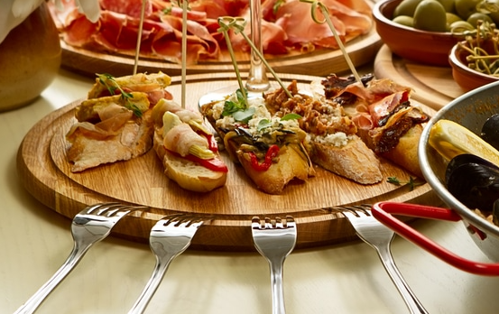
Selected Topic and Reason
Our selected topic is restaurants and their star ratings. We want to be able to predict the star rating of the restaurant based on various attributes such as:
Price
Noise Level
Whether it Serves Alcohol or Not
Restaurant Attire
Etc
Our reason for this topic is that some restaurants, new ones in particular, not have many Yelp ratings. This analysis should help.
Notes:
While Yelp is a standard place to go for reviews, restaurants that are new may not have many ratings. This analysis will assist patrons in finding new restaurants.

Slide 3
Description of the Source of Data
The Dataset came from Yelp. It contains 5 different json data files out of which we are using business.json and review.json files for our analysis. The rest of the data is out of scope for our analysis.
The business.json file contains business data including location data, attributes, categories and star ratings for the restaurants.
The review.json file contains review data including the user_id who wrote the reviews, the business_id for which the review is written and the star reviews for each of the restaurant.

Slide 4
Questions to be Answered With the Data
Are the star ratings correct based on number of reviews and other attributes?
Can we predict the average review per city per category?
What is the percentage for positive and negative reviews per city per category?
What are the top 5 restaurants in a city?

Slide 5
Data Exploration Phase
In the data exploration phase of the project, we researched:
What tables we should use? The reviews table was huge and we only extracted xx columns out of it.
What attributes should we use? What attributes were important and made sense?
What attributes needed to be broken out (non-boolean values) so we could work with them?

Slide 6
Data Analysis Phase
In the analysis phase of the project, we researched:
What machine learning models made sense? Which ones had some impact?
What attributes made sense?
What types of Tableau charts made sense?.

Slide 7
Technologies Used
Languages
Pandas
SQL
Tools
Jupyter Notebook - PythonData or Python3
PG Admin
Google Cloud
Algorithms Used
Linear Regression
SMOTEEN
SMOTE
etc

Slide 8
Result of Analysis
We learned:
Features with an upward linear regression are:
Dogs allowed

Slide 9
Recommendation for a Future Analysis
In the future, we could:
Get a better dataset. Yelp is very hit-or-miss.
Possibly get survey data from restaurant critics since they are professionals and evaluate restaurants in-depth.
Focus on one geographical area (city) that we know has many competitive restaurants.
Have different categories represented.

