Slide 1
Interim Submission
By Abubakarr bangura
GITHUB LINK:
https://github.com/abu-bakarr/10-Academy-Week1

Slide 2
Data InSIght
Top Mobile Device used by customers
Top Mobile Device Manufacturer
Apple
Samsung
Huawei
Huawei B528S-23A,
Apple iPhone 6S (A1688)
Apple iPhone 6 (A1586)
Apple iPhone 7 (A1778)
Apple iPhone Se (A1723)
Apple iPhone 8 (A1905)
Apple iPhone Xr (A2105)
Samsung Galaxy S8 (Sm-G950F)
Apple iPhone X (A1901)

Slide 3
Top 5 from manufacturer
Apple
Samsung
Huawei
Apple iPhone 6S (A1688)
Apple iPhone 6 (A1586)
Apple iPhone 7 (A1778)
Apple iPhone Se (A1723)
Apple iPhone 8 (A1905)
Samsung Galaxy S8 (Sm-G950F)
Samsung Galaxy A5 Sm-A520F
Samsung Galaxy J5 (Sm-J530)
Samsung Galaxy J3 (Sm-J330)
Samsung Galaxy S7 (Sm-G930X)
Huawei B528S-23A
Huawei E5180
Huawei P20 Lite
Huawei Nova 3E
Huawei P20
Huawei Y6 2018

Slide 4
Total Upload
Total Download
6168180943816.0
6168180943816.0

Slide 5
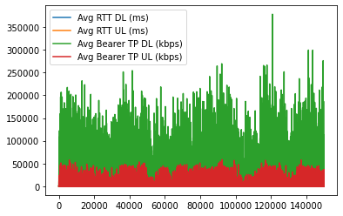
Average TCP Download vs Average RTT Download

Slide 6
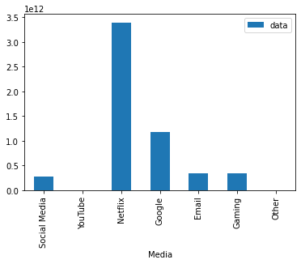
data consumption applications

