Slide 1
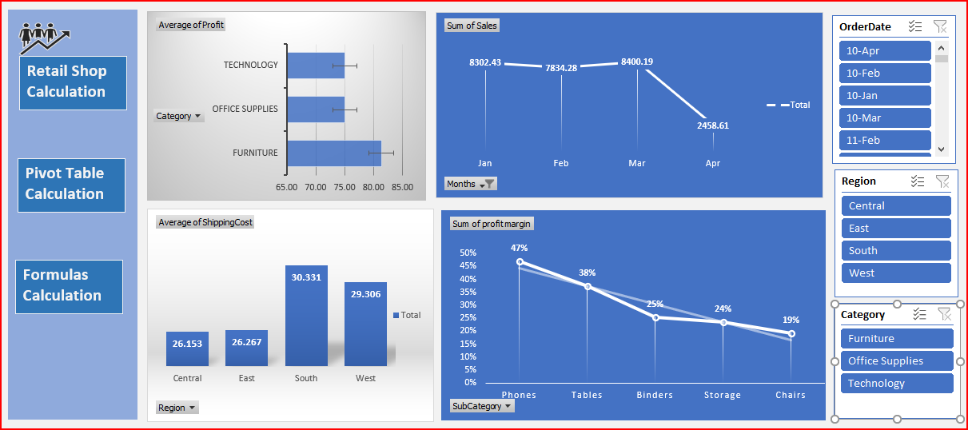
Retail Shop Dashboard

Slide 2
What is Retail?
Retail is the process of selling products or services directly to customers for personal use.
Example: A clothing store sells shirts directly to customers (not businesses).
Basic Retail Calculations | Purpose
Sales Revenue = Price × Qty | Total money earned from sales
Profit = Sales − COGS | Measure of earnings
Gross Margin % = (Profit ÷ Sales) × 100 | Profitability ratio
Inventory Turnover = COGS ÷ Avg. Inventory | Stock efficiency
Discount = Price − (Price × Discount%) | Final selling price
Tools for Retail Analysis:
• Excel — Sales reports, stock management
• SQL — Data queries, inventory database

Slide 3
Retail Sales Analysis Project Highlights
💵 Total Revenue Analyzed: $26995.51M +
💡 Highest Product 81.35% (Furniture)
🏆 Top 5 Customers: 20.31% of Total Sales
🔁 Return Rate: 52% of Total Orders
📊 Monthly Sales Trends: Line Chart Visualized
🚚 Avg. Shipping Cost per Region: $28.95
💰 Top Sub-Category: Phones (47% Profit Margin)

Slide 4
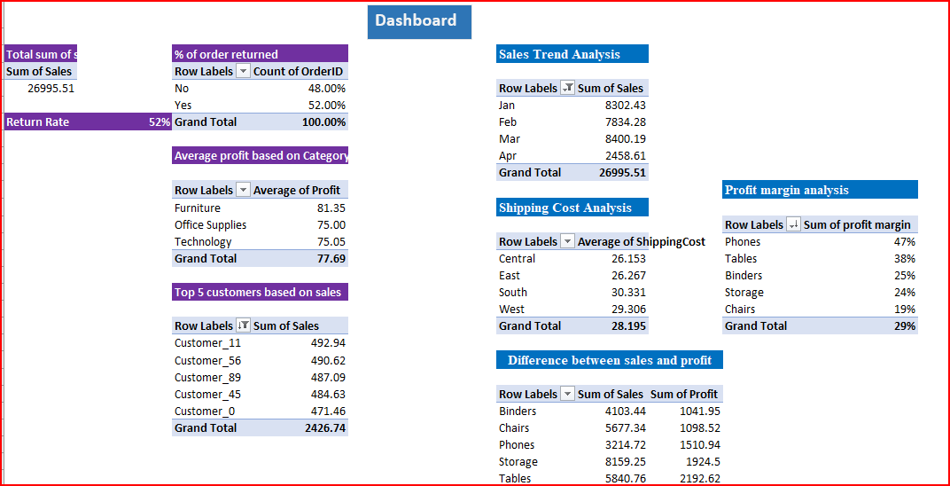
Pivot-Table Analysis

Slide 5
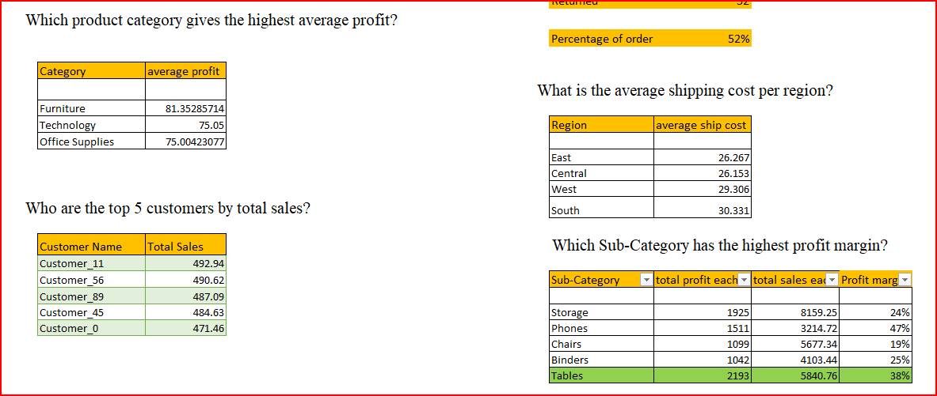
Using Formulas
(SUM, AVERAGEIFS, IF, VLOOKUP)

Slide 6
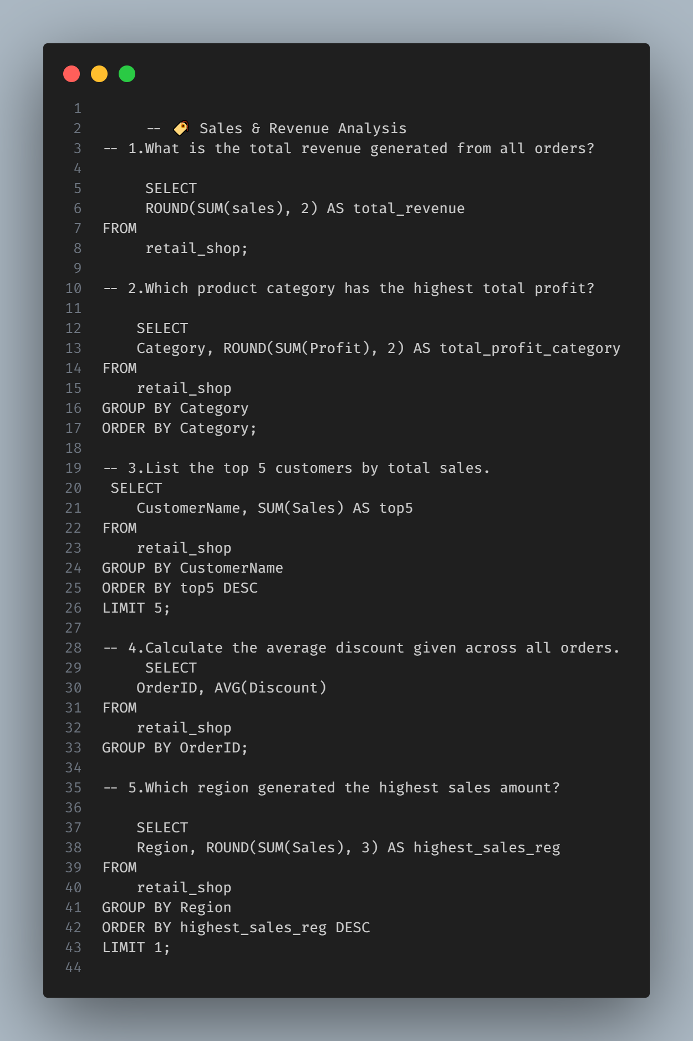
Try Using SQL

Slide 7
Key Insights, Recommendations & Tools
Return Rate: 52%
Average Shipping Cost per Region: $28.95 (Opportunity to optimize return policies and shipping costs)
Product Profitability:
Top Sub-Category by Profit Margin: Phones (47%) (Focus on promoting phone products for higher profitability)
Key Insights & Recommendations:
Reduce return rates by evaluating product descriptions or revising return policies.
Expand promotions for high-margin products like phones.
Nurture relationships with top customers for sustained growth.

