Slide 1
Comparative Analysis of Skin Cancer and Skin Lesion Classification: A performace Evaluation of CNN image classifiers
Task 4
Team : 19
Abu Bakar Hasnath (20301037),
Faisal Shahriar (20301175),
Sayad Md. Prio (20101356),
Sulaiman Hossain Tonmoy (23266033)
CSE424: Data Science for practitioners
Instructor: Annajiat Alim Rasel (AAR)
Notes:
K

Slide 2
Outline
Introduction
Objective
Dataset
Data Preprocessing
Methodology
Result analysis
Limitations

Slide 3
Introduction: Defining the problem statement
The most prevalent type of cancer, skin cancer, is caused by uncontrollably growing skin cells. The main cause of skin cancer are overexposure to ultraviolet(UV) light from the sun or any artificial source.
The deadly complications from skin cancer can be decreased by adequate treatment following early diagnosis.
Recent progress in machine learning, especially in medical image analysis, has shown promise in automating skin lesion detection and categorization.
Early and precise identification of skin cancer is critical for timely diagnosis and treatment, preventing disease progression and improving patient outcomes.
Leveraging machine learning techniques can lead to the development of precise diagnostic tools beneficial for both healthcare professionals and patients.

Slide 4
Objective
To explore a comprehensive technique using machine learning tools for detection and categorize skin cancers
Utilized the HAM10000 dataset, comprising 10,000 medical images of skin cancer with variations in types and patient demographics.
Evaluate the efficiency of the following CNN classifiers: InceptionResNetv2, InceptionV3, ResNet50 and VGG16
So that machine learning application can be readily deployed on the agricultural field

Slide 5
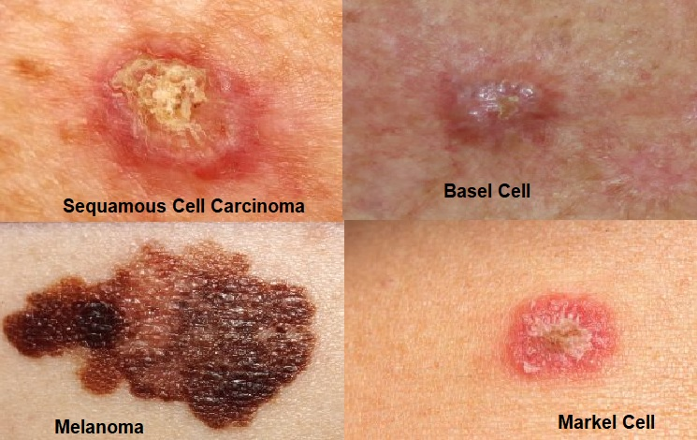
Dataset
Hybrid dataset
Collected from kaggle
Skin cancer
Consists of 20k and 20.6K respectively
Contains 10,000 images
Contain 7 classes
(Actinic keratosis, Basal cell carcinoma, benign lesion, dermatofibroma, melocytic, myeloma and vascular lesion)

Slide 6
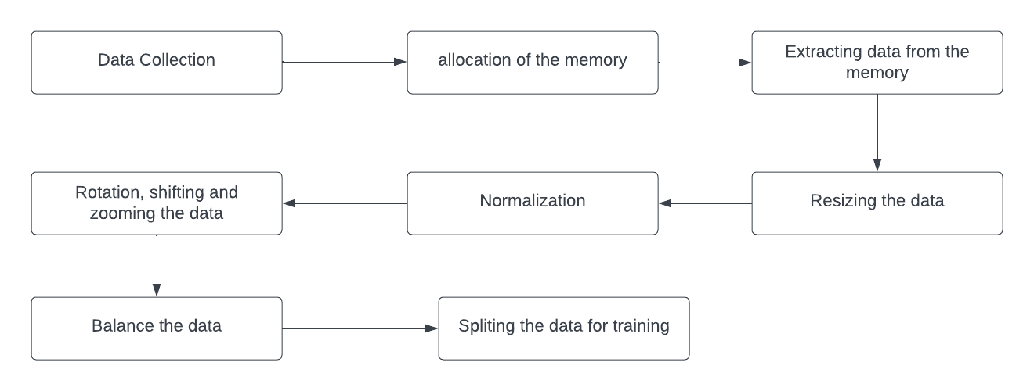
Data Preprocessing
Data preprocessing

Slide 7
Methodology
InceptionResNetV2:
deep convolutional neural network architecture
developed by Google's research architecture team
kernel size (1*1), (3*3), and (5*5)
residual connection intercorporate
Notes:
Healthcare Data Challenge: Healthcare faces challenges in accessing diverse datasets, as medical data is distributed across many institutions globally.
Legal and Regulatory Barriers: Centralized data aggregation for AI training in healthcare is increasingly restricted due to legal and regulatory barriers protecting data privacy.

Slide 8
Methodology
InceptionV3:
Evolved from InceptionResNet V2
capture features at different scales
inception modules are the key component
Auxiliary classifiers are also added to mitigate the layers

Slide 9
Methodology
ResNet50:
deep convolutional neural network architecture
developed by the Microsoft Research team
bottleneck architecture is used
balance of depth and computing efficiency

Slide 10
Methodology
VGG16:
convolutional neural network architecture
developed by Visual Graphic Group (VGG) at University of Oxford
multiple convolutional layers with 3*3 filters
Max pooling layers preserve the most significant features

Slide 11
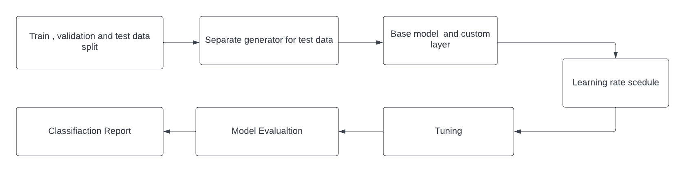
Methodology

Slide 12
Result Analysis
InceptionResNetV2 | 82.70%
InceptionV3 | 83.63%
ResNet50: | 76.43%
VGG16: | 66.95%

Slide 13
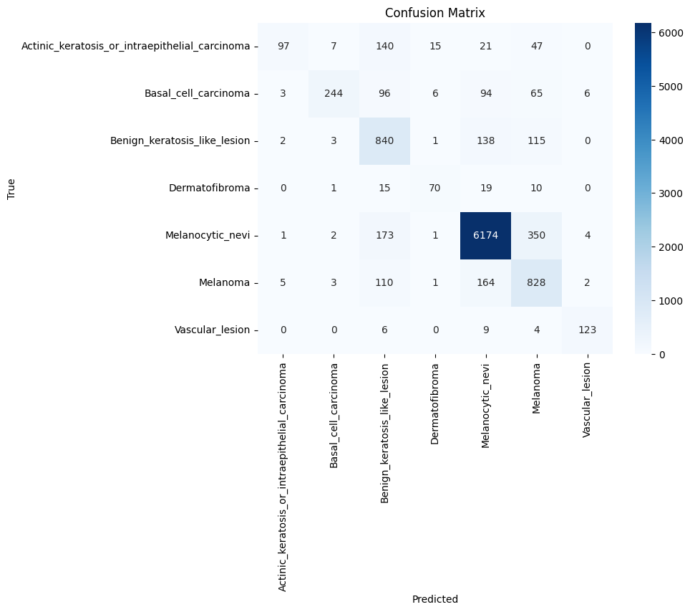
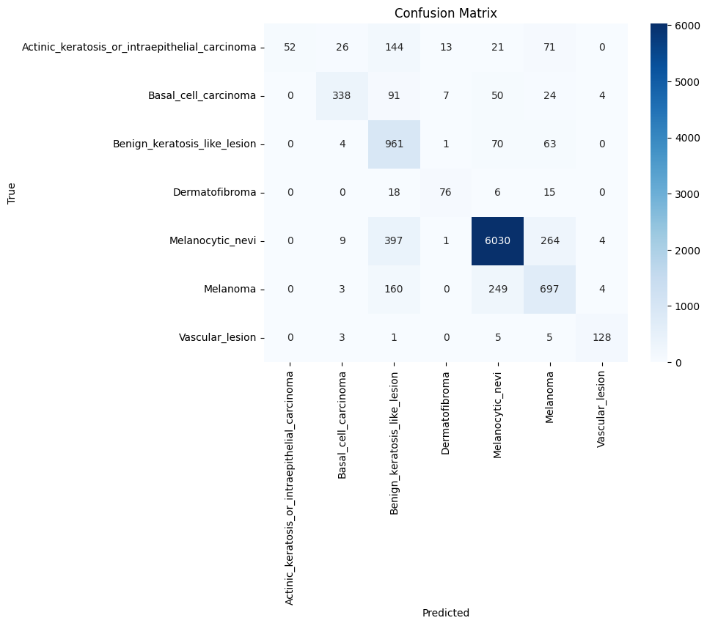
Result Analysis
Inceptionv3
InceptionResNetV2

Slide 14
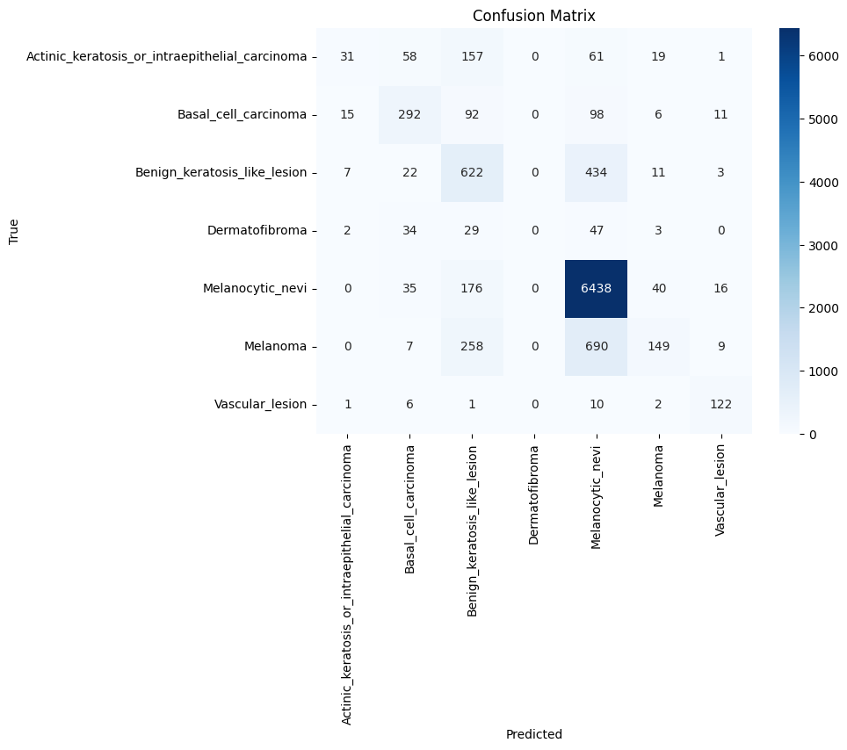
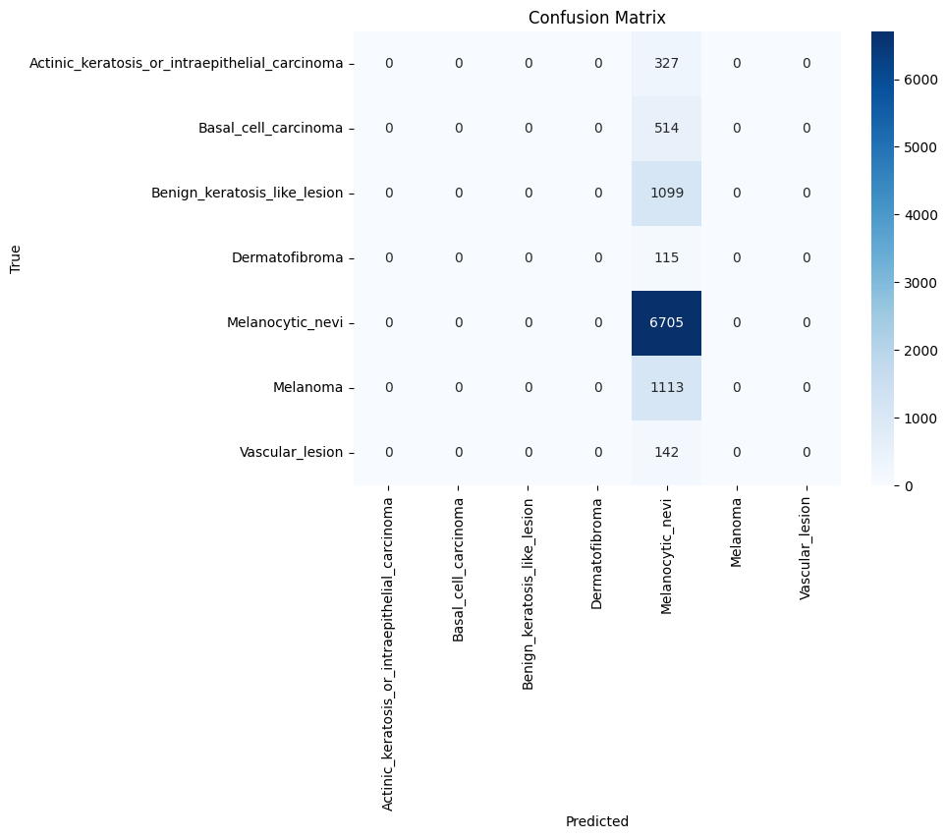
Result Analysis
VGG16
ResNet50

Slide 15
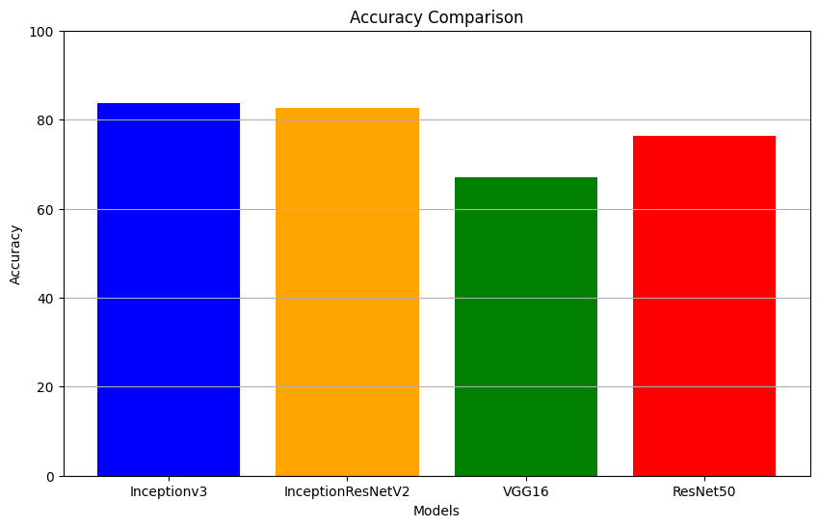
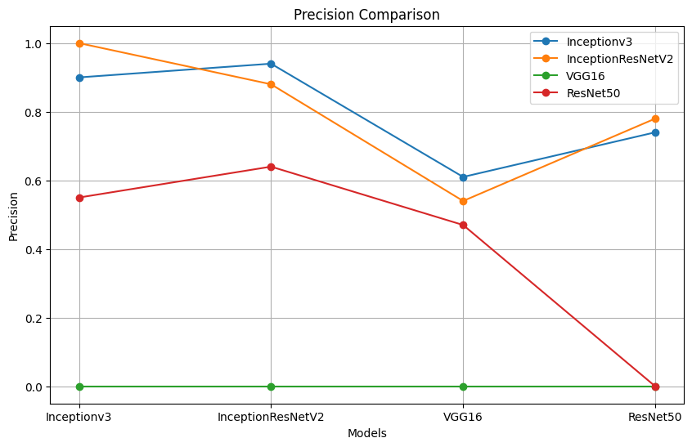
Result Analysis
Inceptionv3 achieved the highest accuracy among the models evaluated, with an accuracy of 83.63%.
InceptionResNetV2 closely followed Inceptionv3 with an accuracy of 82.70%.
ResNet50 showed a reasonable performance with an accuracy of 76.43%.
VGG16 had the lowest accuracy among the models, with an accuracy of 66.95%.
In terms of precision, recall, and F1-score, Inceptionv3 consistently outperformed the other models across all classes.
While VGG16 had the lowest accuracy, it also had the lowest precision, recall, and F1-score across all classes.
ResNet50 showed competitive performance but was outperformed by both Inceptionv3 and InceptionResNetV2 in terms of accuracy and precision.
Overall, Inceptionv3 and InceptionResNetV2 demonstrated superior performance compared to VGG16 and ResNet50 in classifying skin lesions.

Slide 16
Limitations
Requirement of the data
Computational resource
Robustness to noise inputs
Lack of Interpretability

Slide 17
Reference
[1] M. S. Hossain, S. N. Hassan, M. Al-Amin, M. N. Rahaman, R. Hossain, and M. I. Hossain. (2023). Kidney disease detection from ct images using a customized cnn model and deep learning.
[2] Chang Jie, Chen Jiming, Shao Ying. (2023). A pyramid GNN model for CXR-based COVID-19 classification.
[3]N. ul Huda, R. Amin, S. I. Gillani, M. Hussain, A. Ahmed, and H. Aldabbas. (2023) Skin cancer malignancy classification and segmentation using machine learning algorithms. Available: https://www.sciencedirect.com/science/article/pii/S2772375523000084
[4]L. Tiwari, V. Awasthi, R. K. Patra, R. Miri, H. Raja, and N. Bhaskar, “Lung cancer detection using deep convolutional neural networks,” in Data Engineering and Intelligent Computing: Proceedings of 5th ICICC 2021, Volume 1. Springer, 2022, pp. 373–385.
[5]W. Sae-Lim, W. Wettayaprasit, and P. Aiyarak, “Convolutional neural networks using mobilenet for skin lesion classification,” in 2019 16th international joint conference on computer science and software engineering (JCSSE). IEEE, 2019, pp. 242–24

Slide 18
[6]A. Esteva, B. Kuprel, R. A. Novoa, J. Ko, S. M. Swetter, H. M. Blau, and S. Thrun, “Dermatologist-level classification of skin cancer with deep neural networks,” nature, vol. 542, no. 7639, pp. 115–118, 2017.
[7] Joshi, S. K. (2022). Comparison and Performance Evaluation Using Convolution Neural Network-Based Deep Learning Models for Skin Cancer Image Classification. In Advances in Deep Learning for Medical Image Analysis (pp. 53-68). CRC Press.

Slide 19
Thank you for listening

