Slide 1



Call-Center-Dashboard
View in Power BI
Last data refresh:
02/03/2024 07:22:02 UTC
Downloaded at:
02/03/2024 07:24:13 UTC

Slide 2
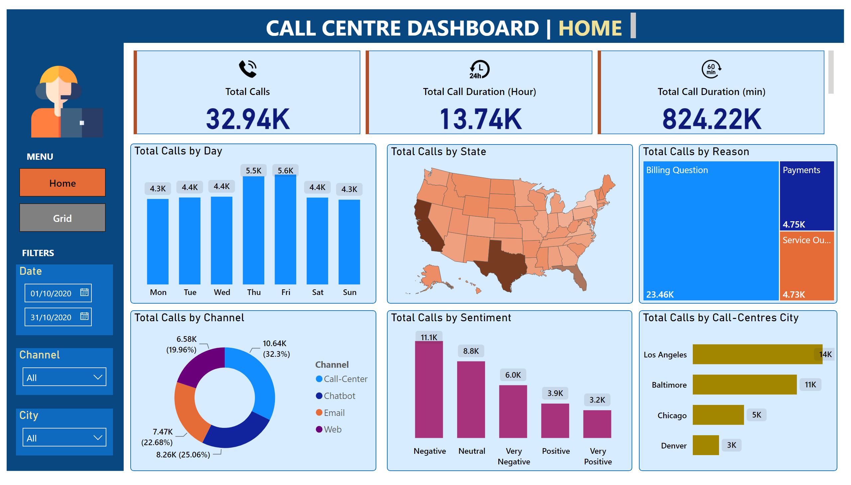
Home
Notes:
shape
No alt text provided
shape
No alt text provided
cardVisual
No alt text provided
textbox
No alt text provided
columnChart
No alt text provided
shapeMap
No alt text provided
treemap
No alt text provided
donutChart
No alt text provided
columnChart
No alt text provided
barChart
No alt text provided
Date
No alt text provided
Channel
No alt text provided
City
No alt text provided
image
No alt text provided
pageNavigator
No alt text provided
textbox
No alt text provided
textbox
No alt text provided

Slide 3
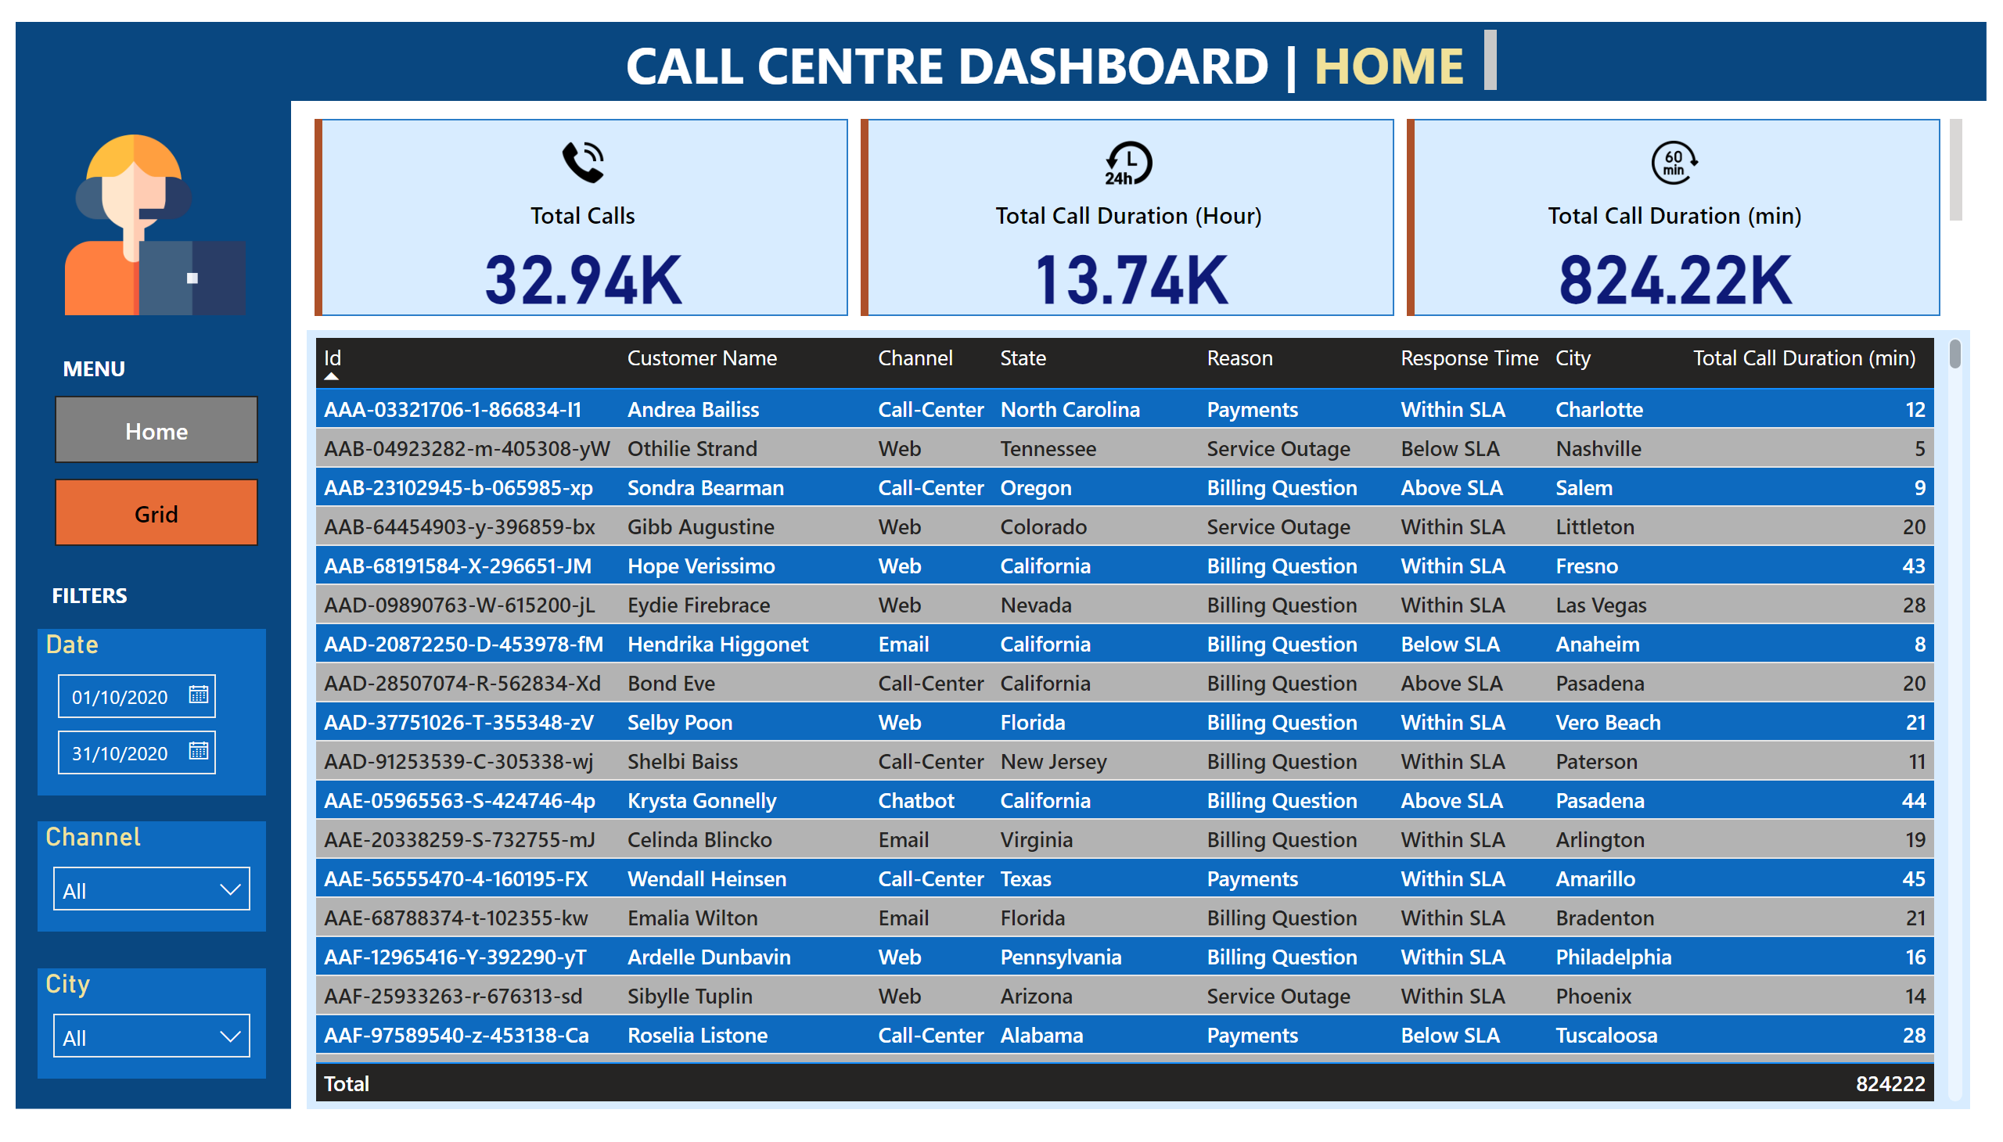
Grid
Notes:
shape
No alt text provided
shape
No alt text provided
cardVisual
No alt text provided
textbox
No alt text provided
Date
No alt text provided
Channel
No alt text provided
City
No alt text provided
image
No alt text provided
tableEx
No alt text provided
pageNavigator
No alt text provided
textbox
No alt text provided
textbox
No alt text provided

