Slide 1
Viva: CyberLure – AI-Enabled Honeypot for Cybersecurity Training
Abdul Ahad
2537327
Shehzad Memon

Slide 2
Project Aims
Cybersecurity training lacks accessible hands-on exposure to real attack data
Honeypot tools like Cowrie generate rich logs — but raw JSON is uninterpretable without specialist knowledge
No existing literature on accessible, AI-enhanced honeypot systems specifically designed for undergraduate education
This project fills that gap: an integrated honeypot + ML + dashboard system built for learners

Slide 3
Project Objectives
Research honeypot architectures (low/medium/high interaction) and relevant ML techniques
Deploy a controlled Cowrie SSH honeypot environment, automated via Ansible
Automate deployment and logging using Ansible playbooks and shell scripting
Collect, preprocess, and extract 17 behavioural features from honeypot logs
Develop and evaluate ML models: KMeans clustering + Random Forest classification
Build an interactive Streamlit dashboard and assess its educational value

Slide 4
Literature Review
HONEYPOTS — Spitzner (2003): low/medium/high-interaction types; Cowrie captures SSH commands and credentials in JSONL format; valuable for education (Almeshekah & Spafford, 2016)
ML FOR INTRUSION DETECTION — KMeans/DBSCAN for unsupervised clustering (Liao et al., 2013); Random Forest/SVM for classification (Ambusaidi et al., 2016); ML applied to honeypot data (Sarker et al., 2020)
CYBERSECURITY TRAINING — Hands-on learning essential (ENISA, 2020; Vykopal et al., 2021); dashboards improve comprehension (Damarevicius & Toldinas, 2020)
GAPS IDENTIFIED:
No accessible, AI-enhanced honeypot system designed for undergraduate education
Existing ML+honeypot systems too complex for beginners
No integrated: honeypot + ML + visual dashboard in one tool

Slide 5
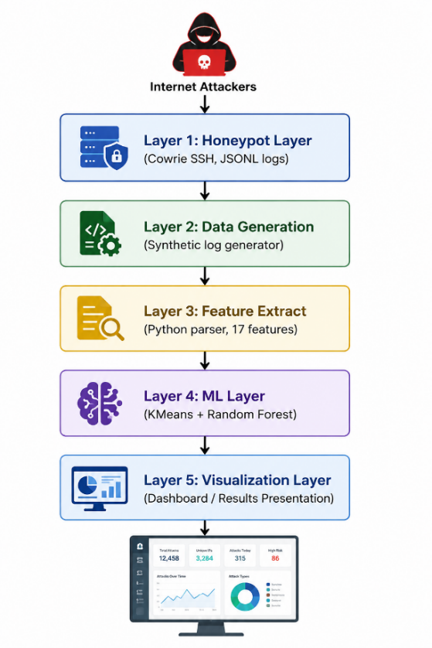
Methodology
APPROACH — Iterative RAD/Agile: 5 phases, each tested independently
SYSTEM ARCHITECTURE (5 layers):
Layer 1 — Honeypot: Cowrie SSH on port 22, logs to JSONL
Layer 2 — Data Generation: 500 synthetic sessions / 3,400 events
Layer 3 — Feature Extraction: Python parser, 17 per-session features
Layer 4 — ML: KMeans clustering (k=6) + Random Forest (200 trees)
Layer 5 — Presentation: Streamlit dashboard, 9 interactive visualisations
KEY TOOLS: Cowrie | Ansible | Python | Streamlit

Slide 6
Summary of the work achieved:
Cowrie SSH honeypot fully configured and automated via an Ansible playbook
Synthetic log generator producing 500 sessions / 3,400 events in authentic Cowrie JSON format
Python feature extraction pipeline: 17 per-session behavioural features
KMeans clustering (k=6) — silhouette score 0.4958 — six attack behaviour categories identified
Random Forest classifier — 100% accuracy on synthetic test set
Streamlit dashboard (CyberLure) with 9 interactive visualisations, sidebar filters, and colour-coded session log

Slide 7
Outline of the demo
Share screen to show the CyberLure Streamlit dashboard
Walk through: KPI metric cards, attack type distribution, top attacking countries, attack timeline
Highlight: behaviour score heatmap — shows how ML differentiates attack types visually
Show: colour-coded session log — Cryptominer (amber), Lateral Movement (orange)
Demonstrate sidebar filters: filter by attack type, country, login attempts
Discuss: what is working, what still needs development

Slide 8
References
Spitzner, L. (2003) Definitions and value of honeypots.
Cowrie Project (2016) Cowrie SSH/Telnet honeypot. GitHub.
Sarker, I.H. et al. (2020) Cybersecurity data science. Journal of Big Data, 7(1).
Vykopal, J. et al. (2021) Scalable learning environments. IEEE FIE 2021.
ENISA (2020) Cybersecurity skills framework.
Kreibich, C. & Crowcroft, J. (2004) Honeycomb. ACM SIGCOMM, 34(1).
Full reference list in dissertation pp. 26–27

