Slide 1

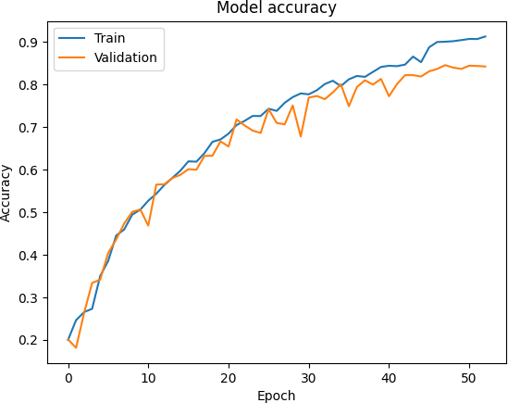
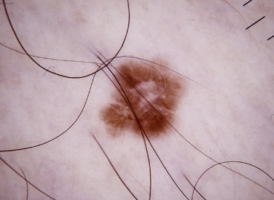
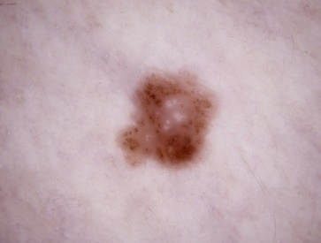
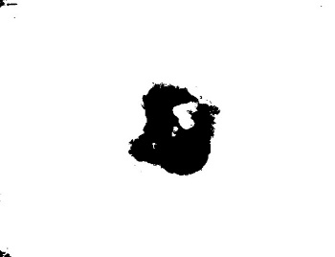
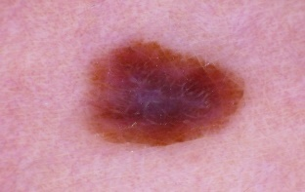

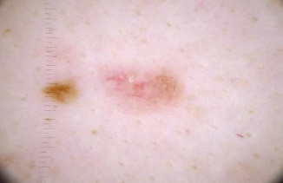
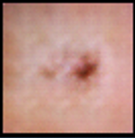
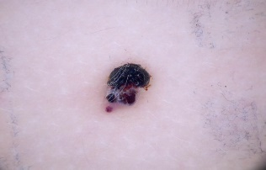
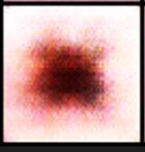
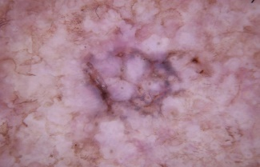
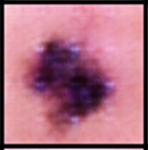
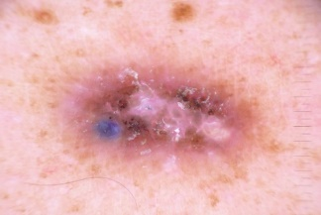
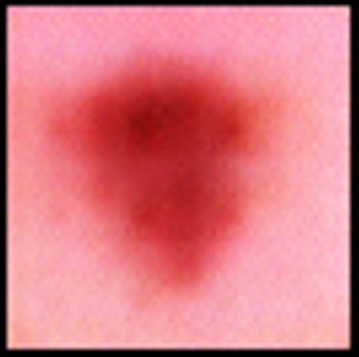
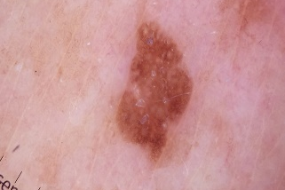
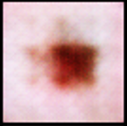
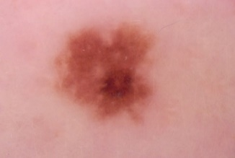
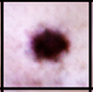



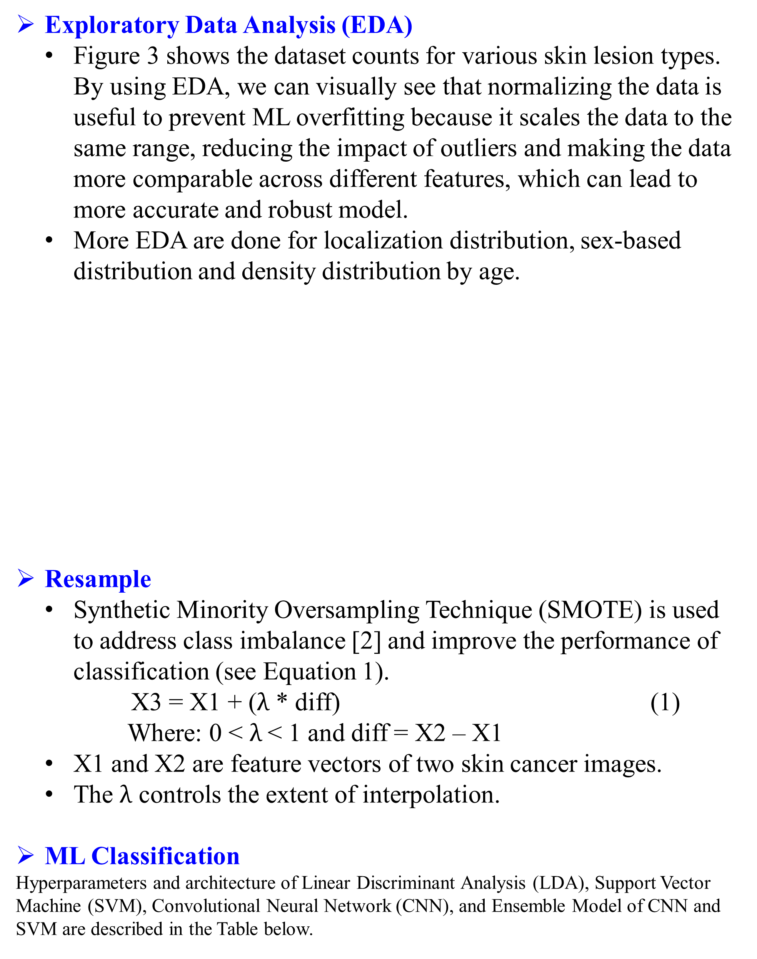
CAPPLab Poster Template | Title of the Poster | CAPPLab Poster Template
Name One¹ and Name Two²
¹School of One and ²Department of Two, Wichita State University, Wichita, KS, USA
Abstract
3. Proposed CADx System
4. Experimental Results
Conventional computer-aided diagnosis (CADx) systems for detecting skin diseases are manual, time-consuming, and error-prone. This work presents a comprehensive research aimed at improving the performance of CADx systems for detecting skin diseases by applying machine learning (ML). The experimental results unveil that the ensemble convolutional neural network (CNN) and support vector machine (SVM) achieve accuracy up to 92% (from CNN accuracy 85% and SVM accuracy 83%).
Exploratory Data Analysis (EDA)
Figure 3 shows the dataset counts for various skin lesion types. By using EDA, we can visually see that normalizing the data is useful to prevent ML overfitting because it scales the data to the same range, reducing the impact of outliers and making the data more comparable across different features, which can lead to more accurate and robust model.
More EDA are done for localization distribution, sex-based distribution and density distribution by age.
Resample
Synthetic Minority Oversampling Technique (SMOTE) is used to address class imbalance [2] and improve the performance of classification (see Equation 1).
X3 = X1 + ($λ$ * diff) (1)
Where: 0 < $λ$< 1 and diff = X2 – X1
X1 and X2 are feature vectors of two skin cancer images.
The $λ$ controls the extent of interpolation.
ML Classification
Hyperparameters and architecture of Linear Discriminant Analysis (LDA), Support Vector Machine (SVM), Convolutional Neural Network (CNN), and Ensemble Model of CNN and SVM are described in the Table below.
Table compares ML classification algorithms:
 |  | Dataset with Fake Images | Dataset without Fake Images | Resampled Dataset without Fake Images
LDA | Accuracy | 0.52 | 0.56 | 0.75
 | Precision | 0.23 | 0.49 | 0.74
 | Recall | 0.25 | 0.55 | 0.75
SVM | Accuracy | 0.67 | 0.75 | 0.83
 | Precision | 0.42 | 0.68 | 0.82
 | Recall | 0.40 | 0.67 | 0.82
CNN | Accuracy | 0.76 | 0.80 | 0.85
 | Precision | 0.54 | 0.83 | 0.85
 | Recall | 0.44 | 0.67 | 0.85
CNN and SVM | Accuracy | 0.79 | 0.82 | 0.92
 | Precision | 0.56 | 0.78 | 0.92
 | Recall | 0.46 | 0.74 | 0.92
1. Introduction
Preprocessing
Noise Removal (Fig. 1)
Resize all images to 64 by 64 pixels
Segmentation
Convert to Binary Image (Fig. 2)
Process called Thresholding
IMAGES
Preprocessing
GAN
Classification
RESULT
EDA
Resample
This study evaluates the performance of CNN, SVM, LDA, and ensemble model of CNN and SVM.
As illustrated in Table 3, CNN and SVM ensemble model, outperformed LDA, SVM and CNN in terms of accuracy, precision and recall across the dataset.
According to the experimental results, ensemble model of CNN and SVM is a more effective model for CADx System in image classification tasks for detecting skin diseases.
Feature Selection
Feature Extraction
Segmentation
Fig. 3: Skin Lesion distribution by Count
Fig. 1: Noise Removal
Fig. 2: Conversion to Binary Image
Fig. 7: CNN Accuracy vs Epoch
2. Background Work
5. Conclusions
AI HAM 10000 Database to Assist Residents in Learning Differential Diagnosis of Skin Cancer [1]
Algorithms | Architecture
Linear Discriminant Analysis (LDA) [3] | Optimized with specific hyperparameter settings, including the ‘svd’ solver, default automatic shrinkage estimation, and number of components value.
Support Vector Machine (SVM) [4] | Optimized using the ‘poly’ kernel and setting the regularization parameter © to 1.0, enabling accurate classification of diverse skin lesion images.
Convolutional Neural Network (CNN) [5] | Designed with a multi-layer architecture, including four convolutional layers with respective filter sizes of (4, 3), followed by max pooling layers to downsample the features. Dropout layers with a rate of 0.25 are inserted after each max pooling layer to prevent overfitting. The architecture also includes a global average pooling layer, two dense layers with relu activation, and L2 regularization. The model is trained for 65 epochs with early stopping and learning rate reduction callbacks.
Ensemble Model of CNN and SVM [6] | Combines predictions for both the CNN and SVM models using a voting mechanism. For consistent predictions, a weight of 1.0 is assigned, while for inconsistent predictions, the weights are set to 0.7 for CNN and 0.3 for SVM. By aggregating the predictions through voting, the ensemble method capitalizes on the strengths of each model.
Machine learning plays a significant role in improving the performance of CADx Systems with the help of the ensemble model ability to learn from input data and make accurate predictions.
CNN’s hierarchical learning capability contributes to its success in image classification.
Future research: Optimizing CNN’s computational efficiency may further enhance its potential for large-scale image classification datasets.
CATEGORY | ORIGINAL IMAGES | GAN IMAGES | DESCRIPTION
Melanoma (MEL) |  |  | A type of skin cancer that develops from pigment-producing cells and can be deadly if not caught early.
Basal Cell Carcinoma (BCC) |  |  | The most common type of skin cancer that typically appears as a waxy bump or lesion on the skin.
Vascular Lesions (VAS) |  |  | A variety of skin conditions caused by abnormal blood vessels, including birthmarks, hemangiomas, and vascular malfunctions.
Actinic Keratoses (AKIEC) |  |  | A pre-cancerous lesion that appears as a scaly or crusty growth and is typically caused by sun damage.
Dermatofibroma (DF) |  |  | A benign skin lesion that appears as a firm, round bump and is typically brown or reddish-brown.
Benign Keratosis-Like Lesions (BKL) |  |  | Benign skin growths resemble actinic keratoses but have different characteristics.
Melanocytic Nevi (NV) |  |  | Common and benign skin growth that are typically tan or brown.
References
[1] C. H. Chang, W. En Wang, F. Y. Hsu, R. Jhen Chen, and H. C. Chang, “AI HAM 10000 Database to Assist Residents in Learning Differential Diagnosis of Skin Cancer,” IEEE Eurasian Conference on Educational Innovation (ECEI), Taipei, Taiwan, 2022, pp. 1-3.
[2] G. A. Pradipta, R. Wardoyo, A. Musdholifah, I. N. H. Sanjaya, and M. Ismail, “SMOTE for Handling Imbalanced Data Problem : A Review,” International Conference on Informatics and Computing (ICIC), Jakarta, Indonesia, 2021, pp. 1-8.
[3] R. O. Duda, P. E. Hart, and D. G. Stork, “Pattern classification,” Wiley-InterScience, 2nd ed.., 2001.
[4] C. Cortes and V. Vapnik, “Support-vector networks. Machine learning,” 20(3), pp. 273-297, 1995.
[5] Y. LeCun, Y. Bengio, and G. Hinton, “Deep learning,” Nature, 521(7553), pp. 436-444, 2015.
[6] R. Logan, B. G. Williams, M. F. da Silva, A. Indani, N. Schcolnicov, A. Ganguly, and S. J. Miller, “Deep Convolutional Neural Networks With Ensemble Learning and Generative Adversarial Networks for Alzheimer's Disease Image Data Classification,” Frontiers in aging neuroscience, 13, 720226, 2021.
(Sample) The parallel computing research at CAPPLab is partially financed by WSU College of Engineering (Fund#D11012, year 2011-2012) and NVIDIA (Fund# 211254, year 2012-2013). (Sample)

