Slide 1


CAPPLab Presentation
Semester Year | ECE Department
“Presentation Title”
Notes:
*) Change CAPPLab Presentation as appropriate: e.g., PhD Dissertation / MS Thesis / MS Report / UG Research Defense
*) Change Semester Year as appropriate: e.g., Spring 2024
*) Change Presentation Title as appropriate: e.g., “Championing Literacy: A Global Quest to Defeat Ignorance”
*) Change Committee Members’ Names as appropriate: e.g., 1) Abu Asaduzzaman, Chair
*) Change Student Name as appropriate: e.g., Md Raihan Uddin
*) Change Date as appropriate: e.g., Mar. 1, 2014
*) Remove these notes
Committee Members:
Name, Chair
Name, External Member
Name, Member
Name, Member
Student:
Name
Date

Slide 2
!!! Important Notes !!!
This is the template for WSU CAPPLab presentations.
It is important that you use this template to prepare your presentation slides.
Try to avoid red color!
You may make some changes for your specific needs per Instructor’s approval.
Use “Animations” as you may need!
Learn more … [1]
WSU: Wichita State University
CAPPLab: Computer Architecture and Parallel Programming Laboratory
[1] “Technical Presentation,” MIT Communication Lab, https://mitcommlab.mit.edu/meche/commkit/technical-presentation/

Slide 3



“Presentation Title”
Outline ►
Introduction
Keywords
Problem Description and Contributions
Background Materials
Proposed Methodology
Description of the proposed work, workflow, etc.
Experimental Details
Experimental Setup / Simulation Details
Simulation Results
Performance Analysis
Cost Analysis
Conclusions
Q/A Discussion
Q/A: Questions/Answers
Student’s Last Name

Slide 4
Speaker Qualifications
Speaker Name with academic standing.
‘Speaker Name’ writes an article for ABC Magazine.
‘Speaker Name’ speaks/presents on this topic at XYZ Conference/Symposium/Workshop.

Slide 5
Presentation Objectives
What will be learned in your presentation?
List the objectives you submitted for this session when you responded to the Call for Abstracts.

Slide 6
Best Practices
Be Clear and Concise
Each slide should contain no more than five bullet points; two graphs, charts, or tables. Each graph, chart, and table must have to have a proper caption.
Font type and sizes must be consistent with what is set in this template.
Text and graphics used in your presentation should not exceed the border of the slide.
When your presentation is printed, you should print the handout with 6 slides per page.

Slide 7
Best Practices (+)
Focus Audience’s Attention
Use color or bolding to emphasize words, but in moderation.
Point the audience to portions of your graphics using a headline or arrow.
Limit the amount of information you include in the slide.
Do not just read the slides word for word.

Slide 8
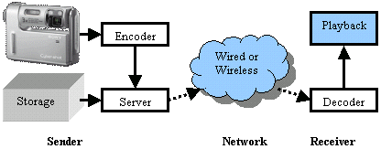
Figures, Captions, Texts, Etc.
In a typical video communication, the sender encodes the data before sending [2].
As illustrated in Fig.1, the receiver decodes the encoded data before playing.
Fig. 1: Video Communication
The sequence of the frames in the original data and the sequence of the frames in the decoded data must be the same.
[2] Asaduzzaman, A., Mahgoub, I., Sanigepalli, P., Kalva, H., Shankar, R., and Furht, B., “Cache Optimization for Mobile Devices Running Multimedia Applications,” in IEEE International Symposium on Multimedia Software Engineering (ISMSE2004), Miami, Florida, Dec. 2004.

Slide 9
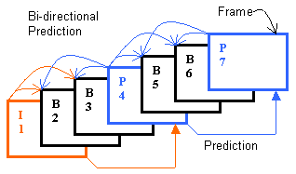
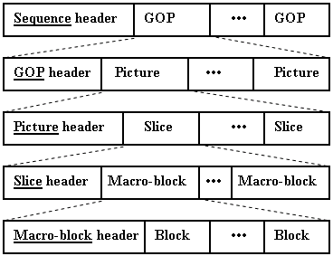
Figures, Captions, Texts, Etc. (+)
Fig. 2 shows the Picture, Slice, Macro-Block, and Block in an MPEG4 group of pictures (GOP).
Fig. 3 illustrates how the picture-frames of an MPEG4 GOP are organized during decoding.
Fig. 2: MPEG4 bit-stream Structure
Fig. 3: MPEG4 Decoding
References to I and P frames; Decoding order = 1, 4, 2, 3, 7, 5, and 6.

Slide 10
Figures, Captions, Texts, Etc. (+)
MPEG4 Workload
Table I shows references and cache miss information for the selected MPEG4 video file.
CL1 – 33% data, 67% instruction; 67% read, 33% write
Table I: Level-1 Data (read/write) and Instruction references
Cache size (K); Line size (Byte) | D1 Refs (K) Total / Miss | I1 Refs (K) Total / Miss | CL1 Refs D1/I1 (%) | D1 Refs R/W (%)
8,8,128; 16 | 18,782 / 512 | 38,758 / 512 | 33/67 | 67/33
16,16,512; 32 | 18,782 / 512 | 38,758 / 106 | 33/67 | 67/33
32,32,2048; 64 | 18,782 / 512 | 38,758 / 39 | 33/67 | 67/33
Lower D1 (D1-95%, I1-98%) and higher CL2 (99.3%) hit rates

Slide 11
Results
CL1 Size
For fixed CL2, Fig. 4 shows miss ratio for various CL1 size.
Important observations
The miss rates remain almost unchanged and using a CL1 size greater than 8+8 KB does not offer any benefit.
Fig. 4: Miss Ratio Vs CL1 Size

Slide 12
Results (+)
CPU Utilization
For fixed CL1, Fig. 5 shows CPU utilization for various CL2 size.
Important observations
Before 512 – decreases slowly
512K – 2M, decreases sharply
After 2M – almost unchanged
Fig. 5: CPU Utilization Vs CL2 Size

Slide 13
Conclusions
Items learned in this presentation. Try to fit in one slide; not more than two slides.
You may repeat from your list of objectives.
What things will the attendees have learned?
What golden nuggets of information have you provided?
One or two important future extensions.

Slide 14
References?
Second to the very last slide to list references. Optional.

Slide 15
“Presentation Title”
Questions?
Notes:
*) Change Presentation Title as appropriate
*) Be ready to address illicit questions and/or comments from the audience
*) Provide your contact information to have further feedback/collaboration
*) Remove these notes
Please send your feedback to:
Name
Email
Phone
Thank You!

