Slide 1


IEEE Conference on ACDSA 2024
Feb. 01-02, 2024 | Mahé, Seychelles
“Performance Analysis of C and Python Parallel Implementations on a Multicore System Using Particle Simulation”
Presenter:
Abu Asaduzzaman, Associate Professor
Wichita State University, USA
Authors:
Abu Asaduzzaman¹, Venkata S.P.T. Telikepalli¹, and Md Raihan Uddin¹
¹Wichita State University, USA
Feb. 1, 2024

Slide 2
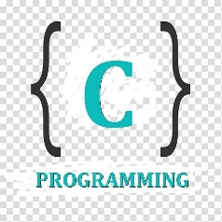



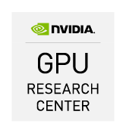
“Performance Analysis of C and Python Parallel Implementations on a Multicore System Using Particle Simulation”
Outline ►
Introduction
Parallel Processing with C and Python on Multicore Systems
Problem Description, Contribution
Related Concepts and Work
Parallel Execution of C and Python Code
Simulation Details
Application, Workflow, Computations
Simulation Results
Serial and Parallel Execution Time
Conclusion
Q/A Discussion
CPU
CPU
CPU
CPU
GPU
Single-Core
Multi-Core
Q/A: Questions / Answers
Asaduzzaman

Slide 3
“Performance Analysis of C and Python Parallel Implementations on a Multicore System Using Particle Simulation”
Introduction
Parallel Processing using C and Python on Multicore Systems
Languages for parallel processing on multicore architecture include: C, C++, Java, and Python
C: translator, closer to machine language, most widely preferred [1, 2]
Python: interpreter, higher level language, most popular [1, 2]
Multicore Architecture with CPU/GPU: Intel, Nvidia, AMD
Multithreading APIs: OpenMP, Open MPI, and CUDA
OpenMP: supports C/C++, not Python because of GIL
> Multithreading module supports Python
Open MPI: supports both C/C++ and Python
CPU: Central Processing Unit | GPU: Graphics Processing Unit | AMD: Advanced Micro Devices
API: Application Programming Interface | OpenMP: Open Multi-Processing
MPI: Message Passing Interface | CUDA: Compute Unified Device Architecture
GIL: Global Interpreter Lock
[1] S. Veeraraghavan, “Top 20 Best Programming Languages To Learn in 2023,” 2023. https://www.simplilearn.com/best-programming-languages-start-learning-today-article
[2] “20 Top Programming Languages for 2023,” 2023. https://devmountain.com/blog/20-top-programming-languages-2020/

Slide 4
“Performance Analysis of C and Python Parallel Implementations on a Multicore System Using Particle Simulation”
Introduction
Problem Description and Contribution
It is often challenging to decide which programming language should provide the best performance for a given set of low-end architecture and applications.
We investigate the performance of C with OpenMP & MPI and the same of Python with multithreading & MPI using particle simulation.
We simulate 1K, 5K, and 10K particles on a three-core system with CentOS and obtain the speedup due to parallel executions.

Slide 5
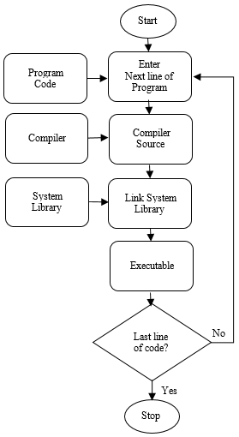
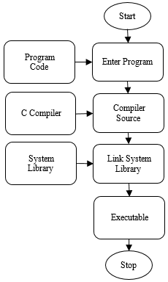
“Performance Analysis of C and Python Parallel Implementations on a Multicore System Using Particle Simulation”
Related Work
Execution of C and Python
Figure 1 shows the major steps to execute C and Python code.
The entire C code is compiled to generate the executable file. C allows memory management, offers powerful performance, but C’s static nature limits dynamic features [3].
Python code is executed using an interpreter that processes each line of code sequentially. Python handles memory internally, results in performance overhead [4].
(a) C (b) Python
Figure 1: Major steps for executing C and Python code
[3] T. Chakrabarty, “Draw the flow chart of the process of compiling and running a C program,” Online Class Notes, 2015, https://onlineclassnotes.com/draw-flow-chart-of-process-of-compiling
[4] S. Ravi, “How Does Python Code Run: C Python And Python Difference,” 2020, https://www.c-sharpcorner.com/article/why-learn-python-an-introduction-to-python/

Slide 6
“Performance Analysis of C and Python Parallel Implementations on a Multicore System Using Particle Simulation”
Related Work
Multicore systems facilitate the work sharing of threads.
MPI for C and Python
During the execution of MPI, all processes use the same compiled binary, and they run the same code.
In Python, we use MPI4Py, while in the C, we use the standard mpi.h library.
Cython [7] is used in this work as a middleware between Python and C/C++.
OpenMP Based Parallelization for C
The OpenMP API is included as a header file in all C programs as an extension to facilitate multithreading usage [5].
Parallelization for Python
The multithreading module helps to facilitate multithreading in Python using start(), run(), and join() methods [6].
[5] N. Singh, “Automatic parallelization using OpenMP API,” International Conference on Signal Processing, Communication, Power and Embedded System (SCOPES), 2016, pp. 291-294.
[6] J. Anderson, “An Intro to Threading in Python,” Real Python, 2023. https://realpython.com/intro-to-python-threading/
[7] S. Behnel, R. Bradshaw, C. Citro, L. Dalcin, D. S. Seljebotn, and K. Smith, “Cython: The best of both worlds,” Computing in Science Engineering, vol. 13, no. 2, pp. 31–39, 2011.

Slide 7
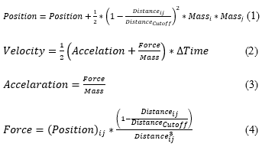
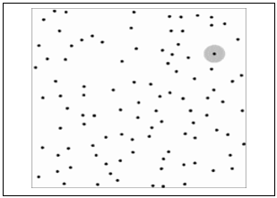
“Performance Analysis of C and Python Parallel Implementations on a Multicore System Using Particle Simulation”
Simulation Details
Application: Particle Simulation [8]
The particle simulation starts by generating particles with random values for position (X and Y) and velocities (X and Y) as depicted in Figure 2.
We compute the equations: (1) for position, (2) for velocity, (3) for acceleration (3), and (4) for force.
Figure 2: Particles in a virtual environment
[8] “Programming Project: Parallelize Particle Simulation,” GitHub, 2023. https://github.com/Nycander/ID1217--Parallelize-Particle-Simulation

Slide 8
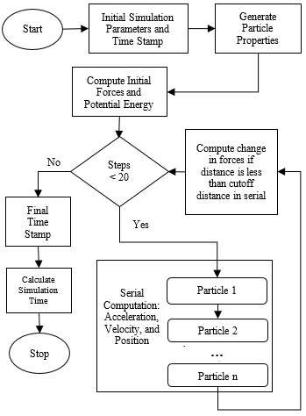
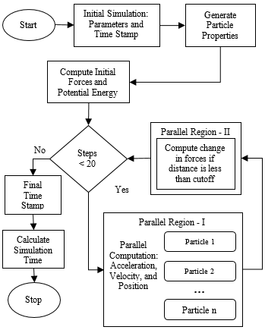
“Performance Analysis of C and Python Parallel Implementations on a Multicore System Using Particle Simulation”
Simulation Details
Workflow: Serial and Parallel
The process flow is illustrated in Figure 3.
The number of steps in the simulation is fixed at 20 for all calculations. After creating the particles, the forces and positions are computed 20 times.
Computation Environment
The system consists of an Intel Xeon Gold 6240 CPU at 2.60GHz. The CPU's core architecture is x86_64.
We use Python/3.9.6/GCCcore-11.2.0.
(a) Serial (b) Parallel
Figure 3: Flowchart for the serial and parallel execution

Slide 9

“Performance Analysis of C and Python Parallel Implementations on a Multicore System Using Particle Simulation”
Simulation Results
Serial Execution Time
The execution times of C and Python serial code for particle simulation are measured for three particle sizes. As shown in Table 1, Python serial code takes more time when compared with the C serial code.
Table 1: Serial execution time due to C and Python Code

Slide 10
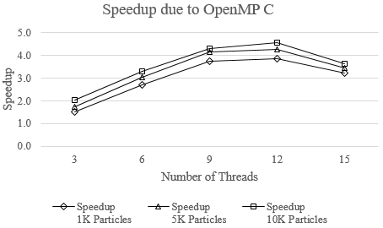
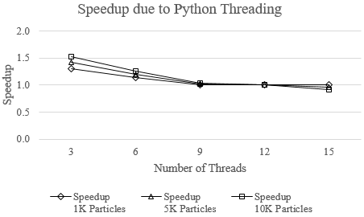
“Performance Analysis of C and Python Parallel Implementations on a Multicore System Using Particle Simulation”
Simulation Results
Parallel Execution Time
Unlike OpenMP C, for the same number of threads, the Python multithreading speedup (comparing with the respective single-thread execution time) decreases with the increase of particles as shown in Figure 5. For more than 12 threads, speedup becomes less than one.
For OpenMP C, the execution time increases as the number of particles increases. However, the speedup increases with the increase of particles as shown in Figure 4. For more than 12 threads, speedup decreases.
Figure 4: Speedup due to OpenMP C
Figure 5: Speedup due to Python multithreading

Slide 11
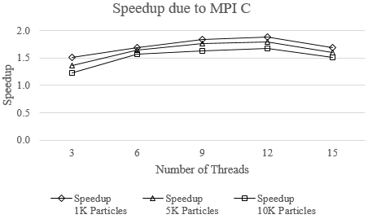
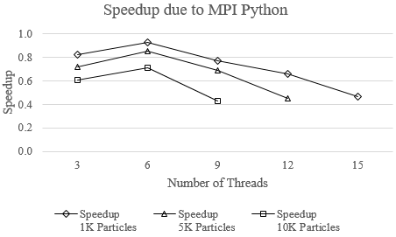
“Performance Analysis of C and Python Parallel Implementations on a Multicore System Using Particle Simulation”
Simulation Results
Parallel Execution Time (+)
Unlike Python multithreading behavior, the MPI Python speedup (comparing with the respective single-thread execution time) increases when the number of threads increases from three to six for all particle sizes as shown in Figure 7.
Like OpenMP C, the MPI C execution time increases as the number of particles increases. However, the speedup increases (for up to 12 threads) with the increase of particles as shown in Figure 6.
Figure 6: Speedup due to MPI C
Figure 7: Speedup due to MPI Python

Slide 12
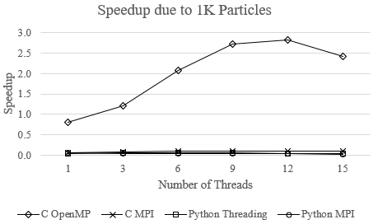
“Performance Analysis of C and Python Parallel Implementations on a Multicore System Using Particle Simulation”
Simulation Results
(cont’d)
Overall, the speedup due to OpenMP C is significant and that due to MPI C is negligible. As shown in Figure 8, the speedup due to Python code (for both multithreading and MPI) remains almost the same.
Figure 8: Speedup due to C and Python code

Slide 13
“Performance Analysis of C and Python Parallel Implementations on a Multicore System Using Particle Simulation”
Conclusion
Python is one of the top most-used programming languages. However, Python cannot use OpenMP, and MPI4Py library takes a significant amount of computation time. Traditionally, C has good supports for parallel programming.
Therefore, it poses a challenge to decide whether C or Python is better for a given parallel computer system.
In this work, we implement particle simulation application using C with OpenMP & MPI and Python with multithreading & MPI.
According to the experimental results using 1K, 5K, and 10K particles, C outperforms Python. For up to 12 threads, C OpenMP shows the best performance, followed by C MPI. As the number of threads increases, Python multithreading and MPI show worse performance.
In our next endeavor, we plan to conduct parallel implementations of real-time data-dependent applications in order to better understand Python’s ability for high performance computing.

Slide 14
“Performance Analysis of C and Python Parallel Implementations on a Multicore System Using Particle Simulation”
Questions?
Please send your feedback to:
Abu Asaduzzaman
abu.asaduzzaman@wichita.edu
+1 (316) 978-5261
Thank You!

