Slide 1




2024 International Conference on Information and Communication Technology (ICICT) in the Institute of Information and Communication Technology (IICT)
“Navigating the Challenges of Machine Learning in Genomic Data Analysis”
Presenter:
Abu Asaduzzaman, Professor and Associate Chair
Electrical and Computer Engineering Department
Wichita State University, Kansas, USA
Oct. 21, 2024

Slide 2

“Navigating the Challenges of Machine Learning in Genomic Data Analysis”
Outline ►
Introduction
Contemporary Machine Learning Models and Healthcare Data Analyses
Challenges with Genomic and Non-Genomic Datasets
Problem Description and Contributions
Background Materials
Datasets, Machine Learning Models
Proposed Methodology
Major Steps and Workflow
Preliminary Results
Experimental Details
Performance Analysis
Conclusions
Collaboration Opportunities
Dr. Zaman
2

Slide 3


Introduction
About Myself
Name: A S MD Asaduzzaman (aka, Abu Asaduzzaman)
Education
PhD and MS in Computer Engineering, Florida Atlantic University
BS in EEE, Bangladesh University of Engineering and Technology
Current Affiliation: Wichita State University (WSU)
Professor and Associate Chair, ECE Department
Director of CAPPLab
Scholarly Activities
Grants: NSF Kansas EPSCoR, DoE Argonne, Nvidia, NetApp, WSU, …
Publications: Journal 22+, Conference 100+, U.S. Patent, …
Reviews: NSF, IEEE and similar journals and conferences, …
Presentations: Japan, Thailand, Turkey, Sri Lanka, …
…
“Abu Asaduzzaman,” https://www.wichita.edu/academics/engineering/CAPPLab/Abu.php
"Computer Architecture and Parallel Programming Laboratory (CAPPLab)" https://www.wichita.edu/academics/engineering/CAPPLab/index.php

Slide 4
Introduction
Machine Learning in Healthcare Data Analyses
Machine learning (ML) is everywhere, including Healthcare!
ML is transforming healthcare by enabling more efficient data analyses and improving patient outcomes
Major applications include predictive analytics; medical imaging; genomics data analyses; clinical decision support; and patient monitoring
Major considerations include data availability, quality, and preprocessing; interpretability; and regulatory compliance (like HIPAA in the U.S.)
HIPAA – Health Insurance Portability and Accountability Act

Slide 5
Introduction
Machine Learning for Imaging to Treat Skin Cancer
Skin cancer is one of the most common types of cancer globally. Traditional approaches for skin neoplasm diagnosis include physical exam, skin biopsy, and image analyses often involve error-prone and time-consuming processes.
Recent studies show that machine learning has promises to effectively classify skin images into different categories such as melanoma and melanocytic nevi.
Machine learning approaches to enhance the performance of computer-aided diagnosis (CADx) systems that diagnose skin diseases are investigated in [1].
[1] Asaduzzaman, A., Thompson, C.C., and Uddin, M.J., “Machine Learning Approaches for Skin Neoplasm Diagnosis,” in
ACS Omega, 2024. (Impact Factor 3.7; Google Scholar | ACS | h5-index 103)

Slide 6
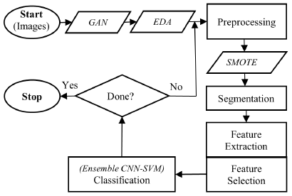
Introduction
Machine Learning for Imaging to Treat Skin Cancer
In the proposed CADx system, generative adversarial network (GAN) is used to identify (and remove) fake images. Figure 1 shows the major steps of the proposed CADx system.
Exploratory data analysis (EDA) is applied to normalize the dataset for preventing overfitting.
Synthetic minority oversampling technique (SMOTE) is employed to rectify class imbalances in the original dataset.
Fig. 1: Steps of the proposed CADx system
Four ML models are utilized: linear discriminant analysis (LDA), support vector machine (SVM), convolutional neural network (CNN), and an ensemble CNN-SVM.
Experimental results using the HAM10000 dataset demonstrate the ability of the machine learning models to improve CADx performance in treating skin neoplasm.
Initially, the LDA, SVM, CNN, and ensemble CNN-SVM show 49%, 72%, 77%, and 79% accuracy, respectively. After applying the ML techniques, the CADx system shows 76%, 83%, 87%, and 94% accuracy, respectively.

Slide 7
Introduction
Genomic and Non-Genomic Data
Non-Genomic Data
Non-Genomic data includes biological, clinical or environmental factors, such as patient age, skin images, lifestyle factors, medical history, and so on. Asaduzzaman et al. [1] use Non-Genomic datasets.
Genomic Data
Genomic data refers to information derived from an organism’s deoxyribonucleic acid (DNA) sequence, including mutations, chromosomal rearrangements, and gene expression profiles.
Studies suggest that Genomic data has potential to provide important features for assessing the functional impact of genetic variants.
Polymorphism Phenotyping (PolyPhen) and Sorting Intolerant From Tolerant (SIFT) in Genomic data are used in ML to predict the impact of amino acid substitutions in proteins.
[1] Asaduzzaman, A., Thompson, C.C., and Uddin, M.J., “Machine Learning Approaches for Skin Neoplasm Diagnosis,” in
ACS Omega, 2024. (Impact Factor 3.7; Google Scholar | ACS | h5-index 103)

Slide 8
Introduction
Genomic Data: PolyPhen and SIFT
PolyPhen
A tool designed to predict the potential effects of amino acid substitutions on the structure and function of human proteins.
It helps in assessing whether a particular genetic mutation could be benign (0 – 0.15), possibly damaging (0.15 – 0.85) or probably damaging (0.85 – 1.0).
SIFT
A tool designed to predict the functional impact of amino acid substitutions in proteins.
Scores from 0.00 to 0.05 are predicted to be damaging (are likely to affect protein function) and scores from 0.05 to 1.00 are considered tolerated (are less likely to affect protein function).
PolyPhen – Polymorphism Phenotyping | SIFT – Sorting Intolerant From Tolerant

Slide 9
Introduction
Problem Description and Contributions
Problem Description
Datasets in The Cancer Genome Atlas (TCGA) from cBioPortal and National Institutes of Health (NIH) have both genomic and non-genomic data. However, best of our knowledge, datasets with separate genomic and non-genomic data ready to be used in ML models to predict PolyPhen and SIFT are not available.
Contributions
We develop a method to split the TCGA dataset into genomic and non-genomic data by preprocessing the original data.
We apply the genomic and non-genomic data in ML models to explore which dataset is better for predicting PolyPhen and SIFT.
Our work leverages the dataset to advance prediction models for analyzing PolyPhen and SIFT.
PolyPhen – Polymorphism Phenotyping | SIFT – Sorting Intolerant From Tolerant

Slide 10
“Navigating the Challenges of Machine Learning in Genomic Data Analysis”
Outline ►
Introduction
Contemporary Machine Learning Models and Healthcare Data Analyses
Challenges with Genomic and Non-Genomic Datasets
Problem Description and Contributions
Background Materials
Datasets, Machine Learning Models
Proposed Methodology
Major Steps and Workflow
Preliminary Results
Experimental Details
Performance Analysis
Conclusions
Collaboration Opportunities
Dr. Zaman
10

Slide 11
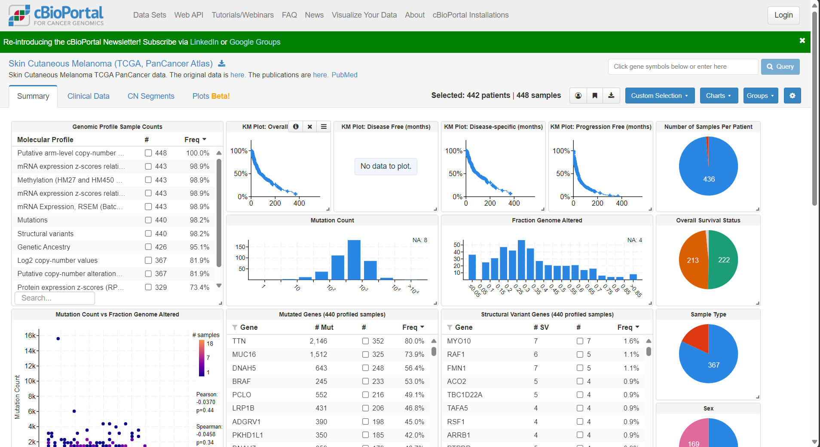
Background Materials: Datasets
"Datasets," https://www.cbioportal.org/datasets

Slide 12
Background Materials: ML Models
ML Models: Strengths and Weaknesses
Three ML Models Used
Strengths and weaknesses of Random Forest (RF), Extreme Gradient Boosting (XGBoost), and an Ensemble model combining RF and XGBoost, highlighting why they are suitable for this work, are shown in Table I.
Table I: Strengths and weaknesses of RF, XGBoost, and the ensemble model
Feature | Machine Learning Models
 | RF | XGBoost | The Ensemble Model
Strength | Handles Missing Data: Can handle missing values and maintain good performance. | Handles Imbalanced Data: Performs well with techniques like weighted loss functions. | Improved Accuracy: Combining the strengths of both models.
Weakness | Less Effective on Small Data: May not perform well for complex models on small datasets. | Sensitive to Noisy Data: Can overfit if the dataset contains noise or irrelevant features. | Increased Complexity: Combining complex models increases computational cost.

Slide 13
“Navigating the Challenges of Machine Learning in Genomic Data Analysis”
Outline ►
Introduction
Contemporary Machine Learning Models and Healthcare Data Analyses
Challenges with Genomic and Non-Genomic Datasets
Problem Description and Contributions
Background Materials
Datasets, Machine Learning Models
Proposed Methodology
Major Steps and Workflow
Preliminary Results
Experimental Details
Performance Analysis
Conclusions
Collaboration Opportunities
Dr. Zaman
13

Slide 14
Proposed Methodology
Major steps of the proposed methodology is shown in Figure 2.
Start
Analyze and Merge Datapoints from Different Files
Data Preprocessing
Genomic and Non-Genomic Data Split
Compare Accuracy due to Genomic and Non-genomic Datasets
Yes
Are both predictions correct?
No
Feature Selection
(Genomic and/or Non-Genomic)
Stop
Genomic
Prediction
Non-Genomic Prediction
Correlation Analysis
Classification Models
Resampling
Fig. 2: Major steps for applying genomic and non-genomic data in machine learning

Slide 15
Start with the NIH/TCGA Datasets
Cancer is essentially a genomic disease, caused by mutations in a cell’s DNA, RNA, and proteins that cause cells to grow excessively. In this study, we utilize the skin cutaneous melanoma dataset from The Cancer Genome Atlas (TCGA) Pan-Cancer Atlas [2].
TCGA dataset, available via cBioPortal website, encompasses over 440 samples and features an extensive catalog of more than 550,000 mutations.
The comprehensive dataset provides a wealth of genomic and non-genomic information, enabling detailed analysis of the genetic mutations of skin cutaneous melanoma. The integration of this dataset into our study facilitates a deeper understanding of the disease, supporting the development of more precise models and personalized treatment strategies.
Total number of samples (files): 440
Total number of mutations: 550,000
DNA – Deoxyribonucleic acid | RNA – Ribonucleic acid
[2] cBioPortal for Cancer Genomics, https://www.cbioportal.org/study/summary?id=skcm_tcga_pan_can_atlas_2018

Slide 16
Merge Datapoints from Different Files
Total number of samples (files): 440
Total number of mutations: 550,000
Select Data Files
From the TCGA datasets, we receive 47 files, including text files. Most of the text files do not contain relevant information (e.g., patient IDs) to help build or combine the datasets.
After careful study of the 47 files, we select the following five files for this research:
data_mutations.txt
data_clinical_patient.txt
data_clinical_supp_hypoxia.txt
data_clinical_sample.txt
data_timeline_sample_acquisition.txt
Before> Total number of files: 440
After> Total number of files: 5

Slide 17
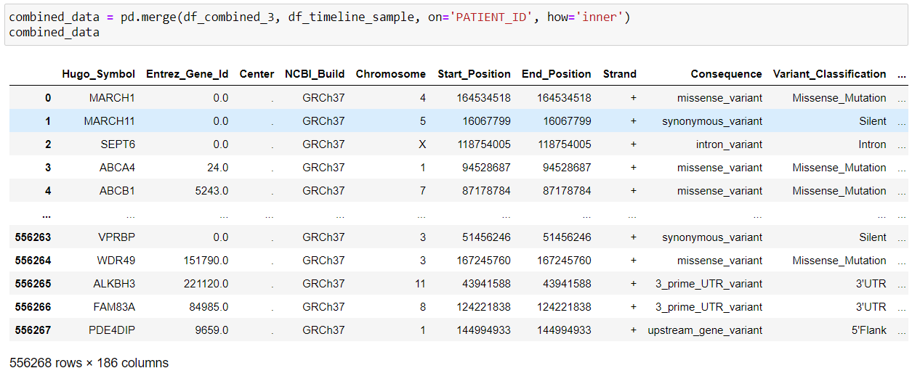
Merge Datapoints from Different Files
The merged dataset shown below is created from the five text files, based on the Patient ID. Here, we have 556,268 rows and 186 columns.
Total number of rows: 556268
Total number of columns: 186

Slide 18
Data Preprocessing
We use two techniques for data preprocessing to convert raw data into a clean, structured format suitable for the ML models.
Data Cleaning
Handling Missing Values
Data Transformation
Encoding Categorical Variables

Slide 19
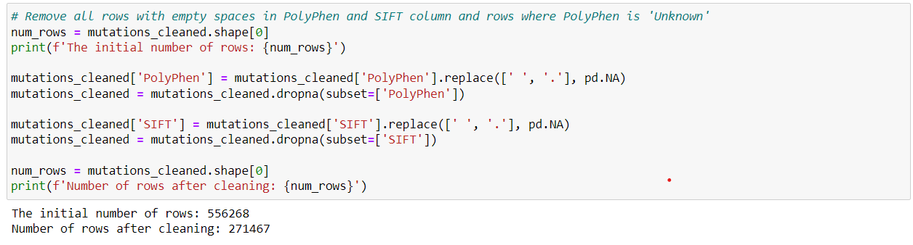
Data Preprocessing
Total number of rows: 556268
Total number of columns: 186
Data Cleaning: Handling Missing Values
Remove all empty rows in PolyPhen and SIFT column
Before> Total number of rows: 556268
After> Total number of rows: 271467

Slide 20
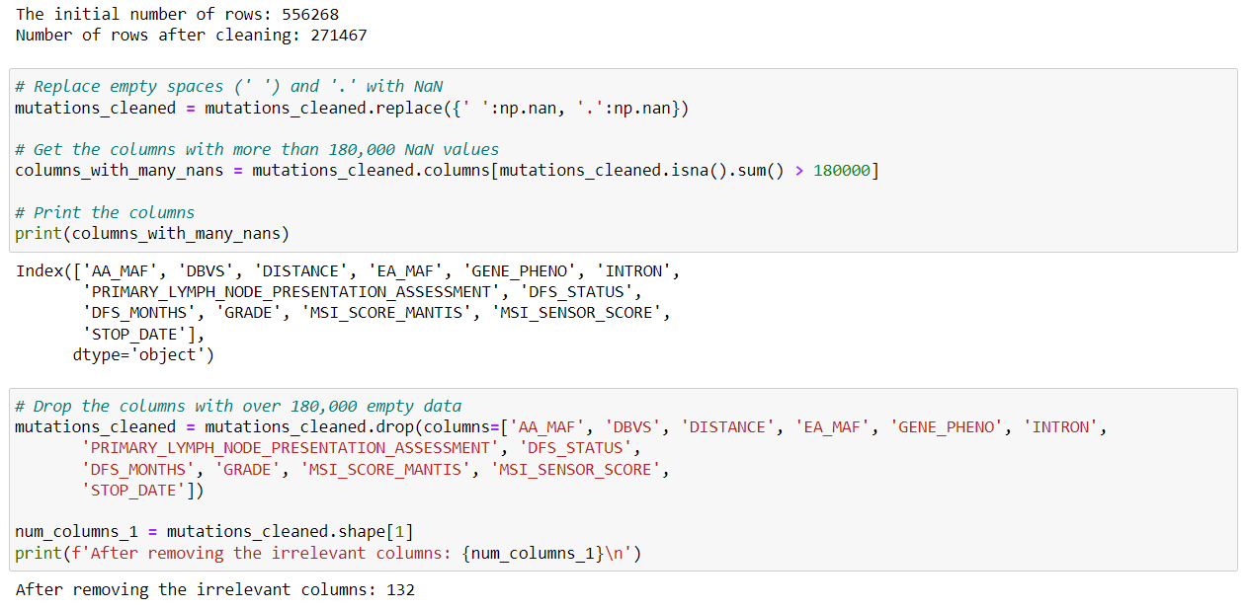
Data Preprocessing
Total number of rows: 271467
Total number of columns: 186
Data Cleaning: Handling Missing Values
Drop columns with large number of missing rows
>> Total number of rows: 271467
>> Total number of columns: 132
Before> Total number of columns: 186
After> Total number of columns : 132

Slide 21
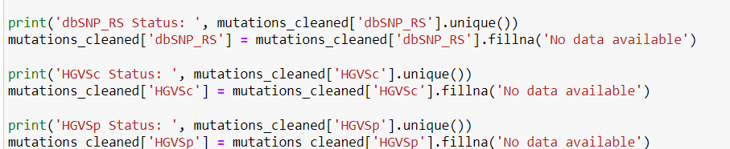
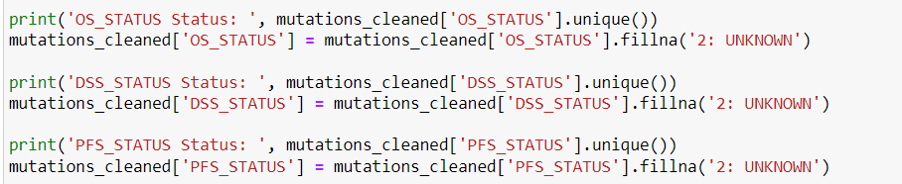
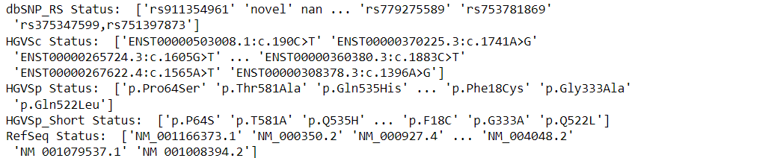
Data Preprocessing
Total number of rows: 271467
Total number of columns: 132
Data Cleaning: Handling Missing Values
Replace missing values (e.g., nan, blank space) with 'No data available' or ‘UNKNOWN' for string columns

Slide 22
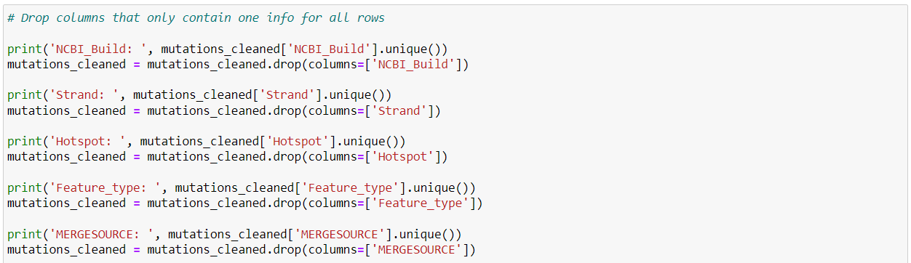
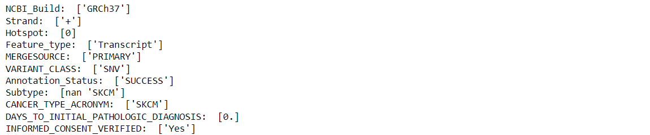
Data Preprocessing
Total number of rows: 271467
Total number of columns: 132
Data Cleaning: Handling Missing Values
Drop columns that contain only one type of information for all rows.
Before Total number of columns: 132
After Total number of columns: 112

Slide 23
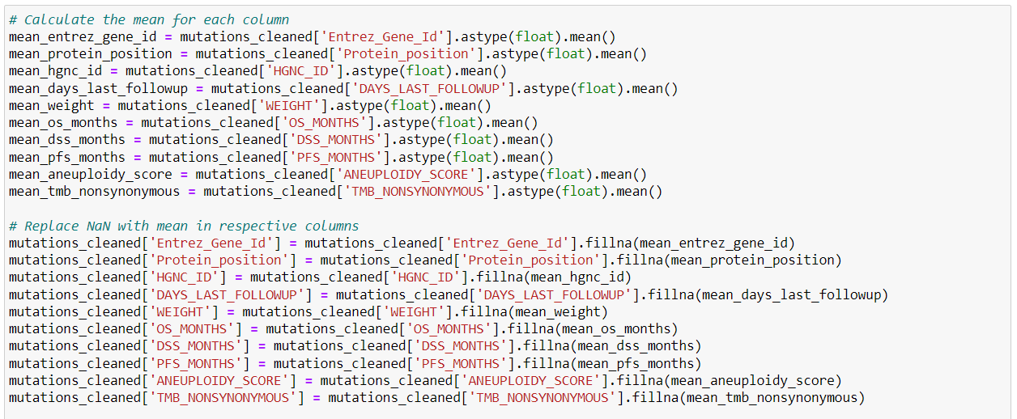
Data Preprocessing
Total number of rows: 271467
Total number of columns: 112
Data Cleaning: Handling Missing Values
Replace missing values in the integer columns with the mean of the respective columns from other rows.

Slide 24
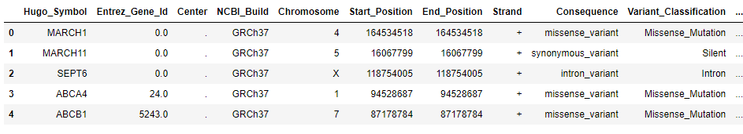
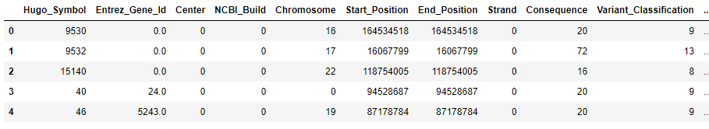
Data Preprocessing
Data Transformation: Encoding Categorical Variables
Encode the categorical variables in the dataset

Slide 25
Data Preprocessing
Initial Number of Rows: 556,268
Initial Number of Columns: 186
Final Number of Rows: 271,467
Final Number of Columns: 112
Data Preprocessing

Slide 26
Genomic and Non-Genomic Data Split
Genomic data refers to information derived from an organism’s DNA sequence, including mutations, chromosomal rearrangements, and gene expression profiles.
Non-Genomic data includes other biological, clinical or environmental factors, such as patient age, lifestyle factors, medical history and so on.

Slide 27
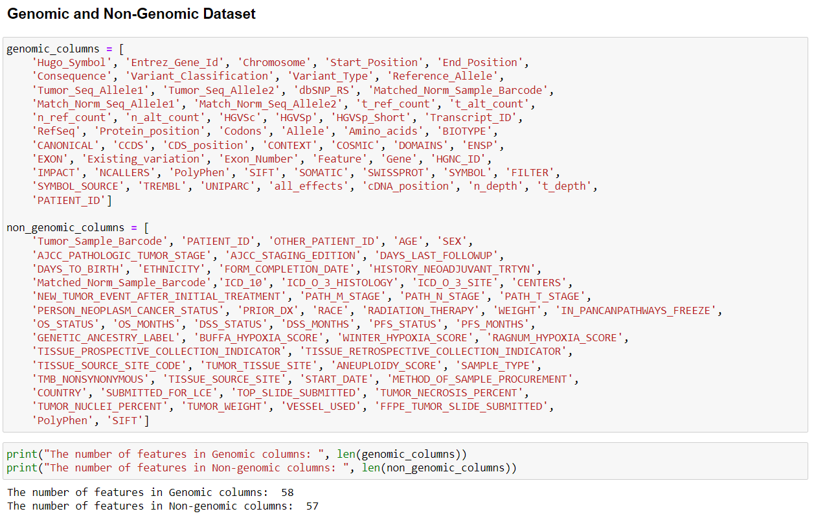
Genomic and Non-Genomic Data Split
Total number of rows: 271467
Total number of columns: 112
Total number of (genomic and non-genomic) columns: 58 + 57 = 115
Duplicated columns: Patient ID, PolyPhen, and SIFT

Slide 28
Feature Selection
Feature selection was performed using a Random Forest model.
Purpose: Identifying the most important features in a dataset that contribute the most to the model's predictive power.
Why It Matters: Reduces overfitting, enhances model interpretability, and decreases computational costs by eliminating irrelevant or redundant features.

Slide 29
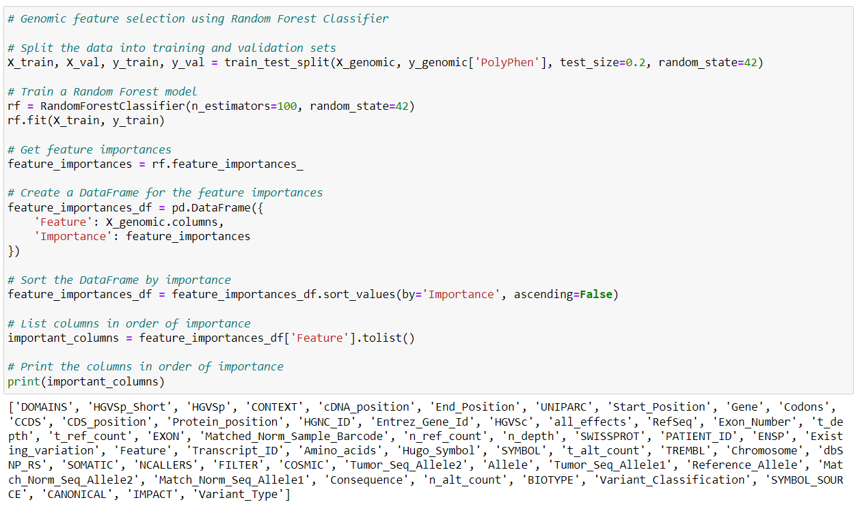
Feature Selection
Example of PolyPhen feature selection using Genomic data
Total number of rows: 271467
For Genomic PolyPhen Dataset,
Before Total number of columns: 58
After Total number of columns: 30
Count: 56, excluding PolyPhen and SIFT

Slide 30
Correlation
Measures the strength and direction of a linear relationship between two variables, ranging from -1 to 1.
A value of 1 indicates a perfect positive correlation, -1 indicates a perfect negative correlation, and 0 indicates no linear relationship.
Identifying high correlation between features can help avoid multicollinearity, which can lead to overfitting and reduce model performance.

Slide 31
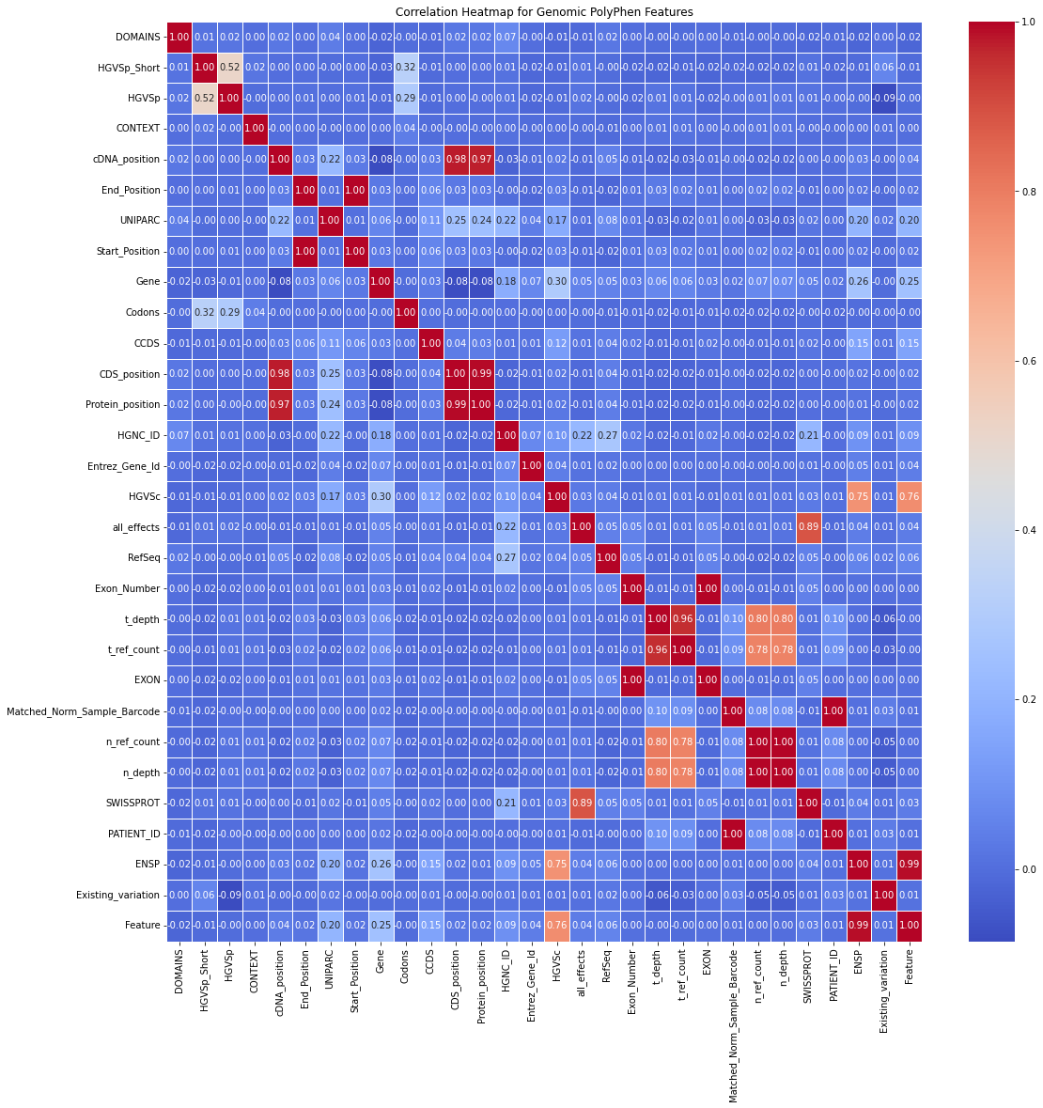
Correlation – Genomic PolyPhen
Before the removal of highly correlated features (30 Features selected during the feature selection stage)
Total number of rows: 271467
For Genomic PolyPhen Dataset,
Before> Total number of columns: 30

Slide 32
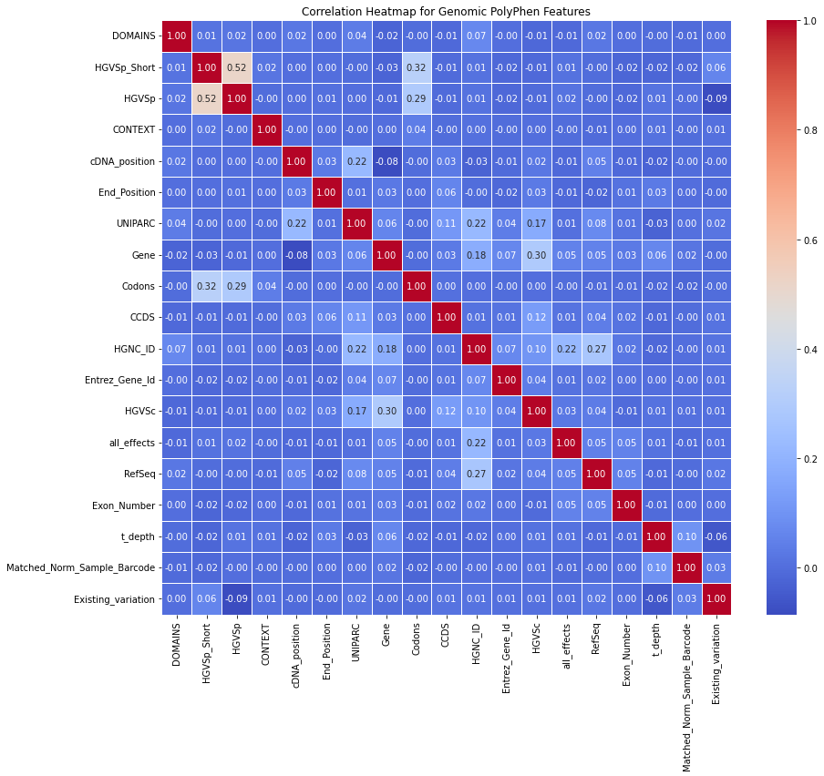
Correlation – Genomic PolyPhen
After the removal of highly correlated features in the dataset (Threshold: 0.70).
Total number of rows: 271467
For Genomic PolyPhen Dataset,
After> Total number of columns: 19
For Genomic PolyPhen,
Total # of rows – 271467
After Split – 58
Feature Selection – 30
Correlation – 19

Slide 33
Resampling
Total number of rows: 271467
Genomic> Total number of columns: 19
Resampling is a technique used to adjust the distribution of data, typically to address class imbalances in classification problems. It involves modifying the dataset by either oversampling the minority class or undersampling the majority class.
Resampling helps prevent models from becoming biased toward the majority class in imbalanced datasets. Without it, models may perform poorly on minority class predictions, leading to inaccurate results.

Slide 34
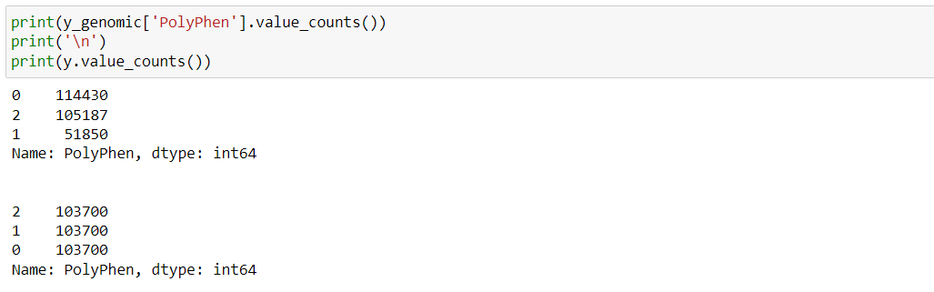
Resampling
Example of resampling technique for PolyPhen using Genomic Dataset.
PolyPhen 0: Benign, 1: Possibly damaging, and 2: Probably damaging
Total number of rows: 271467
For Genomic PolyPhen Dataset,
Total number of columns: 19

Slide 35
Classification
Classification is a supervised machine learning technique used to predict categorical outcomes or labels based on input data. It involves training a model on a labeled dataset where the target variable is categorical, meaning it belongs to a specific class or category. The model learns to recognize patterns and relationships in the data, allowing it to classify new, unseen instances into one of the predefined categories.
Research was done using three algorithms:
Random Forest Model
XGBoost Model
Ensemble Model (Random Forest + XGBoost)

Slide 36
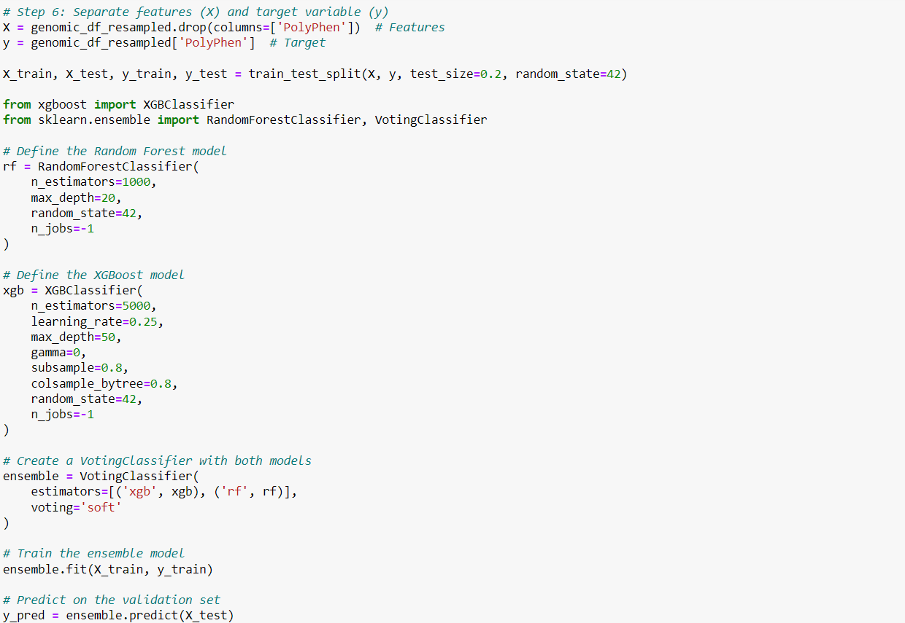
Classification
Ensemble Model Classification for Genomic PolyPhen
Notes:
Blending: Similar to stacking but typically simpler, blending involves training different models and then combining their predictions in some manner (like averaging or weighted averaging) to make the final prediction. For instance, you could average the predictions from Random Forest and XGBoost to produce a final prediction.

Slide 37
“Navigating the Challenges of Machine Learning in Genomic Data Analysis”
Outline ►
Introduction
Contemporary Machine Learning Models and Healthcare Data Analyses
Challenges with Genomic and Non-Genomic Datasets
Problem Description and Contributions
Background Materials
Datasets, Machine Learning Models
Proposed Methodology
Major Steps and Workflow
Preliminary Results
Experimental Details
Performance Analysis
Conclusions
Collaboration Opportunities
Dr. Zaman
37

Slide 38
Preliminary Results
Genomic and Non-Genomic PolyPhen Prediction
Total data points: 271467
Table IV shows the performance metrics of RF Classifier
Table IV : Metrics for PolyPhen Prediction using RF Classifier
Number of Features |  | Training Time (s) |  | Max Accuracy |  | F1-Score
Gen | Non G | Gen | Non G | Gen | Non G | Gen | Non G
58 | 57 | 3590 | 1164 | 81.93 | 55.46 | 0.82 | 0.51
30 | 30 | 3536 | 1017 | 82.19 | 55.51 | 0.82 | 0.52
19 | 21 | 2934 | 802 | 82.24 | 55.51 | 0.82 | 0.52
Split
Feature
Correlate
Genomic dataset performs better
RF – Random Forest
Non G – Non Genomic
PolyPhen – Polymorphism Phenotyping

Slide 39
Preliminary Results
Genomic and Non-Genomic SIFT Prediction
Total data points: 271467
Table V shows the performance metrics of RF Classifier
Table V: Metrics for SIFT Prediction using RF Classifier
Number of Features |  | Training Time (s) |  | Max Accuracy |  | F1-Score
Gen | Non G | Gen | Non G | Gen | Non G | Gen | Non G
58 | 57 | 4523 | 1392 | 89.03 | 77.34 | 0.89 | 0.77
30 | 30 | 3760 | 1094 | 89.25 | 77.34 | 0.89 | 0.77
18 | 22 | 3470 | 810 | 89.44 | 77.33 | 0.89 | 0.77
Split
Feature
Correlate
Genomic dataset performs better
RF – Random Forest
Non G – Non Genomic
SIFT – Sorting Intolerant From Tolerant

Slide 40
Preliminary Results
Genomic and Non-Genomic PolyPhen Prediction
Total data points: 271467
Table II shows the performance metrics of XGBoost Classifier
Table II: Metrics for PolyPhen Prediction using XGBoost Classifier
Number of Features |  | Training Time (s) |  | Max Accuracy |  | F1-Score
Gen | Non G | Gen | Non G | Gen | Non G | Gen | Non G
58 | 57 | 1921 | 5309 | 88.33 | 55.35 | 0.88 | 0.52
30 | 30 | 1569 | 3836 | 88.21 | 55.36 | 0.88 | 0.52
19 | 21 | 1217 | 3372 | 88.12 | 55.39 | 0.88 | 0.52
Split
Feature
Correlate
Genomic dataset performs better
Non G – Non Genomic
PolyPhen – Polymorphism Phenotyping
Notes:
The training time for the non-genomic dataset is much higher than that of the genomic dataset, probably because the model takes very large number of iterations for the non-genomic dataset. ???

Slide 41
Preliminary Results
Genomic and Non-Genomic SIFT Prediction
Total data points: 271467
Table III shows the performance metrics of XGBoost Classifier
Table III: Metrics for SIFT Prediction using XGBoost Classifier
Number of Features |  | Training Time (s) |  | Max Accuracy |  | F1-Score
Gen | Non G | Gen | Non G | Gen | Non G | Gen | Non G
58 | 57 | 1592 | 2913 | 95.06 | 77.23 | 0.95 | 0.77
30 | 30 | 967 | 2596 | 95.03 | 77.23 | 0.95 | 0.77
18 | 22 | 727 | 1983 | 95.04 | 77.25 | 0.95 | 0.77
Split
Feature
Correlate
Genomic dataset performs better
Non G – Non Genomic
SIFT – Sorting Intolerant From Tolerant
Notes:
The training time for the SIFT prediction is lower than that of the PolyPhen prediction, because the SIFT predicts damaged or tolerated, but the PolyPhen predicts benign, probably damaging, or possibly damaging. ???

Slide 42
Preliminary Results
Genomic and Non-Genomic PolyPhen Prediction
Total data points: 271467
Table VI shows the performance metrics of Ensemble XGBoost and RF
Table VI: Metrics for PolyPhen Prediction using the Ensemble Model
Number of Features |  | Training Time (s) |  | Max Accuracy |  | F1-Score
Gen | Non G | Gen | Non G | Gen | Non G | Gen | Non G
58 | 57 | 5632 | 9642 | 88.43 | 55.45 | 0.88 | 0.52
30 | 30 | 4514 | 8323 | 88.42 | 55.47 | 0.88 | 0.52
19 | 21 | 2878 | 6382 | 88.30 | 55.49 | 0.88 | 0.52
Split
Feature
Correlate
Genomic dataset performs better
RF – Random Forest
Non G – Non Genomic
PolyPhen – Polymorphism Phenotyping

Slide 43
Preliminary Results
Genomic and Non-Genomic SIFT Prediction
Total data points: 271467
Table VII shows the performance metrics of Ensemble XGBoost and RF
Table VII: Metrics for SIFT Prediction using the Ensemble Model
Number of Features |  | Training Time (s) |  | Max Accuracy |  | F1-Score
Gen | Non G | Gen | Non G | Gen | Non G | Gen | Non G
58 | 57 | 5166 | 3977 | 95.13 | 77.31 | 0.95 | 0.77
30 | 30 | 4966 | 3778 | 95.14 | 77.31 | 0.95 | 0.77
18 | 22 | 4033 | 2829 | 95.12 | 77.32 | 0.95 | 0.77
Split
Feature
Correlate
Genomic dataset performs better
RF – Random Forest
Non G – Non Genomic
SIFT – Sorting Intolerant From Tolerant
Notes:
After Data Split: G 58, NG 57
After Feature Selection: G 30, NG 30
After Correlation: G 19, NG 21

Slide 44
Preliminary Results
Performance of Genomic and Non-Genomic Datasets
Total data points: 271467
Table VIII shows the summary of XGBoost and the Ensemble Model
Table VIII: Summary of PolyPhen prediction of XGBoost and Ensemble Model
Stages of Preprocessing | Training Time (s) |  |  |  | Max Accuracy
 | XGBoost |  | Ensemble |  | XGBoost |  | Ensemble
 | Gen | Non G | Gen | Non G | Gen | Non G | Gen | Non G
After Data Split | 1921 | 5309 | 5632 | 9642 | 88.33 | 55.35 | 88.43 | 55.45
After Feature Selection | 1569 | 3836 | 4514 | 8323 | 88.21 | 55.36 | 88.42 | 55.47
After Correlation | 1217 | 3372 | 2878 | 6382 | 88.12 | 55.39 | 88.30 | 55.49
Genomic dataset performs better. Ensemble is the best model.
PolyPhen – Polymorphism Phenotyping
Notes:
After Data Split: G 58, NG 57
After Feature Selection: G 30, NG 30
After Correlation: G 19, NG 21

Slide 45
Preliminary Results
Performance of Genomic and Non-Genomic Datasets
Total data points: 271467
Table IX shows the summary of XGBoost and the Ensemble Model
Table IX: Summary of SIFT prediction of XGBoost and Ensemble Model
Stages of Preprocessing | Training Time (s) |  |  |  | Max Accuracy
 | XGBoost |  | Ensemble |  | XGBoost |  | Ensemble
 | Gen | Non G | Gen | Non G | Gen | Non G | Gen | Non G
After Data Split | 1592 | 2913 | 5166 | 3977 | 95.06 | 77.23 | 95.13 | 77.31
After Feature Selection | 967 | 2596 | 4966 | 3778 | 95.03 | 77.23 | 95.14 | 77.31
After Correlation | 727 | 1983 | 4033 | 2829 | 95.04 | 77.25 | 95.12 | 77.32
Genomic dataset performs better. Ensemble is the best model.
SIFT – Sorting Intolerant From Tolerant
Notes:
After Data Split: G 58, NG 57
After Feature Selection: G 30, NG 30
After Correlation: G 19, NG 21

Slide 46
Conclusions
The genomic datasets provide more accurate predictions for PolyPhen and SIFT compared to the non-genomic datasets.
Reducing the number of features leads to a decrease in training time.
Model accuracy and F1-score are roughly the same as the number of features is reduced, leading to more efficient models with respect to the training time.
Experiments with more machine learning models to improve PolyPhen and SIFT classification predictions are needed.
We plan to explore different feature selection methods to rank features by importance, for example, principal component analysis (PCA) and Auto-Encoder.
SIFT – Sorting Intolerant From Tolerant
PolyPhen – Polymorphism Phenotyping

Slide 47
“Navigating the Challenges of Machine Learning in Genomic Data Analysis”
Outline ►
Introduction
Contemporary Machine Learning Models and Healthcare Data Analyses
Challenges with Genomic and Non-Genomic Datasets
Problem Description and Contributions
Background Materials
Datasets, Machine Learning Models
Proposed Methodology
Major Steps and Workflow
Preliminary Results
Experimental Details
Performance Analysis
Conclusions
Collaboration Opportunities
Dr. Zaman
47

Slide 48
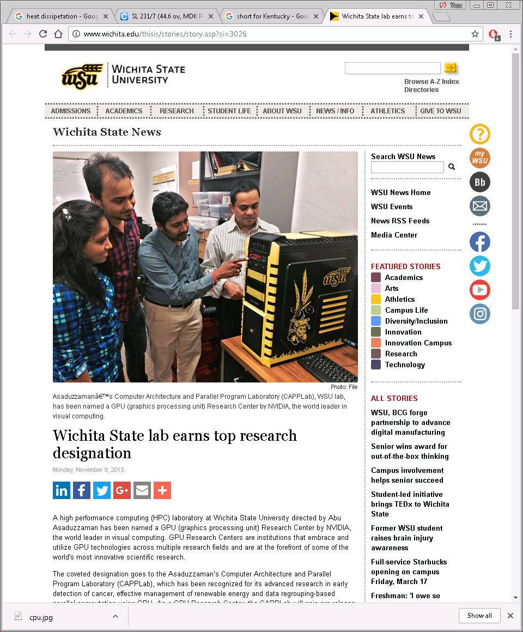

Dr. Zaman; WSU-5261

Slide 49










Research Activities
Research supported by DoE Argonne, NSF Kansas EPSCoR, Nvidia, CybertronPC, …
Asaduzzaman, A., “Expand PETSc Library to Support Data-Intensive Real-Time Simulation,” awarded by the Department of Energy Argonne National Laboratory Exascale Computing Project (ECP) Co-Design Center for Online Data Analysis and Reduction (CODAR); total $43,815 (one student to support) for one year.
Asaduzzaman, A., “Open2C framework and OpenSoC Fabric to build up a communication-aware level-2 cache controller,” 2020 Summer Research at Berkeley Lab, host scientist John Shalf, Project38, the DOE Office of Science.
Asaduzzaman, A., Thompson, C.C., and Uddin, M.J., “Machine Learning Approaches for Skin Neoplasm Diagnosis,” in ACS Omega, 2024. (Impact Factor 3.7; Google Scholar | ACS | h5-index 103).
Sibai, F., El-Moursy, A., and Asaduzzaman, A., “Hardware Acceleration of the STRIKE String Kernel Method for Estimating Protein to Protein Interactions,” in IEEE/ACM Transactions on Computational Biology and Bioinformatics (TCBB), Manuscript No. TCBB-2020-01-0008.
CAPPLab earned top research designation (GPU Research Center) by Nvidia in 2015.
Dr. Zhang works in Argonne’s Mathematics and Computer Science division and teaches in the Department of Computer Science, Illinois Institute of Technology
Hong Zhang
PETSc Team
Md. Jashim Uddin
Research Asso. Professor
Vanderbilt University, TN
School of Medicine
Henry J. Neeman
Associate Professor
Assistant Vice President, IT – Research
Director, OU Supercomputing Center for Education & Research
University of Oklahoma
hneeman@ou.edu

Slide 50

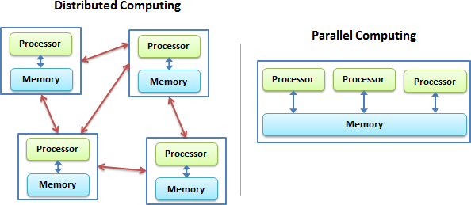
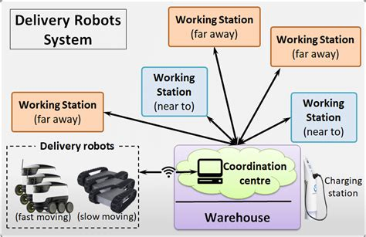


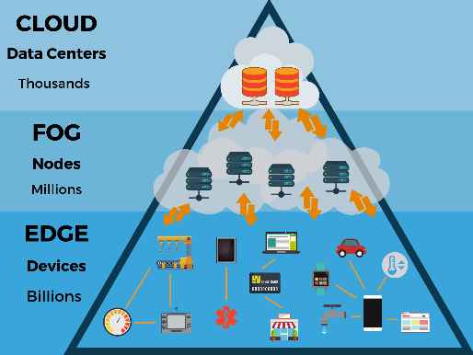
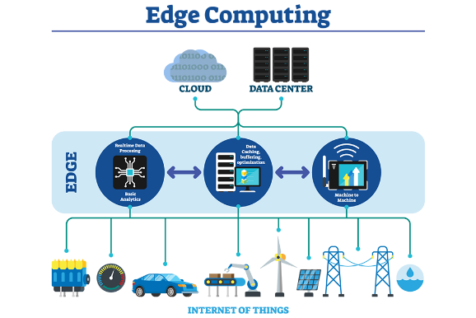
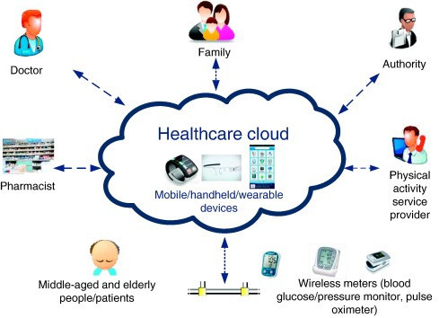
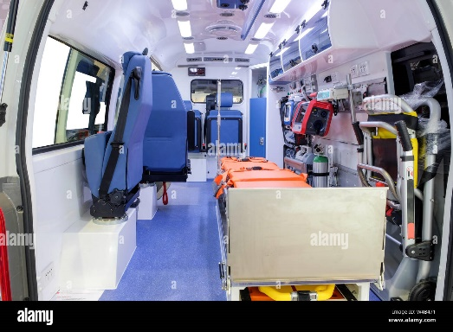

Research Opportunity
CAPPLab
Students
High Performance Computing (HPC)
Data Analytics / Decision Making
?
Duncan
Cloud-Edge Computing
Machine Learning in Healthcare
Raihan
Koteswara Rao

Slide 51


About WSU
About Wichita State University
Wichita State University (WSU) is a public research university in Wichita, Kansas, United States. It is governed by the Kansas Board of Regents. The university offers more than 60 undergraduate degree programs in more than 200 areas of study in nine colleges. The university's graduate school offers more than 50 master's degrees in more than 100 areas and a specialist in education degree and 13 doctoral degrees. It is classified among "R2: Doctoral Universities – High research activity".
Wichita State is the house of the original Pizza Hut. Two Wichita State students, brothers Dan and Frank Carney, started the Pizza Hut business in 1958. The restaurant has since become one of the biggest pizza chains in the world. The original building resides at Wichita State as a museum.
“Wichita State University,” https://en.wikipedia.org/wiki/Wichita_State_University

Slide 52
International Conference on Information and Communication Technology (ICICT) in the Institute of Information and Communication Technology (IICT)
“Navigating the Challenges of Machine Learning in Genomic Data Analysis”
Contact:
Abu Asaduzzaman, Professor and Associate Chair
abu.asaduzzaman@wichita.edu | +1-316-978-5261
https://www.wichita.edu/academics/engineering/CAPPLab/Abu.php
Thank you!

