Slide 2
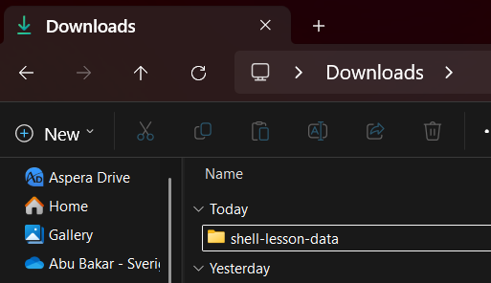
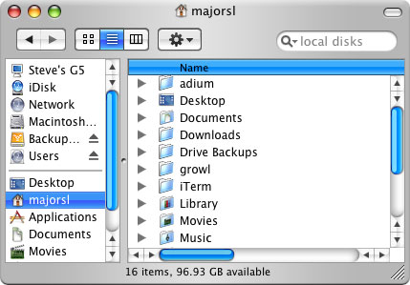
GUI

Slide 3
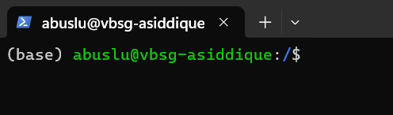
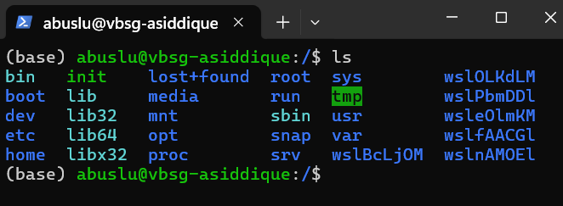
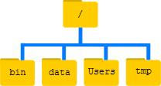
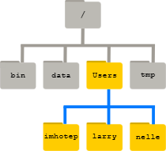
CLI (Linux)

Slide 4
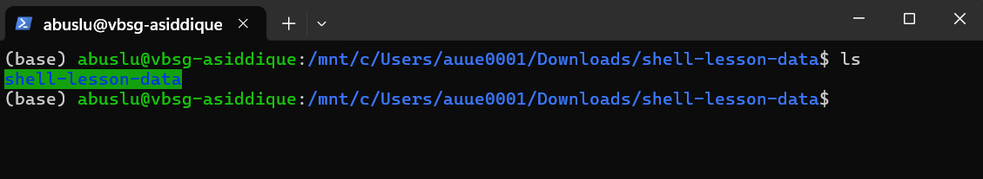
GUI vs Linux
Graphical User Interface (GUI):
visual representations
Command Line Interface (CLI): WSL, Terminal, LINUX, Ubuntu, UNIX etc
text representations
shell (or bash) is a program that allows you to control CLI with keyboard

Slide 5
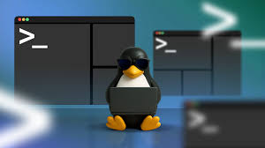
Why Linux?
A powerful command-line interface (CLI)
Built for multi-user systems.
An enormous amount of software is freely available
Bioinformatics tools can only be used through a CLI
shell makes your work less boring
shell makes your work less error-prone
shell makes your work more reproducible
Computationally intensive job
Remote computer or cloud computing

Slide 6
Navigating your file system

Slide 7
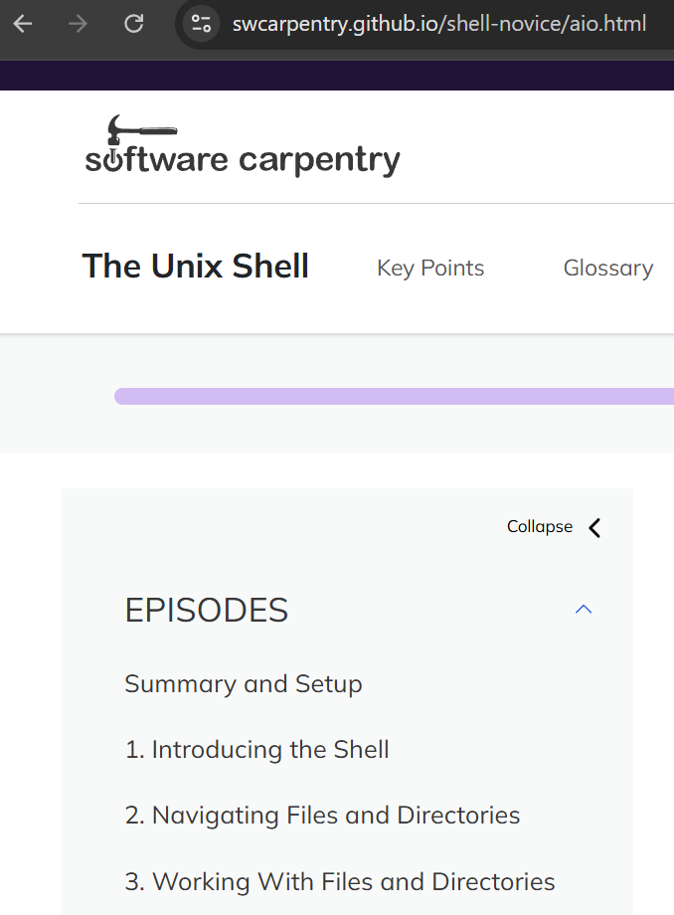
Navigating your file system

Slide 8
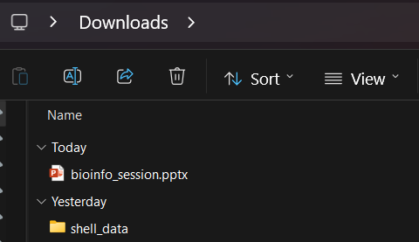
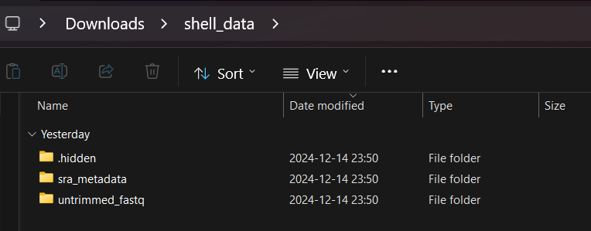
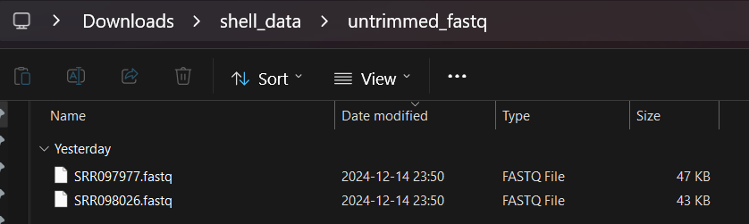
Navigating your file system

Slide 9
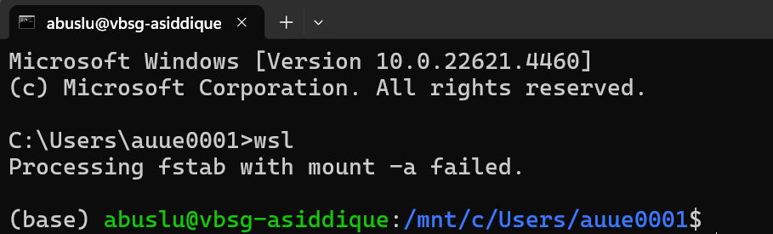
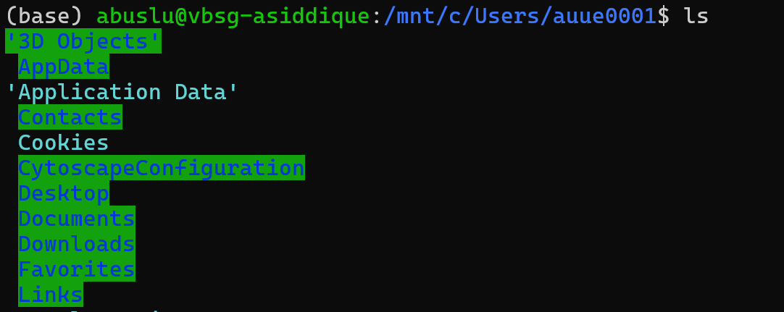
Navigating your file system
ls – list content of directory

Slide 10
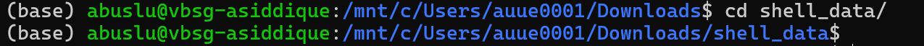
Navigating your file system
cd – change working directory

Slide 11
Navigating your file system

Slide 12
Navigating your file system
pwd – print working directory

Slide 13
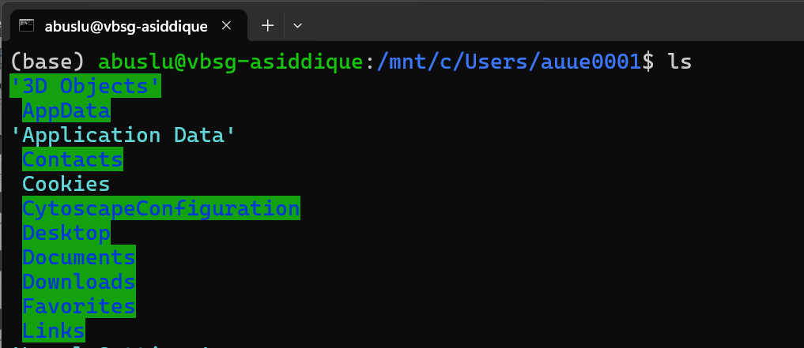
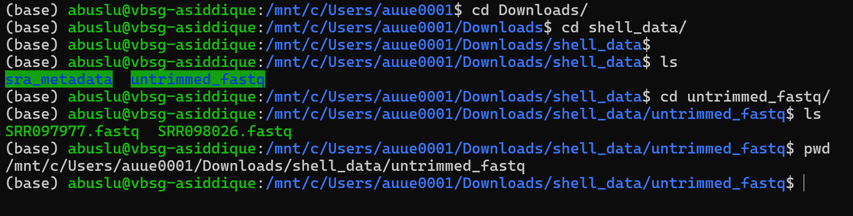
Navigating your file system
Summary

Slide 14
Absolute/Relative path
Absolute paths
Starts with a /
Defined from the root of the file system
/home/abuslu/shell_data/sra_metadata/SraRunTable.txt
/home/abuslu/shell_data/untrimmed_fastq/SRR098026.fastq
Like an address: Sweden, Uppsala, Ultuna, Biocentre, 4th floor, room x

Slide 15
Absolute/Relative path
Relative paths
Does not start with a /
Relative to where you are when using it
sra_metadata/SraRunTable.txt
../untrimmed_fastq/SRR098026.fastq
Like a direction ‘straight, then turn left, 2 blocks later’

Slide 16
Summary
○ ls – list content of directory
○ cd – change working directory
○ pwd – print working directory
○ absolute/relative paths

Slide 17
More practice
○ ls – list content of directory
○ cd – change working directory
○ pwd – print working directory
○ absolute/relative paths
○ mkdir – make a directory
○ cp – copy a file
○ mv – move a file
○ less – view a file
○ nano – view and edit a file
○ rm – remove a file
○ head / tail
○ grep
○ find
○ wildcards
○ tab completion – use it!!!
○ top – see active processes
○ man – manual pages or anycommand --help
○ exit – Log out current terminal
30 minutes…

Slide 18
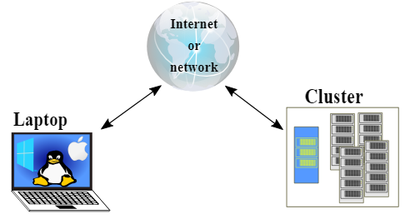
Computer cluster

Slide 19
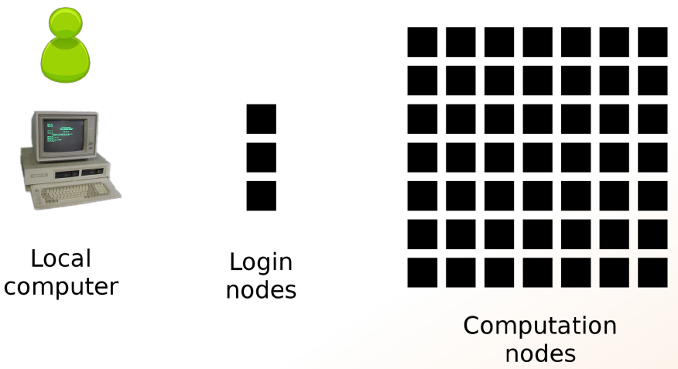
Computer cluster

Slide 20
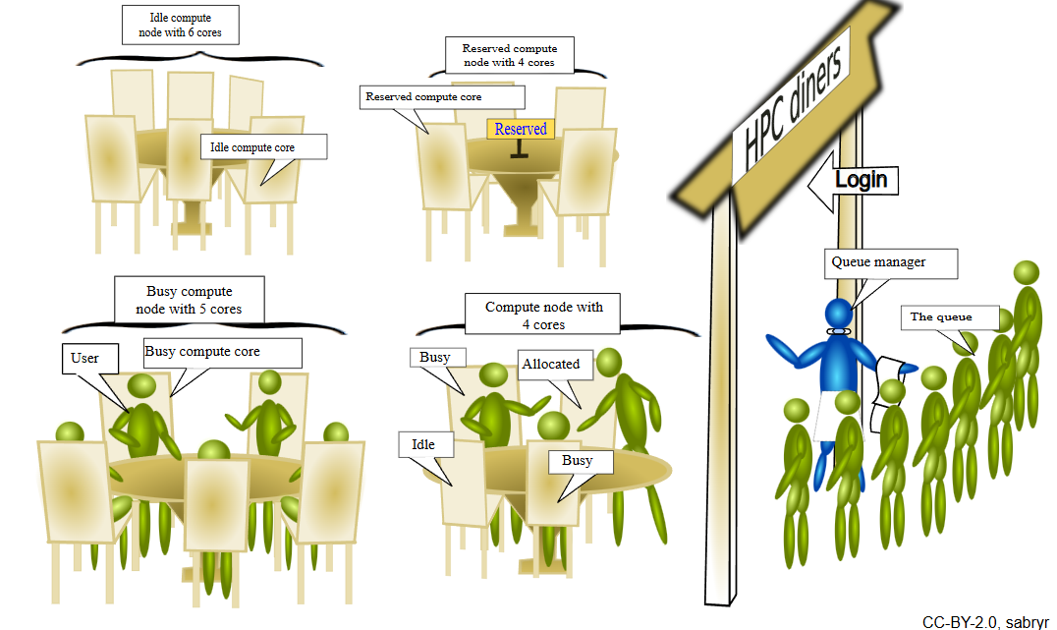
Computer cluster

Slide 21
Online materials
Unix/Linux
Data Carpentry datacarpentry/shell-genomics | website
Teaching materials at the Harvard Chan Bioinformatics Core hbctraining/Intro-to-shell-flipped | website
Ted Laderas laderast/bash_for_bioinformatics | website
SIB Swiss Institute of Bioinformatics sib-swiss/unix-first-steps-training
Software Carpentry swcarpentry/shell-novice | website
The Carpentries Lab carpentries-lab/metagenomics-shell | website
UC Davis Bioinformatics Core Training Page ucdavis-bioinformatics-training/2023-September-Introduction-to-the-Command-Line-for-Bioinformatics

Slide 22
Navigating your file system
Online terminal
https://www.terminaltemple.com/
https://copy.sh/v86/?profile=linux26&ref=itsfoss.com
17 Best Online Linux Terminals and Online Bash Editors

