Slide 1

Raster-Vector Interactions
Alexander Abuabara
DAEN 489 ISEN 489 Spring 2026

Slide 2
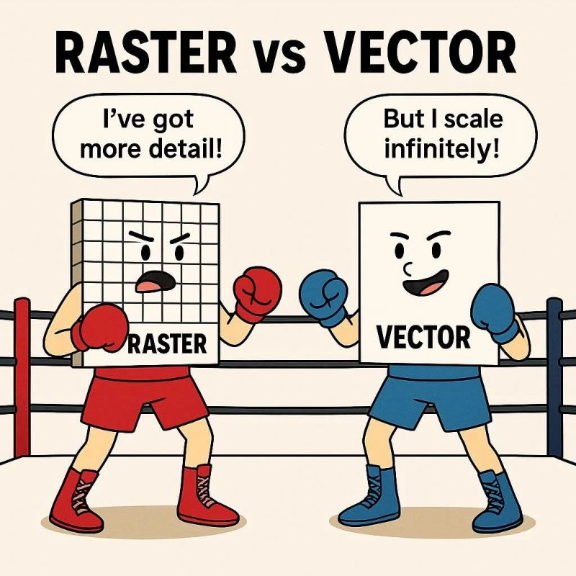
Overview
Raster data represent continuous spatial variation as a grid of cells (pixels).
Vector data represent discrete geographic features as points, lines, or polygons.
Many practical geospatial problems require blending these models:
Satellite imagery + Administrative boundaries
Terrain surfaces + Sampled field locations
Continuous environmental surfaces + Spatial regions of interest
The focus of raster–vector interaction is on how to combine, extract, convert, and analyze together raster and vector datasets in a consistent spatial framework.

Slide 3
Raster Cropping and Masking with Vector Boundaries
Raster datasets often extend far beyond the area of interest.
Cropping reduces spatial extent, improving performance.
Masking sets values outside a vector boundary to NA, focusing analysis on relevant regions.
crop() reduces the raster's geographical extent.
mask() applies a spatial filter based on vector boundaries.
We use both crop() and mask() together in most cases .
This two-step process ensures efficient focus on the study area.
library(sf)
library(terra)
library(dplyr)
# Read and reproject data
srtm = rast(system.file("raster/srtm.tif", package = "spDataLarge"))
zion = read_sf(system.file("vector/zion.gpkg", package = "spDataLarge"))
zion = st_transform(zion, st_crs(srtm))
# Crop and mask
srtm_cropped = crop(srtm, zion)
srtm_masked = mask(srtm, zion)
srtm_cropped = crop(srtm, zion)
srtm_final = mask(srtm_cropped, zion)
srtm_inv_masked = mask(srtm, zion, inverse = TRUE)

Slide 4
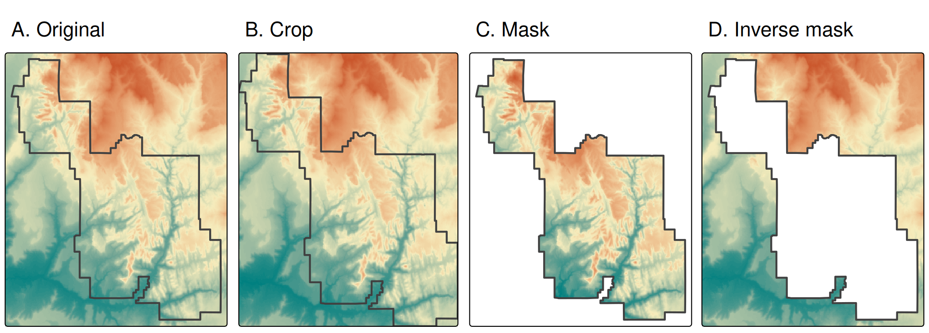
Raster cropping and raster masking.

Slide 5
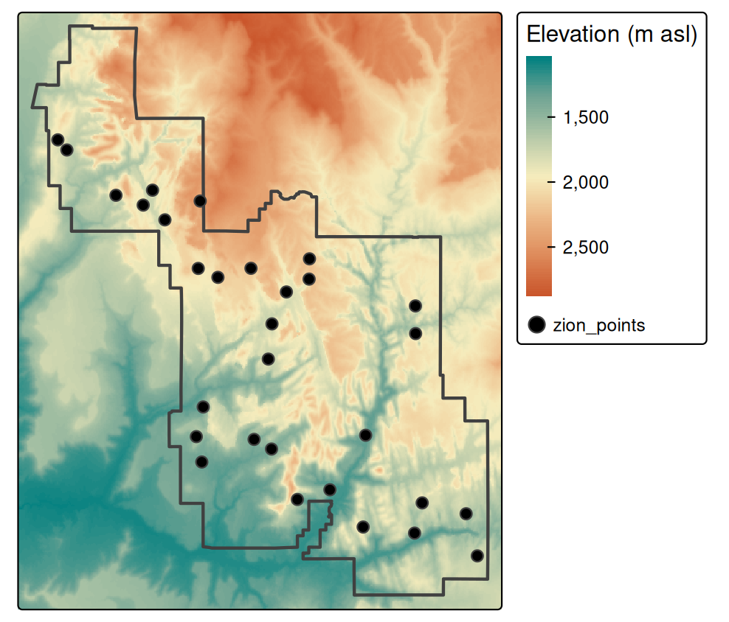
Raster Extraction: Linking Raster Values to Vector Geometry
Raster extraction retrieves raster values at spatial locations defined by a vector dataset.
Depending on the vector feature type (points, lines or polygons) the nature of extracted results changes.
Examples
Points: returns values at cell centroids closest to each point.
Lines: yields values for raster cells intersected by the line (or along sampled points).
Polygons: retrieves all cell values inside a polygon, allowing summary statistics.
# Elevation Sampling (Points)
data("zion_points", package = "spDataLarge")
elevation = terra::extract(srtm, zion_points)
zion_points = cbind(zion_points, elevation)
Locations of points used for raster extraction.

Slide 6
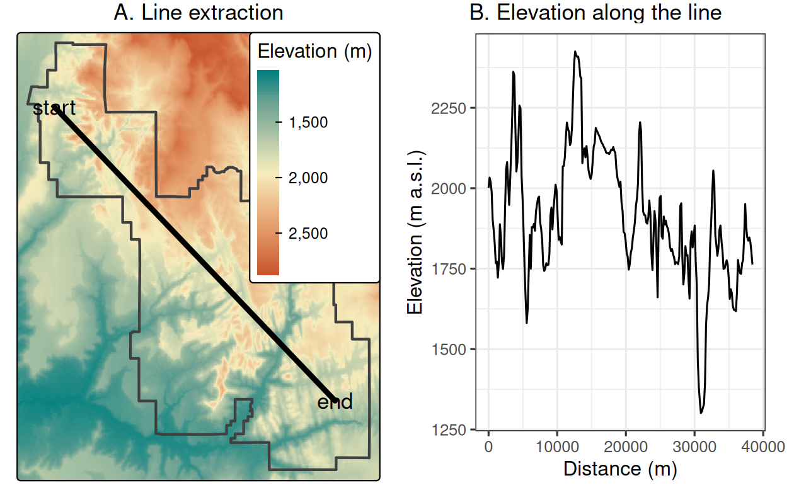
Raster Extraction With Line Selectors
zion_transect = cbind(c(-113.2, -112.9), c(37.45, 37.2)) |>
st_linestring() |>
st_sfc(crs = crs(srtm)) |>
st_sf(geometry = _)
zion_transect$id = 1:nrow(zion_transect)
zion_transect = st_segmentize(zion_transect, dfMaxLength = 250)
zion_transect = st_cast(zion_transect, "POINT")
zion_transect = zion_transect |>
group_by(id) |>
mutate(dist = st_distance(geometry)[, 1])
zion_elev = terra::extract(srtm, zion_transect)
zion_transect = cbind(zion_transect, zion_elev)
Location of a line used for (A) raster extraction and (B) the elevation along this line.

Slide 7
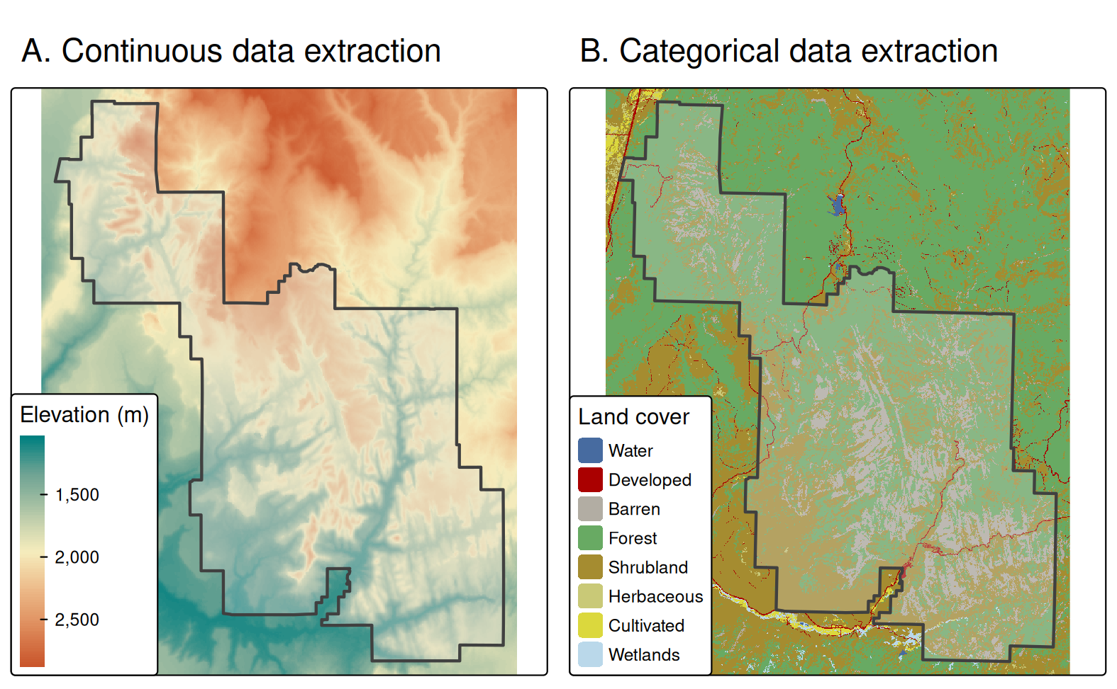
Area used for (A) continuous and (B) categorical raster extraction.

Slide 8
Rasterization: Converting Vector Features to Raster Form
Rasterization transforms vector features into a raster grid aligned with a template:
Simplifies feature topology,
Enables raster-based modeling (e.g., machine learning, surface modeling),
Aligns disparate datasets to a common grid for analysis.
Using varying summary statistics or criteria creates different raster outputs:
Default: presence/absence grid
fun = "length" count of vector points per cell
fun = sum on attribute aggregated attribute value per cell
cycle_hire_osm = spData::cycle_hire_osm
cycle_hire_osm_projected = st_transform(cycle_hire_osm, "EPSG:27700")
raster_template = rast(ext(cycle_hire_osm_projected), resolution = 1000, crs = crs(cycle_hire_osm_projected))
ch_raster1 = rasterize(cycle_hire_osm_projected, raster_template)
ch_raster2 = rasterize(cycle_hire_osm_projected, raster_template, fun = "length")
ch_raster3 = rasterize(cycle_hire_osm_projected, raster_template, field = "capacity", fun = sum, na.rm = TRUE)
Rasterization of lines and polygons requires careful handling of cell touch rules (e.g., using touches = TRUE).

Slide 9
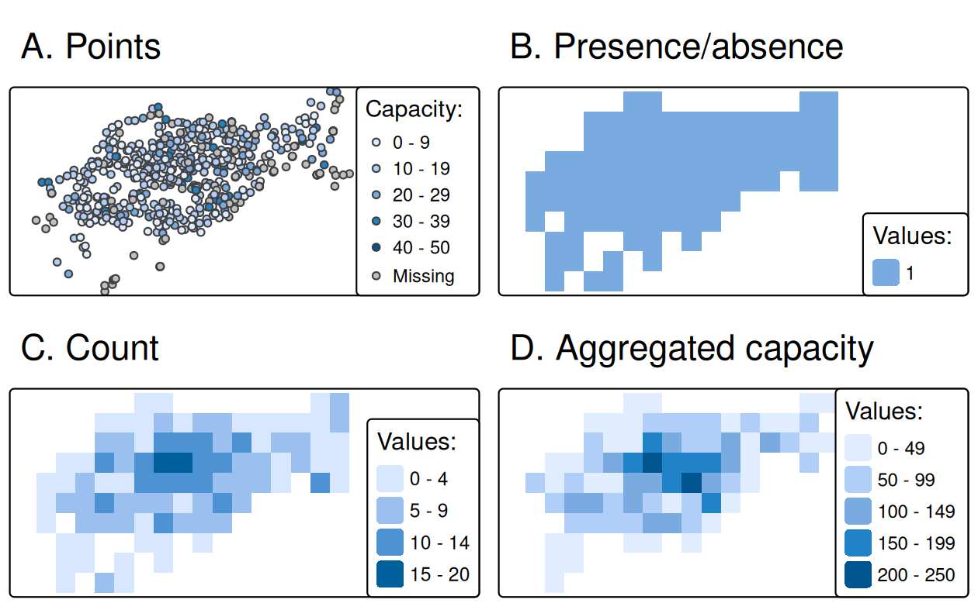
Examples of point rasterization.

Slide 10
Rasterization: Converting Vector Features to Raster Form
Another dataset based on California's polygons and borders (created below) illustrates rasterization of lines.
After casting the polygon objects into a multilinestring, a template raster is created with a resolution of a 0.5 degree.
california = dplyr::filter(us_states, NAME == "California")
california_borders = st_cast(california, "MULTILINESTRING")
raster_template2 = rast(ext(california), resolution = 0.5, crs = st_crs(california)$wkt)
california_raster1 = rasterize(california_borders, raster_template2, touches = TRUE)
california_raster2 = rasterize(california, raster_template2)

Slide 11
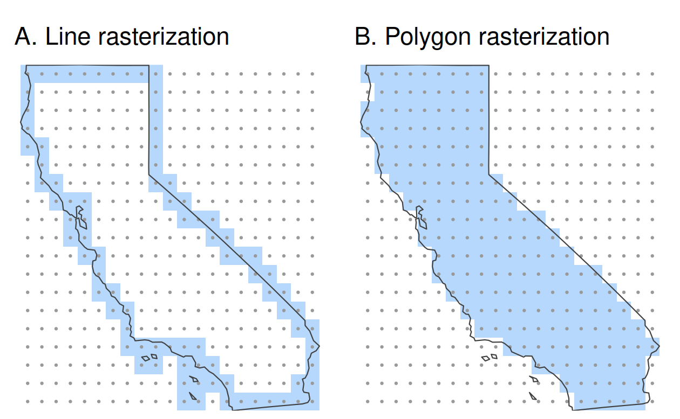
Examples of line and polygon rasterizations.

Slide 12
Spatial Vectorization: Raster → Vector Conversion
Vectorized output may be better suited for feature extraction, topology building, or certain types of spatial queries.
Common vectorization tasks include:
Cell centroid extraction → point representation
Contour line generation → isolines for continuous surfaces
Polygonization → vector polygons for raster classes or objects
Vectorization supports advanced feature analysis and integration with other vector-based spatial models.
elev = rast(system.file("raster/elev.tif", package = "spData"))
elev_point = as.points(elev) |> st_as_sf()
dem = rast(system.file("raster/dem.tif", package = "spDataLarge"))
cl = as.contour(dem) |> st_as_sf()
plot(dem, axes = FALSE); plot(cl, add = TRUE)
grain = rast(system.file("raster/grain.tif", package = "spData"))
grain_poly = as.polygons(grain) |> st_as_sf()
Examples:
Points: every non-NA raster cell becomes a point geometry.
Contours: lines representing constant value intervals.
Polygons: convert clusters of cells into polygons, with optional aggregation via dissolved borders.

Slide 13
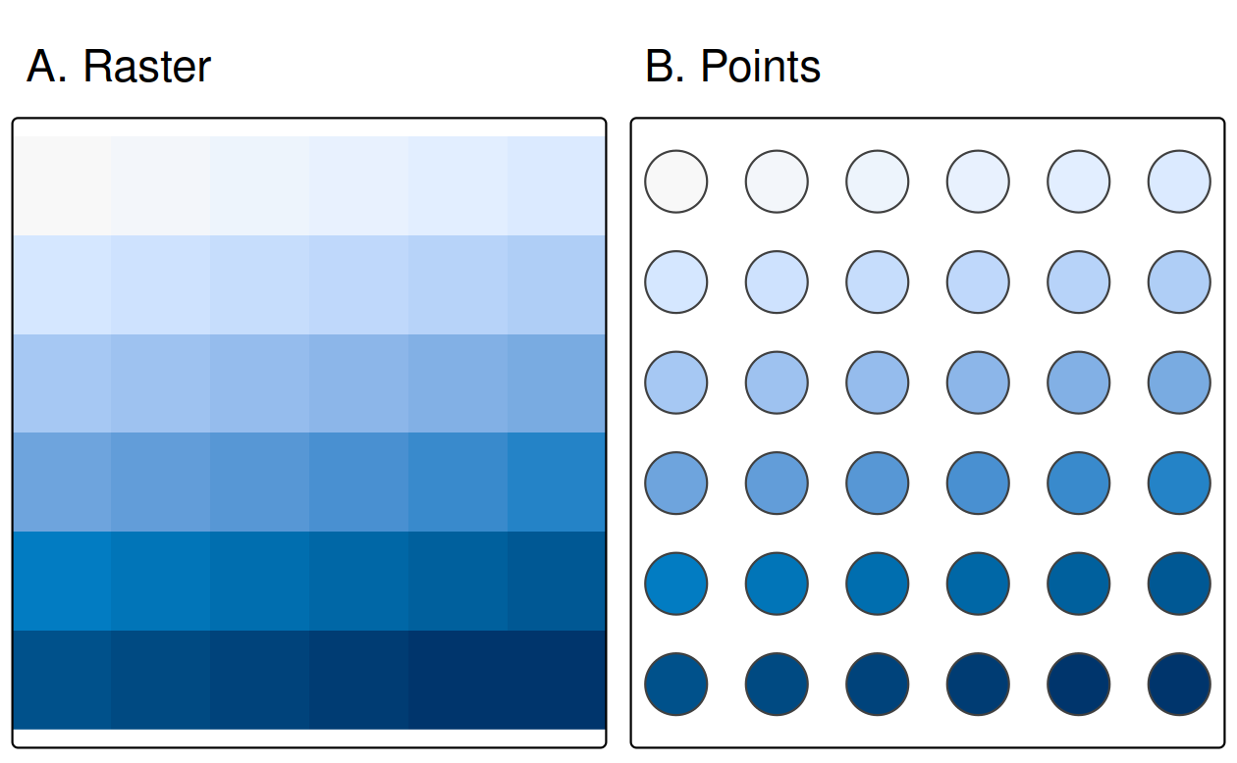
Raster and point representation of the elev object.

Slide 14
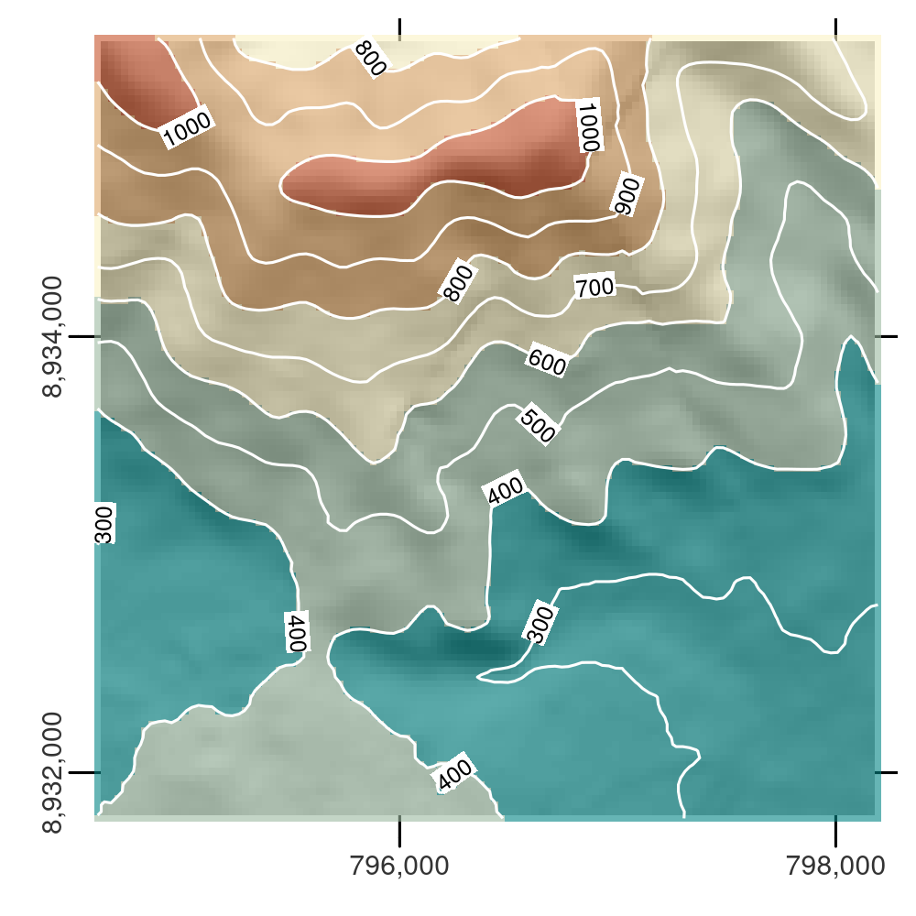
Digital elevation model with hillshading, showing the southern flank of Mt. Mongón overlaid with contour lines.

Slide 15
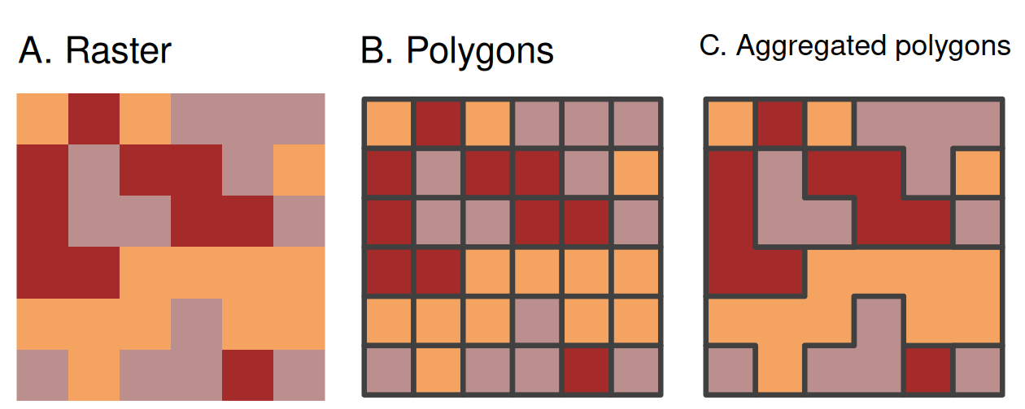
Vectorization of (A) raster into (B) polygons (dissolve = FALSE) and aggregated polygons (dissolve = TRUE).

Slide 16
Key Considerations Integrating Raster & Vector Data
Coordinate Reference System (CRS) Consistency
Always ensure that raster and vector data share the same CRS before interaction, otherwise extractions or overlays may misalign.
Resolution and Pixel Size Influence
Raster resolution affects spatial detail and computational costs:
Too coarse → loss of meaningful detail.
Too fine → heavier processing and memory use.
Use Appropriate Extraction Tools
Standard extraction tools may underperform on large datasets; specialized packages (e.g., exactextractr) offer faster and more precise operations for polygon extraction.

Slide 17
Practical Use ^{(ideas for projects, maybe?)}
Environmental & Civil Engineering
Extract elevation values within watershed polygons.
Rasterize stormwater network buffers to identify influence zones.
Overlay rainfall rasters with parcel polygons for exposure assessment.
Transportation Engineering
Extract raster values along road lines.
Aggregate risk metrics by district polygon.
Rasterize maintenance zones to align with predictive risk models.
Energy & Utilities Engineering
Extract slope and vegetation cost surfaces along candidate corridors.
Mask cost surfaces by exclusion zones.
Rasterize corridor alternatives into a common cost grid.
Urban Systems Engineering
Extract mean temperature by census tract.
Polygonize high-temperature raster clusters.
Join heat intensity with demographic indicators

Slide 18

Raster–vector Workloads Are Compute-Intensive
Common patterns:
Chunked raster processing
Parallel extraction jobs
Distributed tiling strategies
Serverless raster clipping APIs
Engineering implications:
Partition by spatial tile.
Cache derived raster products.
Maintain metadata lineage for spatial transformations.

Slide 19
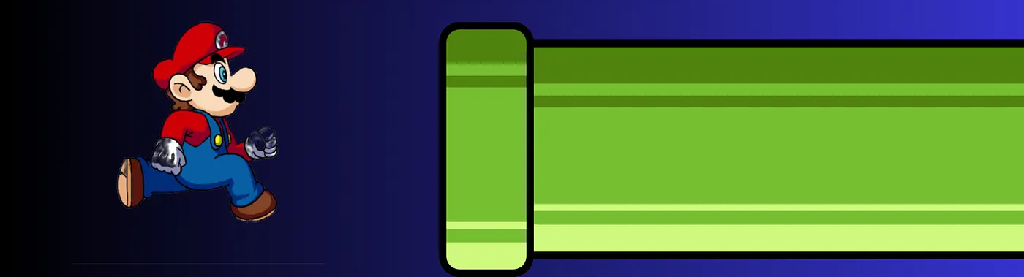
Data Pipelines & ETL Design
Engineering teams can:
Store rasters in cloud object storage (Cloud-Optimized GeoTIFFs, COGs).
Store vectors in spatial databases (PostGIS).
Precompute extraction summaries for analytics layers.
Maintain consistent CRS and grid alignment standards.
Rasterization is often used to:
Convert operational vector data into ML-ready gridded features.
Create feature stacks for spatial machine learning.

Slide 20
Data Pipelines & ETL Design
Raster–vector interaction becomes a structured spatial ETL problem:
Raster–vector interaction is not just GIS, it is:
Spatial feature engineering
Infrastructure modeling
Data-driven operations/intelligence
Scalable geospatial data systems
Stage | Example
Ingest | Load satellite raster + vector shapefiles
Transform | Reproject, align resolution, crop/mask
Enrich | Extract raster values to vector features
Aggregate | Summarize metrics per region
Serve | Store in spatial database or data warehouse

Slide 21

Practice Questions
Suppose your Digital Elevation Model (DEM) has 30m resolution, but parcel boundaries are highly irregular and small. What biases might arise when extracting mean elevation per parcel?
How would raster resolution influence flood depth estimate when summarized at the parcel level?
If rainfall rasters and elevation rasters have different resolutions and CRSs, what preprocessing steps are required before interaction?
Design a reproducible pipeline that updates flood exposure metrics monthly as new rainfall rasters become available.

