Slide 1

Phase 4 Delivery
DAEN 460 Capstone Senior Design
Alexander Abuabara
Spring 2026

Slide 2
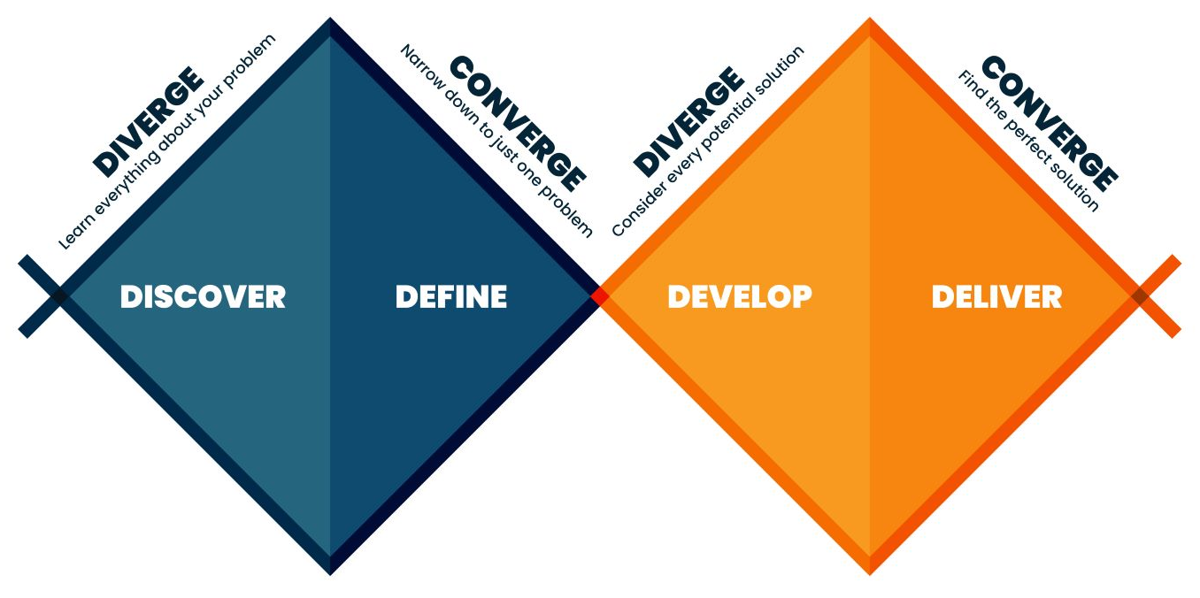

Slide 3

Today’s Agenda
Exit Interviews (everyone needs to be here next week!) ISEN UG Program Staff
Comms activity
Ethics
Elevator Pitch
Final Report Template and Expectations
Phase 4 Process and Requirements
Revise
Constrains
Standards

Slide 4
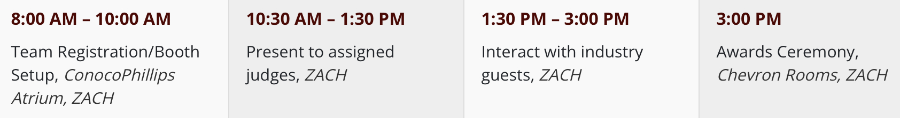
Upcoming Semester Schedule
4/14 Phase 4 Presentations BH/COE
4/14 mandatory attendance for all 2:15-3:15 Senior Exit Interviews
4/21 Phase 4 Presentations ML
4/24 ^{in-person, all day} COE Showcase schedule at https://tamueps.secure-platform.com/
5/5^{5 PM} Final Report Due

Slide 5

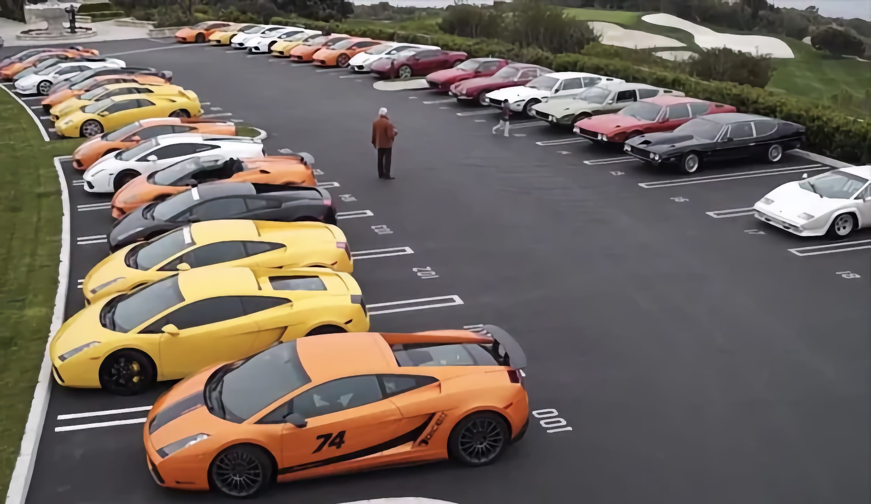
Final/Phase 4 Presentation
Welcome to invite sponsors ^{(and others)} to attend your presentation
Coordinate if you need something
Such as parking

Slide 6
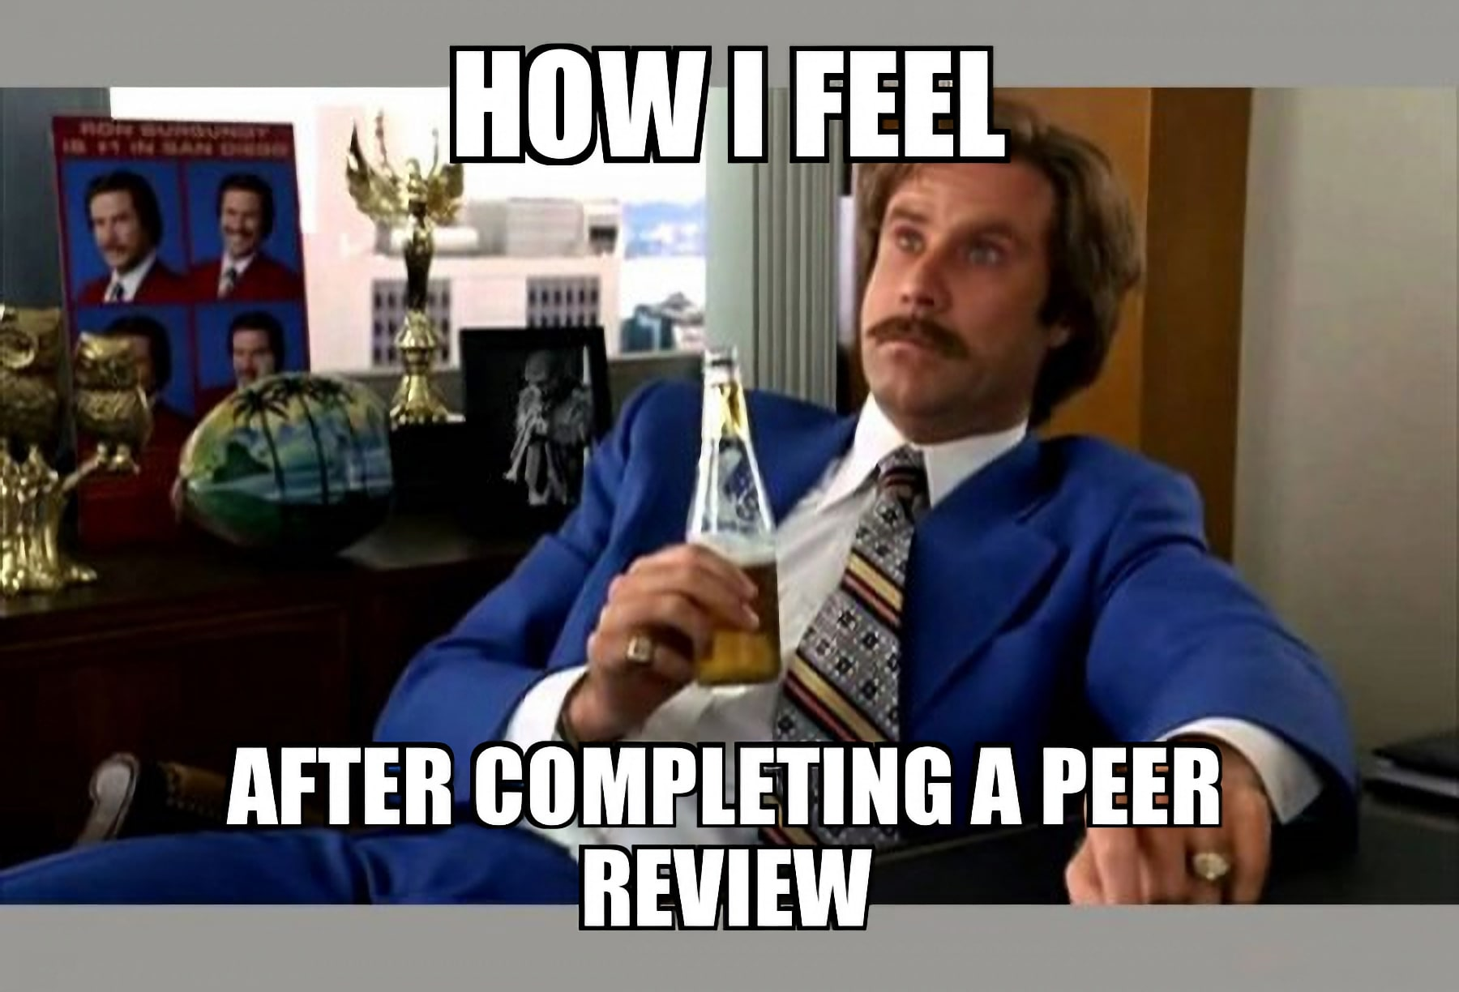
Peer Evaluation
Forms
Developing this week
Peer Evaluation due after the final report
You will rate your performance on the project as well as teammates
A grade (12% of overall grade) determined using:
Peer Evaluation ratings and comments
Class attendance/tardiness/participation
Instructors' observation of team participation/contribution

Slide 7
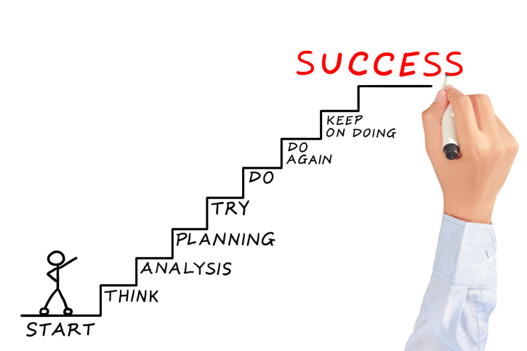

Critique your own project against learning outcomes rather than technical checklists only!
You are not being graded on reproducing a solution but on the quality of your thinking and decisions!
You're not just working alongside your peers, you're learning with them.
The goal is to move from individual results to shared success through real collaboration.
Peers are teammates, not just people doing the same assignment.
The aim is to build a culture of shared responsibility and genuine collaboration.
Pay attention to how and why you think the way you do when learning!

Slide 8
Learning Outcomes (syllabus) Ability to:
Identify, formulate, and solve complex engineering problems by applying principles of engineering, science, and mathematics.
Apply engineering design to produce solutions that meet specified needs with consideration of public health, safety, and welfare, as well as global, cultural, social, environmental, and economic factors.
Communicate effectively with a range of audiences.
Recognize ethical and professional responsibilities in engineering situations and make informed judgments, which must consider the impact of engineering solutions in global, economic, environmental, and societal contexts.
Function effectively on a team whose members together provide leadership, create a collaborative and inclusive environment, establish goals, plan tasks and meet objectives.
Develop and conduct appropriate experimentation, analyze and interpret data and use engineering judgment to draw conclusions.
Acquire and apply new knowledge as needed, using appropriate learning strategies.

Slide 9
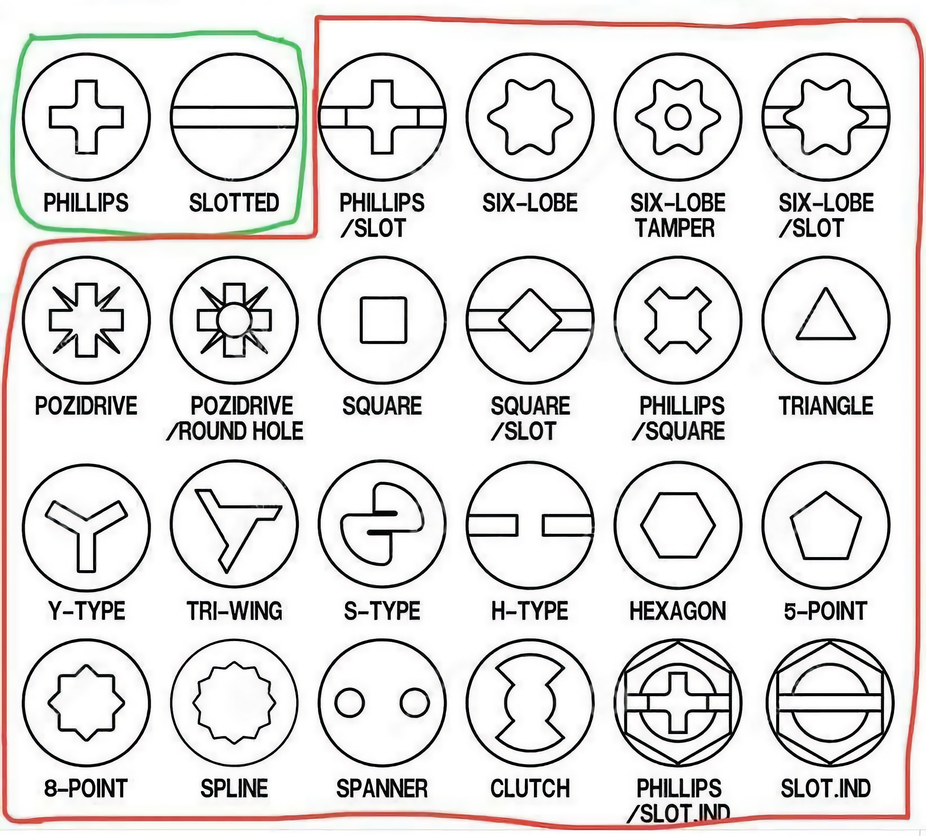
Standards ^{(A Universal Language)}
IT NEEDS TO BE REVIEWED IN ALL PROJECTS!
Standards are the agreed-upon rules and technical specifications that ensure safety, reliability, and interoperability. Without them, your lightbulb might not fit into a socket made by a different company.
Safety & Compliance: Regulatory bodies (like OSHA or the FAA) mandate standards to prevent catastrophic failure and protect the public.
Interchangeability: Standards like ISO or ASME ensure that parts from different global suppliers work together seamlessly.
Quality Benchmarks: Following established standards provides a baseline for "what good looks like," reducing the risk of design flaws.
Screw standards define the dimensions, thread pitch, and tolerances for fasteners to ensure interchangeability and strength, with the two primary systems being the Unified Thread Standard (UTS/Imperial) in North America and ISO Metric worldwide. Key standards include ISO 68-1 for metric, and ASME B1.1 for unified inch threads (UNC/UNF).

Slide 10
Engineering Standards
IT NEEDS TO BE REVIEWED IN ALL PROJECTS!
Data Quality & Governance
ISO/IEC 8000 – Data Quality Standard: Defines requirements for reliable and accurate data across systems.
ISO/IEC 11179 – Metadata Registry Standard: Governs how data elements and metadata should be defined and documented.
ISO/IEC 38505 – Data Governance Framework: Defines governance practices for managing organizational data.
General Data Protection Regulation (GDPR)
Data Management Body of Knowledge
DAMA International Data Management Framework (DMBOK): Widely used reference covering: data governance, data architecture, data quality, master data management, metadata management
Data Architecture
The Open Group TOGAF Enterprise architecture framework often used in data platform design.
World Wide Web Consortium standards (JSON, XML, RDF, etc.) that govern structured data exchange.
ISO/IEC 9075 – SQL Standard: The formal specification behind relational databases.
Data Security Standards
ISO/IEC 27001 – Information Security Management
National Institute of Standards and Technology Cybersecurity Framework
These can govern encryption, access control, auditing, breach management.

Slide 11
Engineering Standards
IT NEEDS TO BE REVIEWED IN ALL PROJECTS!
Manufacturing: ASME Y14.5 (GD&T), ASTM Standards, ISO 2768 (General Tolerances), ISO 9001, ANSI Standards, IPC Standards, API Standards
Aerospace & Defense: AS9100, ASME Standards, ASTM F519, MIL-STD-810 (Environmental Engineering), MIL-STD-461 (EMC), RTCA DO-160 (Environmental Testing), SAE AS Standards, ISO 9100 Series
Healthcare: ISO 13485, IEC 60601 (Medical Electrical Equipment), ISO 14971 (Risk Management), ASTM Standards (Medical Devices), FDA 21 CFR Part 820 (Quality Systems Regulation), ANSI/AAMI Standards
Food Industry: ISO 22000 (Food Safety Management), 3-A Sanitary Standards, ANSI/NSF Standards, ASTM Food Packaging Standards, EHEDG (European Hygienic Engineering & Design Group), GMP Engineering Standards

Slide 12
Comms Activity

Slide 13
Phase 4 / Phase 4 Guidelines
On Canvas

Slide 14
Phase 4
Phase 4 is about delivering the results of your project
You should provide actionable information that will allow your sponsor to implement your solution and/or continue development based on your research
Your presentation should provide enough analysis to prove you have rigorously examined the problem and your solution
You should also show that you have considered appropriate engineering standards and constraints as you developed your solution
Phase 4 technical grade will not be subject to resubmissions

Slide 15
Phase 4 Presentation Guidelines
Project Recap
In addition to displaying your problem statement in the introduction, provide a project recap
A slide or two (visuals are good) explaining the "why" of your project and your efforts to date
This is likely going to be included in your showcase poster as a project introduction
Think of it as your "elevator pitch", but along with a minute or so to talk, you'll have visuals to back it up

Slide 16
Phase 4 Presentation Guidelines
Final Design Architecture
Explain your solution, focus on functionality, keep technical details to a minimum
Map your requirements to your solution, indicate how each requirement is satisfied by the design (focus on key requirements if you have many)
If your results are research focused, identify areas of research and map to key requirements

Slide 17
Phase 4 Presentation Guidelines
Analysis
Analyze your final solution using appropriate criteria (some may be same used in Phase 3)
Economic, performance, risk are three areas
Define each clearly as they are presented
Other areas of analysis should be explored as appropriate for your project
For research, discuss the impact of the research and analysis of validity

Slide 18
Phase 4 Presentation Guidelines
Engineering Standards and Constraints
Describe any engineering standards that guided your solution and discuss relevance
Explain any constraints faced by your team/project and how they are addressed
See guidelines document for tips

Slide 19
Phase 4 Presentation Guidelines
Conclusion and Recommendations
Finalize the presentation by summarizing what your outcomes indicate (don't go through final design again, but reference earlier information as needed to "wrap up" your results)
Include any implementation plan you have created
If future work to continue/expand your project is likely, indicate areas of focus that might take

Slide 20
Phase 4 Presentation Guidelines
ABET Accreditation Alignment
Phase 4 presentation and final report must explicitly demonstrate your ability to apply engineering design to produce solutions that meet specified needs!
Engineering Standards and Project Constraints go beyond just naming a standard (like OSHA or ISO):
You must explicitly identify the specific standards (e.g., IEEE, ASME, NIST, ISO) that informed your design.
Clearly state how your design specifically protects the user or the public.
Analysis should consider broader impact of your design.
Address any ethical dilemmas encountered: ensure your narrative reflects informed, ethical decision-making.

Slide 21
Showcase Tips
Do very brief introductions
Tell a story, not get bogged down in technical details
Focus on the process you went through, not the details of each step
State the requirements of your solution clearly
Identify multiple solutions you may have explored, but don't spend a lot of time detailing them
Explain your solution and go through the analysis of how it meets your requirements
End with a strong conclusion, if there are relevant metrics proving the validity of your solution, present them!

Slide 22
Showcase Tips
Check requirements
All team members should be present (but not at the same time)
Limit presenters to 2-3 people is fine if desired
Judging criteria
Problem definition (25%)
Design methodology (25%)
Achieved or expected outcomes (25%)
Overall quality of the presentation (25%)

Slide 23

Future
The people who are crazy enough to think they can change the world are the ones who do.
Steve Jobs "Think Different" Campaign Speech 09/1997
https://youtube.com/watch?v=b4n8uT12ij8&t=410

