Slide 1

Phase 3 Develop
DAEN 460 Capstone Senior Design
Alexander Abuabara
Spring 2026

Slide 2
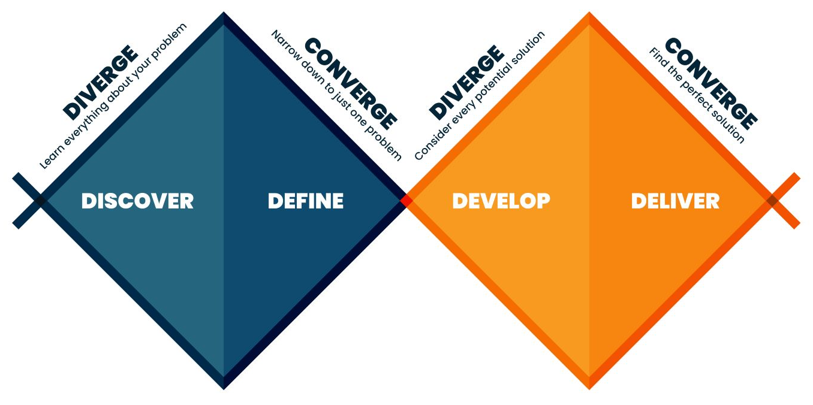

Slide 3

Today’s Agenda
Introduction
Comms activity
Phase 3 Process and Requirements
Research Project Decision Making Process
Costs
Constrains
Standards

Slide 4
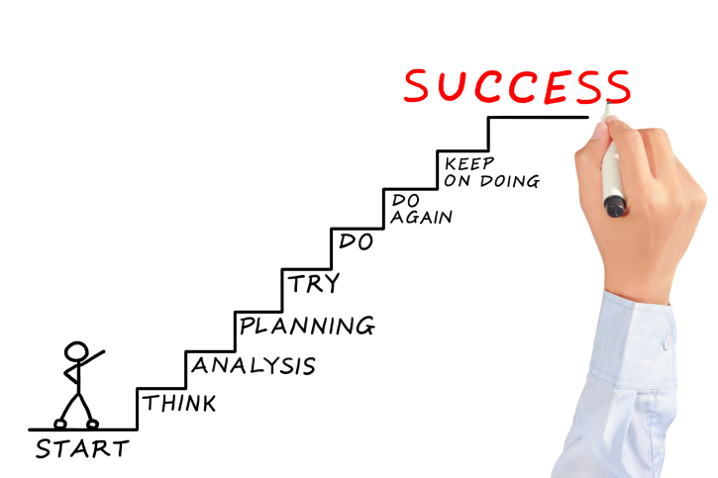

Critique your own project against learning outcomes rather than technical checklists only!
You are not being graded on reproducing a solution but on the quality of your thinking and decisions!
You're not just working alongside your peers, you're learning with them.
The goal is to move from individual results to shared success through real collaboration.
Peers are teammates, not just people doing the same assignment.
The aim is to build a culture of shared responsibility and genuine collaboration.
Also, paying attention to how and why you think the way you do when learning!

Slide 5
Learning Outcomes (syllabus) Ability to:
Identify, formulate, and solve complex engineering problems by applying principles of engineering, science, and mathematics.
Apply engineering design to produce solutions that meet specified needs with consideration of public health, safety, and welfare, as well as global, cultural, social, environmental, and economic factors.
Communicate effectively with a range of audiences.
Recognize ethical and professional responsibilities in engineering situations and make informed judgments, which must consider the impact of engineering solutions in global, economic, environmental, and societal contexts.
Function effectively on a team whose members together provide leadership, create a collaborative and inclusive environment, establish goals, plan tasks and meet objectives.
Develop and conduct appropriate experimentation, analyze and interpret data and use engineering judgment to draw conclusions.
Acquire and apply new knowledge as needed, using appropriate learning strategies.

Slide 6
Upcoming Semester Schedule
4/7 Phase 4 Kickoff
4/14 Phase 4 Presentations BH/COE
4/14mandatory attendance for all 2:15-3:15 Senior Exit Interviews
4/21 Phase 4 Presentations ML
4/24^{in-person, all day} COE Showcase check schedule: https://tamueps.secure-platform.com/judges/
5/5^{5 PM} Final Report Due

Slide 7
Final/Phase 4 Presentation
Welcome to invite sponsors to attend your presentation
Please coordinate if you need to arrange parking for them

Slide 8
Awards Ceremony
If your team wins an award in the showcase (either ISEN or overall), you will receive an email inviting you to the awards ceremony!
There will be a lot of things going on that day (graduation, reception, etc.), but try to make the awards ceremony to have your picture taken with your team and instructors :)

Slide 9
Peer Evaluation
Peer Evaluation will be due after the final report
You will be asked to rate your performance on the project as well as your teammates
A grade (representing 12% of your overall grade) will be determined using:
Peer Evaluation ratings and comments
Class attendance/tardiness/participation
Instructors' observation of team participation/contribution

Slide 10
Comms Activity

Slide 11
Phase 3
Phase 3 is about moving into solutions
You should be able to convert your "as-is" model into a "to-be" model
Addresses needs/requirements/actions previously defined
Model can be revision of as-is, or a new model (i.e. simulation)
To-be model should be solution independent, it should be achievable in various ways
Solution Concepts

Slide 12
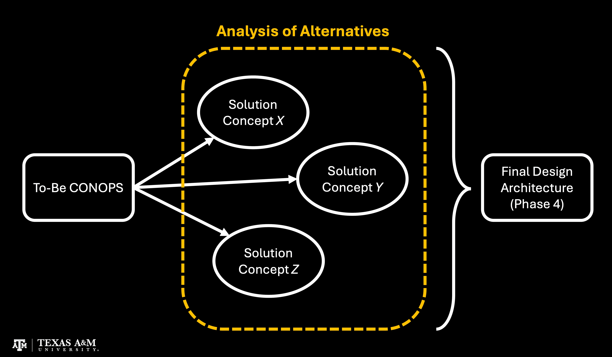

Slide 13
Solution Concepts
Develop various concepts that provide a solution to your problem
Even if you've decided on a path already, you should be able to present alternative solutions that you considered
Screen out any concepts that are not feasible or practical
Ensure that remaining concepts meet requirements (leading to "To-be")
Present concepts independent of evaluation criteria first

Slide 14
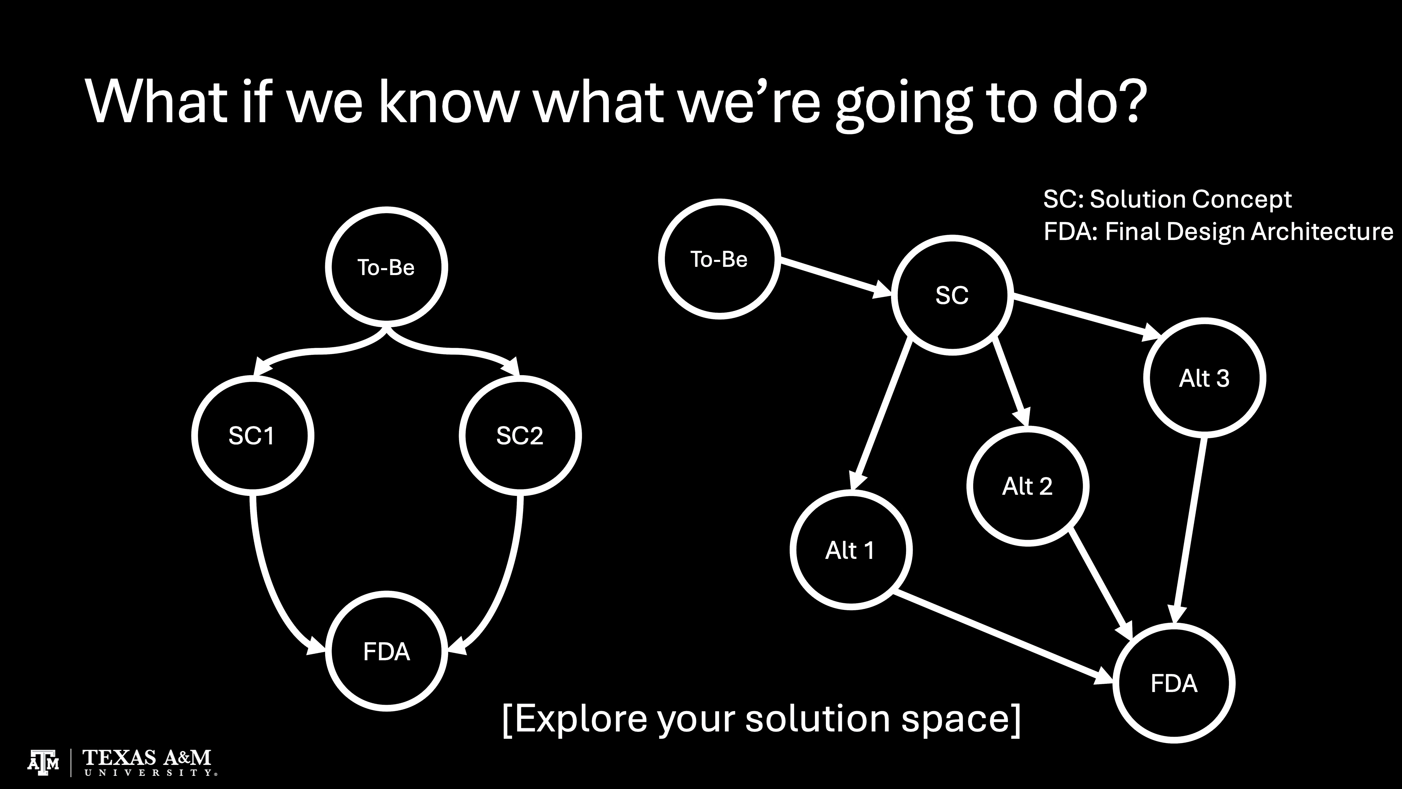

Slide 15
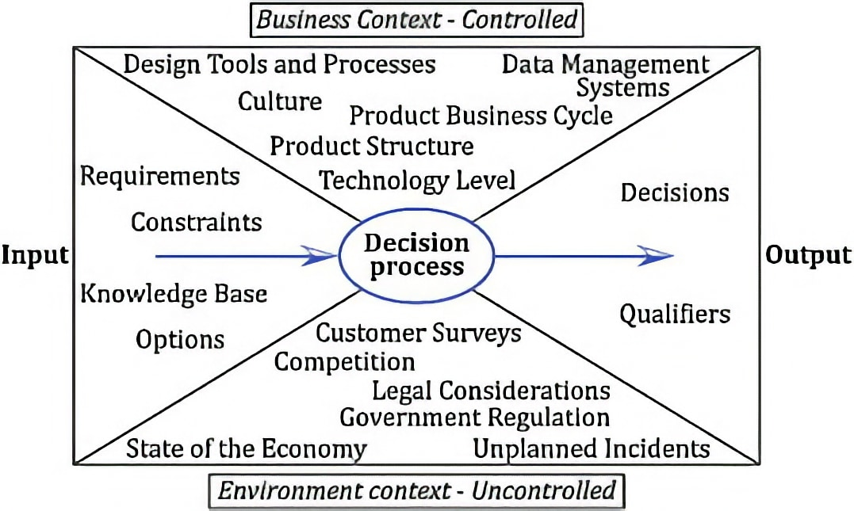
Keep in mind …
Where has your sponsor given you the freedom to make an engineering decision?

Slide 16
Hopefully, you have already made some progress regarding the solution you will be delivering your sponsor.
It doesn't make sense to backtrack with your Analysis of Alternatives (AoA).
By that, I mean:
If you are developing a data analytics tool, it is far less fruitful to compare platforms (VBA vs. PowerBI vs. Python vs. R vs. C/C++ vs. Java, etc.) than compare algorithmic approaches.
Refining Rather than Restarting: You've already done significant work in defining needs, requirements, and engineering actions.
AoA helps refine and validate your direction rather than sending you back to square one.

Slide 17
Data-Driven Justification AoA quantifies trade-offs so that you can justify your final solution selection with economic, risk, and performance-based reasoning.
Data Analysis
Informed
Decision
Making

Slide 18
Evaluation Criteria
Develop the criteria to be used to evaluate concepts
Engineering standards
Constraints
Economic
All the above must be considered in your evaluation (ABET requirement)
Economic analysis can be estimation of costs and/or benefits but must be appropriate and as thorough as possible.

Slide 19
Costs
Every engineering decision has a price tag.
Cost isn't just the price of parts; it's a multi-variable equation that dictates whether a product is viable or sustainable.
Fixed vs. Variable: You must account for one-time research and development (R&D) costs versus the recurring cost of materials and labor.
Life-Cycle Costs: Modern engineering looks beyond the "shelf price" to include maintenance, energy consumption, and eventual disposal or recycling.
The Trade-off: Reducing costs often impacts quality or performance, a constant tug-of-war known as "value engineering."

Slide 20
Constraints/Boundaries
Constraints are the non-negotiable limits within which the solution must exist.
If the design process is a sandbox, the constraints are the wooden walls.
Physical: Limits on size, weight, material properties, and power consumption.
Environmental: Requirements for temperature resistance, humidity, or operating in a vacuum.
Resources: Limited time (deadlines), available manpower, and specific manufacturing equipment.

Slide 21
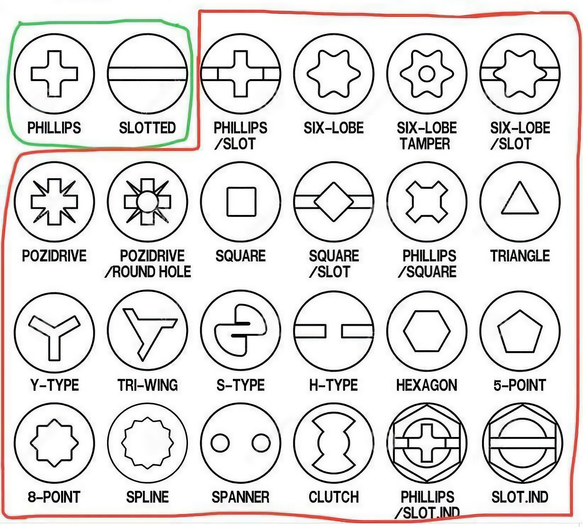
Standards ^{(A Universal Language)}
Standards are the agreed-upon rules and technical specifications that ensure safety, reliability, and interoperability. Without them, your lightbulb might not fit into a socket made by a different company.
Safety & Compliance: Regulatory bodies (like OSHA or the FAA) mandate standards to prevent catastrophic failure and protect the public.
Interchangeability: Standards like ISO or ASME ensure that parts from different global suppliers work together seamlessly.
Quality Benchmarks: Following established standards provides a baseline for "what good looks like," reducing the risk of design flaws.
Screw standards define the dimensions, thread pitch, and tolerances for fasteners to ensure interchangeability and strength, with the two primary systems being the Unified Thread Standard (UTS/Imperial) in North America and ISO Metric worldwide. Key standards include ISO 68-1 for metric, and ASME B1.1 for unified inch threads (UNC/UNF).

Slide 22
Establish & Evaluate
Analyze & Select
Document & Present
Define measurable evaluation criteria Score solutions, prioritize feasibility Consider cost, efficiency, & scalability
• Conduct trade-off analysis: Performance, cost, & risk analysis
• Select solution, justify with criteria
• Adjust for scenario & assumption changes
Document process & findings clearly Use visuals with salient results

Slide 23
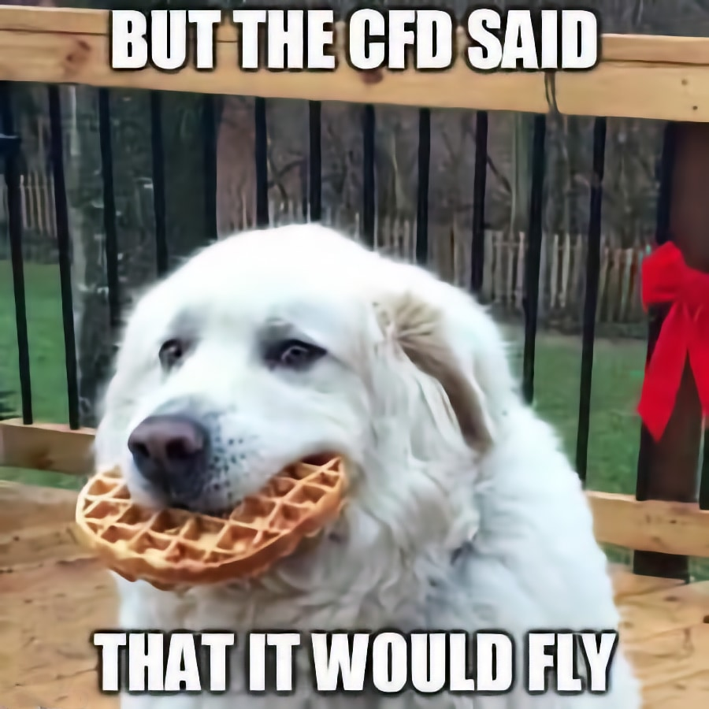
Concept Evaluation
Evaluate concepts based on criteria
Score and/or rank them (PUGH Chart, WDM, …)
Include trade-off analysis (advantages/disadvantages)
Select a best concept to move forward with detailed design and analysis
PS. Computational Fluid Dynamics (CFD)

Slide 24
Establish & Evaluate
Analyze & Select
Document & Present
Define measurable evaluation criteria Score solutions, prioritize feasibility Consider cost, efficiency, & scalability
• Conduct trade-off analysis: Performance, cost, risk analysis
• Select solution, justify with criteria
• Adjust for scenario & assumption changes
Document process & findings clearly Use visuals with salient results

Slide 25
Establish & Evaluate
Analyze & Select
Document & Present
Define measurable evaluation criteria Score solutions, prioritize feasibility Consider cost, efficiency, & scalability
• Conduct trade-off analysis: Performance, cost, & risk analysis
• Select solution, justify with criteria
• Adjust for scenario & assumption changes
Document process & findings clearly Use visuals with salient results

Slide 26
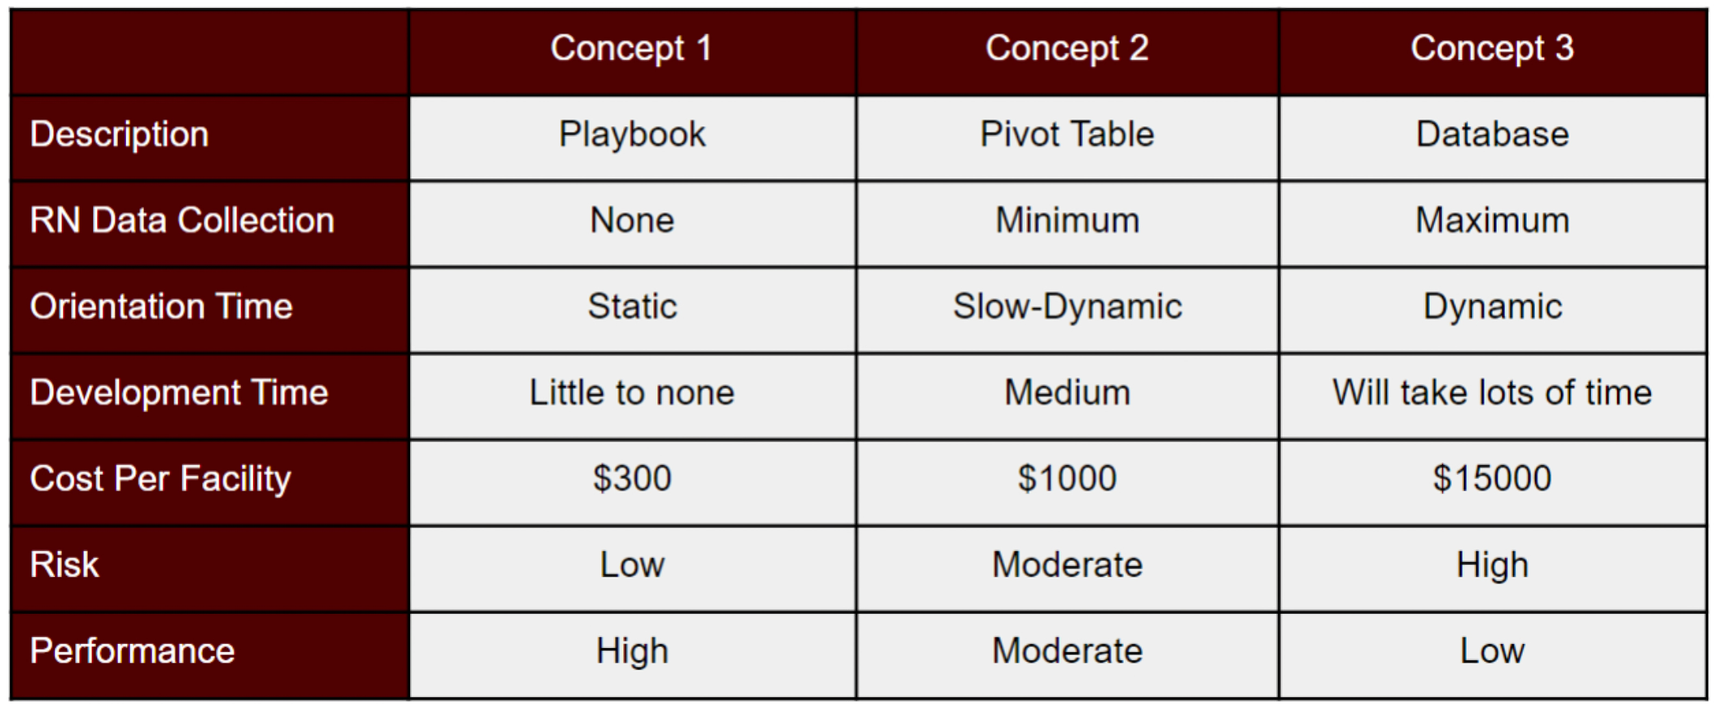
Solution Concept Identification
Create a Summary Table

Slide 27
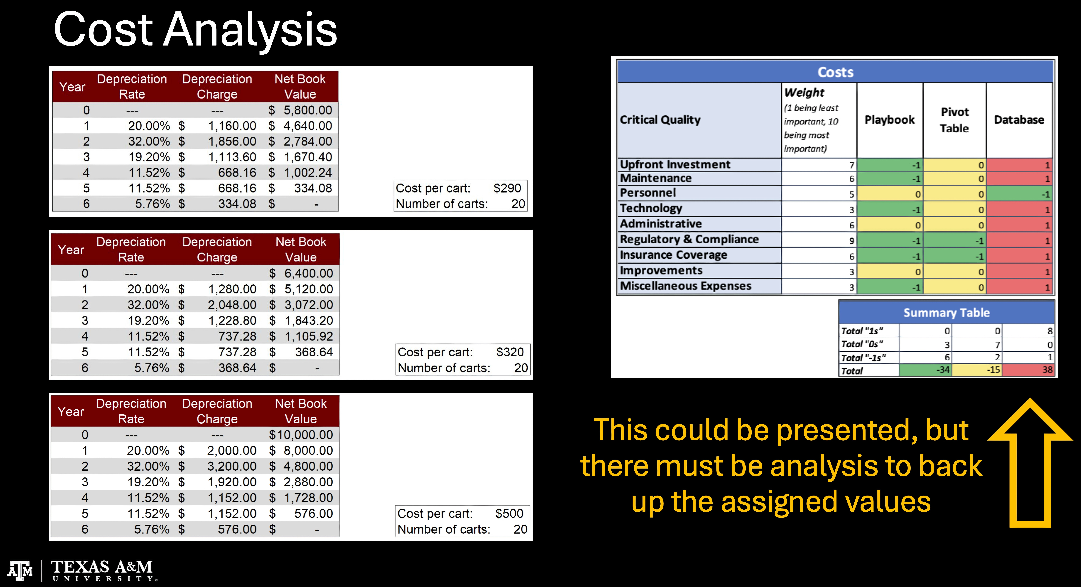

Slide 28
Avenues for Economic Analysis
Opportunity Cost Exploration
Sensitivity Analysis
Cost-Benefit Analysis
Break-Even & Payback Period
The options for analysis shown in this presentation are by no means an exhaustive list.
Search for the methods which best utilize the dimensions in which you'll be comparing your alternatives.

Slide 29
For Capstone Context
Lower bound: typical prototype or academic implementation using managed cloud services and limited data.
Upper bound: closer to small production pilot projects with stronger infrastructure and security.
Cost components typically include:
Cloud infrastructure (storage, compute)
Data ingestion tools
Engineering labor
Data governance / compliance
Visualization or ML integration

Slide 30
Typical Cost Components
These ranges usually reflect several major categories:
Cost Component | Typical Share of Budget
Engineering Labor | 40–60%
Cloud Compute | 15–25%
Storage | 10–20%
Data Pipeline & Orchestration Tools | 5–15%
Monitoring, Security, Governance | 5–10%

Slide 31
Associated Project Costs by Industry
Industry | Example Data Engineering Project | Typical Data Sources | Infrastructure Needs | Estimated Project Cost (USD)
Healthcare | Patient data integration & analytics pipeline | EHR systems, lab records, insurance claims | Secure storage, HIPAA-compliant cloud, ETL pipelines | $20,000 – $80,000
Finance / Banking | Fraud detection data platform | Transaction logs, customer accounts, market feeds | Streaming ingestion, real-time processing, high security | $30,000 – $120,000
Retail / E-Commerce | Customer behavior & recommendation pipeline | Website logs, purchase history, inventory data | Data warehouse, streaming analytics, ML integration | $15,000 – $70,000
Manufacturing | IoT predictive maintenance pipeline | Sensor data, machine logs, maintenance records | Edge ingestion, time-series storage, streaming ETL | $25,000 – $90,000
Transportation / Logistics | Fleet tracking and route optimization data system | GPS data, vehicle telemetry, delivery records | Real-time pipelines, geospatial processing | $20,000 – $85,000
Energy / Utilities | Smart grid or energy usage analytics pipeline | Smart meter data, weather feeds, grid telemetry | Large-scale time-series processing, distributed storage | $30,000 – $100,000
Telecommunications | Network performance monitoring platform | Call detail records, network logs, usage metrics | High-volume ingestion, distributed processing | $40,000 – $150,000
Social Media / Marketing | Social sentiment and engagement analytics | Social APIs, campaign metrics, clickstream data | Data lake, NLP pipelines, batch + streaming | $10,000 – $50,000
Government / Public Sector | Open data integration and transparency dashboards | Census data, city infrastructure data, public records | Data lakehouse, visualization layer | $15,000 – $60,000
Education | Student performance analytics pipeline | LMS logs, enrollment data, course performance | Data warehouse, batch processing, BI dashboards | $8,000 – $40,000

Slide 32
Dataset Size vs. Estimated Data Engineering Project Cost
Dataset Size | Example Scale | Typical Technologies | Infrastructure Complexity | Estimated Project Cost (USD)
< 1 GB | Small structured datasets, CSV files, API pulls | Python, Pandas, SQLite, simple ETL scripts | Very Low | $1,000 – $5,000
1 – 10 GB | Small relational databases, multiple APIs | Python ETL, PostgreSQL, basic orchestration | Low | $3,000 – $12,000
10 – 100 GB | Moderate analytics datasets, event logs | Airflow/Prefect pipelines, cloud storage, data warehouse | Medium | $8,000 – $30,000
100 GB – 1 TB | Clickstream data, IoT telemetry, transaction logs | Spark, cloud data lake (S3/Azure/GCS), orchestration tools | Medium–High | $20,000 – $80,000
1 – 10 TB | Large enterprise datasets, multi-source integration | Distributed compute (Spark/Databricks), streaming pipelines | High | $50,000 – $200,000
10 – 100 TB | Enterprise-scale historical analytics | Data lakehouse architectures, scalable orchestration | Very High | $150,000 – $600,000
100 TB+ | Large-scale platforms (telecom, social media, finance) | Distributed storage, real-time ingestion, advanced governance | Enterprise | $500,000 – $2M+

Slide 33
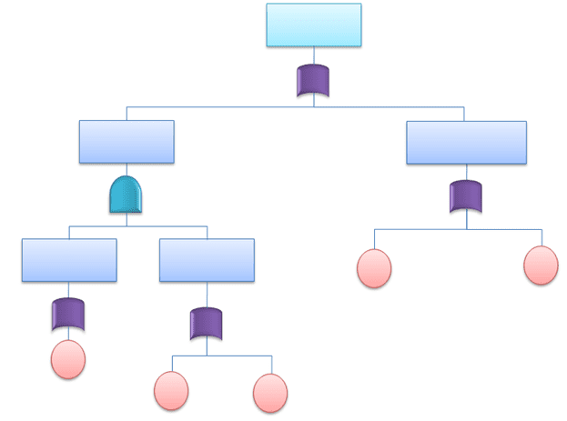
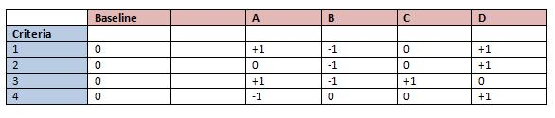
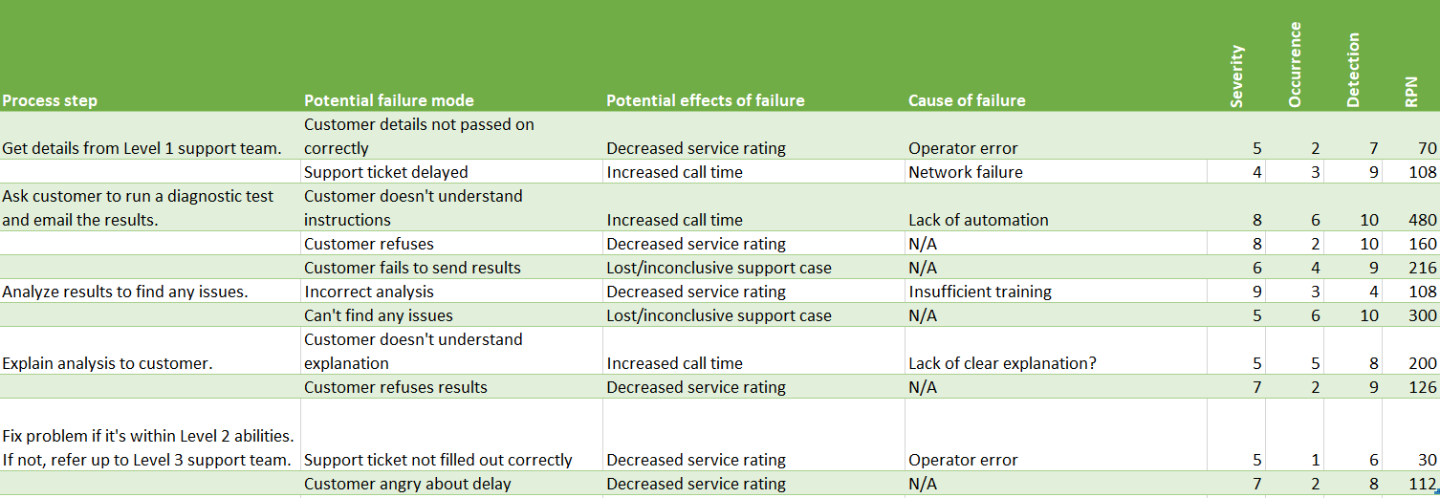
Risk Analysis Resources
Fault Tree Analysis (FTA) https://sixsigmastudyguide.com/fault-tree-analysis/
Pugh Analysis https://sixsigmastudyguide.com/pugh-analysis/
Failure Mode Effects Analysis (FMEA) https://sixsigmastudyguide.com/failure-mode-effects-analysis-fmea/

Slide 34
Engineering Standards
Data Quality & Governance
ISO/IEC 8000 – Data Quality Standard: Defines requirements for reliable and accurate data across systems.
ISO/IEC 11179 – Metadata Registry Standard: Governs how data elements and metadata should be defined and documented.
ISO/IEC 38505 – Data Governance Framework: Defines governance practices for managing organizational data.
General Data Protection Regulation (GDPR)
Data Management Body of Knowledge
DAMA International Data Management Framework (DMBOK): Widely used reference covering: data governance, data architecture, data quality, master data management, metadata management
Data Architecture
The Open Group TOGAF Enterprise architecture framework often used in data platform design.
World Wide Web Consortium standards (JSON, XML, RDF, etc.) that govern structured data exchange.
ISO/IEC 9075 – SQL Standard: The formal specification behind relational databases.
Data Security Standards
ISO/IEC 27001 – Information Security Management
National Institute of Standards and Technology Cybersecurity Framework
These can govern encryption, access control, auditing, breach management.

Slide 35
Engineering Standards
Manufacturing: ASME Y14.5 (GD&T), ASTM Standards, ISO 2768 (General Tolerances), ISO 9001, ANSI Standards, IPC Standards, API Standards
Aerospace & Defense: AS9100, ASME Standards, ASTM F519, MIL-STD-810 (Environmental Engineering), MIL-STD-461 (EMC), RTCA DO-160 (Environmental Testing), SAE AS Standards, ISO 9100 Series
Healthcare: ISO 13485, IEC 60601 (Medical Electrical Equipment), ISO 14971 (Risk Management), ASTM Standards (Medical Devices), FDA 21 CFR Part 820 (Quality Systems Regulation), ANSI/AAMI Standards
Food Industry: ISO 22000 (Food Safety Management), 3-A Sanitary Standards, ANSI/NSF Standards, ASTM Food Packaging Standards, EHEDG (European Hygienic Engineering & Design Group), GMP Engineering Standards

Slide 36
Engineering Constraints
Manufacturing: Cost, Production efficiency, Material availability, Manufacturing tolerances, Environmental regulations, Equipment limitations, Safety and ergonomics, Time constraints
Aerospace & Defense: Weight constraints, Aerodynamics, Thermal management, Regulatory compliance (FAA, ITAR), Material strength and fatigue, Electromagnetic compatibility (EMC), Reliability and redundancy, Environmental resistance
Healthcare: Biocompatibility, Sterilization requirements, Patient safety, Regulatory compliance (FDA, ISO), Ergonomics and usability, Reliability and maintainability, Data security (HIPAA), Precision and accuracy
Food Industry: Hygienic design, Material safety and compatibility (food-grade materials), Regulatory compliance (FDA, HACCP), Temperature control, Shelf life, Sanitation and cleaning ease, Packaging integrity, Product contamination prevention

Slide 37
The whole point of …
1. Developing a To-Be CONOPS
2. Generating solution concepts
3. Conducting analysis of alternatives
… is to prove to your sponsor why they can trust you!
The work you've done in phases 1 and 2 show that you understand their system and what needs to be done.
Now, you're showing them that you're confident you've arrived at the best possible means of system transformation.

Slide 38
Phase 3 Guidelines
On Canvas

Slide 39
Project Recap
In addition to displaying your problem statement in the introduction, provide a project recap.
A slide or two (visuals are good) explaining the "why" of your project and your efforts to date.
This is likely going to be included in your showcase video as a project introduction.
Think of it as your "elevator pitch", but along with a minute or so to talk, you'll have visuals to back it up.

Slide 40
To-be Conops
If your to-be system is a modification of the as-is system, briefly show the as-is (with limited explanation).
Focusing on your system requirements, introduce where changes to the system will convert it from "as-is" to "to-be".
Avoid too much detail here, keep it solution neutral.
For research projects, your model may not change (significantly), but point out which parts of the as-is model that your research will potentially impact.
Ensure that your projected research deliverables address the requirements you defined in Phase 2.
Research Projects

Slide 41
Solution Concepts
With a solution neutral to-be model, you can generate various concepts to enable the desired changes.
Even if you've already moved towards a solution, you need to present alternatives you considered.
For research projects, you'll want to present areas of research you considered.

Slide 42
Analysis of Alternatives
Using the criteria you defined (constraints and standards included), compare your alternatives.
Present in a clear, non-technical way. Include any technical back-up in the appendix.
For research projects, you'll want to analyze what you could gain from research you considered and use criteria to compare and decide the area(s) you decided to focus on.

Slide 43
Selection of Alternative
End the Analysis of Alternatives with a clear indication of the concept you selected.
Don't provide a bunch of design details, that'll follow in Phase 4.
Unless you've added or modified requirements or actions, traceability here will be the same as in Phase 2.
If you've added, just note what you've added.
More detail on traceability will be presented in Phase 4.
Traceability

Slide 44
Research Project Decision Making
Results and decision making for research projects may look different from applied projects.
However, the process and decisions made should still reflect the initial information gathering and modeling process
Some decisions about areas to research should have been made.
Areas that can affect the "as-is" state should be the areas of focus.
Areas of research that indicates previous attempts to improve a process are important for comparisons.
Constraints and standards are important and specific research into them should be highlighted.

Slide 45
"You never achieve what you want without falling on your face a few times."
Steve Jobs
Nice reading: https://book.stevejobsarchive.com

Slide 46
