Slide 1

Phase 2 Define
DAEN 460 Capstone Senior Design
Alexander Abuabara
Spring 2026

Slide 2
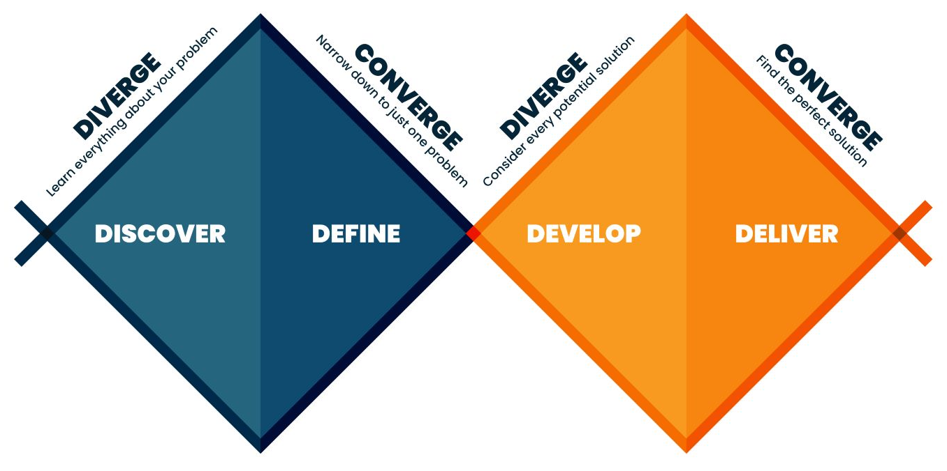

Slide 3
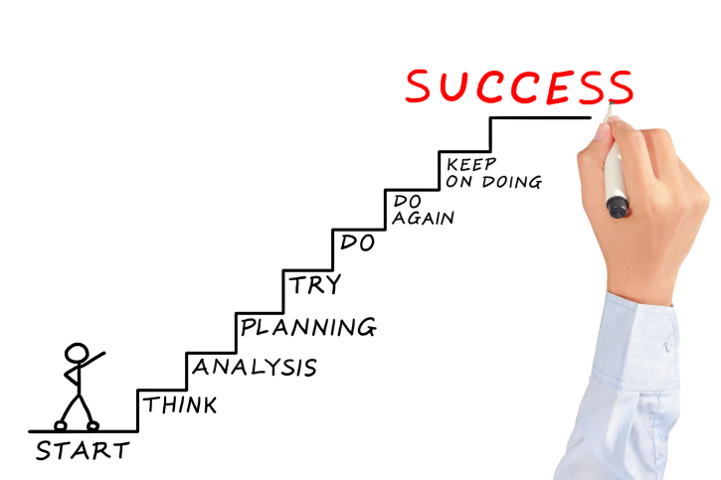

Critique your own project against learning outcomes rather than technical checklists only!
You are not being graded on reproducing a solution but on the quality of your thinking and decisions!
Peers are not parallel workers, but as part of a shared system. Shift the culture from individual performance to collective responsibility and make collaboration (not cooperation only)!
Metacognition ... why I'm thinking what I'm thinking → make the invisible visible!

Slide 4
Learning Outcomes (read the syllabus!) Ability to:
Identify, formulate, and solve complex engineering problems by applying principles of engineering, science, and mathematics.
Apply engineering design to produce solutions that meet specified needs with consideration of public health, safety, and welfare, as well as global, cultural, social, environmental, and economic factors.
Communicate effectively with a range of audiences.
Recognize ethical and professional responsibilities in engineering situations and make informed judgments, which must consider the impact of engineering solutions in global, economic, environmental, and societal contexts.
Function effectively on a team whose members together provide leadership, create a collaborative and inclusive environment, establish goals, plan tasks and meet objectives.
Develop and conduct appropriate experimentation, analyze and interpret data and use engineering judgment to draw conclusions.
Acquire and apply new knowledge as needed, using appropriate learning strategies.

Slide 5


Slide 6
Shift From Engagement to Ownership
Unmotivated students often feel done to, not in control
Make Progress Visible (small steps)
Real Stakes (welcome to the real-world! bad models, biased algorithms, broken pipelines)
Reduce Cognitive Overload (break complex tasks into structured checkpoints)
Normalize Struggle Publicly (show common mistakes)
Increase Social Accountability (you are more likely to prepare when others depend on you!)
Introduce Constructive Friction (low challenge?)
Use Structured Reflection (what is still unclear? what felt right? what strategy helped you learn?)
Address the Hidden Variables (office hours, brief 1:1 check-ins)
Remember Our Standards and Support (high expectations/standards, we want Y'ALL to succeed!)

Slide 7

Today’s Agenda
Virtual Project Showcase
Communication Activity
Customer Needs/Technical Objectives (revisions/updates)
Requirements/Engineering Actions
Systems Modeling
ABET information
Phase 2 Guidelines

Slide 8
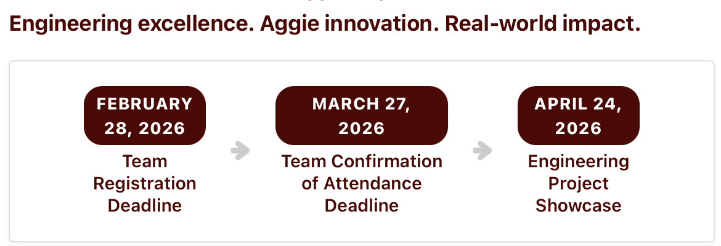
Virtual Project Showcase Registration
https://tamueps.secure-platform.com/students
Required assignment for all teams, submit proof on Canvas
Project title will identify your team in published material, ensure you get it correct!

Slide 9
Communication Activity
Communication is a Superpower

Slide 10
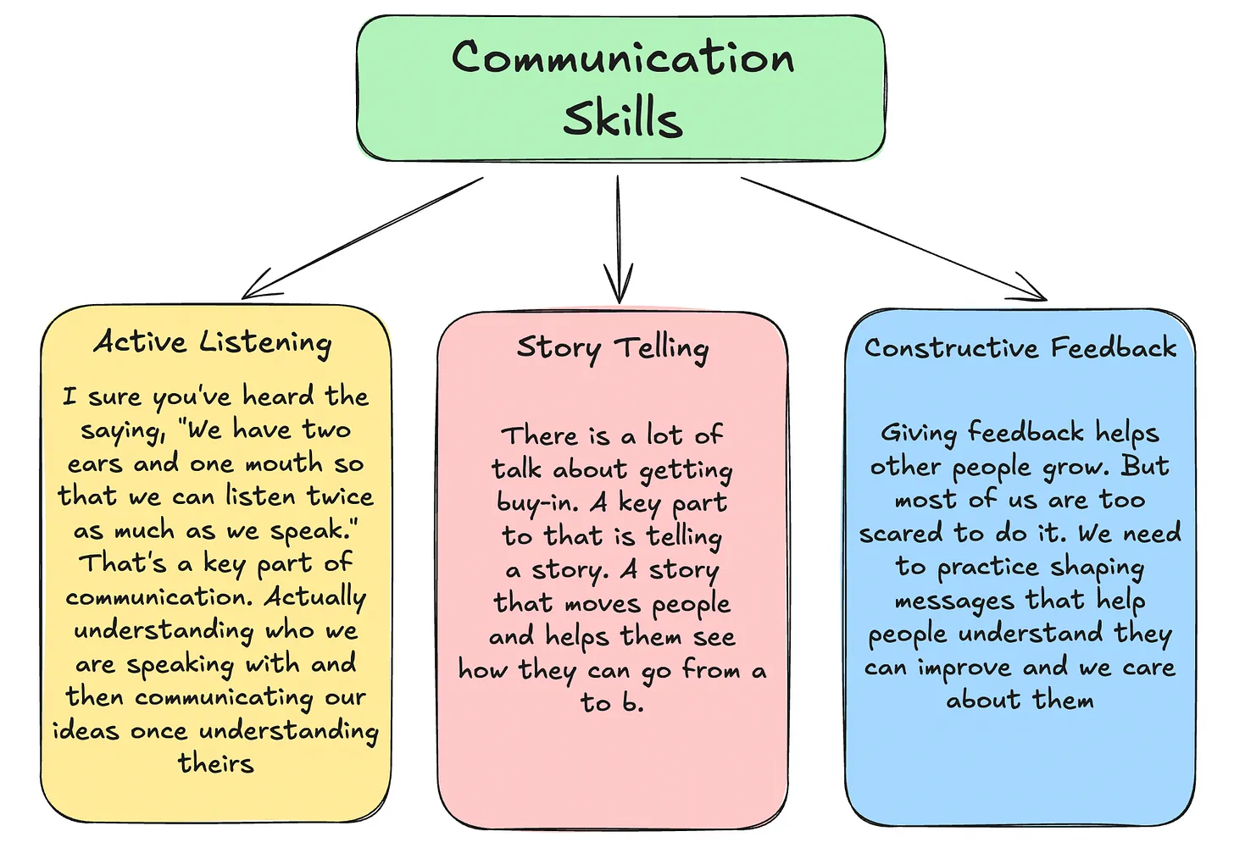
Ref.: 7 Lessons I Learned the Hard Way From 9+ Years as a Data Engineer

Slide 11
Customer Needs (Voice of the Customer)
By now you should have a least some customer needs identified
Typically, this comes from:
The project description
Discussion with the sponsor/stakeholders
Needs should not be directed towards a potential solution
Often a flaw of needs created without a thorough technical analysis

Slide 12
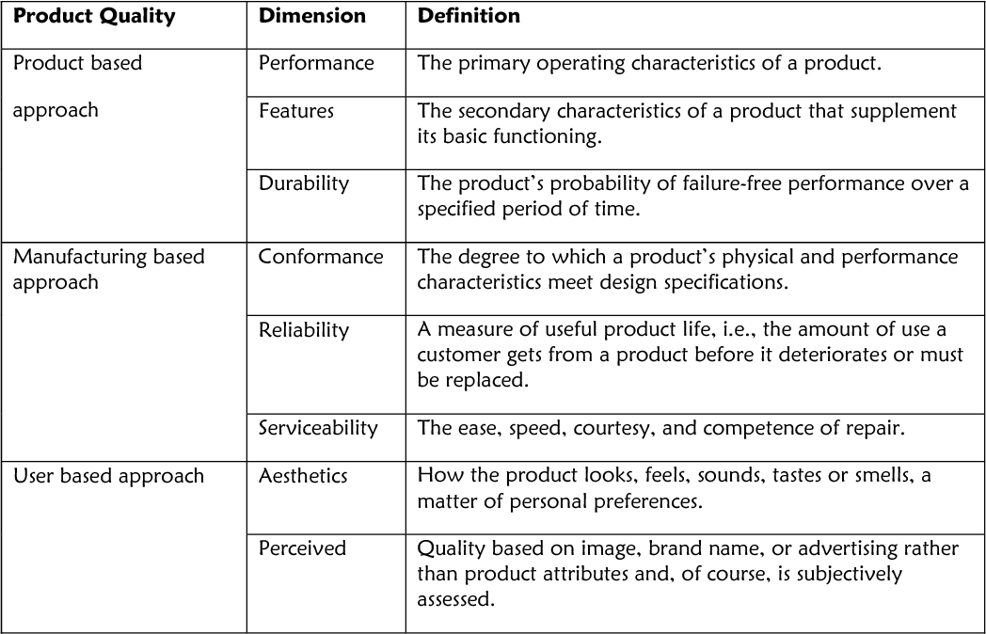
Customer Needs
Garvin's dimensions of quality can provide the framework to identify needs
As you model your "system", keep these important quality dimensions in mind to identify additional needs

Slide 13
Requirements (Voice of the Engineer)
Aka Engineering Characteristics
Requirements are objective/testable/measurable
Precise, clear, concise: "The system shall…"
Should address one or more (typically) of the customer needs
Should be developed after a good representation and analysis of the problem!
Demonstrate how data engineering moves from vague stakeholder expectations ("fast, accurate, reliable data") to clear, testable, operational requirements tied to infrastructure, product characteristics, and process controls
Input / Process / Output (I/P/O)

Slide 14
Requirements Example
I/P/O: There exists a need for reliable, high-quality data to support near real-time business decisions
Performance
What does "near real-time" mean?
< 1 minute latency?
5 minutes?
Hourly refresh?
Quality
What constitutes "high-quality data"?
Completeness?
Accuracy?
Consistency across systems?
Schema stability?

Slide 15
Requirements Example Cont.
I/P/O: There exists a need for reliable, high-quality data to support near real-time business decisions
Usability
Can analysts easily access the data?
Is it queryable without specialized engineering support?
Are business definitions standardized?
Safety / Governance
Is sensitive data protected?
Are regulatory requirements met (PII handling, auditability)?
Cost
Comparable to existing cloud/data warehouse budgets
Competitive storage and compute utilization
Avoid unnecessary duplication of datasets

Slide 16
Requirements Example Cont. ...
We generate a candidate set of customer needs: statements, which if addressed by the "product" would resolve the I/P/O
Interviews and investigation; leveraging Garvin's dimensions
Requirements are then developed from the needs; precise, clear, concise, testable, measurable
Data should be available within N minutes of source system update
Data should be at least 99% complete
Critical business metrics should be consistent across dashboards
Data pipelines should not fail silently
Users should not require engineering intervention to access curated datasets
Sensitive fields should not be exposed to unauthorized users
Data refresh schedules should be transparent and visible

Slide 17
Requirements are then developed from the needs: precise, clear, concise, testable, measurable
Using the need as an organizing device for the requires:
Data should be available within N minutes
Product
End-to-end pipeline latency ≤ 5 min (source commit to warehouse avail.)
95th percentile latency ≤ 7 minutes
Infrastructure
Streaming ingestion supports ≥ 10,000 events/sec
Data warehouse auto-scales to maintain query latency ≤ 3 seconds for standard BI workloads
Process
Monitoring alerts triggered if latency exceeds SLA (Service Level Agreement) for > 2 consecutive intervals
Incident response time ≤ 15 minutes

Slide 18
Requirements are then developed from the needs: precise, clear, concise, testable, measurable
Using the need as an organizing device for the requires:
Data should be accurate and complete
Product
Record completeness ≥ 99.5% per batch / Ref. integrity violations ≤ 0.1%
Schema validation enforced at ingestion
Infrastructure
Automated data quality checks executed on every load
Failed quality checks block downstream publication
Process
Daily reconciliation against source system totals
Root cause analysis completed within 1 business day for quality breaches

Slide 19
Requirements are then developed from the needs: precise, clear, concise, testable, measurable
Using the need as an organizing device for the requires:
Data should be secure
Product
Role-based access control enforced at dataset and column level
PII fields encrypted at rest and in transit
Infrastructure
Access logs retained for ≥ 365 days
Audit events queryable within 24 hours
Process
Quarterly access review
Automated removal of inactive accounts after 30 days

Slide 20
Requirements are then developed from the needs: precise, clear, concise, testable, measurable
Using the need as an organizing device for the requires:
Data platform should be cost-effective
Product
Storage cost per TB ≤ defined cloud budget threshold
Compute utilization ≥ 70% during peak workload windows
Infrastructure
Automatic suspension of idle clusters after 5 minutes
Lifecycle policies archive cold data after 180 days
Process
Monthly cost variance report delivered to stakeholders
Optimization review conducted quarterly

Slide 21
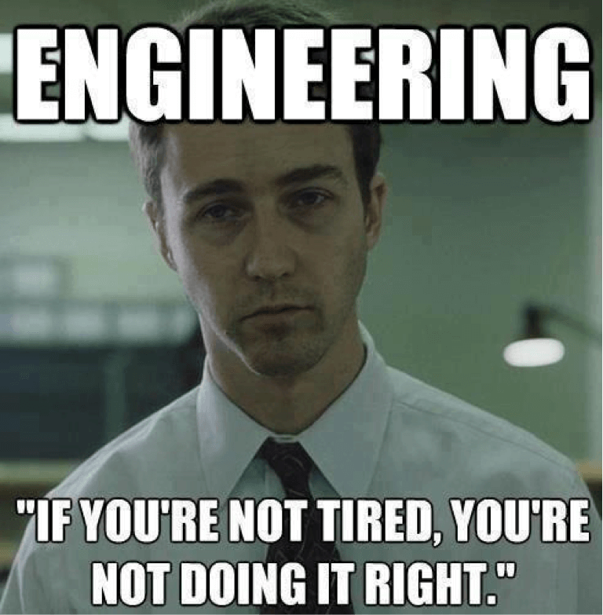
Engineering Actions
Recall "The Plan"
This is where you start refining the plan
What additional information is needed
What needs to be done
By whom
By when
What determines when the action is complete

Slide 22
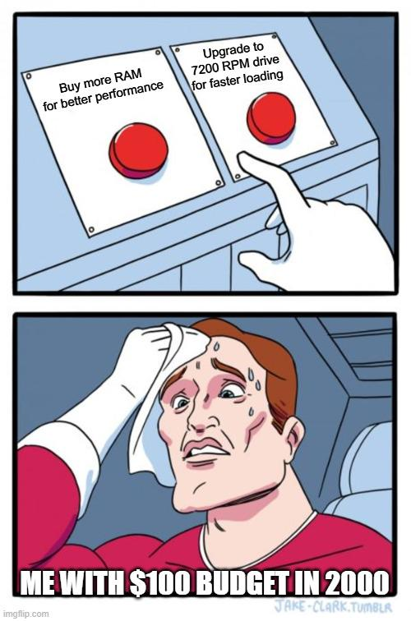
Constraints
Projects are subject to constraints
They can be
Time
Financial
Resources (personnel and/or facilities)
Safety
Other
Note: The semester should not be listed as a constraint for your project. Specific time constraints related to your sponsor might be identified, but the semester schedule creates deadlines, not constraints.

Slide 23
Codes, Standards, and Specifications
Codes
A code is a set of rules for performing some task, as in the local city building code or fire code.
Standards
A standard is less prescriptive and can be defined as a set of technical definitions and guidelines.
Specification
A specification describes how a system should work, and is usually much more specific and detailed than a standard, but sometimes it is difficult to differentiate between documents that are called standards and those called specifications.

Slide 24
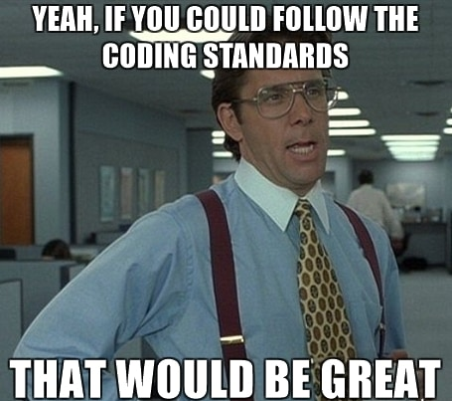
Where do you find applicable codes/standards?
Your project sponsor should know specific codes/standards applicable to their systems and processes
Your faculty advisor may be able to suggest codes that might apply
Engineering standards bodies and organizations might have applicable codes

Slide 25
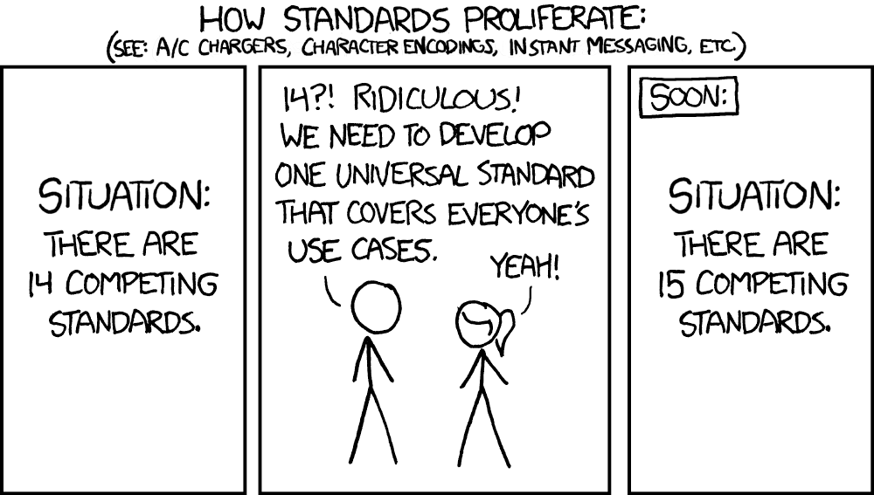
ANSI, NIST, ASTM, ASME, ISO
The American National Standards Institute (ANSI) is the coordinating organization for the voluntary standards system for the United States (www.ansi.org)
The standards responsibility of the U.S. government is carried out by the National Institute for Standards and Technology (NIST)
ASTM International is the major organization that prepares standards in the field of materials and product systems
The ASME prepares the well-known Boiler and Pressure Vessel Code that is incorporated into the laws of most states
ISO is the international organization for standardization (www.iso.org)

Slide 26
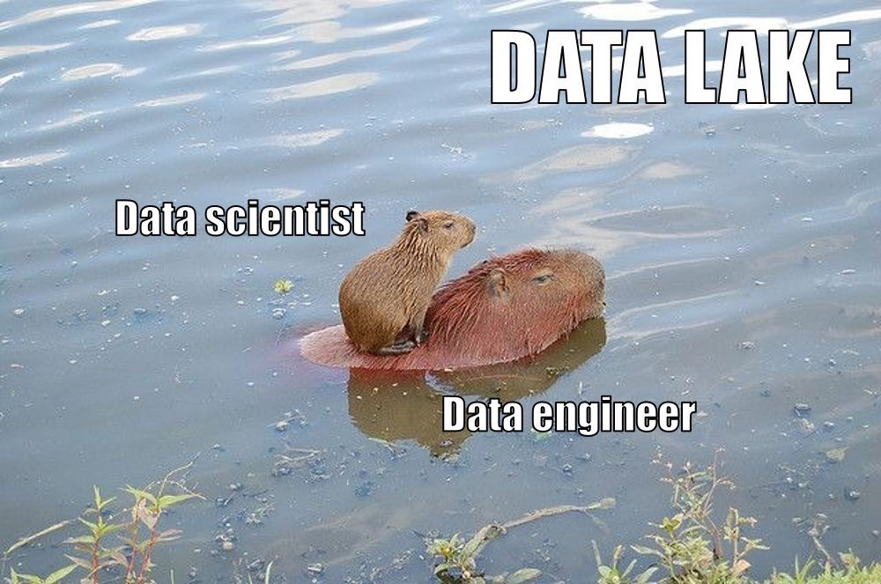
Resources for Requirements and Actions
Resources are provided on Canvas to assist with requirements and actions:
MIT Requirements Definition Presentation
ISEN Requirements and Actions for Research Projects

Slide 27
Systems Modeling
System modeling is the process of creating abstract representations of real-world systems to understand, analyze, design, or improve them.
Instead of working directly with the full complexity of reality, we build structured models that capture the system's key components, relationships, inputs, outputs, and behaviors.
A system can be physical (e.g., a manufacturing plant), informational (e.g., a database pipeline), organizational (e.g., a supply chain), or computational (e.g., a distributed software architecture).

Slide 28
Systems Modeling
At its core, system modeling is about disciplined abstraction: capturing what matters most so we can reason rigorously about complex systems!
Common approaches include conceptual, mathematical, simulation, and data-driven models, each simplifying a system through diagrams (such as graphs or block diagrams), mathematical equations (such as differential equations), simulations, or logical structures.
Check examples: https://en.wikipedia.org/wiki/Systems_modeling

Slide 29
System Modeling helps to:
Clarify how parts of a system interact
Predict behavior under different conditions
Identify bottlenecks or failure points
Compare alternative designs before implementation
Support optimization and decision-making

Slide 30
→ Please review the slides from the 5th/6th week of last semester! link here

Slide 31
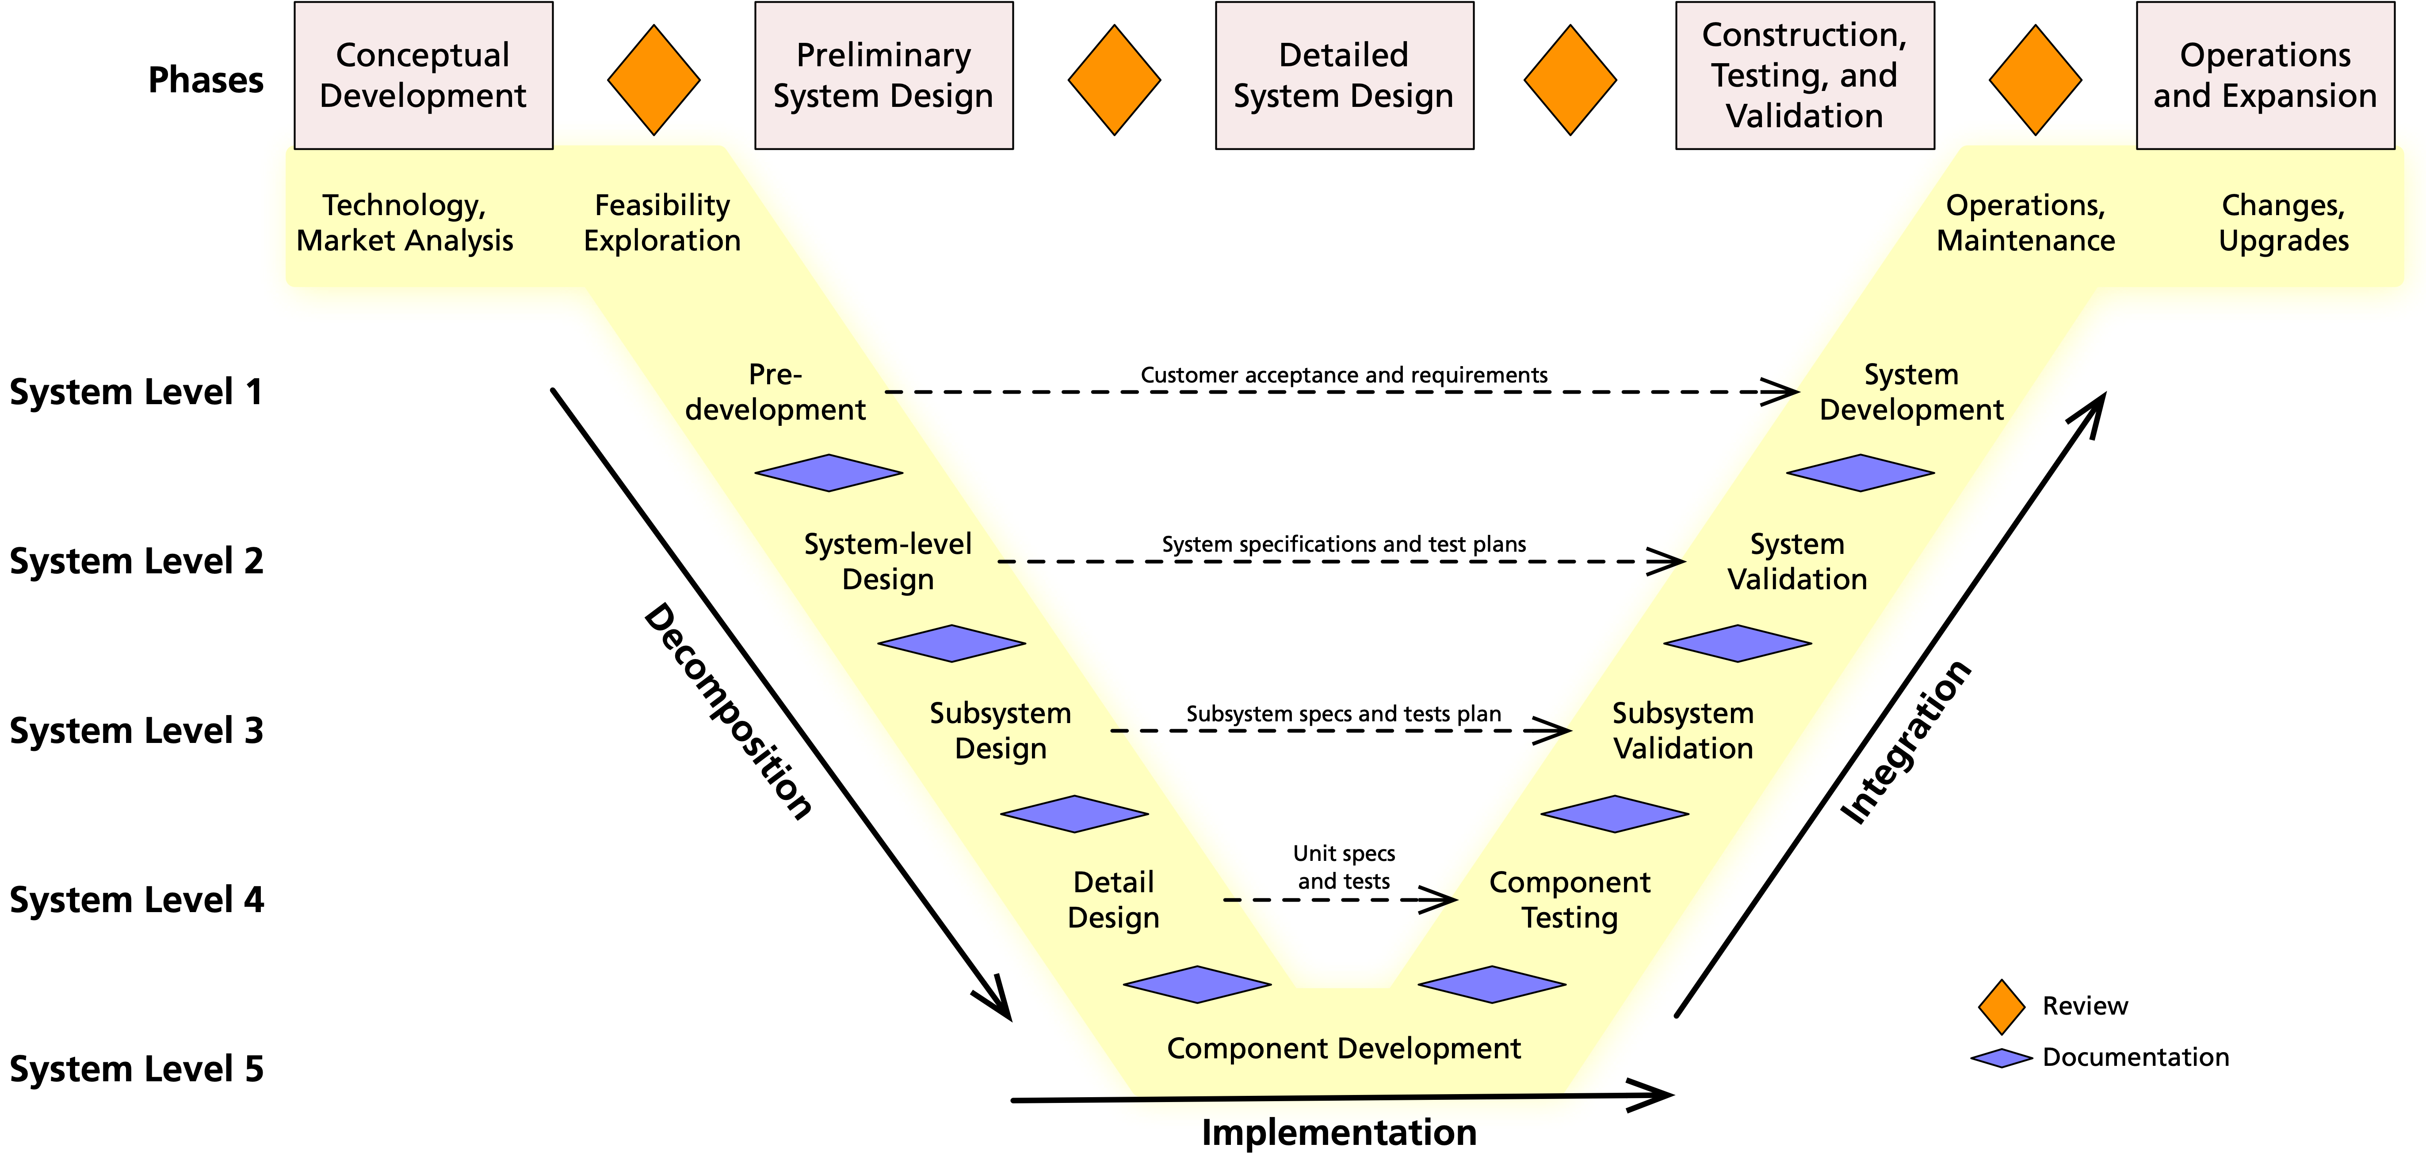

Slide 32
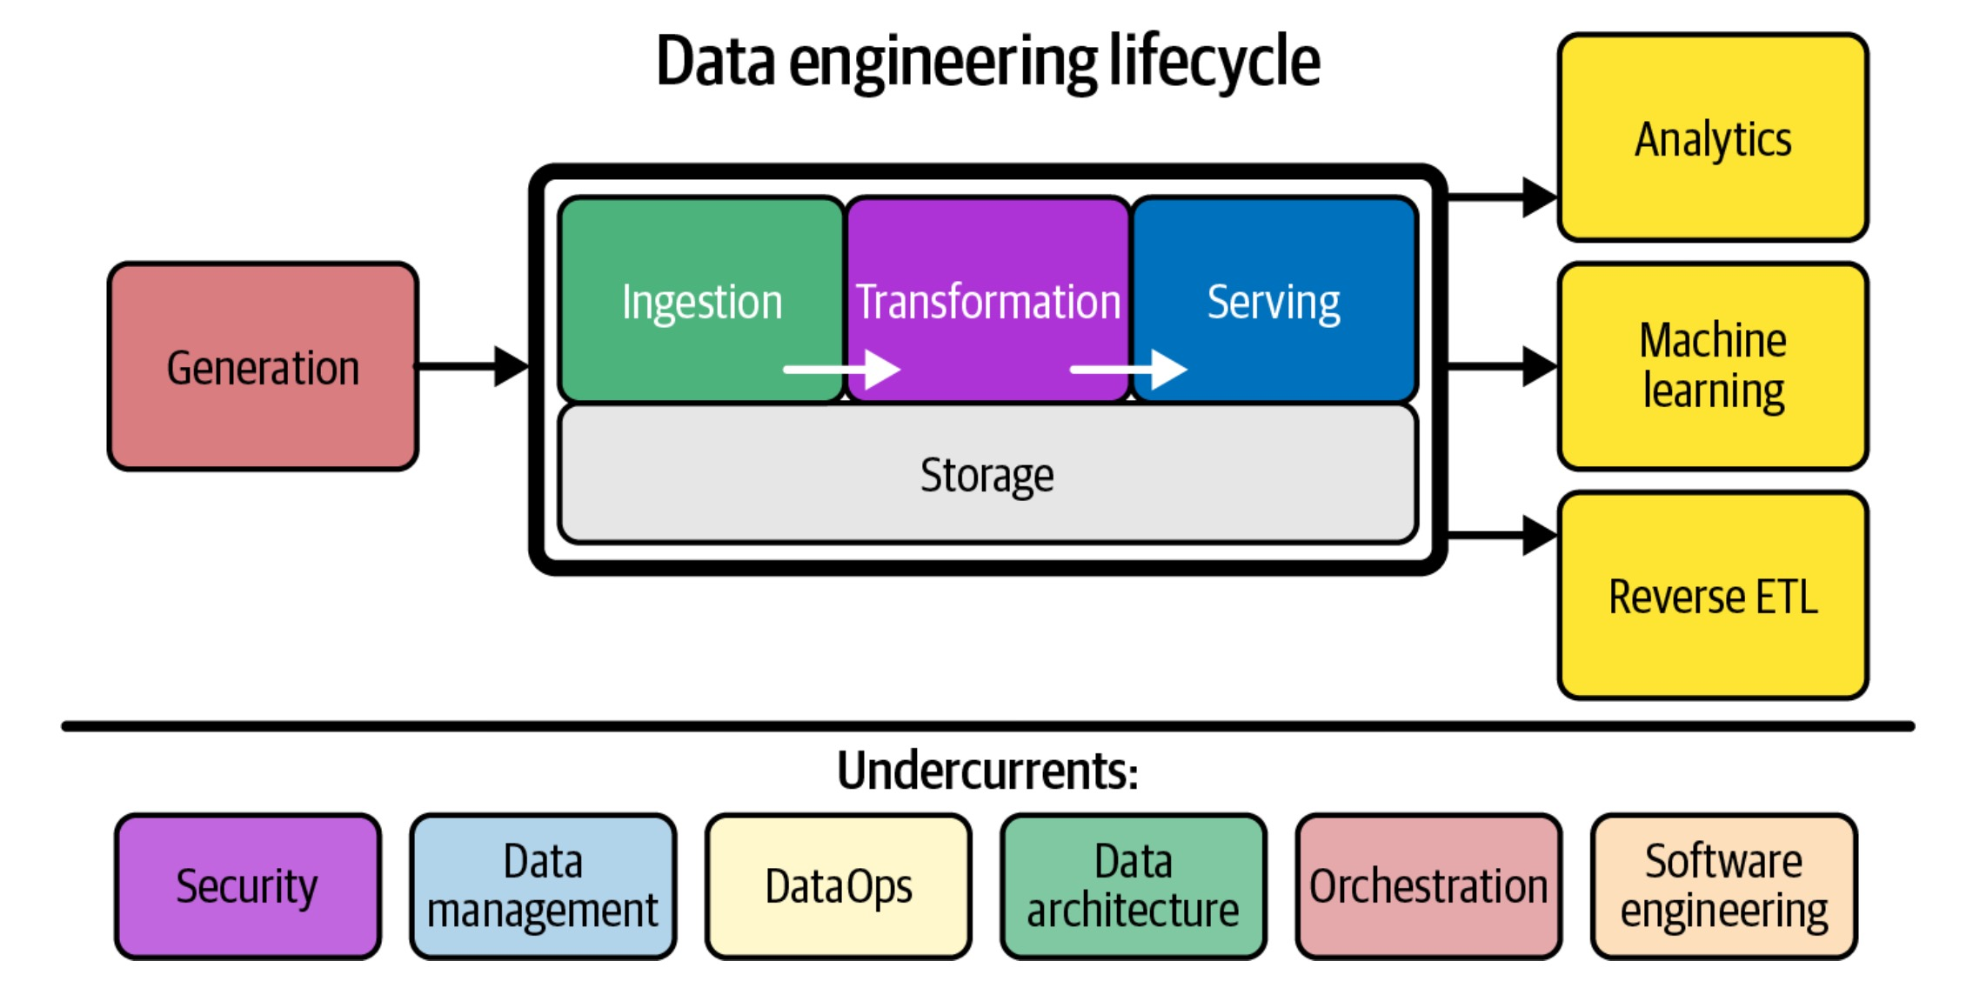

Slide 33
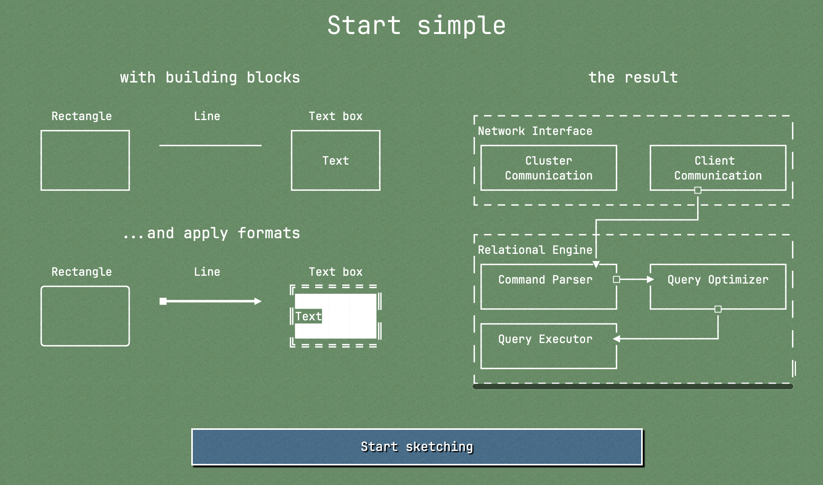
MonoSketch

Slide 34
ABET Accreditation and Student Outcomes
ABET reviews the ISEN programs
Demonstration of meeting established criteria must be documented
Criterion 3, Student Outcomes describes the expectations for students in and graduating
Criterion 5, Curriculum requires a culminating major engineering design experience that:
Incorporates appropriate engineering standards and multiple constraints
Is based on the knowledge and skills acquired in earlier course work
DAEN 460 is a primary course used for evaluation
ABET is an important component of the value of your degree!

Slide 35
Documentation of Student Outcomes
As part of your final report deliverables, your team will be expected to complete a questionnaire about student outcomes → SLIDE 4 in this presentation!
You will reference and link to sections of the report that meet the expected outcomes
All outcomes need to be addressed (although some specific questions on the form may not be applicable)

Slide 36
Phase 2 Guidelines
On Canvas

Slide 37
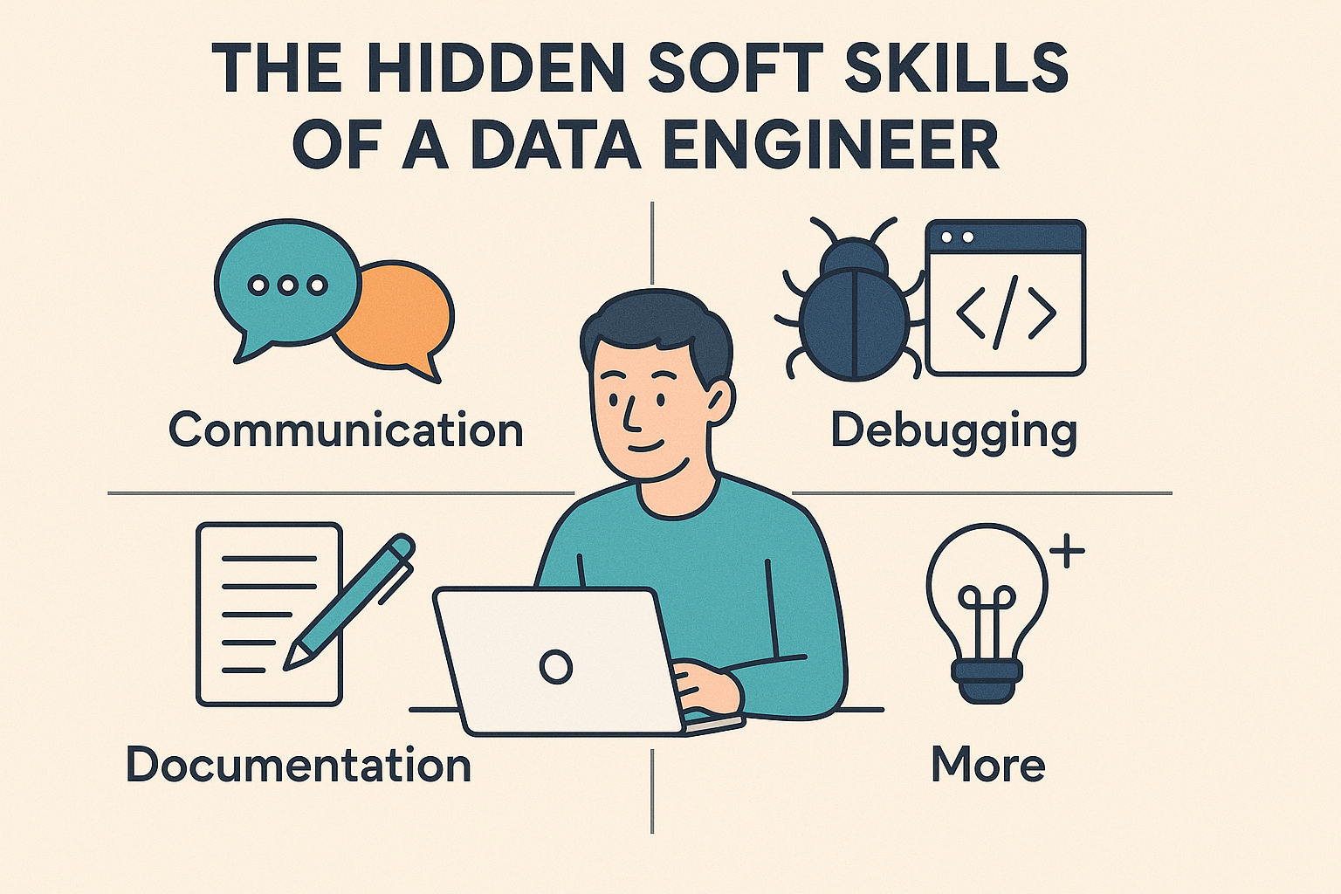
Nice reading: https://medium.com/@VijayRodrigues18/the-hidden-soft-skills-of-a-data-engineer-communication-debugging-documentation-and-more-25210d64e265

