Slide 1
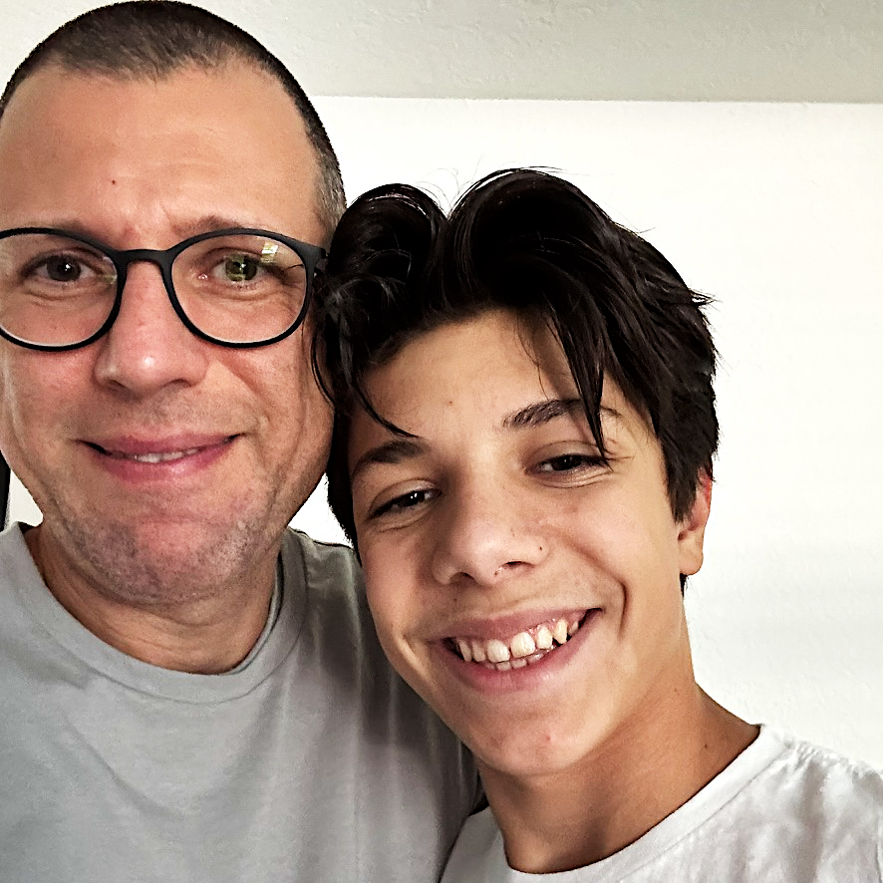
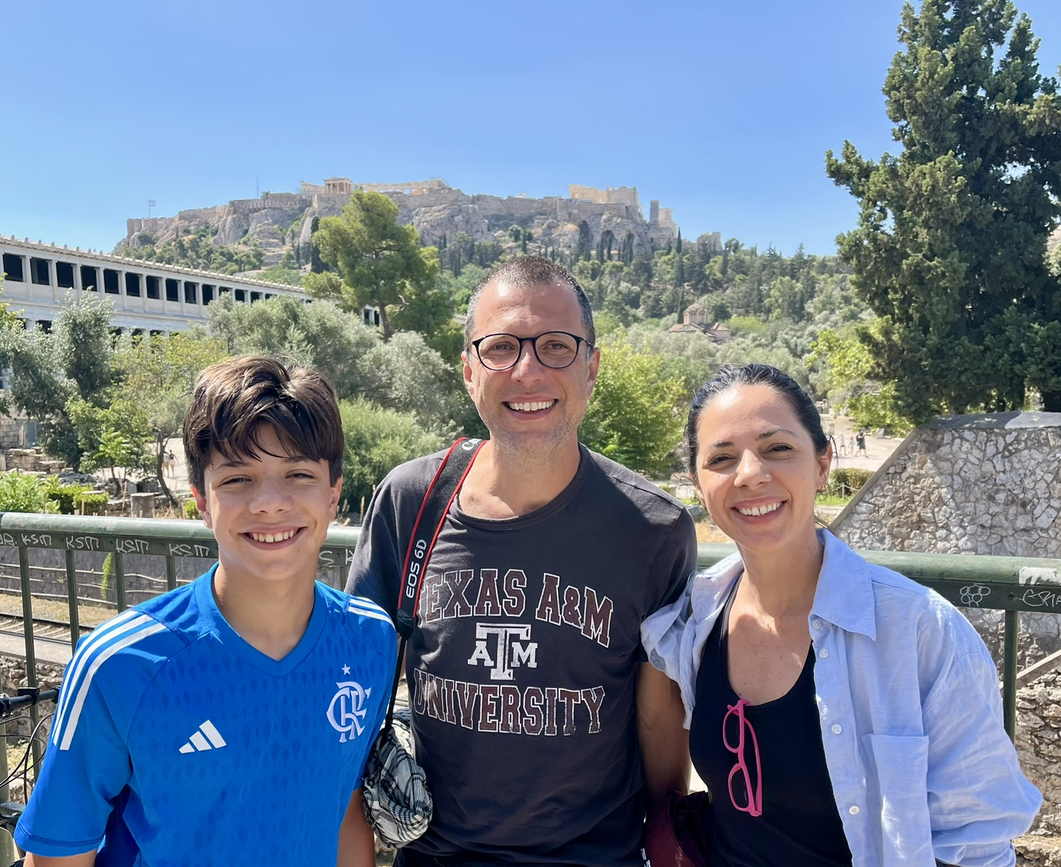
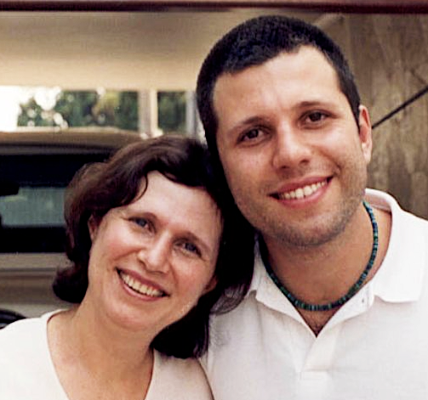
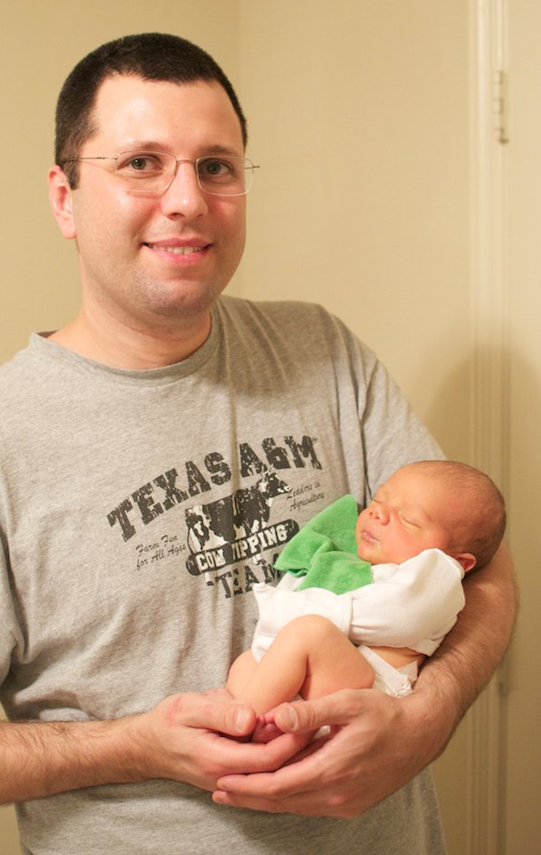
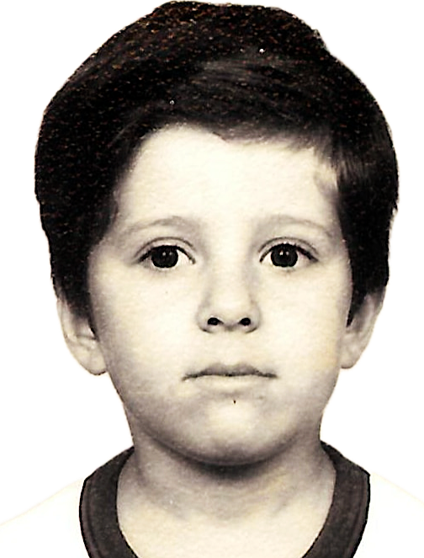
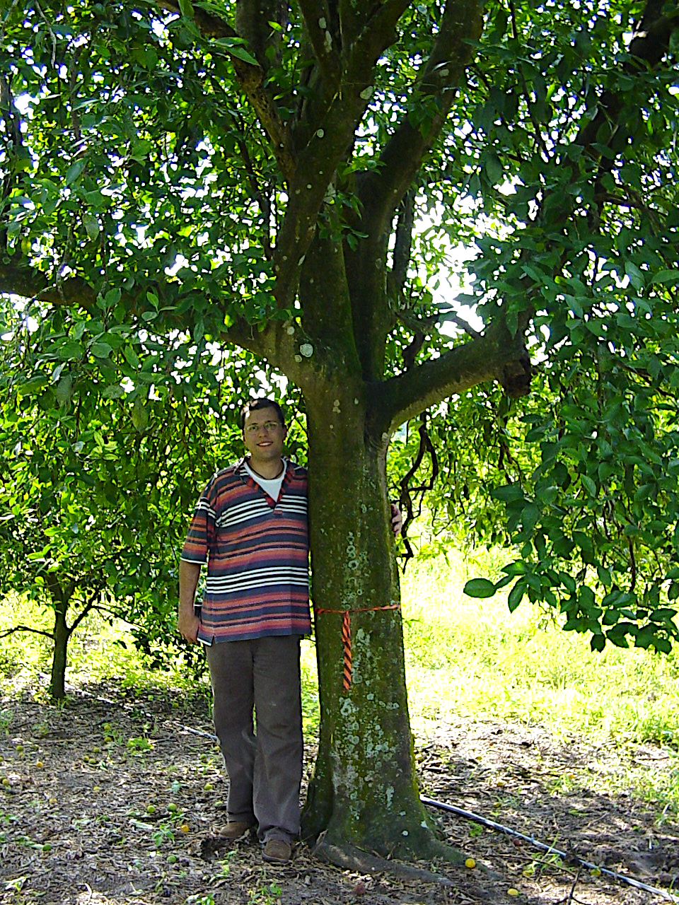
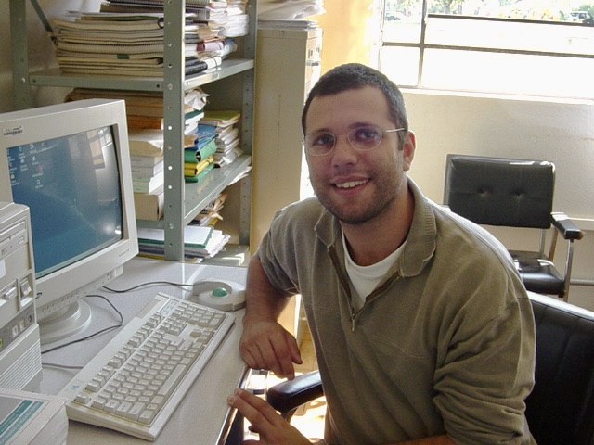
finish a marathon (why not)
prepare/publish my textbook become a fantastic professor
see my son grow up
Instructional Assistant Professor, faculty senator. 2024
postdoc TAMU/NIST Risk Community Planning 2002-2023
PhD in Urban and Regional Science. 2022
start teaching research methods, statistics, and GIS. 2017
start working with hurricane evacuation studies, 2015
move to College Station, 2007
master in Industrial Production Engineering. 2006
work with forecast models and logistics. 2002-2005
graduate in Civil Engineering. 2001
born in Rio, 1976
Notes:
personal journey
- love happens
- home

Slide 2
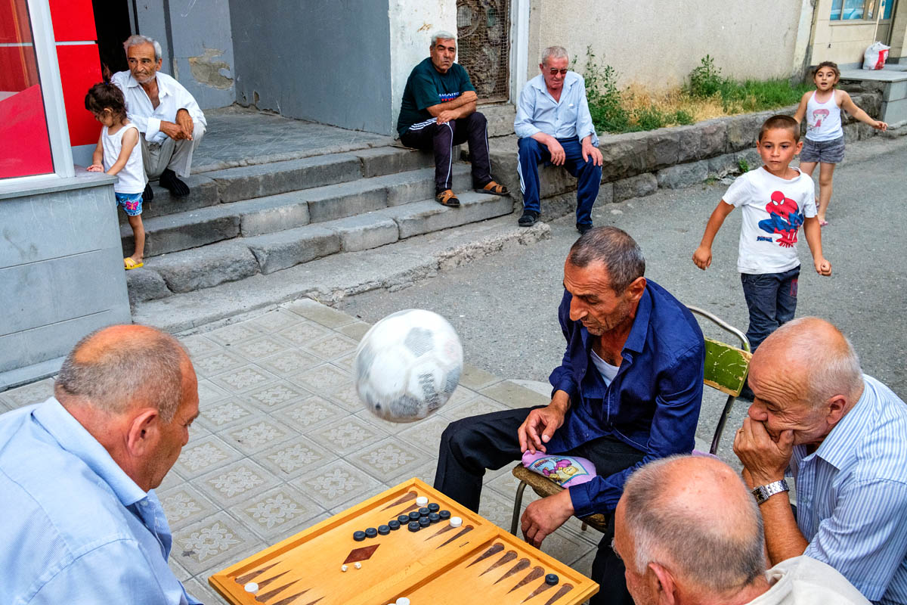
Street Games, Echmiadzin, Armenia Maciej Dakowicz 2017.07.06

Slide 3
PARADIGMS
assumptions, concepts, values, and practices
THINKING
INTRIGUING
PROBABILITIES
STORIES, GENERATIONS
GAMES
By interpreting data from different perspectives, we transform mere information into wisdom, allowing us to model the future with clarity and intention.
Street Games, Echmiadzin, Armenia Maciej Dakowicz 2017.07.06

Slide 4
why not problem-solving?
in lists of key employability skills, problem solving usually appears at the top ^{(that makes sense)}
what is the difference between problem-solving and problem-structuring?
the key to answering this question is not in a protracted wrangle about the differences but in examining the nature of problems
problem-structuring involves defining, organizing, and clarifying a problem before attempting to solve it, ensuring a more effective resolution

Slide 5
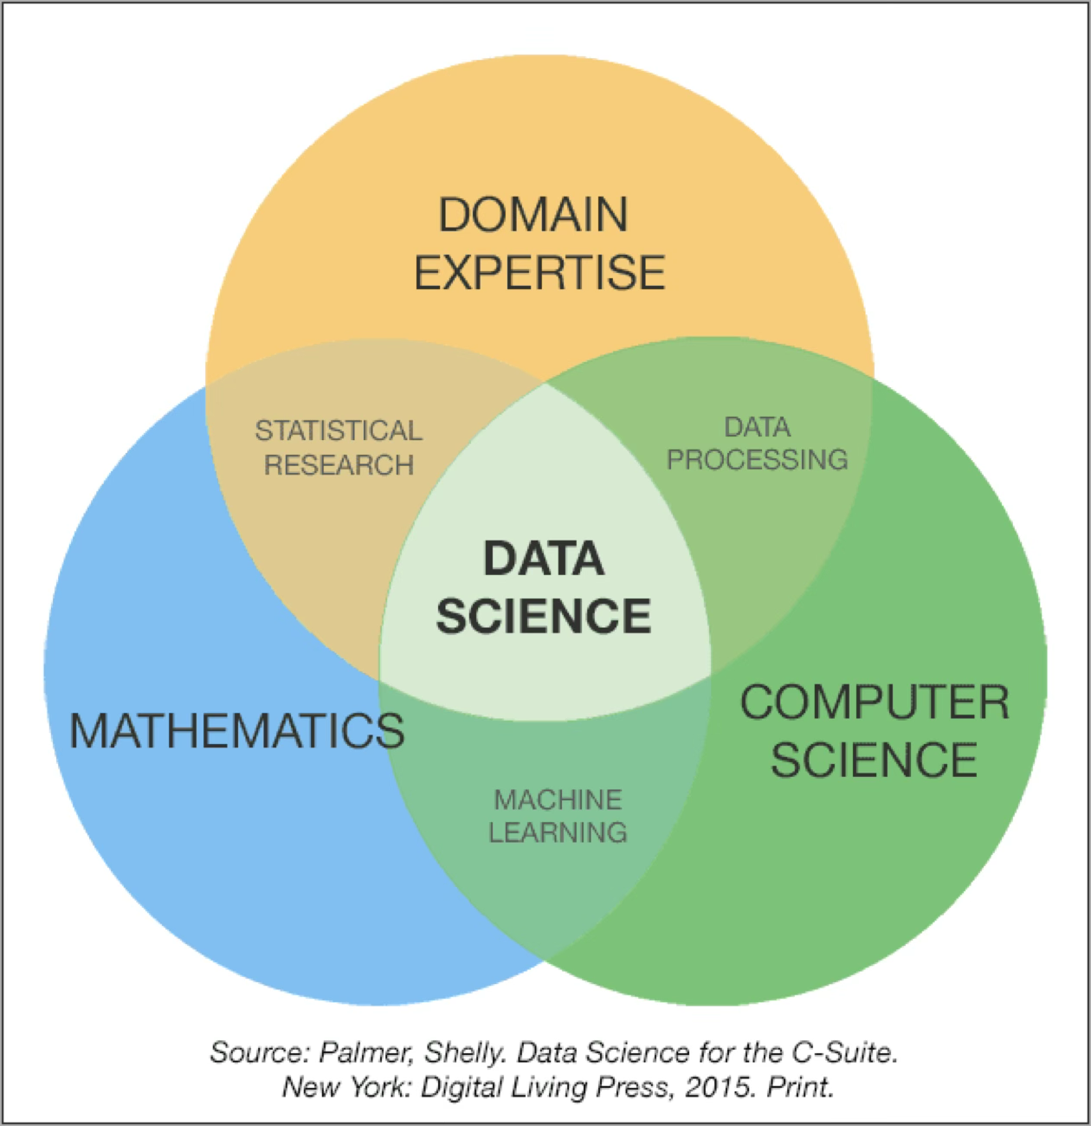
am i making you data engineer?

Slide 6
