Slide 1

Geographic Data and Spatial ETL
Attribute Operations, Pre-processing, Workflows
Alexander Abuabara
DAEN 489 ISEN 489 Spring 2026

Slide 2
Plan for Today
Previously
Attribute Data in Spatial ETL
Intro to Thematic Maps
Vector Attribute Operations
Raster Attribute Operations
Pre-Processing Workflows in Spatial ETL
Questions to Practice
Assignment #2

Slide 3
Previously
Spatial Data Models
Vector vs Raster
Coordinate reference systems (CRS)
Spatial Objects
sf objects: geometry + attributes
terra rasters: value grids with implicit spatial metadata

Slide 4
Spatial Data Models
Vector
Points, Lines, Polygons
Discrete features with attributes
sf package
Raster
Grid cells with values
Continuous surfaces
terra package

Slide 5
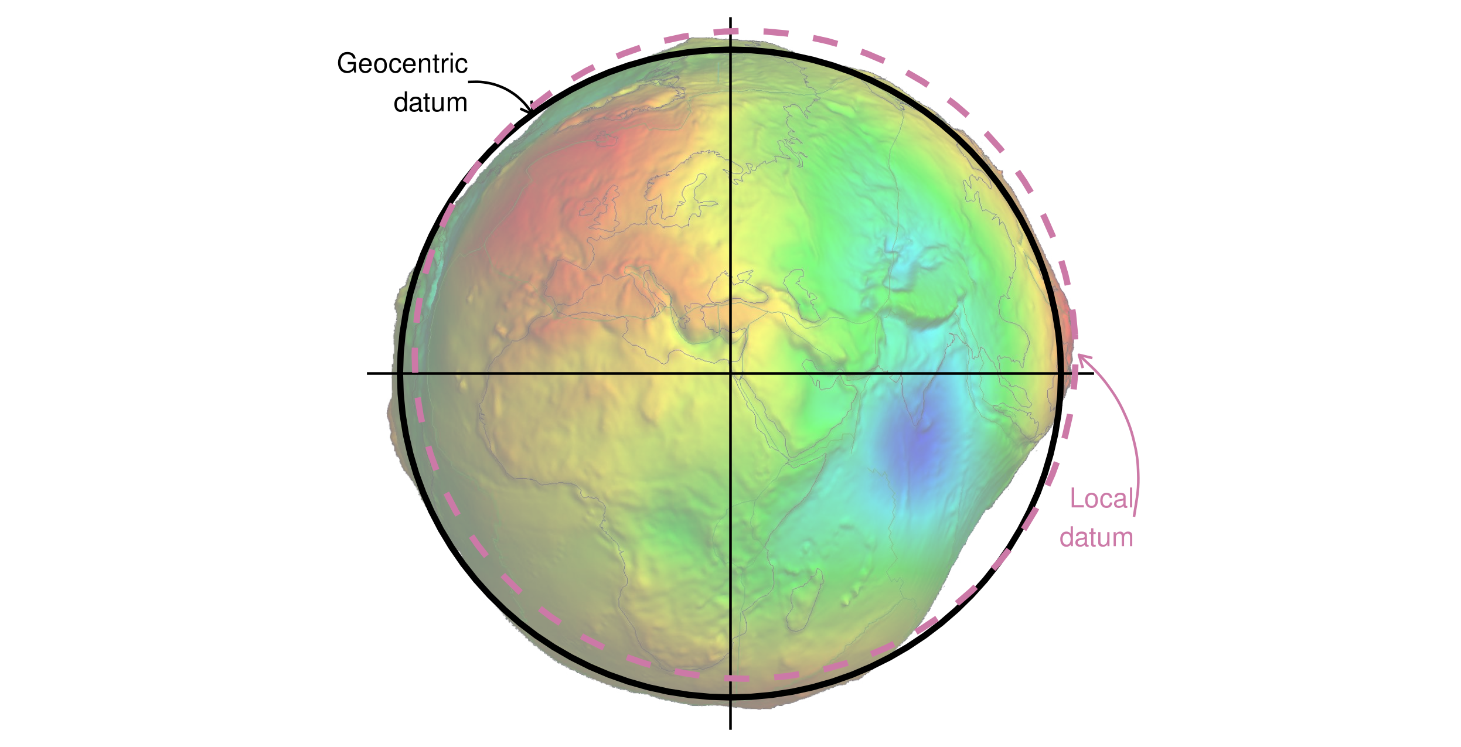
Coordinate Reference Systems (CRS)
Geocentric and local geodetic datums shown on top of a geoid (in false color and the vertical exaggeration by 10,000 scale factor). Image of the geoid is adapted from the work of Ince et al. (2019).

Slide 6
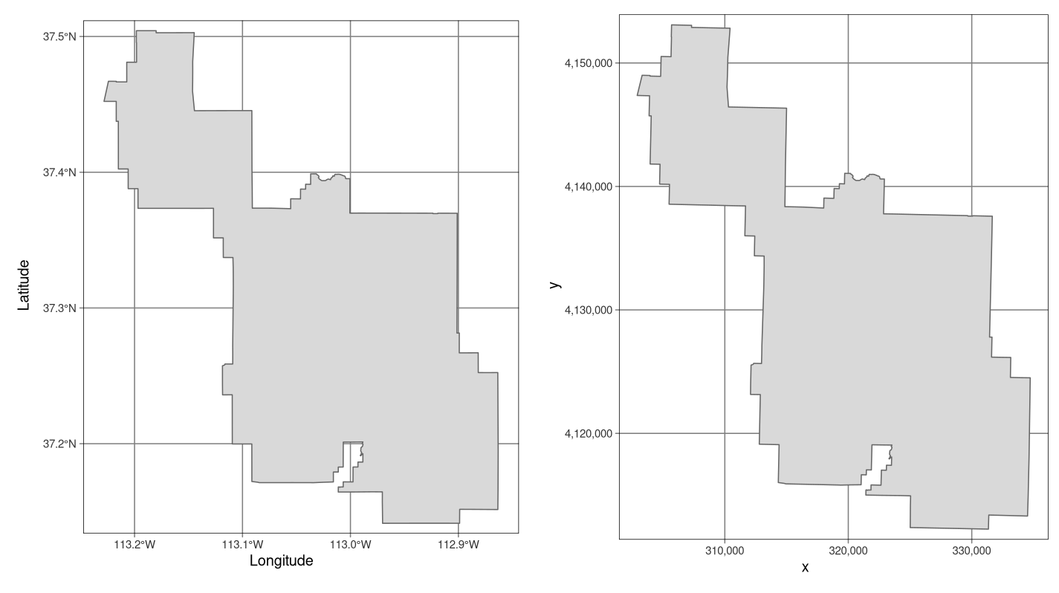
CRS Example
Examples of geographic (WGS 84; left) and projected (NAD83 / UTM zone 12N; right) coordinate systems for a vector data type.

Slide 7
Some Essential R Packages
dplyr
Pipe operators (%>%)
filter(), select(), mutate()
group_by(), summarize()
Works with sf objects
sf
Vector data handling
Integrates with tidyverse
Sticky geometry column
Fast spatial operations
spData
Datasets for Spatial Analysis
units
sf objects have native support for units
terra
Raster data handling
Fast computation
Multi-layer support
Memory efficient

Slide 8
Features and Attribute Data
Features are real world things such as roads, property boundaries, sites and so on
A feature has a:
Geometry (which determines if it is a point, polyline or polygon)
Attributes (which describe the feature)
Feature
Geometry
Attributes
Point
Polyline
Polygon

Slide 9
Attribute Data
What are attributes?
Non-spatial data combined with spatial features (Examples: bus stop name, population count, elevation value, land use category)
Difference between geometry and attribute data
Geometry data defines the spatial location and shape of features using coordinates, answering “where” an object is
Attribute data describes the non-spatial, qualitative, or quantitative characteristics of those features, such as names, types, or values, answering “what” the object is
They are linked by unique identifiers in GIS

Slide 10
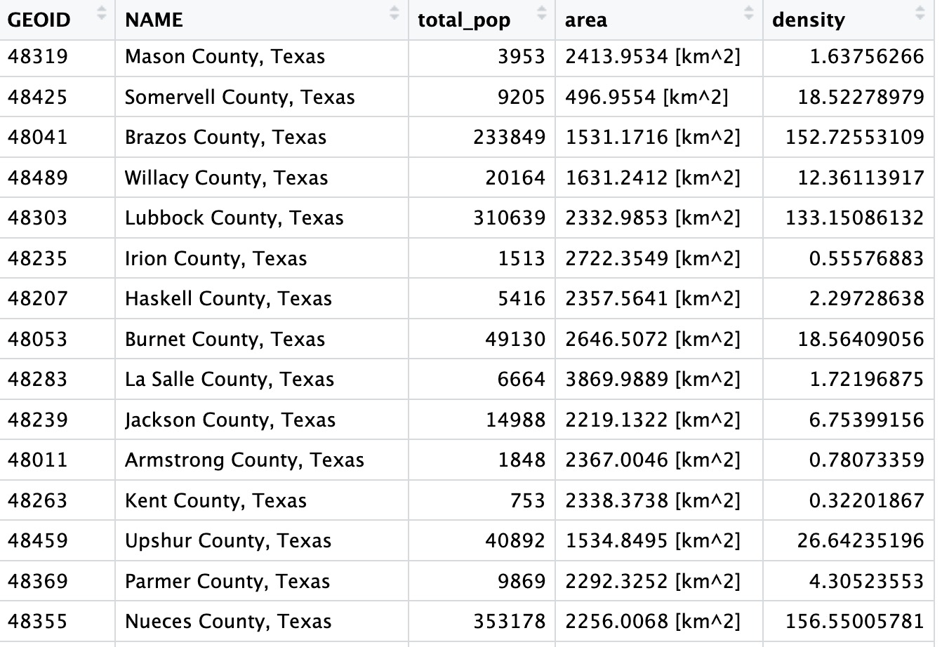
Attribute Table
Attribute
Record

Slide 11
Attribute Data; Extract, Transform, Load
Why attribute operations are central to ETL
Essential for filtering, merging, aggregating, and reshaping datasets
Direct impact on analytics outcomes

Slide 12
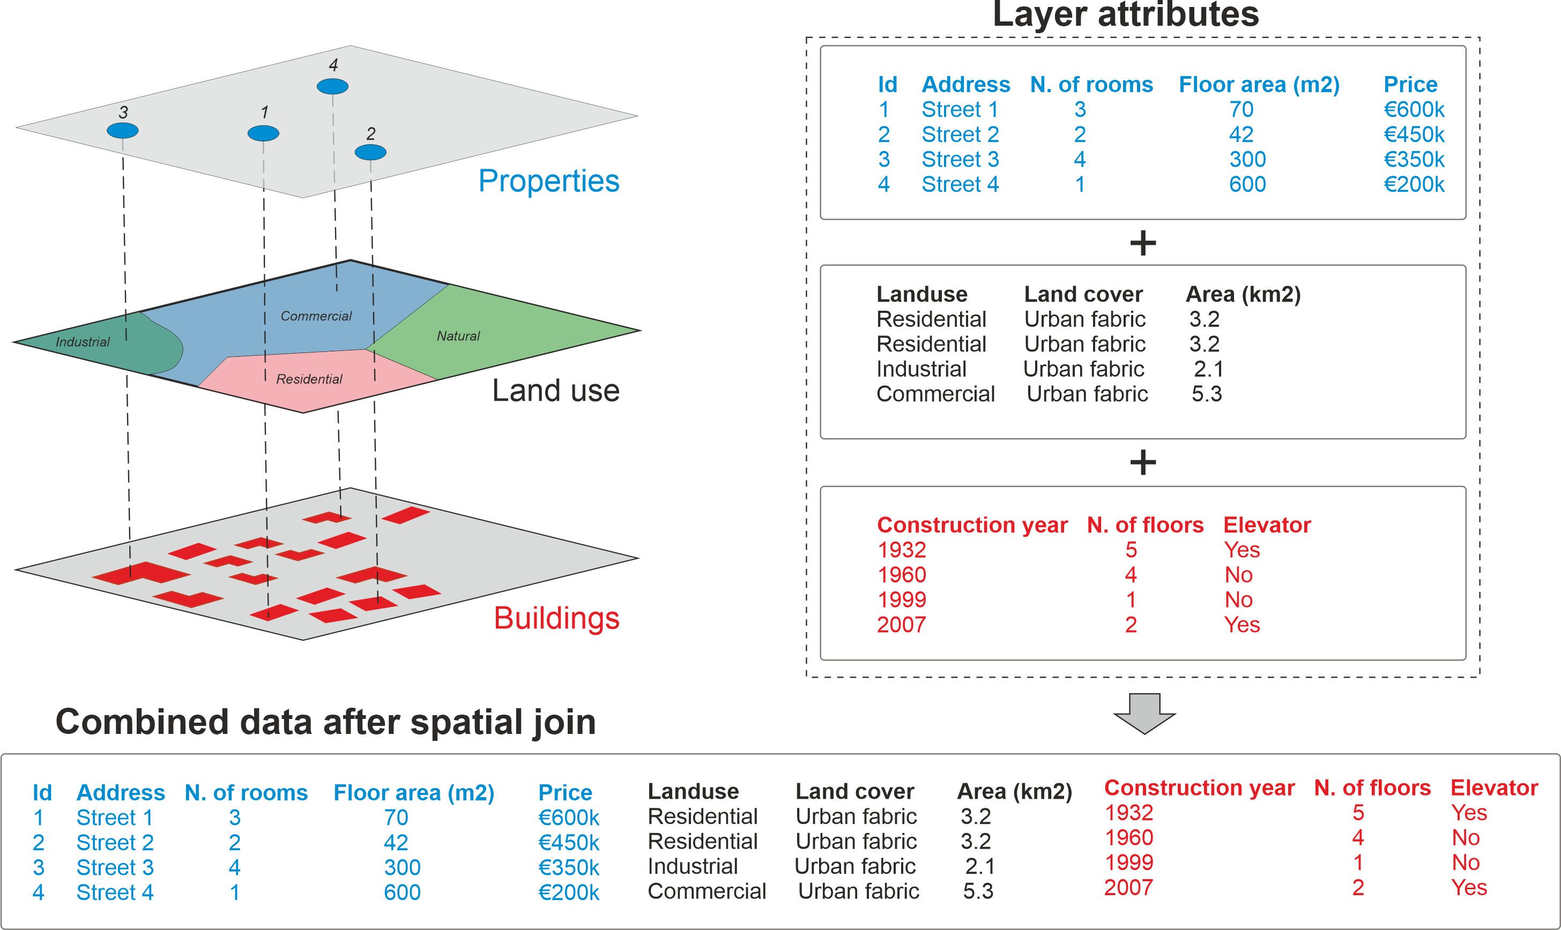
Attribute Data Workflow

Slide 13
Statistical Maps & Thematic Mapping
A thematic map is used to show spatial patterns
Data is aggregated by predefined spatial units (e.g., countries, states, districts)
Thematic maps include types such as choropleth, dot density, proportional symbol, and isopleth maps
They display the spatial distribution of one or more data themes across selected geographic areas
Data can be:
Quantitative (e.g., population change, income levels)
Qualitative (e.g., soil types, land use)
To create a vector thematic map, select the attribute field in the map layer that represents the data to be mapped

Slide 14
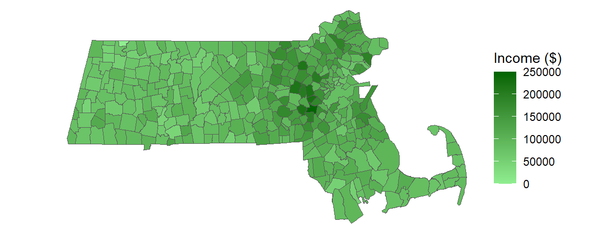
Distribution Maps
Example of a continuous color scheme applied to a choropleth map
Such a map^{(continuous)} may not be as informative as one would like it to be
In statistics, we seek to reduce large sets of continuous values to discrete entities to help us better “handle” the data

Slide 15
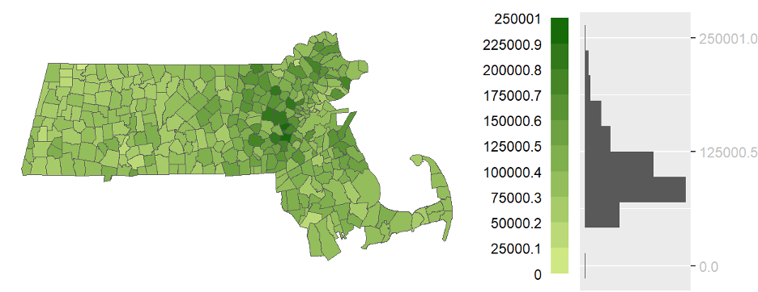
Equal Interval
An equal interval choropleth map using 10 bins
In the field of statistics, discretization of values can take on the form of a histogram where values are assigned to one of several equal width bins
A choropleth map classification equivalent is the equal interval classification scheme

Slide 16
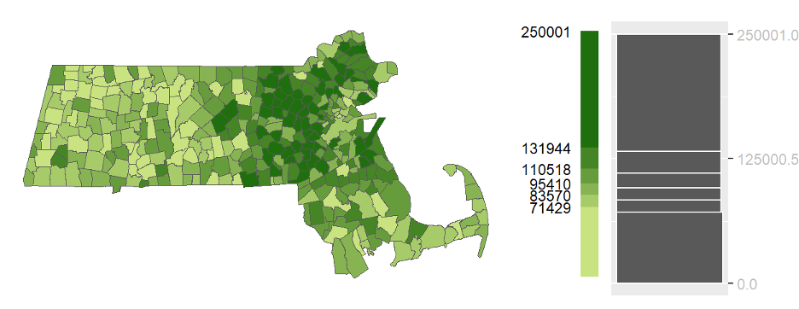
Quantile Map
While an equal interval map benefits from its intuitiveness, it may not be well suited for data that are not uniformly distributed across their range
Quantiles define ranges of values that have equal number of observations
Six quantiles with each quantile representing the same number of observations

Slide 17
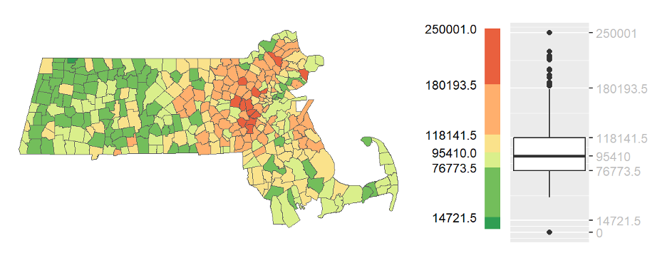
Boxplot Map
The discretization of continuous values can also include measures of centrality (e.g., the mean and the median) and measures of spread (e.g., standard deviation units) with the goal of understanding the nature of the distribution such as its shape (e.g., symmetrical, skewed, normal) and range

Slide 18
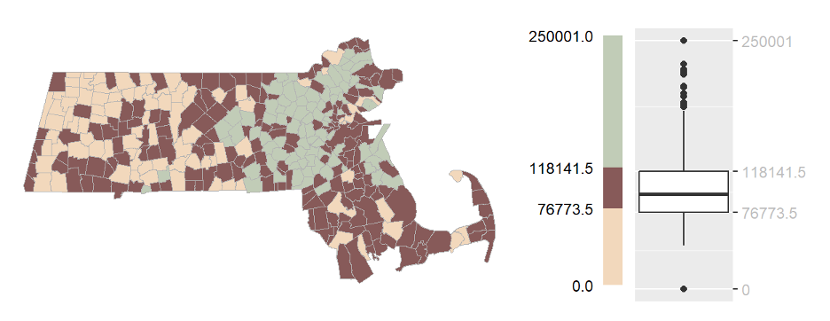
IQR Map
The IQR map is a reduction of the boxplot map whereby we reduce the classes to just three: the interquartile range (IQR) and the upper and lower extremes

Slide 19
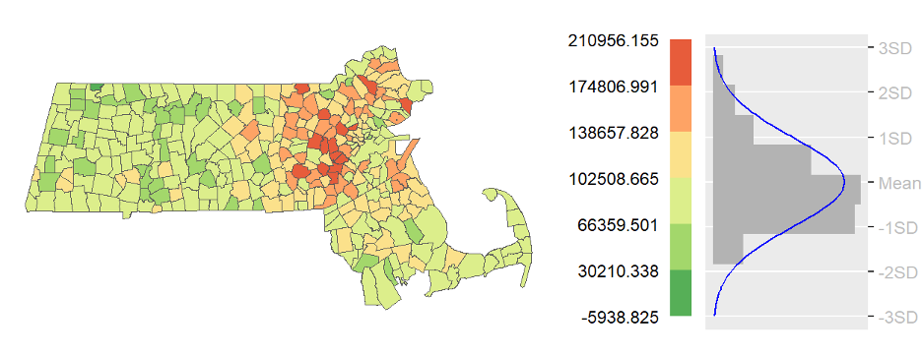
Standard Deviation Map
Note from the figure that the income data do not follow a normal distribution exactly; they have a slight skew toward higher values
This results in more polygons being assigned higher class breaks than lower ones

Slide 20
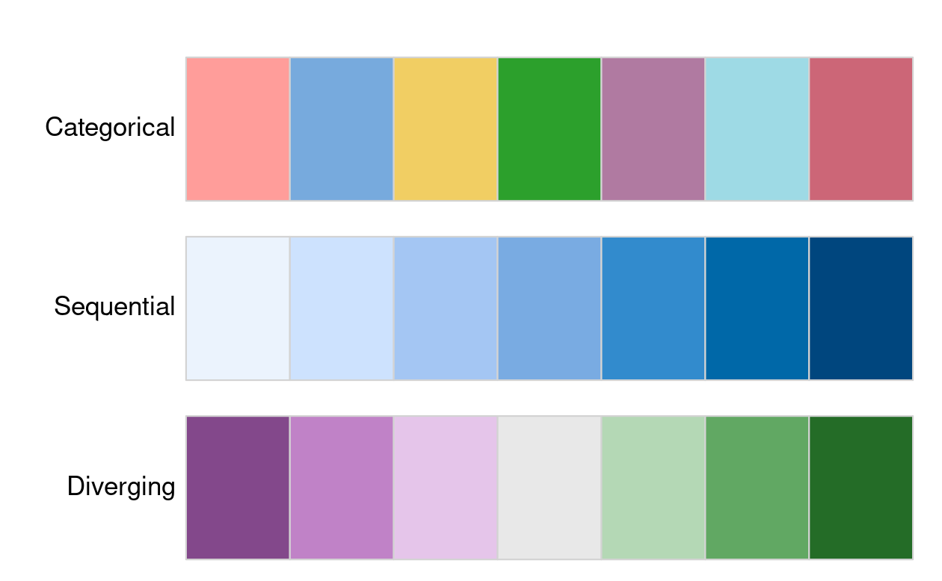
Color Ramps
COLORBREWER - color advice for cartography at https://colorbrewer2.org/

Slide 21
Color Ramps Best Practices
Categorical palettes
Consist of easily distinguishable colors and are most appropriate for categorical data without any particular order such as state names or land cover classes.
Colors should be intuitive: rivers should be blue, for example, and pastures green.
Avoid too many categories: maps with large legends and many colors can be uninterpretable.
Sequential palettes
Follow a gradient, for example from light to dark colors (light colors often tend to represent lower values), and are appropriate for continuous (numeric) variables.
Sequential palettes can be single (greens goes from light to dark green, for example) or multi-color/hue.
Diverging palettes
Typically range between three distinct colors (purple-white-green) and are usually created by joining two single-color sequential palettes with the darker colors at each end.
Their main purpose is to visualize the difference from an important reference point, e.g., a certain temperature, the median household income or the mean probability for a drought event.

Slide 22
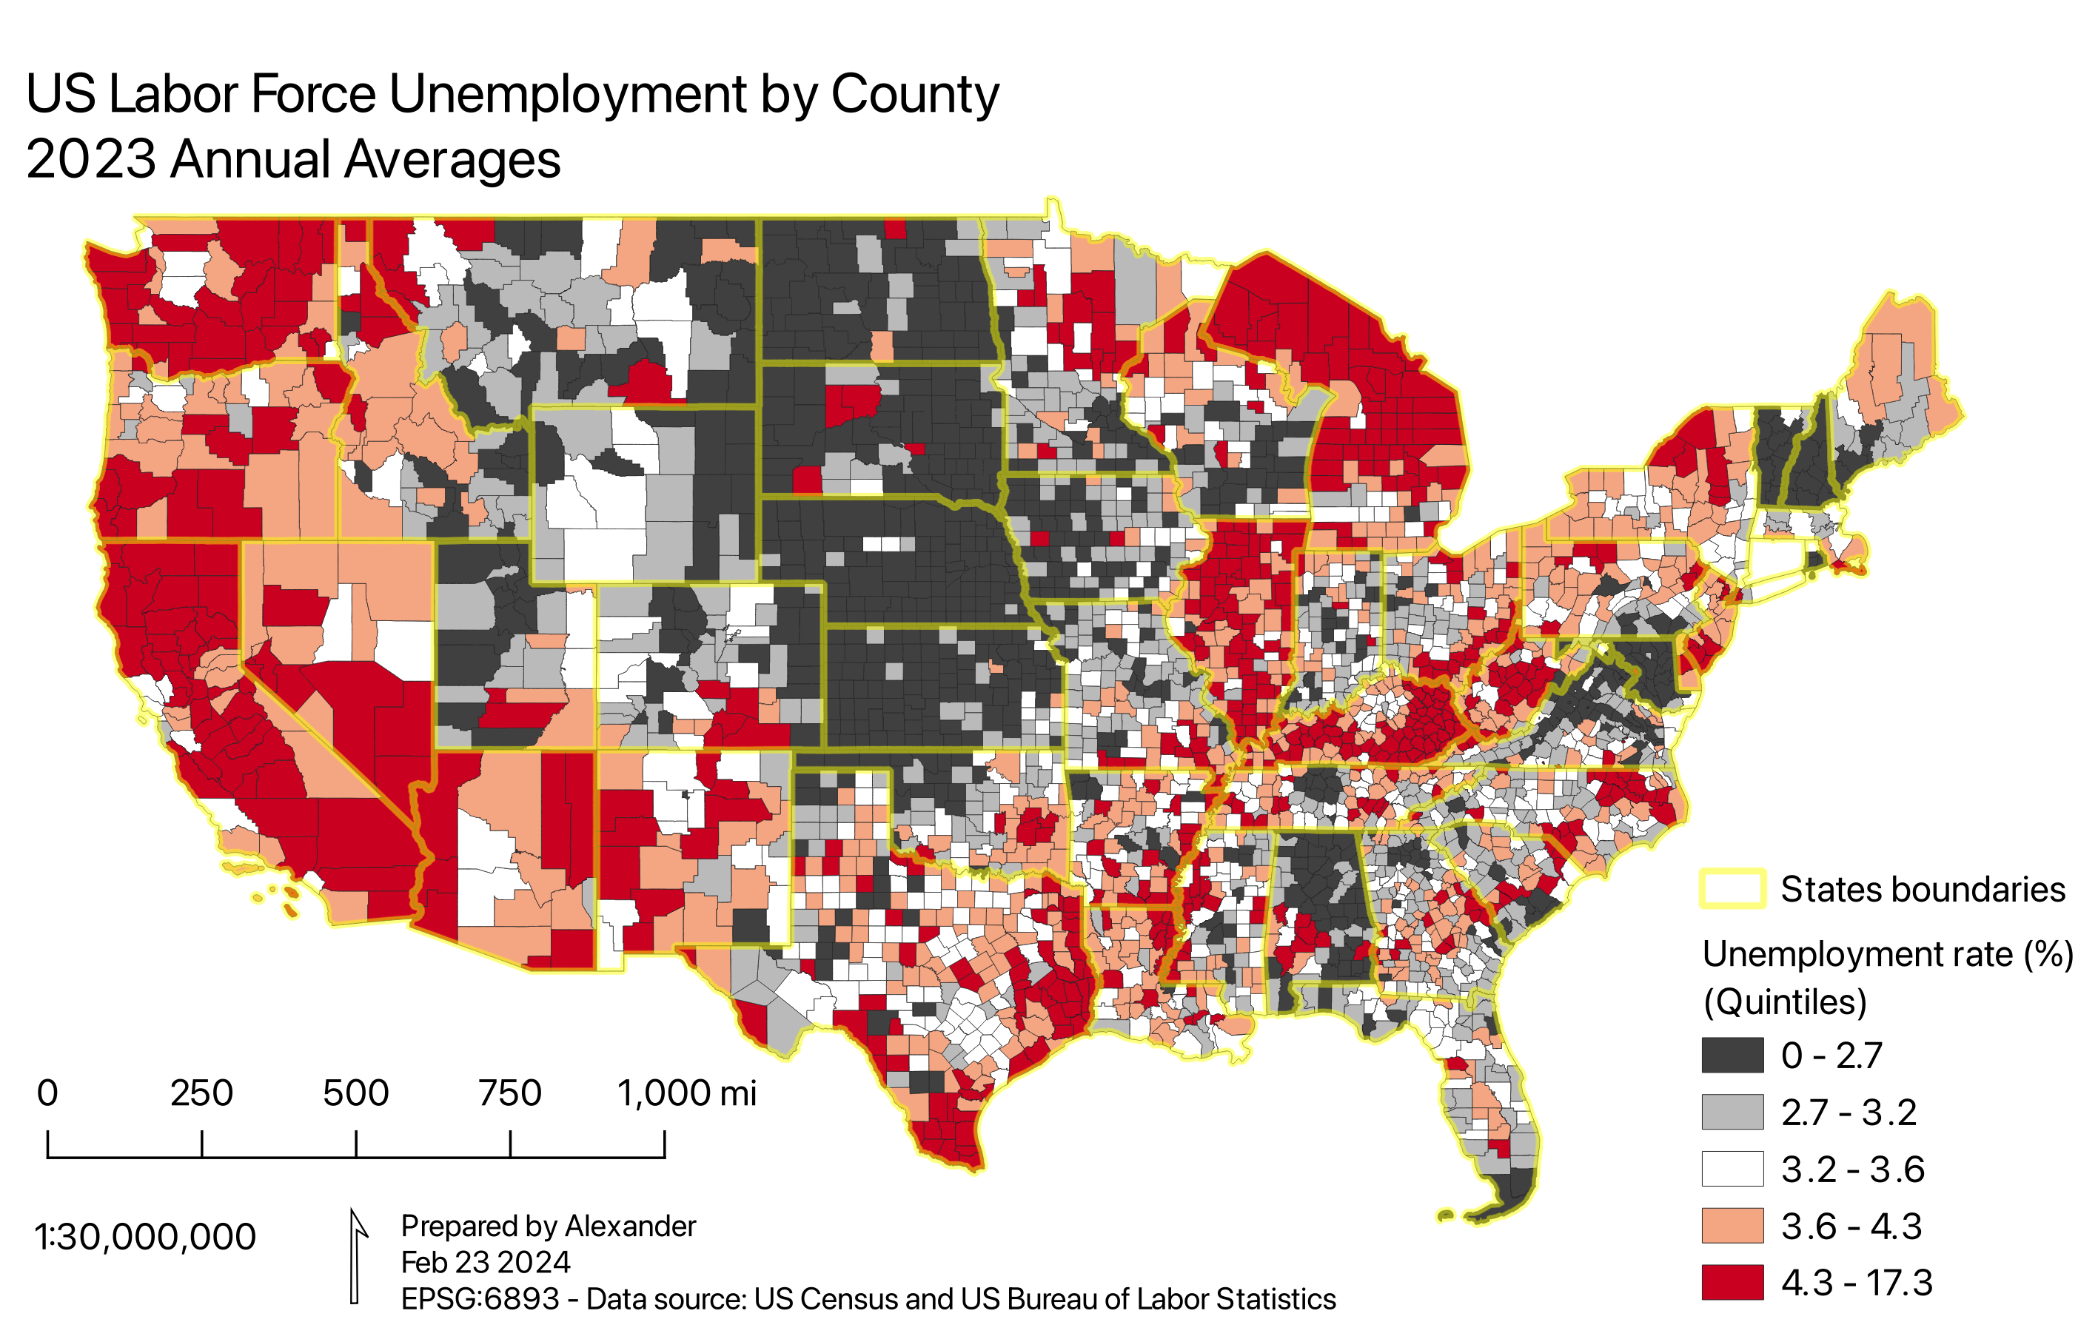
Color Ramp Example

Slide 23
Vector Attribute Operations 1
Subsetting
Row filtering with filter()
Column selection with select()
Base R vs tidyverse approaches

Slide 24
Subsetting
Base R Approach
tidyverse Approach
Using [ ] operator:
Using dplyr verbs:
# Subset rows & columns
world[1:5, ]
# Logical subsetting
small = world[
world$area < 10000, ]
# Select columns
select(world, name, pop)
# Filter rows
filter(world,
area_km2 < 10000)
Key Functions
select() | choose columns
filter() | subset rows by condition
slice() | select rows by position
pull() | extract single column as vector

Slide 25
Chaining Operations with Pipes (Ref.)
The pipe operator enables expressive, readable code
Without Pipes (Nested)
With Pipes (|> or %>%)
result = slice(
select(
filter(world,
continent=='Asia'),
name, continent),
1:5)
result = world |>
filter(
continent == 'Asia') |>
select(name, continent) |>
slice(1:5)
❌ Hard to read
✓ Clear & readable
Benefits of Piping
No intermediate variable names needed
Easy to add/remove steps
Works with RStudio keyboard shortcuts
Ctl + Shift + M on Windows or Linux
Cmd + Shift + M on Mac

Slide 26
Vector Attribute Operations 2
Aggregation techniques
Summarizing data by groups (e.g., all or categories)
Use of aggregate(), group_by(), summarise()
Handling spatial attributes in aggregation

Slide 27
Aggregation
Summarize data with grouping variables
Example: Population by Continent
world_agg = world |>
group_by(continent) |>
summarize(
Pop = sum(pop),
Area = sum(area_km2),
N = n()
) |>
mutate(
Density = Pop / Area
)
Key Concepts
group_by() | Define grouping variable
summarize() | Aggregate with functions
mutate() | Create new columns
n() | Count observations
Result: New sf object with one row per group + unified geometry

Slide 28
Vector Attribute Operations 3
Attribute joins
Joining non-spatial tables to spatial data via keys
Differences between relational joins and spatial joins (spatial joins covered later in spatial operations)

Slide 29
Attribute Joins
Combine tables based on shared key variable
left_join()
Keep all rows from first table, add matching data from second
world_coffee = left_join(world, coffee_data)
inner_join()
Keep only rows with matches in both tables
world_coffee = inner_join(world, coffee_data)
full_join()
Keep all rows from both tables, fill NA where no match
world_coffee = full_join(world, coffee_data)

Slide 30
Vector Attribute Operations 4
Creating / transforming attributes
Generating new metrics (e.g., density, ratios)
Use of mutate(), transmute()
Renaming attributes with rename(), setNames()

Slide 31
Vector Attribute Operations 4
Geometry retention and removal
How operations preserve or drop geometry
When to use st_drop_geometry() Or st_set_geometry(NULL)

Slide 32
Raster Attribute Operations
Raster attributes basics
Grid values as attributes
Spatial meaning of raster cell indices and resolution
Subsetting and extraction
Extracting cell values from layers
Working with continuous vs categorical rasters
Global raster operations
Summary statistics across full raster extents

Slide 33
Raster Data Operations
Raster Data Operations
Subsetting Methods
# Numeric raster
elev = rast(
nrows = 6, ncols = 6,
xmin = -1.5, xmax = 1.5,
ymin = -1.5, ymax = 1.5,
vals = 1:36
)
# Categorical raster
grain = rast(...,
vals = factor(grain_char))
# Row-column indexing
elev[1, 1]
# Cell ID
elev[1]
# Extract all values
values(elev)
# Modify values
elev[1, 1] = 0
Summary Statistics
global() | Calculate statistics
freq() | Frequency table
summary() | Quick overview
hist() | Visualization

Slide 34
Map Algebra (More Later in Raster Analysis)
Cell-by-cell combination of raster data layers
Each cell has a value
Simple operations can be applied to values
Unary operations apply to one layer
Binary operations apply to two data layers
More complex operations apply to many layers
3 | 3 | 3 | 3 | 3 | 3
3 | 3 | 3 | 2 | 2 | 2
3 | 3 | 2 | 2 | 2 | 2
3 | 2 | 2 | 1 | 1 | 1
3 | 2 | 2 | 1 | 1 | 1
3 | 2 | 2 | 1 | 1 | 1
9 | 9 | 9 | 9 | 9 | 9
9 | 9 | 9 | 6 | 6 | 6
9 | 9 | 6 | 6 | 6 | 6
9 | 6 | 6 | 3 | 3 | 3
9 | 6 | 6 | 3 | 3 | 3
9 | 6 | 6 | 3 | 3 | 3
x → 3x

Slide 35
Pre-Processing Workflows
Establishing a reproducible workflow
Scripted workflows vs ad-hoc steps
Importance of documentation and version control
Typical pre-processing steps
Data import and initial inspection
Attribute cleaning (e.g., selecting relevant fields, renaming)
Coordinate system standardization
Handling missing or inconsistent values

Slide 36
Spatial ETL Workflow
Extract → Transform → Load pipeline for spatial data
Extract
Read spatial data (sf, terra)
Import attributes (from CSV/DB)
Web APIs & services
Transform
Filter & subset
Aggregate & summarize
Join & merge
Create new attributes
Load
Write to file formats
Export to database
Publish to web services
Best Practices • Use pipes for readable workflows • Preserve geometries with sf operations • Drop geometry when speed matters • Document transformations

Slide 37
Practical Example: Coffee Production
Complete workflow from data join to visualization
# 1. Load data
library(sf)
library(dplyr)
library(spData)
# 2. Join spatial + attribute data
world_coffee = left_join(world, coffee_data,
by = 'name_long')
# 3. Filter & aggregate
top_producers = world_coffee |>
filter(!is.na(coffee_production_2017)) |>
select(name_long, coffee_production_2017) |>
arrange(desc(coffee_production_2017)) |>
slice(1:10)
# 4. Visualize
plot(world_coffee['coffee_production_2017'])
Geometry column preserved throughout!
sf objects behave like data.frames

Slide 38
Best Practices
Efficiency considerations
When to drop geometry for speed
tidyverse vs base R performance tradeoffs
Data integrity and accuracy
Validate joins and aggregations
Check spatial and attribute consistency
Reproducibility standards
Use of R Markdown, notebooks, and code containers^{(Docker)}

Slide 39
Common Pitfalls
Losing geometry column
Solution: Use dplyr verbs or st_drop_geometry() explicitly
Avoid: world$name Use: pull(world, name)
Mismatched join keys
Solution: Transform to same coordinate system before operations
left_join(world, data, by = join_by(name == country))
Mismatched join keys
Solution: Transform to same coordinate system before operations
left_join(world, data, by = join_by(name == country))
Mismatched join keys
Solution: Transform to same coordinate system before operations
st_transform(data, crs = st_crs(world))

Slide 40
Questions to Practice
Can you explain what attribute transformation is and give an example of when you would create a new feature from existing data?
How do you typically handle missing or inconsistent values during the data pre-processing stage?
Why is data normalization or standardization important, and in what situations would you apply it?
Can you describe a typical data analysis workflow, from receiving raw data to producing final insights?

Slide 41
Assignment #2 – Objective
Workflow in R ^{(or Python)}
Load spatial data (sf, terra)
Subset and clean attributes
Join external attribute table to spatial data
Compute summary statistics
Export results for visualization or modeling

Slide 42
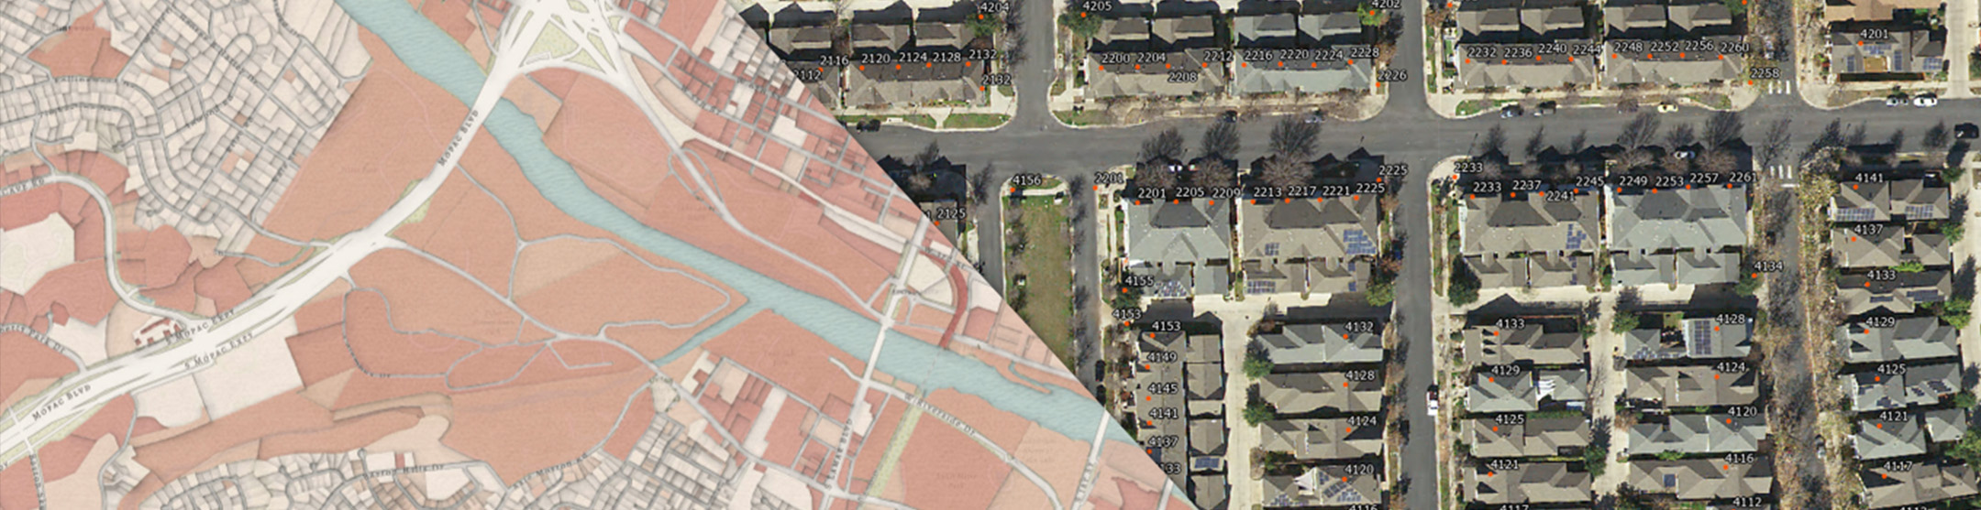
Assignment #2 – Background
Land parcels are boundaries that have associated information such as property owner, land use, value, and location attributes
Improvement value refers to the assessed monetary value attributed not to the land itself but to the physical improvements on the land (typically buildings and other structures). In the context of property assessment, this is often used as a proxy for the built environment's contribution to total property worth (e.g., houses, garages, renovations).
Follows
Data Acquisition
Data Preparation
Aggregation and Analysis
Integrate Census Data
Visualizations
Documentation and Reporting

Slide 43
Assignment #2 – Part 1
1. Data Acquisition
Parcel Data
Visit the Texas Natural Resources Information System (TNRIS) portal https://tnris.org/stratmap/land-parcels.html
Select parcel data for 5 neighboring counties of your choice
Download the 2025 parcel datasets for each county and unzip in a folder (a local folder with raw parcel shapefiles files for the counties)

Slide 44
Assignment #2 – Part 2
2. Data Preparation
Using R (with sf, dplyr, and tidyr)
Read the parcel files, standardize and inspect
Combine all counties into a single sf object
If needed, ensure projections^{(and fields)} are consistent across counties
Inspect STAT_LAND_ and IMP_VALUE
Filter for single-family houses
Define single family residential by the parcel state code: STAT_LAND_ == "A"

Slide 45
Assignment #2 – Hints 1
library(sf)
target_crs <- 4326 # WGS84, change as needed/appropriated
parcels <- list.files(
path = "/Users/abuabara/Downloads/DAEN489_data/parcels",
pattern = "\\.shp$",
full.names = TRUE,
recursive = TRUE
)
parcels_all <- do.call(
rbind,
lapply(
parcels,
function(f) {
x <- st_read(f, quiet = TRUE)
if (is.na(st_crs(x))) {
st_crs(x) <- target_crs
}
x <- st_transform(x, target_crs)
x$source_file <- basename(f)
x
}
)
)
parcels_all$STAT_LAND_2 <- substr(parcels_all$STAT_LAND_, 1, 1)

Slide 46
Assignment #2 – Part 3
3. Aggregation and Analysis
Aggregate Improvement Value
For each county, calculate:
The total improvement value of single-family parcels
Parcel count

Slide 47
Assignment #2 – Hints 2
library(dplyr)
agg_parcels <- parcels_all %>%
filter(STAT_LAND_ == "A") %>%
st_set_geometry(NULL) %>%
group_by(COUNTY) %>%
summarise(GEOID = unique(FIPS),
total_imp_value = sum(IMP_VALUE, na.rm = TRUE),
parcel_count = n())
library(tidyr)
parcels_all %>%
st_drop_geometry() %>%
filter(!is.na(IMP_VALUE) & IMP_VALUE > 0) %>%
group_by(COUNTY, STAT_LAND_2) %>%
summarise(n = n(),
IMP_VALUE = sum(IMP_VALUE, na.rm = TRUE),
.groups = 'drop') %>%
arrange(desc(n)) %>%
pivot_wider(names_from = STAT_LAND_2,
values_from = n,
values_fill = 0)

Slide 48
Assignment #2 – Part 4
4. Integrate Census Data
Acquire Census TIGER/Line Data
Use the tidycensus packages to download:
County boundaries
Population estimates (e.g., ACS 5‑year estimate for total population)
Merge with Parcel Aggregates
Join population data by county GEOID or name
Compute Per Capita Metrics
Average improvement value per capita
Average population per single-family parcel

Slide 49
Assignment #2 – Hints 3
library(tidycensus)
census_api_key("YOUR API GOES HERE")
pop_data <- get_acs(geography = "county",
# county = "Brazos",
county = unique(agg_parcels$COUNTY),
output = "wide",
geometry = FALSE,
variables = c(pop = "B01001_001"),
state = "TX",
year = 2023)
agg_parcels <- agg_parcels %>%
left_join(pop_data, by = "GEOID") %>%
mutate(
imp_value_per_capita = total_imp_value / popE
)

Slide 50
Assignment #2 – Part 5
5. Visualization
Basic thematic maps
Use tmap ^{(or ggplot2)} to produce:
Basic choropleth map of total improvement value by county
Basic choropleth map of average improvement value per inhabitant
You may also consider including supporting plots, such as:
Bar charts or scatterplots showing:
Population vs. improvement value
Parcel count vs. per capita value
Interpretation
Comment on spatial patterns (e.g., regional real estate markets, population density relationships)

Slide 51
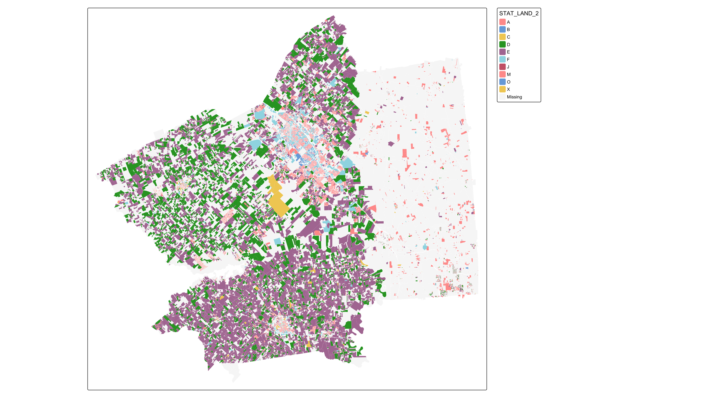
Assignment #2 – Hints 4
library(tmap)
tm_shape(parcels_all) +
tm_polygons(fill = "STAT_LAND_2", lwd = 0)
example

Slide 52
Assignment #2 – Part 6
6. Documentation and Reporting
Reproducible script or Jupyter notebook
Clean, commented ^{(as possible)}
Reproducible from data download to map output
Include
Data sources and preprocessing steps
Results and interpretations
Limitations and potential extensions (e.g., overlay zoning, flood risk)
Visuals
Please include / submit maps and charts with captions

Slide 53
Appendix Geographic Data & Spatial ETL with Python Attribute Operations 1
Libraries and Data
# Libraries
import numpy as np
import pandas as pd
import geopandas as gpd
import rasterio
import rasterio.plot
import matplotlib.pyplot as plt
# Data
world = gpd.read_file('/Users/abuabara/…/DAEN489/pydata/world.gpkg')
src_elev = rasterio.open('/Users/abuabara/…/DAEN489/pydata/elev.tif')
src_grain = rasterio.open('/Users/abuabara/…/DAEN489/pydata/grain.tif')
src_multi_rast = rasterio.open('/Users/abuabara/…/DAEN489/pydata/landsat.tif')

Slide 54
Attribute Operations 2
Vector Attribute Subsetting
Subset Countries with Small Area
world.head()
idx_small = world['area_km2'] < 10000
small_countries = world[idx_small]
small_countries
Logic to Combine Conditions
asia_small = world[
(world['continent'] == 'Asia') &
(world['area_km2'] < 10000)
]
asia_small[['name_long', 'continent', 'area_km2']]
Select Specific Columns & Rows
asia_subset = world[world['continent'] == 'Asia'] \
.loc[:, ['name_long', 'continent']] \
.iloc[0:5, :]
asia_subset

Slide 55
Attribute Operations 3
Aggregation With Attributes
Sum Population by Continent (Attribute Only)
world_pop = world.groupby('continent')[['pop']].sum().reset_index()
world_pop
Spatial Aggregation with Geometry
world_agg = world[['continent','pop','geometry']] \
.dissolve(by='continent', aggfunc='sum') \
.reset_index()
world_agg.plot(column='pop', legend=True)
Joining Attributes Between Datasets
Attribute Join
Join Variation — Inner Join
coffee_data.head()
world_coffee = pd.merge(
world, coffee_data,
on='name_long', how='left'
)
world_coffee[['name_long', 'coffee_production_2016']]
coffee_inner = pd.merge(
world, coffee_data,
on='name_long', how='inner'
)
coffee_inner

Slide 56
Attribute Operations 4
Creating & Transforming Attributes
Population Density
world2 = world.copy()
world2['pop_density'] = world2['pop'] / world2['area_km2']
world2[['name_long','pop_density']]
Drop Geometry for Pure Attribute Table
world2 = world2.drop('geometry', axis=1)
world2 = pd.DataFrame(world2)
world2.head()

Slide 57
Attribute Operations 5
Read Raster as NumPy Array
Read Raster as NumPy Array
plt.close('all')
rasterio.plot.show(elev)
elev = src_elev.read(1)
elev
Raster Summaries
np.mean(elev)
elev_float = elev.astype('float64')
elev_float[0,2] = np.nan
np.nanmean(elev_float)
Raster Categorical Frequency
plt.close('all')
rasterio.plot.show(grain)
grain = src_grain.read(1)
freq = np.unique(grain, return_counts=True)
plt.bar(*freq)
plt.show()

