Slide 1

Phase 1 Discover
DAEN 459/460 Capstone Senior Design
Alexander Abuabara
Fall 2026

Slide 2
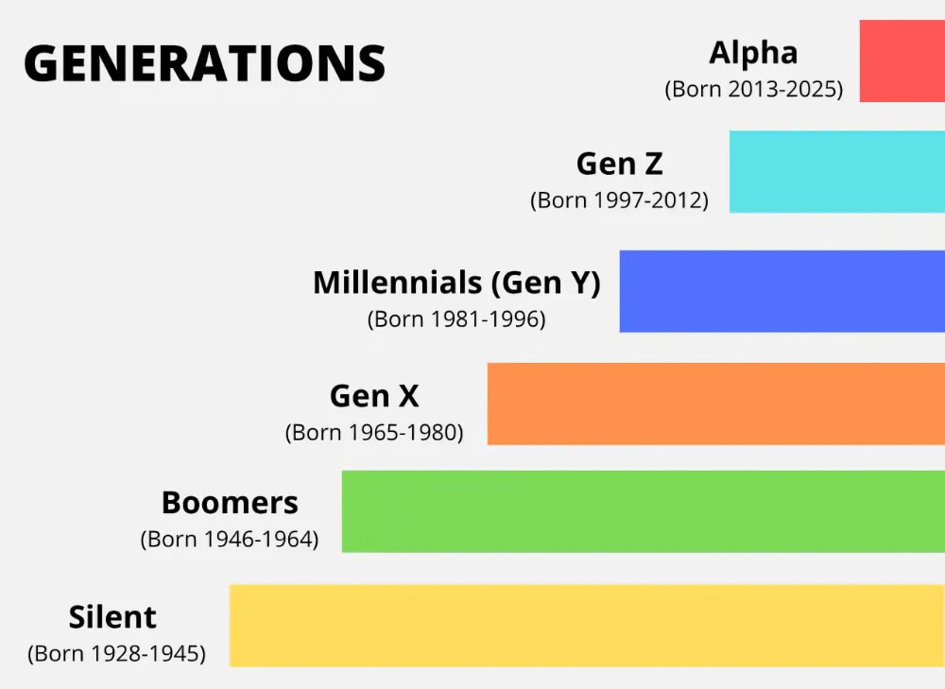

Slide 3
Bosses are firing Gen Z grads just months after hiring them
After two years of complaints, employers are now acting. Many are terminating Gen Z hires within months of onboarding.
Top concern?

Slide 4
Bosses are firing Gen Z grads just months after hiring them
After two years of complaints, employers are now acting. Many are terminating Gen Z hires within months of onboarding.
Top concern?
Lack of motivation and initiative (50% of managers cite as the primary reason for termination)
Other major issues reported:
Unprofessional behavior,
Poor organization,
Weak communication skills.
Practical workplace challenges include:
Frequent lateness to work and meetings,
Inappropriate office attire,
Use of unsuitable language in professional settings.
Ref.:
https://fortune.com/article/why-are-companies-firing-gen-z-employees-workplace-bosses-workers-jobs/
https://www.cnbc.com/2025/12/08/how-recent-grads-are-dealing-with-the-shrinking-pool-of-entry-level-jobs.html

Slide 5
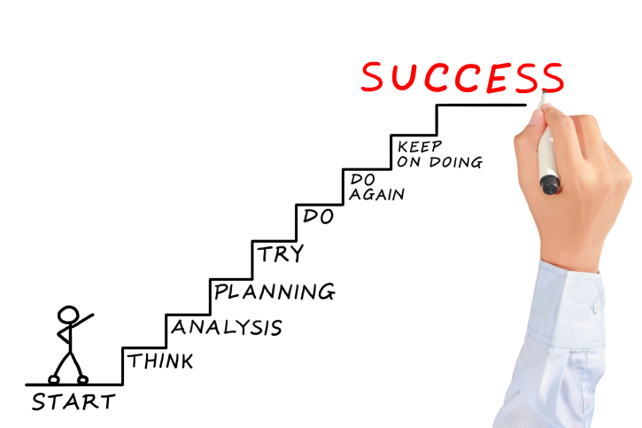
Critique your own project against learning goals rather than technical checklists only!
You are not being graded on reproducing a solution but on the quality of your thinking and decisions!
Peers are not parallel workers, but as part of a shared system. Shift the culture from individual performance to collective responsibility and make collaboration (not cooperation only)!
Metacognition ... why I'm thinking what I'm thinking → make the invisible visible!

Slide 6
Reminder ^{(of templates and more)}
Meeting Report with Project Sponsor.docx
Project Charter Template.docx
Points of Contact of the Projects

Slide 7
Readings for Wed and Friday Lab
The Five Dysfunctions of a Team https://youtu.be/z8jHFk0uLlk?si=qXPD1feeKFoWX0wP
Bullet Journal https://www.thelazygeniuscollective.com/blog/how-to-bullet-journal
Amish Hackers https://kk.org/thetechnium/amish-hackers-a/

Slide 8
Project Charter Capture Clear, Actionable Project Needs
After the 1st meeting with sponsor ...
Draft project plan −→ initial charter outline
Identify gaps in requirements, assumptions, and constraints
Re-assign roles? (notetaker, lead, etc.)
Estimate resources, best/educated guess (Brainstorm, plan scenarios for time, skills, any type of cost)
Draft a sequence of activities and a project schedule framework (set of tools, processes, and methods for developing and controlling a project's timeline)
Get started identifying risks and planning mitigations
Finalize first project charter draft (next week, in parallel to the project management plan if possible)

Slide 9

Sponsor Meeting Tips
Be prepared
Agenda prepared and sent ahead of time
Questions prepared
Team knows who will speak and on what topic
Team members assigned to take notes (record audio/video only and only if sponsor agrees)
Listen more than you speak
Wait for sponsor to answer questions, don’t interrupt with additional questions
Don’t try to provide immediate solutions, this is still a 2-semester long project!

Slide 10
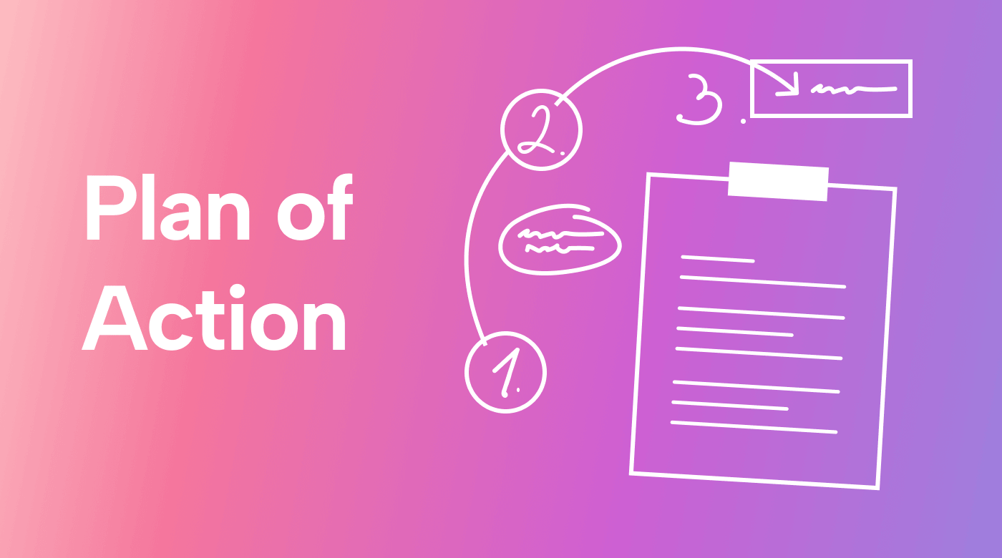
Sponsor Meeting Tips
Ask for clarification on anything you don't understand
Ask for meaning of any terms or acronyms the sponsor uses! Don’t assume your teammates will know!
Don't pretend to understand something you don’t.
End the meeting with plans
Action items for team or sponsor with target dates.
Next meeting date set or proposed.

Slide 11

Sponsor Meeting Tips
Already thinking ahead … after the meeting:
What went well?
What do you wish you'd done prior to the meeting that you did not?
Did all the team get to introduce themselves?
Were your expectations met for the next meeting?
Did you identify some needed information and establish a target date?
Did you set a follow-up meeting or recurring meeting?
What can be improved?

Slide 12

Sponsor Meeting Tips
Remain positive and upbeat throughout the project
Not everything will go perfectly, don't expect it to and don't get down when it doesn’t.
Never talk bad about anyone; sponsor, team member, instructors (especially).
If someone needs to miss a meeting
Make sure the sponsor knows why, explain at the start of the meeting that … can't make it because …
Make sure to follow up with person that missed to distribute information and/or action items!

Slide 13

Sponsor Meeting Tips
Ensure meetings don't go longer than allotted
Listen for clues sponsor needs to go (“well, that about wraps it up…”, “OK, if there isn't anything else…”, etc.)
Don't be afraid to call the sponsor if emails are not answered and you need answers
Set target dates for required information and follow up,
If you call and they don't answer, leave a voicemail.

Slide 14


Sponsor Meeting Tips !
You'll be surprised by the doors this can open...
Dress appropriately (ask if in doubt) https://careercloset.tamu.edu/
Phone on silent mode and simply don't use it!!
Follow all safety rules (and instructions),
Ask before taking photos or videos,
Document who you meet with,
You are representing Texas A&M, be a good example!

Slide 15

Team Dynamics
1. You are called a team for a reason
You have the same goals
You each have skills and abilities
2. Share the load
No one gets a free pass
Work independently but together

Slide 16
Team Dynamics
3. Recognize and acknowledge differences
Compromise
Use individual strengths to make the team better
4. If you have difficulty
Try to work things out together (don't talk bad about anyone!)
Contact instructor team for assistance only if you can't work it out

Slide 17

Faculty Advisor
You will have to identify a potential faculty advisor, do it ASAP!
For areas of research interest/expertise, consult the ISEN website, follow research tab to Research Fields.
Your project does not need to perfectly align with a professor's research field, but they are more likely to accept if it is something that interests them.

Slide 18
Advisors Identifying and Approaching
Review potential matches
Check ISEN faculty research areas
Reflect on your project's needs and interests
Reach out professionally
Draft a concise introductory email (project topic, goals, timeline)
Request a brief meeting to discuss mutual fit
Prepare for meetings
Be ready to explain your project vision
Bring initial notes from your first meeting
Confirm commitment
Secure agreement and establish possible meeting cadence
Inform me and Nathan once advisor is confirmed

Slide 19
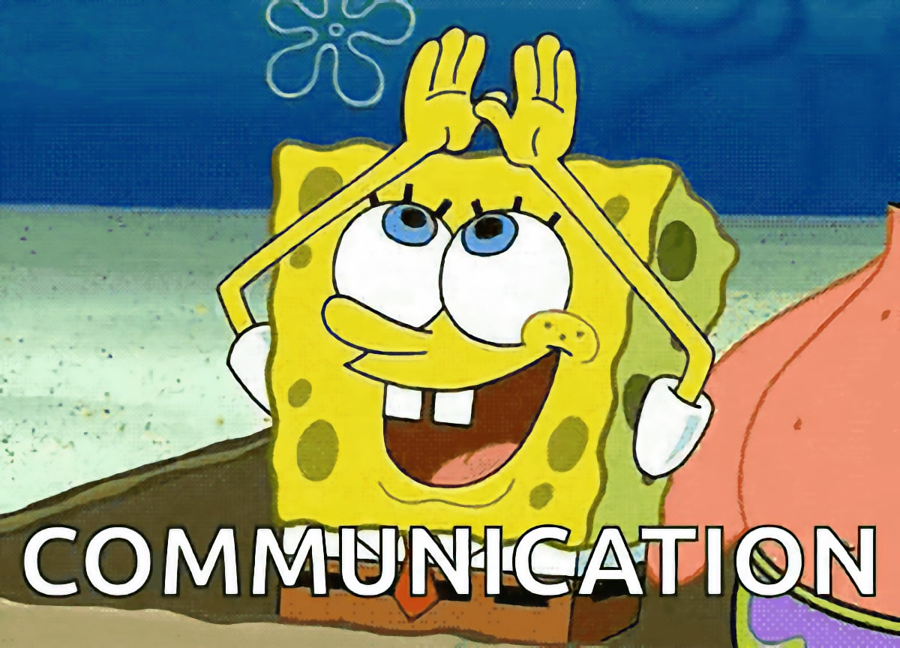

Slide 20
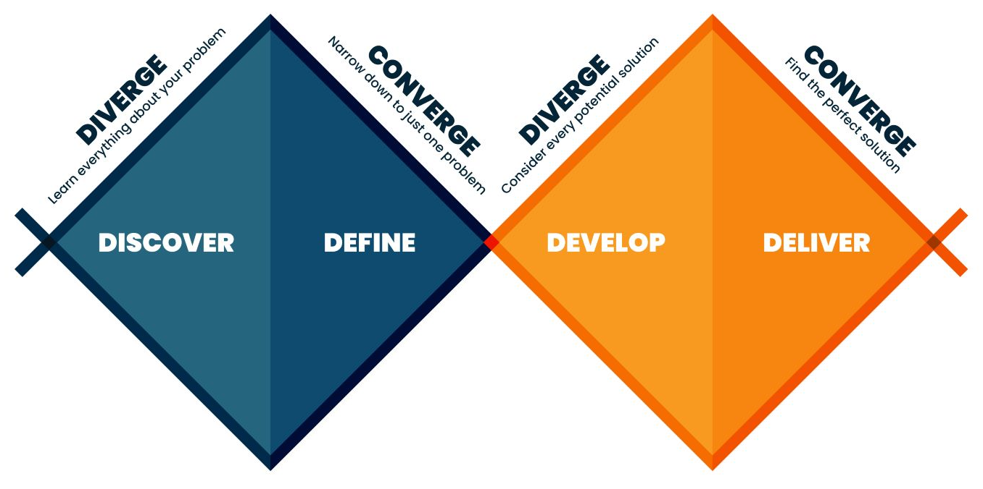
Phase 1 Discover
Phase 1 will set the direction for your project.
Phase 1 is not about solutions; it is about the problem/opportunity.

Slide 21

Phase 1 Discover
Phase 1 will set the direction for your project.
Phase 1 is not about solutions; it is about the problem/opportunity.
Some primary goals for Phase 1 include
Establishing good/effective communication is also a goal!
Information gathering,
Problem definition,
Client needs identification,
Technical objectives development.

Slide 22
Information Gathering
Will occur continuously throughout the project, but critical at beginning.
Necessary for defining parameters and scope of project.
Information can include (but not limited to)
Sponsor company,
Industry/market,
Competitors,
Standards/Constraints that guide or limit the solution (ABET).
Sources can include
Sponsor, trade publications or other public published material, internet.
The goal of Phase 1 is to gather as much information as possible, even if you're not sure it's relevant.

Slide 23
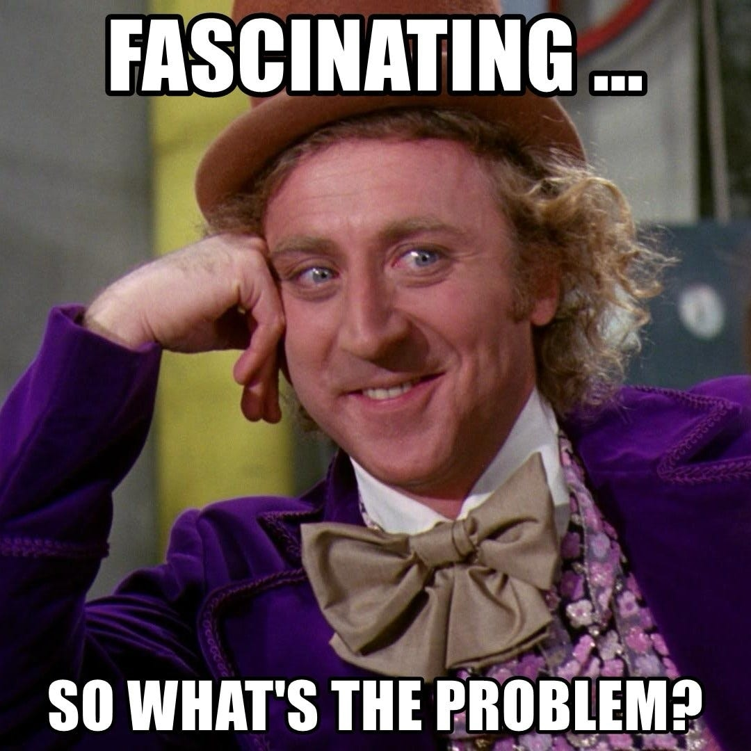
Problem Definition
Should be a concise statement of the problem facing your sponsor
Focus on the source of the problem, not the symptoms or solution,
Keep the language simple, avoid technical jargon,
Avoid detail, that will be fleshed out with customer needs.
Done in conjunction with Information Gathering.

Slide 24
Problem Definition ^{(Example)}
Should be a concise statement of the problem facing your sponsor
Focus on the source of the problem, not the symptoms or solution,
Keep the language simple, avoid technical jargon,
Avoid detail, that will be fleshed out with customer needs.
Done in conjunction with Information Gathering.
Good: The Radiology Department at Texas A&M Hospital experiences prolonged imaging turnaround times due to inefficiencies in the order processing workflow, resulting in delayed clinical decision-making.
Not so good: The Radiology Department at Texas A&M Hospital has many problems with imaging, staff availability, communication between departments, patient flow, and rising costs, which together negatively impact hospital efficiency and patient satisfaction.

Slide 25
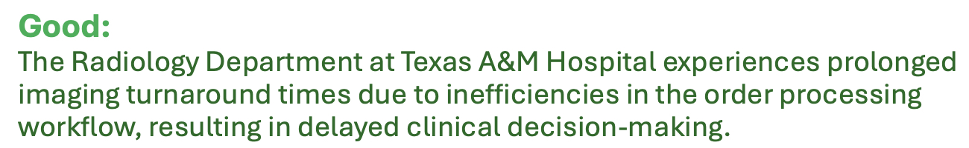

Why this is stronger?

Slide 26
Why this is stronger?
Focuses on a single, primary process (order processing workflow)
Names one measurable outcome (imaging turnaround time)
Avoids mixing staffing, length of stay, and cost into the core problem
Creates a clear target for data collection and pipeline design

Slide 27


Why this is "not so good"?

Slide 28
Why this is "not so good"?
Too broad: bundles multiple domains (staffing, communication, flow, cost, satisfaction)
No clear process focus: unclear what system or workflow should be instrumented
No measurable primary metric: nothing specific to optimize or monitor
Hard to translate into a data pipeline: unclear what data to collect, where, or why
This kind of statement is common in practice. And it's exactly what makes data projects drift or fail.

Slide 29
Client Needs
Likely discovered as part of problem definition development, but this allows you to expand on the problem definition with statements of specific needs
Should be a list of things in clear, unambiguous, non-technical terms
May be provided directly by the sponsor or you may need to solicit and/or interpret them from conversations and other research
Number client needs for identification in traceability matrix
The client needs...
N1: Awareness of data quality, security, and compliance risks
N2: Limited exposure to corrupted, incomplete, or inconsistent data in production systems
N3: A standardized process to increase adoption and correct usage of data pipelines and tools
N4: Fewer system and pipeline failures, reducing operational downtime

Slide 30
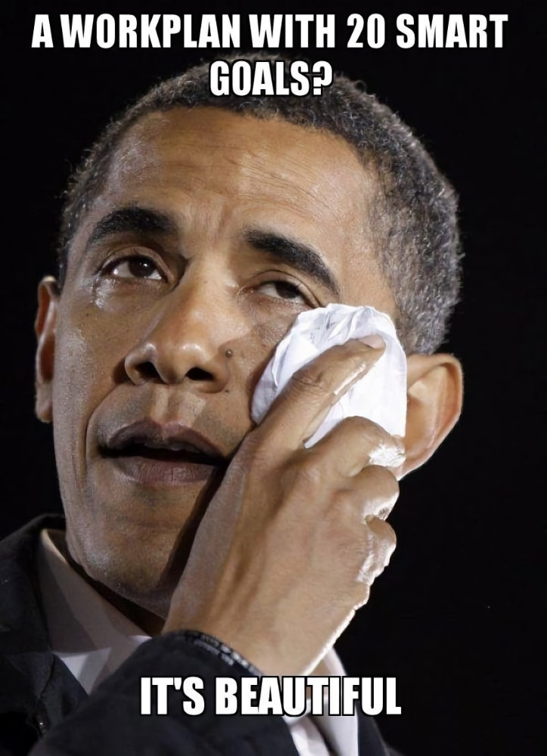
Technical Objectives
Technical objectives should translate the customer needs and problem definition into actionable, measurable goals.
Each objective should be Specific, Measurable, Achievable, Relevant, and Time-bound (SMART).

Slide 31
Technical Objectives
Technical objectives should translate the customer needs and problem definition into actionable, measurable goals.
Each objective should be Specific, Measurable, Achievable, Relevant, and Time-bound (SMART).
Number TO's for traceability purposes.
Technical objectives should address how the project will solve the defined problem and satisfy the customer needs.
TO1: Reduce data pipeline failure rates (by xx%)
TO2: Increase engineer awareness of data quality and reliability risks
TO3: Improve automated workflow orchestration activation
TO4: Decrease system downtime (to less than xx)
TO5: Eliminate identified data leakage and schema integrity issues
At this point your TO's may not have defined performance indicators, but they will evolve as the project moves forward.

Slide 32
Technical Objectives for Open-ended Research Projects
Your goals should center around developing knowledge, frameworks, and methodologies that help answer key questions or inform decision-making.
If your project is more research-focused, your objectives may not have quantifiable performance improvement criteria.
For research-driven projects, technical objectives should:
Define Key Questions What are you trying to discover, validate, or understand?
Establish Analytical Frameworks What methods, models, or simulations will you develop?
Characterize System Relationships How do the key factors of your problem/system interact?
Develop Conceptual or Qualitative Deliverables What frameworks, decision-support tools, methodologies, or documentation will your team generate?
See the document posted on Canvas for examples.

Slide 33
Example Research-Oriented Data Engineering Project Objectives
Suppose your team is studying data pipeline reliability in large-scale streaming systems. Your technical objectives might be:
Key Questions – What factors most strongly influence end-to-end latency and data loss in a real-time streaming pipeline? – How do different buffering strategies affect system stability under peak load?
Analytical Frameworks – Develop a benchmarking framework to simulate varying data arrival rates and system loads. – Design experiments using controlled workloads to compare multiple pipeline architectures.
System Relationships – Analyze how ingestion rate, buffer size, and processing throughput interact to produce bottlenecks. – Model the relationship between fault frequency and recovery time.
Conceptual or Qualitative Deliverables – Produce a decision framework that guides engineers in selecting buffering and checkpointing strategies. – Create documentation that outlines best practices for designing resilient streaming pipelines.

Slide 34
Traceability
Traceability will ensure that your project is on track to meet your technical objectives.
At this point you should connect defined client needs to technical objectives in a traceability matrix.
Client needs will likely not map one-to-one to technical objectives, but all client needs should map to at least one technical objective.
Client Needs (N) | Technical Objectives (TO)
N1 | TO1, TO3, TO6
N2 | TO2, TO4
… | …

Slide 35
Short Presentation
Let's try to make a short presentation: Fri Sep 11 and/or Fri Sep 18?
Teams can practice and we all (instructor + classmates) can provide input/feedback
Do not try to present everything you've learned so far (time is limited).
Appendix is for information you've gathered that might be relevant:
Reference information as necessary in presentation,
Don't present appendix slides,
Technical grade for Information Gathering will be partially based on appendix content.
Practice your presentation, both individual parts and as a team!

Slide 36
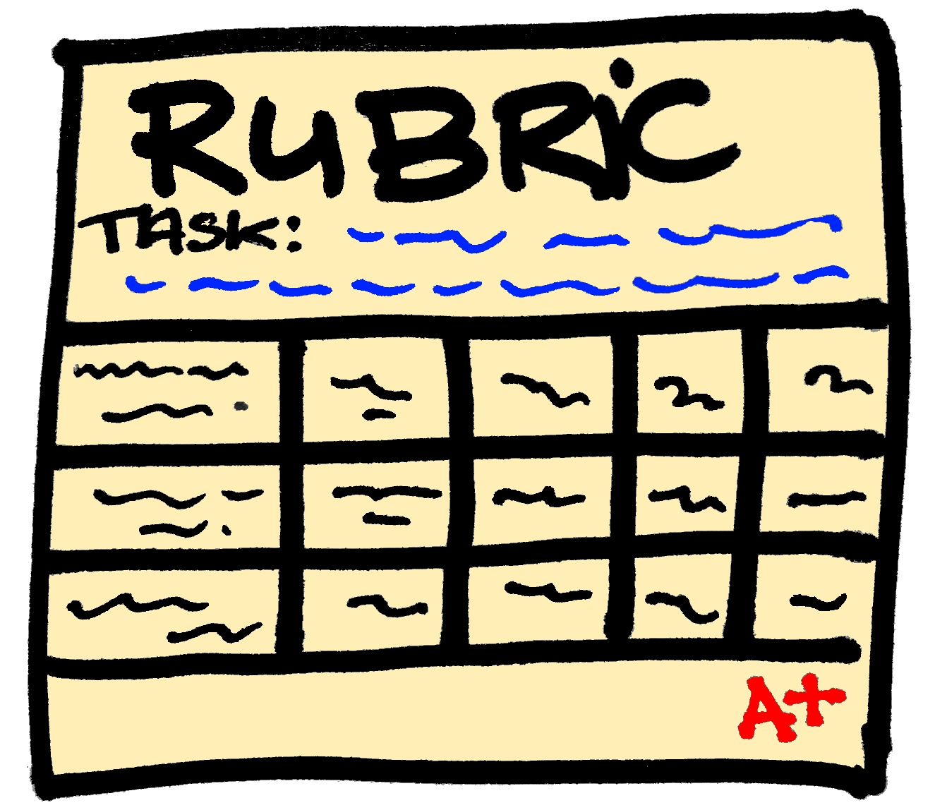
Phase 1 Presentation Rubric
Problem Definition & Motivation: Clearly defines the capstone problem, explains why it matters, and identifies the intended users, stakeholders, or business impact.
Project Scope & Objectives: Establishes realistic Phase 1 goals, specific deliverables, and clear boundaries for what is and is not included in the project.
Proposed Approach: Presents a logical technical approach, including anticipated data sources, tools, methods, architecture, or analytical techniques.
Feasibility & Planning: Demonstrates that the project is achievable within the available time and resources, with appropriate milestones, responsibilities, and identified risks.
Presentation Quality: Communicates the project clearly and professionally, with effective visuals, organized content, and the ability to respond thoughtfully to questions.

Slide 37
Drafting Questions & Follow-up Messages
Be specific and concise ("What format should the dataset use?")
Prioritize by urgency and impact (critical path first)
Avoid assumptions; confirm facts ("Can we assume ...?")

Slide 38
Message Template
Greeting – Address sponsor respectfully
Thank You – Acknowledge time and input
Summary – Recap key points from last meeting
Action Items – List clarifications or next steps
Next Meeting Proposal – Offer times/dates or request confirmation

Slide 39
Best Practices
Use a single team email thread or project board
Confirm receipt and agreements in writing
Update faculty advisor on major changes or risks
Always cc-me abuabara@tamu.edu

Slide 40
"Least But Not Last"
To keep meetings on track:
Group leaders will also be hosts on Zoom, and they must remove anyone who does not behave appropriately.
Discuss within your group what the minimum expectations should be, as this will affect everyone in the team!

