Slide 1

Making Maps and Cartographic Design
Alexander Abuabara
DAEN 489 ISEN 489 Spring 2026

Slide 2
Project Proposal Updates
Spreadsheet to help organize the groups
https://docs.google.com/spreadsheets/d/1RqVF_3GTnQsld3ikscjSPqKV1eLFaDH0qI4oAXluFZs/edit?usp=sharing
One idea for a project:
Determine in multiple years if there is a statistically significant difference (paired sample t-test) between the aggregated LandScan population estimates and the Census residential population (where people live) at multiple census geometric boundary levels (tract, county, zip-code, etc.)

Slide 3
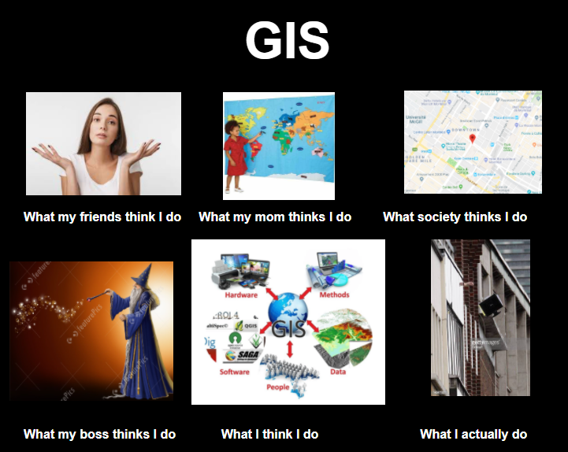
Introduction
Cartography is the intersection of art, science, and technology
Mapmaking
Gerardus Mercator (1512–1594) is generally considered the most famous cartographer in history.
A Flemish geographer, he revolutionized navigation by developing the Mercator projection in 1569, a cylindrical map projection still widely used today.
He also popularized the term "atlas" for a collection of maps.
Goal: To communicate complex spatial information clearly and accurately to a specific audience.
Key: What is the story you want your map to tell?
Design is not just "making it pretty" but functional.
Poorly designed maps can leave a bad impression.
Common design issues include:
Poor placement, size and readability of text,
Careless selection of colors.
https://www.reddit.com/r/GISmemes/comments/kqax4y/anyone_with_me/

Slide 4
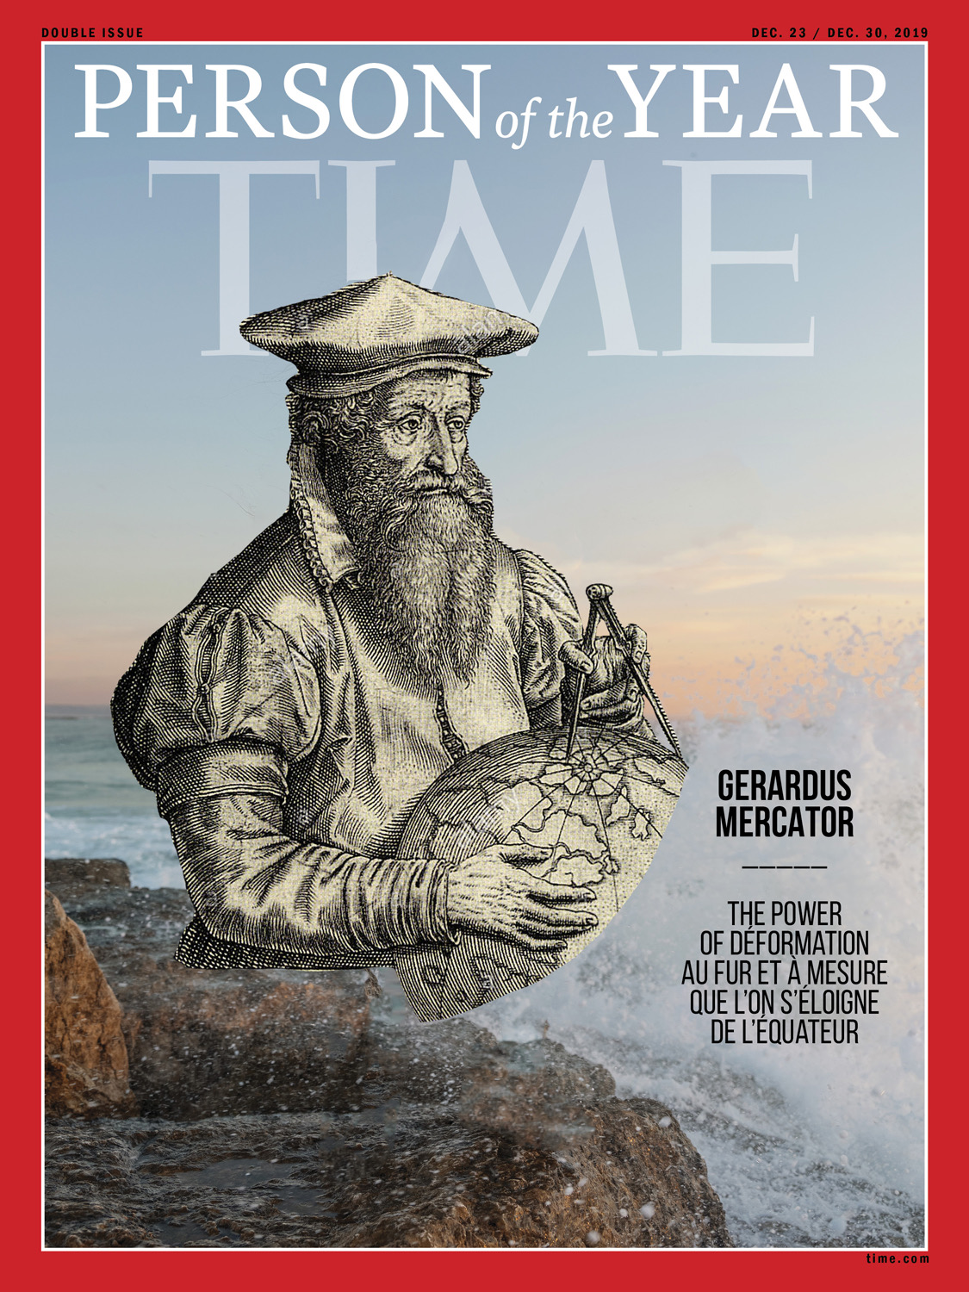
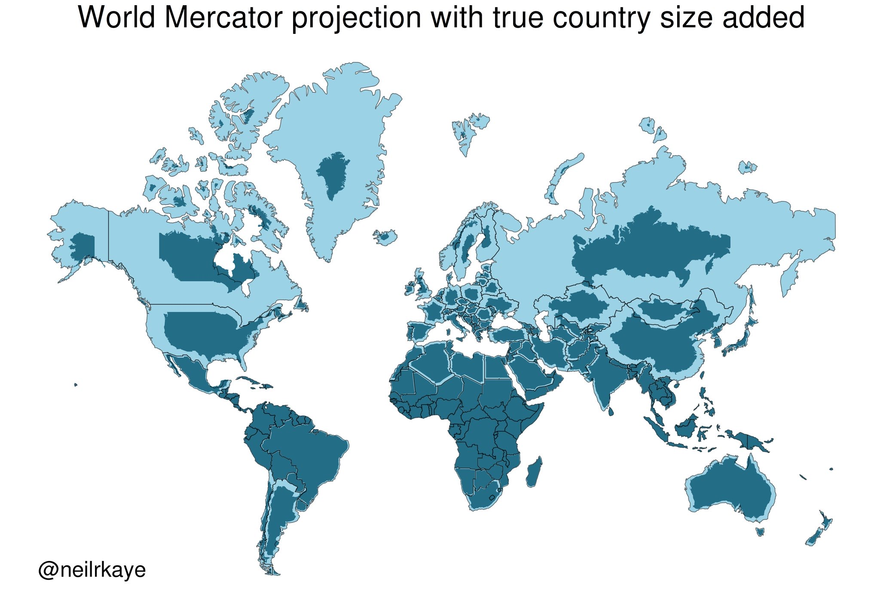

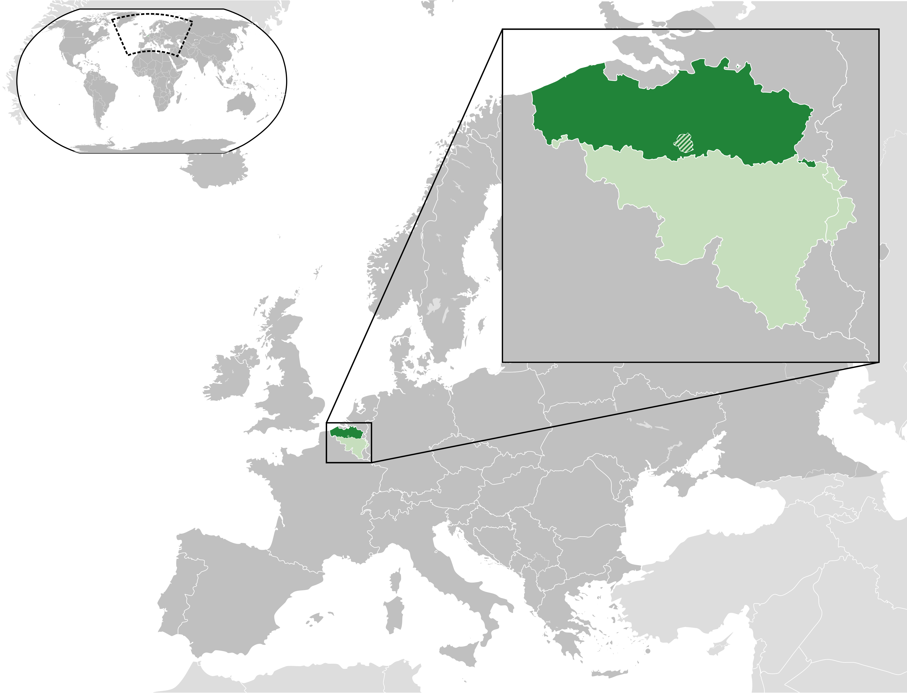
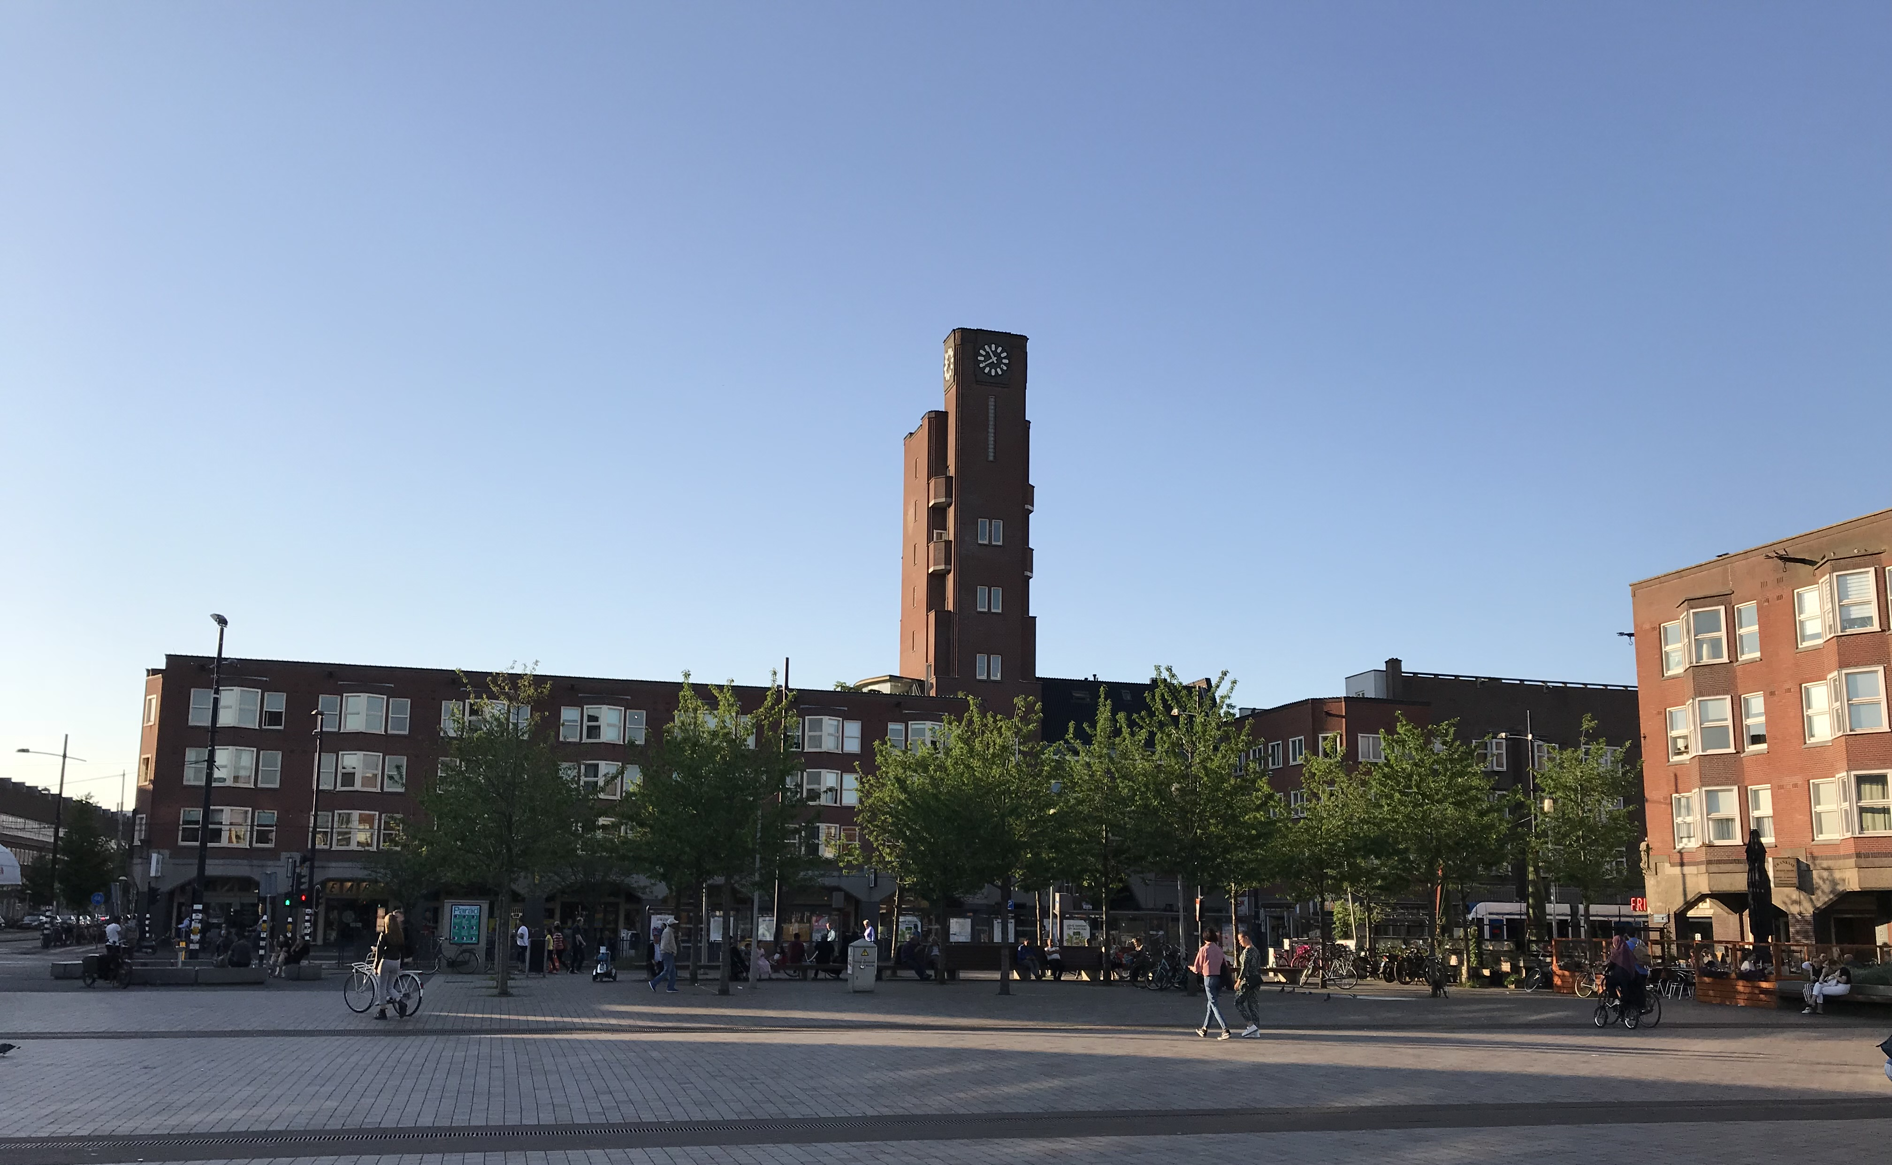


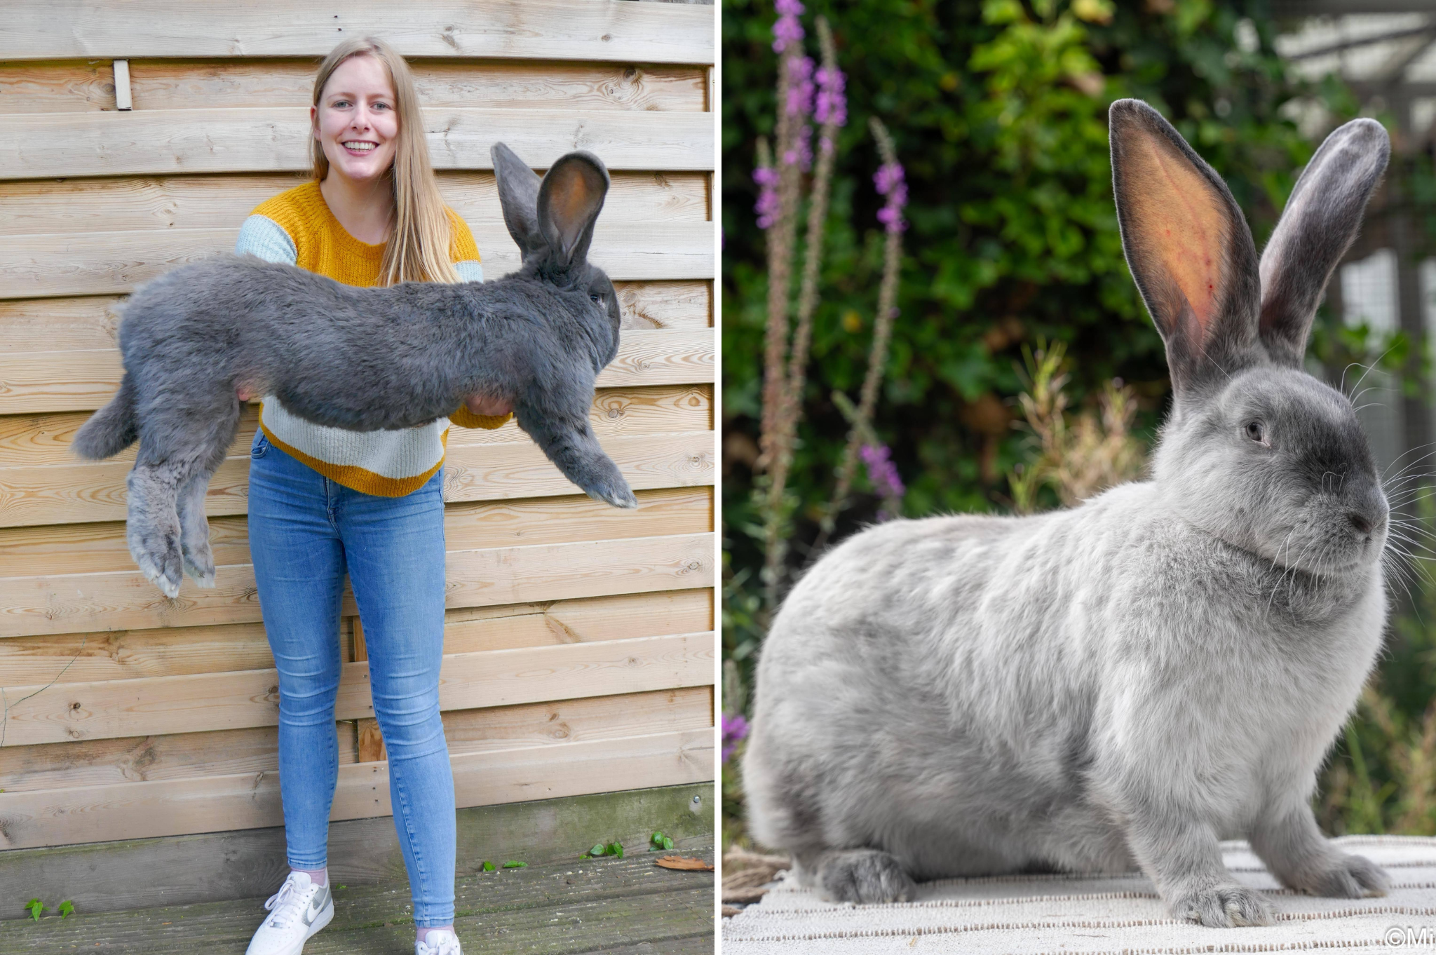
Flemish people or Flemings
https://en.wikipedia.org/wiki/Flemish_people

Slide 5
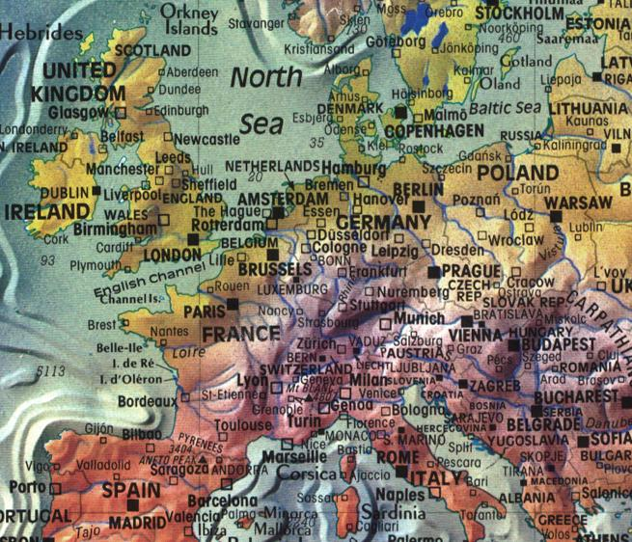
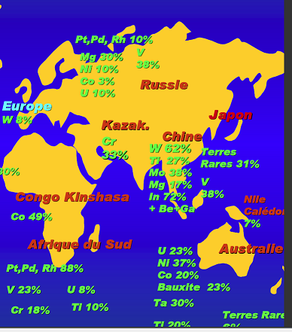
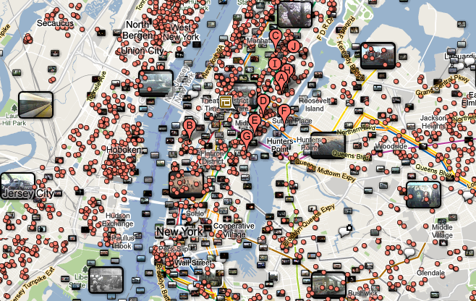
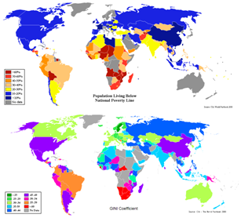
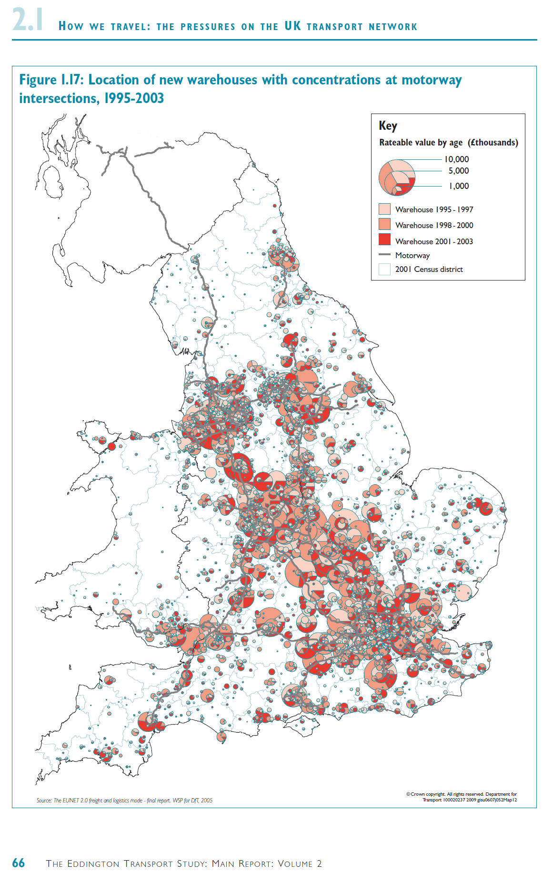
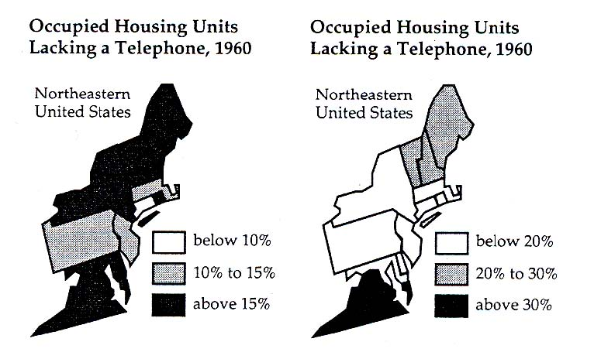
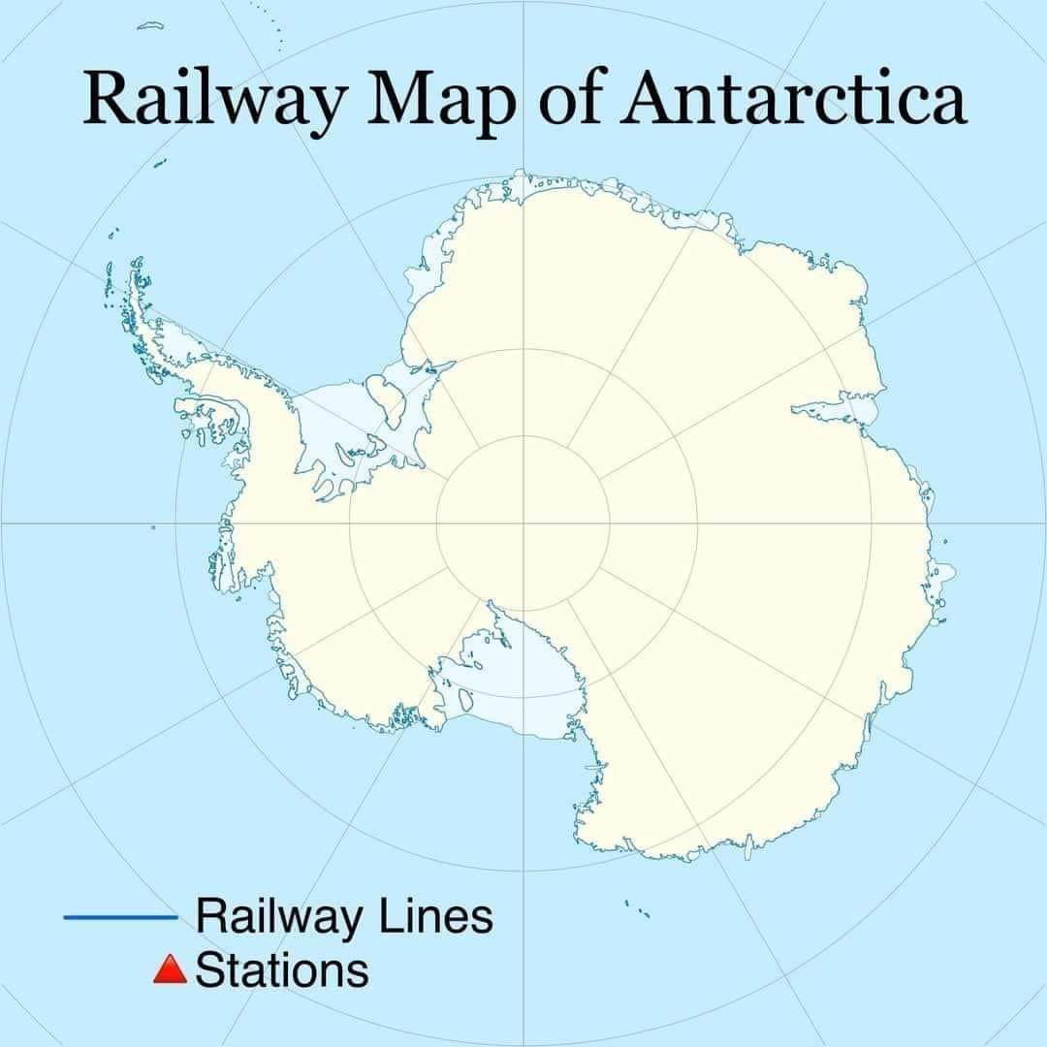
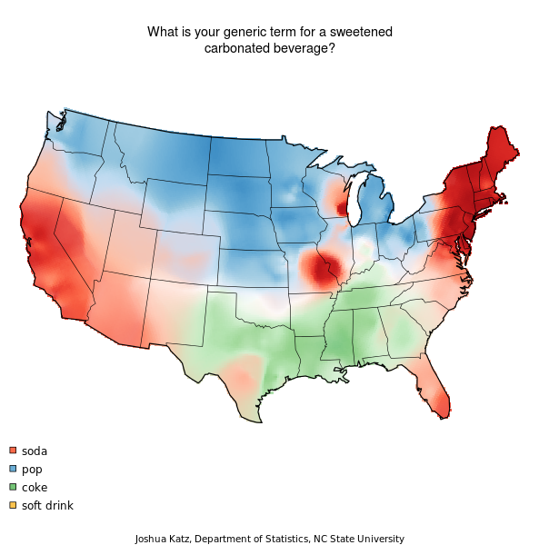
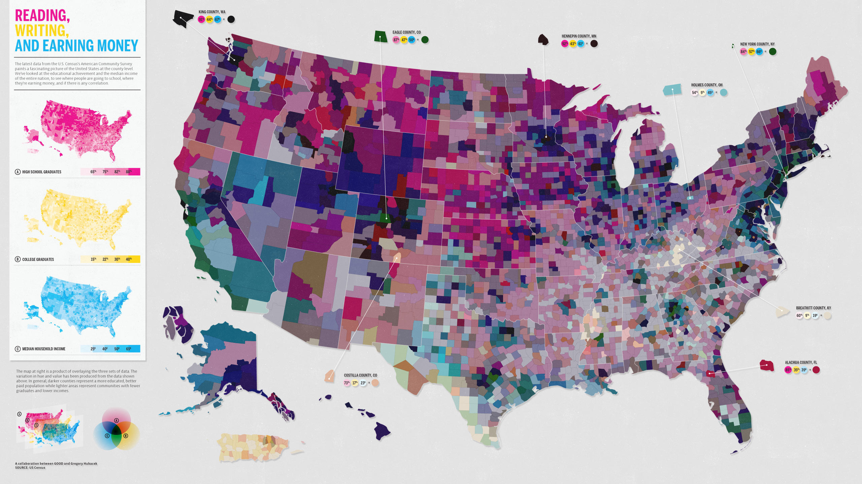

Slide 6
Static maps

Slide 7
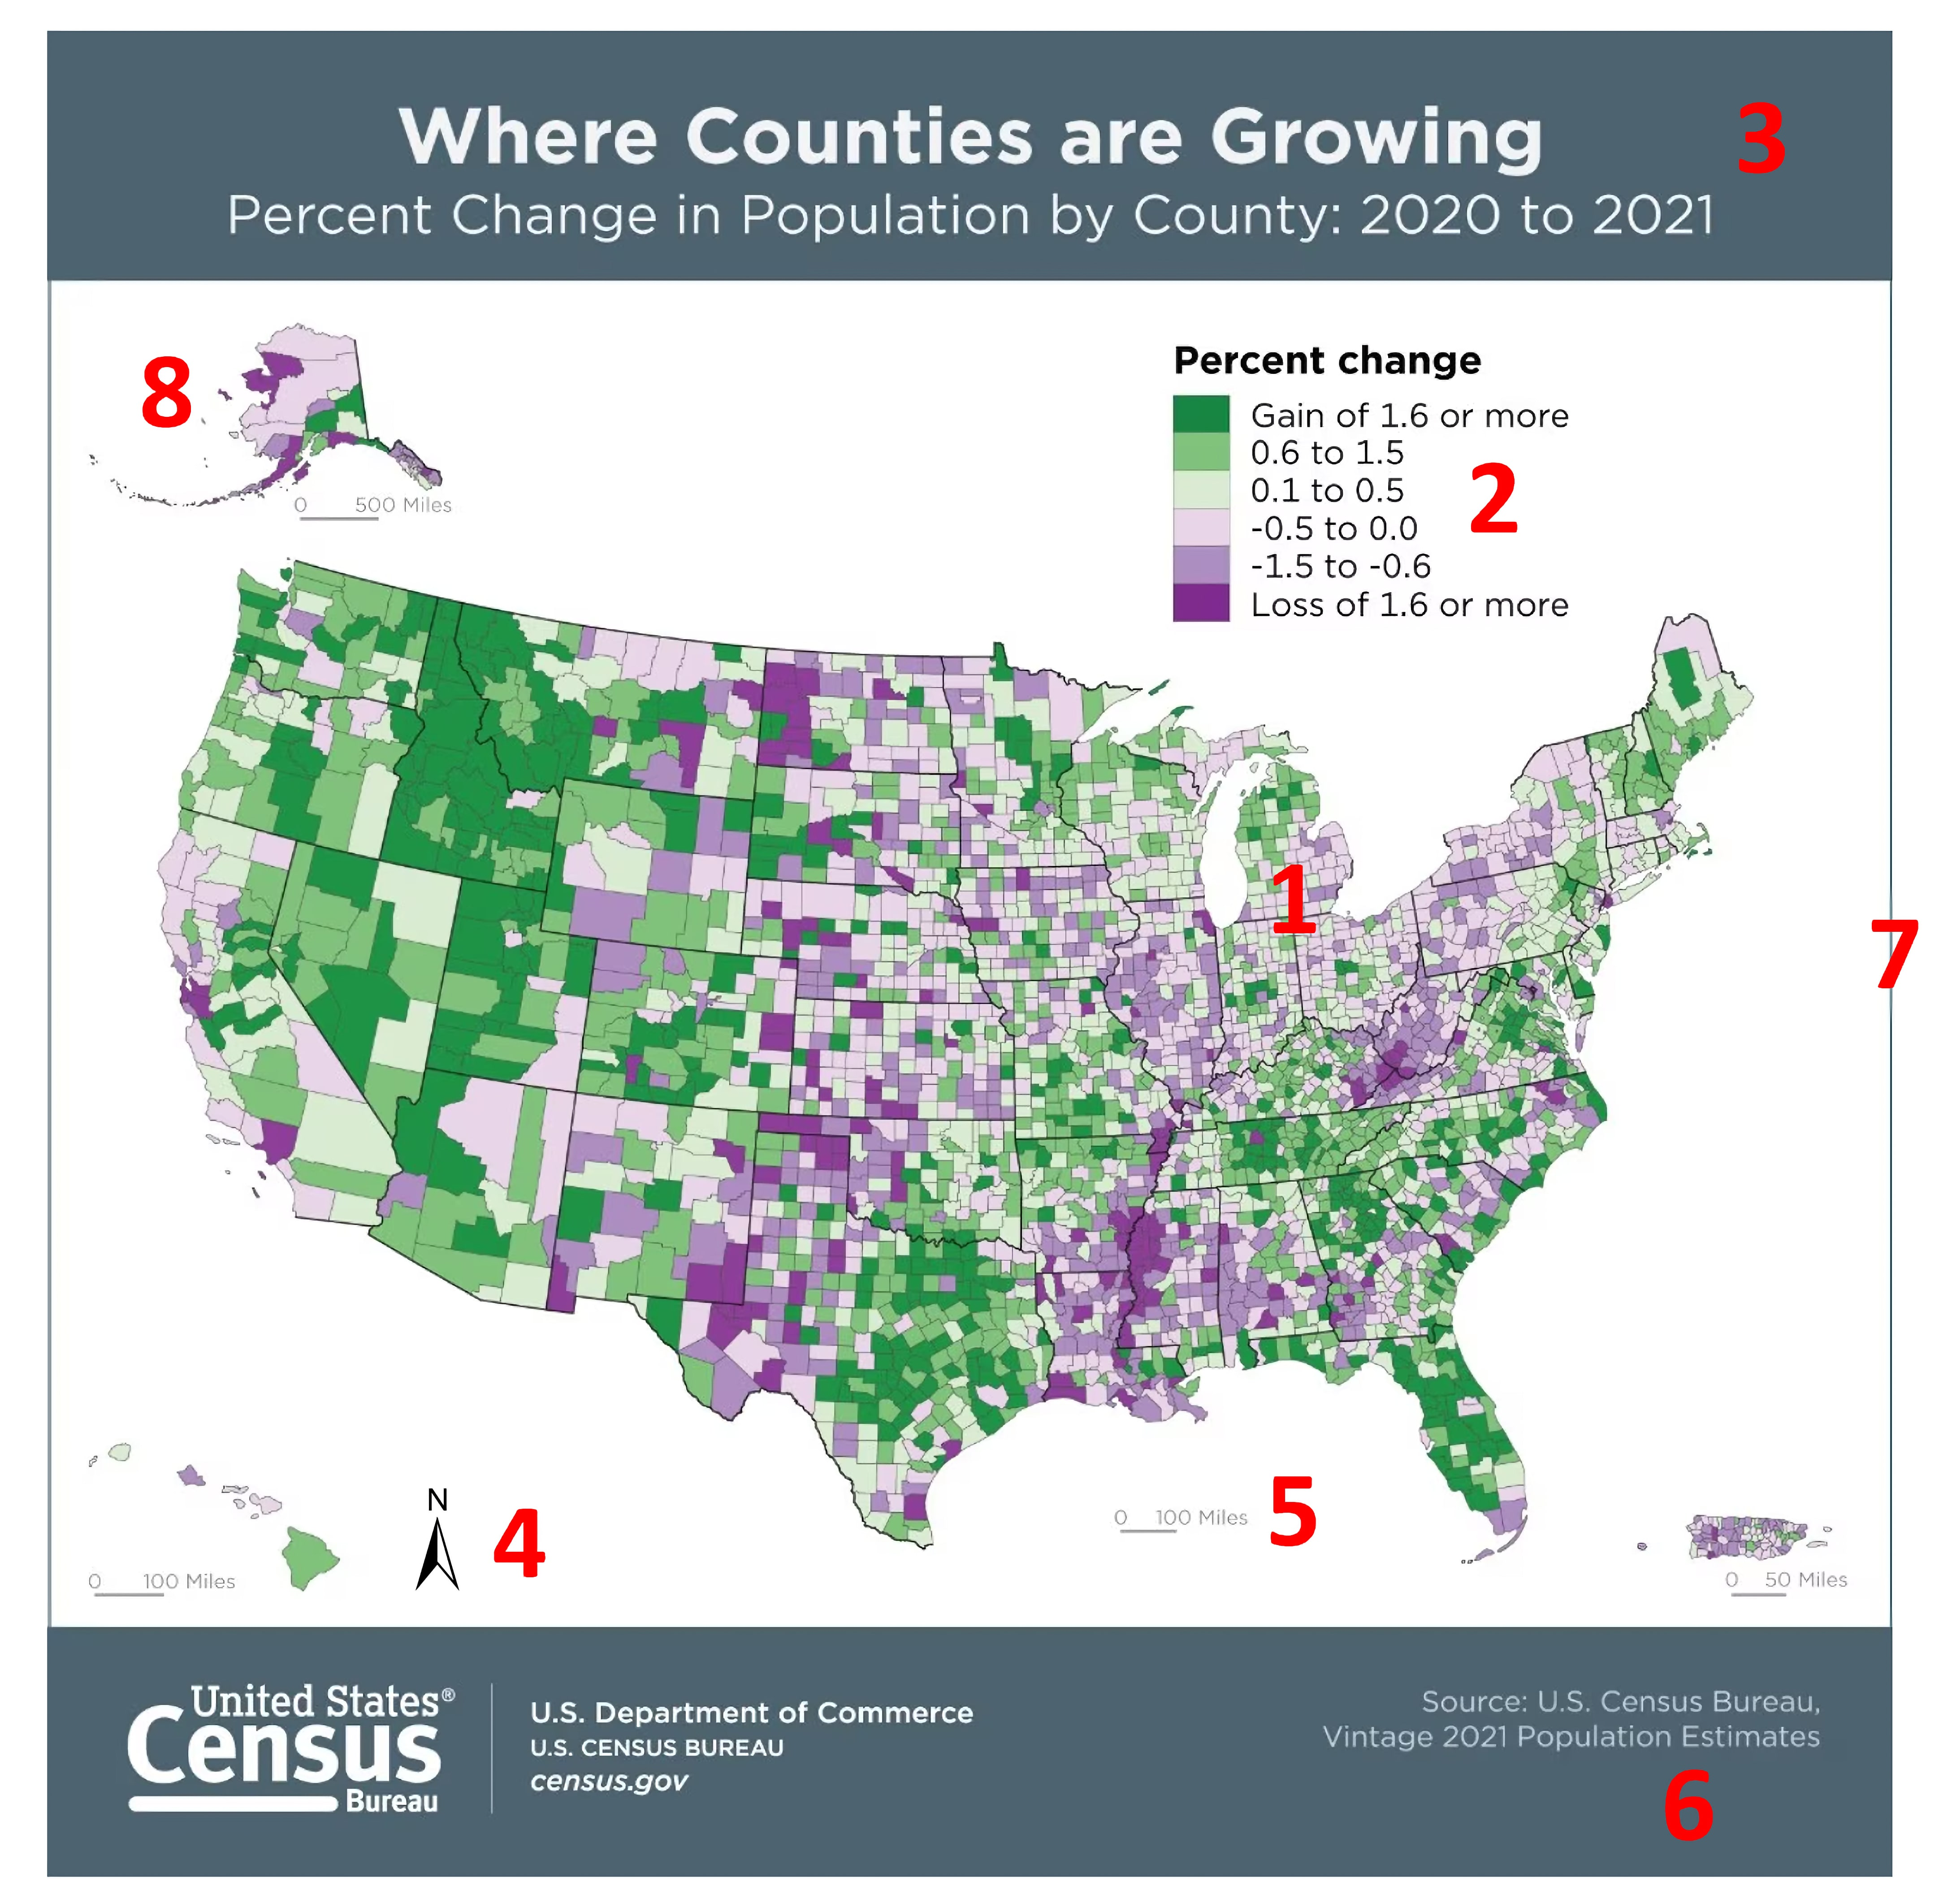
Map showing the elements that can be part of a map layout
Data (or map) frame
Map legend
Map title
North arrow
Map scale bar
Metadata (or map citation)
Border
Inset (or locator) map

Slide 8
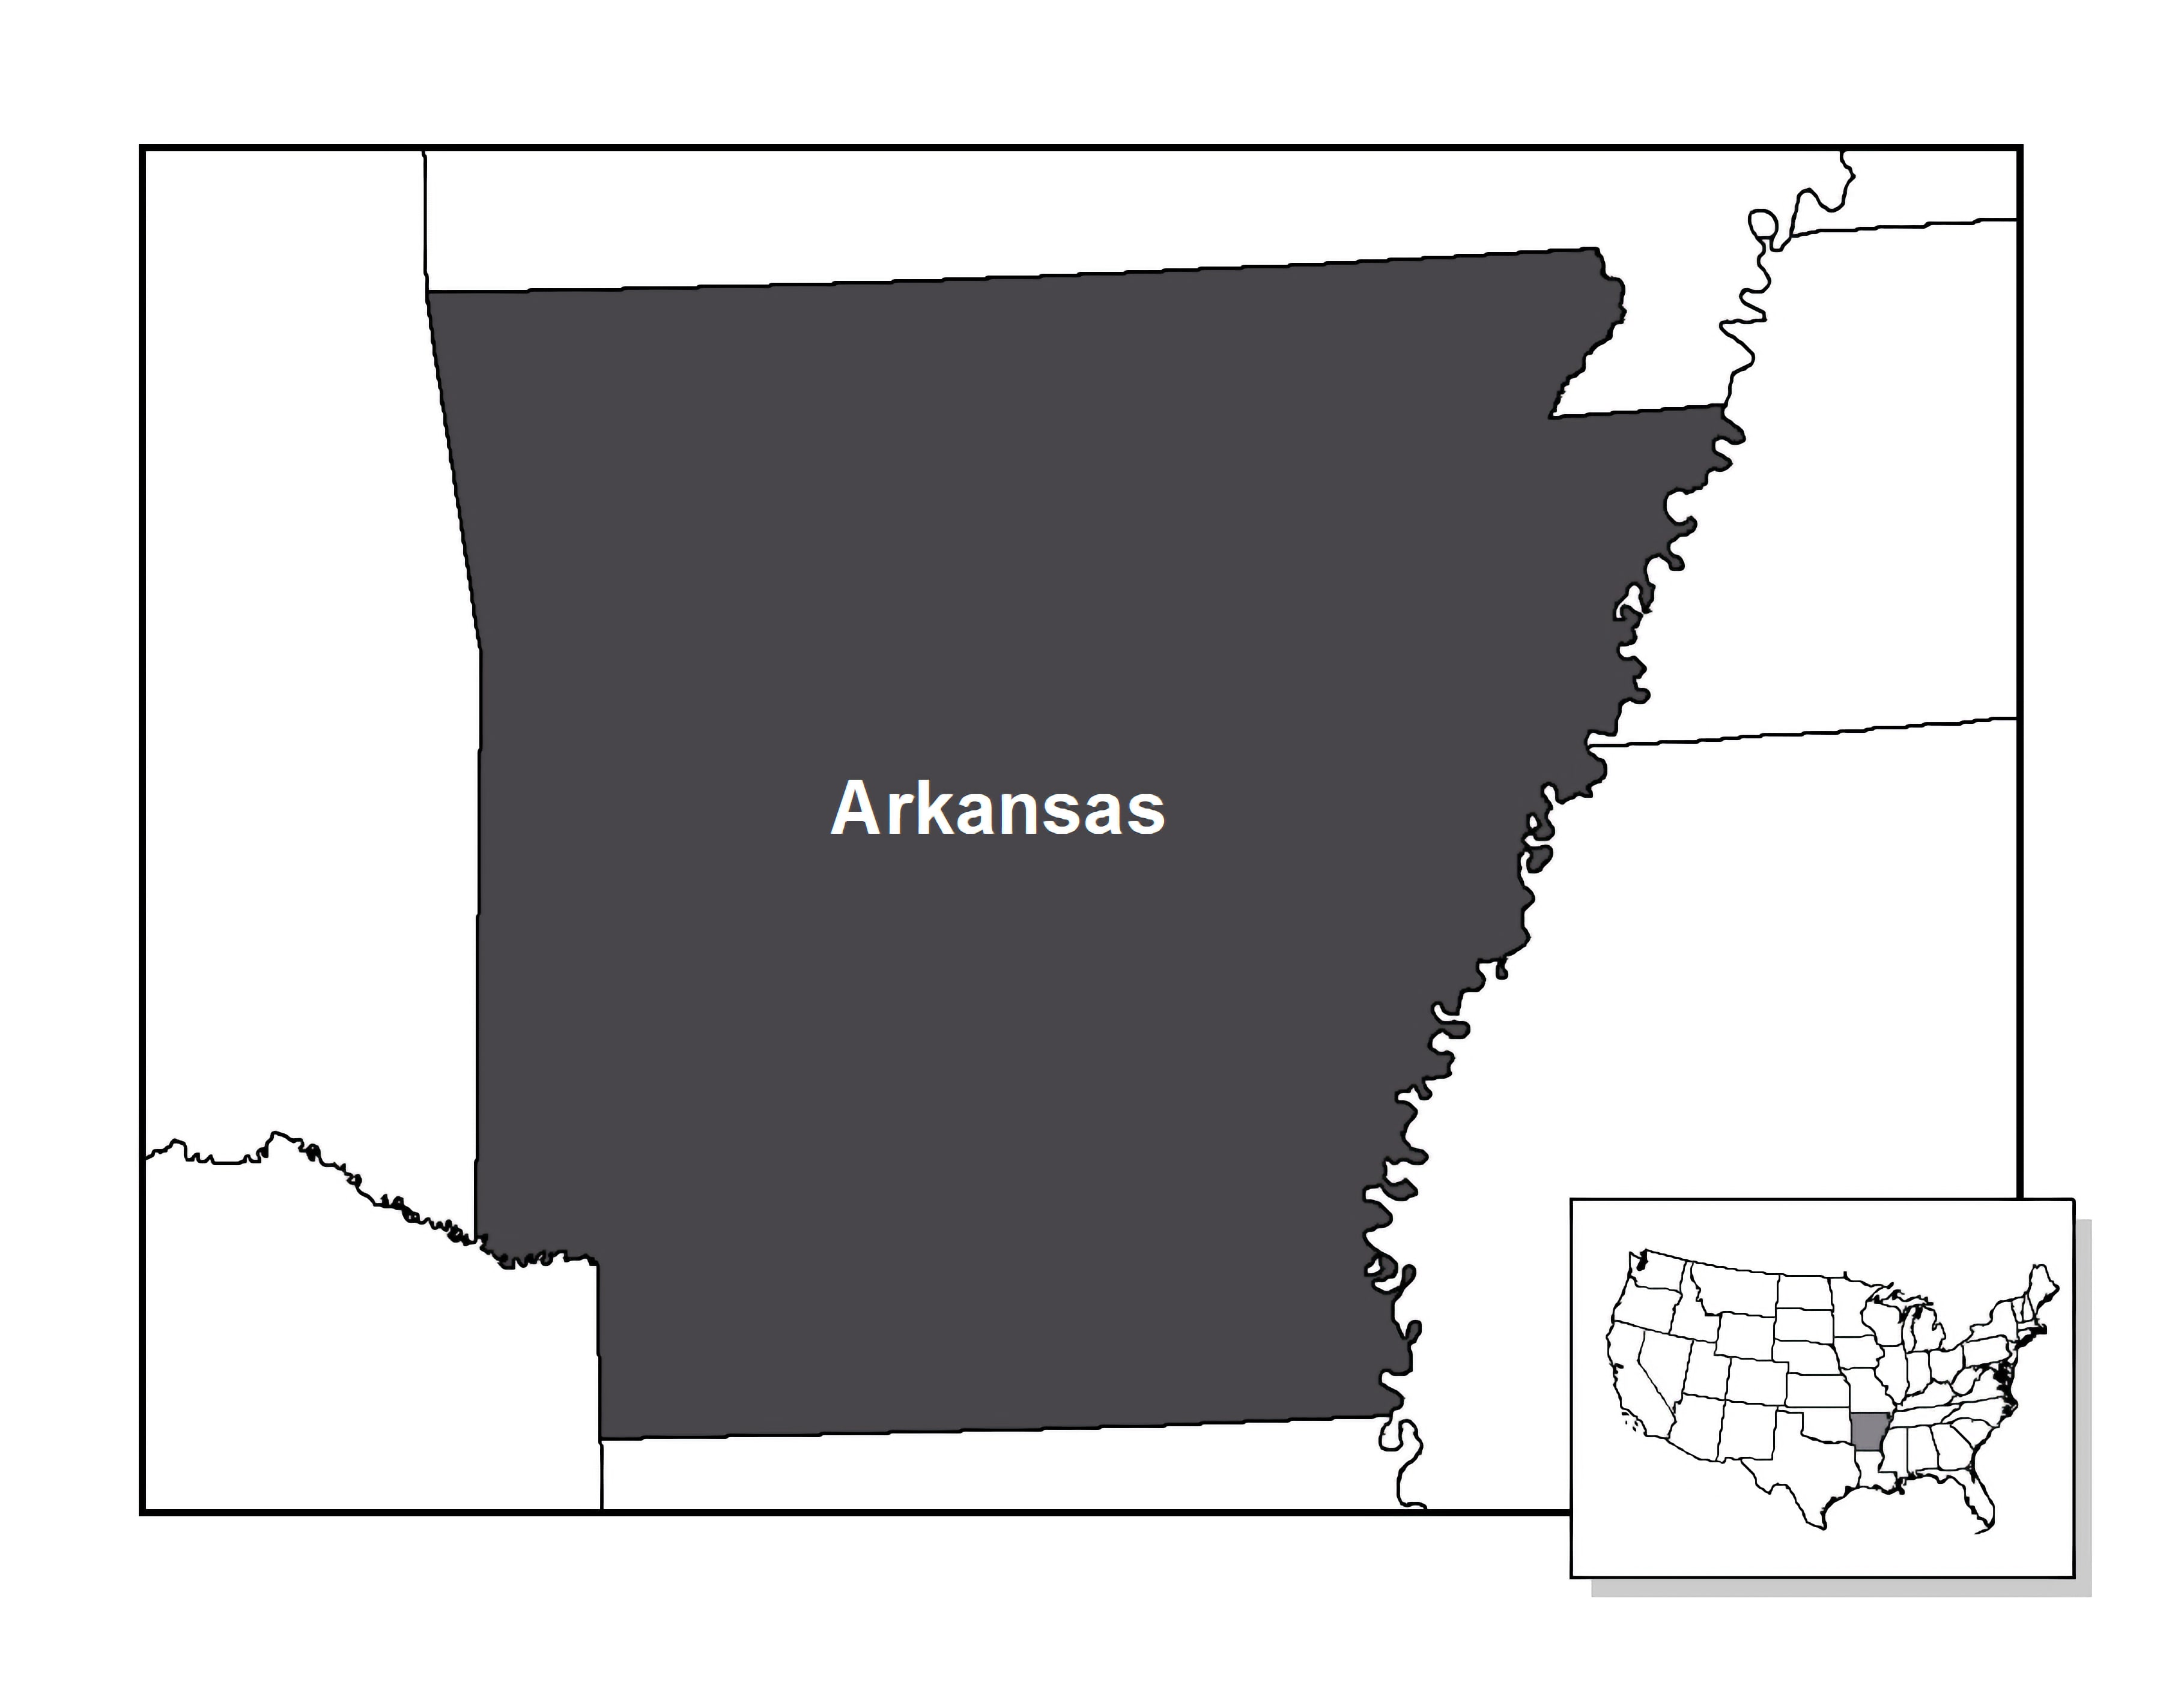
The map body map element is the main focus of the map and should be visually dominant in every case. The map body contains the features important to the message of the map. The map body should be made as large as possible on the medium but should also leave room for other map elements and should not crowd the edges so that the map has a little "breathing room". The map body is the only map element that is absolutely required when composing a map. However, the map is often much more useful when other map elements are included.

Slide 9
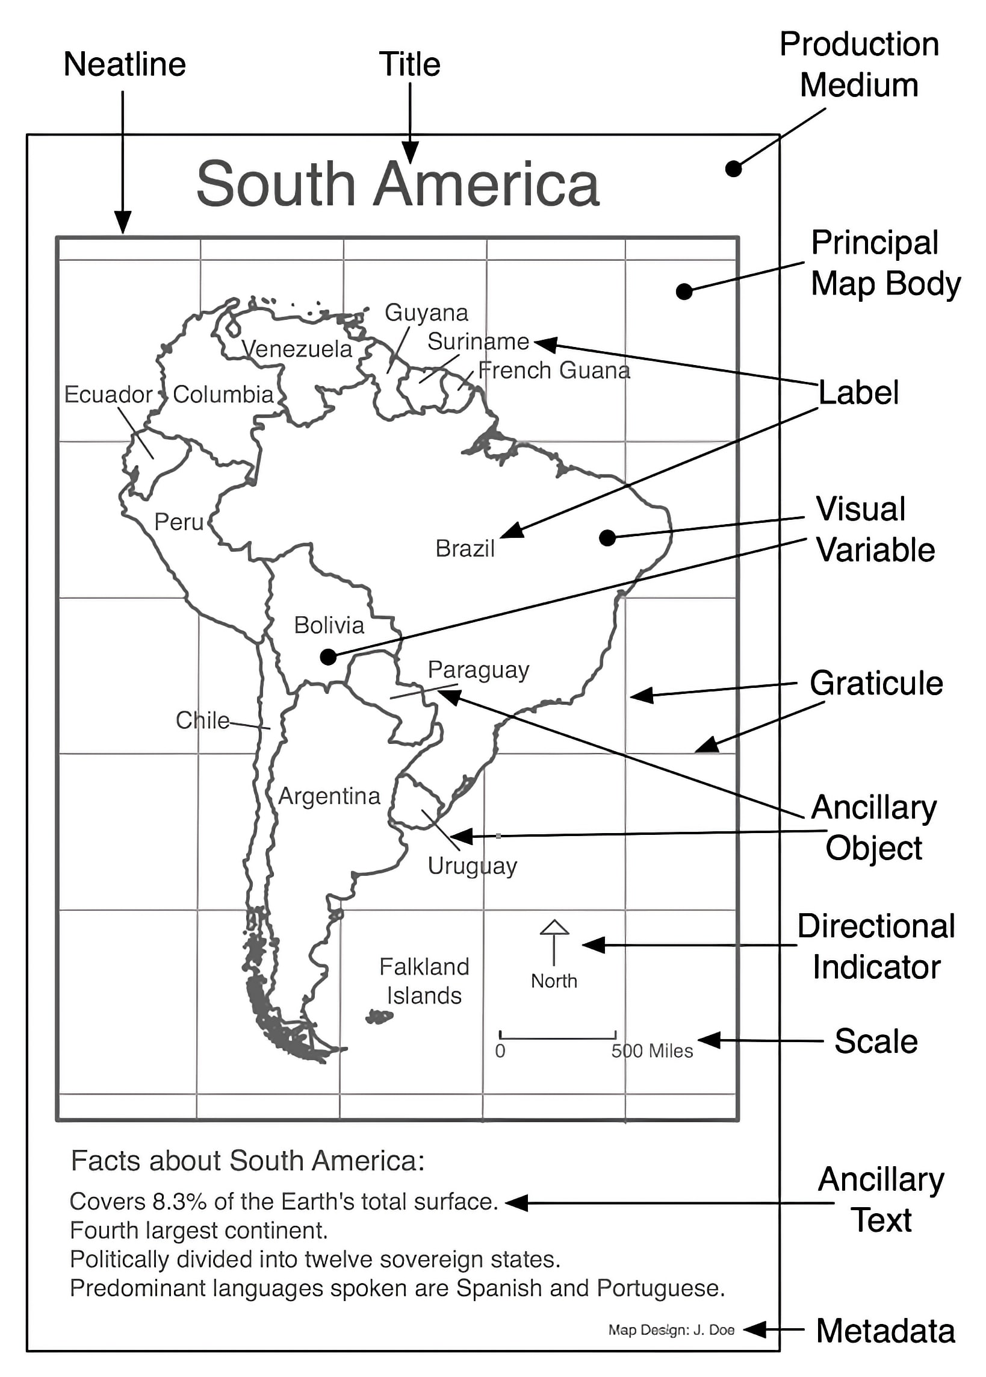

Slide 10
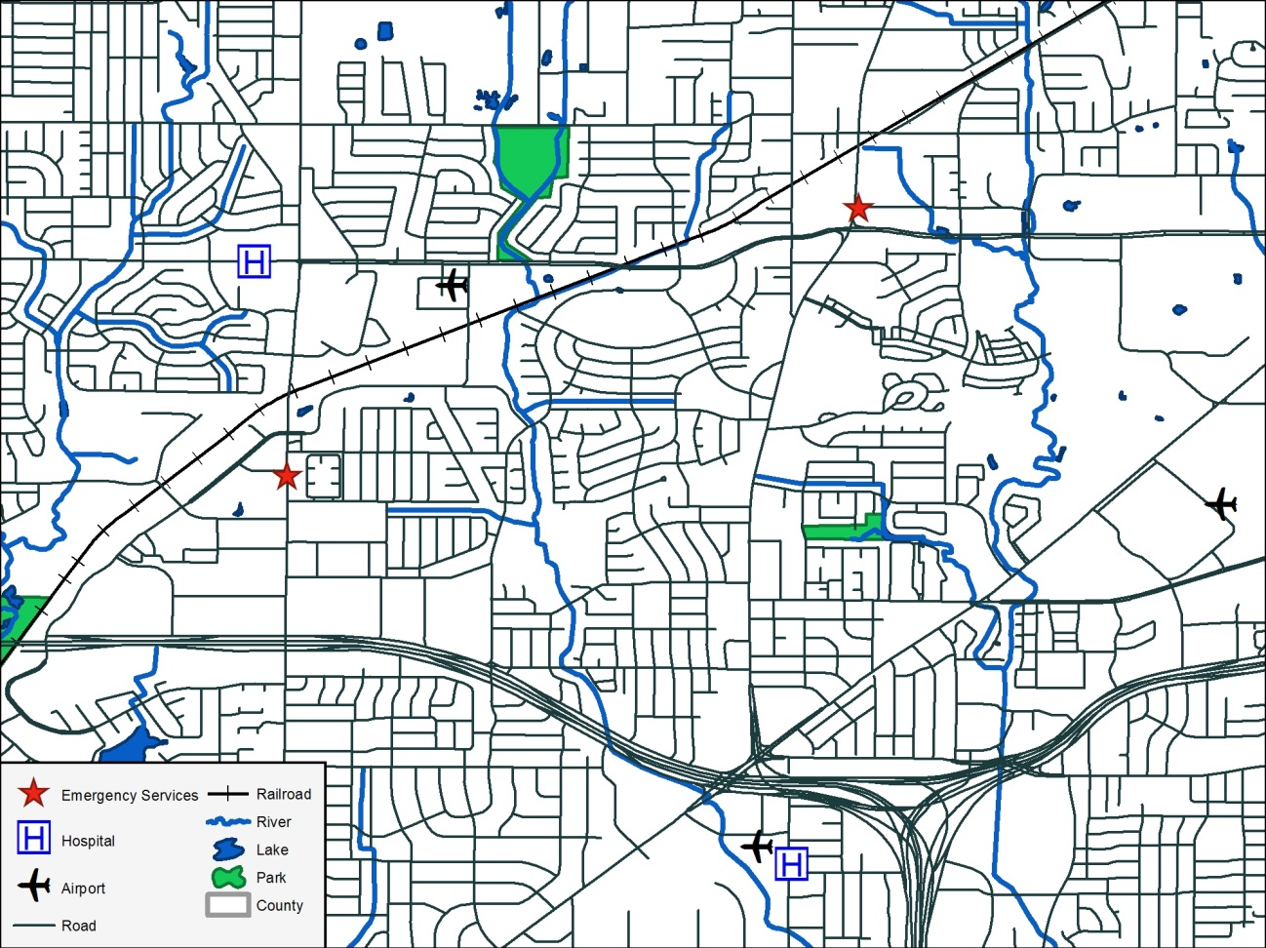
A General Reference Map
This map legend has two columns of information that are roughly equal in size. Each map feature is identified with a symbol that is identical to the symbol found on the map followed by the name of the map feature to the right of the symbol. On this general reference map legend common features such as lakes, parks, rivers, railroads, and roads are included, where they may not be included on thematic maps.

Slide 11
Basic Steps to Create a Basemap
Install/load Libraries
tigris package to fetch the data
ggplot2 (or tmap) for visualization.
Enable Caching
Use options(tigris_use_cache = TRUE) to save downloaded files locally, preventing repeated downloads.
Fetch Geographic Data
Call functions like states(), counties(), or roads() to retrieve the desired geometry.
Plot the Data
Use geom_sf() in ggplot2 to render the spatial object.

Slide 12
Example 1
library(tigris)
library(ggplot2)
# Cache data for faster future use (recommended)
options(tigris_use_cache = TRUE)
# 1. Fetch U.S. state boundaries
# cb = TRUE uses a lower-resolution "Cartographic Boundary" for faster plotting
us_states <- states(cb = TRUE, resolution = "20m")
# 2. Shift Alaska, Hawaii, and Puerto Rico for a standard "national" view
us_states_shifted <- shift_geometry(us_states)
# 3. Create the basemap
ggplot(data = us_states_shifted) +
geom_sf(fill = "whitesmoke", color = "darkgray") +
theme_void() +
labs(title = "U.S. State Basemap")

Slide 13
Example 2
library(tigris)
library(ggplot2)
library(sf)
library(dplyr)
options(tigris_use_cache = TRUE)
# 1. Get County Boundary
county_bound <- counties(state = "TX", cb = TRUE) %>%
filter(NAME == "Travis")
# 2. Get Water Bodies
county_water <- area_water(state = "TX", county = "Travis")
# 3. Get Roads (Primary and Secondary for clarity; 'roads()' gets every street)
county_roads <- primary_secondary_roads(state = "TX") %>%
st_intersection(county_bound) # Clip roads to the county boundary

Slide 14
ggplot() +
# Layer 1: County Background
geom_sf(data = county_bound, fill = "#fdfdfd", color = "black", size = 0.5) +
# Layer 2: Water
geom_sf(data = county_water, fill = "#a2d2ff", color = "transparent") +
# Layer 3: Roads
geom_sf(data = county_roads, color = "#6c757d", size = 0.2) +
# Formatting
theme_void() +
labs(
title = "Basemap of Travis County, TX",
subtitle = "Including Waterways and Primary/Secondary Roads",
caption = "Source: US Census Bureau via tigris"
) +
theme(
plot.title = element_text(face = "bold", hjust = 0.5),
plot.subtitle = element_text(hjust = 0.5),
panel.background = element_rect(fill = "white", color = NA)
)

Slide 15
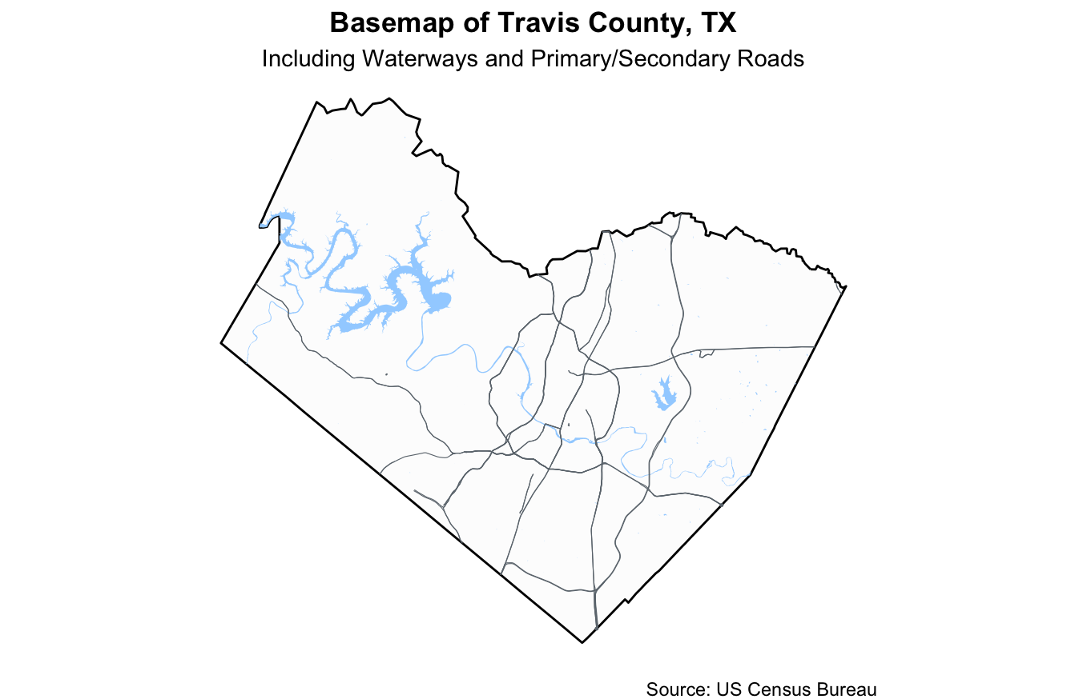

Slide 16
library(ggspatial)
ggplot() +
geom_sf(data = county_bound, fill = "wheat", color = "black", size = 0.5) +
geom_sf(data = county_water, fill = "#a2d2ff", color = "transparent") +
geom_sf(data = county_roads, color = "#6c757d", size = 0.2) +
# Add Scale Bar
annotation_scale(
location = "bl", # 'bl' = bottom left
width_hint = 0.4, # Proportion of the map the scale bar should take
style = "ticks" # Can also use "bar"
) +
# Add North Arrow
annotation_north_arrow(
location = "tr", # 'tr' = top right
which_north = "true", # Aligns to true north
pad_x = unit(0.2, "in"),
pad_y = unit(0.2, "in"),
style = north_arrow_fancy_orienteering()
) +
theme_void() +
labs(
title = "Basemap of Travis County, TX",
caption = "Caption: Scale and orientation provided by ggspatial"
)

Slide 17
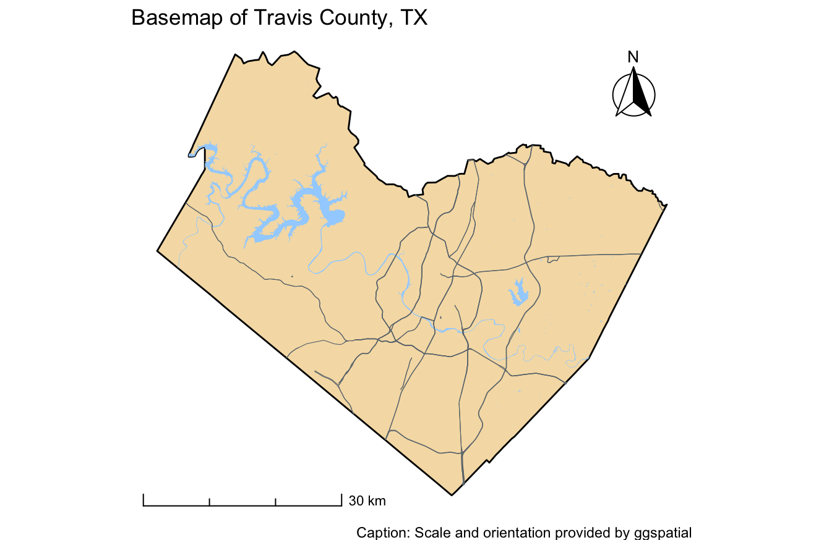

Slide 18
# Filter for large water bodies (in square meters)
large_water <- county_water %>%
mutate(area = as.numeric(st_area(.))) %>%
filter(area > 1000000) # Adjust this number based on your specific county
# Get a cleaned list of unique primary roads for labeling
road_labels <- county_roads %>%
filter(!is.na(FULLNAME)) %>%
group_by(FULLNAME) %>%
summarize() %>% # This dissolves multi-line geometries for cleaner labeling
st_centroid() # Place text at the center point of the road
library(ggrepel) # Optional but much better for label placement
ggplot() +
geom_sf(data = county_bound, fill = "#fdfdfd", color = "black") +
geom_sf(data = county_water, fill = "#a2d2ff", color = "transparent") +
geom_sf(data = county_roads, color = "#6c757d", size = 0.2) +
# Label Water Bodies
geom_sf_text(data = large_water, aes(label = FULLNAME),
color = "#0077b6", fontface = "italic", size = 3, check_overlap = TRUE) +
# Label Roads
geom_sf_text(data = road_labels, aes(label = FULLNAME),
color = "black", size = 2.5, check_overlap = TRUE) +
annotation_scale(location = "bl") +
annotation_north_arrow(location = "tr", style = north_arrow_minimal()) +
theme_void()

Slide 19
# A cleaned list of unique primary roads for labeling
road_labels <- county_roads %>%
filter(!is.na(FULLNAME)) %>%
group_by(FULLNAME) %>%
summarize() %>% # This dissolves multi-line geometries for cleaner labeling
st_centroid() %>% # Place text at the center point of the road
ungroup() %>%
slice_sample(n = 10) # Randomly pick 10
# Or longest roads
road_labels <- county_roads %>%
filter(!is.na(FULLNAME)) %>%
group_by(FULLNAME) %>%
summarize() %>% # Merges all segments of the same road name
mutate(road_length = st_length(geometry)) %>%
arrange(desc(road_length)) %>% # Sort by length
slice_head(n = 7) %>% # Take the top 7
st_point_on_surface() # Better than centroid for winding roads

Slide 20
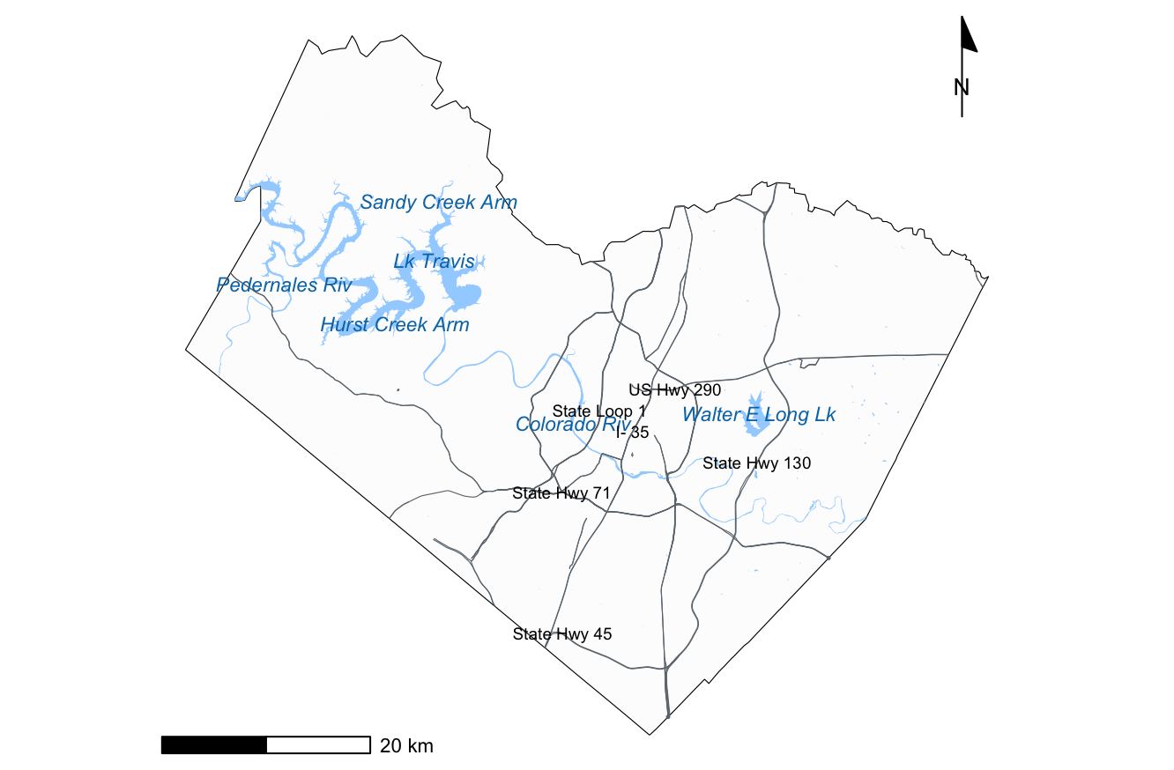

Slide 21
Data Representation Thematic Maps
A popular way of presenting information about spatial patterns is to use a thematic map.
Data is aggregated by predefined spatial units (geo-administrative layers, e.g., countries, states, or districts).
A broader category that includes various types of maps (e.g., choropleth, dot density, proportional symbols, isopleth maps, etc.)
A thematic map shows the spatial distribution of one or more specific data themes for selected geographic areas.
The data may be quantitative (e.g., percentage population change, income distribution) or qualitative (e.g., predominant soil types).
The basic way to create a vector thematic map is to identify the field in the attribute table of the map layer that will be used for mapping.
Note, the basemaps can be used for context!

Slide 22
Data Representation Thematic Maps
Vector data have attributes that describe properties of the features.
The attributes are stored in a table.
Rows are records.
There is one record per feature in the vector layer.
Columns are fields.
Fields represent properties of the feature (e.g. height, color etc.)
Fields can contain numerical, string (text) and date information.
The attribute data can be used to determine how it is symbolized.
If the attribute of a vector layer is not used to determine its symbology, it is drawn using a single symbol only.
Graduated color symbology groups the data into discrete classes.
Continuous color symbology assigns colors from a color range to the features based on their attributes.
Classifying attribute data (into nominal, ordinal, interval, and ratio types) helps in selecting appropriate spatial analysis and thematic mapping techniques.
Normalized data* (e.g., percentages or densities) instead of raw count values in a choropleth map helps to prevent misleading interpretations due to differences in area size.
* normalization (min-max scaling to a range), standardization (type of normalization, but using z-score/mean centering)

Slide 23
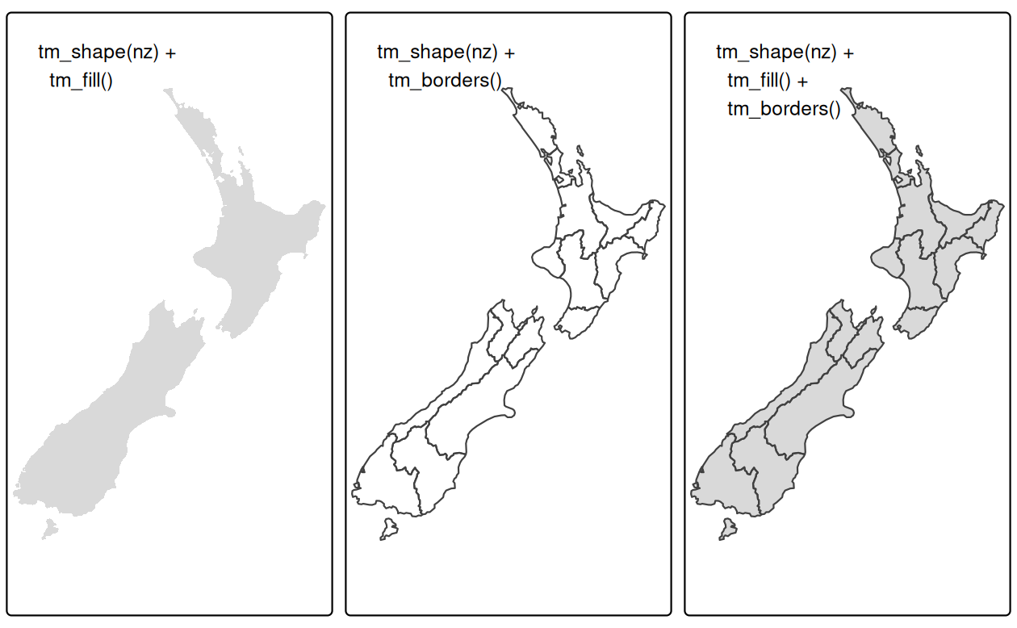
tmap basics
Like ggplot2, tmap is based on the idea of a 'grammar of graphics'.
This involves a separation between the input data and the aesthetics (how data are visualized):
each input dataset can be 'mapped' in a range of different ways including location on the map (defined by data's geometry), color, and other visual variables.
The basic building block is tm_shape() (which defines input data: a vector or raster object), followed by one or more-layer elements such as tm_fill() and tm_dots().
Example
library(sf)
library(terra)
library(dplyr)
library(spData)
library(spDataLarge)
library(tmap) # for static and interactive maps
library(leaflet) # for interactive maps
library(ggplot2) # tidyverse data visualization package
nz_elev = rast(system.file("raster/nz_elev.tif",
package = "spDataLarge"))
# Add fill layer to nz shape
tm_shape(nz) + tm_fill()
# Add border layer to nz shape
tm_shape(nz) + tm_borders()
# Add fill and border layers to nz shape
tm_shape(nz) + tm_fill() + tm_borders()

Slide 24
Data Representation Rate vs Count
Count (Absolute): The raw number of occurrences within a boundary (e.g., total number of traffic accidents, total population).
Rate (Relative): A value derived by dividing the count by a denominator, such as population or land area (e.g., accidents per 1,000 residents, cases per square mile).
"Population Bias" Trap … when mapping Counts at the geographic level:
Large or densely populated counties will almost always appear as "hotspots."
You end up mapping where people live rather than the intensity of the variable.
Example: Mapping total COVID-19 cases will always highlight Los Angeles and New York City, even if the risk of infection is higher in a small rural town.
Feature | Use Count When... | Use Rate When...
Objective | You need to know the total magnitude or volume. | You need to compare the intensity or risk across regions.
Resource Allocation | Determining how many total vaccines to ship to a county. | Determining which county has the highest infection risk.
Visual Encoding | Best used with Proportional Symbols (bubbles). | Best used with Choropleth Maps (shaded regions).
"Never shade a county map based on raw counts." >> To normalize data for fair comparison, always convert counts to rates (normalization) using a common denominator (Rate = Count / Population ​× 100,000) or density (Density = Count / Area​).

Slide 25
library(sf)
library(dplyr)
library(ggplot2)
library(patchwork)
library(viridis)
# Create simple square geometries to represent counties in a grid
polys <- st_sfc(
st_polygon(list(matrix(c(0,0, 1,0, 1,1, 0,1, 0,0), ncol=2, byrow=TRUE))), # Bottom Left
st_polygon(list(matrix(c(1,0, 2,0, 2,1, 1,1, 1,0), ncol=2, byrow=TRUE))), # Bottom Right
st_polygon(list(matrix(c(0,1, 2,1, 2,2, 0,2, 0,1), ncol=2, byrow=TRUE))) # Top (Large)
)
# Convert to sf object and add the table data
df <- data.frame(
name = c("Rural County", "Suburban County", "Urban County"),
total_incidents = c(50, 100, 500),
population = c(5000, 50000, 1000000),
incident_rate = c(10.0, 2.0, 0.5) # Incidents per 1,000)
# Join geometry to data
comparison_data <- st_sf(df, geometry = polys)
# Add centroid coordinates for labeling
comparison_data <- comparison_data %>%
mutate(
centroid = st_centroid(geometry),
lon = st_coordinates(centroid)[,1],
lat = st_coordinates(centroid)[,2])

Slide 26
# 2. CREATE MAP 1: WRONGFUL (COUNT) ----------------------------------------
map_count <- ggplot(comparison_data) +
# Shade by Total Incidents
geom_sf(aes(fill = total_incidents), color = "black", size = 0.5) +
# Color scale
scale_fill_viridis_c(option = "rocket", begin = 0.3, end = 1) +
geom_text(aes(x = lon, y = lat, label = name),
fontface = "bold", nudge_y = 0.2, check_overlap = TRUE) +
geom_text(aes(x = lon, y = lat, label = paste("Count:", total_incidents)),
size = 3.5, nudge_y = -0.1) +
geom_text(aes(x = lon, y = lat, label = paste("Pop:", format(population, big.mark=","))),
size = 3.5, nudge_y = -0.3) +
theme_void() +
labs(
title = "Map 1: Wrongful Showing (Raw Count)",
subtitle = "Darker colors focus only on magnitude, ignoring population size.",
fill = "# of\nIncidents"
) +
theme(
plot.title = element_text(color = "red", face = "bold", size = 14),
legend.position = "right",
plot.margin = margin(10,10,10,10)
)

Slide 27
# 3. CREATE MAP 2: CORRECT (RATE) ------------------------------------------
map_rate <- ggplot(comparison_data) +
geom_sf(aes(fill = incident_rate), color = "black", size = 0.5) +
scale_fill_viridis_c(option = "mako", direction = -1) +
geom_text(aes(x = lon, y = lat, label = name),
fontface = "bold", nudge_y = 0.2, check_overlap = TRUE) +
geom_text(aes(x = lon, y = lat, label = paste("Rate:", incident_rate)),
size = 3.5, nudge_y = -0.1, color = "white") +
theme_void() +
labs(
title = "Map 2: Correct Showing (Normalized Rate)",
subtitle = "Darker colors focus on intensity, revealing the true hotspot.",
fill = "Rate per\n1,000 Pop."
) +
theme(
plot.title = element_text(color = "green4", face = "bold", size = 14),
legend.position = "right",
plot.margin = margin(10,10,10,10)
)
# 4. DISPLAY COMPARISON USING PATCHWORK ------------------------------------
comparison_plot <- map_count / map_rate # Stack them vertically
comparison_plot <- map_count + map_rate # Stack them vertically
comparison_plot

Slide 28
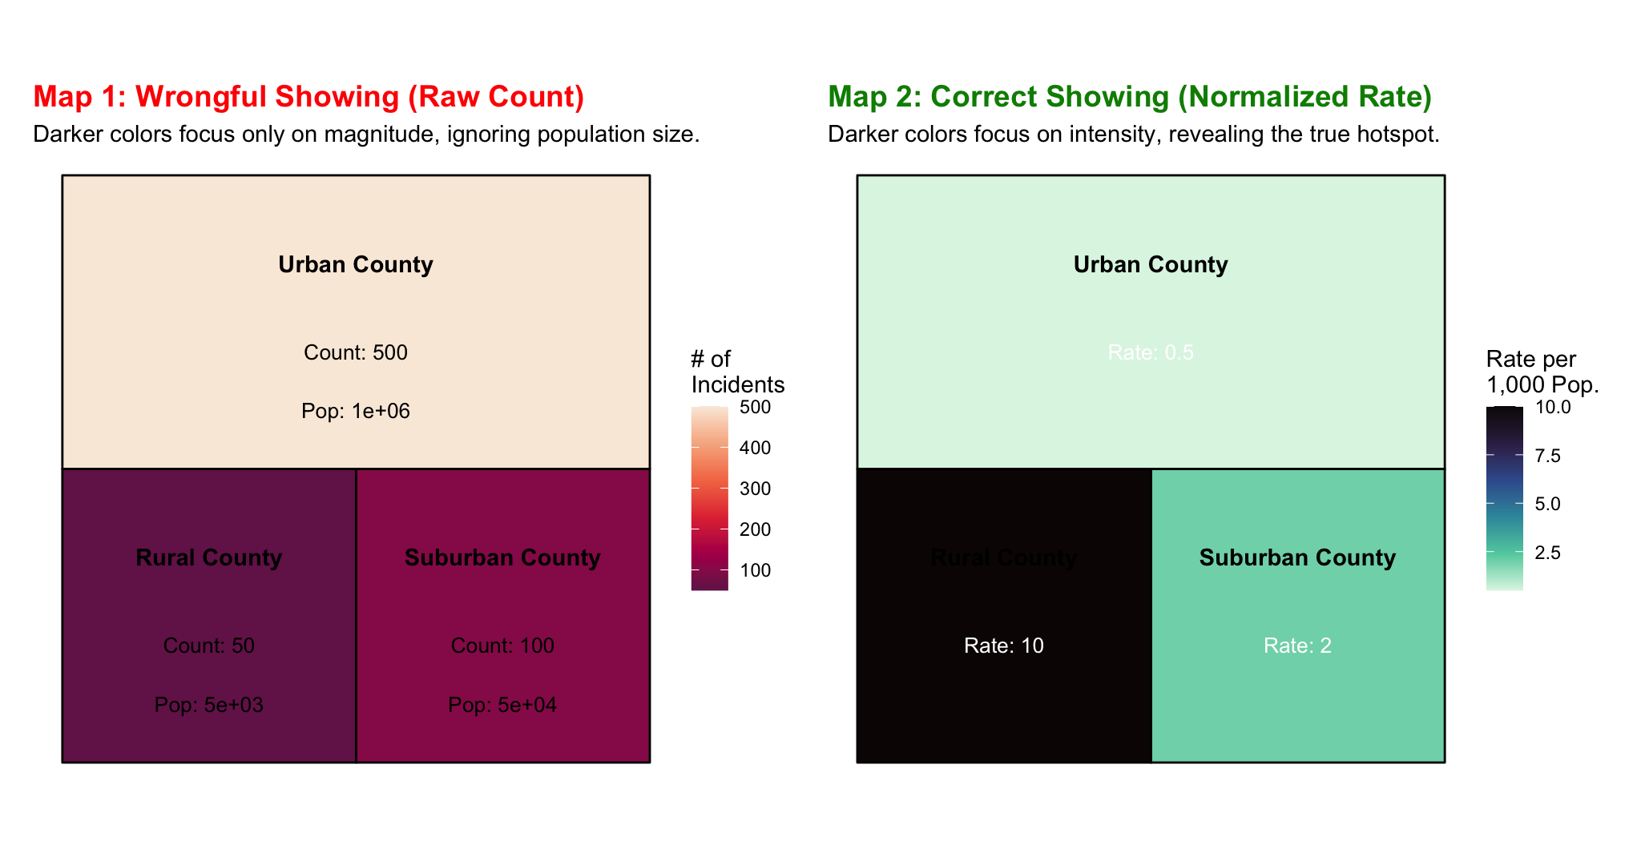

Slide 29
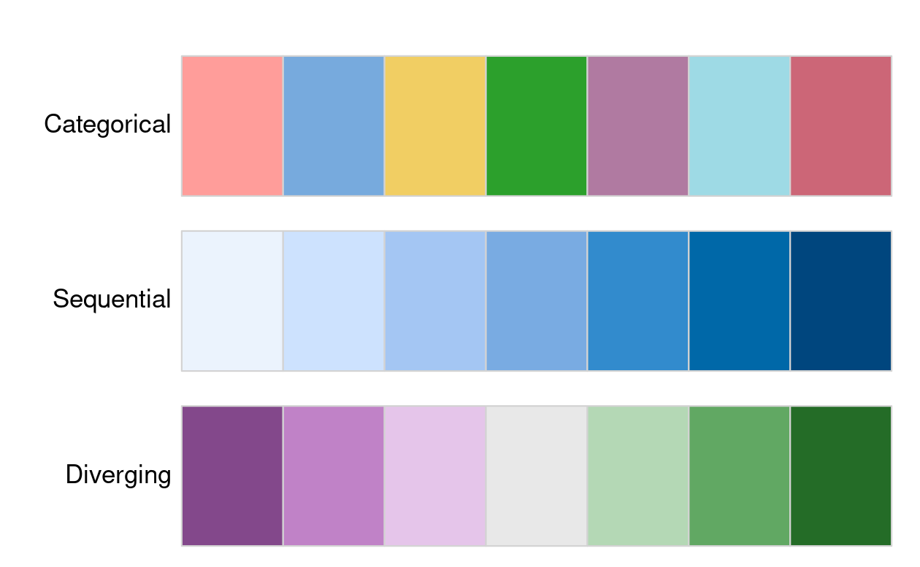
Data Representation Color
There are two important principles for consideration when working with colors: perceptibility and accessibility.
R color cheatsheet
ColorBrewer: Color Advice for Maps
Categorical palettes
Consist of easily distinguishable colors and are most appropriate for categorical data without any particular order such as state names or land cover classes.
Colors should be intuitive: rivers should be blue, for example, and pastures green.
Avoid too many categories: maps with large legends and many colors can be uninterpretable.
Sequential palettes
Follow a gradient, for example from light to dark colors (light colors often tend to represent lower values), and are appropriate for continuous (numeric) variables.
Sequential palettes can be single (greens goes from light to dark green, for example) or multi-color/hue.
Diverging palettes
Typically range between three distinct colors (purple-white-green) and are usually created by joining two single-color sequential palettes with the darker colors at each end.
Their main purpose is to visualize the difference from an important reference point, e.g., a certain temperature, the median household income or the mean probability for a drought event.

Slide 30
Legend
After we decided on our visual variable and its properties, we should move our attention toward the related map legend style.
Using the tm_legend() function, we may change its title, position, orientation, or even disable it.
The most important argument in this function is title, which sets the title of the associated legend.
In general, a map legend title should provide two pieces of information:
what the legend represents
what the units are of the presented variable.
Check the scales … breaks control how the values are represented on the map and in the legend, and they largely depend on the selected visual variable.
The default setting uses 'pretty' breaks
But breaks allows you to manually set the breaks
n sets the number of bins into which numeric variables are categorized
values defines the color scheme, for example, BuGn

Slide 31
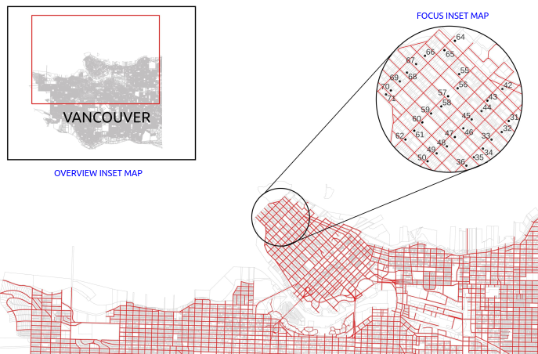
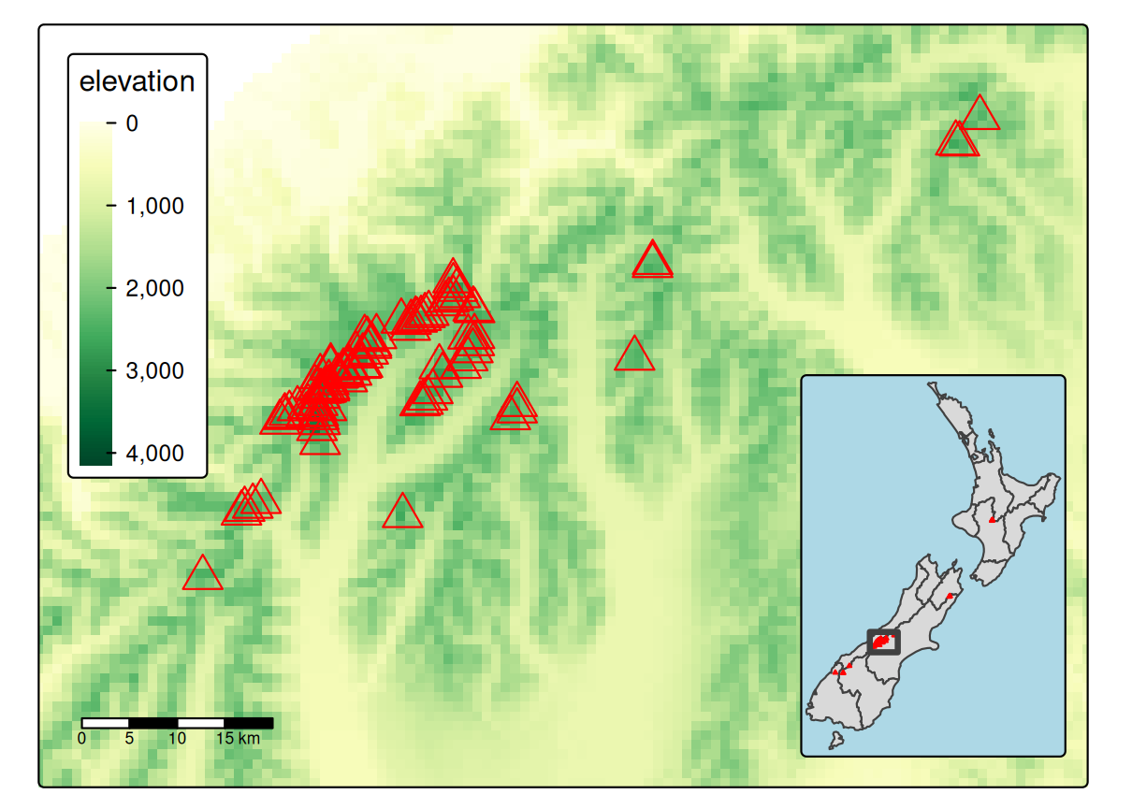
Context Inset Maps
An inset map is a smaller map rendered within or next to the main map.
It could serve many different purposes, including providing a context or bringing some non-contiguous regions closer to ease their comparison.

Slide 32
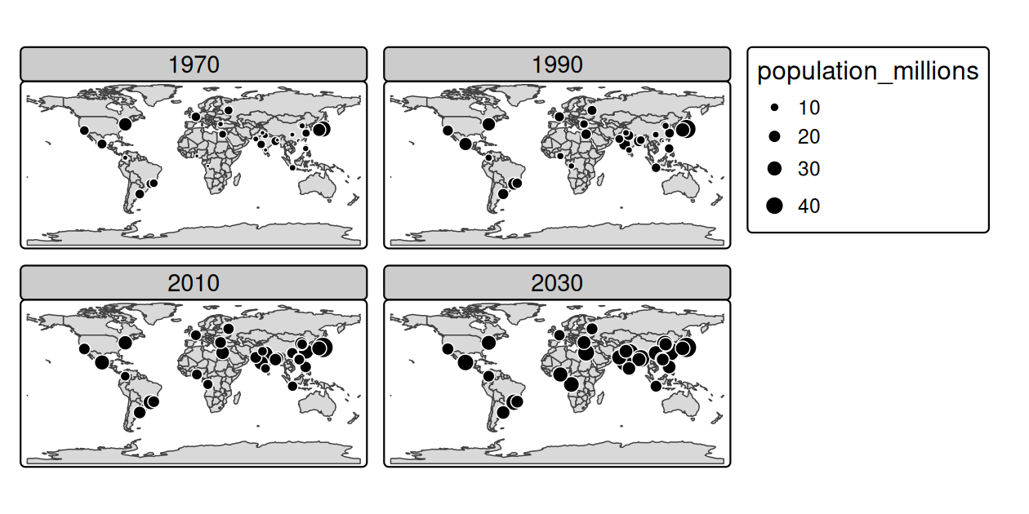
Faceted Maps
Faceted maps, also referred to as 'small multiples', are composed of many maps arranged side-by-side, and sometimes stacked vertically.
Facets enable the visualization of how spatial relationships change with respect to another variable, such as time.
Example
urb_1970_2030 = urban_agglomerations |>
filter(year %in% c(1970, 1990, 2010, 2030))
tm_shape(world) +
tm_polygons() +
tm_shape(urb_1970_2030) +
tm_symbols(fill = "black", col = "white", size = "population_millions") +
tm_facets_wrap(by = "year", nrow = 2)

Slide 33
Animated maps

Slide 34
Faceted maps can show how spatial distributions of variables change (e.g., over time), but the approach has disadvantages.
Facets become tiny when there are many of them.
Animated maps solve these issues. Although they depend on digital publication, this is becoming less of an issue as more and more content moves online.
Example
urb_anim = tm_shape(world) + tm_polygons() +
tm_shape(urban_agglomerations) + tm_symbols(size = "population_millions") +
tm_facets_wrap(by = "year", nrow = 1, ncol = 1, free.coords = FALSE)
tmap_animation(urb_anim, filename = "urb_anim.gif", delay = 25)

Slide 35
Interactive maps

Slide 36
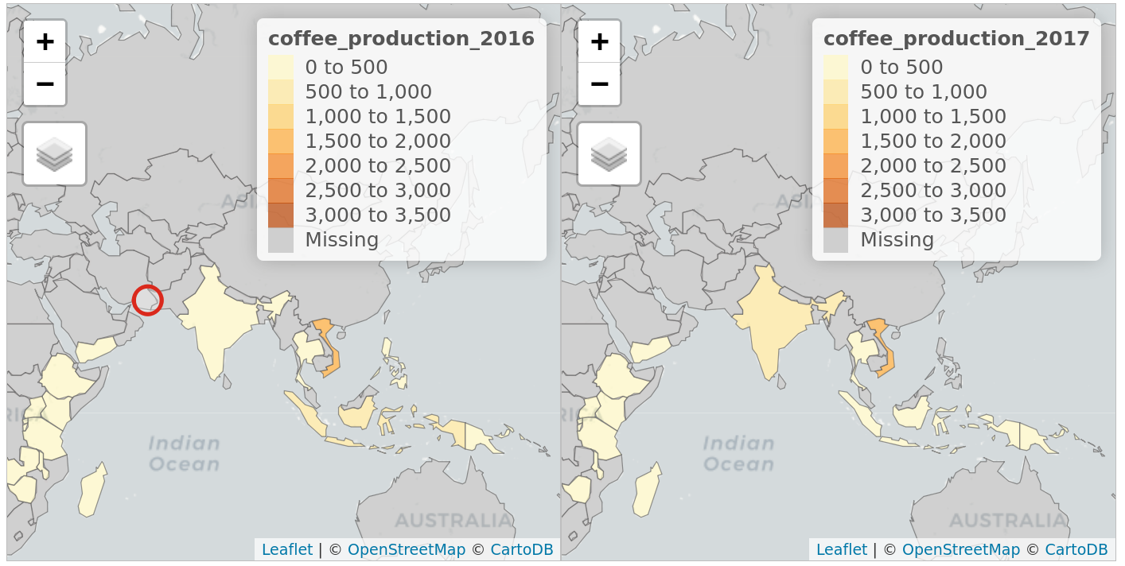
While static and animated maps can enliven geographic datasets, interactive maps can take them to a new level.
Interactivity can take many forms, the most common and useful of which is the ability to pan around and zoom into any part of a geographic dataset overlaid on a 'web map' to show context.
Less advanced interactivity levels include pop-ups which appear when you click on different features, a kind of interactive label
Example
tmap_mode("view")
map_nz
map_nz + tm_basemap(server = "OpenTopoMap")
world_coffee = left_join(world, coffee_data, by = "name_long")
facets = c("coffee_production_2016", "coffee_production_2017")
tm_shape(world_coffee) + tm_polygons(facets) +
tm_facets_wrap(nrow = 1, sync = TRUE)

Slide 37
Mapping applications

Slide 38
While interactive web maps (e.g., leaflet) allow for zooming and panning, mapping applications provide a higher level of interactivity and scalability by using server-side frameworks.
Limitations of basic web maps:
Fixed interface: The UI is static and cannot be easily customized by the user.
Data scaling: Basic web maps struggle with very large datasets as all content is typically pre-loaded.
Low complexity: Difficult to integrate complex dashboards, real-time graphs, or multi-variable relationships.
The Power of Shiny (for R Users):
Rapid development: Convert R code directly into interactive web apps without needing deep HTML/JS knowledge.
Integration: Seamlessly embed maps using functions like leaflet::renderLeaflet()
Reactive logic: Maps can update instantly based on user input, filters, or external data changes.
Enterprise-Level Framework:
For high-traffic or massive data needs, R can interface with or be replaced by dedicated map servers:
GeoServer / MapServer: Mature, scalable servers for thousands of daily users.
GeoDjango: Python-based framework for complex geospatial web development.

Slide 39
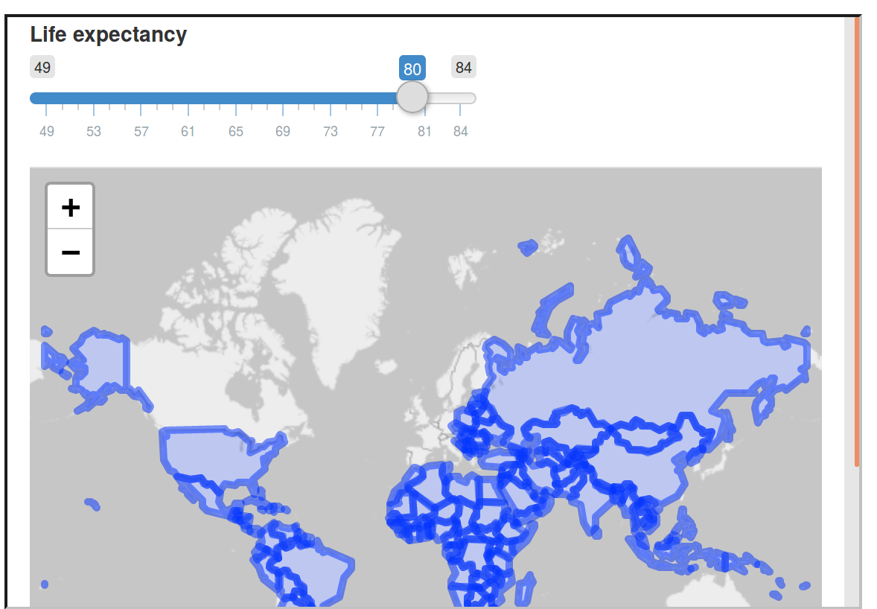
library(shiny) # for shiny apps
library(leaflet) # renderLeaflet function
library(spData) # loads the world dataset
ui = fluidPage(
sliderInput(inputId = "life", "Life expectancy", 49, 84, value = 80),
leafletOutput(outputId = "map")
)
server = function(input, output) {
output$map = renderLeaflet({
leaflet() |>
# addProviderTiles("OpenStreetMap.BlackAndWhite") |>
addPolygons(data = world[world$lifeExp < input$life, ])})
}
shinyApp(ui, server)

Slide 40
More References
Cartographic Design Process https://colorado.pressbooks.pub/makingmaps/chapter/cartographic-design-process/
Crime Mapping and Spatial Data Analysis using R Chapter 6 Basics of cartographic design: elements of a map https://maczokni.github.io/crime_mapping/basics-of-cartographic-design-elements-of-a-map.html

Slide 41
Next
Getting started with statistical learning
Exploratory spatial data analysis https://cran.r-project.org/web/packages/geostan/vignettes/measuring-sa.html
Measures of spatial autocorrelation https://r-spatial.org/book/15-Measures.html
Point pattern analysis https://r-spatial.org/book/11-PointPattern.html
Spatial interpolation https://r-spatial.org/book/12-Interpolation.html

Slide 42
Notes
Meet a new format: geoJSON
GeoJSON is an open standard format designed for representing simple geographical features, along with their non-spatial attributes.
It is based on JSON, the JavaScript Object Notation.
It is a format for encoding a variety of geographic data structures and is the most common format for geographical representation in the web.
Unlike ESRI shapefiles, with GeoJSON data everything is stored in a single file.

