Slide 1

Spatial Statistics
Alexander Abuabara
DAEN 489 ISEN 489 Spring 2026

Slide 2
Today
Exploratory spatial data analysis
Measures of Spatial Autocorrelation
Point Pattern Analysis
(vs)
Spatial Interpolation

Slide 3
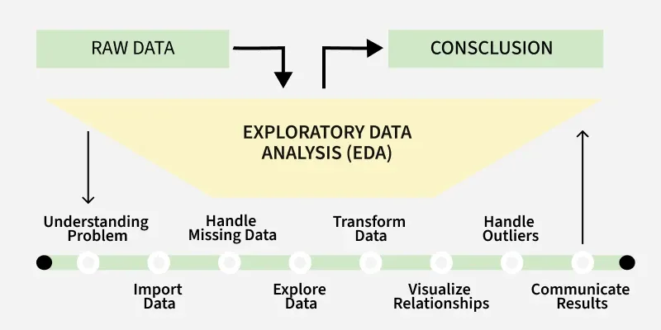
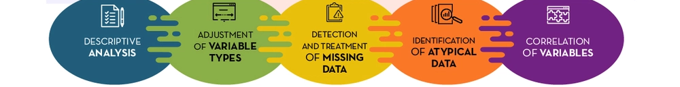
Exploratory Data Analysis (EDA)
Exploratory Data Analysis (EDA) uses a range of visual techniques (such as histograms, scatter plots, and similar tools) to summarize complex datasets.
By condensing the data and filtering out less relevant details, these methods highlight key patterns, trends, and variations, making the most important features easier to interpret.

Slide 4
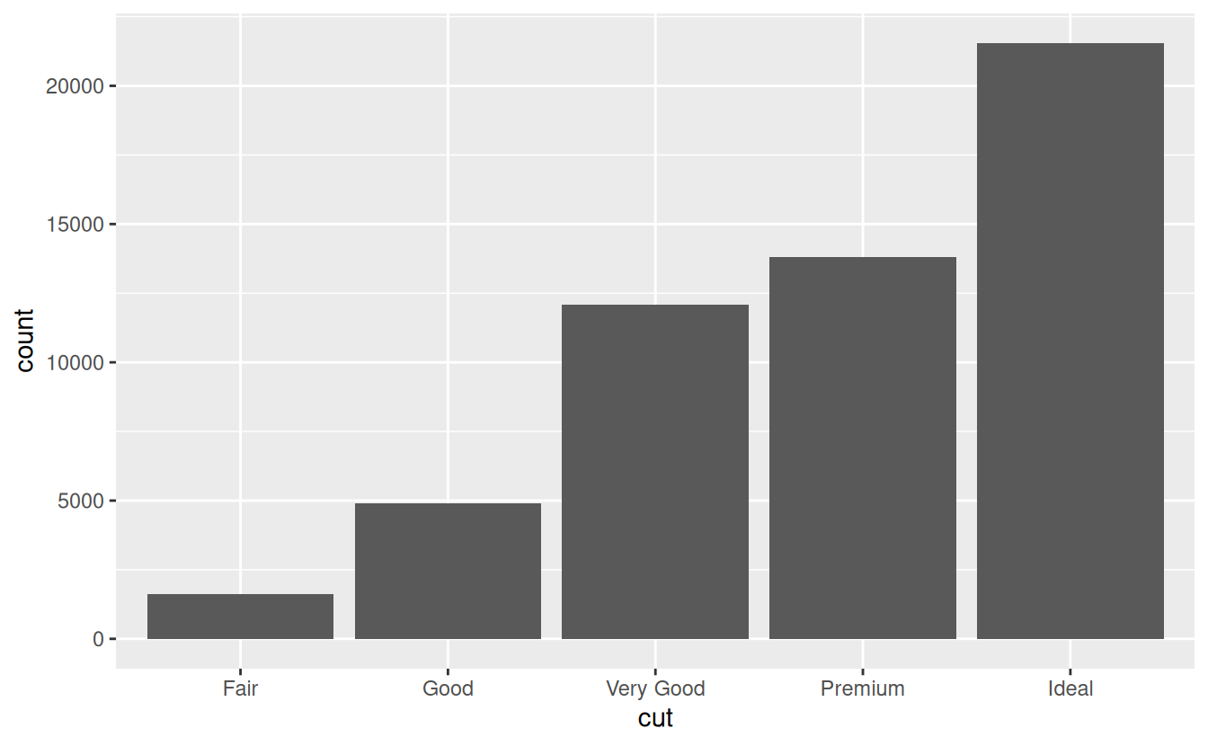
Exploratory Data Analysis (EDA)
Questions
Your goal during EDA is to develop an understanding of your data.
The easiest way to do this is to use questions as tools to guide your investigation:
What type of variation occurs within my variables?
What type of covariation occurs between my variables?
Variation is the tendency of the values of a variable to change from measurement to measurement.
Visualizing distributions:
Example 1 ^{(cat.)}
library(ggplot2)
summary(diamonds$cut)
# Fair 1610
# Good 4906
# Very Good 12082
# Premium 13791
# Ideal 21551
diamonds %>%
count(cut)
# cut n
# <ord> <int>
# 1 Fair 1610
# 2 Good 4906
# 3 Very Good 12082
# 4 Premium 13791
# 5 Ideal 21551
ggplot(data = diamonds) + geom_bar(mapping = aes(x=cut))
R for Data Science Exploratory Data Analysis
https://r4ds.had.co.nz/exploratory-data-analysis.html

Slide 5
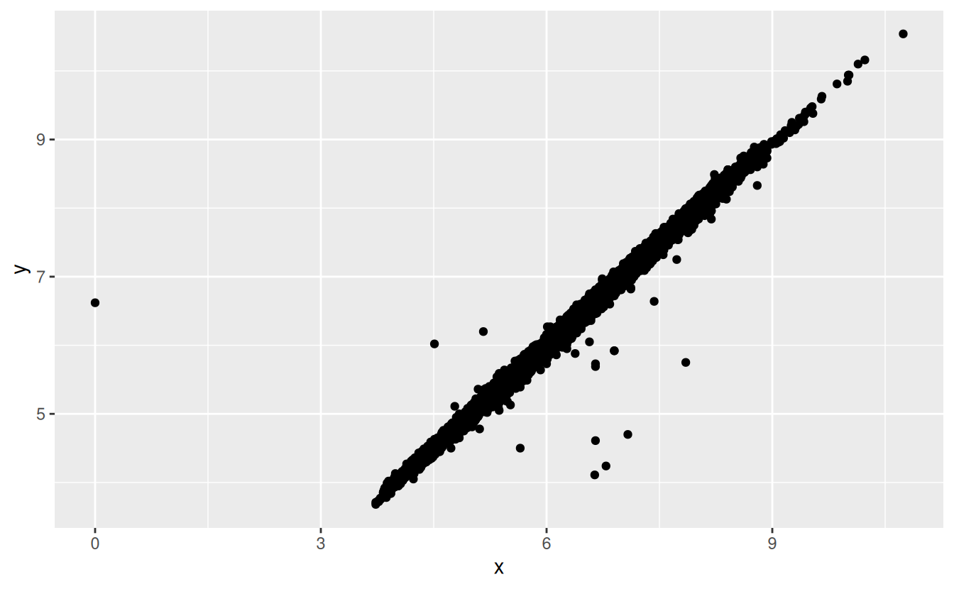
Exploratory Data Analysis (EDA)
Missing Values
If you've encountered unusual values in your dataset and simply want to move on to the rest of your analysis, you have two options:
Drop the entire row with the strange values.
Replacing the unusual values with missing values.
Example 1 ^{(cat.)}
# I don't recommend this option
# bc just because one
# measurement is invalid,
# doesn't mean all the
# measurements are
diamonds2 <- diamonds %>%
filter(between(y, 3, 20))
diamonds2 <- diamonds %>%
mutate(y = ifelse(y < 3 | y > 20, NA, y))
ggplot(data = diamonds2,
mapping = aes(x = x,
y = y)) +
geom_point(na.rm = TRUE)
🥸
missing values should never silently go missing

Slide 6

Exploratory Spatial Data Analysis (ESDA)
ESDA extends traditional EDA by incorporating the spatial dimension of data.
In addition to standard visual summaries, ESDA emphasizes mapping (including residual patterns), breaking down spatial structures into meaningful components, and quantifying the degree of spatial dependence or clustering.
By highlighting unusual observations (such as values that differ markedly from their neighbors), ESDA allows analysts to interpret patterns in their geographic context.
More broadly, the principles of exploratory analysis emphasize open-ended investigation and typically avoid formal hypothesis testing in the early stages of analysis.
Don't be like this neighbor ...

Slide 7

Tobler's First Law of Geography
"Everything is related to everything else, but near things are more related than distant things." Waldo Tobler (1930-2018)
Distance Decay The further apart two things are, the less they interact or influence each other
Spatial Autocorrelation The mathematical way to measure this "relatedness"
Neighborhood Effect Expect neighbors to be similar
Friction of distance
If it's raining at a house, it's likely raining at neighbor's house, but it might be sunny somewhere else.
The price of a house is heavily influenced by the prices of the houses on that same street.
People in neighboring towns usually speak with similar accents; people across the country sound different.

Slide 8
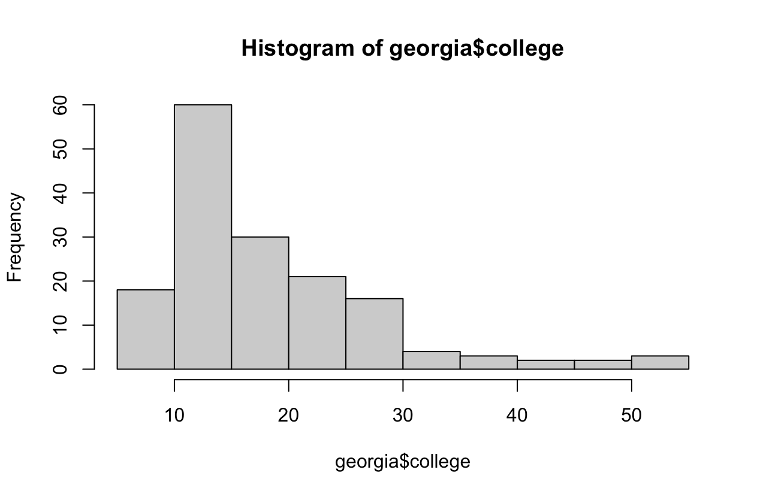
(Spatial) Diagnostic Summary
If we pass any variable x and its corresponding spatial object (e.g., simple features) to the sp_diag function, it returns a histogram, Moran scatter plot, and map of the estimates:
Example 2 ^{(cont.)}
library(geostan)
library(ggplot2)
library(gridExtra)
data("georgia")
hist(georgia$college)
summary(georgia$college)
# Min. 1st Qu. Median Mean 3rd Qu. Max.
# 7.0 12.0 15.2 18.2 21.4 51.7

Slide 9
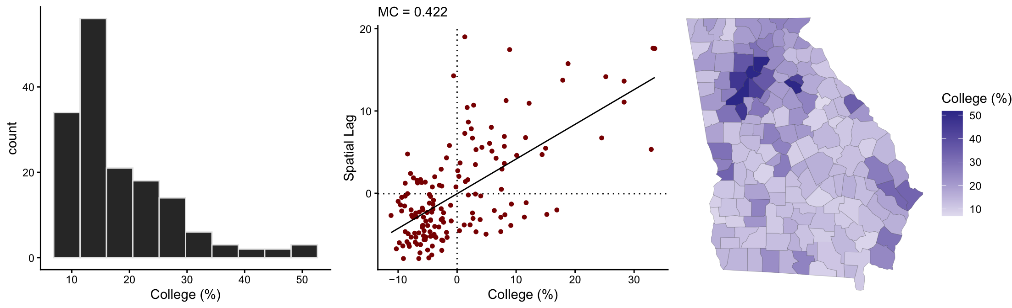
Spatial Diagnostic Summary
If we pass any variable x and its corresponding spatial object (e.g., simple features) to the sp_diag function, it returns a histogram, Moran scatter plot, and map of the estimates:
Example 2 ^{(cont.)}
library(geostan)
library(ggplot2)
library(gridExtra)
data("georgia")
sp_diag(georgia$college, georgia, name = "College (%)")

Slide 10
Spatial Lag
The spatial lag (y-axis) represents the average value of the variable in neighboring locations for each observation.
In this case, for each county, it is the average College (%) of its neighboring counties.
It provides a way to compare a location's value (x-axis) with the surrounding context.
Points along the upward trend indicate that counties with high (or low) college attainment tend to be surrounded by similar counties.
Points far from the trend suggest local anomalies (e.g., a county very different from its neighbors).
Spatial Weights Matrix (𝑊): Defines the structure of the neighborhood. Common types include connectivity ^{(neighbors get equal weight)} and inverse distance (closer neighbors get higher weight).

Slide 11
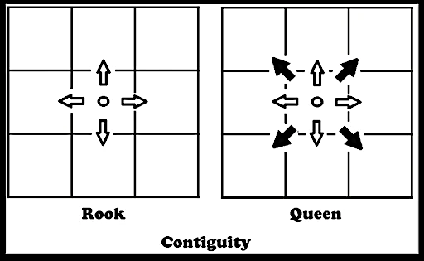
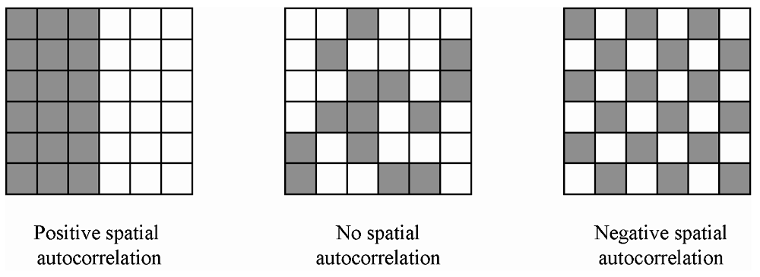
Spatial Weights Matrix
To summarize spatial information for the purpose of data analysis, we use an 𝑁×𝑁 matrix, which we will call 𝑊.
Given some focal point/area on the map, the term "neighbor" will refer to any other area that is considered geographically 'near'.
The meaning is context specific, but with areal data the most common choice is to say that all areas whose borders touch each other are neighbors. Sometimes a distance threshold is used.
"B" for binary; use "W" for row-standardized weights.
Method for determining neighbors:
queen, rook, or k-nearest neighbors (see details ?shape2mat for more information)
Example 2
W <- shape2mat(georgia, style = "W")
# Contiguity condition: queen
# Number of neighbors per unit, summary:
# Min. 1st Qu. Median Mean 3rd Qu. Max.
# 1.000 4.000 5.000 5.409 6.000 10.000
#
# Spatial weights, summary:
# Min. 1st Qu. Median Mean 3rd Qu. Max.
# 0.1000 0.1429 0.1667 0.1849 0.2000 1.0000

Slide 12

Spatial Lag
To calculate the spatial lag for a specific location, we use this formula:
$y_{lag,i}=\sum_{j=1}^{n}{w_{ij}y_{j}}$
$y_{lag,i}$ is the spatial lag value for location $i$
The summation adds up the weighted values of all neighbors.
$w_{ij}$ is the spatial weight.
This number tells how much location $j$ influences location $i$
If they are neighbors, $w$ might be 1 (or a fraction)
If they are far apart, $w=0$
$y_{j}$ is the actual value of the variable (like price or temperature) at the neighboring location $j$.

Slide 13
Spatial Lag
Example:
If you have three neighbors with college graduation rates of 30%, 32%, and 28%
They are all weighted equally (1/3 each)
The spatial lag for your county is: = (0.33 × 30%) + (0.33 × 32%) + (0.33 × 28%) = 9.9% + 10.56% + 9.24% = 29.7%
If your county actual rate is 45% and the county spatial lag ^{(neighborhood average)} 29.7%, the county is an "outlier" or a "hot spot". Even though it is surrounded by counties where only about 30% of people have degrees, your county is performing significantly higher.
In a research paper, this might lead to ask: "Why is your county different? Does it have a major university or a specific industry that its neighbors lack?"
Without the spatial lag, you wouldn't realize just how much your county stands out from its local context.

Slide 14
Moran's I Coefficient
A measure of spatial autocorrelation:
Quantifies how similar values are across nearby locations.
The value ranges roughly from -1 to +1:
Positive (0.422) → nearby areas tend to have similar values (clustering)
Near 0 → spatial randomness
Negative → nearby areas tend to be dissimilar (dispersion)
A value of 0.422 indicates a moderate positive spatial autocorrelation, meaning counties with similar college attainment levels tend to cluster geographically.
Spatial autocorrelation refers to the degree to which values of a variable are similar ^{(or dissimilar)} across nearby geographic locations.
In essence, it captures whether "location matters" in the distribution of a variable (i.e., whether what happens in one place is related to what happens nearby).

Slide 15
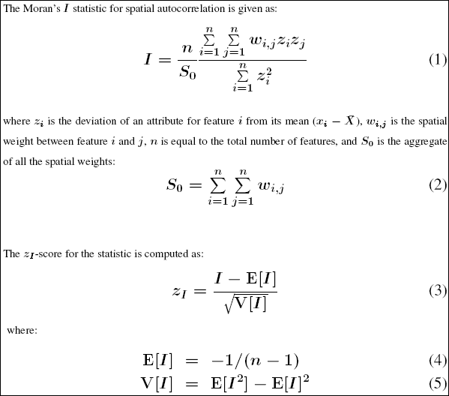
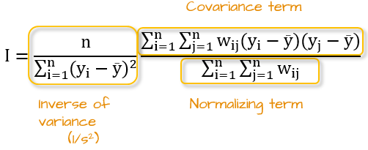
Moran's I Coefficient
Moran's I is calculated as a version of the standard correlation coefficient, but instead of comparing two different variables (like height and weight), it compares the same variable with its spatial lag (itself vs. its neighbors).
It essentially tells you if the pattern is clustered (similar values together), dispersed (like a checkerboard), or random.
Check: https://gis.stackexchange.com/questions/421403/using-weight-component-in-moran-i-calculation
⤷ https://desktop.arcgis.com/en/arcmap/latest/tools/spatial-statistics-toolbox/h-how-spatial-autocorrelation-moran-s-i-spatial-st.htm

Slide 16
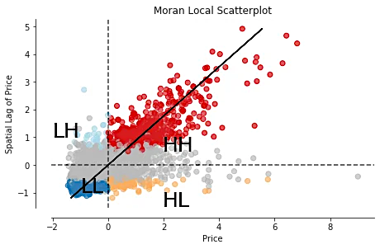
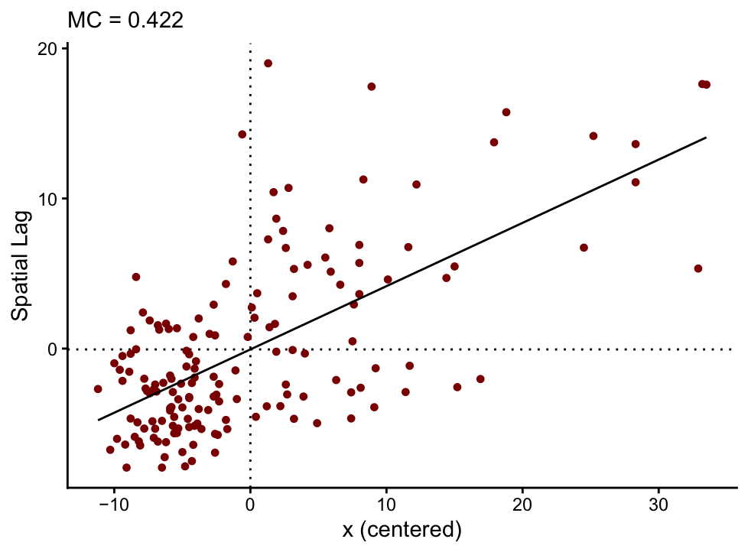
Moran scatter plot
moran_plot(georgia$college, W)
mc(georgia$college, W)
# 0.422
gr(georgia$college, W)
# 0.567
mc(x, W) + gr(x, W)
# 0.989
The Geary Ratio (often called Geary's C) is another way to measure spatial autocorrelation. While Moran's I focuses on how values "co-vary" (move together), Geary's C focuses on the actual distance or difference between neighboring values.
The GR is more sensitive than the MC to negative SA, and, as such, it is sensitive to local outliers. When a variable does not contain influential local outliers, the sum of its GR and MC values will be equal to about 1.

Slide 17
Local Indicators of Spatial Association (LISAs)
The LISA is a class of local SA statistics.
Every LISA is related to a global SA index (such as the MC and GR).
A LISA statistic does two specific things for every location:
Indicates Clustering: It tells you if that specific spot is surrounded by similar values (forming a cluster).
Summing to Global: If you added up all the LISA values for every location on the map, they would equal the "Global" Moran's I.
Four Categories of LISA (Moran Scatterplot categories):
High-High (Hot Spots)
A high-value location surrounded by other high-value neighbors.
Example: A wealthy neighborhood surrounded by other wealthy neighborhoods.
Low-Low (Cold Spots)
A low-value location surrounded by other low-value neighbors.
Example: A rural area with low internet speeds surrounded by other areas with slow internet.
High-Low (Spatial Outlier)
A "High" value location surrounded by "Low" value neighbors.
Example: A single skyscraper in the middle of a small farming town.
Low-High (Spatial Outlier)
A "Low" value location surrounded by "High" value neighbors.
Example: A small park or vacant lot in the middle of a dense, expensive downtown.

Slide 18
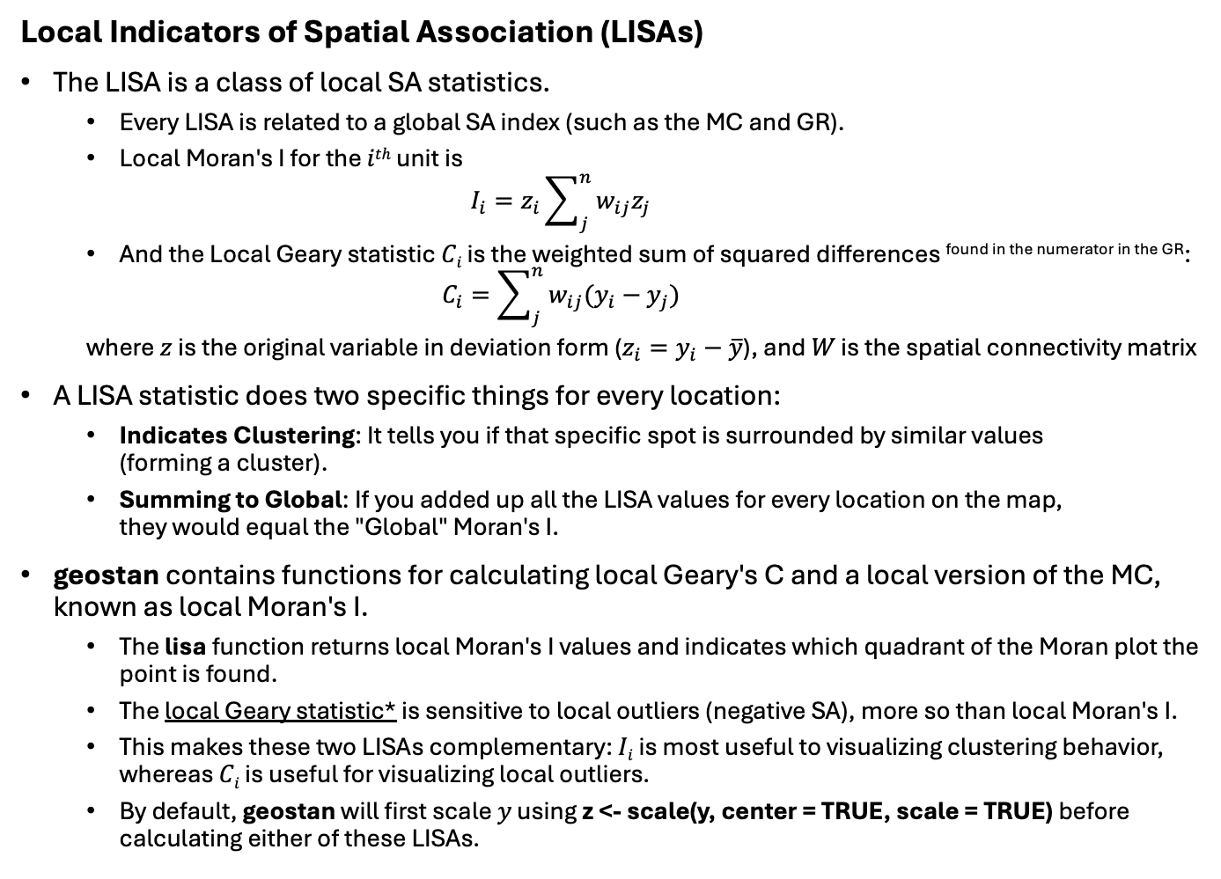
Local Indicators of Spatial Association (LISAs)
The LISA is a class of local SA statistics.
Every LISA is related to a global SA index (such as the MC and GR).
Local Moran's I for the 𝑖^{𝑡ℎ} unit is $I_{i}=z_{i}\sum_{j}^{n}{w_{ij}z_{j}}$
And the Local Geary statistic 𝐶_{𝑖} is the weighted sum of squared differences found in the numerator in the GR: $C_{i}=\sum_{j}^{n}{w_{ij}(y_{i}−y_{j})}$
where $z$ is the original variable in deviation form ($z_{i}=y_{i}−\overline{y}$), and 𝑊 is the spatial connectivity matrix
A LISA statistic does two specific things for every location:
Indicates Clustering: It tells you if that specific spot is surrounded by similar values (forming a cluster).
Summing to Global: If you added up all the LISA values for every location on the map, they would equal the "Global" Moran's I.
geostan contains functions for calculating local Geary's C and a local version of the MC, known as local Moran's I.
The lisa function returns local Moran's I values and indicates which quadrant of the Moran plot the point is found.
The local Geary statistic* is sensitive to local outliers (negative SA), more so than local Moran's I.
This makes these two LISAs complementary: 𝐼_{𝑖} is most useful to visualizing clustering behavior, whereas 𝐶_{𝑖} is useful for visualizing local outliers.
By default, geostan will first scale 𝑦 using z <- scale(y, center = TRUE, scale = TRUE) before calculating either of these LISAs.
* https://cran.r-project.org/web/packages/geostan/vignettes/measuring-sa.html

Slide 19
Local Indicators of Spatial Association (LISAs)
W <- shape2mat(georgia, "W")
# Contiguity condition: queen
# Number of neighbors per unit, summary:
# Min. 1st Qu. Median Mean 3rd Qu. Max.
# 1.000 4.000 5.000 5.409 6.000 10.000
#
# Spatial weights, summary:
# Min. 1st Qu. Median Mean 3rd Qu. Max.
# 0.1000 0.1429 0.1667 0.1849 0.2000 1.0000
x <- log(georgia$income)
Ii <- lisa(x, W)
head(Ii)
# Li type
# 1 0.139 LL
# 2 0.574 LL
# 3 1.327 HH
# 4 1.473 HH
# 5 -0.688 HL
# 6 3.282 HH
Ci <- lg(x, W)
head(Ci)
# [1] 1.183 0.381 1.049 0.347 6.307 0.509
"HH" indicates a high value surrounded by high values; "LL" is a low surrounded by low values, and so on.
The local Geary statistic can be calculated using the lg function.

Slide 20
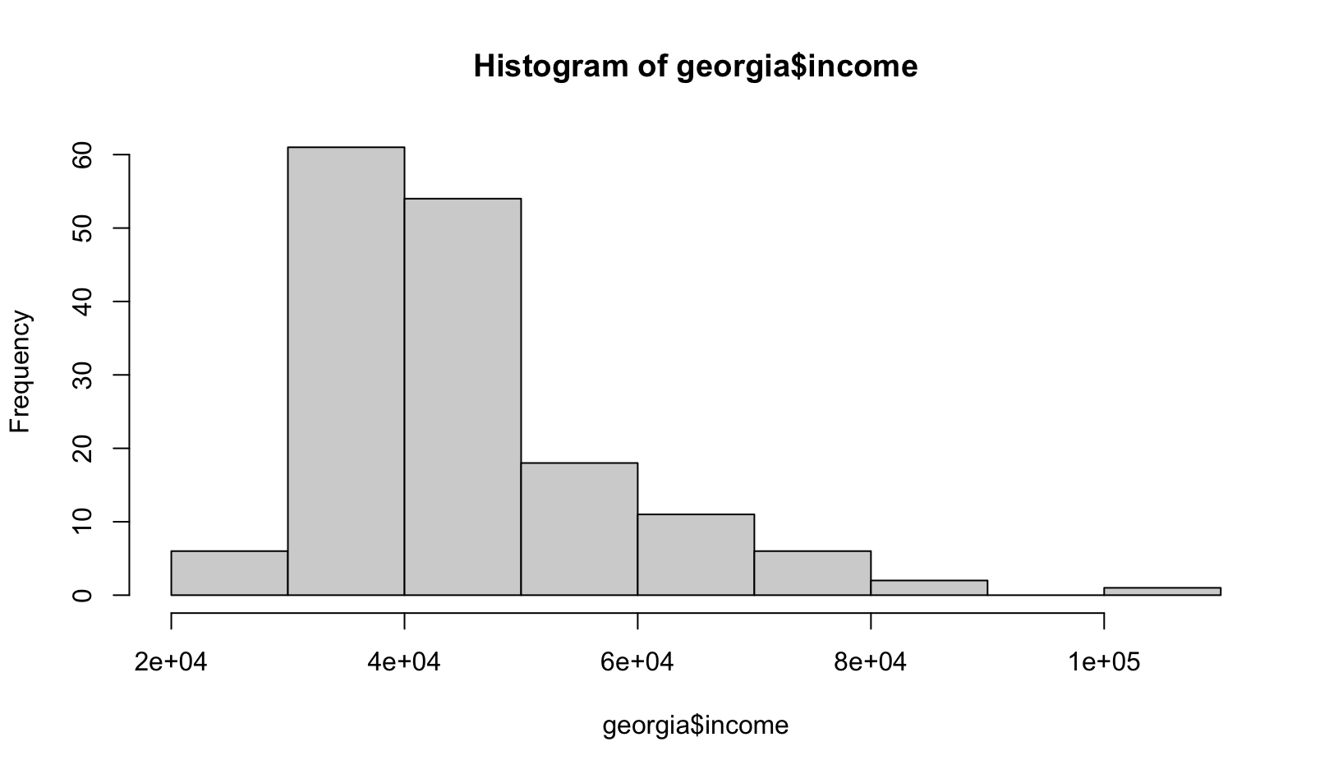
Local Indicators of Spatial Association (LISAs)
W <- shape2mat(georgia, "W")
# Contiguity condition: queen
# Number of neighbors per unit, summary:
# Min. 1st Qu. Median Mean 3rd Qu. Max.
# 1.000 4.000 5.000 5.409 6.000 10.000
#
# Spatial weights, summary:
# Min. 1st Qu. Median Mean 3rd Qu. Max.
# 0.1000 0.1429 0.1667 0.1849 0.2000 1.0000
x <- log(georgia$income)
Ii <- lisa(x, W)
head(Ii)
# Li type
# 1 0.139 LL
# 2 0.574 LL
# 3 1.327 HH
# 4 1.473 HH
# 5 -0.688 HL
# 6 3.282 HH
Ci <- lg(x, W)
head(Ci)
# [1] 1.183 0.381 1.049 0.347 6.307 0.509
Main reasons to log income (tame the data):
1) fix skewed data
2) focus on percentages
- Without Log: The difference between $20k and $30k ($10,000) looks the same as the difference between $100k and $110k ($10,000).
- With Log: The math treats the jump from $20k to $30k as a 50% increase, which is much more significant than the 10% increase from $100k to $110k.
In geography, a 50% difference in wealth between two neighboring counties is usually a more important "spatial association" than a flat dollar amount.
3) stability of variance (homoscedasticity, "spread" of the data is consistent)

Slide 21
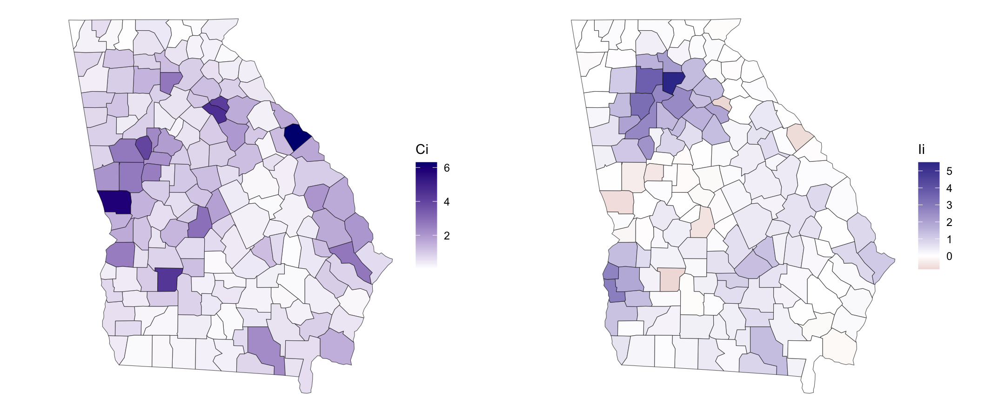
Local Indicators of Spatial Association (LISAs)
Maps of the two local statistics highlight different qualities:
𝐼_{𝑖} draws attention to clustering,
𝐶_{𝑖} draws attention to discontinuities and outliers.
Due to their complementary strengths, these two indices are best used together.
Ci_map <- ggplot(georgia) +
geom_sf(aes(fill=Ci)) +
scale_fill_gradient(high = "navy",
low = "white") + theme_void()
Li_map <- ggplot(georgia) +
geom_sf(aes(fill=Ii$Li)) +
scale_fill_gradient2(name = "Ii") + theme_void()
gridExtra::grid.arrange(Ci_map, Li_map, nrow = 1)
LISA is the most useful tool because it provides a Cluster Map.
Instead of just saying "the state has a high crime rate," a LISA map can show you the specific blocks where the crime is clustered (Hot Spots) or the specific safe zones (Cold Spots). It helps people put resources exactly where they are needed most.

Slide 22
Effective Sample Size (ESS)
Spatial patterns aren't just visual: they fundamentally change the information content of a dataset.
When data points are spatially autocorrelated, they are not independent, which reduces the amount of "new" evidence each additional observation provides.
High SA leads to redundant information.
Using conventional statistical methods (which assume independence) on spatial data often leads to "perilous" results, as the methods overestimate the true sample size.
ESS represents the number of independent observations that would contain the same amount of information as your spatially dependent dataset.
The n_eff function approximates ESS using the Simultaneous Autoregressive (SAR) model framework.
x <- log(georgia$income)
c(nominal_n = nrow(georgia),
rho = aple(x, W),
MC = mc(x, W),
ESS = n_eff(rho = rho, n = n))
# nominal_n rho MC ESS
# 159.00000 0.70100 0.49800 23.34735
Metric | Value
Nominal Sample Size | 159
Spatial Autocorrelation | 0.70
Effective Sample Size | ~23
Bottom Line: Because of strong spatial patterns, 159 data points only provide the same statistical "punch" as 23 independent observations.
False Confidence: Conventional methods might report a "significant" correlation that is just an artifact of spatial patterning.
Inflated Type I Error: Much more likely to find a relationship where none exists if you ignore the reduced effective sample size.
* The APLE is an estimate of the spatial autocorrelation parameter one would obtain from fitting an intercept-only SAR model. Note, the APLE approximation is not reliable when the number of observations is large.

Slide 23
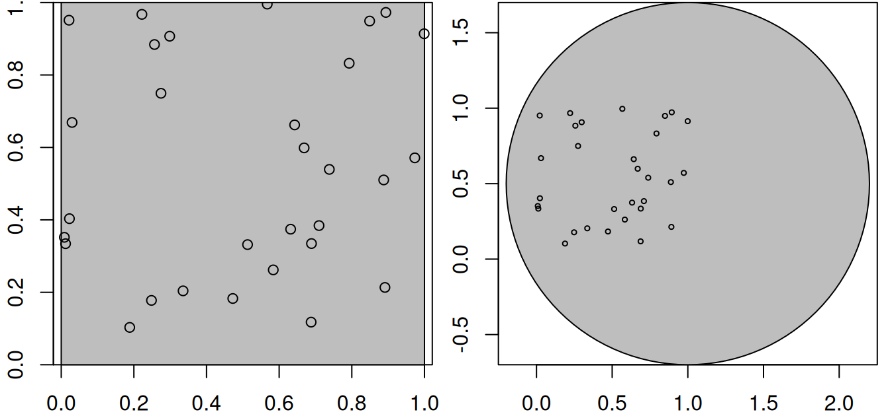
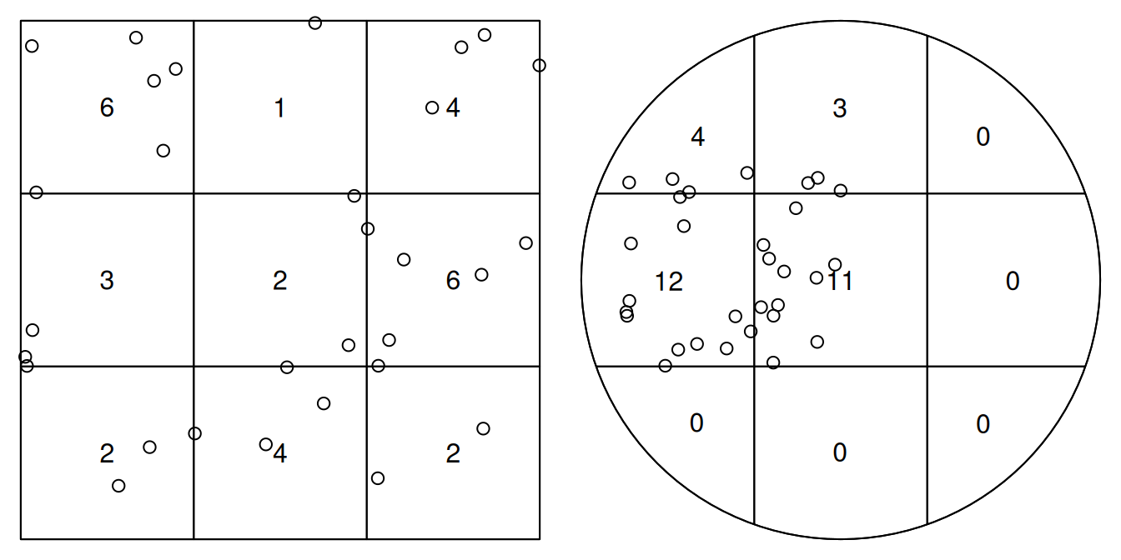
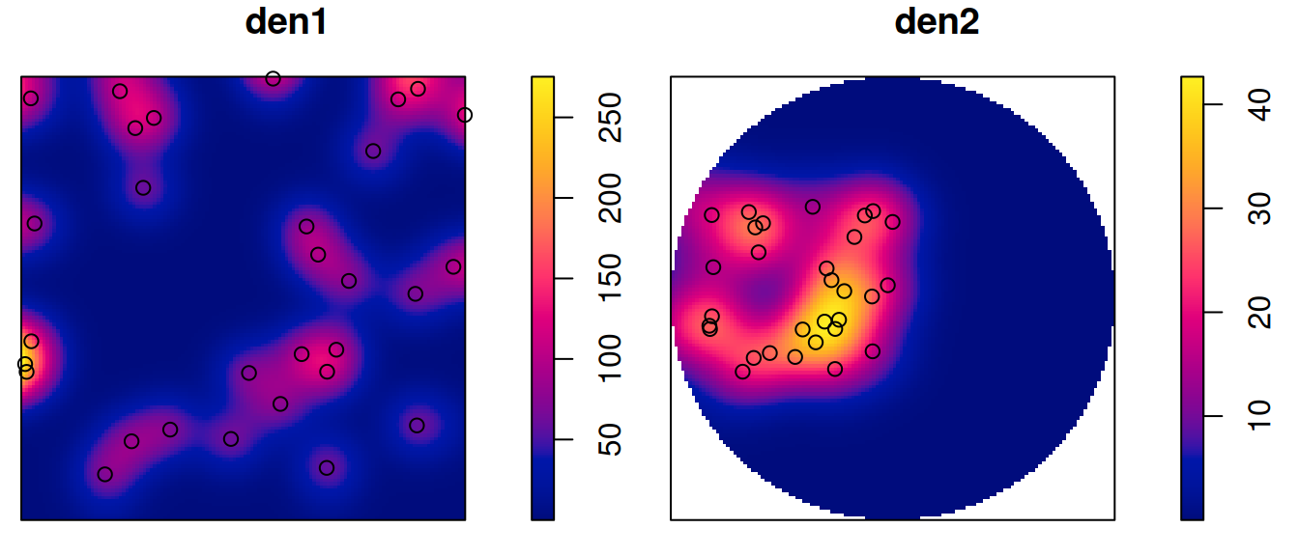
Point Pattern Analysis (PPA)
Point pattern analysis is concerned with describing patterns of points over space and making inference about the process that could have generated an observed pattern.
The focus lies on the information carried in the locations of the points, and typically these locations are not controlled by sampling but a result of a process we are interested in (such as animal sightings, accidents, disease cases, or tree locations).
This is opposed to geostatistical processes (next!) where we have values of some phenomenon everywhere, but observations limited to a set of locations that we can control (at least in principle).
In geostatistical problems the prime interest is not in the observation locations but in estimating the value of the observed phenomenon at unobserved locations.
Point pattern analysis typically assumes that for an observed area, all points are available, meaning that locations without a point are not unobserved as in a geostatistical process, but are observed and contain no point.

Slide 24
Point Pattern Analysis (PPA)
Point patterns have an observation window.
PPA don't just care about where the points are; cares about the space they could have occupied.
The "window" (W) is the bounded region where the point process is observed.
Empty Space Matters! In PPA, a location without a point is just as informative as a location with one. If we don't define the window, we don't know if an empty area is "empty" or simply "unobserved."
Intensity is defined as the number of points divided by the area.
Without a precise window, you cannot accurately calculate the area, making density measures meaningless.
Points near the boundary of the window are "missing" neighbors that exist outside the study area.
This can bias statistics like the nearest-neighbor distance.
We use the observed pattern to infer the properties of a "process".
# Point patterns have an observation window.
# Consider the points generated randomly by
library(sf)
n <- 30
set.seed(13531)
xy <- data.frame(x = runif(n), y = runif(n)) |>
st_as_sf(coords = c("x", "y"))
# then these points are (by construction) uniformly # distributed, or completely spatially random, over # the domain. For a larger domain, they are not # uniform for the two square windows w1 and w2
w1 <- st_bbox(c(xmin = 0, ymin = 0,
xmax = 1, ymax = 1)) |> st_as_sfc()
w2 <- st_sfc(st_point(c(1, 0.5))) |> st_buffer(1.2)
Check full code at:
https://r-spatial.org/book/11-PointPattern.html

Slide 25
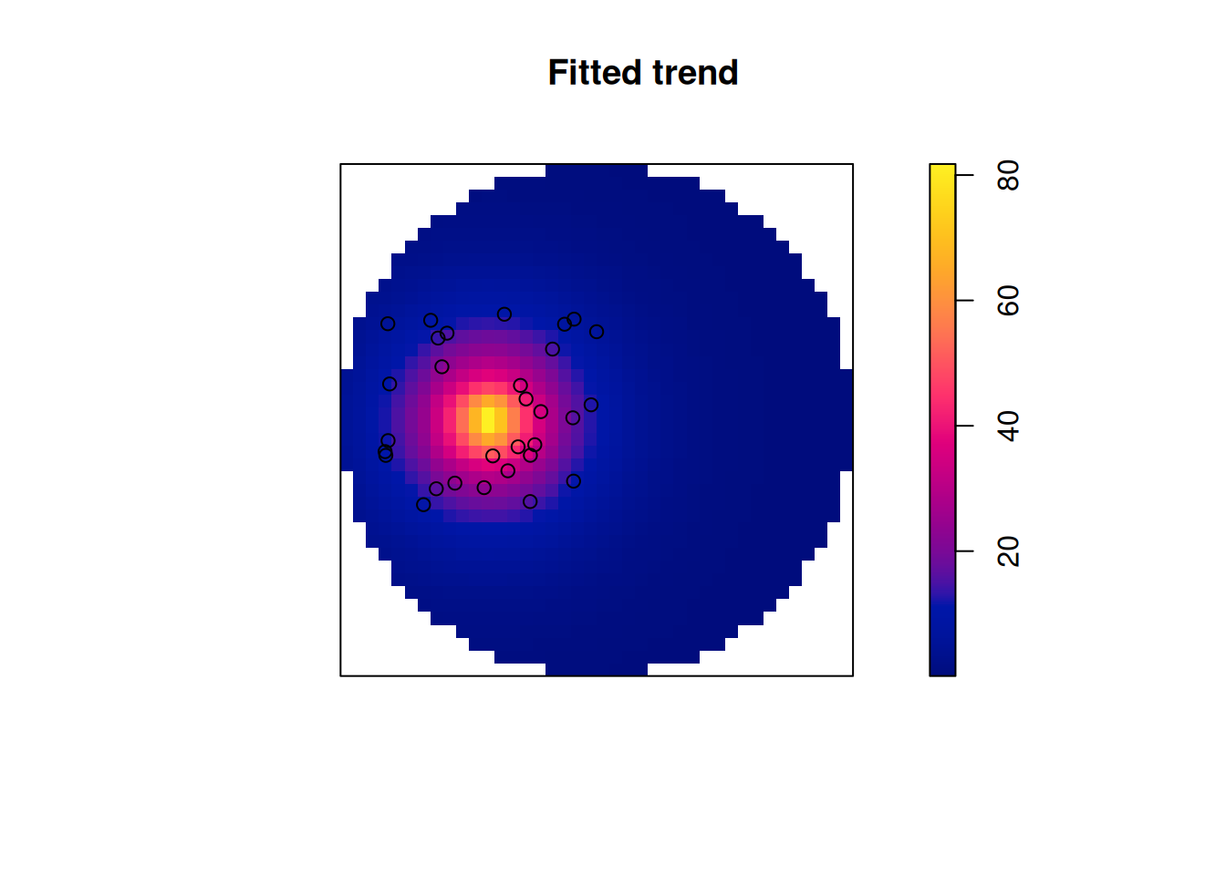
Point Pattern Analysis (PPA)
Point patterns in spatstat are objects of class ppp that contain points and an observation window (an object of class owin).
We see that the bounding box of the points is used as observation window when no window is specified.
The density maps created this way are obviously raster images, and we can convert them into stars (raster) object.
library(stars)
s1 <- st_as_stars(den1)
(s2 <- st_as_stars(den2))
predict(m,
covariates = list(dist = as.im(s2["dist"]))) |>
st_as_stars()
# We can create a ppp from points by
library(spatstat) |>
suppressPackageStartupMessages()
as.ppp(xy)
# Planar point pattern: 30 points
# window: rectangle = [0.009, 0.999] x [0.103, 0.996] units
Check full code at:
https://r-spatial.org/book/11-PointPattern.html

Slide 26
Point Pattern Analysis (PPA)
Types of Observation Windows
Rectangular: The simplest form, defined by x and y ranges (bounding box).
Polygonal: Irregular shapes (e.g., a city boundary, a forest, or a specific plot of land).
Binary Masks (Rasters): A grid where cells are marked as "inside" or "outside" the study area.
Common Pitfalls
Arbitrary Windows: Using a simple bounding box for a study area that is actually irregular can lead to "diluted" density (underestimating intensity).
"Convenience" Window: Often, we set the window to the bounding box of the points themselves.
This is dangerous because it assumes points could not have occurred outside that tight cluster, which is rarely true.
Alignment: Ensure your window and your points use the same Coordinate Reference System (CRS).
Check full code at:
https://r-spatial.org/book/11-PointPattern.html

Slide 27
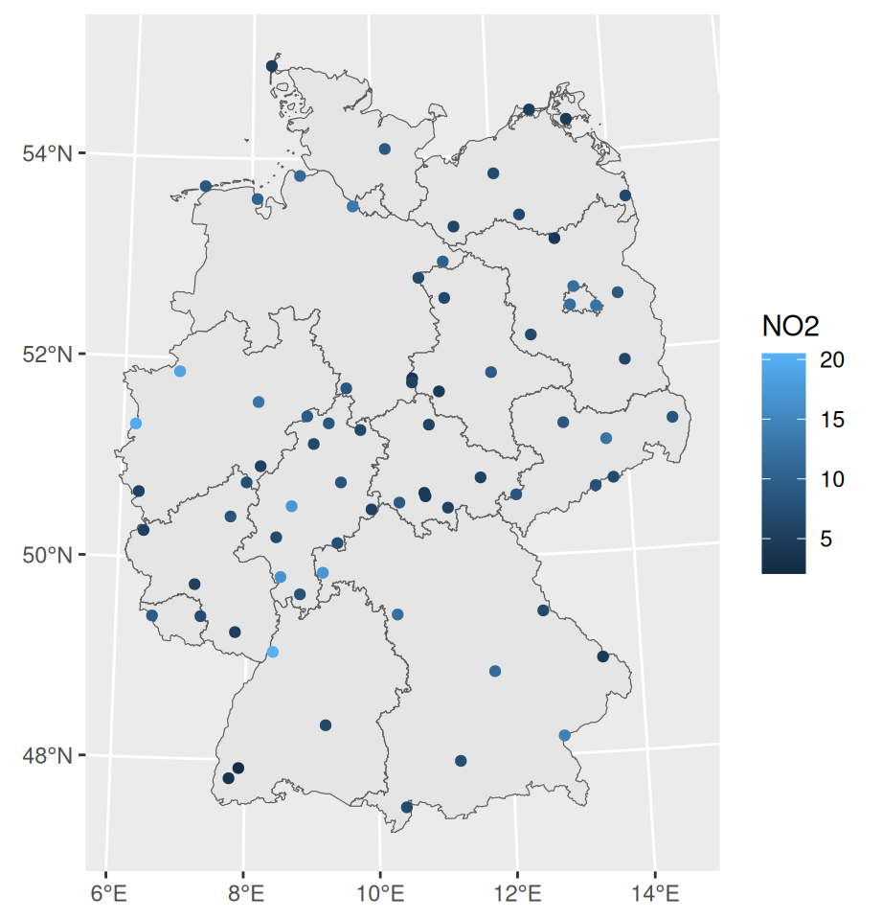
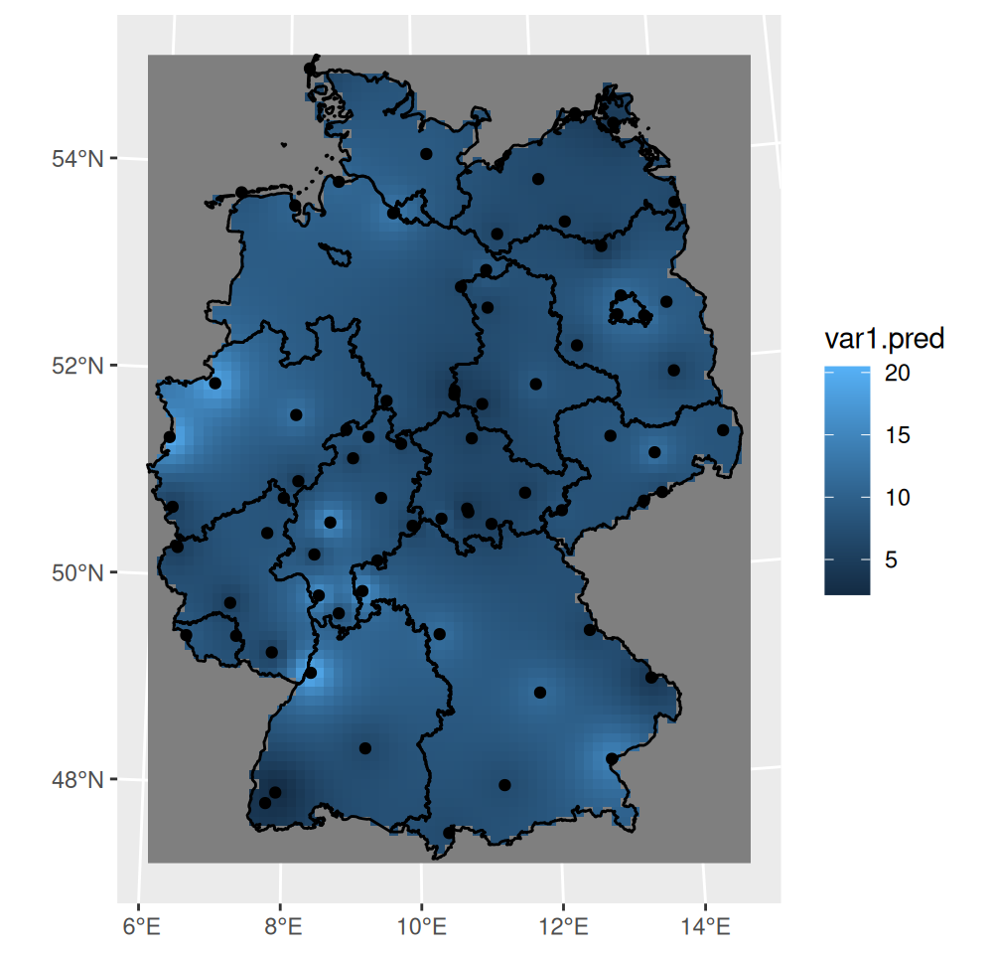

Interpolation (IDW)
Spatial interpolation is the activity of estimating values of spatially continuous variables (fields) for spatial locations where they have not been observed, based on observations.
The statistical methodology for spatial interpolation (called geostatistics) is concerned with the modelling, prediction, and simulation of spatially continuous phenomena.
Perhaps the simplest interpolation method is inverse distance weighted interpolation (IDW), which is a weighted average, using weights inverse proportional to distances from the interpolation location: $\hat{z}\left(s_{0}\right)=\frac{\sum_{i=1}^{n}{w_{i}}z\left(s_{i}\right)}{\sum_{i=1}^{n}{w_{i}}}$
with $w_{i}={\left|s_{0}−s_{i}\right|}^{−p}$, and the inverse distance power p typically taken as 2 or optimized using cross-validation. We can compute inverse distance interpolated values using gstat::idw,
library(gstat)
i <- idw(NO2~1, no2.sf, grd)
ggplot() +
geom_stars(data = i,
aes(fill = var1.pred,
x = x, y = y)) +
xlab(NULL) + ylab(NULL) +
geom_sf(data = st_cast(de,
"MULTILINESTRING")) +
geom_sf(data = no2.sf)
Check full code at:
https://r-spatial.org/book/12-Interpolation.html

Slide 28
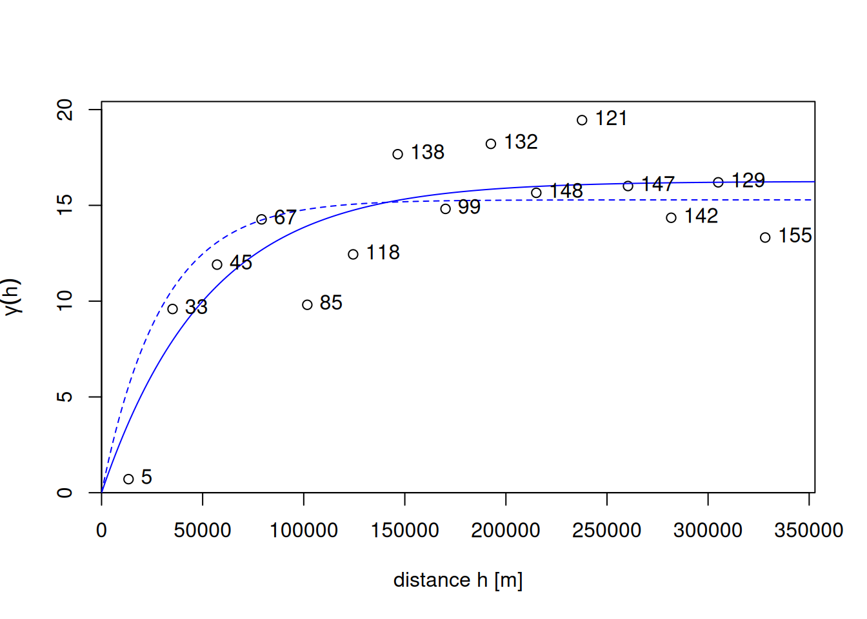
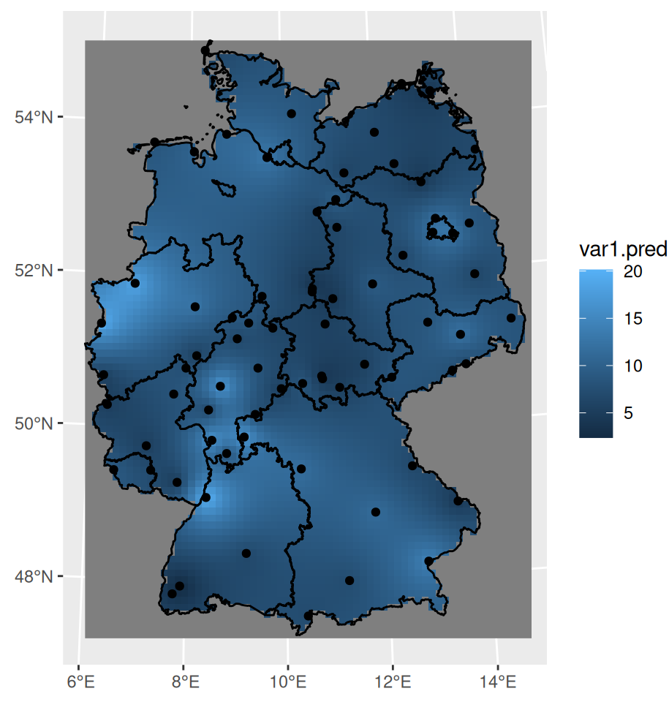
Interpolation (Kriging)
Kriging is a geostatistical interpolation method that predicts values at unsampled locations using sampled data points by modeling their spatial autocorrelation.
It computes optimal weights based on distance, data arrangement, and a variogram model, providing both predictions and estimation variance to quantify uncertainty.
Kriging is widely used in mining, geology, and environmental science for mapping.
What is the primary advantage of Kriging over Inverse Distance Weighting (IDW)?
Kriging provides a measure of prediction uncertainty (standard error), whereas IDW does not.
Predicts values at unsampled locations based on a regionalized variable model
Goes beyond simple distance-weighting
Measures how similarity decreases with distance
Uses the variogram to define weights
Minimizes the variance of estimation errors
Provides a prediction error map (krige variance)
Different types ^{(Ordinary, Simple, Universal)} for various data trends
v.m <- fit.variogram(v, vgm(1, "Exp", 50000, 1)) # Fitting variogram models
k <- krige(NO2~1, no2.sf, grd, v.m) # Using ordinary kriging
ggplot() + geom_stars(data = k, aes(fill = var1.pred, x = x, y = y)) +
xlab(NULL) + ylab(NULL) +
geom_sf(data = st_cast(de, "MULTILINESTRING")) +
geom_sf(data = no2.sf) + coord_sf(lims_method = "geometry_bbox")
Check full code at:
https://r-spatial.org/book/12-Interpolation.html

Slide 29
References
Spatial Data Science https://r-spatial.org/book/
Exploratory Spatial Data Analysis https://cran.r-project.org/web/packages/geostan/vignettes/measuring-sa.html

Slide 30
Next Spatial Modeling
Spatial Regression https://r-spatial.org/book/16-SpatialRegression.html
Spatial Econometrics Models https://r-spatial.org/book/17-Econometrics.html

