Slide 1

Phase 1 Discover
DAEN 460 Capstone Senior Design
Alexander Abuabara
Spring 2026

Slide 2
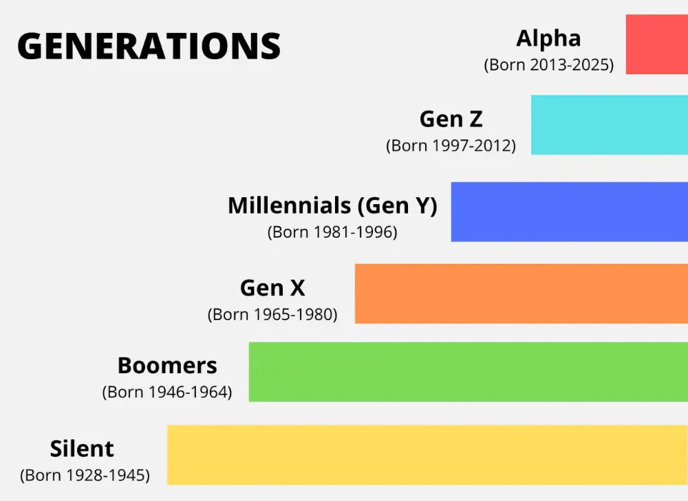

Slide 3
Bosses are firing Gen Z grads just months after hiring them
After two years of complaints, employers are now acting. Many are terminating Gen Z hires within months of onboarding.
Top concern?

Slide 4
Bosses are firing Gen Z grads just months after hiring them
After two years of complaints, employers are now acting. Many are terminating Gen Z hires within months of onboarding.
Top concern?
Lack of motivation and initiative (50% of managers cite as the primary reason for termination)
Other major issues reported:
Unprofessional behavior,
Poor organization,
Weak communication skills.
Practical workplace challenges include:
Frequent lateness to work and meetings,
Inappropriate office attire,
Use of unsuitable language in professional settings.
Ref.:
https://fortune.com/article/why-are-companies-firing-gen-z-employees-workplace-bosses-workers-jobs/
https://www.cnbc.com/2025/12/08/how-recent-grads-are-dealing-with-the-shrinking-pool-of-entry-level-jobs.html

Slide 5
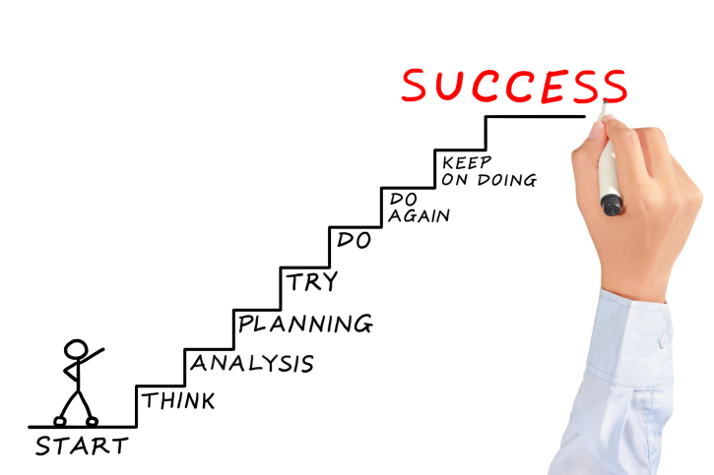
Critique your own project against learning goals rather than technical checklists only!
You are not being graded on reproducing a solution but on the quality of your thinking and decisions!
Peers are not parallel workers, but as part of a shared system. Shift the culture from individual performance to collective responsibility and make collaboration (not cooperation only)!
Metacognition ... why I'm thinking what I'm thinking → make the invisible visible!

Slide 6

Today’s Agenda
Sponsor Meetings and Project Advice
Communication Team
Phase 1 Discover
& Presentation Guidelines
Mini Project Management Packet
Gantt Chart

Slide 7

Sponsor Meeting
How about feedback from last semester?
What went well?
What do you wish you'd done prior to the meeting that you did not?
Did all the team get to introduce themselves?
Were your expectations met for the next meeting?
Did you identify some needed information and establish a target date?
Did you set a follow-up meeting or recurring meeting?
What can be improved?

Slide 8

Sponsor Meeting Tips
Be prepared
Agenda prepared and sent ahead of time
Team knows who will speak and on what topic
Questions prepared
Team member(s) assigned to take notes (record audio/video only if sponsor agrees)
Listen more than you speak
Wait for sponsor to answer questions, don’t interrupt with additional questions
Don’t try to provide immediate solutions, this is still a semester long project

Slide 9
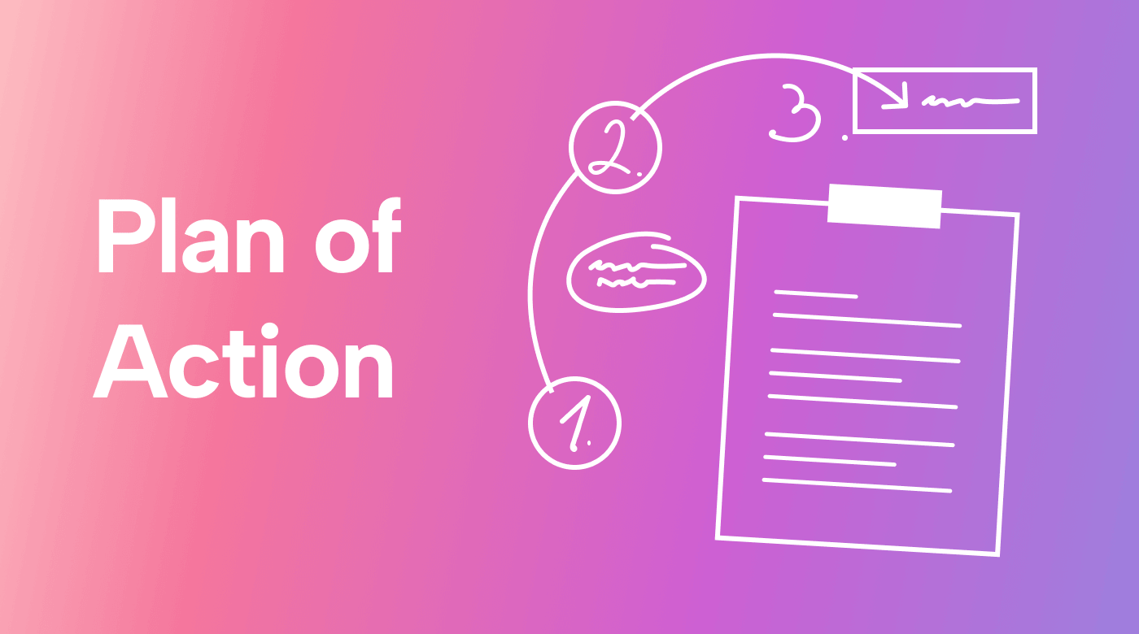
Sponsor Meeting Tips
Ask for clarification on anything you don't understand
Ask for meaning of any terms or acronyms the sponsor uses! Don’t assume your teammates will know!
Don't pretend to understand something you don’t.
End the meeting with plans
Action items for team or sponsor with target dates.
Next meeting date set or proposed.

Slide 10

Sponsor Meeting Tips
Remain positive and upbeat throughout the project
Not everything will go perfectly, don't expect it to and don't get down when it doesn’t.
Never talk bad about anyone; sponsor, team member, instructors (especially).
If someone needs to miss a meeting
Make sure the sponsor knows why, explain at the start of the meeting that … can't make it because … .
Make sure to follow up with person that missed to distribute information or action items!

Slide 11

Sponsor Meeting Tips
Ensure meetings don't go longer than allotted
Listen for clues sponsor needs to go (“well, that about wraps it up…”, “OK, if there isn't anything else…”, etc.)
and, not meeting related but:
Don't be afraid to call the sponsor if emails are not answered and you need answers
Set target dates for required information and follow up,
If you call and they don't answer, leave a voicemail.

Slide 12


Sponsor Meeting Tips !
You'll be surprised by the doors this can open...
Dress appropriately (ask if in doubt) https://careercloset.tamu.edu/
Phone on silent mode and don't use it,
Follow all safety rules (and instructions),
Ask before taking photos or videos,
Document who you meet with,
You are representing Texas A&M, be a good example!

Slide 13

Team Dynamics
1. You are called a team for a reason
You have the same goals
You each have skills and abilities
2. Share the load
No one gets a free pass
Work independently but together

Slide 14
Team Dynamics
3. Recognize and acknowledge differences
Compromise
Use individual strengths to make the team better
4. If you have difficulty
Try to work things out together (don't talk bad about anyone!)
Contact instructor team for assistance only if you can't work it out

Slide 15

Faculty Advisor
If you have not identified yet a potential faculty advisor, do it ASAP!
For areas of research interest/expertise, consult the ISEN website, follow research tab to Research Fields.
Your project does not need to perfectly align with a professor's research field, but they are more likely to accept if it is something that interests them.

Slide 16


Slide 17
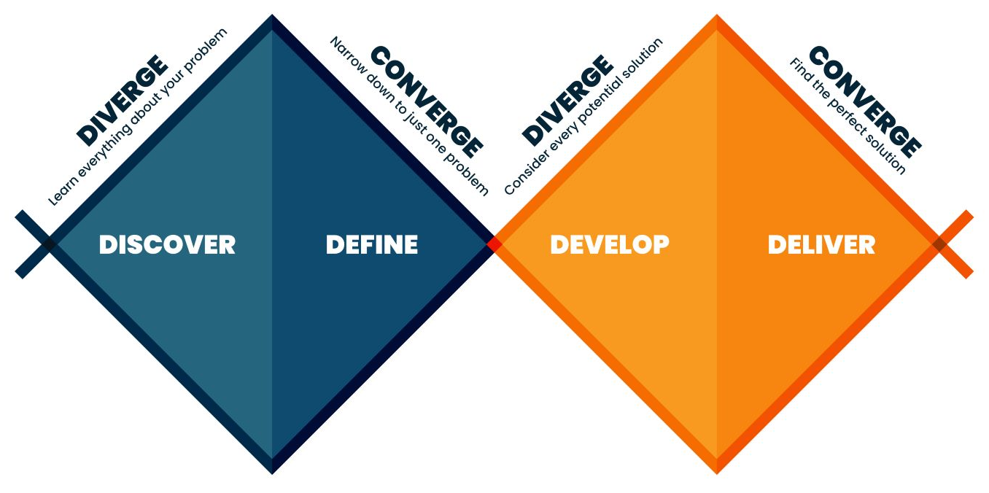
Phase 1 Discover
Phase 1 will set the direction for your project.
Phase 1 is not about solutions; it is about the problem/opportunity.

Slide 18

Phase 1 Discover
Phase 1 will set the direction for your project.
Phase 1 is not about solutions; it is about the problem/opportunity.
Some primary goals for Phase 1 include
Establishing good/effective communication is also a goal!
Information gathering,
Problem definition,
Client needs identification,
Technical objectives development.

Slide 19
Information Gathering
Will occur continuously throughout the project, but critical at beginning.
Necessary for defining parameters and scope of project.
Information can include (but not limited to)
Sponsor company,
Industry/market,
Competitors,
Standards/Constraints that guide or limit the solution (ABET).
Sources can include
Sponsor, trade publications or other public published material, internet.
The goal of Phase 1 is to gather as much information as possible, even if you're not sure it's relevant.

Slide 20
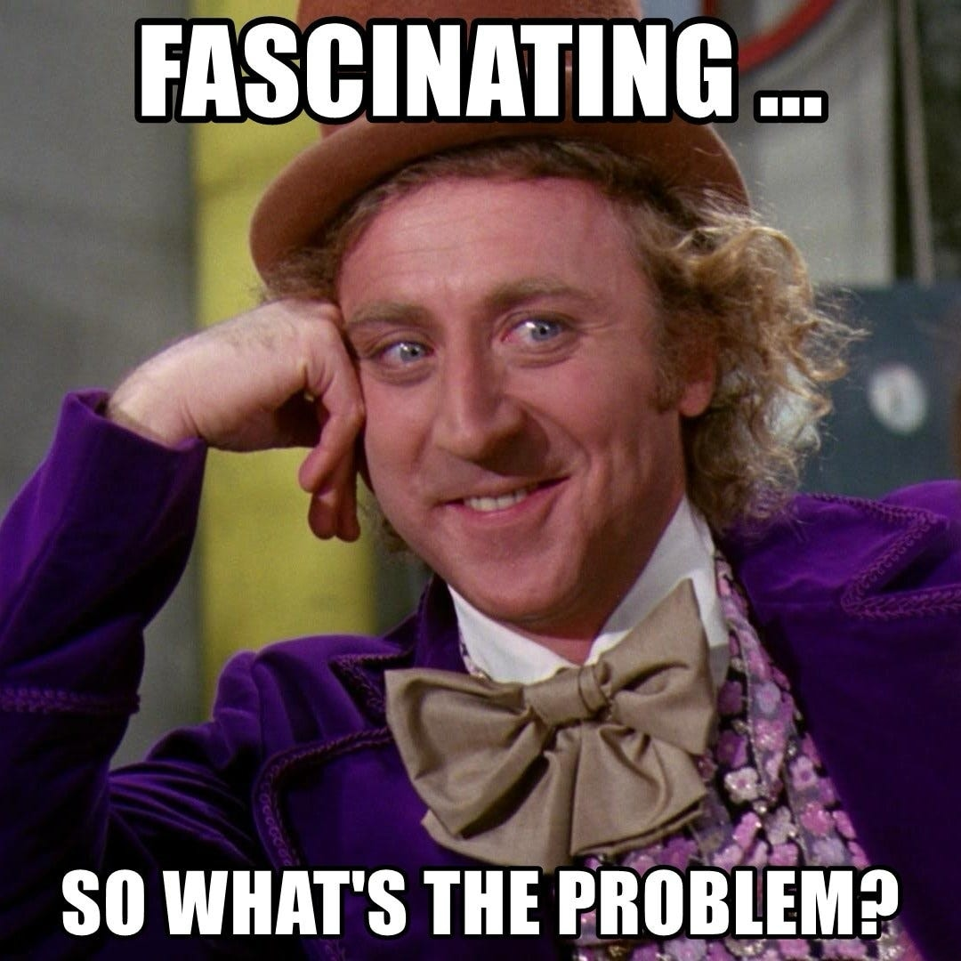
Problem Definition
Should be a concise statement of the problem facing your sponsor
Focus on the source of the problem, not the symptoms or solution,
Keep the language simple, avoid technical jargon,
Avoid detail, that will be fleshed out with customer needs.
Done in conjunction with Information Gathering.

Slide 21
Problem Definition ^{(Example)}
Should be a concise statement of the problem facing your sponsor
Focus on the source of the problem, not the symptoms or solution,
Keep the language simple, avoid technical jargon,
Avoid detail, that will be fleshed out with customer needs.
Done in conjunction with Information Gathering.
Good: The Radiology Department at Texas A&M Hospital experiences prolonged imaging turnaround times due to inefficiencies in the order processing workflow, resulting in delayed clinical decision-making.
Not so good: The Radiology Department at Texas A&M Hospital has many problems with imaging, staff availability, communication between departments, patient flow, and rising costs, which together negatively impact hospital efficiency and patient satisfaction.

Slide 22
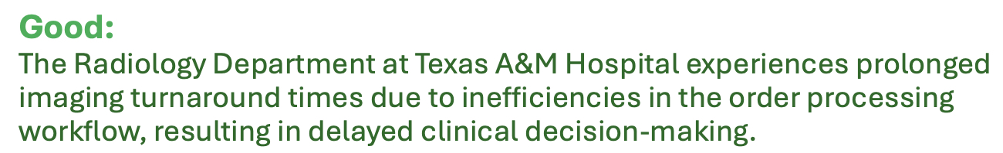

Why this is stronger?

Slide 23
Why this is stronger?
Focuses on a single, primary process (order processing workflow)
Names one measurable outcome (imaging turnaround time)
Avoids mixing staffing, length of stay, and cost into the core problem
Creates a clear target for data collection and pipeline design

Slide 24
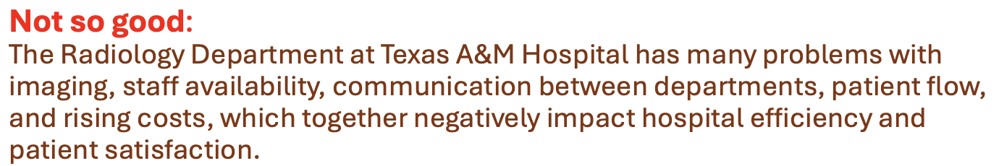

Why this is “not so good”?

Slide 25
Why this is “not so good”?
Too broad: bundles multiple domains (staffing, communication, flow, cost, satisfaction)
No clear process focus: unclear what system or workflow should be instrumented
No measurable primary metric: nothing specific to optimize or monitor
Hard to translate into a data pipeline: unclear what data to collect, where, or why
This kind of statement is common in practice. And it's exactly what makes data projects drift or fail.

Slide 26
Client Needs
Likely discovered as part of problem definition development, but this allows you to expand on the problem definition with statements of specific needs
Should be a list of things in clear, unambiguous, non-technical terms
May be provided directly by the sponsor or you may need to solicit and/or interpret them from conversations and other research
Number client needs for identification in traceability matrix
The client needs...
N1: Awareness of data quality, security, and compliance risks
N2: Limited exposure to corrupted, incomplete, or inconsistent data in production systems
N3: A standardized process to increase adoption and correct usage of data pipelines and tools
N4: Fewer system and pipeline failures, reducing operational downtime

Slide 27

Technical Objectives
Technical objectives should translate the customer needs and problem definition into actionable, measurable goals.
Each objective should be Specific, Measurable, Achievable, Relevant, and Time-bound (SMART).

Slide 28
Technical Objectives
Technical objectives should translate the customer needs and problem definition into actionable, measurable goals.
Each objective should be Specific, Measurable, Achievable, Relevant, and Time-bound (SMART).
Number TO's for traceability purposes.
Technical objectives should address how the project will solve the defined problem and satisfy the customer needs.
TO1: Reduce data pipeline failure rates (by xx%)
TO2: Increase engineer awareness of data quality and reliability risks
TO3: Improve automated workflow orchestration activation
TO4: Decrease system downtime (to less than xx)
TO5: Eliminate identified data leakage and schema integrity issues
At this point your TO's may not have defined performance indicators, but they will evolve as the project moves forward.

Slide 29
Technical Objectives for Open-ended Research Projects
Your goals should center around developing knowledge, frameworks, and methodologies that help answer key questions or inform decision-making.
If your project is more research-focused, your objectives may not have quantifiable performance improvement criteria.
For research-driven projects, technical objectives should:
Define Key Questions What are you trying to discover, validate, or understand?
Establish Analytical Frameworks What methods, models, or simulations will you develop?
Characterize System Relationships How do the key factors of your problem/system interact?
Develop Conceptual or Qualitative Deliverables What frameworks, decision-support tools, methodologies, or documentation will your team generate?
See the document posted on Canvas for examples.

Slide 30
Example Research-Oriented Data Engineering Project Objectives
Suppose your team is studying data pipeline reliability in large-scale streaming systems. Your technical objectives might be:
Key Questions – What factors most strongly influence end-to-end latency and data loss in a real-time streaming pipeline? – How do different buffering strategies affect system stability under peak load?
Analytical Frameworks – Develop a benchmarking framework to simulate varying data arrival rates and system loads. – Design experiments using controlled workloads to compare multiple pipeline architectures.
System Relationships – Analyze how ingestion rate, buffer size, and processing throughput interact to produce bottlenecks. – Model the relationship between fault frequency and recovery time.
Conceptual or Qualitative Deliverables – Produce a decision framework that guides engineers in selecting buffering and checkpointing strategies. – Create documentation that outlines best practices for designing resilient streaming pipelines.

Slide 31
Traceability
Traceability will ensure that your project is on track to meet your technical objectives.
At this point you should connect defined client needs to technical objectives in a traceability matrix.
Client needs will likely not map one-to-one to technical objectives, but all client needs should map to at least one technical objective.
Client Needs (N) | Technical Objectives (TO)
N1 | TO1, TO3, TO6
N2 | TO2, TO4
… | …

Slide 32
Phase 1 Presentation Guidelines
Presentation guidelines document is posted on Canvas.
Provides general guidelines on how and what to present, but your project should guide the content.
Do not try to present everything you've learned so far (time is limited).
Appendix is for information you've gathered that might be relevant:
Reference information as necessary in presentation,
Don't present appendix slides,
Technical grade for Information Gathering will be partially based on appendix content.
Practice your presentation, both individual parts and as a team!

Slide 33
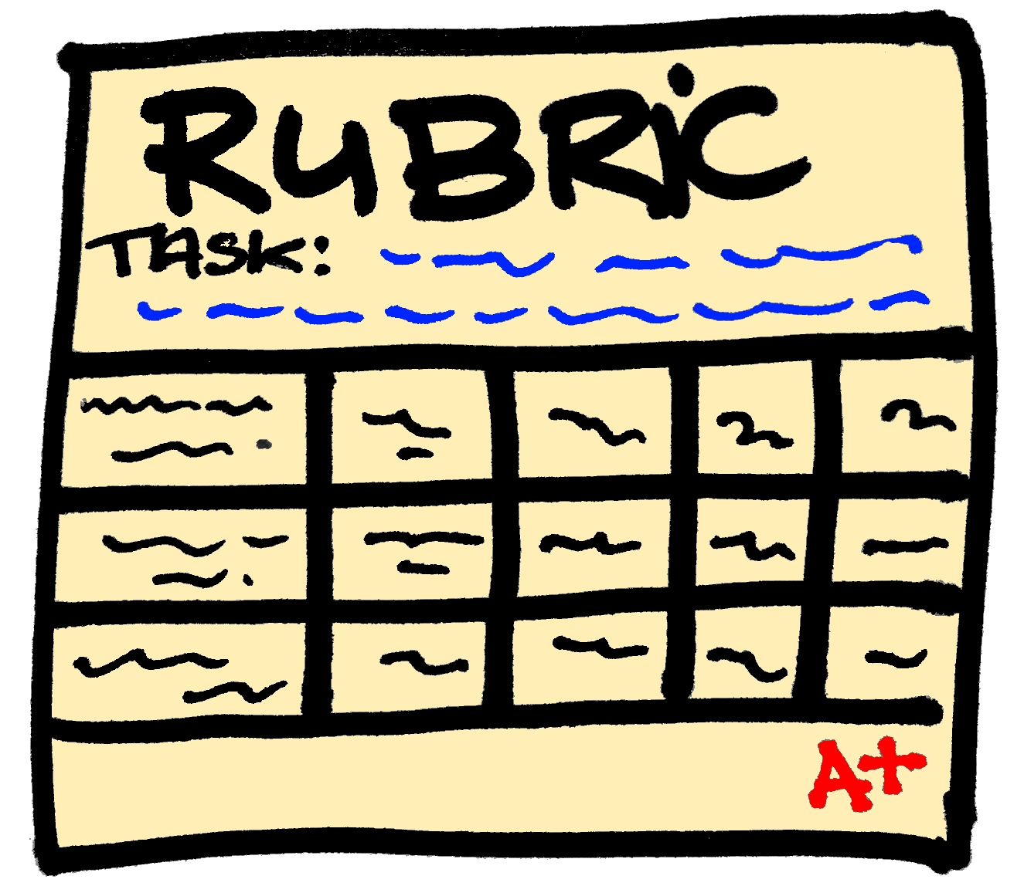
Phase 1 Presentation Rubric
Built into Canvas assignment,
Primary instructor will provide input/feedback,
Half of the missed points can be recovered by resubmitting the content.

Slide 34

Mini Project Management Packet
It demonstrates how the project will be planned, governed, executed, monitored, and communicated in a professional data engineering environment.
It extends your Fall semester project charter and confirms your team's ability to manage scope, risk, quality, and delivery in addition to building the pipeline.
It defines what will be done as technical objectives.
Due date is prior to Phase 2 kickoff.

Slide 35

Gantt Chart
See documents posted on Canvas.
Make the chart useful for your project, don't just do it to check a box!

