Slide 1

Basics of Spatial Regression
Alexander Abuabara
DAEN 489 ISEN 489 Spring 2026

Slide 2

Question
We all know: "Go to college, get a better job, make more money"
Let us look at all 254 Texas counties
See if education is a driver of wealth

Slide 4
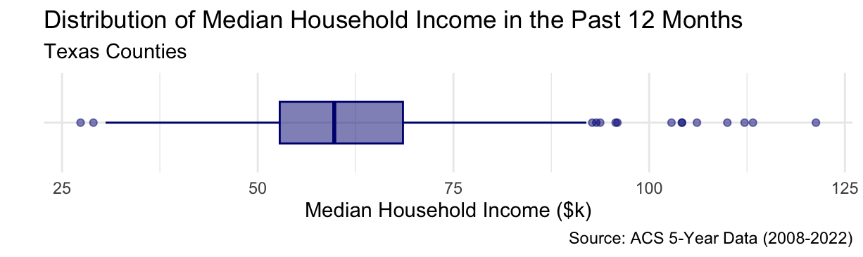
Data
Pulled 2022 ACS 5-year census data.
Dependent Variable: Median Household Income

Slide 5
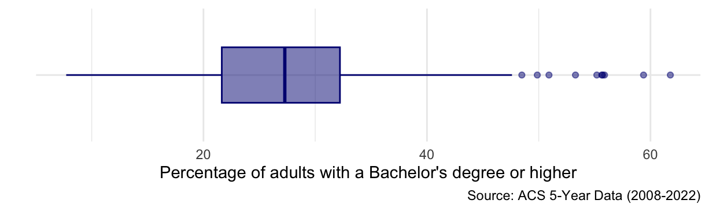
Data
Pulled 2022 ACS 5-year census data.
Dependent Variable: Median Household Income
Independent Variable: Percentage of adults with a Bachelor's degree or higher

Slide 6
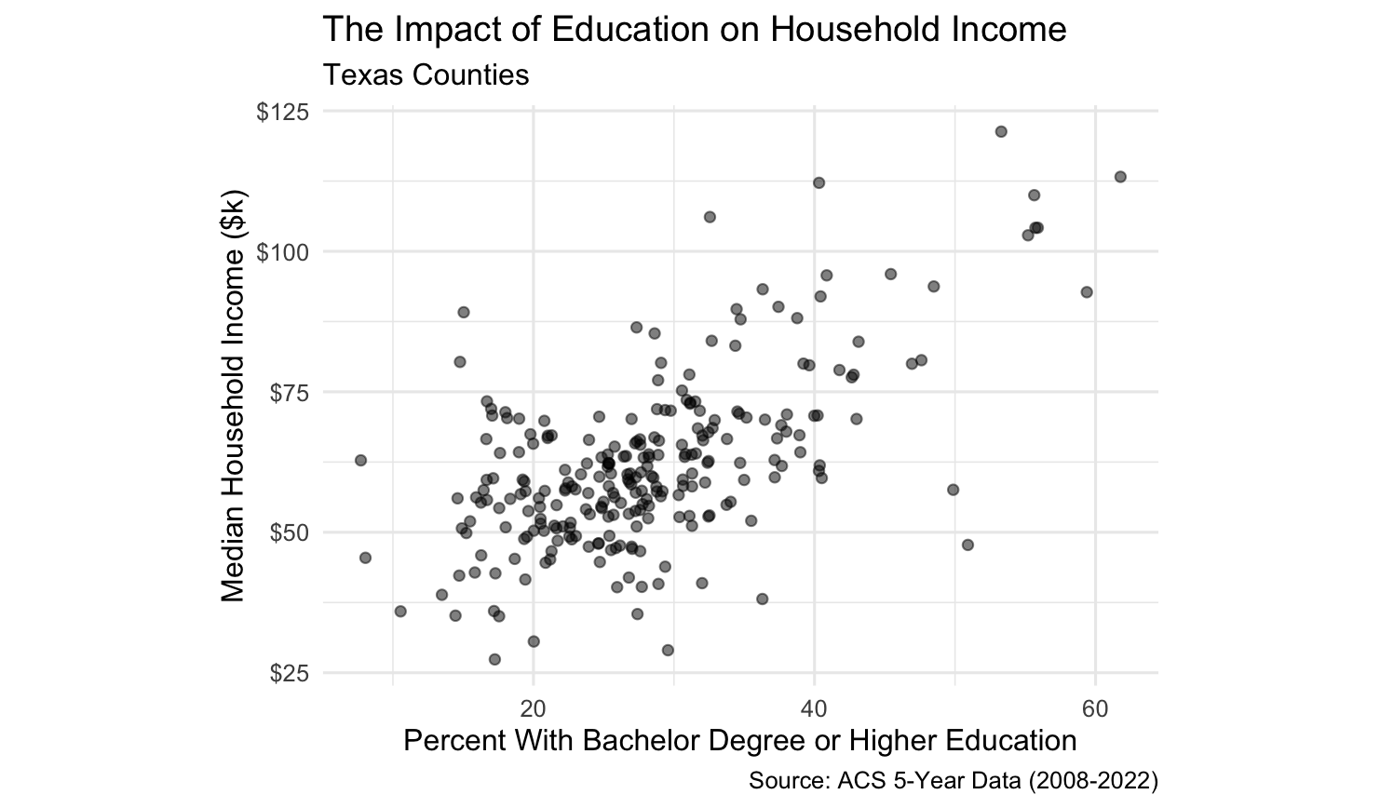

Slide 7

Baseline (OLS)
First model, a simple linear regression:
$$Y_{i}=β_{0}+β_{1}X_{i}+∈_{i}$$
Y: Median Household Income.
X: % with a Bachelor's degree or higher.
This model assumes ϵ (the error) is independent.
============================================================
Dependent variable:
----------------------------------------
med_income_k
(1) (2)
------------------------------------------------------------
pct_with_diploma 1.03***
Constant 62.04*** 33.13***
------------------------------------------------------------
Observations 253 253
R2 0.00 0.38
Residual Std. Error 15.23 (df = 252) 11.98 (df = 251)
F Statistic 156.10*** (df = 1; 251)
============================================================
Note: *p<0.1; **p<0.05; ***p<0.01

Slide 8
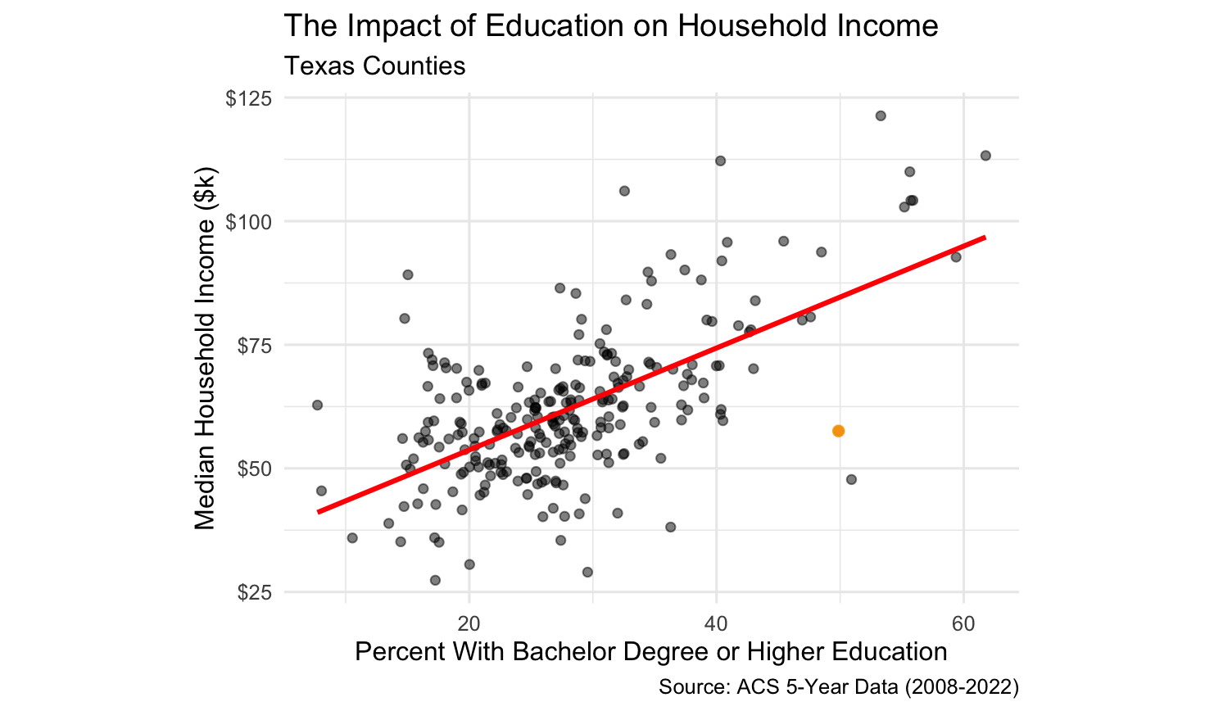
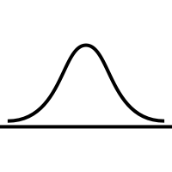
Baseline (OLS)
As education goes up, income follows.
Basic scatterplot and baseline model shows a strong, positive correlation
This model assumes every county is independent*
It assumes that what happens in Travis County has zero effect on Williamson County.
We know that's not how the real-world works.

Slide 9
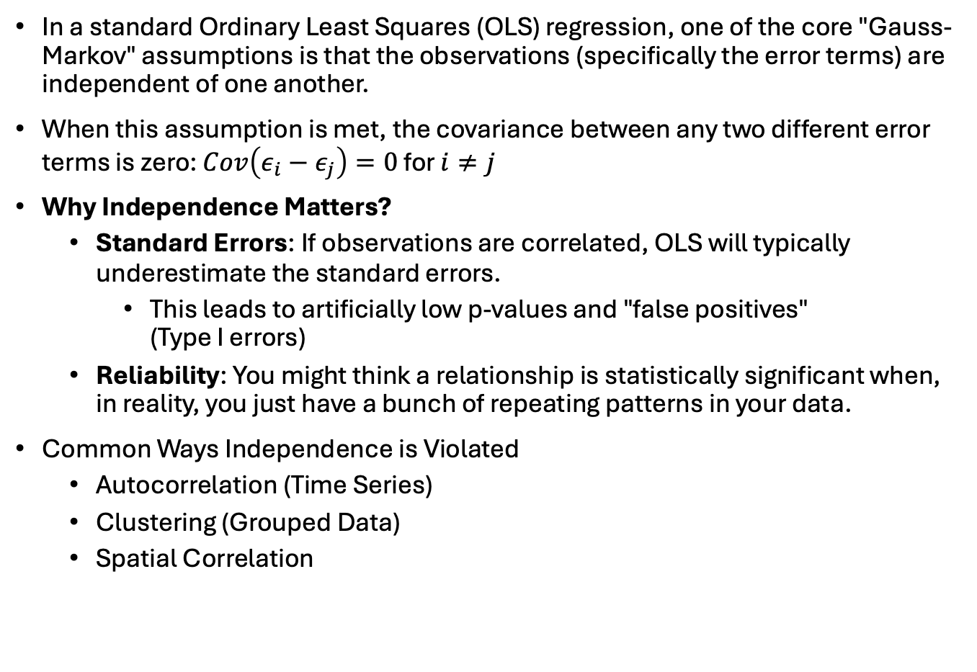
In a standard Ordinary Least Squares (OLS) regression, one of the core "Gauss-Markov" assumptions is that the observations (specifically the error terms) are independent of one another.
When this assumption is met, the covariance between any two different error terms is zero: $Cov\left(ε_{i}−ε_{j}\right)=0$ for $i≠j$
Why Independence Matters?
Standard Errors: If observations are correlated, OLS will typically underestimate the standard errors.
This leads to artificially low p-values and "false positives" (Type I errors)
Reliability: You might think a relationship is statistically significant when, in reality, you just have a bunch of repeating patterns in your data.
Common Ways Independence is Violated
Autocorrelation (Time Series)
Clustering (Grouped Data)
Spatial Correlation

Slide 10
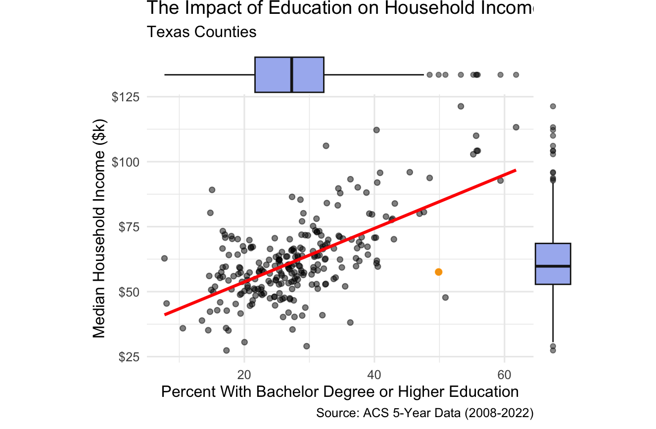
Brazos

Slide 11
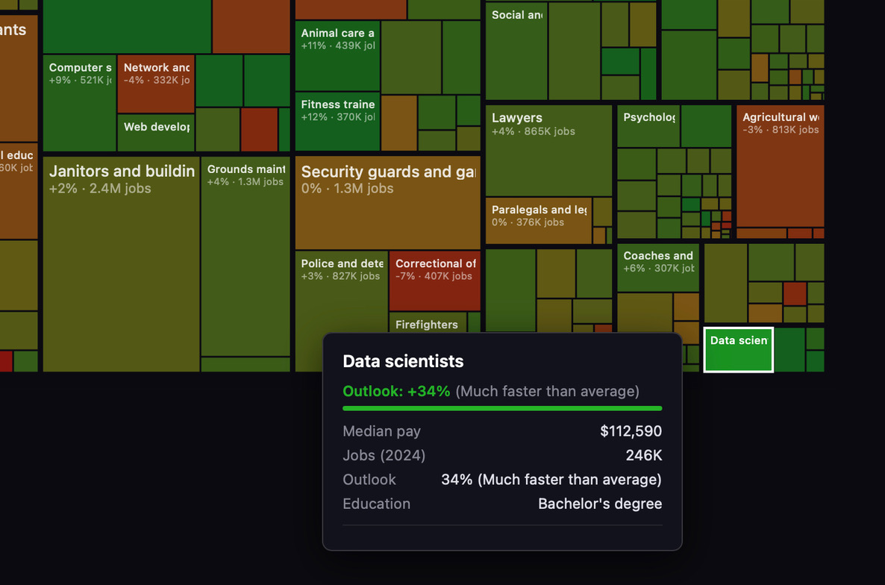
PS. Just sharing some labor statistics data:
- https://www.bls.gov/ooh/fastest-growing.htm
- https://www.bls.gov/ooh/math/data-scientists.htm
- https://www.bls.gov/ooh/architecture-and-engineering/industrial-engineers.htm
PS. This job market visualization (https://karpathy.ai/jobs/) is also interesting …
helps to see the size of each area in the overall working force.

Slide 12

Question 2
Geography could also be an influencer too ...

Slide 13
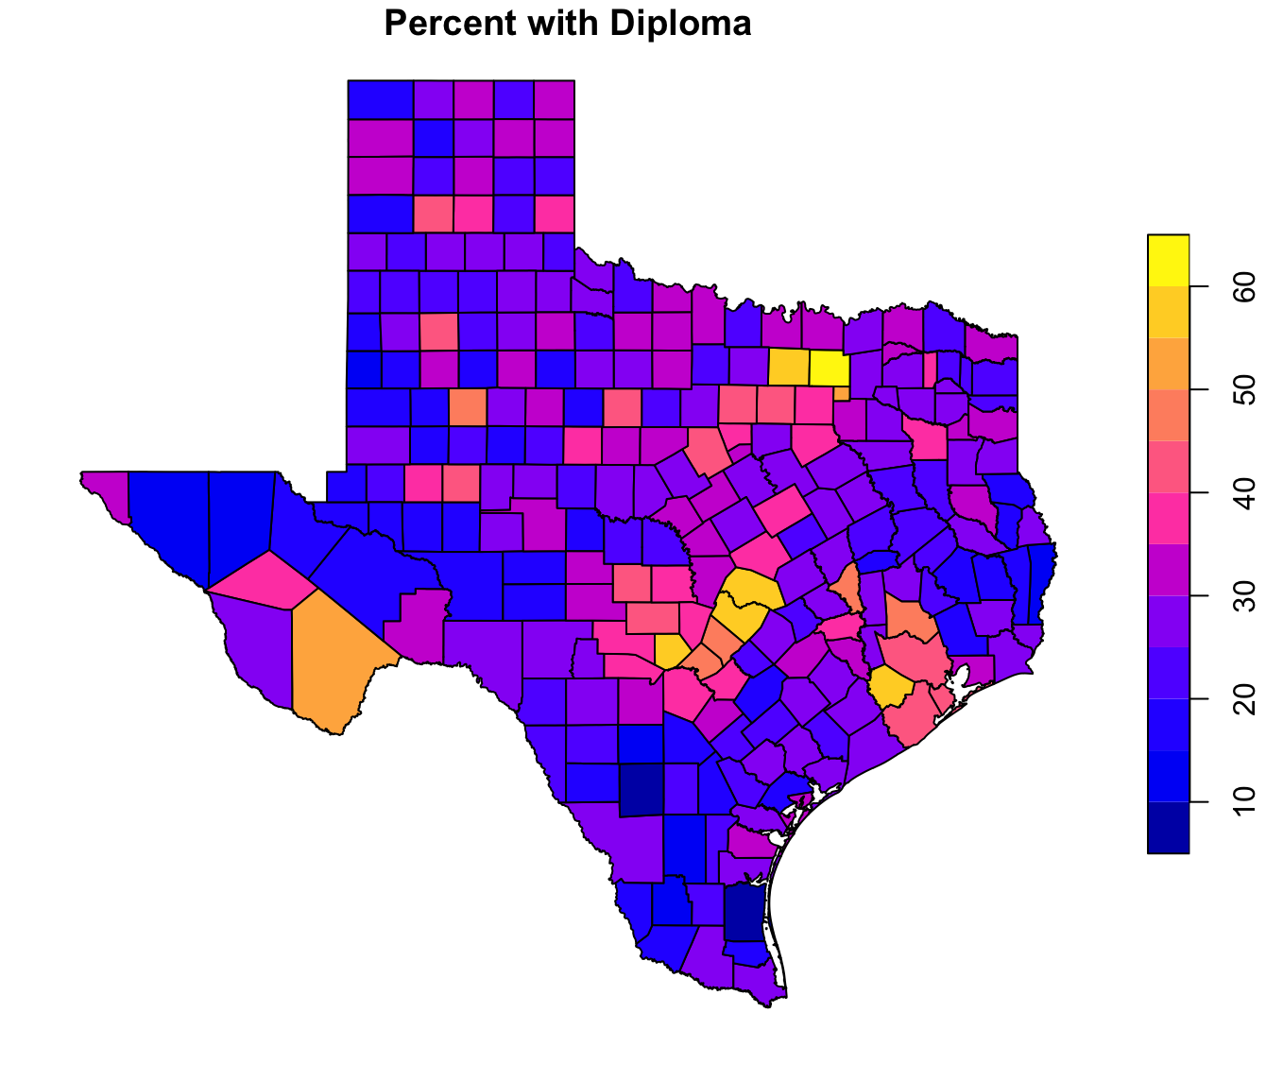
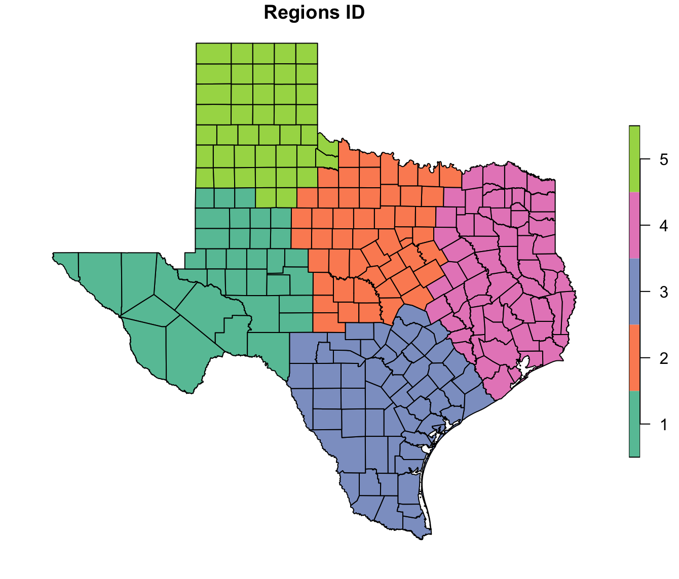
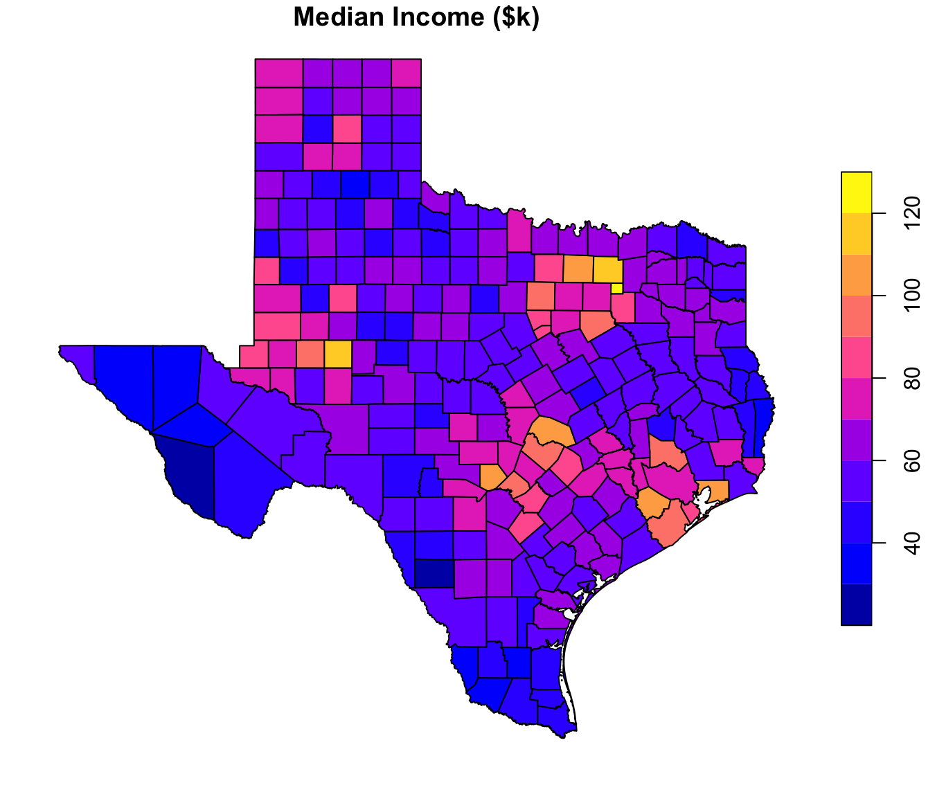

Slide 14
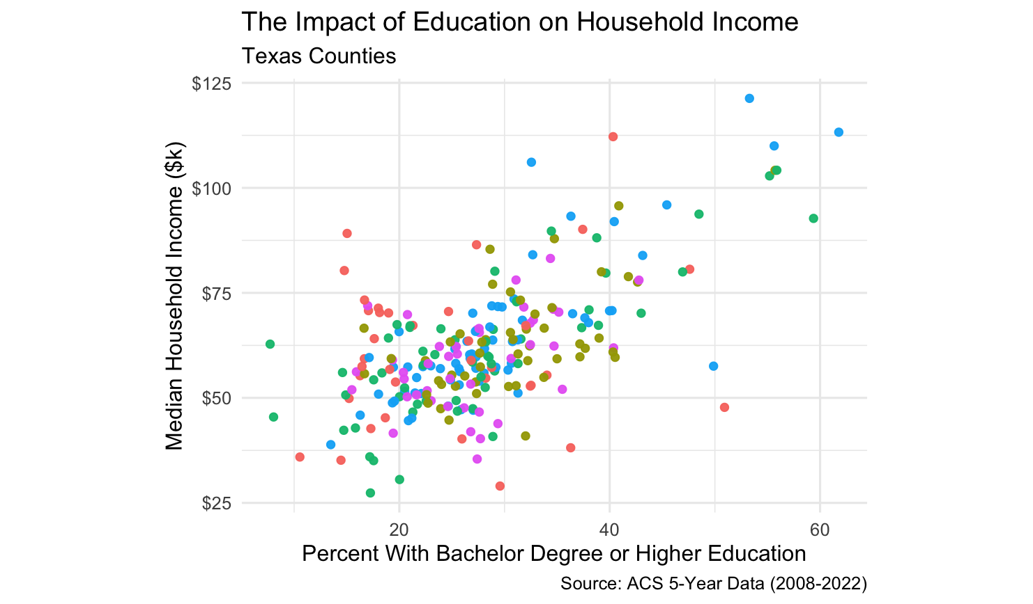
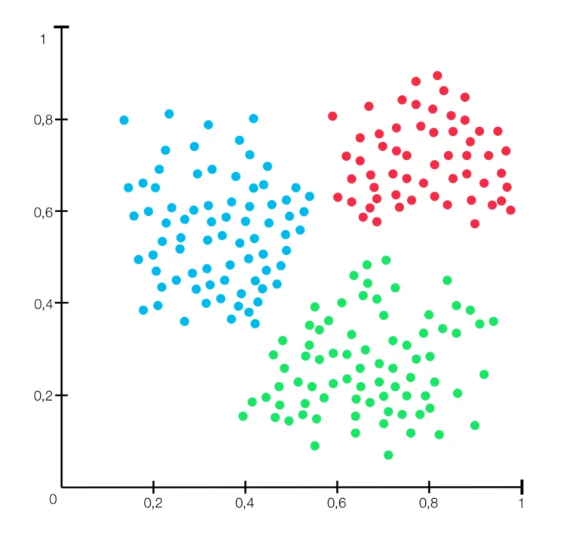

Slide 15
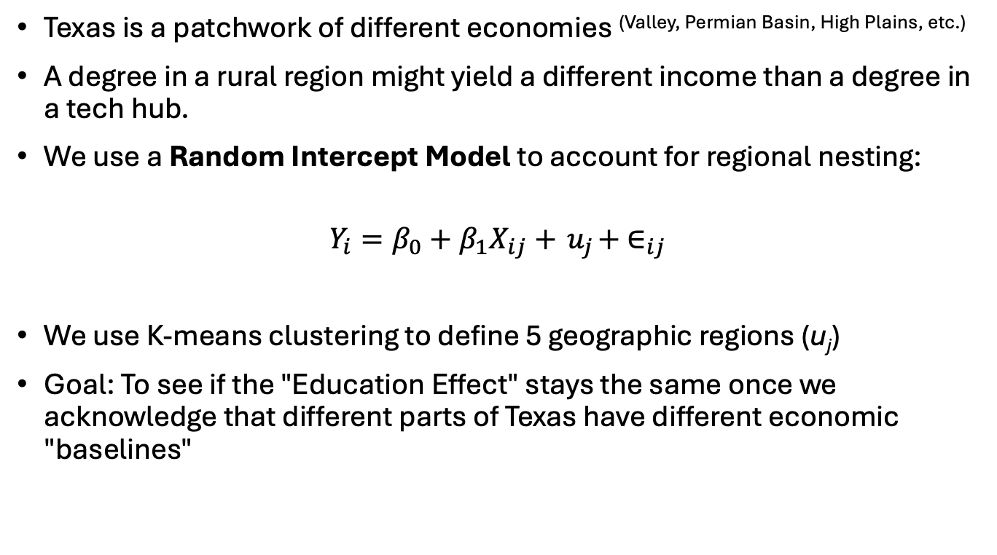
Multilevel Model
Texas is a patchwork of different economies (Valley, Permian Basin, High Plains, etc.)
A degree in a rural region might yield a different income than a degree in a tech hub.
We use a Random Intercept Model to account for regional nesting:
$$Y_{i}=β_{0}+β_{1}X_{ij}+{ u}_{j}+ ∈_{ij}$$
We use K-means clustering to define 5 geographic regions (u_{j})
Goal: To see if the "Education Effect" stays the same once we acknowledge that different parts of Texas have different economic "baselines"

Slide 16
Multilevel Model
==========================================================================
Dependent variable:
------------------------------------------------------
med_income_k
OLS linear
mixed-effects
(1) (2) (3)
--------------------------------------------------------------------------
pct_with_diploma 1.03*** 1.03***
Constant 62.04*** 33.13*** 33.10***
--------------------------------------------------------------------------
Observations 253 253 253
R2 0.00 0.38
Adjusted R2 0.00 0.38
Log Likelihood -987.20
Akaike Inf. Crit. 1,982.00
Bayesian Inf. Crit. 1,997.00
Residual Std. Error 15.23 (df = 252) 11.98 (df = 251) 11.97
==========================================================================
Note: *p<0.1; **p<0.05; ***p<0.01

Slide 17
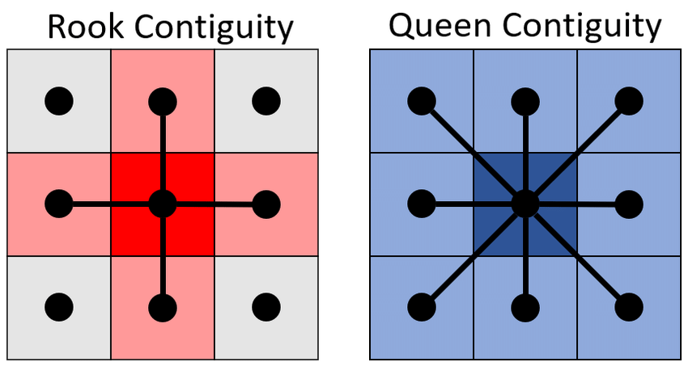
How do we define "nearby"?
In this analysis, let us use Queen Contiguity:
If two counties share even a single corner, they are neighbors (like a Queen on a chessboard)
Spatial Weights Matrix (W)
If county A and B are neighbors, W_{ab} = 1; otherwise, 0
Then row-standardize the matrix so the influence of all neighbors sums to 1
This allows us to calculate a "Spatial Lag" essentially the weighted average of everything happening next by

Slide 18
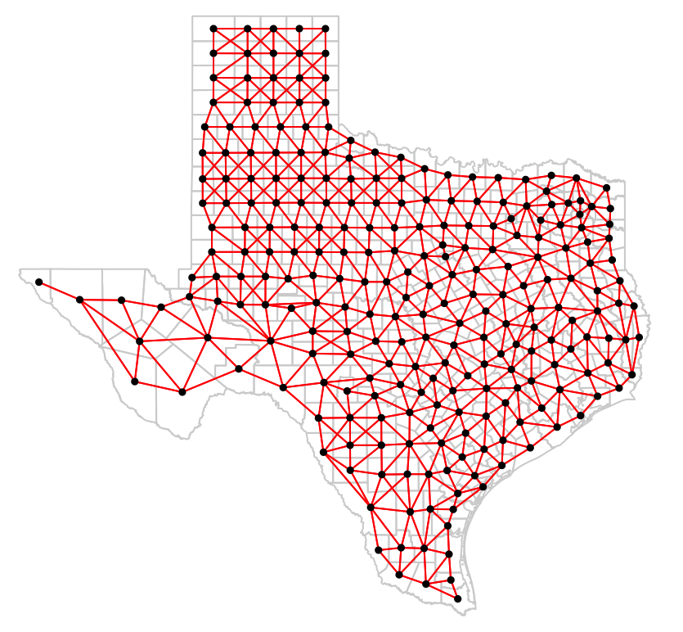

Slide 19
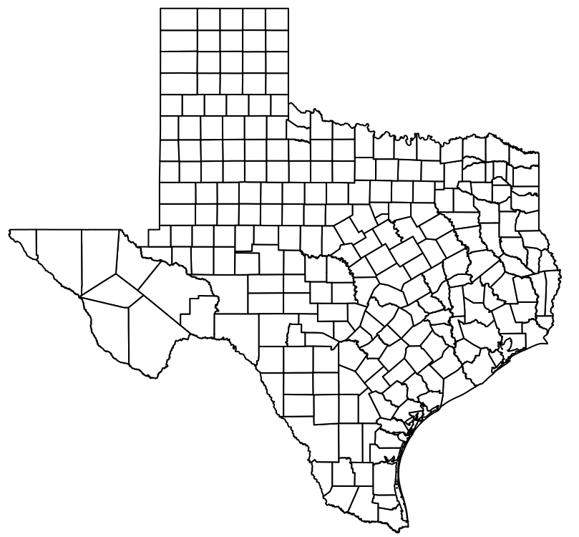
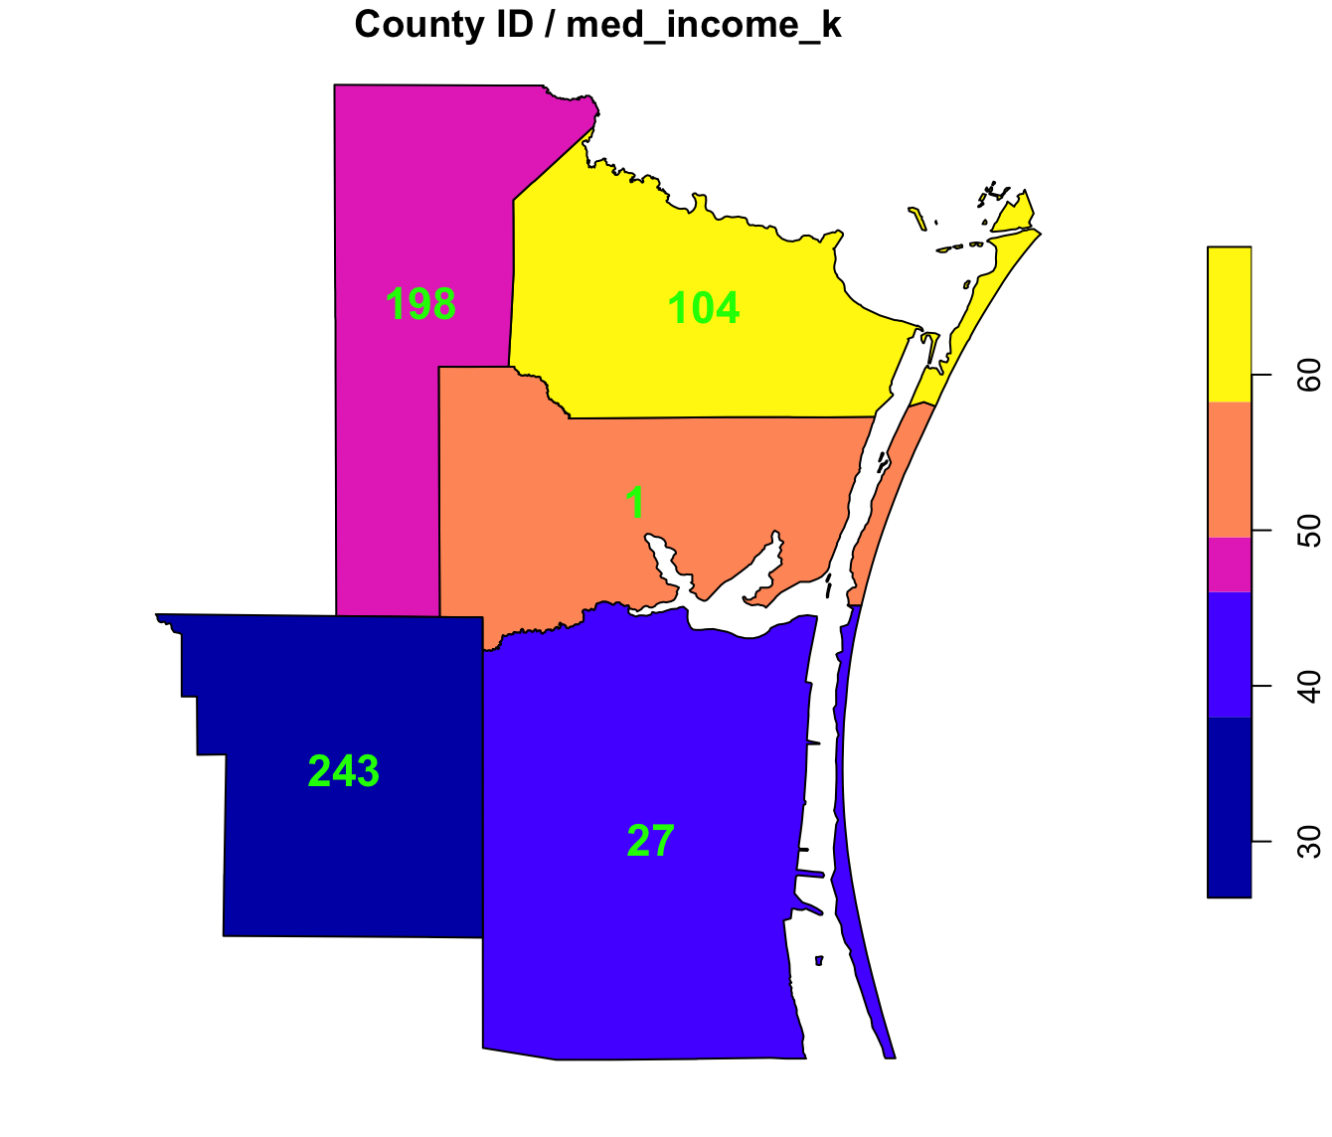
from to weights
1 1 27 0.25
2 1 104 0.25
3 1 198 0.25
4 1 243 0.25

Slide 20
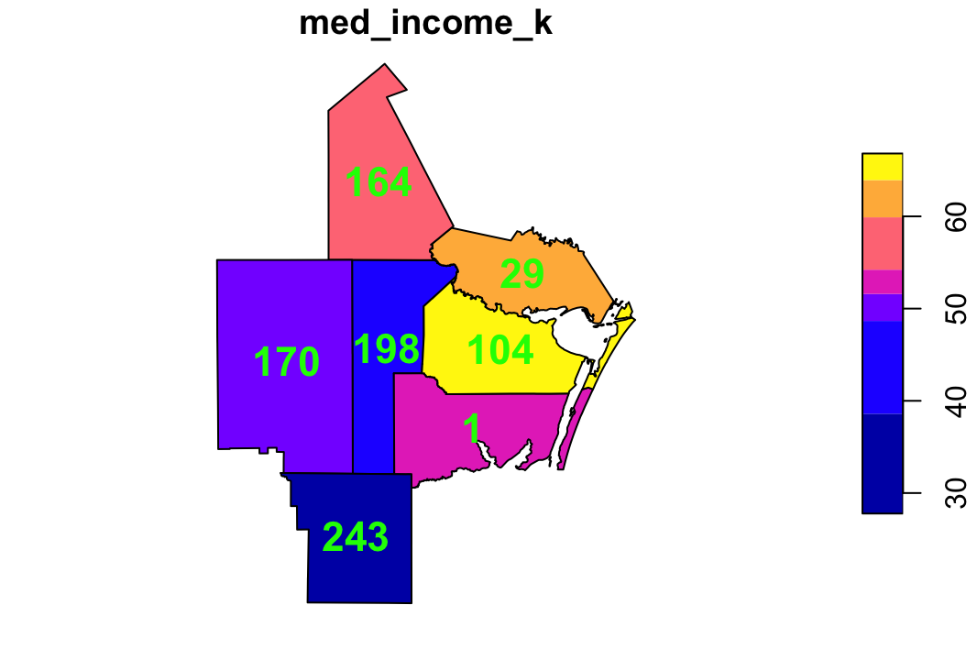
from to weights
1 198 1 0.1667
2 198 29 0.1667
3 198 104 0.1667
4 198 164 0.1667
5 198 170 0.1667
6 198 243 0.1667

Slide 21
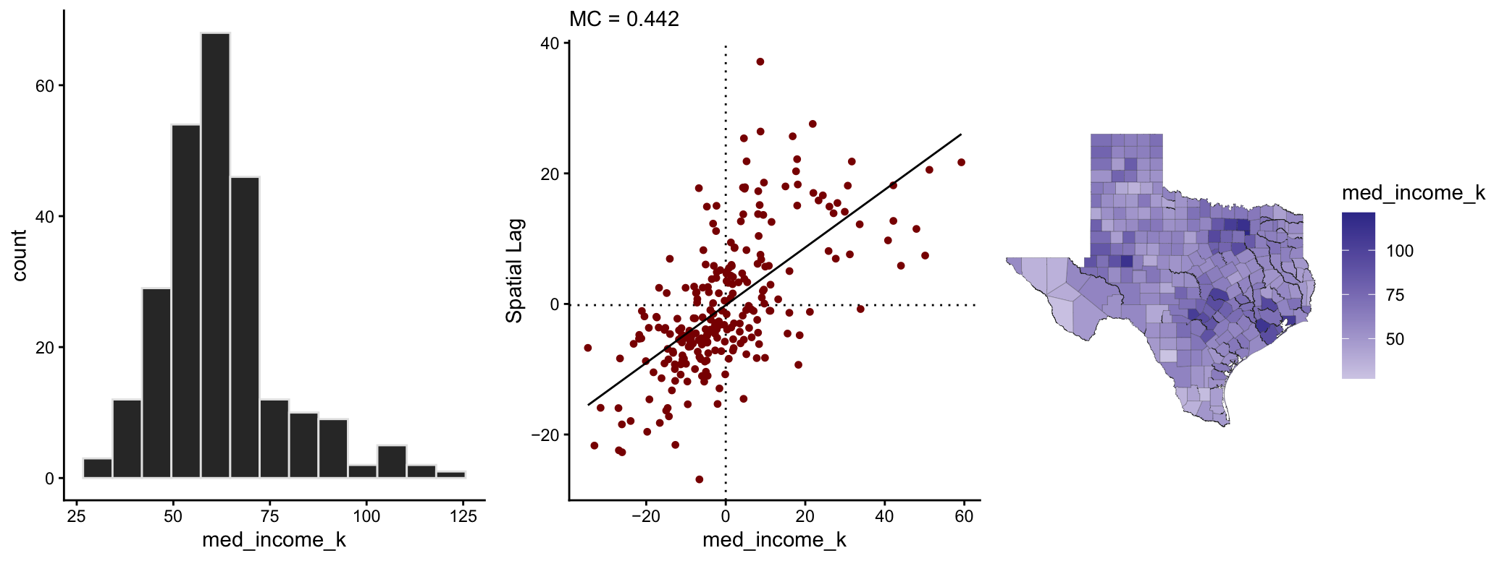

Spatial Lag
The spatial lag (y-axis) represents the average value of the variable in neighboring locations for each observation.
The scatterplot axis are centered around 0.
Mean-Centering: The function calculates the average for all counties.
Subtraction: then subtracts that average from every county value $(x_{i}−\overline{x})$.
Spatial Lag: is the weighted average of the centered values of a county's neighbors.

Slide 22
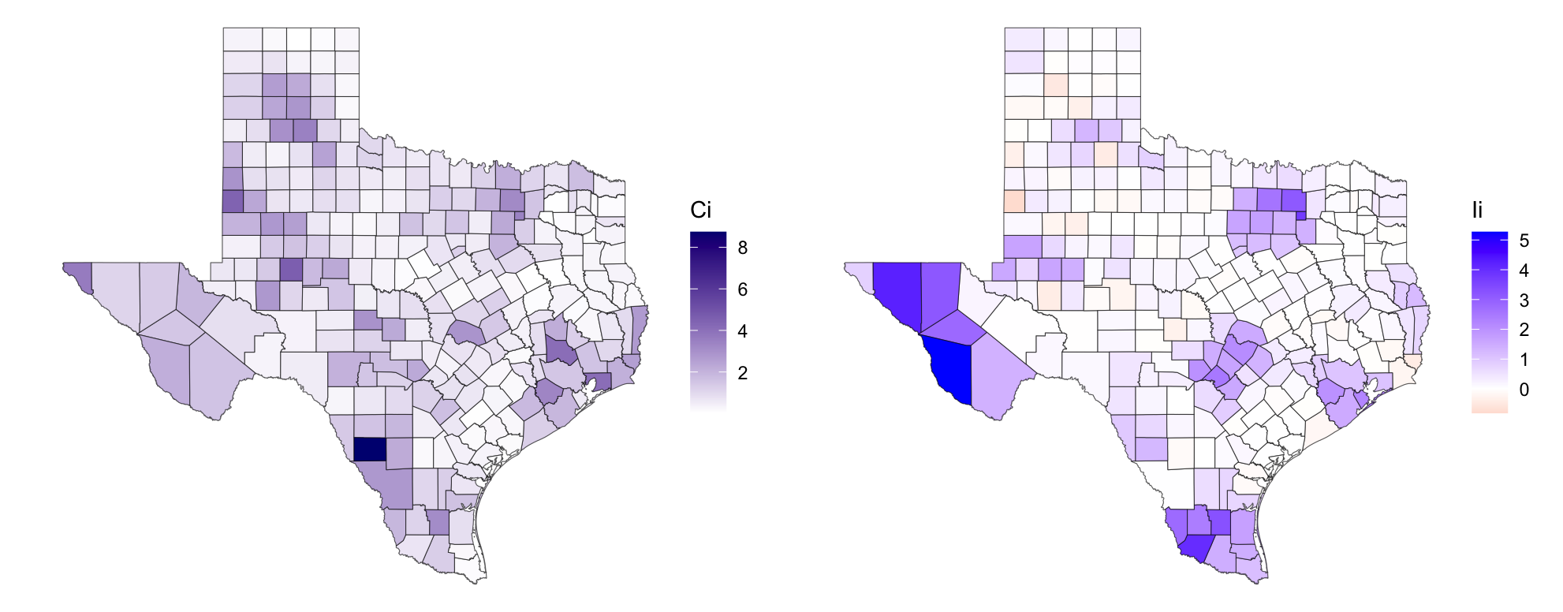
(LISAs)
Local Indicators of Spatial Association
Local Geary: absolute difference between a county and its neighbors (dissimilarity).
Usually:
small values of Ci indicate positive spatial autocorrelation (neighbors are similar)
large values indicate negative spatial autocorrelation (neighbors are different)
The dark blue areas represent counties that have very different values compared to their immediate neighbors. These are your spatial outliers:
Local Moran's I: cross-product of deviations from the mean. Measures whether a county and its neighbors are both above or both below the average.
Positive values (Blue): Indicate Spatial Clusters. This means the county is surrounded by neighbors with similar values (High-High or Low-Low).
Near Zero (White): Indicates a random spatial distribution.
Negative values (Red/Pink): Indicate Spatial Outliers. A "High" value surrounded by "Low" values, or vice versa.
The cluster of blue suggests areas share a common trend with their neighbors ("High-High" of the variable)

Slide 23
Local Indicators of Spatial Association (LISAs)
Indicates Clustering: specific spots surrounded by similar values
High-High (Hot Spots) A wealthy surrounded by wealthy
Low-Low (Cold Spots) ^{A poor surrounded by poor}
High-Low (Spatial Outlier)
Low-High (Spatial Outlier)

Slide 24
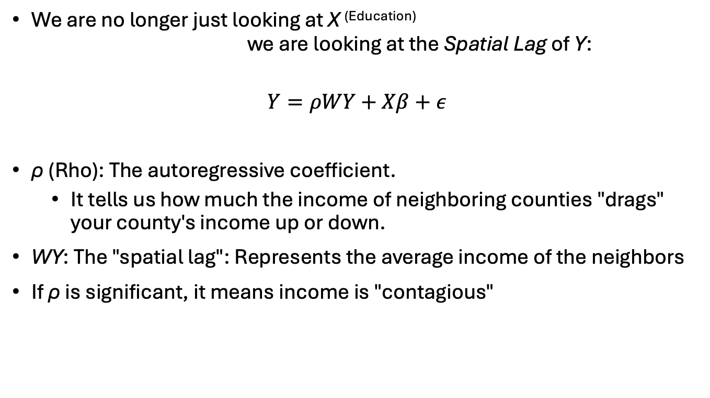
Spatial Lag Model (SAR)
We are no longer just looking at X ^{(Education)} we are looking at the Spatial Lag of Y:
$$Y=ρWY+Xβ+ε$$
ρ (Rho): The autoregressive coefficient.
It tells us how much the income of neighboring counties "drags" your county's income up or down.
WY: The "spatial lag": Represents the average income of the neighbors
If ρ is significant, it means income is "contagious"

Slide 25
Multilevel Model
============================================================================================
Dependent variable:
------------------------------------------------------------------------
med_income_k
OLS linear spatial
mixed-effects autoregressive
(1) (2) (3) (4)
--------------------------------------------------------------------------------------------
pct_with_diploma 1.03*** 1.03*** 0.77***
Constant 62.04*** 33.13*** 33.10*** 7.58**
--------------------------------------------------------------------------------------------
Observations 253 253 253 253
R2 0.00 0.38
Adjusted R2 0.00 0.38
Log Likelihood -987.20 -953.20
Akaike Inf. Crit. 1,982.00 1,914.00
Residual Std. Error. 15.23 (df = 252) 11.98 (df = 251) 11.97 10.22
============================================================================================
Note: *p<0.1; **p<0.05; ***p<0.01

Slide 26
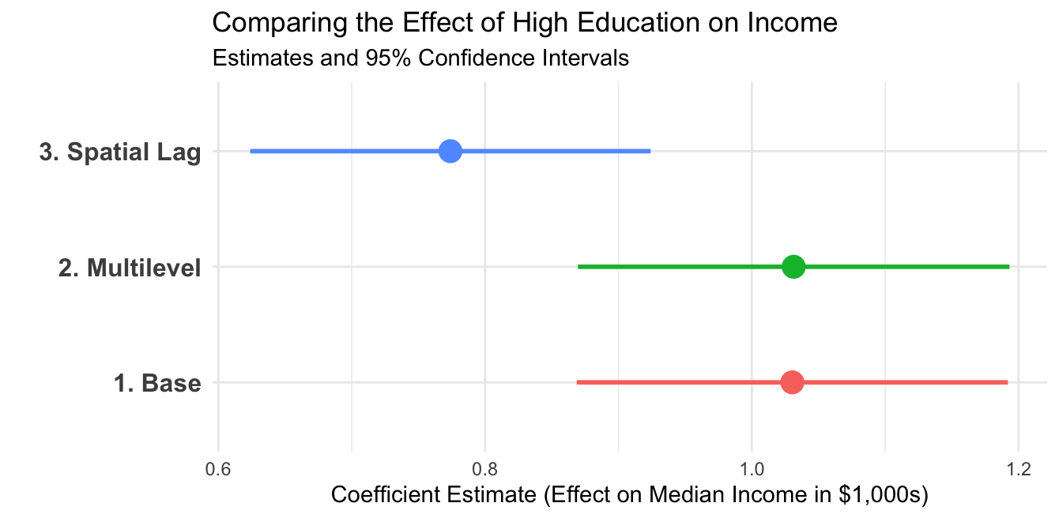
In the simple OLS model:
"Education" was "stealing" the "credit" that actually belonged to the neighbors.
For instance: A county might be wealthy partly because of its degrees, but also because it's a bedroom community for a neighboring wealthy city.
The Spatial Lag model separates these two:
The coefficient for Education gets smaller.
Tells us the direct effect of the degree versus the indirect effect of the location.
Conclusions:
Education remains a primary driver of income across all models.
Being educated in a "wealthy cluster" is different than in a "spatial void".
Implication: To boost Texas economy, we can't just fund schools in isolation but foster regional ecosystems bc prosperity clearly spills over boundary lines.

Slide 27
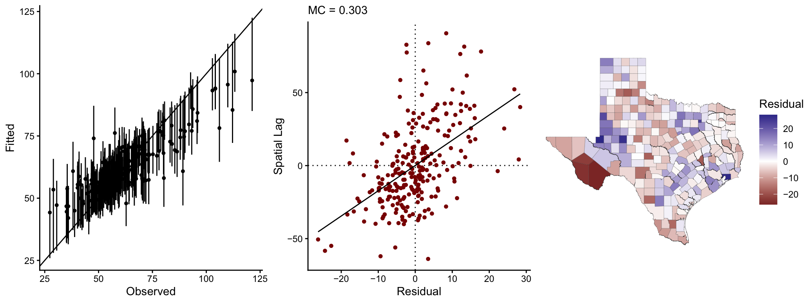
0.0 = Perfectly random (Goal)
0.303 => Clustered
One more thing ^{("Model Stress Test")}
Where is the spatial model succeeding? Where is the "Geography of Texas" still outsmarting your math?
Notice that as income gets higher ^{(the right side of the graph)}, the error bars get longer and the dots drift further from the line.
The model is good at predicting income for "average" counties, struggles with the extremely wealthy or extremely poor outliers.
0.303 tells that the model errors are "contagious."
If the model under-predicts income in one county, it is very likely to under-predict it in the neighboring county too.
We have reduced the spatial bias, but we haven't eliminated it!

Slide 28

Learn More Vignettes
Exploratory spatial data analysis https://cran.r-project.org/web/packages/geostan/vignettes/measuring-sa.html
Spatial analysis (with geostan) https://cran.r-project.org/web/packages/geostan/vignettes/spatial-analysis.html
Spatial measurement error models https://cran.r-project.org/web/packages/geostan/vignettes/spatial-me-models.html
Custom spatial models (with RStan and geostan) https://cran.r-project.org/web/packages/geostan/vignettes/custom-spatial-models.html
Raster regression https://cran.r-project.org/web/packages/geostan/vignettes/raster-regression.html

Slide 29
References
Spatial Data Science https://r-spatial.org/book/
Spatial Regression (Markov random field and multilevel models) https://r-spatial.org/book/16-SpatialRegression.html
Spatial Econometrics Models https://r-spatial.org/book/17-Econometrics.html

Slide 30

Tobler's First Law of Geography
"Everything is related to everything else, but near things are more related than distant things." Waldo Tobler (1930-2018)
Distance Decay The further apart two things are, the less they interact or influence each other
Spatial Autocorrelation The mathematical way to measure this "relatedness"
Neighborhood Effect Expect neighbors to be similar
Friction of distance
If it's raining at a house, it's likely raining at neighbor's house, but it might be sunny somewhere else.
The price of a house is heavily influenced by the prices of the houses on that same street.
People in neighboring towns usually speak with similar accents; people across the country sound different.

Slide 31
Effective Sample Size (ESS)
Spatial patterns aren't just visual: they fundamentally change the information content of a dataset.
When data points are spatially autocorrelated, they are not independent, which reduces the amount of "new" evidence each additional observation provides.
High SA leads to redundant information.
Using conventional statistical methods (which assume independence) on spatial data often leads to "perilous" results, as the methods overestimate the true sample size.
ESS represents the number of independent observations that would contain the same amount of information as your spatially dependent dataset.
The n_eff function approximates ESS using the Simultaneous Autoregressive (SAR) model framework.
x <- log(georgia$income)
c(nominal_n = nrow(georgia),
rho = aple(x, W),
MC = mc(x, W),
ESS = n_eff(rho = rho, n = n))
# nominal_n rho MC ESS
# 159.00000 0.70100 0.49800 23.34735
Metric | Value
Nominal Sample Size | 159
Spatial Autocorrelation | 0.70
Effective Sample Size | ~23
Bottom Line: Because of strong spatial patterns, 159 data points only provide the same statistical "punch" as 23 independent observations.
False Confidence: Conventional methods might report a "significant" correlation that is just an artifact of spatial patterning.
Inflated Type I Error: Much more likely to find a relationship where none exists if you ignore the reduced effective sample size.
* The APLE is an estimate of the spatial autocorrelation parameter one would obtain from fitting an intercept-only SAR model. Note, the APLE approximation is not reliable when the number of observations is large.

