Slide 1

Geometry Operations with Vector Data
Alexander Abuabara
DAEN 489 ISEN 489
Spring 2026
Att. Code ####

Slide 2
Overview
So far, we have:
Explained the structure of geographic datasets
(core components: geometry, attributes, topology)
Manipulate geographic datasets based on their:
Non-geographic attributes (filters and subsets), and
And spatial relations (subsets and topological relations)
This week focuses on manipulating even more the geographic elements of spatial objects. By:
Simplifying,
Creating buffers, and
Converting vector geometries.

Slide 3
Learning Outcomes (Week 5/Assignment #3)
By completing this week/assignment, you should be able to:
Design a spatial data workflow from raw public datasets
Perform spatial transformations and joins
Evaluate methodological choices in spatial overlay analysis
Integrate multiple administrative boundary datasets
Produce summary statistics from engineered spatial data
Clearly communicate your analytical plan and tradeoffs

Slide 4
Emphasis
Data Engineering
Build the system
Scalable pipeline design
Modular, reproducible code
Schema + storage strategy
Computational efficiency
Production-oriented thinking
Industrial Engineering
Evaluate the decision impact
Sensitivity to spatial design choices
Analytics/risk interpretation
Distributional analysis of value
Operational implications
Policy and planning relevance
Shared Expectation
Design and justify a defensible spatial workflow

Slide 5
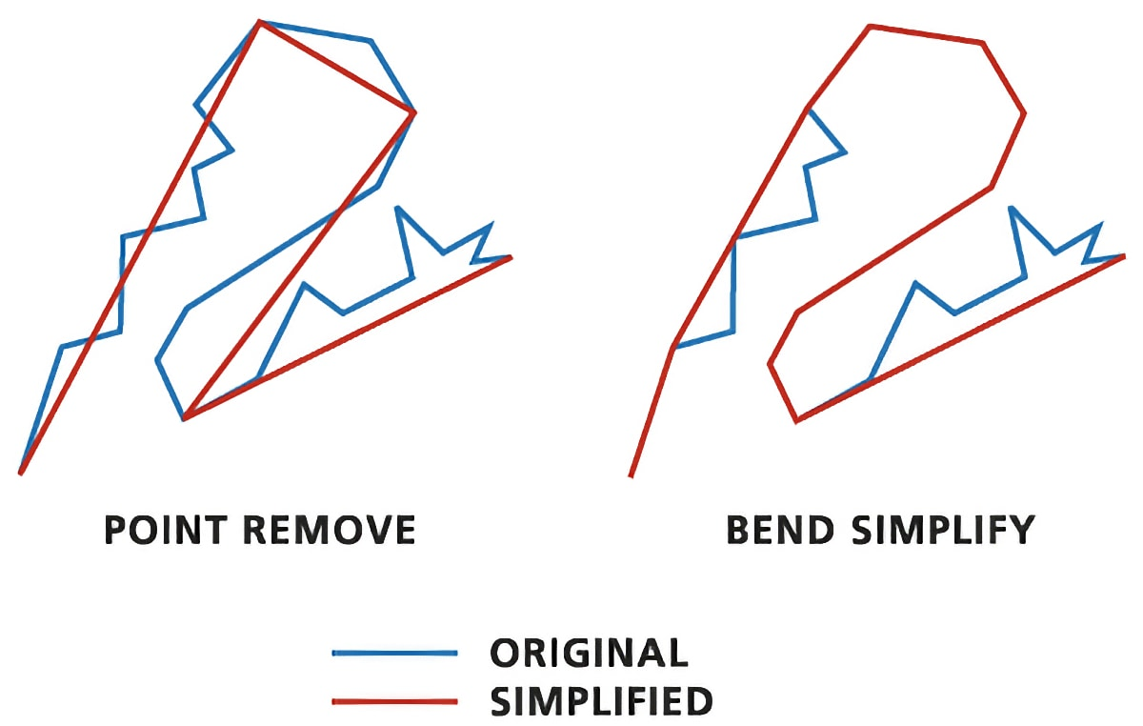
Simplification
Simplification is a process for generalization of vector objects (lines and polygons) usually for use in smaller scale maps.
Another reason for simplifying objects is to reduce the amount of memory they consume (disk space and network bandwidth). It may be wise to simplify complex geometries before publishing them as interactive maps :)

Slide 6
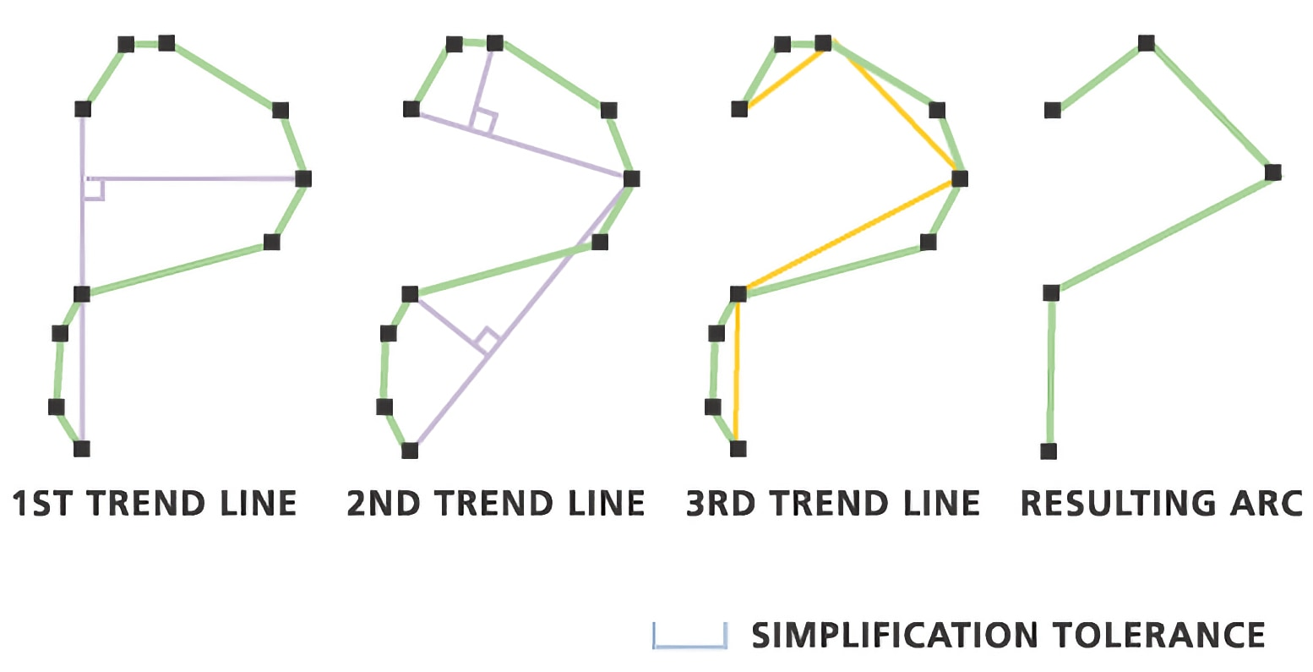
Douglas-Peucker algorithm
Boundaries are simplified by removing vertices, decimating a curve composed of line segments to a similar curve with fewer points.

Slide 7
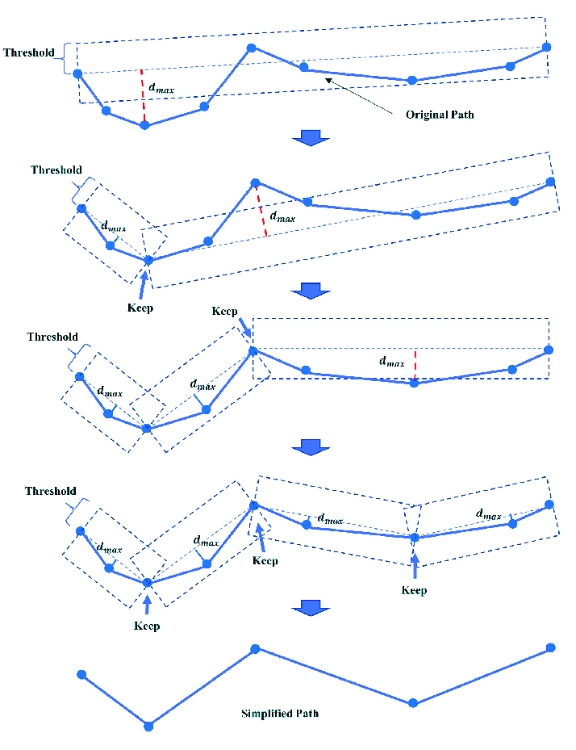
st_simplify()
The sf package provides st_simplify(), which uses the Douglas-Peucker algorithm to reduce the vertex count.
st_simplify() uses the dTolerance to control the level of generalization in map units.

Slide 8
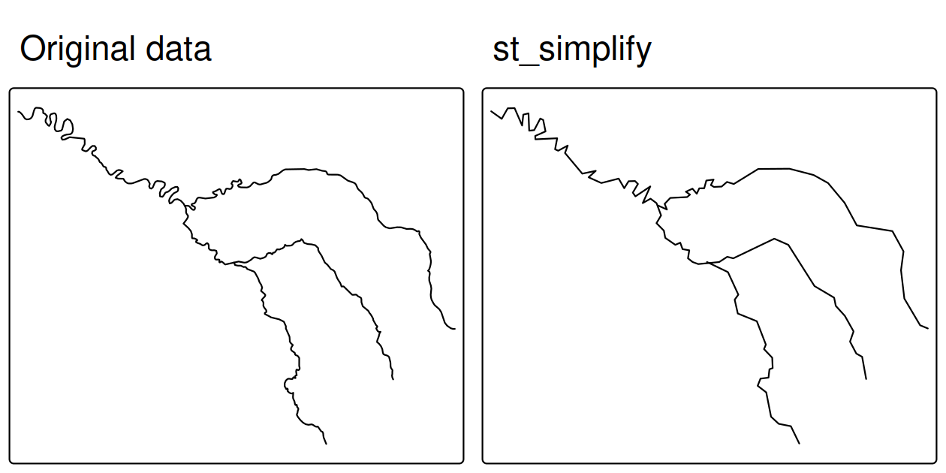
Simplification of a LINESTRING geometry representing the River Seine and tributaries
library(sf)
library(dplyr)
library(spData)
seine_simp = st_simplify(seine, dTolerance = 2000) # 2000 m
object.size(seine)
# 18096 bytes
object.size(seine_simp)
# 9112 bytes
The resulting object is a copy of the original but with fewer vertices.
This is apparent, with the result being visually simpler and consuming less memory than the original object (as verified).

Slide 9
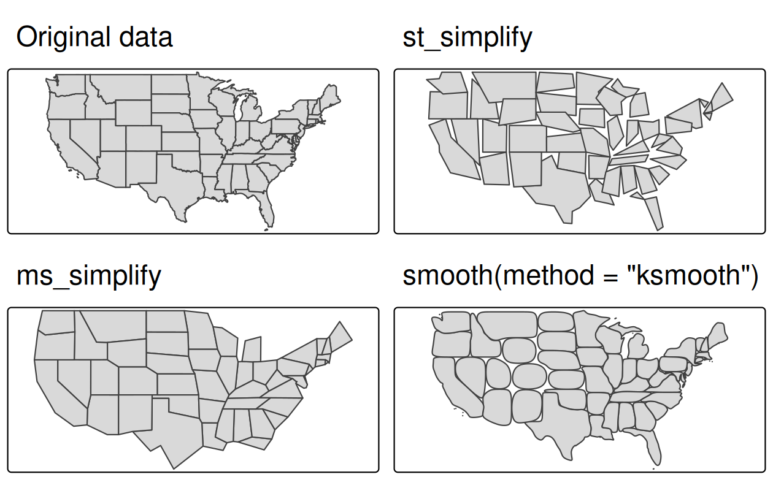
Simplification Example
us_states_simp1 = st_simplify(us_states, dTolerance = 100000) # 100 km
A limitation with st_simplify() is that it simplifies objects on a per-geometry basis
This means the 'topology' is lost, resulting in overlapping and 'holey' areal units

Slide 10
Simplification Alternative
us_states_simp1 = st_simplify(us_states, dTolerance = 100000) # 100 km
# proportion of points to retain
# (0-1; default 0.05)
us_states_simp2 = rmapshaper::ms_simplify(us_states, keep = 0.01, keep_shapes = TRUE)
rmapshaper provides an alternative
By default it uses the Visvalingam algorithm (which overcomes some limitations of the Douglas-Peucker algorithm)

Slide 11
Simplification, Another Alternative
us_states_simp1 = st_simplify(us_states, dTolerance = 100000) # 100 km
# proportion of points to retain
# (0-1; default 0.05)
us_states_simp2 = rmapshaper::ms_simplify(us_states, keep = 0.01, keep_shapes = TRUE)
us_states_simp3 = smoothr::smooth(us_states, method = "ksmooth", smoothness = 6)
smoothr implements three techniques for smoothing:
Gaussian kernel regression,
Chaikin's corner cutting algorithm, and
Spline interpolation
All described in the package website: https://strimas.com/smoothr/
Similar to st_simplify(), the smoothing algorithms don't preserve 'topology'

Slide 12
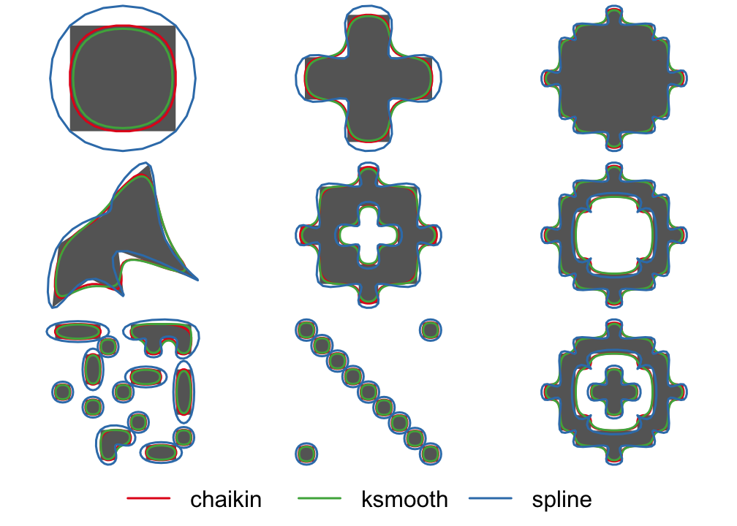
smoothr offers a variety of tools for smoothing and tidying spatial features (i.e., polygons and lines) to make them more aesthetically pleasing, especially when converting raster data to vector format.

Slide 13
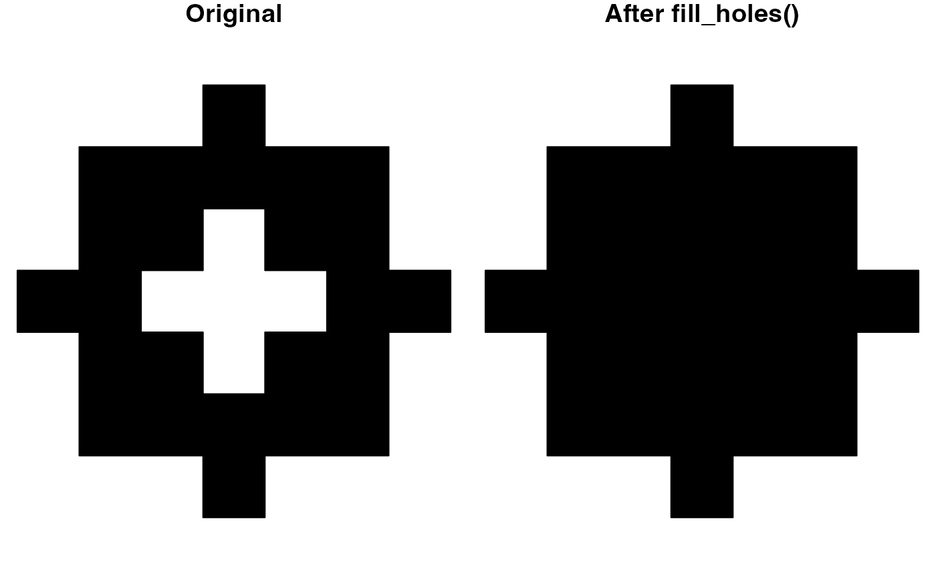

Also, on smoothr
drop_crumbs() Removes small lines or polygons based on a length or area threshold
fill_holes() Fill small holes in polygons
Crumbs?
we will explore it more on raster-to-polygon conversion

Slide 14
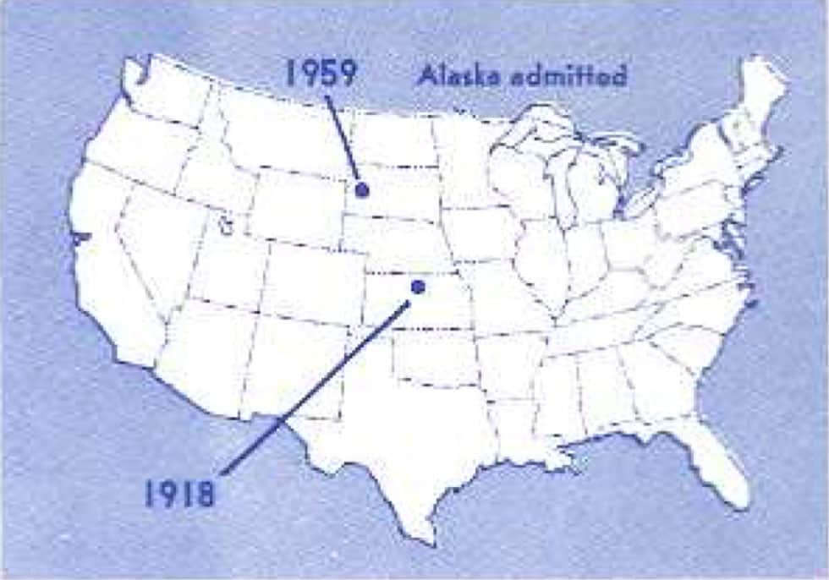
Centroids
Centroid operations identify the center of geographic objects
Like statistical measures of central tendency (including mean and median definitions of 'average'), there are many ways to define the geographic center of an object
All of them create single point representations of more complex vector objects
The most used centroid is the geographic centroid

Slide 15
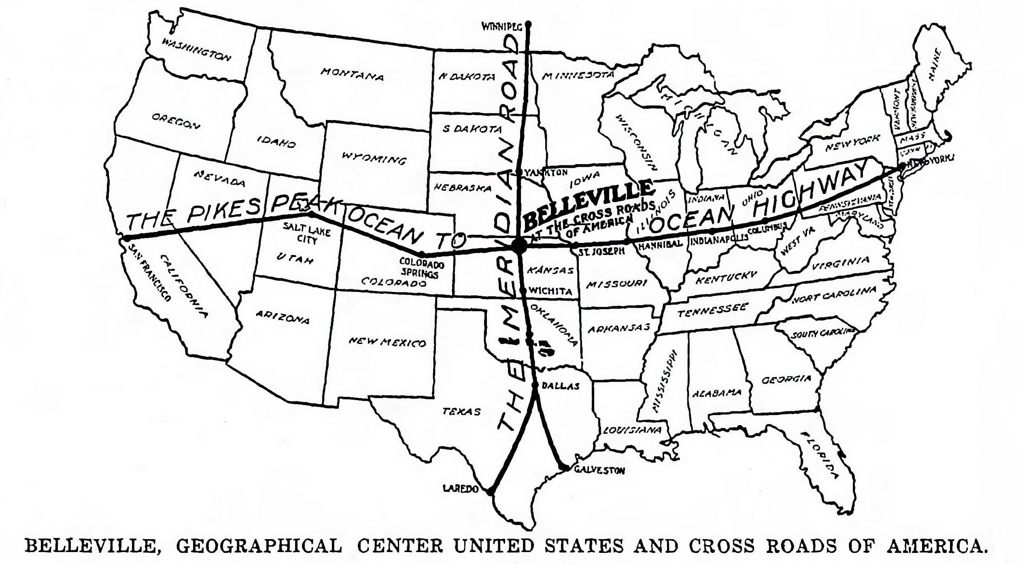
Geographic Center of the US

Slide 16
Centroids
Geographic centroids have many uses, for example:
To create a simple point representation of complex geometries
To estimate distances between polygons
Sometimes the geographic centroid falls outside the boundaries of their parent objects (think of a doughnut).
In such cases point on surface operations can be used to guarantee the point will be in the parent object (e.g., for labeling irregular multipolygon objects such as island states)

Slide 17
Geographic Centroids of Each State
https://www.maps.com/mapping-the-middles-geographic-center-us/
https://en.wikipedia.org/wiki/List_of_geographic_centers_of_the_United_States

Slide 18
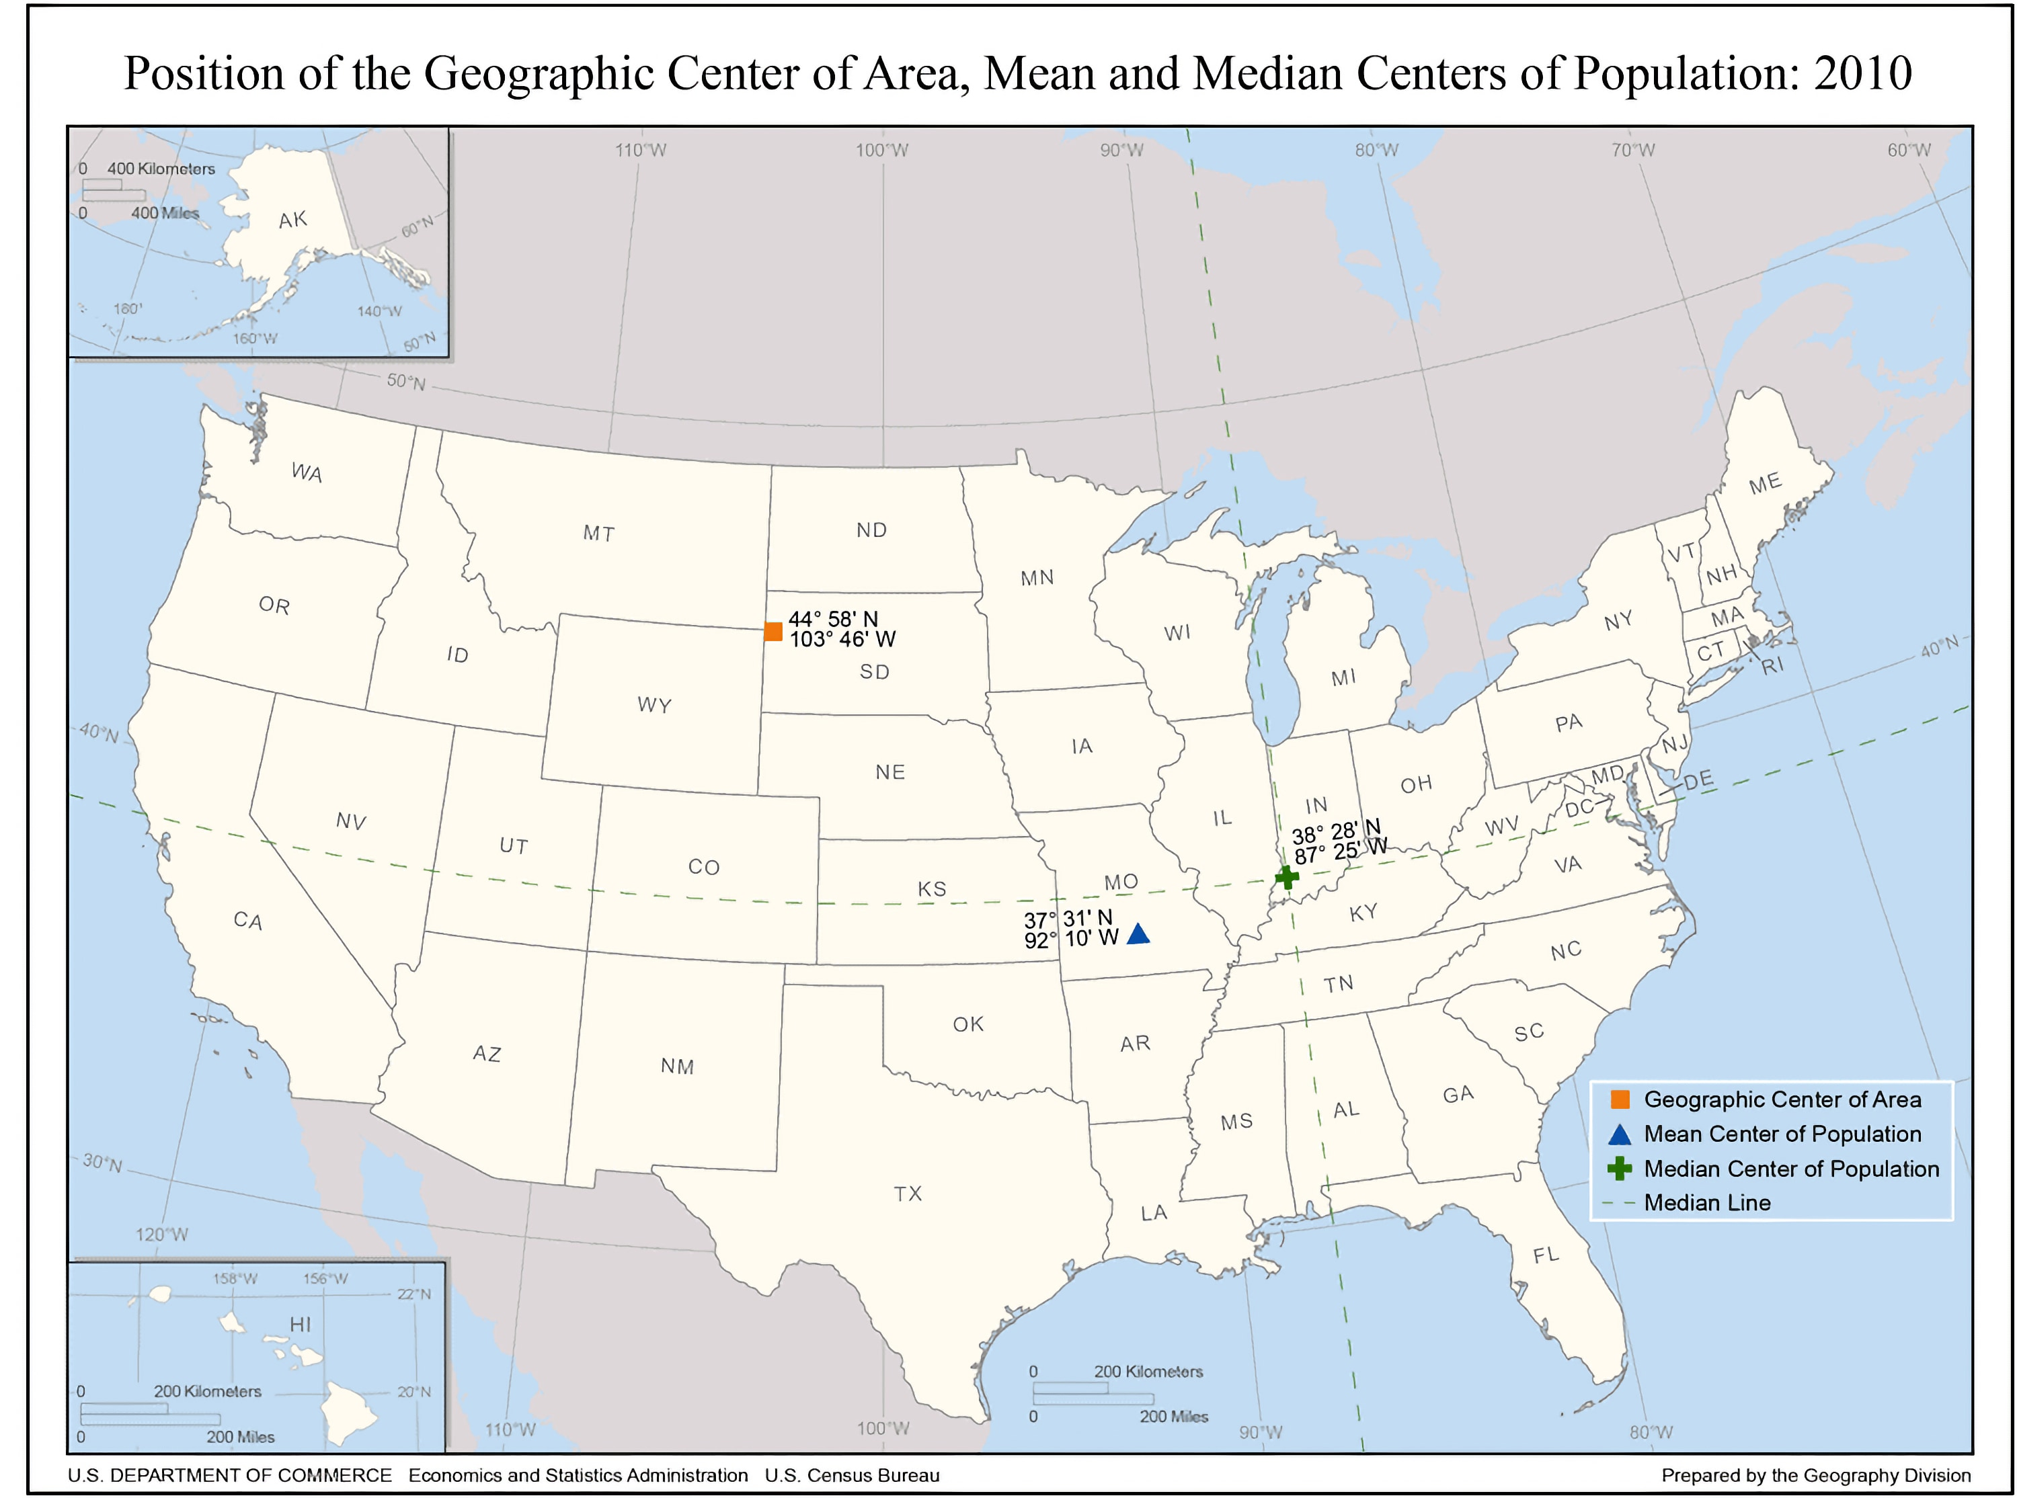
https://en.wikipedia.org/wiki/Geographic_center_of_the_United_States

Slide 19
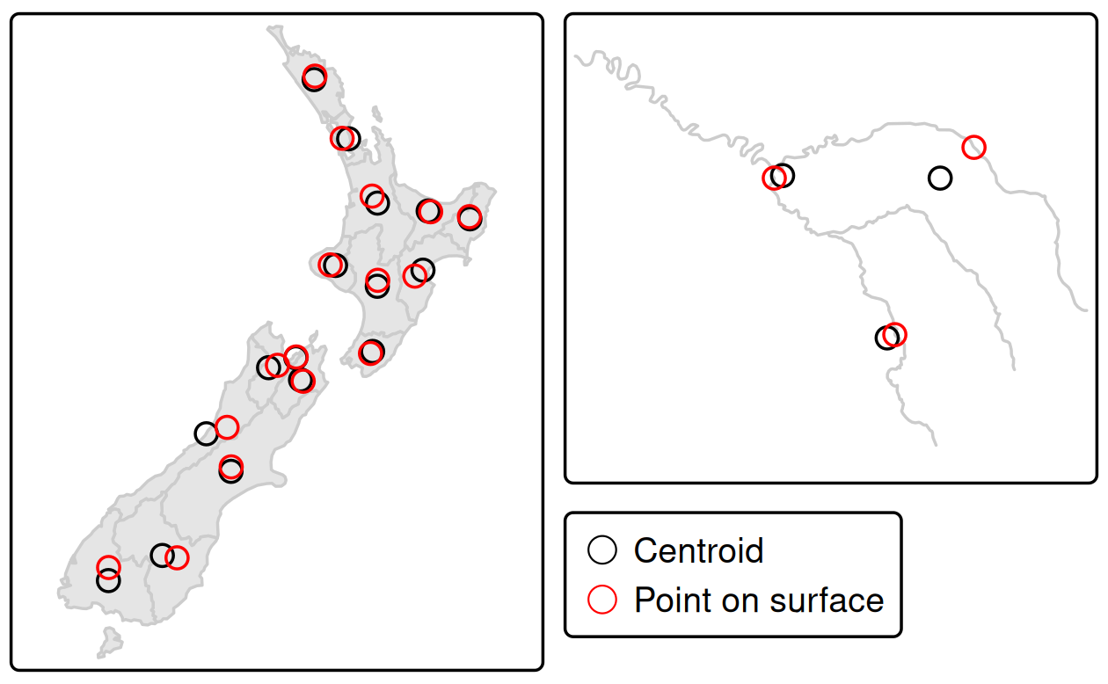
Centroid Example
Notice that the red points always lie on their parent objects!
They are created with st_point_on_surface()
nz_centroid = st_centroid(nz)
nz_pos = st_point_on_surface(nz)
plot(st_geometry(nz), col = "lightgray")
plot(st_geometry(nz_centroid), add = TRUE, pch = 19, col = "blue")
plot(st_geometry(nz_pos), add = TRUE, pch = 18, col = "red")
seine_centroid = st_centroid(seine)
seine_pos = st_point_on_surface(seine)
plot(st_geometry(seine), col = "black")
plot(st_geometry(seine_centroid), add = TRUE, pch = 19, col = "blue")
plot(st_geometry(seine_pos), add = TRUE, pch = 18, col = "red")
# Warning message: st_centroid/st_point_on_surface assumes attributes are constant over geometries
>> The warning is reminding you that centroid/point on surface calculation is purely geometric; any associated attributes may not meaningfully reflect the point location.

Slide 20
Buffers
Buffers are polygons representing the area within a given distance of a geometric feature
Regardless of whether the input is a point, line or polygon, the output is a polygon
Unlike simplification (which is often used for visualization and reducing file size), buffering tends to be used for geographic data analysis
How many points are within a given distance of this line?
Which demographic groups are within travel distance of this new shop?

Slide 21
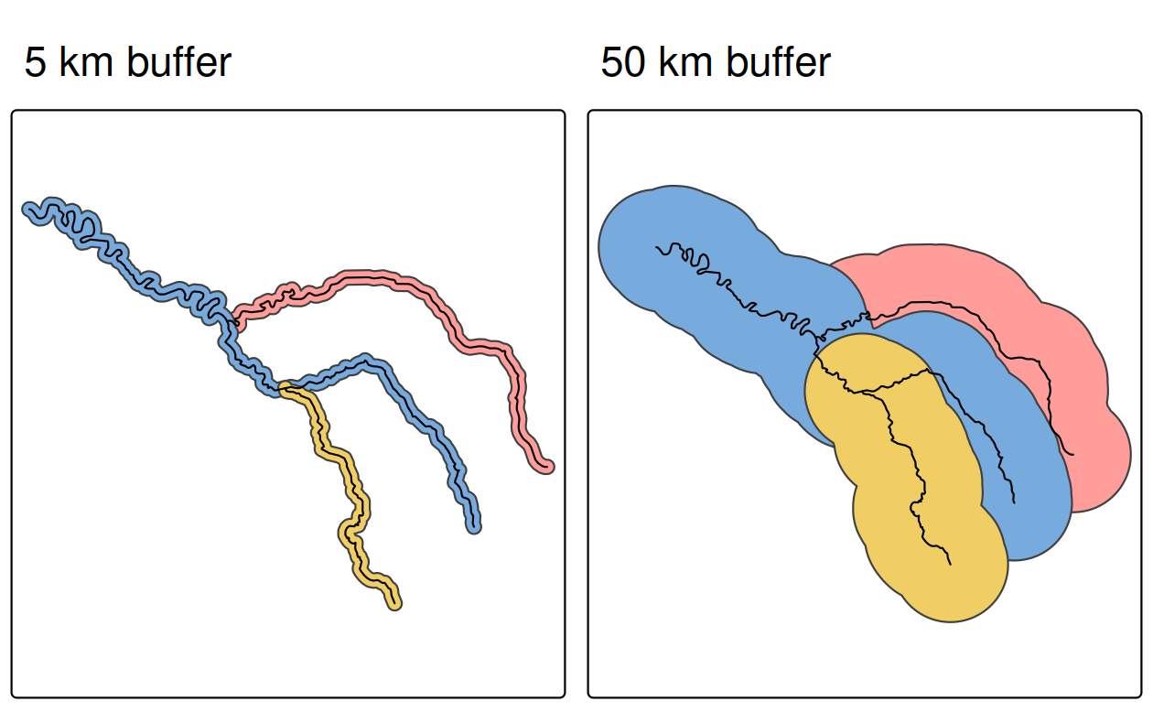
Buffer Example
seine_buff_5km = st_buffer(seine, dist = 5000)
seine_buff_50km = st_buffer(seine, dist = 50000)
Buffers of different sizes surrounding the River Seine and tributaries
These buffers were created with command st_buffer()
It requires at least two arguments: an input geometry and a distance, provided in the units of the CRS (in this case meters)

Slide 22
Negative Buffer (special case)
Positive distances → expand outward from the feature
Negative distances → shrink inward toward the feature interior (where valid)
Why Negative Buffers?
Contract the geometry (e.g.,, to remove edge areas)
Create inner rings inside polygons to represent an interior margin
Model safety or exclusion zones inside a boundary

Slide 23
Affine Transformations
Affine transformations are an essential part of geocomputation
Affine transformation is any transformation that preserves lines and parallelism
However, angles or length are not necessarily preserved
Affine transformations include, among others:
Shifting (translation)
Scaling
Rotation
For example:
Shifting is needed for labels placement
Scaling is used in non-contiguous area cartograms

Slide 24
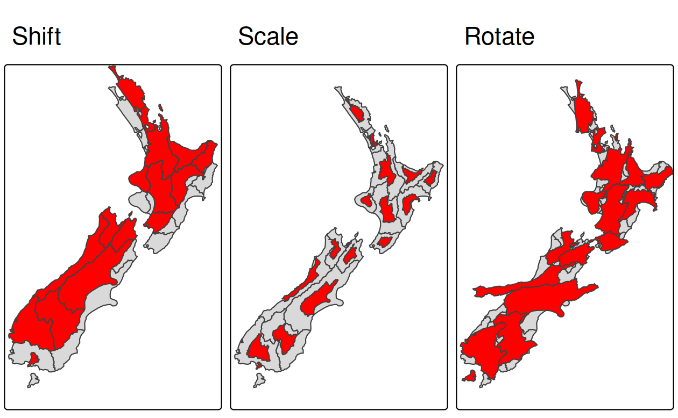
Shift Example
Shifting moves every point by the same distance in map units
It could be done by adding a numerical vector to a vector object
nz_sfc = st_geometry(nz)
# shift 100 km north (assuming projected CRS in meters)
nz_shift = nz_sfc + c(0, 100000)
plot(st_geometry(nz_sfc), col = "lightgray")
plot(st_geometry(nz_shift), col = "red", add = TRUE)

Slide 25
Scale Example
Scaling enlarges or shrinks objects by a factor
It can be applied either globally or locally
Global scaling increases or decreases all coordinates values in relation to the origin coordinates, while keeping all geometries topological relations intact
nz_centroid_sfc = st_centroid(nz_sfc)
nz_scale = (nz_sfc - nz_centroid_sfc) * 0.5 + nz_centroid_sfc
plot(st_geometry(nz_sfc), col = "lightgray")
plot(st_geometry(nz_scale), col = "red", add = TRUE)

Slide 26
Rotate Example
The rotation function accepts one argument: a rotation angle in degrees
Rotation could be done around selected points, such as centroids
rotation = function(a){
r = a * pi / 180 #degrees to radians
matrix(c(cos(r), sin(r), -sin(r), cos(r)), nrow = 2, ncol = 2)
}
nz_rotate = (nz_sfc - nz_centroid_sfc) * rotation(30) + nz_centroid_sfc
plot(st_geometry(nz_sfc), col = "lightgray")
plot(st_geometry(nz_rotate), col = "red", add = TRUE)

Slide 27
Clipping
Spatial clipping is a form of spatial subsetting that involves changes to the geometry columns of at least some of the affected features.
Clipping can only apply to features more complex than points: lines, polygons and their 'multi' equivalents.

Slide 28
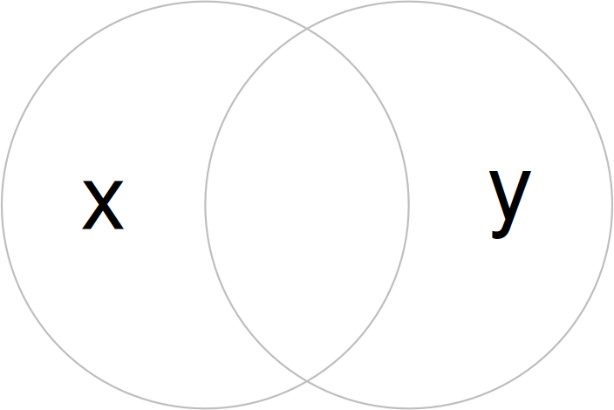
Clipping Example
b = st_sfc(st_point(c(0, 1)), st_point(c(1, 1))) # create 2 points
b = st_buffer(b, dist = 1) # convert points to circles
plot(b, border = "gray")
text(x = c(-0.5, 1.5), y = 1, labels = c("x", "y"), cex = 3) # add text
Imagine you want to select not one circle or the other, but the space covered by both x and y

Slide 29
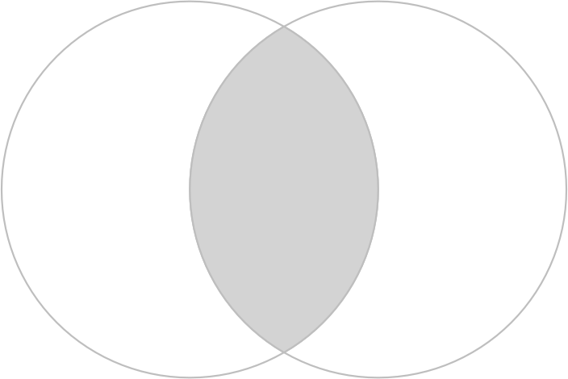
Clipping Example
x = b[1]
y = b[2]
x_and_y = st_intersection(x, y)
plot(b, border = "gray")
plot(x_and_y, col = "lightgray", border = "gray", add = TRUE) # intersecting area
This can be done using the function st_intersection()

Slide 30
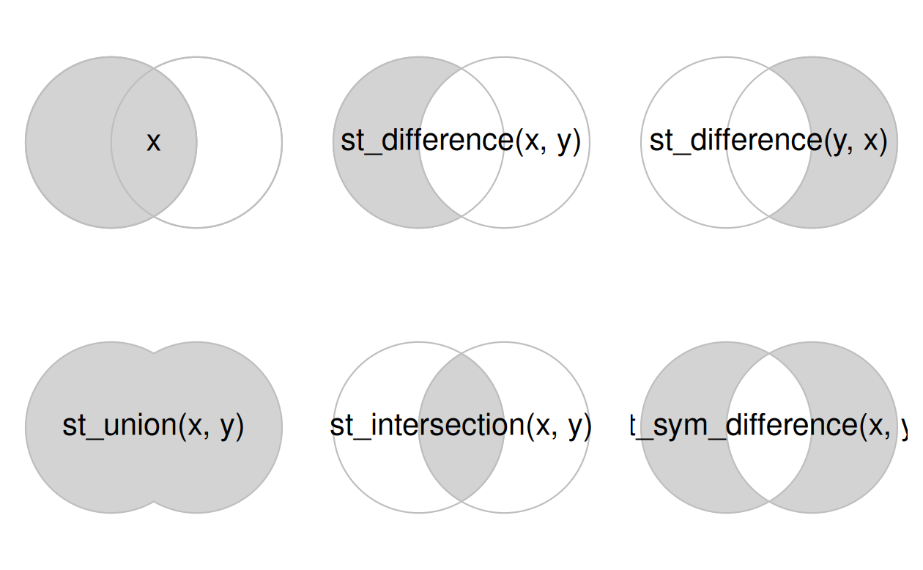
Spatial equivalents of logical operators
The subsequent code chunk demonstrates how this works for all combinations of the 'Venn' diagram representing x and y.

Slide 31
Subsetting and Clipping
Clipping objects can change their geometry
But it can also subset objects, returning only features that intersect (or partly intersect) with a clipping/subsetting object
NOTE
A bounding box is the smallest axis-aligned rectangle that fully contains a geometry
Useful for: (i) quick summary of spatial extent, (ii) set plot limits or map viewports, (iii) crop or filter spatial data, (iv) align datasets before spatial joins, and (v) define spatial query windows
st_bbox()
Defines the minimum and maximum coordinates that enclose ("envelopes"*) all geometries
Returns the bounding box of a spatial object
A named numeric vector with: xmin, ymin, xmax, ymax
Includes a CRS attribute
Can be coerced to: Numeric vector, Matrix, Polygon (st_as_sfc())
* https://postgis.net/docs/ST_Envelope.html

Slide 32
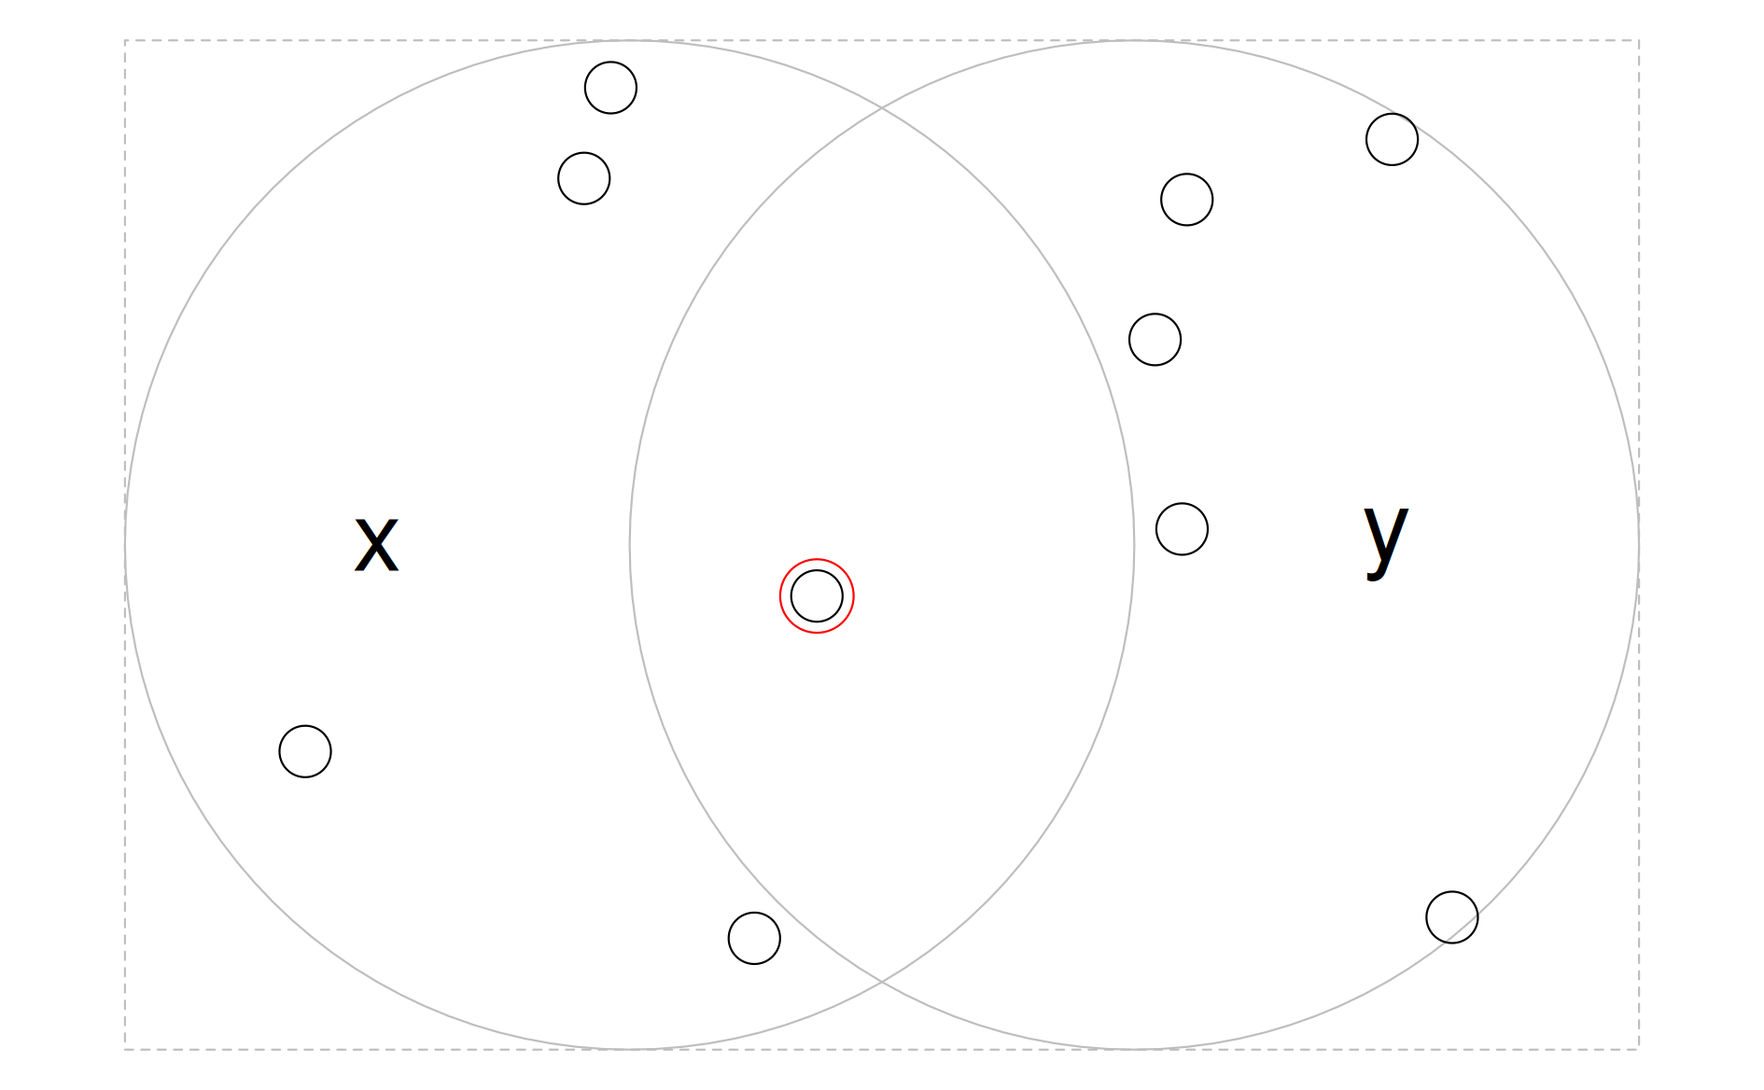
Subsetting Example
bb = st_bbox(st_union(x, y))
box = st_as_sfc(bb)
set.seed(2024)
p = st_sample(x = box, size = 10)
p_xy1 = p[x_and_y]
plot(box, border = "gray", lty = 2)
plot(x, add = TRUE, border = "gray")
plot(y, add = TRUE, border = "gray")
plot(p, add = TRUE, cex = 3.5)
plot(p_xy1, cex = 5, col = "red", add = TRUE)
text(x = c(-0.5, 1.5), y = 1, labels = c("x", "y"), cex = 3)
Randomly distributed points within the bounding box enclosing circles x and y
The point that intersects with both objects x and y is highlighted

Slide 33
Subsetting Example
bb = st_bbox(st_union(x, y))
box = st_as_sfc(bb)
set.seed(2024)
p = st_sample(x = box, size = 10)
x_and_y = st_intersection(x, y)
Randomly distributed points within the bounding box enclosing circles x and y
The point that intersects with both objects x and y is highlighted

Slide 34
Subsetting Example
# way #1
p_xy1 = p[x_and_y]
# way #2
p_xy2 = st_intersection(p, x_and_y)
# way #3
sel_p_xy = st_intersects(p, x, sparse = FALSE)[, 1] & st_intersects(p, y, sparse = FALSE)[, 1]
p_xy3 = p[sel_p_xy]
The code chunk below demonstrates three ways to achieve the same result
Which implementation to use?
Generally more concise implementations should be favored (1st approach)
We will return to the question of choosing between different implementations of the same technique or algorithm later

Slide 35
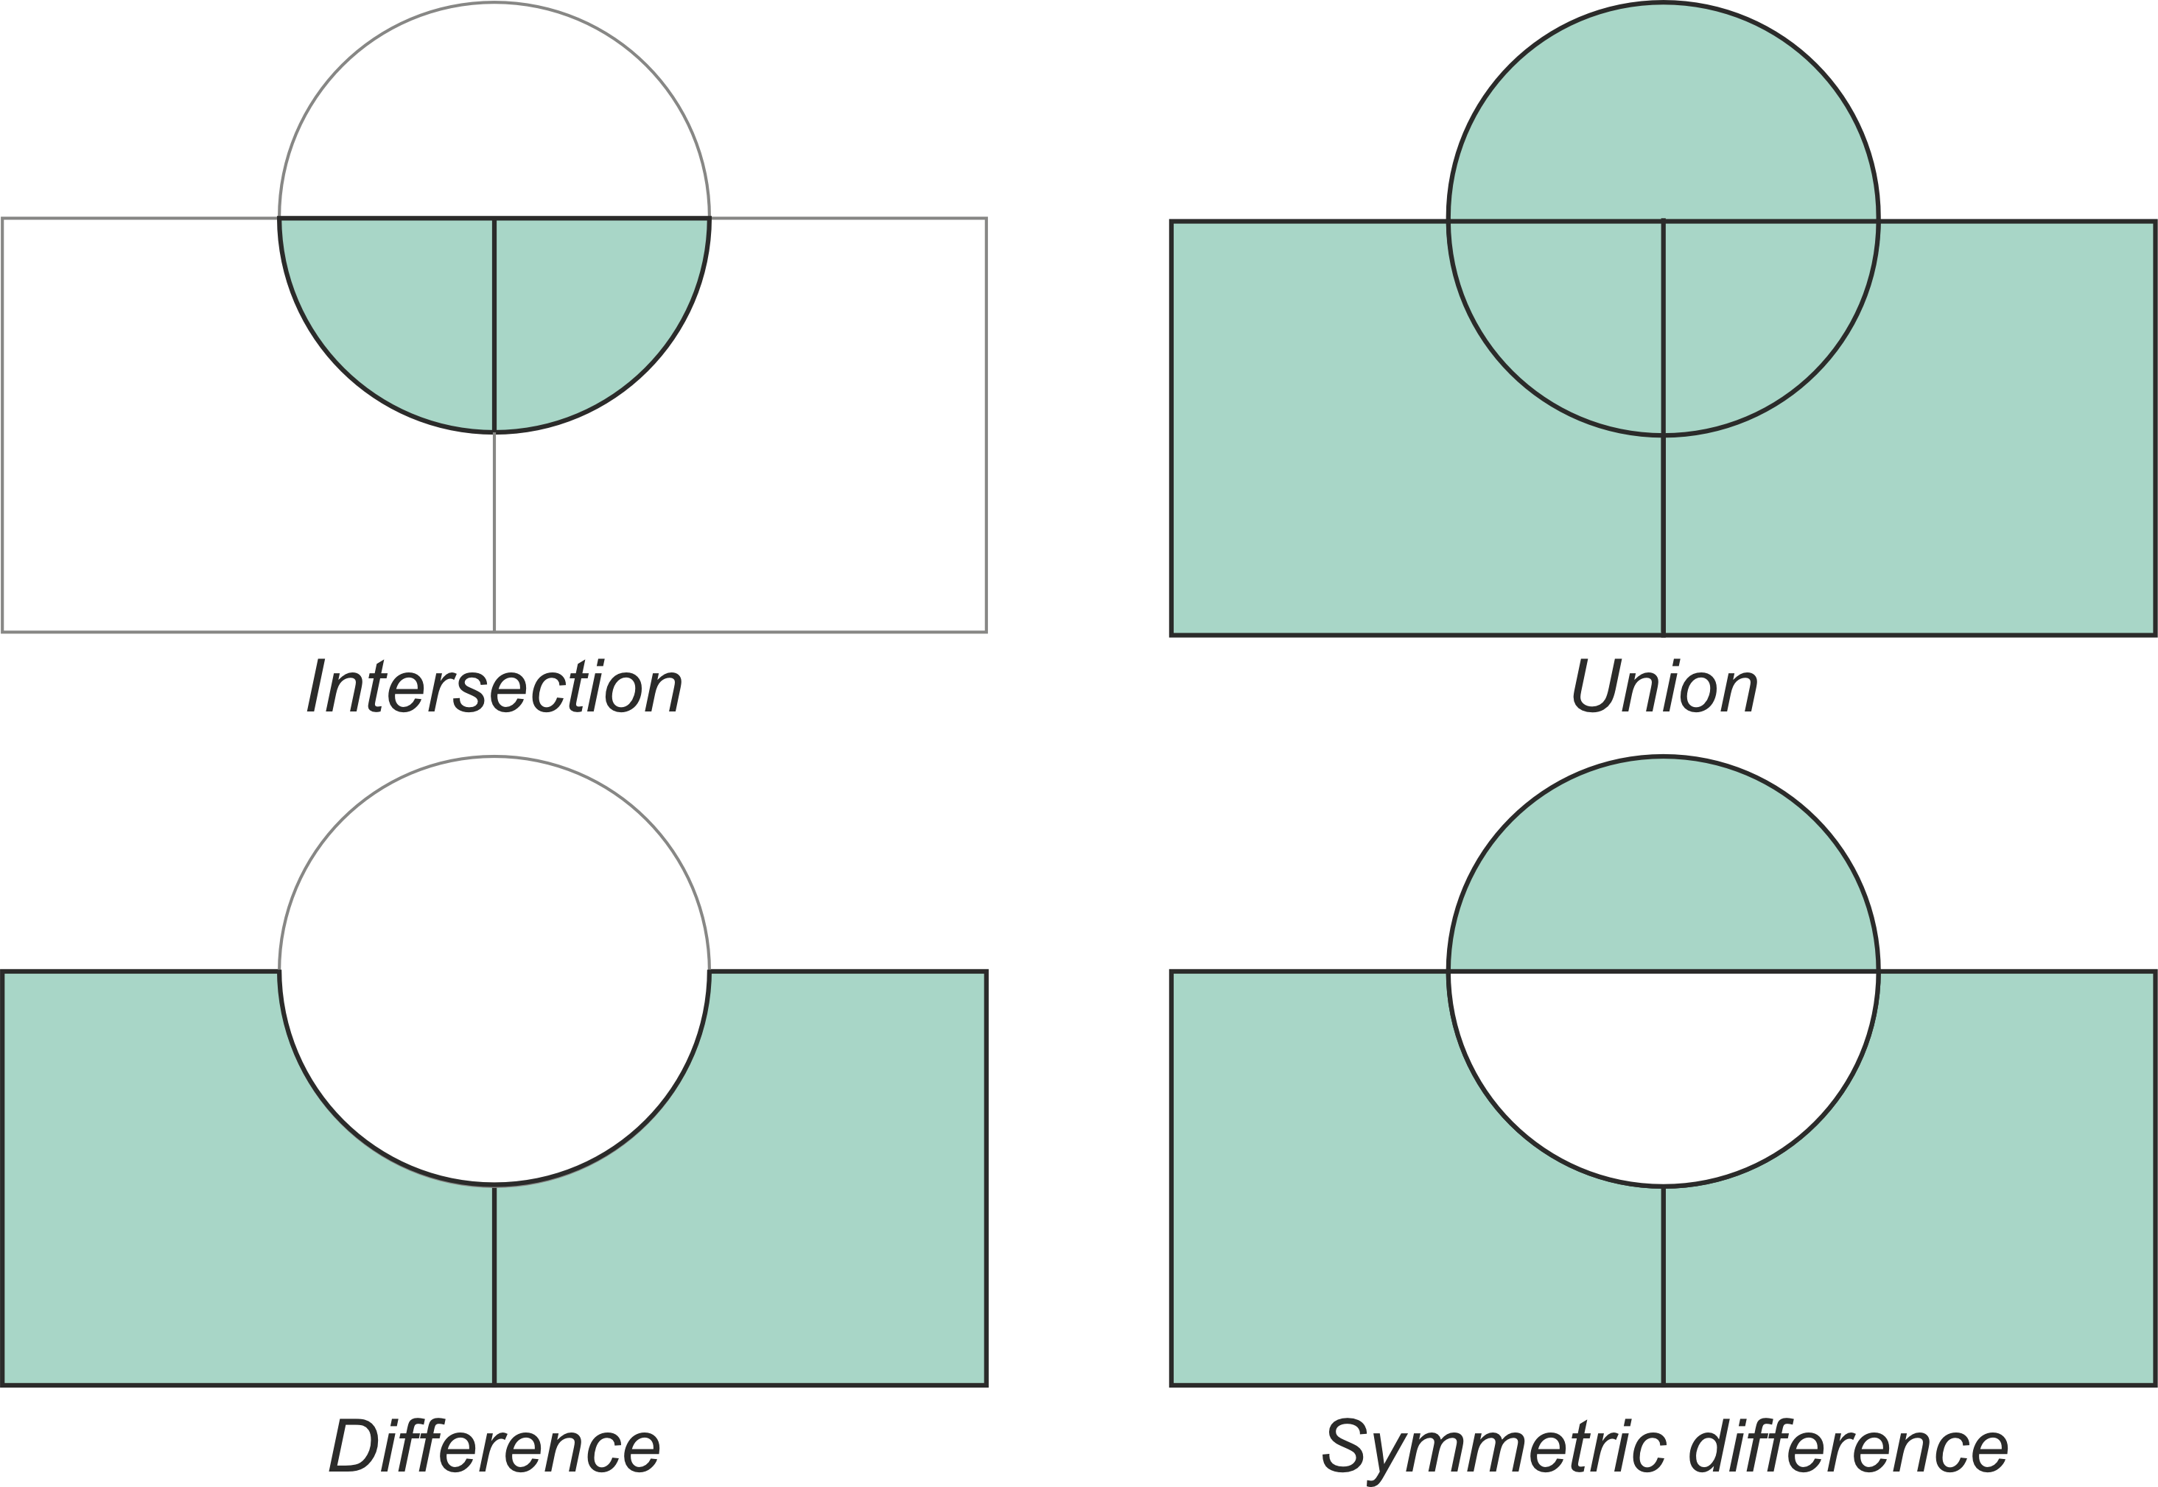
Geometry Unions
Spatial aggregation can silently dissolve the geometries of touching polygons in the same group
https://pythongis.org/index.html
https://pythongis.org/part2/chapter-06/nb/08-overlay-analysis-with-vector-data.html

Slide 36
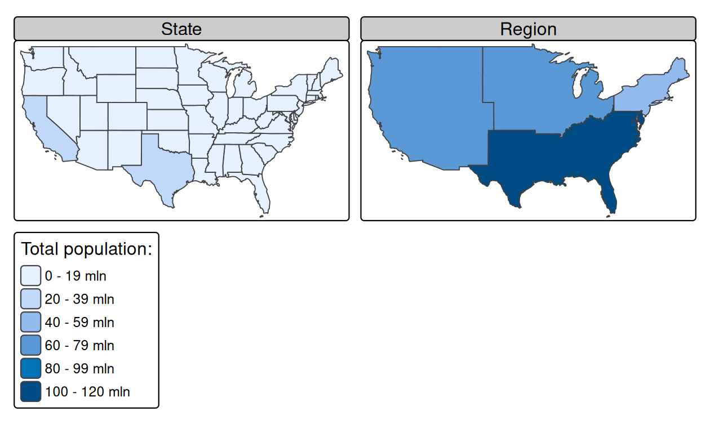
Geometry Union Example
regions = aggregate( x = us_states[, "total_pop_15"], by = list(us_states$REGION), FUN = sum, na.rm = TRUE)
regions2 = us_states |>
group_by(REGION) |>
summarize(pop = sum(total_pop_15, na.rm = TRUE))
us_west = us_states[us_states$REGION == "West", ]
us_west_union = st_union(us_west)
texas = us_states[us_states$NAME == "Texas", ]
texas_union = st_union(us_west_union, texas)
Spatial aggregation on contiguous polygons, illustrated by aggregating the population of US states into regions, with population represented by color.
The 48 US states and DC (us_states) are aggregated into four regions using base and dplyr functions
Note the operation automatically dissolves boundaries between states

Slide 37
Geometry Union Example
regions = aggregate( x = us_states[, "total_pop_15"], by = list(us_states$REGION), FUN = sum, na.rm = TRUE)
regions2 = us_states |>
group_by(REGION) |>
summarize(pop = sum(total_pop_15, na.rm = TRUE))
us_west = us_states[us_states$REGION == "West", ]
us_west_union = st_union(us_west)
texas = us_states[us_states$NAME == "Texas", ]
texas_union = st_union(us_west_union, texas)
Behind the scenes, both aggregate() and summarize() combine the geometries and dissolve the boundaries between them using st_union()
The function can also take two geometries and unite them, as demonstrated in the code chunk which creates a united western block incorporating Texas ☺

Slide 38
Type Transformations
Geometry casting is a powerful operation that enables transformation of the geometry type
Conversion from multipoint to linestring is a common operation that creates a line object from ordered point observations, such as GPS measurements or geotagged media
This, in turn, allows us to perform spatial operations such as the calculation of the length of the path traveled
Conversion from multipoint or linestring to polygon is often used to calculate an area
For example, from the set of GPS measurements taken around a lake or from the corners of a building lot
Geometry casting of simple features geometry column (sfc) and simple features objects works the same as for sfg in most of the cases
One important difference is the conversion between multi-types to non-multi-types
As a result of this process, multi-objects of sfc or sf are split into many non-multi-objects

Slide 39
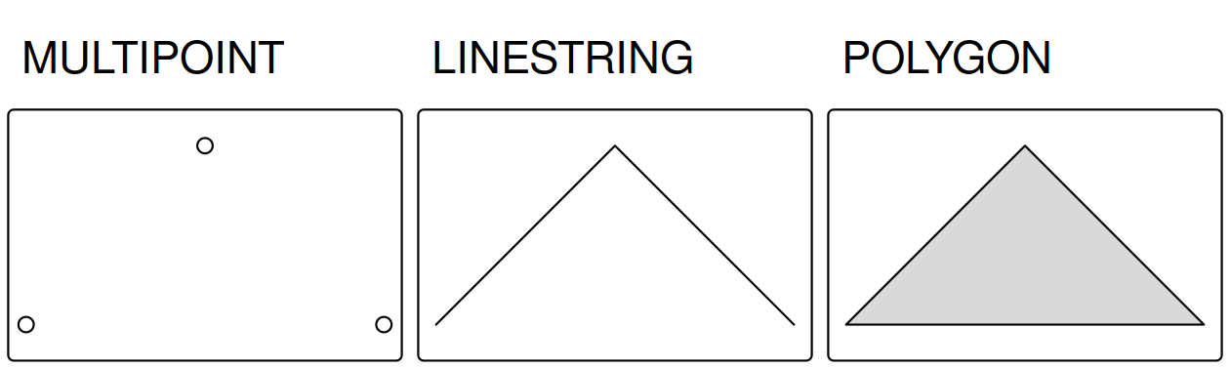
Type Transformations
Examples of a linestring and a polygon casted from a multipoint geometry
multipoint = st_multipoint(matrix(c(1, 3, 5, 1, 3, 1), ncol = 2))
linestring = st_cast(multipoint, "LINESTRING")
polyg = st_cast(multipoint, "POLYGON")

Slide 40
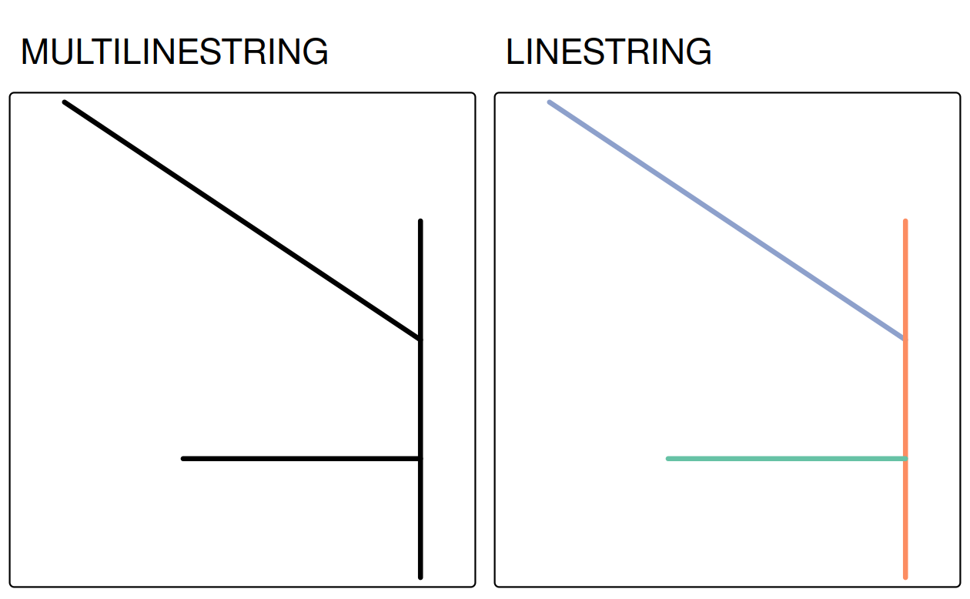
Type Transformations
Examples of type casting between multilinestring (left) and linestring (right)
multipoint_2 = st_cast(linestring, "MULTIPOINT")
multipoint_3 = st_cast(polyg, "MULTIPOINT")
all.equal(multipoint, multipoint_2)
# [1] TRUE
all.equal(multipoint, multipoint_3)
# [1] TRUE

Slide 41
Assignment #3
Due Mon Feb 23 at 5 PM

Slide 42
Background
You are asked to:
Integrate parcel data, FEMA floodplain data, and US Census geographic boundaries to evaluate flood risk exposure of single-family structures and its relationship to parcel improvement value in Brazos County, TX
You must clearly document:
Your data acquisition strategy
Your data cleaning and preprocessing steps
Your spatial design decisions (projection, geometry transformations, buffering logic, joins)
Your reasoning for analytical choices
Use the tools we learned so far >> reproducibility and clarity are essential!

Slide 43
Introductions
This assignment is intentionally designed with limited procedural instructions
One of the primary objectives is for you to demonstrate how you plan, structure, and justify a spatial data engineering workflow
Grade will consider as much on analytical design decisions as on final outputs
Same data. Same base assignment. Different focus.
DAEN: Build the infrastructure for spatial analytics
ISEN: Evaluate the decision of spatial analytics
Shared Expectation: Design and justify a defensible spatial workflow
As you work on the assignment, please be prepared to explain and walk through your decisions if asked!
You should be able to clearly describe what you did and why
Make sure you truly understand your workflow and results

Slide 44
Part 1: Data Acquisition and Planning
Obtain Brazos County Parcel Data https://brazoscad.org/tax-information/gis/
Ensure the dataset includes:
Parcel geometry
Improvement value (or comparable building value metric)
Parcel identifier
Document:
Data source and format
Coordinate reference system (CRS)
Any missing or inconsistent fields
Transform Parcels to Points
Convert parcel polygons to point representations
Justify:
Whether you use centroids, interior points, or another approach
The implications of this choice for flood risk classification
Potential bias introduced by large or irregular parcels
Discuss:
What happens if a parcel intersects multiple flood zones?
Does a point representation simplify or distort risk classification?

Slide 45
Part 2: Flood Risk Engineering
Acquire FEMA flood hazard layer(s) for Brazos County https://floodmaps.fema.gov/NFHL/status.shtml
Document :
Dataset details, CRS, geometry type
Flood zone classification fields
Reclassify Floodplain Categories
Reclassify flood zones into 100-year, 500-year, or Outside floodplain
Define:
Which FEMA zone codes correspond to each category
How ambiguous or special zones are handled
Provide a reclassification table in your report
Assign a flood risk category to each parcel (spatial join?)
Should parcels be intersected as polygons?
Should parcels be converted to points first?
Does buffering make sense? If so, what should be buffered? Parcels or floodplain?
Why? Explain your approach

Slide 46
Part 3: Census Geography Integration
Acquire county boundaries from the U.S. Census Bureau (e.g., TIGER/Line or tigris or tidycensus)
Check Brazos County geometry
Ensure CRS compatibility with other layers
Acquire Census "Places" boundaries
Document:
Definition of "place"
How incorporated and census-designated places differ (if relevant)
Assign Parcels to Places
Using a spatial join:
Assign each parcel to a Census Place
Then filter to include only Places located in Brazos County
Discuss:
How you handle parcels that fall outside any Place
Whether to rely on intersection or centroid containment

Slide 47
Part 4: Summary Statistics
After constructing the final parcel dataset with:
Flood risk classification + Place assignment + Improvement value
Produce the following summary statistics:
4.1 Parcel Counts
Total number of single-family parcels in:
100-year floodplain, 500-year floodplain, Outside floodplain
In-risk vs out-of-risk totals (define clearly what qualifies as "at risk")
4.2 Improvement Value Comparisons
Compute average improvement value for parcels:
Inside flood risk areas and outside flood risk areas
Separate averages for 100-year vs 500-year zones
Median values and standard deviation
4.3 Possible questions to discuss:
Are differences economically meaningful?
Are there extreme values influencing the mean?
Would transformation (e.g., log values) be appropriate?
Also:
Any tradeoffs between computational efficiency and spatial precision.
Potential sources of misclassification, or assumptions that could affect conclusions.

Slide 48
Deliverables
Submit:
A reproducible script or notebook (R or Python)
A short technical report explaining:
Data sources
Workflow design
Key assumptions
Justification for spatial decisions
Interpretation / summary results (i.e., the tables below)
(4–5 pages recommended)
Tables of summary statistics
Final engineered dataset (parcels with flood and place attributes)

Slide 49
Question to Practice
Why is selecting an appropriate projected CRS important when performing buffering or area-based spatial operations?
When assigning flood risk to parcels, what is the primary tradeoff between using parcel centroids versus full parcel polygons?
Discuss:
Under what circumstances would buffering floodplain polygons make sense? Data misalignment? Vertical vs horizontal uncertainty? Policy-driven safety margins? When might buffering introduce bias?
When reclassifying detailed FEMA flood zones into 100-year and 500-year categories: What information is lost? When is aggregation justified? Could collapsing categories hide meaningful differences in risk?
Suppose average improvement value is higher outside flood risk areas. Does this imply flood risk reduces property value? What confounding factors might exist (e.g., land use, zoning, development age)? Would median be more appropriate than mean? Why?

Slide 50
Hints
Before you begin the assignment, take time to prepare your work and structure your workflow thoughtfully.
Strong data engineering is rarely about writing code immediately, it is about designing a clear, efficient, and reproducible process.
Clarify the objective first (draw a simple diagram of your data flow)
Sketch the pipeline before coding (think in terms of stages)
Break the assignment into modular components (be explicit about: schema, column names, types, constraints, expected formats, null handling rules, naming conventions)
Define your data contracts early
Plan for reproducibility
Anticipate "edge cases" and data quality issues (as possible)
Think about performance and scale (even if the dataset is small)
Version your thinking, not just your code (keep notes on design decisions)

Slide 51
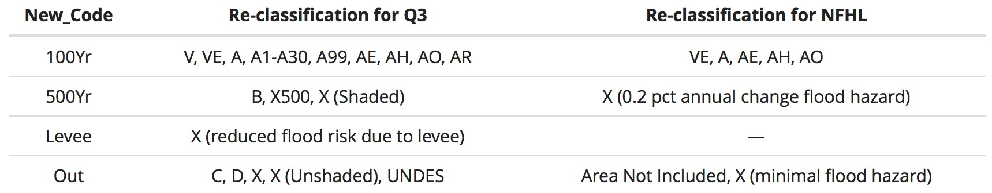
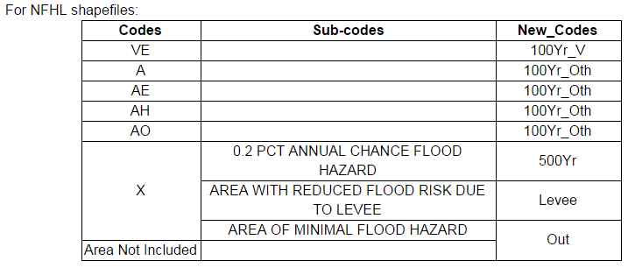
Possible Reclassification
Possible to find a lot of sources referring ultimately to FEMA … such as:
NFHL: http://www.floodmaps.com/zones.htm

Slide 52
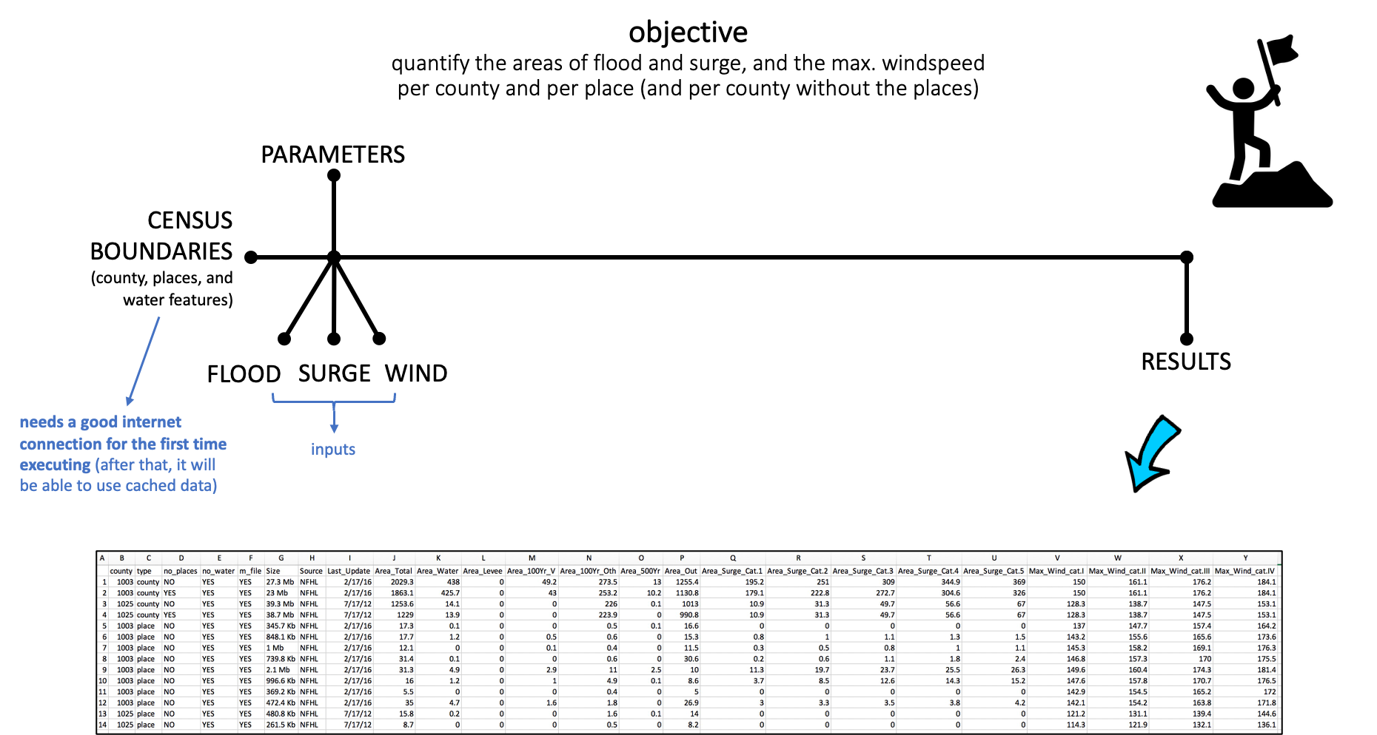

Slide 53
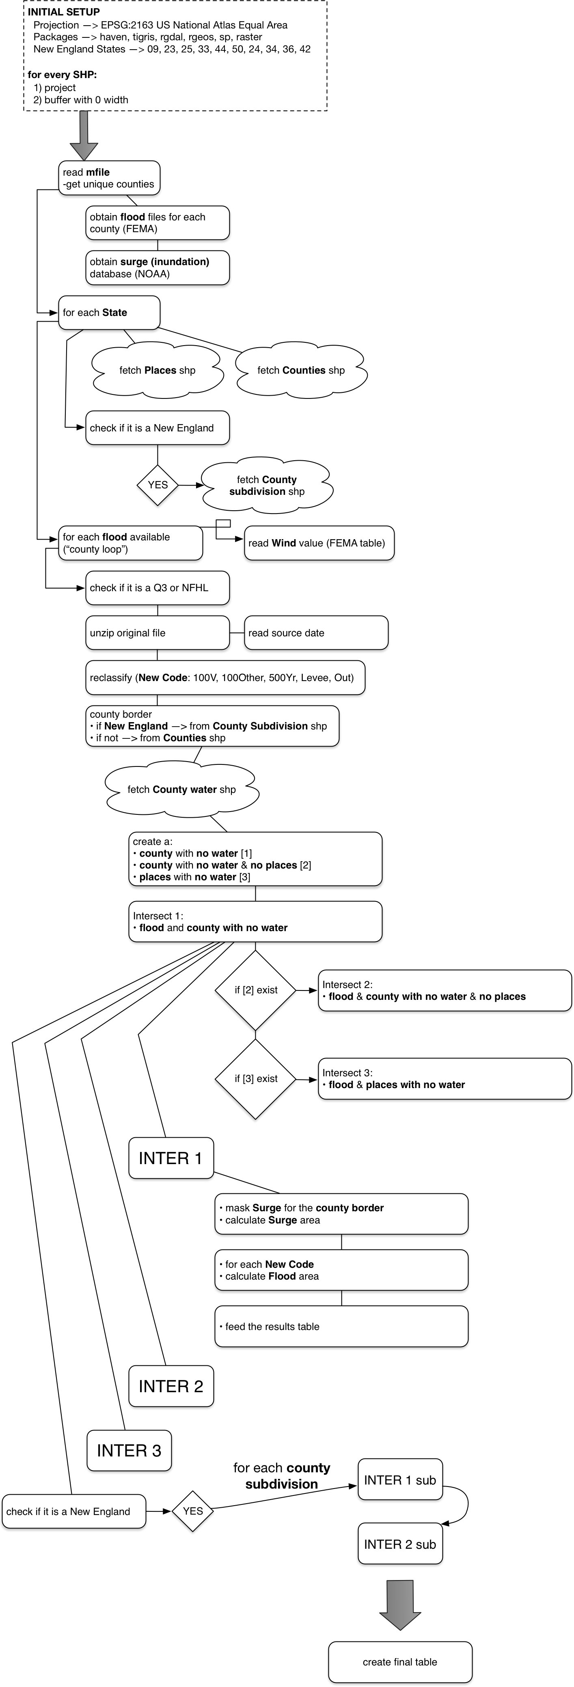

Slide 54
# FLOODPLAIN RECLASSIFICATION EXAMPLE
library(sf)
library(janitor)
library(tidyverse)
filter <- dplyr::filter
rename <- dplyr::rename
select <- dplyr::select
summarise <- dplyr::summarise
`%nin%` = Negate(`%in%`)
projection = 4326 # WGS84
setwd("/Users/alexander/Downloads/")
floodplain <- st_read("/Users/alexander/Downloads/21083C_20091203/S_FLD_HAZ_AR.shp")
floodplain <-
floodplain %>%
filter(!st_is_empty(.)) %>%
st_make_valid() %>%
st_transform(projection) %>%
clean_names() %>%
filter(st_geometry_type(.) %in% c("POLYGON", "MULTIPOLYGON"))
floodplain %>%
st_drop_geometry() %>%
count(
fld_zone,
zone_subty
)
# fld_zone zone_subty n
# 1 A <NA> 74
# 2 AE FLOODWAY 6
# 3 AE <NA> 24
# 4 X 0.2 PCT ANNUAL CHANCE FLOOD HAZARD 60
# 5 X AREA OF MINIMAL FLOOD HAZARD 538
floodplain_class <-
floodplain %>%
mutate(
fld_class = case_when(fld_zone %in% c("VE", "V", "AE", "AH", "AO", "A", "A99") ~ "100Yr",
fld_zone %in% c("X500") ~ "500Yr",
fld_zone == "X" & zone_subty == "0.2 PCT ANNUAL CHANCE FLOOD HAZARD" ~ "500Yr",
TRUE ~ "Out")
) %>% filter(fld_class != "Out") %>%
# select(fld_zone, zone_subty, fld_class) %>%
group_by(fld_class) %>%
summarise() %>%
st_make_valid()
st_write(floodplain_class, "floodplain_21083C_20091203.shp")

